Slide 1
Master of Arts in Teaching & Teacher Preparation Programs
Ashley Ciraulo Stuart
Program Advisor
aciraulo@csus.edu

Slide 2
Becoming a Public School
Teacher in California
Prove you know HOW to teach– “teaching credential preparation program”
Prove you know WHAT you will teach (math, social science, PE, etc.) – “Subject Matter Competency”

Slide 3
Program Options
Bilingual Authorization in Spanish and Hmong
Multiple Subject (K-6)
Single Subject (7-12)
Special Education:
Mild/Moderate Support
Needs
Extensive Support Needs
Early Childhood
Notes:
Mild/Moderate and moderate/severe candidates can also receive a multiple subject credential as part of our “dual” program

Slide 4
Program Structure
Students admitted into the program are divided into smaller cohort groups that complete the program in 2-4 semesters (depending on program)
A cohort model offers a community of support in which concern for the individual student and their development is the focus
Includes the Master of Arts in Teaching (additional 2 semesters)

Slide 5
How to prove you know WHAT you will teach (Subject Matter Competency)
Pass a standardized test (CSET – California Subject Exam for Teachers) in your subject area
Undergraduate Major in the subject matter area to include SPECIFIED list of courses (subject matter waiver)
Complete coursework that fulfils the competency domains

Slide 6
How do I qualify for a
Subject Matter Coursework Review
If you are in a subject matter wavier program, have your major advisor complete your SMC verification form
If you plan to have your coursework evaluated for SMC, complete the qualtrics survey in the application instructions
If you think your major meets subject matter competency, complete the qualtrics survey in the application instructions
Notes:
Keep in mind that not all universities have approved subject matter waiver programs in all subject areas. Make sure to check with your major advisor at your university for clarification

Slide 7
Examination Administrations
For Teaching Majors
Subject Area:
English, Science, Math, Social Science, Multiple Subject
Testing Options:
Continuous Computer based testing options offered
Monday – Friday
Subject Area:
Art, Health Science, PE, Music, World Language, Home Economics
Testing Options:
Four week testing blocks throughout the year (check website for exact testing blocks)
Notes:
Not all CSET exams are offered continuously Monday - Saturday…if you plan to teach an “elective” subject area (Art, PE, World Languages) those CSETs are offered in four 4-week testing windows a year, so plan ahead to schedule those exams.

Slide 8
Courses: PUBH 136 – School Health Education EDUC 100A/B – Educating the Exceptional Learner in Inclusive Settings EDUC 170 – Introduction to Bilingual Education KINS 172 – Movement Education (MS ONLY) CHDV 30 or Introduction to Human Development Course (ECSE ONLY)
The pre-requisite courses are NOT admission requirements, but they must be completed prior to starting a credential program (by August) complete in summer school before starting the program complete a pre-requisite equivalent
Pre-Requisite Courses

Slide 9
Pre-Requisite Courses
How to Apply: Teaching Credentials

Slide 10
Bilingual Authorization
In-depth preparation for work with English Learners (ELs) through additional coursework through infusion of EL content in all credential courses
Emphasis on teachers who are committed to increasing social justice and educational equality for low income and culturally and linguistically diverse groups
Bilingual Authorization offered in Spanish & Hmong; must be fluent; for students whose cultural, historical and language abilities relate to the targeted populations
For more information, contact the College of Education Equity Coordinator, Karina Figueroa-Ramirez, at figueroaramirez@csus.edu

Slide 11
Master of Arts in Teaching
All students accepted for admission into the Multiple or Single Subject Credential Programs are additionally admitted to the MAT Program - Students can opt out of continuing for their MAT
The College of Education offers additional MA programs for students who want a more traditional MA experience
The MAT courses must be taken in sequence, starting the summer after completion of the Multiple or Single Subject Credential Program
Contact the Program Coordinator, Dr. Mae Chaplin at mae.chaplin@csus.edu with questions
Notes:
Keep in mind that not all universities have approved subject matter waiver programs in all subject areas. Make sure to check with your major advisor at your university for clarification

Slide 12
CSUS University Application calstate.edu/apply $70 application fee Review: Cal State Apply Application Instructions Supplemental Application Instructions
Application & Admission Process
Notes:
Make sure to review the Cal State Apply instructions while completing the application – there are a few sections of the Cal State Apply application that do not need to be completed. The instructions are a screen – by – screen guide to completing that application

Slide 13
Application & Admission Process:
Transcripts
Sac State Student
No transcripts required with your Cal State Apply application – Sac State already has access to all of your transcripts
Non Sac State Students
One official transcript from every college and university attended required with your Cal State Apply application
Notes:
I recommend that non-Sac State students order all of their transcripts and have them sent directly to them. then can put all transcripts in an envelop, mail directly to the Office of Graduate Studies to ensure ALL transcripts are received and processed

Slide 14
Additional Admission Requirements
Subject Matter Competency
Basic Skills (i.e., CBEST)
2.50 minimum GPA (or 2.75 in last 60 sem/90 qtr units)
Minimum 45 hours experience working with the age group and population of students you want to teach
2 reference forms
Essay
Certificate of Clearance
Group Interview
Notes:
If you are applying for the fall semester – make sure all test are passed no later than March

Slide 15
FALL SEMESTER Applications available: October 1st Applications due: February 1st Website: www.csus.edu/college/education/teaching-credentials “Application Information”
Teacher Preparation Program Application

Slide 16
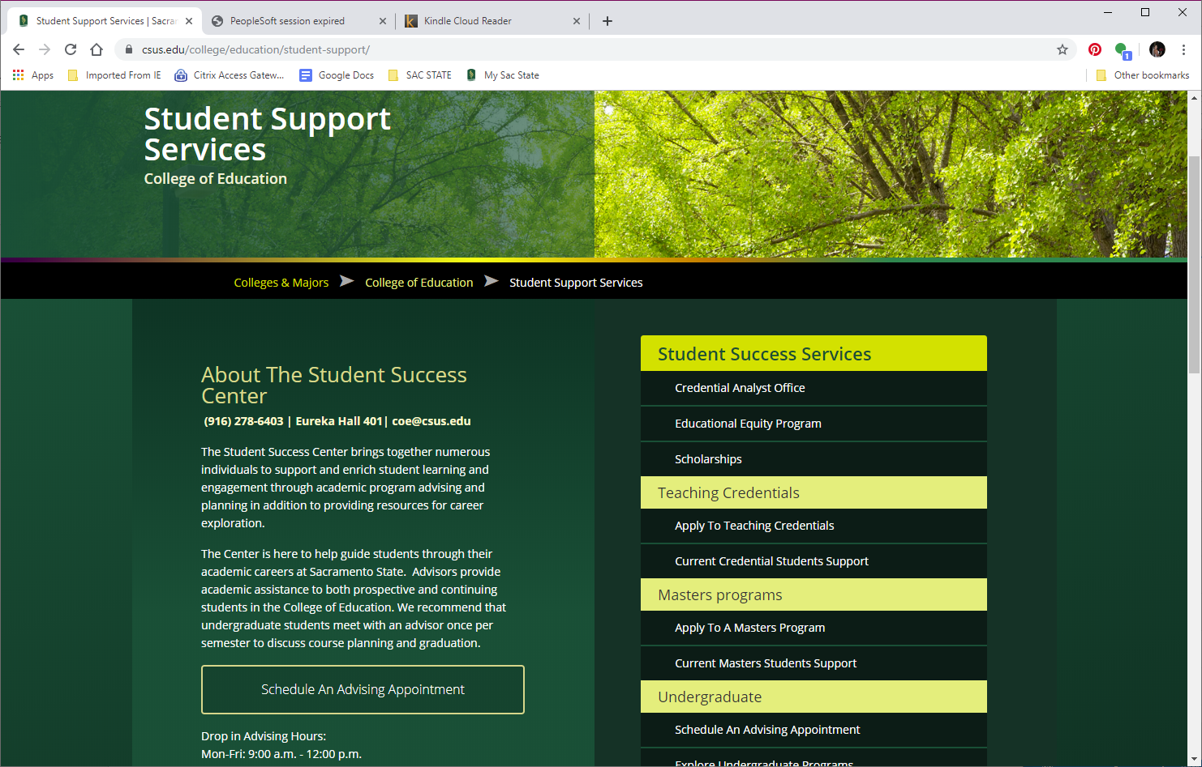
Scholarships & Grants

Slide 17
Teaching for Change
Multicultural/Social Justice – an overarching core value
Multicultural/Social Justice encompasses educational, economic, and political arenas. It is a commitment to equity and fairness in treatment and access to opportunities and resources for everyone, recognizing that all is not equal.
As future educators, you will be committed to actively eradicating structural and institutional racism, sexism, classism, linguicism, ableism, ageism, heterosexism, religious bias, etc.
As future educators, you are responsible for the collective good of society, not simply your own individual interests.

