Slide 1
Autism Spectrum Disorders
John-Michael Gomez
Amanda Crisp Handleson
Melissa Munoz
Yelena Novakovskiy
Lauren Pape

Slide 2
“Imagine a song stuck in your head...and it never goes away. Imagine people's voices sounding so loud they're like fire engines. Imagine your soft cotton T-shirt feeling like a burlap bag. Imagine not being able to feel food in your mouth, or a full bladder. Imagine someone's simple touch feeling like fire. Imagine having feeling in your hair and the pain of having it cut. Imagine having autism.”
(Autism Society of Wisconsin, http://www.asw4autism.org/)

Slide 3
DSM-IV TR 5 Different Diagnostic Categories:
Source: Brock, 2006

Slide 4
Autistic Disorder
Characteristics:
Qualitative impairment in social interaction
Qualitative impairment in communication
Restricted, repetitive, and stereotyped patterns of behavior, interests, and activities

Slide 5
Autistic Disorder
Delays or abnormal functioning in at least one of the following areas with onset prior to age 3 years
1. Social interaction
2. Language as used in social communication or
3. Symbolic or imaginative play
The disturbance is not better accounted for by Rhett’s disorder or Childhood Disintegrative Disorder

Slide 6
Asperger’s Disorder
Asperger’s Disorder: Autism must be ruled out before Asperger’s is considered
Characteristics: Markedly abnormal or impaired development in social interaction and a markedly restricted repertoire of activities and interests (language abilities and cognitive functioning is not affected).
Socially inappropriate statements, speaks in monotone, speaks incessantly about own interests which adversely affects conversational reciprocity

Slide 7
Asperger’s Disorder
DSM-IV TR Criteria:
Symptom onset typically seen later
Same as Autistic Disorder with the exception that there are no criteria for a qualitative impairment in communication.
The disturbance causes clinically significant impairment in social, occupational, or other important areas of functioning.
There is no clinically significant general delay in language (e.g., single words used by age 2 years, communicative phrases used by age 3 years).
There is no clinically significant delay in cognitive development or in the development of age-appropriate self-help skills, adaptive behavior (other than in social interaction), and curiosity about the environment in childhood.

Slide 8
Rett’s Disorder
Rett’s Disorder is a unique developmental disorder that is first recognized in infancy and seen almost always in girls, but can be rarely seen in boys.
Prevalence Rate: 1 per 20,000
Characteristics:
Involves a pattern of:
Head growth deceleration (5-48 months)
A loss of fine motor skill
The presence of awkward gait and trunk movement.
During adolescents females, exhibit muscle wasting, scoliosis, spasticity, decreased mobility
Notes:
Rett syndrome is a unique developmental disorder that is first recognized in infancy and seen almost always in girls, but can be rarely seen in boys.
Rett syndrome has been most often misdiagnosed as autism, cerebral palsy, or non-specific developmental delay

Slide 9
Rett’s Disorder
DSM-IV TR Criteria:
Symptoms seen before the age of 4; however, symptoms usually seen before the age of 2
(A) All of the following:
apparently normal prenatal and perinatal development
apparently normal psychomotor development through the first 5 months after birth
normal head circumference at birth
(B) Onset of all of the following after the period of normal development
deceleration of head growth between ages 5 and 48 months
loss of previously acquired purposeful hand skills between 5 and 30 months with the subsequent development of stereotyped hand movements (e.g., hand-wringing or hand washing)
loss of social engagement early in the course ( although often social interaction develops later)
appearance of poorly coordinated gait or trunk movements
severely impaired expressive and receptive language development with severe psychomotor retardation

Slide 10
Rett’s Disorder
Specific Educational Implications
No standard Rett’s Disorder teaching approach.
The student’s education must be tailored to meet her specific needs.
Scoliosis is one of the most disabling features in Rett’s Disorder, recommendations in the school consist of a program of walking, standing for at least half an hour a day, and positioning in a supportive chair.
A stimulating program should be activated during school hours to encourage eye contact and reaching for objects.
Rett's Disorder
http:/www.rettsyndrome.org

Slide 11
Childhood Disintegrative Disorder
CDD: Very rare; A distinct pattern of regression following at least two years of normal development.
1.7 per 100,000
Most likely affects males
Characteristics:
Impaired development of social interaction and communication
Restricted, repetitive and stereotyped patterns of behaviors, interests, and mannerisms

Slide 12
Childhood Disintegrative Disorder
DSM-IV TR Classification:
Symptoms seen before the age of 10 years old
Same criteria as in Autism and the following:
(A) Apparently normal development for at least the first 2 years after birth as manifested by the presence of age-appropriate verbal and nonverbal communication, social relationships, play, and adaptive behavior.
(B) Clinically significant loss of previously acquired skills (before age 10 years) in at least two of the following areas:
expressive or receptive language
social skills or adaptive behavior
bowel or bladder control
play
motor skill

Slide 13
PDD-NOS
Pervasive Developmental Disorder’s – Not Otherwise Specified
Characteristics:
Experience difficulty in at least two of three Autistic Disorder symptom clusters
Do not meet the complete diagnostic criteria for any other PDD
Typically have milder symptoms

Slide 14
PDD-NOS
DSM-IV TR Classification:
“This category should be used when there is a severe and pervasive impairment in the development of reciprocal social interaction associated with impairment in either verbal or nonverbal communication skills or with the presence of stereotyped behavior, interests, and activities, but the criteria are not met for a specific Pervasive Developmental Disorder, Schizophrenia, Schizotypal Personality Disorder, or Avoidant Personality Disorder.”
For example, this category includes "atypical autism" - presentations that do not meet the criteria for Autistic Disorder because of late age at onset, atypical symptomatology, or subthreshold symptomatology, or all of these.”

Slide 15
Disorder: | Differentiating features from Autistic Disorder:
Asperger’s Disorder | Language development is not delayed Normal intelligence, more abstract thinking Later symptom onset Gross and fine motor problems
Rett’s Disorder | Typically only affects girls Head growth deceleration Loss of fine motor (hand) skill Hand writing Awkward gait and trunk movement Mutations in the MECP2 gene (on the X chromosome)
Childhood Disintegrative Disorder | - Regression following at least two years of normal development

Slide 16
Educational Implications
Educational programs for students with autism or PDD focus on improving communication, social, academic, behavioral, and daily living skills.
The classroom environment should be structured so that the program is consistent and predictable
Present material visually as well as verbally
Interaction with non-disabled peers is also important
These students provide models of appropriate language, social, and behavior skills.
Its very important to develop programs with parents, so that learning activities, experiences, and approaches can be carried over into the home and community.
Source: http://www.teachersandfamilies.com/sped/prof/autism/education.html

Slide 17
Best Practices in Assessment
How is Autism identified?

Slide 18
How is Autism identified?
Autism is identified through observations, interviews, thorough developmental history assessment, behavior checklists, psychological tests and meeting of DSM-IV criteria.

Slide 19
Observations
Ask yourself the following questions as you are observing:
Does child make spontaneous eye contact, make eye contact when requested, or no eye contact?
Is the child’s play behavior appropriate? Does the child show repetitive manipulations of toys?
Does the child avoid looking at parents, refuse to cooperate with parents, refuse intimate contact with parents?
What type of affect does the child display?
Is the child engaging with you, or aloof?
Note the child’s facial expressions, postures, and mannerisms.
Structured observation forms like the Autism Diagnostic Observation Schedule-WPS (ADOS-WPS) can be useful in observations.

Slide 20
Interviewing
Use a structured interview form to facilitate the interview process with parents, teachers and other adults in the child’s life.
Tables B-9 through B-13 in Sattler have examples of structured interview forms to utilize.
The Autism Diagnostic Interview-Revised (ADI-R). Semi-Structured Contains five sections: Opening questions, communication, social development and play, repetitive and restrictive behaviors, and general behavior problems.

Slide 21
Rating Scales and Questionnaires
The Gilliam Autism Rating Scale (GARS)
The Childhood Autism Rating Scale (CARS)
The Social Communication Questionnaire (SCQ)
The Autistic Disorder Questionnaire (ADQ)

Slide 22
How is Autism identified?
One must meet 6 out of 12 DSM-IV criteria’s to be identified as autistic.

Slide 23
DSM-IV criteria for Autism diagnosis
Deficits in reciprocal social interaction
1a) Difficulty using non-verbal behaviors to regulate social interaction
Ex. trouble looking other’s in eye, unusual intonation or voice quality.
1b) Failure to develop age appropriate peer relationships
Ex. Few or no friends, trouble interacting in groups or following cooperative rules of a game.
1c) Little sharing of pleasure, achievements, or interests with others
Ex. Enjoys favorite activities alone, little interest in or reaction to praise.
1d) Lack of social or emotional reciprocity
Ex. Does not respond to others, does not notice when others are hurt or upset.

Slide 24
DSM-IV criteria for Autism diagnosis
Deficits in Communication
2a) Delay in, or total lack of language development
Ex. No words before the age of 2, no simple phrases by the age of 3.
2b) Difficulty holding conversations
Ex. Little back and forth with others, speaks only about areas of special interest
2c) Unusual or repetitive language
Ex. Repeating what others say to them, repeating from books, vidoes or commercials at inappropriate times.
2d) Play that is not appropriate for developmental level
Ex. Does not act out scenarios with toys, rarely pretends an object is something else (ex. a banana is a phone).

Slide 25
DSM-IV criteria for Autism Diagnosis
Restrictive, repetitive behaviors, interests, or activities
3a) Interests that are narrow in focus, overly intense or unusual
Ex. Difficulty “letting go” of special topics or activities
3b) Unreasonable insistence on sameness or following same routine
Ex. easily upset by minor changes in routine, needs advanced warnings about changes.
3c) Repetitive motor mannerisms
Ex. Flapping hands when excited or upset, walking or running on tiptoe
3d) Pre-occupation with parts of objects
Ex. uses objects in unusual ways, likes objects that move (wheels of car)

Slide 26
What are the considerations for the need of a diagnostic assessment?

Slide 27
Indications for need of diagnostic assessment
Observation and caregiver interview indicate the child exhibits or exhibited (as indicated on developmental history) early warning signs and red flags.
The evaluator has made use of valid ASD screening measures.
Other disorders are ruled out.

Slide 28
Considerations : Early Years
Extreme stranger anxiety
A need for sameness in their environment and routine.
Teeth grinding which does not stop.
Fussy eater
The feeling that your child is deaf. Many children with autism have had many hearing tests .
A sense that they are in their own world.
Extreme hypersensitivity to pain or hyposensitivity (lack or feeling) to pain.
Lack of fear in extreme situations.
TOO much fear in situations which are not scary at all.
Hypersensitivity to touch, smell, or taste of food due to certain textures.

Slide 29
Considerations: School Age Years
Lacks appropriate social exchange with peers
Have difficulty following a conversation.
May have extreme difficulty when there is differences in schedules
May interpret messages literally
May have difficulty taking turns in conversation
Difficulty recognizing emotions in their peers
Have trouble playing group games

Slide 30
Special Education Eligibility

Slide 31
Section 3030 (g) A pupil exhibits any combination of the following Autistic-like behaviors, to include but not limited to:
An inability to use oral language for appropriate communication.
A history of extreme withdrawal or relating to people inappropriately and continued impairment in social interaction from infancy through early childhood.
An obsession to maintain sameness.
Extreme preoccupation with objects or inappropriate use of objects or both.
Extreme resistance to controls.
Displays peculiar motoric mannerisms and motility patterns.
Self-stimulating, ritualistic behavior.

Slide 32
An obsession to maintain sameness. Extreme preoccupation with objects or inappropriate use of objects or both.
Need for routine around particular time or activities such as, mealtime, bedtime, going to school.
Becomes overly distressed if routine is interrupted. May consist of compulsive behaviors.
Obsessive thoughts regarding death, illness, accidents. (Howlin, 1998)

Slide 33
Extreme resistance to controls. Displays peculiar motoric mannerisms and motility patterns. /Self-stimulating, ritualistic behavior.
staring at lights, repetitive blinking, moving fingers in front of the eyes, hand-flapping
tapping ears, snapping fingers, making vocal sounds
rubbing the skin with one's hands or with another object, scratching
rocking front to back, rocking side-to-side
placing body parts or objects in one's mouth, licking objects
smelling objects, sniffing people

Slide 34
Is the child’s education adversely affected as a result of their disability?
As defined in Educating Children with Autism, a book sponsored by US Department of Education, "Education" is the "fostering of acquisition of skills or knowledge... including not only academic learning, but also socialization, adaptive skills, language and communication, and reduction of behavior problems - to assist a child to develop independence and personal responsibility." (Educating Children with Autism, National Research Council p. 12)

Slide 35
Assessment to Intervention
Preschool to Graduation

Slide 36
Range of Services
A wide range of services can be available for students with autism, including
Special education teachers/aides,
Speech therapists,
Behavioral therapists,
Occupational therapists,
Physical therapists, and
Counselors/psychologists.
Services required for an individual student with autism can change over time.

Slide 37
Range of Services
Educational objectives for students with autism can include the development of
Expressive verbal language, receptive language, nonverbal communications skills
A functional symbolic communication system
Social skills
Engagement and flexibility in developmentally appropriate tasks and play
Fine and gross motor skills
Cognitive skills (symbolic play and academic skills)
Conventional/appropriate behaviors
Independent organizational skills and skills for success in a regular classroom

Slide 38
Communication
One of the most significant goals for an autistic child's individual program plan is to foster increased communication. The majority of students with autism experience communication challenges that require direct intervention. Strategies that are positive and fit within the child’s typical environments have been shown to increase student skills in this area.

Slide 39
Communication
Prior to determining appropriate objectives and goals, a base level of interpretable
communication must be established by observing the child within the school
setting. The information is then combined with observations from parents and
therapists to determine the most desired methods to use for helping the child become
an effective communicator.
Some Effective Interventions:
Difficulty with expressive language:
Augmentative/Alternative Communication Devices
PECS (Picture Exchange Communication System)
Sign Language
Communication Boards
Difficulty with receptive Language:
PECS paired with verbal commands
Total Communication

Slide 40
Communication: Difficulty with Expressive Language Augmentative/Alternative Communication Devices
PECS (Picture Exchange Communication System):
PECS is a picture based communication system wherein the student gives a picture or symbol of a desired item in exchange for the item itself. Intended to develop spontaneous communication.
Sign Language:
Sign language as total communication may lead to verbal language
Almost all children with autism can learn to sign despite motor difficulties.
Sign language may lead to improved vocal behavior in verbal children with delayed echolalia.
Sign is acquired faster and more accurately than picture symbol systems.
Signs can be prompted. You have your hands with you all day!
Communication Boards:
The simplest type of communication aid is the communication board where children
touch or points to a symbol, photograph, drawing or words to indicate a desired activity. As the child's attending skills and comprehension increase, various versions of boards
may be explored.

Slide 41
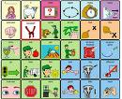
Communication Board

Slide 42
Communication: Difficulty with Receptive Language
PECS Paired with Verbal Commands :
When giving a verbal command, hand the child the corresponding PECS icon at the same time the verbal command is given.
Total Communication:
Involves the use of sign language with corresponding spoken words simultaneously.
The National Autistic Society: http://www.nas.org.uk

Slide 43
Challenging Behaviors
Disruptive behaviors must be a focus of intervention, especially if they limit the ability of children to participate in the least restrictive environment.
The following might be appropriate:
Functional Behavioral Assessment
Priming
Visual Schedules
ABA
Sensory Integration Therapy

Slide 44
Challenging Behaviors
Functional Behavioral Assessment (FBA):
Students with autism frequently engage is disruptive behaviors to escape demands or aversive sensory stimuli. Therefore, a FBA should be conducted to identify the function of the child’s challenging behavior.
Priming:
Many students with autism are troubled when they do not know the schedule or upcoming activities. Priming addresses these needs as a low-cost, time-efficient strategy that provides structure and predictability. Priming typically involves showing the actual materials that will be used in a lesson the day or morning before the lesson.
Visual Schedules:
A set of pictures that communicates a series of activities or the steps of a specific activity. They are meant to help children understand and manage the daily events in their lives.

Slide 45
Challenging Behaviors: Self-Stimulation
Many children with autism use self-stimulation behaviors, or "stimming," as a means to calm themselves or demonstrate that they are excited.
Some examples of "stimming" include: rocking,
hand-flapping, humming, clapping, manipulating an object and
jumping up and down. Some behavior can also be self-injurious.
Suggested Interventions:
ABA (Applied Behavioral Analysis)
Sensory Integration Therapy (Occupational Therapy)

Slide 46
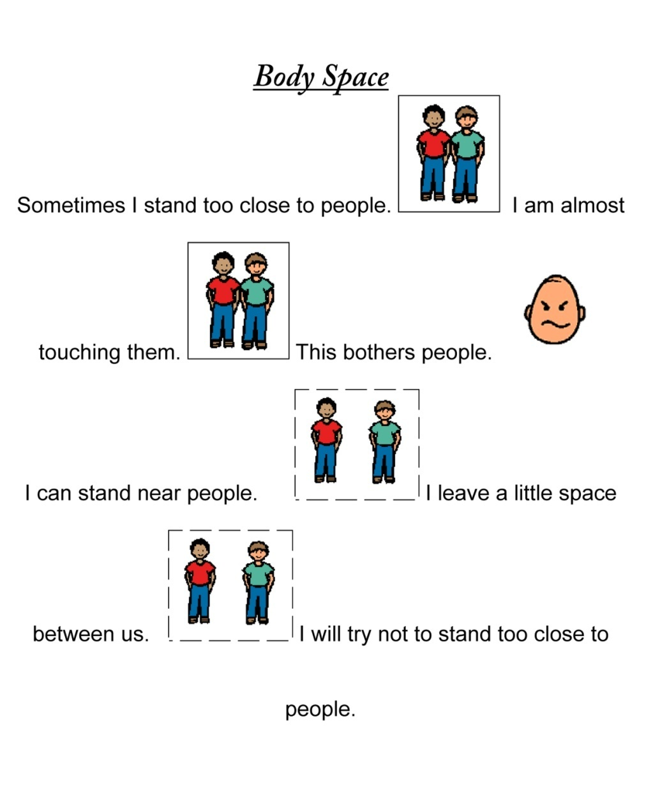
Social Skills
Exploits instruction in social acceptable ways to behavior and interact with others.
Adult-directed group interventions
Peer-mediated interventions
Social Stories
Notes:
Model social interaction, turn taking, reciprocity
Identify peers with strong social skills and pair the student with them so he has good models for social interaction. Provide peers with strategies for eliciting communication or other targeted objectives, but be careful not to turn the peer into a teacher—strive to keep peer interactions as natural as possible.
A social story is a short story that explains a specific challenging social situation. The goal is to find out what is happening in a situation.

Slide 47
Social Skills
Explain problematic social situations
Say
Event
OR
Problem
Choice
OR
Action
Goal
OR
Outcome
Think
Alternative
Alternative
Say
Notes:
There are specific choices to be made and that each choice has a specific consequence
Problematic social situation: who was involved, what happened
Brainstorming of options for responding to the situation
Explore the consequences for each option identified
Response that has the most desirable consequences
Develop and action plan

Slide 48
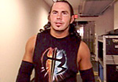
Social Skills
Jeff and Matt Hardy are rule breakers on WWE. They are acting when they break the rules on TV. When Jeff and Matt go to school they follow the rules. They also follow the rules at home. When Jeff Hardy has to do something that the teacher tells him to do he does not complain. He knows that the teacher is in charge and sometimes he has to do things he doesn’t want to do. Matt Hardy does not tell people he is bored when he is doing something at school. Matt and Jeff Hardy follow the rules and then they get to have fun when they are done with their work.
Power Cards
Jeff and Matt Hardy say:
Follow the rules at school
Follow the rules at home
Do what your teacher says without complaining
Have fun and get rewards for following directions
Jeff and Matt say that you rock!
http://www.kansasasd.com/KSASD/Home.html
Notes:
This is a card that the student can place on his desk or keep in his pocket.

Slide 49
Academic Skill Acquisition
Example:
Pull down pants
Pull down underwear
Sit on toilet
Use toilet paper
Pull up underwear
Pull up pants
Flush toilet
Go play
Training and Education of Autistic and Related Communication Handicapped Children (TEACCH)
Individualized assessment and planning is used to create a highly-structured environment (organized with visual supports) to help the individual map out activities and work independently.
Notes:
TEACCH was developed by Dr. Eric Schopler at the University of North Carolina in the 1970s and is used by many public school systems. This method is often less intensive than Applied Behavior Analysis or Verbal Behavior programs in the preschool years. A TEACCH classroom is usually very structured, with separate, defined areas for each task, such as individual work, group activities, and play. It relies heavily on visual learning, a strength for many children with autism and PDD. The children use schedules made up of pictures and/or words to order their day and to help them move smoothly between activities. Children with autism may find it difficult to make transitions between activities and places without such schedules. Social interaction and verbal communication may not be heavily stressed because TEACCH is more focused on accommodating a child's autistic traits than in trying to overcome them.

Slide 50
Academic Skill Acquisition
Weaknesses in attention, organization, transition, and auditory processing.
Visual schedules
Visual cues
To forewarn the student when something is going to end, stop or be all done
To guide the student through physical space
Make directions and learning expectations clearly understood

Slide 51
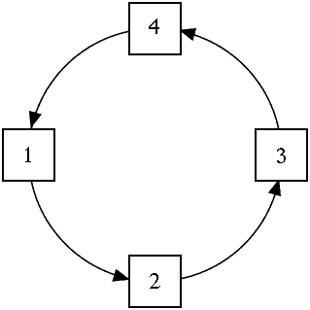
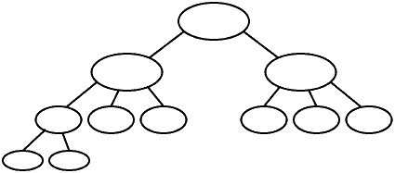
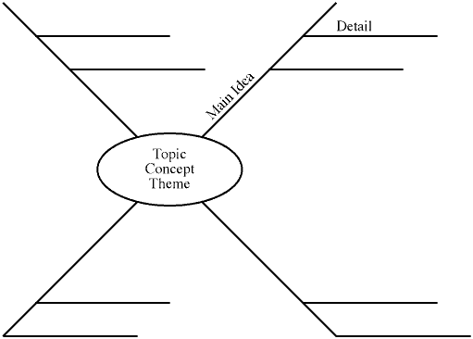
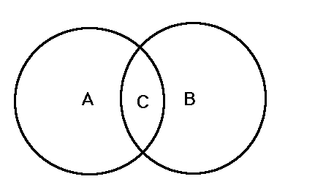
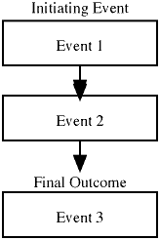
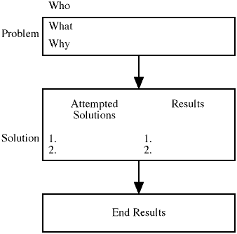
Academic Skill Acquisition
Reading fluency and/or comprehension difficulties
Highlighted text
Study guides
Graphic Organizers
Network Tree | Spider | Cycle
Chain of Events | Problem/ Solution | Venn Diagram

Slide 52
Academic Skill Acquisition
Written expression (e.g. handwriting) difficulties, difficulty with note taking
Conduct assessments verbally
Use a computer instead of writing by hand
Projects instead of papers
For notes, provide an outline or allow student to ask for a copy of peer notes

Slide 53
References
Autism Society of Wisconsin http://www.asw4autism.org/ California State University. Sacramento, 13 & 20 April 2009.
Autism Research Institute (2007) Stereotypic (Self-Stimulatory) Behavior, Retrieved April 20, 2009 from http://www.autism.com/families/problems/stim.htm
Bell, L (Eds.). (2008). School community tool kit: A tool kit to assist members of the school community in understanding and supporting students with autism. New York: Autism Speaks Inc.
Bopp, KD., et. al. 2004. “Speech-Language Pathologists’ Roles in the Delivery of Positive Behavior Support for Individuals with Developmental Disabilities.” Speech Lang Pathol. 13 (1): 5-19.
Brock, S. E., Jimerson, S. R., & Hansen, R. L. (2006). Identification, assessing and treating autism at school. New York: Springer.
Brock, Stephen, “Austism: Case Finding and Screening” and “Autism: Diagnosis and Psycho-educational Evaluation.” EDS 247 Lecture.
Brock, S. E., Silva, K., Riffey, A., & Ludena, S. (2007, March). Interventions for Autism Spectrum Disorders. Paper presented at the annual meeting of the California Association of School Psychologists, Los Angeles, CA.
http://www.teachersandfamilies.com/sped/prof/autism/education.htm

Slide 54
Resources
Koegel, L. K., Koegel, R. L., Frea,W., & Green-Hopkins, I. (2003). Priming as a method of coordinating services for students with autism. Language, Speech, and Hearing Services in School, 34, 228-235.
National Autistic Society (2005, May) Obsessions, repetitive behaviours and routines, Retrieved April 19, 2009 from http://www.nas.org.uk/
Oroznoff, Sally. (2002) A Parent’s Guide to Asperger’s Syndrome and High-Functioning Autism.. New York: The Guilford Press.
Sherman, Dave. no date. Autism - Your Child's Legal Rights to a Special Education, Retrieved April 21, 2009 from http://www.aboutautismlaw.com/index.html
Strickle, L., Doetz, J., Woodworth, M. S., & Hoffmeier, S. (2009). Kansas Autism Spectrum Disorders. Retrieved April 23, 2009 from http://www.kansasasd.com/KSASD/Home.html
United States Government Accountability Office. (2005). Special education: Children with autism. (Report to the Chairman and Ranking Minority Member, Subcommittee on Human Rights and Wellness, Committee on Government Reform, House of Representatives). Washington, DC: U.S. Government Printing Office.

