Slide 1

Assessment, Identification, and Treatment of Autism Spectrum Disorders at School
Stephen E. Brock, Ph.D., NCSP California State University, Sacramento NASP 2013 Summer Conference July 9, 2013 Cincinnati, OH

Slide 2
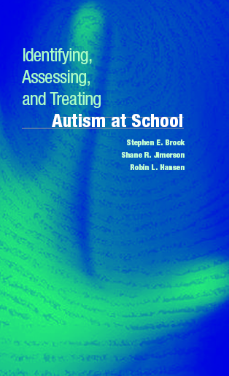
Acknowledgement
Adapted from…
Brock, S. E., Jimerson, S. R., & Hansen, R. L. (2006). Identifying, assessing, and treating autism at school. New York: Springer.

Slide 3
How Much do Know About Autism?
A CDC Quiz
Notes:
http://www.cdc.gov/ncbddd/autism/quiz.html
How much do you know about ASDs? Test your knowledge...
Key = 1e, 2c, 3c, 4d, 5d/b, 6b, 7a, 8e, 9b, 10c
1. Which of the following are signs that a child might have an ASD?
a) The child does not respond to their name by 12 months b) The child does not point at objects to show interest (point at an airplane flying over) by 14 months c) The child does not play "pretend" games (pretend to "feed" a doll) by 18 months d) The child avoids eye contact and wants to be alone e) All of the above
2. Do people with ASDs have delayed language development?
a) Yes b) No c) Sometimes
3. At what age can an ASD be diagnosed?
a) 3 years b) 2 years c) 18 months d) 12 months
4. At what ages should all children be screened for developmental delays and disabilities during regular well-child doctor visits?
a) 9 months b) 18 months c) 2 years d) All of the above
5. Is there a cure for ASDs?
a) Yes d) No
6. Public early intervention treatment services through the Individuals with Disabilities Education Act (IDEA, Part C) are available for children of what age?
a) Birth – 2 years b) Birth – 3 years c) 2 – 4 years d) 3 – 5 years
7. Can you start treatment services before getting an ASD diagnosis?
a) Yes b) No
8. Which of the following are known risk factors that can make a person more likely to develop an ASD?
a) Genetics b) Poor parenting skills. c) Certain medical conditions, such as Fragile X syndrome and Down syndrome d) A, B, and C e) A and C only
9. Do ASDs occur equally in all racial, ethnic, socioeconomic, and gender groups?
a) Yes b) No
10. If you’re concerned that your child might have an ASD or other developmental problem, what should you do?
a) Talk to family and friends to see if they agree with your concerns b) Wait awhile to see if he or she grows out of it c) Talk to a health care provider, or your local early intervention program about your concerns d) Get started with treatment therapies

Slide 4
Workshop Outline
Introduction
  Reasons for Increased Vigilance
  Diagnostic & Special Education Classifications
  Psychologist Roles, Responsibilities, Limitations
  Epidemiology
  Etiology
Case Finding
Screening
Diagnostic Evaluation
Psycho-educational Evaluation (Treatment)
Notes:
Here is my presentation outline (list workshop elements).

Slide 5
Introduction:
Reasons for Increased Vigilance
Autistic spectrum disorders are much more common than once thought.
  70 (vs. 4 to 6) per 10,000 in the general population (Saracino, Noseworthy, Steiman, Reisinger, & Fombonne, 2010).
  The prevalence of parent-reported ASD among children aged 6–17 was 2% in 2011–2012
    In other words, 1 in 50 parents report their 6-17 year old has ASD (vs. 1 in 86 in 2007) (Blumberg et al., 2013).
  Dramatic increases in the numbers served under the autism IDEA eligibility classification (Brock, 2006).
Notes:
If 4 million children are born in the United States every year, approximately 36,500 children will eventually be diagnosed with an ASD. Assuming the prevalence rate has been constant over the past two decades, we can estimate that about 730,000 individuals between the ages of 0 to 21 have an ASD.
Diagnostic and Assessment Issues in Autism
Surveillance and Prevalence
Jennifer Saracino & Julianne Noseworthy &
Mandy Steiman & Lisa Reisinger & Eric Fombonne
Dev Phys Disabil (2010) 22:317–330
DOI 10.1007/s10882-010-9205-1
Surveillance Summaries December 18, 2009 / 58(SS10);1-20
Prevalence of Autism Spectrum Disorders --- Autism and Developmental Disabilities Monitoring Network, United States, 2006
Please note: An erratum has been published for this article. To view the erratum, please click here.
Autism and Developmental Disabilities Monitoring Network Surveillance Year 2006 Principal Investigators
Corresponding author: Catherine Rice, PhD, National Center on Birth Defects and Developmental Disabilities, CDC, 1600 Clifton Rd. NE, MS E-86, Atlanta, GA 30333, Telephone: 404-498-3860; Fax: 404-498-0792; E-mail: crice@cdc.gov.
Recent epidemiological studies have documented a worldwide increase in the number of individuals identified with autism over the past decade. While early research suggested classic autism to be relatively rare (4 to 6 per 10,000 or about 1 per 2,000; Lotter, 1967), more recent findings suggest that when viewed as a spectrum of disorders and including children at the milder end of the spectrum autism is much more prevalent than previously thought (60 per 10,000 or approximately 1 per 160; Chakrabarti & Fombonne, 2001). While improved diagnostic practices and expanded classification systems account for a portion of this increase, some researchers now believed that yet to be identified environmental factors may have emerged in recent decades that place infants and children at increased risk for developing autism (Ozonoff & Rogers, 2003). Regardless of the cause (or more likely the causes) of this increased rate of autism spectrum disorders (ASD), there is no argument that today’s educators are more likely to identify and be asked to serve students with autism than in years past.
Global prevalence of autism and other pervasive developmental disorders.
Authors:
Elsabbagh, Mayada, Department of Psychiatry, Montreal Children's Hospital, Montreal, PQ, Canada
Divan, Gauri, Sangath, Goa, India
Koh, Yun‐Joo, Korea Institute for Children’s Social Development, Seoul, South Korea
Kim, Young Shin, Child Study Center, Yale University School of Medicine, New Haven, CT, US
Kauchali, Shuaib, Nelson R Mandela School of Medicine, University of KwaZulu-Natal, South Africa
Marcín, Carlos, Mexican Autism Clinic, Mexico City, Mexico
Montiel‐Nava, Cecilia, Psychology Department, La Universidad del Zulia, Maracaibo, Venezuela
Patel, Vikram, Centre for Global Mental Health, London School of Hygiene and Tropical Medicine, London, United Kingdom
Paula, Cristiane S., Developmental Disorders Program, Mackenzie Presbyterian University, Sao Paulo, Brazil
Wang, Chongying, Center for Behavioural Science, Nankai University, Tianjin, China
Yasamy, Mohammad Taghi, World Health Organization, Switzerland
Fombonne, Eric, Department of Psychiatry, Montreal Children's Hospital, Montreal, PQ, Canada, eric.fombonne@mcgill.ca
Address:
Fombonne, Eric, Department of Psychiatry, Montreal Children's Hospital 4018 Ste-Catherine West, Montreal, PQ, Canada, H3Z 1P2, eric.fombonne@mcgill.ca
Source:
Autism Research, Vol 5(3), Jun, 2012. pp. 160-179.
Page Count:
20
Publisher:
US: John Wiley & Sons.
Other Publishers:
United Kingdom: Wiley-Blackwell Publishing Ltd.
ISSN:
1939-3806 (Electronic)
1939-3792 (Print)
Language:
English
Keywords:
epidemiology, global health, pervasive developmental disorders, autism, geographic factors, cultural factors, socioeconomic factors, prevalence estimates, clinical presentation
Abstract:
We provide a systematic review of epidemiological surveys of autistic disorder and pervasive developmental disorders (PDDs) worldwide. A secondary aim was to consider the possible impact of geographic, cultural/ethnic, and socioeconomic factors on prevalence estimates and on clinical presentation of PDD. Based on the evidence reviewed, the median of prevalence estimates of autism spectrum disorders was 62/10,000. While existing estimates are variable, the evidence reviewed does not support differences in PDD prevalence by geographic region nor of a strong impact of ethnic/cultural or socioeconomic factors. However, power to detect such effects is seriously limited in existing data sets, particularly in low‐income countries. While it is clear that prevalence estimates have increased over time and these vary in different neighboring and distant regions, these findings most likely represent broadening of the diagnostic concepts, diagnostic switching from other developmental disabilities to PDD, service availability, and awareness of autistic spectrum disorders in both the lay and professional public. The lack of evidence from the majority of the world's population suggests a critical need for further research and capacity building in low‐ and middle‐income countries. (PsycINFO Database Record (c) 2012 APA, all rights reserved)
Autism and Developmental Disabilities Monitoring Network Surveillance Year 2008 Principal Investigators, CDC. (2012). Prevalence of autism spectrum disorders - Autism and Developmental Disabilities Monitoring Network, 14 Sites, United States, 2008. MMWR Morbidity and Mortality Weekly Report:, 61(SS03), 1-19. Retrieved March 29, 2012, from http://www.cdc.gov/mmwr/preview/mmwrhtml/ss6103a1.htm?s_cid=ss6103a1_w. [top]
CDC. (2010). Autism Spectrum Disorders-Data & Statistics. Retrieved January 28, 2011, from http://www.cdc.gov/ncbddd/autism/data.html. [top]
Brugha, T. S, McManus, S., Bankart, J., Scott, F., Purdon, S., Smith, J., et al (2011). Epidemiology of autism spectrum disorders in adults in the community in England. Archives of General Psychiatry, 68(5), 459-465. [top]

Slide 6
Introduction:
Reasons for Increased Vigilance
Autism can be identified early in development,
and…
Early intervention is an important determinant of the course of autism.
Notes:
Research suggests that 75 to 88 percent of children with Autistic Disorder show signs of this condition in the first two years of life, with 31 to 55 percent displaying symptoms in their first year (Young & Brewer, 2002).
These data combined with additional research suggesting relatively substantial cortical plasticity during early development and findings that intensive early intervention results in improved outcomes for children with ASD (Ozonoff & Rogers, 2003; Rogers, 2001; Rogers, 1998), have lead to a consensus that such early intensive intervention is essential (Mastergeorge, Rogers, Corbett, & Solomon, 2003).
Thus, it is critical for educators, in particular those working in infant and preschool settings, to ensure that children with ASD are identified as soon as possible.

Slide 7
Introduction:
Reasons for Increased Vigilance
Not all cases of autism will be identified before school entry.
  Median Age of ASD identification is 4.5 to 5.5 years of age.
    Event though for 51–91% of children with an ASD, developmental concerns had been recorded before 3-years.
Rice (2007). http://www.cdc.gov/ncbddd/autism/data.html
Notes:
The median age of earliest ASD diagnosis is between 4.5 and 5.5 years, but for 51–91 percent of children with an ASD, developmental concerns had been recorded before three years of age. [Read article]
Studies have shown that about one third of parents of children with an ASD noticed a problem before their child’s first birthday, and 80% saw problems by 24 months. [Read summary]
Research has shown that a diagnosis of autism at age 2 can be reliable, valid, and stable. ^{[1]} But despite evidence that ASDs can often be identified at around 18 months, many children do not receive final diagnoses until they are much older. [Read article]
Another reason for increased attention to the ASD is the fact that not all cases of these disorders will be identified before children enter school. While it should be expected that most of the more severe cases of autism will be identified before children reach school age, it needs to be acknowledged that many will “slip through the cracks” and go undiagnosed until after they enter kindergarten. For example, data from a survey conducted in the United Kingdom reveals that the average age of diagnosis for children with Autistic Disorder was about 5.5 years (Howlin & Asgharian, 1999). In particular, it is not unusual for students with milder forms of ASD (i.e., Asperger’s Disorder) to go undiagnosed until after school entry. Among this group the average age of diagnosis was reported to be 11 years. Only rarely is it given to children under the age of 5 years (Howlin & Asgharian, 1999). Consistent with these data is the fact that the number of children with autism served under IDEA reaches its peak among children ages 6 to 11 years (U.S. Department of Education, 2003). Thus, it is critical for all educators (not just those working in infant and preschool settings) to understand ASD and be vigilant for these disorders.

Slide 8
Introduction:
Reasons for Increased Vigilance
Most children with autism are identified by school resources.
  Only three percent of children with ASD are identified solely by non-school resources.
  All other children are identified by a combination of school and non-school resources (57 %), or by school resources alone (40 %)
Yeargin-Allsopp et al. (2003)
Notes:
In a study by Yeargin-Allsopp et al. (2003) of the 1996 prevalence of autism in Atlanta, it was found that only three percent of children with ASD were identified solely by non-school resources. All other children were identified by a combination of school and non-school resources (57 %), or by school resources alone (40 %). Thus, it might be anticipated that there is an expectation for educators to at the very least be involved in the identification process.

Slide 9
Introduction:
Reasons for Increased Vigilance
Full inclusion of children with ASD in general education classrooms.
  Students with disabilities are increasingly placed in full-inclusion settings.
  In addition, the results of recent studies suggesting a declining incidence of mental retardation among the ASD population further increases the likelihood that these children will be mainstreamed (Chakrabarti & Fombonne, 2001).
  Consequently, today’s educators are more likely to encounter children with autism during their careers.
Notes:
Finally, it is important to acknowledge that current research and practice are moving toward the integration of special and general education (Koegel & Koegel, 1995). Students with disabilities are increasingly placed in full-inclusion settings. In addition, the results of recent studies suggesting a declining incidence of mental retardation among the ASD population further increases the likelihood that these children will be mainstreamed (Chakrabarti & Fombonne, 2001). Consequently, today’s educators are more likely to encounter children with autism during their careers. Given these observations, it is essential that both special and general educators alike have up-to-date information regarding ASD.

Slide 10
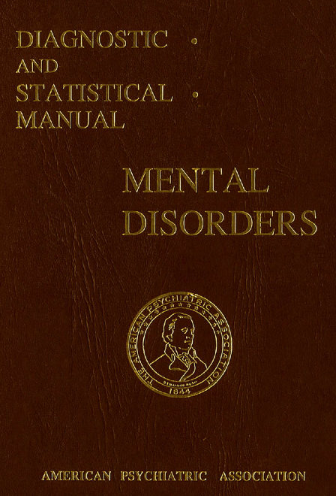
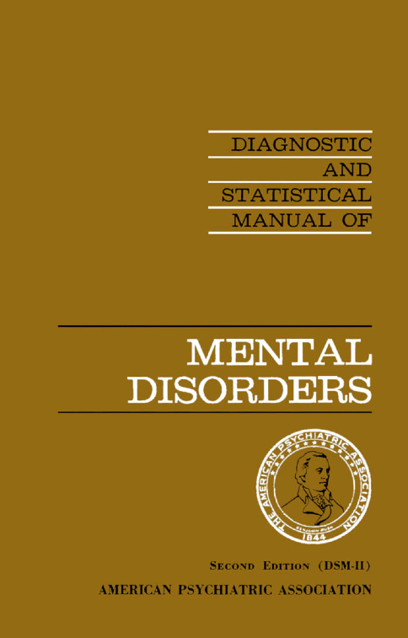
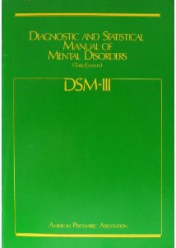
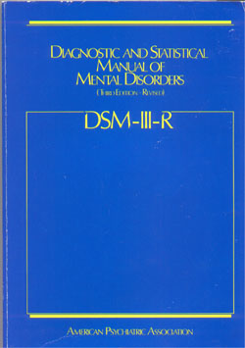
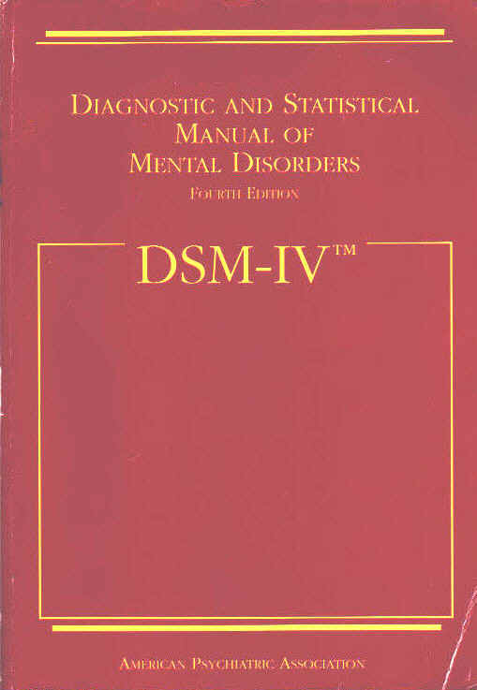
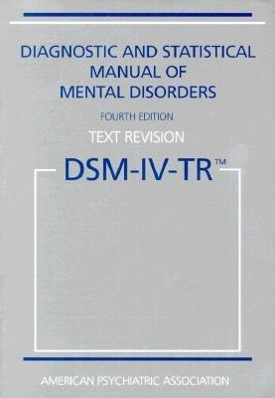
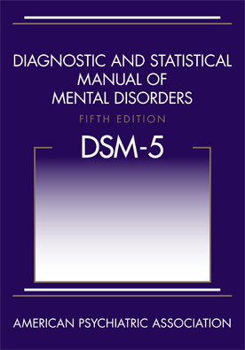
Introduction:
Diagnostic vs. Special Education Classifications
1952 1968 1980 1987 1994 2000 2013
History of Diagnostic Classification
DSM-I (1952) & DSM-II (1968)
  Schizophrenic Reaction (Childhood Type)
DSM-III (1980)
  Pervasive Developmental Disorder
    Childhood Onset PDD, Infantile Autism, Atypical Autism
DSM-III-R (1987)
  Pervasive Developmental Disorder
    PDD-NOS, Autistic Disorder
DSM-IV (1994) & DSM-IV-TR (2000)
  Pervasive Developmental Disorder
    PDD-NOS, Autistic Disorder, Childhood Disintegrative Disorder, Rett’s Disorder
Notes:
ICD-10-CM Still Includes DSM-IV diagnoses
F84Pervasive developmental disorders
F84.0Autistic disorder
F84.2Rett's syndrome
F84.3Other childhood disintegrative disorder
F84.5Asperger's syndrome
F84.8Other pervasive developmental disorders
F84.9Pervasive developmental disorder, unspecified

Slide 11
Introduction:
Diagnostic vs. Special Education Classifications
APA (2013)
Diagnostic Classification: DSM-5
Section II: Diagnostic Criteria and Codes
  Placed within the subclass of Neurodevelopmental Disorder.
    Autism Spectrum Disorder
    Social Communication Disorder
CQ article
DSM-IV-TR | DSM-5
Autistic Disorder Asperger’s Disorder Rett’s Disorder Childhood Disintegrative Disorder PDD Not Otherwise Specified | Autism Spectrum Disorder Social Communication Disorder
Notes:
Delete the term “Pervasive Developmental Disorders.” Symptoms are not pervasive – they are specific to social-communication domain plus restricted, repetitive behaviors/fixated interests. Overuse of PDD-NOS leads to diagnostic confusion (and may have contributed to autism “epidemic”). Overlap of PDD-NOS and Asperger disorder. Recommend new diagnostic category: “Autism Spectrum Disorder”
Rett’s will be removed as a separate disorder: ASD behaviors are not particularly salient in Rett’s Disorder patients except for brief period during development. ASD are defined by specific sets of behaviors, not etiologies (at present) so inclusion of Rett’s Disorder is atypical. Patients with Rett’s Disorder who have autistic symptoms can still be described as having ASD, and clinicians should use the specifier “with known genetic or medical condition” to indicate symptoms are related to Rett.
Delete the term Asperger Disorder: Criteria used in DSM-IV do not match the original cases described by Asperger (his cases meet autism criteria). No clinical or research evidence for separation of Asperger disorder from autism (High functioning autism = Asperger dx). Diagnostic biases apparent, with rich, white males receiving Asperger dx, while poorer, non-Caucasian populations receive PDD-NOS diagnosis (See site differences in CDC surveillance data)
Delete the term Childhood Disintegrative Disorder: New knowledge that developmental regression in ASD is a continuous variable, with wide range in the timing and nature of the loss of skills, as well as the developmental milestones that are reached prior to regression. Rarity of CDD diagnosis makes systematic evaluation difficult, but review of accumulated world’s literature shows that CDD has important differences from other ASD’s, including the acuity and severity of regression, as well as co-occurring physical symptoms, such as loss of bowel and bladder control. (Need to look for neurological disorder)
AUTISM, ASPERGER and PDD-NOS will be collapsed into a single dx: AUTISM SPECTRUM DISORDER. JUSTIFICATION: Scientific evidence and clinical practice show that a single spectrum better reflects the symptom presentation, time-course and response to treatment. Separation of ASD from typical development is reliable & valid while separation of disorders within the spectrum is not (e.g., Asperger and PDD-NOS used interchangeably, as are HFA and Asperger). Many states provide services only for dx of autism; as expected, PDD-NOS and Asperger disorder are rare dx’s in those jurisdictions
Sensitivity has been “sacrificed” in order to improve specificity: Merging Asperger disorder (and PDD-NOS) into autism spectrum disorder results in loss of identity and ignores uniqueness of Asperger dx. Pre-/post DSM-5 research studies will not be comparable. Changes in criteria threaten services delivery .
Social Communication Disorder: Diagnosis is needed for: (a) Children with current dx of PDD-NOS on the basis of social communication deficits, (b) Individuals with significant social skills deficits. Criteria appeared to function well in field trials. Should NOT be included in ASD section because it defines a group of individuals with related, but separate symptoms

Slide 12
Introduction:
Diagnostic vs. Special Education Classifications
APA (2013)
Revision Goals
  Better recognize “essential shared features” of ASDs
  Provide a clearer and simpler diagnosis
    DSM-IV-TR
      PDD Dx = 2,027 symptom combinations
    DSM-5
      ASD Dx = only 11 different ways to meet diagnosis (if all three of Criterion A’s social communication and social interaction symptoms are required).
APA (2000; 2013)
Notes:
We may just have one label (“Autism”), where before we had three, and what was over 2K Sx combos leading to a PDD Dx, may be replaced by 11 Sx combos leading to an Autism Dx. McParland (2012)

Slide 13
Introduction:
Diagnostic vs. Special Education Classifications
APA (2013)
DSM-5 Diagnostic Classifications
Autism Spectrum Disorder (pp. 50-59)
  Persistent impairment in reciprocal social communication and social interaction; and restricted, repetitive patterns of behavior, interests, or activities.
Social (Pragmatic) Communication Disorder (pp. 47-49)
  Problems with pragmatics, as manifested by deficits in understanding and following social rules of verbal and nonverbal communication.
DSM-IV-TR to DSM-5
Notes:
Severity of ASD Symptoms
•Pattern of Onset and Clinical Course
•Etiologic factors
•Cognitive abilities (IQ)
•Associated conditions
CLINICIANS WILL BE ENCOURAGED TO DESCRIBE THESE DETAILS WITH DIAGNOSTIC SPECIFIERS
THREE will become TWO
–Social Communication domain will be created by merger of key symptoms from the DSM-IV Social and Communication domains
–Fixated interests and repetitive behavior or activity
JUSTIFICATION:
•Deficits in communication are intimately related to social deficits. The two are “manifestations” of a single set of symptoms that are often present in differing contexts.
•This de-emphasizes language skills not employed in the context of social communication.
•Fixes the “double-counting” problem of DSM-IV

Slide 14
Introduction:
Diagnostic vs. Special Education Classifications
IDEIA 2004 Autism Classification (P.L. 108-446, Individuals with Disabilities Education Improvement Act (IDEIA), 2004, USDOE Regulations for IDEA 2004 [§ 300.8(c)(1)])
“Autism means a developmental disability significantly affecting verbal and nonverbal communication and social interaction, generally evident before age three, that adversely affects a child’s education performance. Other characteristics often associated with autism are engagement in repetitive activities and stereotypical movements, resistance to environmental change or change in daily routines, and unusual responses to sensory experiences. (i) Autism does not apply if a child’s educational performance is adversely affected primarily because the child has an emotional disturbance, as defined in paragraph (c)(4) of this section. (ii) A child who manifest the characteristics of autism after age three could be identified as having autism if the criteria in paragraph (c)(1)(i) of this section are satisfied.”
Notes:
It is critical to recognize that DSM IV-TR diagnoses are not synonymous with special education eligibility (Fogt et al., 2003; Department of Education, 2000).

Slide 15
Introduction:
Psychologist Roles, Responsibilities, and Limitations
All psychologists need to be more vigilant for signs of autism among students they serve
  and better prepared to assist in the process of identifying these disorders.
Notes:
From the findings just mentioned, it is clear that school psychologists need to be more vigilant for symptoms of ASD among the students they serve, and better prepared to identify these disorders.
All school psychologists need to be able to engage in case finding, screening, and referral for diagnostic assessments.
While it is anticipated that not all school psychologists will have had the supervised training experiences required to diagnose ASD, it is expected that all school psychologists should know how to assist in the process of diagnosing ASD.
This should include the administration of psycho-educational assessments to determine learning strengths and challenges, as well as to help determine special education eligibility and develop IEP goals and objectives.

Slide 16
Introduction:
Psychologist Roles, Responsibilities, and Limitations
Case Finding
  All psychologists should be expected to participate in case finding (i.e., routine developmental surveillance of children in the general population to recognize risk factors and identify warning signs of autism).
    This would include training general educators to identify the risk factors and warning signs of autism.
Notes:
Case finding refers to routine developmental surveillance of all students in the general population to identify atypical developmental patterns.
Case finding efforts do not diagnosis autism or other developmental disorders, but rather are designed to signal the presence of risk factors and/or warning signs, and the need for further screening and evaluation.
Ideally provided by primary care providers at well baby check-ups.
School personnel involved in preschool programs may also play an important role in case finding (as mandated by Child Find regulations)
Given the fact that not all instance of ASD will be identified before children enter school, all school psychologists should be expected to engage in case finding. This would include training general educators to identify the risk factors and warning signs of ASD.

Slide 17
Introduction:
Psychologist Roles, Responsibilities, and Limitations
Screening
  All school psychologists should be prepared to participate in the behavioral screening of the student who has risk factors and/or displays warning signs of autism (i.e., able to conduct screenings to determine the need for diagnostic assessments).
  All school psychologists should be able to distinguish between screening and diagnosis.
Notes:
All students at-risk for autism (as identified by case finding efforts) should be screened for this disorder. Such screening is designed to help determine the need for additional diagnostic assessments.
Because these screenings are relatively quick and easy it has been suggested that screening referral decisions be rather liberal.
According to Filipek et al. (1999), autism screenings should include lead screening, audiological evaluations, and behavioral screenings.
All school psychologists should be prepared to participate in the behavioral screening of the student who has risk factors and/or displays warning signs of autism.
It is important to reiterate that the purpose of screening is not to diagnosis ASD, but rather to determine if such diagnostic assessments are warranted.
All school psychologists should be able to distinguish between screening and diagnosis.

Slide 18
Introduction:
Psychologist Roles, Responsibilities, and Limitations
Only those school psychologists with appropriate training and supervision should diagnose a specific autism spectrum disorder.
Notes:
When approaching the diagnosis of an ASD it is important to keep in mind that no single test will reliably identify this disorder.
As a result diagnostic assessment requires multiple methods employed across multiple settings.
Also, it is important to acknowledge that the ability to determine if a student has a specific ASD, as defined by DSM IV-TR, requires special clinical training and supervised practice.
Only those school psychologists with appropriate training and supervision should diagnose autism.
In fact, according to the National Research Council (2001): “The level of expertise required for effective diagnosis and assessment may require the services of individuals, or a team of individuals, other than those usually available in a school setting” (p. 26).

Slide 19
Introduction:
Psychologist Roles, Responsibilities, and Limitations
Special Education Eligibility
  All psychologists should be expected to conduct the special education eligibility evaluation, which determines educational needs.
  The ability to conduct such assessments will require psychologists to be knowledgeable of the accommodations necessary to obtain valid test results when working with the child who has an ASD.
Notes:
While many school psychologists will not be the primary diagnostician of a specific ASD (as defined by DSM IV-TR),
All school psychologists should be expected to conduct the psycho-educational evaluation that is a part of the diagnostic process and that determines educational needs.
From such evaluations student strengths and challenges are identified, and important program planning data obtained (including documentation of possible special education eligibility).
DSM IV-TR diagnostic criteria are not synonymous with IDEA eligibility criteria.
While suggestive of the need for supportive services, a specific ASD diagnosis is clearly not sufficient when determining special education eligibility.
Thus, school psychologists will need to conduct psycho-educational assessments to assist IEP teams in determining if a student with an ASD requires special education assistance.
The ability to conduct such assessments will require school psychologists to be knowledgeable of the accommodations necessary to obtain valid test results when working with the child who has an ASD.

Slide 20
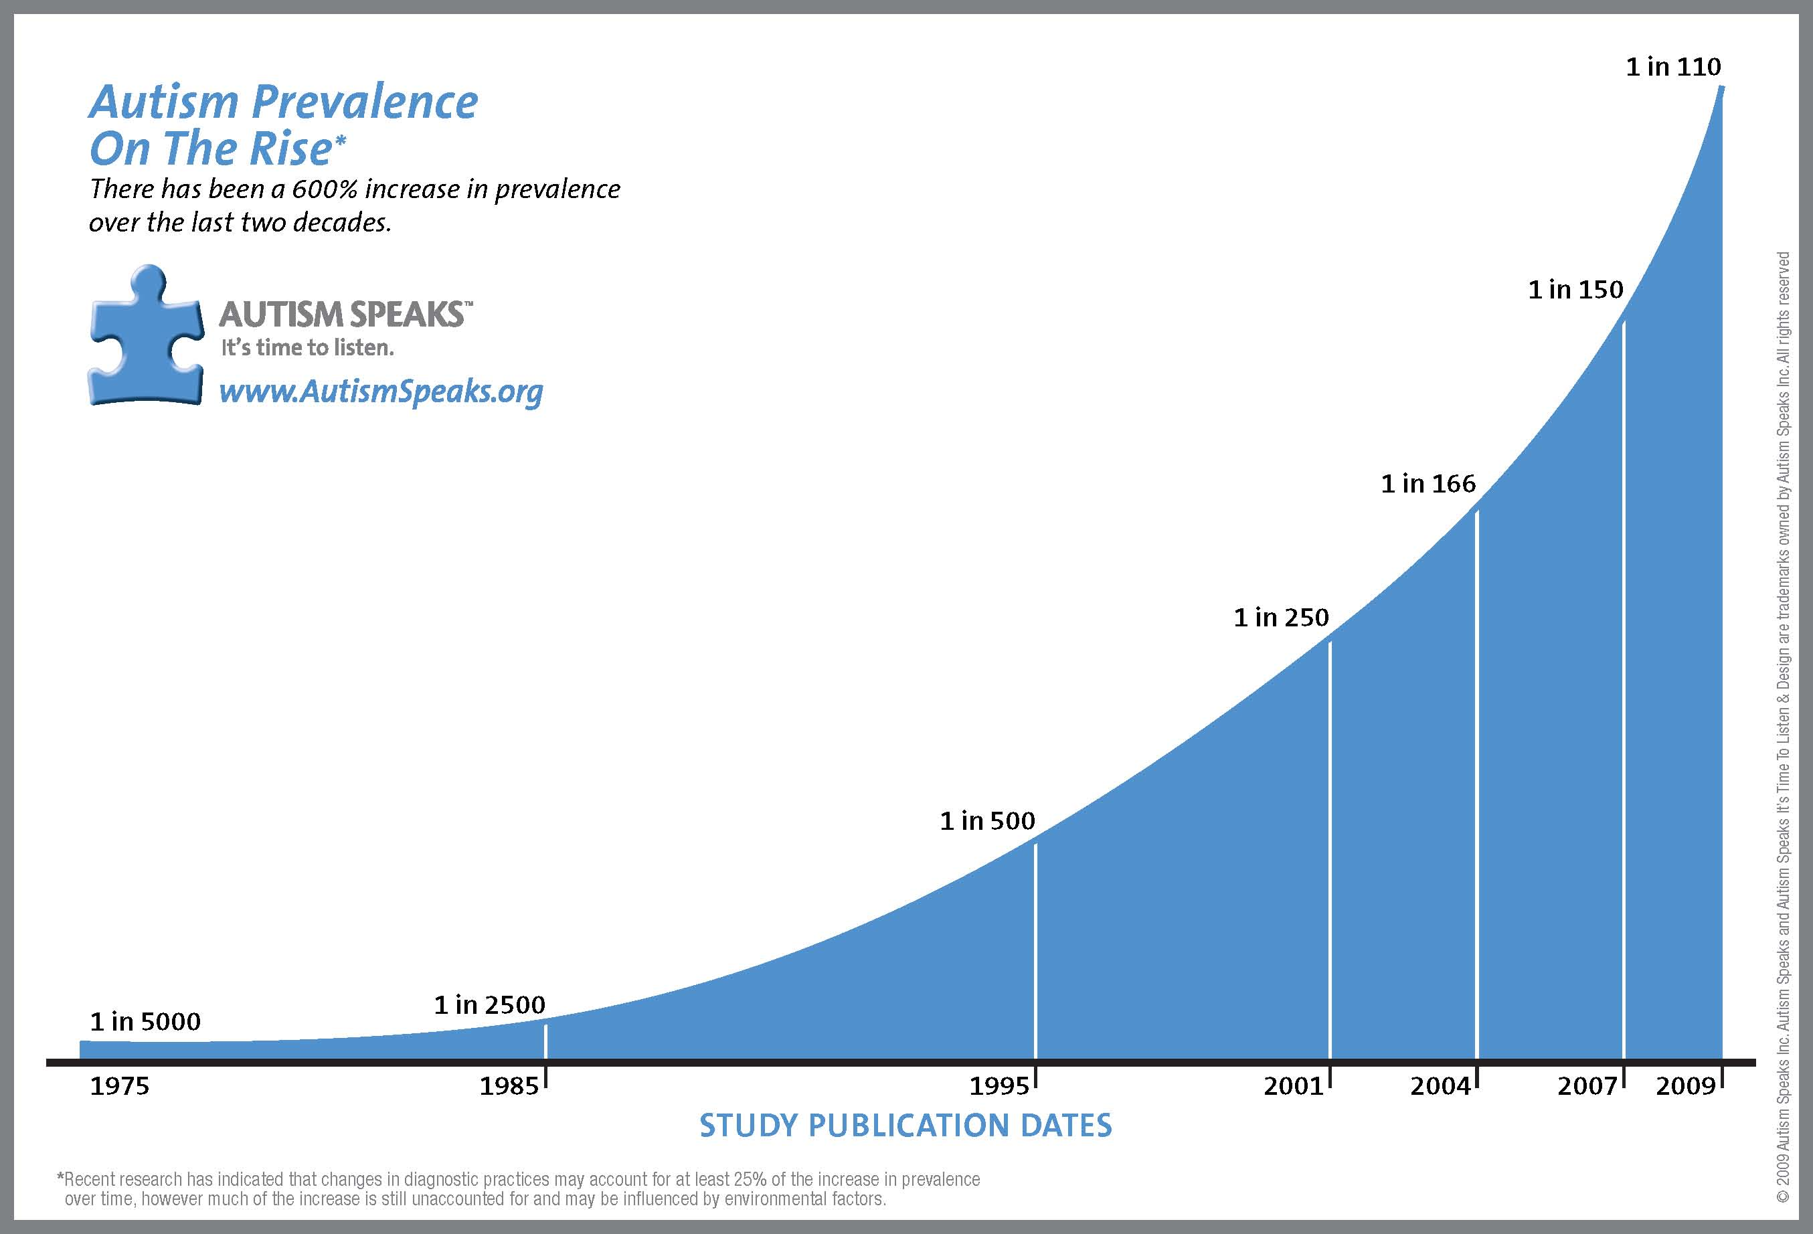
Introduction:
Epidemiology (General Population)
Notes:
Changes in diagnostic criteria. The initial studies of the incidence of autism employed a rather narrow definition of autism (classic or Kanner’s autism), one that is more closely aligned with what is currently labeled Autistic Disorder.
Heightened public awareness of autism. Heightened public awareness (and related media coverage) of these disorders, and a such caregivers are more likely to recognize and refer children with autism then they were in years past.
Increased willingness and ability to diagnosis autism. Health care professionals are simply doing a better job of identifying children with ASD.
Availability of resources for children with autism. For example, since 1991 autism has been an IDEA special education eligibility classification. It has provided an important motivation for identifying students as children with autism. In addition, the mandate for early intervention services for children and the many advocacy groups...
Yet to be identified environmental factors. Supporting this hypothesis is the Report to the Legislature (2002). This research project investigated reports of a 273% increase in reported cases of autism in California during the time period 1987 to 1998. From the obtained data it was concluded that there was no evidence that changes in demographics, the frequency of appropriate diagnoses, or diagnostic criteria alone contributed to the increased rate of autism.
Interestingly, analysis of the same data by Croen, Grether, Hoogstrate, & Selvin (2002) suggested that “diagnostic substitution” of autism for mental retardation explains the increase in ASD rates. In other words, their interpretation of the data suggested that the increase in ASD rates might be to a significant extent explained by a decrease in the use of the diagnosis of mental retardation. While the possibility that the rate of autism is in fact increasing cannot be ruled out, Fombonne (2003b) concluded that the evidence for a causal association between environmental factors and ASD is “weak” (p. 88).

Slide 21
Introduction:
Epidemiology (General Population)
Explanations for Changing ASD Rates
Changes in diagnostic criteria.
Heightened public awareness of autism.
Increased willingness and ability to diagnose autism.
Availability of resources for children with autism.
Yet to be identified environmental factors.
Notes:
Changes in diagnostic criteria. The initial studies of the incidence of autism employed a rather narrow definition of autism (classic or Kanner’s autism), one that is more closely aligned with what is currently labeled Autistic Disorder.
Heightened public awareness of autism. Heightened public awareness (and related media coverage) of these disorders, and a such caregivers are more likely to recognize and refer children with autism then they were in years past.
Increased willingness and ability to diagnosis autism. Health care professionals are simply doing a better job of identifying children with ASD.
Availability of resources for children with autism. For example, since 1991 autism has been an IDEA special education eligibility classification. It has provided an important motivation for identifying students as children with autism. In addition, the mandate for early intervention services for children and the many advocacy groups...
Yet to be identified environmental factors. Supporting this hypothesis is the Report to the Legislature (2002). This research project investigated reports of a 273% increase in reported cases of autism in California during the time period 1987 to 1998. From the obtained data it was concluded that there was no evidence that changes in demographics, the frequency of appropriate diagnoses, or diagnostic criteria alone contributed to the increased rate of autism.
Interestingly, analysis of the same data by Croen, Grether, Hoogstrate, & Selvin (2002) suggested that “diagnostic substitution” of autism for mental retardation explains the increase in ASD rates. In other words, their interpretation of the data suggested that the increase in ASD rates might be to a significant extent explained by a decrease in the use of the diagnosis of mental retardation. While the possibility that the rate of autism is in fact increasing cannot be ruled out, Fombonne (2003b) concluded that the evidence for a causal association between environmental factors and ASD is “weak” (p. 88).

Slide 22
Introduction:
Epidemiology (Special Education)
U.S. Department of Education (2013)
Notes:
In 1991 the US Department of Education added autism as a specific special education eligibility category. Since that time the number of children classified for special education purposes as autistic has steadily increased. From data provided by the U.S. Department of Education (2003), this slide illustrates the increase in the number of students falling in this special education eligibility classification. In 2003 there was a total of 141,022 school-aged students (6 to 21 years of age) with autism served under IDEA, most of whom (85,995) were 6- to 11-years-old.

Slide 23
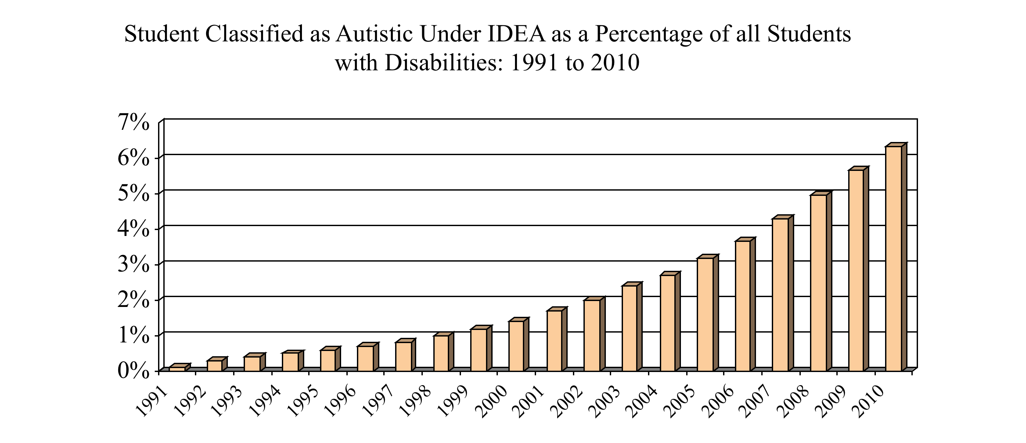
Introduction:
Epidemiology (Special Education)
U.S. Department of Education (2011) https://www.ideadata.org/PartBData.asp
Notes:
Taking into account increases in the population of all students served under IDEA, this slide illustrates that autism, as a percentage of students in special education, is also increasing. In 2004 students classified with autism represented 2.7 percent of all school age students with disabilities served under IDEA (up from one tenth of one percent in 1991).

Slide 24
Preface: Changes in Selected Eligibility Categories Rates
U.S. Department of Education (2013)
Notes:
Explain slide and then ask:
At you look at these national tend lines what explanations to you have to the changing numbers of students in these selected special education eligibility categories.
Congress initially specified two conditions – Schizophrenia and autism – that would statutorily qualify a student as emotionally disturbed in its efforts to give educators clear and specific guidance regarding exactly how they defined ED (Tibbetts, 2013).
The term autism, meaning “living in self” (in Greek aut means self, and ism refers to a state), was coined by a Swiss psychiatrist, Eugene Bleuler, in 1911, to describe self absorption due to poor social relatedness in schizophrenia
Although clearly differentiated from childhood psychoses of late onset, autism continued to be labeled a childhood psychosis, albeit of early onset, until
the early 1970s
Eisenberg. L. (1972). The classification of childhood psychosis reconsidered. Journal of Autism and Child Schizophrenia, 2, 338–342.
Rutter, M. (1972). Childhood schizophrenia reconsidered. Journal of Autism and Child Schizophrenia, 2, 315-337.

Slide 25
Introduction:
Epidemiology (Special Education)
Explanations for Changing Rates in Special Education
  IEP teams have become better able to identify students with autism.
  Autism is more acceptable in today’s schools than is the diagnosis of mental retardation.
  The intensive early intervention services often made available to students with autism are not always offered to the child whose primary eligibility classification is mental retardation.
Brock (2006)
Notes:
Brock, S. E. (2006). An examination of the changing rates of autism in special education. The California School Psychologist, 11, 31-39.
A potential explanation for the changes in autism and mental retardation rates is that IEP teams have become better able to identify students with autism and that a percentage of students with mental retardation were previously misclassified. Another explanation for this classification substitution might be found in the authors’ anecdotal observation that the diagnosis of autism is more acceptable in today’s schools than is the diagnosis of mental retardation. While the later diagnosis has a fairly uniform (and typically poor) prognosis, the diagnosis of autism appears to be viewed by many of today’s educators (and parents) has having the potential for a positive adult outcome. In addition, the intensive early intervention services often made available to students with autism are not always offered to the child whose primary eligibility classification is mental retardation. Thus, IEP teams may be especially motivated to identify students as eligible for IDEA services under the autism criteria.

Slide 26
Introduction:
Causes
While Kanner initially suggested ASD to have a biological basis, most early efforts to identify the causes of autism focused on inadequate nurturance by emotionally cold and indifferent parents.
Today it is now accepted that the behavioral manifestations of autism are a consequence of abnormal brain development, structure, and function.
Notes:
Before bullets = Researchers have been trying to find the causes of autism since it was first identified by Kanner in 1943.
After bullets = In the words of Ozonoff and Rogers (2003): “It is now abundantly clear that autism is a biological disorder and is not caused by parenting deficiencies or other social factors” (p. 18).

Slide 27
Introduction:
Causes
Strock (2004)
Notes:
Strock, M. (2004). Autism spectrum disorders (Pervasive developmental disorders). [NIH Publication No. NIH-04-5511] Bethesda, MD: National Institute of Mental Health, National Institutes of Health, U.S. Department of Health and Human Services.

Slide 28
Introduction:
Causes
While it is clear that autism has an organic etiology, the underlying causes of these neurological differences, and exactly how they manifest themselves, is much more controversial.
The etiology of autism is complex and multifaceted; likely resulting from the interaction of genetic, environmental, and neurological factors.
It has been suggested that some combination of…
  genetic predisposition(s) and
  gene by environmental interaction(s)
  result in the brain abnormalities, which in turn are the causes of the range of behaviors we currently refer to as autism spectrum behaviors.
Notes:
Literature reviews conducted by Muhle, Trentacoste, and Rapin (2004), Rapin and Katzman (1998), and Newschaffer, Fallin, and Lee (2002) suggest the etiology of autism to be complex and multifaceted; resulting from the interaction of genetic, neurological, and environmental factors.

Slide 29
Introduction:
Causes Flowchart (read from top down)
Notes:
My crude scheme for ASD etiology…
ASD behaviors are a consequence of neurobiological (or brain based) pathologies
The origins of these brain differences appear to be genetic and/or environmental factors.
While there may be some examples of an ASD being the direct consequence of genetic or environmental factors, what has been suggested to be most likely that specific genetic predispositons interact with specific environmental factors and result in the brain differences that are associated (and appear to cause) ASD behaviors.
Next, I’m going to provide further discussion of genetic and environmental factors, the neurobiological pathologies associated with ASD.

Slide 30
Introduction:
Causes
Genetics
  ASD runs in families
    Identical Twins (60 to 90 percent concordance)
    Sibling recurrence rate
      0.052 for maternal half siblings
      0.00 for a small number of paternal half siblings
      0.095 for full siblings
  Multiple genetic factors likely cause most cases of autism.
  The variability of ASD manifestations among even identical twins argues strongly that simple models of inheritance do not completely account for this ASD.
Constantino et al. (2013)
Notes:
Before last bullet ask…
“What is it about identical twin data that clearly indicates that a Genetic defect is not a likely source of all ASD cases?”
If ASD was a purely genetic condition we would expect 100 % concordance among identical twins.
Constantino, J. N., Department of Psychiatry, Washington University School of Medicine, St Louis, MO, US, constantino@wustl.edu
Todorov, A., Department of Psychiatry, Washington University School of Medicine, St Louis, MO, US
Hilton, C., Program in Occupational Therapy, Washington University School of Medicine, St Louis, MO, US
Law, P., Kennedy Krieger Institute, Johns Hopkins University, Baltimore, MD, US
Zhang, Y., Department of Psychiatry, Washington University School of Medicine, St Louis, MO, US
Molloy, E., Department of Psychiatry, Washington University School of Medicine, St Louis, MO, US
Fitzgerald, R., Department of Psychiatry, Washington University School of Medicine, St Louis, MO, US
Geschwind, D., Department of Neurology, University of California, Los Angeles, CA, US
Address:
Constantino, J. N., constantino@wustl.edu
Source:
Molecular Psychiatry, Vol 18(2), Feb, 2013. pp. 137-138.
Page Count:
2
Publisher:
United Kingdom: Nature Publishing Group.
ISSN:
1476-5578 (Electronic)
1359-4184 (Print)
Language:
English
Keywords:
disease transmission, genetic mechanisms, disease recurrence, siblings, autism spectrum disorders
Abstract:
Presents a study which aims to examine the genetic mechanisms of transmission in autism spectrum disorders (ASD). The authors compared autism recurrence in half siblings versus that in full siblings, using data from over five thousand families enrolled in the Interactive Autism Network (IAN). Recurrence rate among full siblings was observed to be approximately twice that among half siblings, providing strong evidence of genetic transmission of ASD. The data included 5237 families with an ASD-affected child and at least one additional sibling. The recurrence rate was 0.052 for maternal half siblings 0.00 for the small number of paternal half siblings and 0.095 for full siblings. There was no difference in the full sibling recurrence rate in families with additional half siblings compared with those without. This is the first report of the half sibling full sibling recurrence ratio from a large population of families affected by autism. Given that an estimated 10-25% of the remaining causal variance is explainable on the basis of de novo mutation, these data substantially contribute to the information base on the genetic structure of autism and strongly support a major role of genetic factors in the ontogeny of ASD including the intergenerational transmission of additive genetic susceptibility factors through unaffected mothers. (PsycINFO Database Record (c) 2013 APA, all rights reserved)

Slide 31
Introduction:
Causes
Widely Studied Candidate Genes
1. reelin (RELN)
2. serotonin transporter gene (SLC6A4)
3. Bacillus subtilis ycnF (GABR)
4. neuroligin (NLGN)
5. oxytocin receptor (OXTR)
6. hepatocyte growth factor receptor (MET)
7. calcium-binding mitochondrial carrier protein Aralar1 (SLC25A12)
8. glutamate receptor (GluR6)
9. contactin-associated protein-like 2 (CNTNAP2)
10. lactoylglutathione lyase (GLO1)
11. tryptophan hydroxylase 2 (TPH2)
Xiaohong et al. (2012)
Notes:
Genes associated with autism spectrum disorder, Xiaohong Li, Hua Zou W. Ted Brown,
Brain Research Bulletin, Volume 88, Issue 6, 1 September 2012, Pages 543–552
However, even the most critical observers admit that substantial progress has been achieved in this realm during the past decade. The most promising genes, such as NLGN and SLC6A4, are involved in the physiological and pathophysiological processes of neurogenesis, neuronal migration, and synaptogenesis. However, analysis of newly discovered variants may also play important roles in helping to elucidate the underlying networks and pathways involved in ASD.
In conclusion, data remain inconclusive for the majority of candidate genes tested so far. Still, we have good reason to be optimistic regarding gene discovery in ASD now and in the future. Cytogenetic, linkage, association studies and array analysis have provided promising results. Emerging genetic technologies and analysis tools offer even more powerful approaches for developing insights into the etiology of ASD. In addition, genetic studies facilitate other autism research such as biochemical and neuroimaging studies, which will, in turn, provide evidence and valuable clues to direct future genetic studies.
Genes Loci
1. reelin 7q22
2. serotonin transporter gene (SLC6A4) 17q11.1–17q12
3. Bacillus subtilis ycnF (GABR) 15q11–15q13
4. neuroligin (NLGN)3q26(NLGN1), 17p13 (NLGN2), Xq13 (NLGN3), Xp22.3 (NLGN4), Yq11.2 (NLGN4Y)
5. oxytocin receptor (OXTR) 3p24–3p25
6. hepatocyte growth factor receptor (MET) 7q31.2
7. calcium-binding mitochondrial carrier protein Aralar1 (SLC25A12) 2q31
8. glutamate receptor (GluR6) 6q21
9. contactin-associated protein-like 2 (CNTNAP2) 7q35
10. lactoylglutathione lyase (GLO1) 6p21.3–6p21.2
11.tryptophan hydroxylase 2 (TPH2) 12q21.1

Slide 32
Introduction:
Causes
Environment
  To the extent the environment has a causal role in ASD, it has been suggested that it does so by interacting with certain genes.
    In other words, a certain gene or gene combinations may generate a susceptibility to autism that is in turn triggered by a certain environmental factor or factors.
  Insufficient evidence to implicate any 1 perinatal or neonatal factor in ASD etiology.
    Exposure to a broad class of conditions reflecting general compromises to perinatal and neonatal health increases risk.
  Gardener et al. (2011)
Notes:
Pediatrics 2011;128;344; originally published online July 11, 2011;
Hannah Gardener, Donna Spiegelman and Stephen L. Buka
Genetic Heritability and Shared Environmental
Factors Among Twin Pairs With Autism
Joachim Hallmayer, MD; Sue Cleveland, BS; Andrea Torres, MA; Jennifer Phillips, PhD; Brianne Cohen, BA;
Tiffany Torigoe, BA; Janet Miller, PhD; Angie Fedele, BA; Jack Collins, MBA; Karen Smith, BS; Linda Lotspeich, MD;
Lisa A. Croen, PhD; Sally Ozonoff, PhD; Clara Lajonchere, PhD; Judith K. Grether, PhD; Neil Risch, PhD
Arch Gen Psychiatry. 2011;68(11):1095-1102.
The results suggest that environmental factors common to twins explain about 55% of the liability to autism. Although genetic factors also play an important role, they are of substantially lower magnitude than estimates from prior twin studies of autism. Nearly identical estimates emerged for ASD, suggesting that ASD presents the same liability spectrum as strict autism.

Slide 33
Introduction:
Causes
Environment
  Recent research suggest that environmental factors may play a more important role than was once thought.
    Factors common to twins explain about 55% of the liability to autism (with only 37% being attributable to common genes).
Hallmayer et al. (2011)
Notes:
Pediatrics 2011;128;344; originally published online July 11, 2011;
Hannah Gardener, Donna Spiegelman and Stephen L. Buka
Genetic Heritability and Shared Environmental
Factors Among Twin Pairs With Autism
Joachim Hallmayer, MD; Sue Cleveland, BS; Andrea Torres, MA; Jennifer Phillips, PhD; Brianne Cohen, BA;
Tiffany Torigoe, BA; Janet Miller, PhD; Angie Fedele, BA; Jack Collins, MBA; Karen Smith, BS; Linda Lotspeich, MD;
Lisa A. Croen, PhD; Sally Ozonoff, PhD; Clara Lajonchere, PhD; Judith K. Grether, PhD; Neil Risch, PhD
Arch Gen Psychiatry. 2011;68(11):1095-1102.
The results suggest that environmental factors common to twins explain about 55% of the liability to autism. Although genetic factors also play an important role, they are of substantially lower magnitude than estimates from prior twin studies of autism. Nearly identical estimates emerged for ASD, suggesting that ASD presents the same liability spectrum as strict autism.

Slide 34
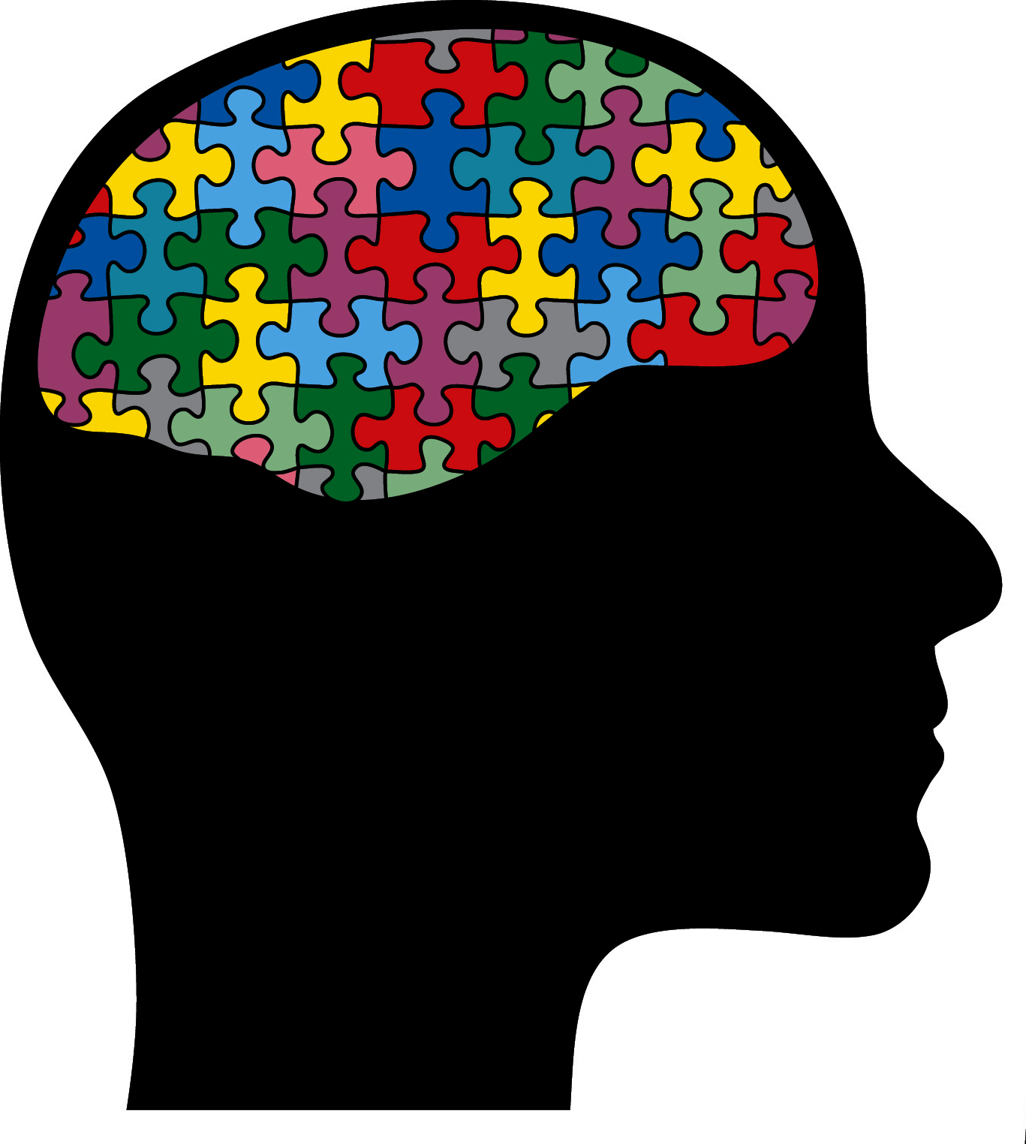
Introduction:
Causes
Neurobiology
  Brain Size
    Rapid and excessive increase in head circumference during the first year
    MRI data suggests brain size discriminates ASD children from typically developing peers
    More rapid growth/larger brain size is associated with more severe ASD.
Courchesne, Campbell, & Solso (2011)

Slide 35
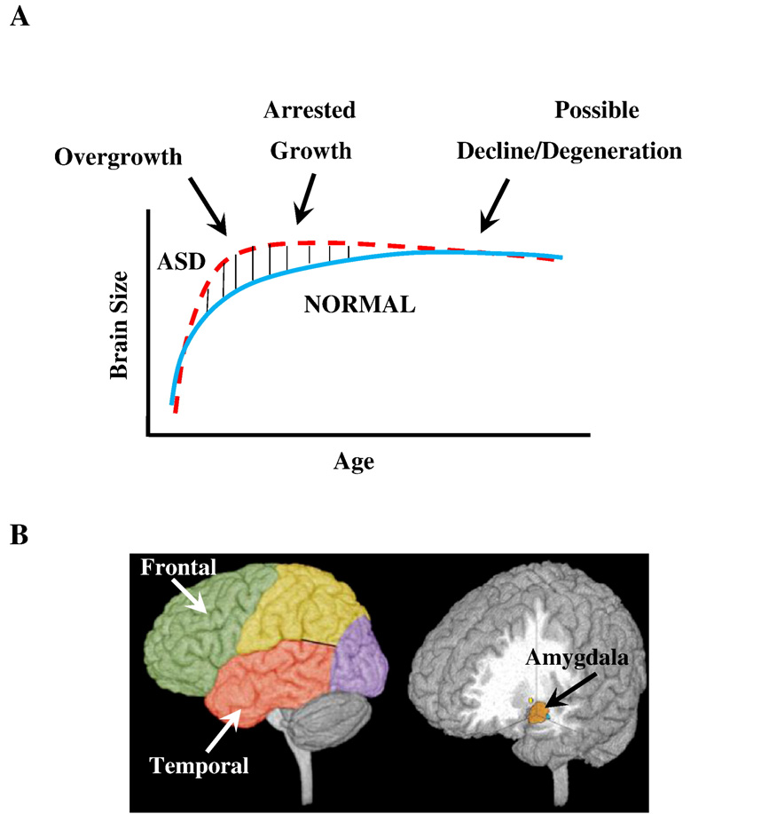
Introduction:
Causes (Brain Growth)
Sites of brain overgrowth
Courchesne, Campbell, & Solso (2011)
Notes:
Model of early brain overgrowth in autism that is followed by arrest of growth. Red line represents ASD, while blue line represents age-matched typically developing individuals. In some regions and individuals, the arrest of growth may be followed by degeneration, indicated by the red dashes that slope slightly downward.
Sites of regional overgrowth in ASD include frontal and temporal cortices and amygdala (from Courchesne et al., 2007).

Slide 36
Introduction:
Causes
Neurobiology
  Brain Structure
    Postmortem and MRI research that has documented most major brain structures are affected. These areas include the hippocampus and amygdala, cerebellum, cerebral cortex, limbic system, corpus callosum, basal ganglia, and brain stem.
    Individuals with autism differed from normally developing people in the size, number, and arrangement of minicolumns in the prefrontal cortex and in the temporal lobe.
    Minicolumns are considered to be the basic anatomical and physiological unit of the brain; it takes in, processes, and then responds to stimuli. They have been compared minicolumns to information processing computer chips.
Notes:
Using computerized imagining software to obtain cell measurements, Casanova et al. (2002) found the autistic group’s minicolumns to be more narrow that then was found among the normal control group. Specifically, the autistic group’s minicolumns were more numerous, smaller, and less compact in their arrangement (i.e., the cells were more dispersed) than those found among the control group.
The authors speculate that the extra minicolumns may result in cortical “noise” (p. 431). They further suggest that their findings are consistent with the view that autism is a disorder of the brain’s arousal-modulating systems and that due to the extra minicolumns “…autistic individuals experience a chronic state of overarousal and exhibit abnormal behaviors to diminish this arousal” (p. 431).
If correct, this hypothesis may help to explain some of the behavioral abnormalities observed among individuals with ASD. For example, difficulty establishing and maintaining eye contact may be a consequence of being overpowered by the stimuli received when looking someone in the eye.

Slide 37
Introduction:
Causes
Neurobiology
  Brain Chemistry
    Abnormal serotonin levels.
    Serotonin is involved in the formation of new neurons in the brain (“neurogenesis”), and is thought to be important in the regulation of neuronal differentiation, synaptogenesis, and neuronal migration during development.
    Supporting the hypothesis that abnormal serotonin metabolism is common among individuals with ASD, is the finding that depletion of tryptonphan (a precursor of serotonin) in the diet worsens the behavior of a substantial percentage children of children with ASD.
Notes:
It has also been suggested that the inhibition of gamma-aminobutyric acid (GABA) may contribute to the specific functional deficits in autism (e.g. impaired ability to process sensory information and learning tasks). Hussman (2001) proposed a hypothesis of suppressed GABAergic inhibition in autism, which results in excessive stimulation of glutamate-specialized neurons and loss of sensory gating. It is suggested that this hypothesis of impaired neurotransmission in autism is consistent with a broad range of findings from other neurochemical and neuroanatomic research.
Rapin and Katzman (1998) who provide a clear and concise review of diagnostic issues, prevalence and etiology of autism, report that in terms of chemical pathology, current biochemical evidence is at best “speculative, weak, and contradictory.” However, one of the more reliable findings appears to be elevated levels of serotonin in the blood of about 25% of individuals with autism, although correlations with brain levels of serotonin remain unclear.

Slide 38
Workshop Outline
Introduction
Case Finding
  Looking
  Listening
  Questioning
Screening
Diagnostic Evaluation
Psycho-educational Evaluation (Treatment)
Notes:
Here is my presentation outline (list workshop elements).

Slide 39

Case Finding
Looking
  for risk factors and warning signs of atypical development.
Listening
  REALLY LISTENING to parental concerns about atypical development.
Questioning
  caregivers about the child’s development.
Notes:
Case finding involves looking, listening, and questioning.
First, school psychologists need to look for ASD and be able to recognize risk factors and warning signs. Such “looking” may include school wide developmental screening and staff development.
Second, school psychologists need to be good listeners and able to recognize caregiver concerns that signal the possible presence of ASD symptoms.
Finally, they need to know how to question caregivers so as to further identify possible ASD symptoms.

Slide 40
Case Finding:
Looking for Risk Factors
Known Risk Factors
  High Risk
    Having an older sibling with autism.
  Moderate Risk
    The diagnosis of tuberous sclerosis, fragile X, or epilepsy.
    A family history of autism or autistic-like behaviors.
Notes:
According to Newschaffer, Fallin, & Lee (2002): “The only identifiable group known for certain to have a substantively elevated ASD risk is siblings of affected individuals” (p. 139).
Thus, special attention needs to be directed toward the siblings of individuals diagnosed with ASD.
Those who display any ASD symptom should be immediately screened for these disorders.
Other risk factors that might be classified as having some association with ASD, and might be considered moderate risk factors, include a prior diagnosis of tuberous sclerosis, fragile X, or epilepsy, and/or the presence of a family history of autism or autistic-like behaviors.

Slide 41
Case Finding:
Looking for Risk Factors
Currently there is no substantive evidence supporting any one non-genetic risk factor for ASD.
However, given that there are likely different causes of ASD, it is possible that yet to be identified non-heritable risk factors may prove to be important in certain subgroups of individuals with this disorder.
  There may be an interaction between the presence of specific genetic defects and specific environmental factors.
  Individuals with a particular genetic predisposition for ASD may have a greater risk of developing this disorder subsequent to exposure to certain non-genetic risk factors.
  In particular, it has been suggested that prenatal factors such as maternal infection and drug exposure deserve further examination.
Notes:
Currently there is no substantive evidence supporting any one non-genetic risk factor for ASD.
However, given that there are likely different causes of ASD, it is possible that yet to be identified non-heritable risk factors may prove to be important in certain subgroups of individuals with this disorder.
In other words, there may be an interaction between the presence of specific genetic defects and specific environmental factors.
Individuals with a particular genetic predisposition for ASD may have a greater risk of developing this disorder subsequent to exposure to certain non-genetic risk factors.
In particular, it has been suggested that prenatal factors such as maternal infection and drug exposure deserve further examination.

Slide 42
Case Finding:
Looking for Warning Signs
Infants and Preschoolers
  Absolute indications for an autism screening
    • No big smiles or other joyful expressions by 6 months.^{b}
    • No back-and-forth sharing of sounds, smiles, or facial expressions by 9 months.^{b}
    • No back-and-forth gestures, such as pointing, showing, reaching or waving bye-bye by 12 months.^{a,b}
    • No babbling at 12 months.^{a, b}
    • No single words at 16 months.^{a, b}
ªFilipek et al., 1999; ^{b}Greenspan, 1999; and ^{c}Ozonoff, 2003.
Notes:
While the presence of risk factors signal the need to be vigilant for ASD, observation of warning signs provides concrete evidence suggestive of these disorders.
Developed from several different sources (Filipek et al., 2000; Greenspan, 1999; Ozonoff, 2003), the next two slides provides a list of warning signs that are considered absolute indicators of the need for an ASD screening.

Slide 43
Case Finding:
Looking for Warning Signs
Infants and Preschoolers
  Absolute indications for an autism screening
    • No 2-word spontaneous (nonecholalic) phrases by 24 months.^{a, b}
    • Failure to attend to human voice by 24 months.^{c}
    • Failure to look at face and eyes of others by 24 months.^{c}
    • Failure to orient to name by 24 months.^{c}
    • Failure to demonstrate interest in other children by 24 months.^{c}
    • Failure to imitate by 24 months.^{c}
    • Any loss of any language or social skill at any age.^{a, b,} ^{d}
ªFilipek et al., 1999; ^{b}Greenspan, 1999; ^{c}Ozonoff, 2003; ^{d}Barger et al., 2013
Notes:
Prevalence and Onset of Regression within Autism Spectrum
Disorders: A Meta-analytic Review
Brian D. Barger • Jonathan M. Campbell •
Jaimi D. McDonough
Published online: 2 August 2012
Springer Science+Business Media, LLC 2012
Abstract Rates and onset of regression were meta-analyzed
from 85 articles representing 29,035 participants with
autism spectrum disorders (ASD). Overall prevalence rate
for regression was 32.1, 95 % CI [29.5, 34.8] occurring at
mean of 1.78 years, 95 % CI [1.67, 1.89]. Regression
prevalence rates differed according to four types of
regression: language regression, 24.9 %; language/social
regression, 38.1 %; mixed regression, 32.5 %; and
unspecified regression, 39.1 %. Regression prevalence also
differed according to sampling method: population-based
prevalence was 21.8 %, clinic-based prevalence was
33.6 %, and parent survey-based prevalence was 40.8 %.
Risk of regression was equal for males and females, but
higher for individuals diagnosed with autism versus
another ASD. Later age of regression onset was predicted
by older age of child.

Slide 44
Case Finding:
Looking for Warning Signs
School-Age Children (preschool through upper grades)
  Social/Emotional Concerns
    Poor at initiating and/or sustaining activities and friendships with peers
    Play/free-time is more isolated, rigid and/or repetitive, less interactive
    Atypical interests and behaviors compared to peers
    Unaware of social conventions or codes of conduct (e.g., seems unaware of how comments or actions could offend others)
    Excessive anxiety, fears or depression
    Atypical emotional expression (emotion, such as distress or affection, is significantly more or less than appears appropriate for the situation)
Attwood (1998); Myles, Bock & Simpson (2000)
Notes:
Adapted from Asperger’s Syndrome A Guide for Parents and Professionals (Attwood, 1998), Diagnostic and Statistical Manual of Mental Disorders, 4th ed. (APA, 1994), and The Apserger Syndrome Diagnostic Scale (Myles, Bock and Simpson, 2000)

Slide 45
Case Finding:
Looking for Warning Signs
School-Age Children (preschool through upper grades)
  Communication Concerns
    Unusual tone of voice or speech (seems to have an accent or monotone, speech is overly formal)
    Overly literal interpretation of comments (confused by sarcasm or phrases such as “pull up your socks” or “looks can kill”)
    Atypical conversations (one-sided, on their focus of interest or on repetitive/unusual topics)
    Poor nonverbal communication skills (eye contact, gestures, etc.)
Attwood (1998); Myles, Bock & Simpson (2000)

Slide 46
Case Finding:
Looking for Warning Signs
School-Age Children (preschool through upper grades)
  Behavioral Concerns
    Excessive fascination/perseveration with a particular topic, interest or object
    Unduly upset by changes in routines or expectations
    Tendency to flap or rock when excited or distressed
    Unusual sensory responses (reactions to sound, touch, textures, pain tolerance, etc.)
    History of behavioral concerns (inattention, hyperactivity, aggression, anxiety, selective mute)
    Poor fine and/or gross motor skills or coordination
Attwood (1998); Myles, Bock & Simpson (2000)

Slide 47
Case Finding:
Looking for Atypical Development
Developmental Screening
  Ages and Stages Questionnaire
    Paul H. Brookes, Publishers
  Child Development Inventories
    Behavior Science Systems
  Parents’ Evaluations of Developmental Status
    Ellsworth & Vandermeer Press, Ltd.
Notes:
In addition to being able to recognize and respond to the just mentioned warning signs, case finding also includes school based developmental screenings.
These activities would help not only to identify developmental variations that are consistent with ASD, but will also help to identify other developmental disorders.
As such, these screenings would be consistent with the federal regulations known as “Child Find.”
These regulations require Local Education Agencies to “conduct child find activities to locate all infants and toddlers who may be eligible for early intervention services” [17 CCR 52040(a)].
Developmental screening techniques that have acceptable psychometric properties” include The Ages and Stages Questionnaire; The BIRCANCE® Screens; The Child Development Inventories; and The Parents’ Evaluation of Developmental Status.

Slide 48
Case Finding:
Looking for Atypical Development
Staff Development
  School psychologist efforts to educate teachers about the risk factors and warning signs of ASD would also be consistent with Child Find.
    Giving teachers the information they need to look for ASD will facilitate case finding efforts.
Notes:
Giving teachers the information they need to look for ASD (such as is presented in this workshop) will facilitate case finding efforts.

Slide 49
Case Finding:
Listening to Caregivers
Referring Concerns That Signal the Need for Autism Screening
  Communication Concerns
    Does not respond to his/her name
    Cannot tell me what s/he wants
    Does not follow directions
    Appears deaf at times
    Seems to hear sometimes but not others
    Does not point or wave bye-bye
Filipek et al. (1999)
Notes:
Source: Filipek, P. A. et al. (1999). The screening and diagnosis of autistic spectrum disorders. Journal of Autism and Developmental disorders, 29, 439-484.
When parents have concerns about their child’s development they are typically correct.
Especially in light of reports that almost all parents of children with ASD have concerns about these children by 18 months of age, it is critical for school psychologists to listen, REALLY LISTEN, to parents when they express such concerns.
The following series of slides provides a list of parental concerns that are considered “Red Flags” for ASD.
Obviously, the greater the number of these concerns expressed the greater the need for an immediate ASD screening.
While isolated communication concerns may be indicative of expressive language delays (and not necessarily ASD), social concerns (especially when combined with co-existing communication and behavioral concerns) are particularly important ASD red flags.

Slide 50
Case Finding:
Listening to Caregivers
Referring Concerns That Signal the Need for Autism Screening
  Social Concerns
    Does not smile socially
    Seems to prefer to play alone
    Is very independent
    Has poor eye contact
    Is in his/her own world
    Tunes us out
    Is not interested in other children
Filipek et al. (1999)
Notes:
Parents of children with autism are generally aware of problems in their child’s development by 18 months of age; in the Aspersers group concerns emerged later, at around 30 months of age
Initial worries in both groups centered around abnormal social development but parents of children with Asperser syndrome were less likely to have noted communication problems.
Stereotyped or repetitive behaviorus were not prominent in the early years in either group.

Slide 51
Case Finding:
Listening to Caregivers
Referring Concerns That Signal the Need for Autism Screening
  Behavioral concerns
    Tantrums
    Is hyperactive or uncooperative/oppositional
    Doesn’t know how to play with toys
    Does the same thing over and over
    Toe walks
Filipek et al. (1999)

Slide 52
Case Finding:
Listening to Caregivers
Referring Concerns That Signal the Need for Autism Screening
  Behavioral concerns (continued)
    Has unusual attachments to toys (e.g., always is holding a certain object)
    Lines things up
    Is oversensitive to certain textures or sounds
    Has odd finger and/or body movement patterns
Filipek et al. (1999)

Slide 53
Case Finding:
Questioning Caregivers
Asking about socialization that probe for issues that would signal the need for an autism screening.
  “Does s/he …” or “Is there …”
    cuddle like other children?
    look at you when you are talking or playing?
    smile in response to a smile from others?
    engage in reciprocal, back-and-forth play?
    play simple imitation games, such as pat-a-cake or peek-a-boo?
    show interest in other children?
Filipek et al. (1999)
Notes:
While parental concerns about atypical development are powerful indicators of the need for screenings, the absence of such does not necessarily mean that a student does not currently display ASD behaviors.
Further, as was mentioned above isolated communication concerns may be indicative of expressive language delays (not ASD), and consequently it will be important for those engaged in case finding efforts to be prepared to ask questions about social and behavioral concerns.
Thus, it is critical that for school psychologists to be able to ask questions that will facilitate the identification of ASD behaviors.
The following series of slides provides a list of such questions.

Slide 54
Case Finding:
Questioning Caregivers
Asking about communication that probe for issues that would signal the need for an autism screening.
  “Does s/he …” or “Is there …”
    point with his/hr finger?
    gesture? Nod yes and no?
    direct your attention by holding up objects for you to see?
    anything odd about his/her speech?
    show things to people?
Filipek et al. (1999)

Slide 55
Case Finding:
Questioning Caregivers
Asking about communication that probe for issues that would signal the need for an autism screening (continued).
  “Does s/he …” or “Is there …”
    lead an adult by the hand?
    give inconsistent response to his/her name? … to commands?
    use rote, repetitive, or echolalic speech?
    memorize strings of words or scripts?
Filipek et al. (1999)

Slide 56
Case Finding:
Questioning Caregivers
Asking about behavior that probe for issues that would signal the need for an autism screening.
  “Does s/he …” or “Is there …”
    have repetitive, stereotyped, or odd motor behavior?
    have preoccupations or a narrow range of interests?
    attend more to parts of objects (e.g., the wheels of a toy car)?
    have limited or absent pretend play?
    imitate other people’s actions?
    play with toys in the same exact way each time?
    strongly attached to a specific unusual object(s)?
Filipek et al. (1999)

Slide 57
Workshop Outline
Introduction
Case Finding
Screening
  Behavioral (Infants & Preschoolers)
  Behavioral (School Age Youth)
Diagnostic Evaluation
Psycho-educational Evaluation (Treatment)

Slide 58

Screening
Screening is designed to help determine the need for additional diagnostic assessments.
Notes:
Screening should include both laboratory and behavioral assessments (Filipek et al., 1999, 2000)
Laboratory = lead screenings and audiological evaluations.
Behavioral = behavioral observations and/or checklists.
Screenings results = decisions regarding need for diagnostic assessments.
Because these screenings are relatively quick and easy it has been suggested that the decision to conduct such investigations be rather liberal.
All school psychologists should be prepared to participate in the behavioral screening of the child who displays warning signs of autism

Slide 59
Screening
School psychologists are exceptionally well qualified to conduct the behavioral screening of students suspected to have an ASD.
Several screening tools are available
Initially, most of these tools focused on the identification of ASD among infants and preschoolers.
Recently screening tools useful for the identification of school aged children who have high functioning autism or Asperger’s Disorder have been developed.
Notes:
To the extent that hearing loss explains autistic-like behaviors, referrals should be made.
To the extent that there are other warning signs of an ASD that are not explained by a hearing loss (i.e., social and behavioral concerns), additional evaluation should take place.
It is important to keep in mind that autism can co-occur with hearing loss.
While a hearing loss would argue against the need for additional ASD evaluations, educators working with the student should continue to be vigilant for indicators of autism and make additional diagnostic referrals as indicated.
School psychologists are not expected to conduct this type of testing, however, it is important for them to know about the audiological assessment’s role in ASD screening.The hearing tests conducted as part of any autism screening must be comprehensive in nature.

Slide 60
Screening:
Infants & Preschoolers
CHecklist for Autism in Toddlers (CHAT)
  Designed to identify risk of autism among 18-month-olds
  Takes 5 to 10 minutes to administer,
  Consists of 9 questions asked of the parent and 5 items that are completed by the screener’s direct observation of the child.
  5 items are considered to be “key items.” These key items, assess joint attention and pretend play.
  If a child fails all five of these items they are considered to be at high risk for developing autism.
Notes:
Baron-Cohen, S., Allen, J., & Gillberg, C. (1992). Can autism be detected at 18 months? The needle, the haystack, and the CHAT. British Journal of Psychiatry, 161, 839-43.
Baron-Cohen, S., Cox, A., Baird, G., Swettenham. J., Nightingale, N., Morgan, K., Drew, A., & Charman, T. (1996). Psychological markers in the detection of autism in infancy in a large population. British Journal of Psychiatry, 168, 158-163.
Baird, G., Charman, T., Baron-Cohen, S., Cox, A., Swettenham, J., Wheelwright, S., & Drew, A. (2000). A screening instrument for autism at 18 months of age: A 6-year follow-up study. Journal of the American Academy of Child and Adolescent Psychiatry, 39, 694-702.
Baron-Cohen, S., Wheelwright, S., Cox, A., Baird, G., Charman, T., Swettenham, J., Drew, A., Coehring, P. (2000). Early identification of autism by the CHecklist for Autism in Toddlers (CHAT). Journal of the Royal Society of Medicine, 93, 521-525.
Useful for the school psychologist working in infant and preschool programs.
Re-screening one-month after the first is recommend for all students who fail the CHAT
Any child who fails it twice = diagnostic assessment referral.
Other CHAT items provide additional information designed to allow the screener to differentiate an autistic-like profile from that of a student with a more global developmental delay.
Research support =
83% of 18-month-olds within one sample, who failed the five key items administered twice one month apart, were subsequently diagnosed with autistic disorder at 42 months of age.
None of the children in the low risk group could be assigned this diagnosis at 42 months (Baron-Cohen et al., 1996).

Slide 61
Screening:
Infants & Preschoolers

Slide 62
Screening:
Infants & Preschoolers

Slide 63
Screening:
Infants & Preschoolers
6-year follow-up of a community sample screened with the 2 stage CHAT reveals extremely low false positive rate. However, higher functioning (high IQ) children are missed by this screening (Baird et al., 2000, p. 697).
Notes:
While it has promise for the identification of ASD among a those with severe symptoms, this measure appears less sensitive to the less severe symptoms of ASD (Asperger’s/High Functioning Autism).
Children with milder symptoms did not routinely fail the CHAT at 18 months.
6-year follow-up of a community sample of 16,235 children, screened with the 2-stage CHAT found that higher functioning children (those with higher IQs) were missed by this screening.
However, this study confirmed an extremely low false positive rate.
In other words, children who fail the CHAT will likely go on the later be diagnosed with an ASD.
The 2-stage CHAT had a
positive predictive value of 75% (among those who failed the CHAT, the percentage who have ASD),
sensitivity of 20% 9 (among those with ASD, the percentage who failed the CHAT),
specificity of 98% (among those without ASD, the percentage who pass the CHAT).

Slide 64
Screening:
Infants & Preschoolers
The CHAT is available at:
http://www.paains.org.uk/Autism/chat.htm

Slide 65
Screening:
Infants & Preschoolers
Modified Checklist for Autism in Toddlers (M-CHAT)
  Designed to screen for autism at 24 months of age.
  More sensitive to the broader autism spectrum.
  Uses the 9 items from the original CHAT as its basis.
  Adds 14 additional items (23-item total).
  Unlike the CHAT, however, the M-CHAT does not require the screener to directly observe the child.
  Makes use of a Yes/No format questionnaire.
  Yes/No answers are converted to pass/fail responses by the screener.
  A child fails the checklist when 2 or more of 6 critical items are failed or when any three items are failed.
Notes:
Robins, D. L., Fein, D., Barton, M. L., & Green, J. A. (2001). The modified checklist for autism in toddlers: An initial study investigating the early detection of autism and pervasive developmental disorders. Journal of Autism and Developmental Disorders, 31, 131-144.

Slide 66
Screening:
Infants & Preschoolers
Modified Checklist for Autism in Toddlers (M-CHAT)
  The M-CHAT was used to screen 1,293 18- to 30-month-old children. 58 were referred for a diagnostic/developmental evaluation. 39 were diagnosed with an autism spectrum disorder (Robins et al., 2001).
  Will result in false positives.
  Data regarding false negative is not currently available, but follow-up research to obtain such is currently underway.

Slide 67
Screening:
Infants & Preschoolers
Robins et al. (2001, p. 142)

Slide 68
Screening:
Infants & Preschoolers
Robins et al. (2001, p. 142)

Slide 69
Screening:
Infants & Preschoolers
Robins et al. (2001)

Slide 70
Screening:
Infants & Preschoolers
The M-CHAT is available at
http://www.firstsigns.org/downloads/m-chat.PDF

Slide 71
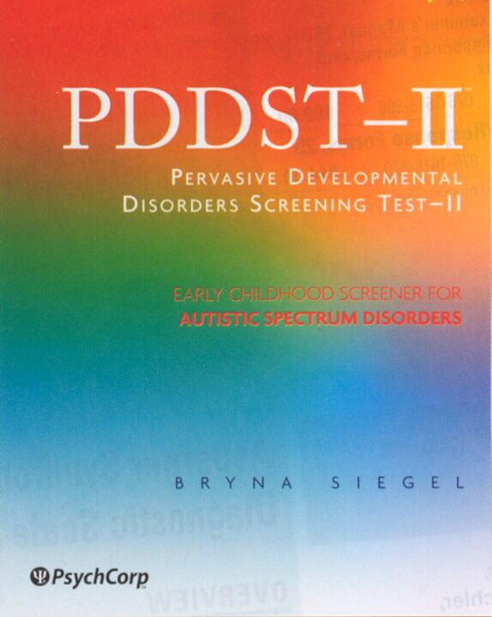
Screening:
Infants & Preschoolers
Pervasive Developmental Disorders Screening Test - II (PDDST-II)

Slide 72
Screening:
Infants & Preschoolers
Pervasive Developmental Disorders Screening Test - II (PDDST-II)
  Has three stages
    The PDDST-II: Stage I designed to help determine if a given child should be evaluated for an ASD.
  Designed to be completed by parents
  Should take no more than 5 minutes.
  Odd numbered items are the critical questions used for autism screening.
  If three or more of the odd numbered items are checked as being “YES, Usually True,” then the result is considered a positive finding for possible ASD and a diagnostic evaluation indicted.
Notes:
A final screening tool designed for very young children, and developed for use within both general and clinical populations is the Pervasive Developmental Disorders Screening Test – II (PDDST-II; Siegel, 2001; soon to be published by The Psychological Corporation). This measure has three stages, with the PDDST-II: Stage I designed to help determine if a given child should be evaluated for an ASD and is the one that the school psychologist working in general education settings would find helpful. It is designed to be completed by parents and should take no more than 5 minutes.

Slide 73
Screening:
Infants & Preschoolers
Pervasive Developmental Disorders Screening Test - II (PDDST-II)
  The odd numbered critical questions are ordered by age in order from highest predictive validity.
    This means the more odd numbered items scored positive, and the more odd numbered items scored positive on the upper half of each section, the more strongly positive the screen.
  Even numbered items significantly differentiate ASD-referred children from those with mild developmental disorders.
    These items are also are ordered by age in order from highest to lowest predictive validity.
Notes:
The odd numbered items are the critical questions used for autism screening. If three or more of the odd numbered items are checked as being “YES, Usually True,” then the result is considered a positive finding for possible ASD and a diagnostic evaluation indicted. The odd numbered critical questions are ordered by age in order from highest predictive validity. This means the more odd numbered items scored positive, and the more odd numbered items scored positive on the upper half of each section, the more strongly positive the screen. Even numbered items significantly differentiate ASD-referred children from those with mild developmental disorders. These items are also are ordered by age in order from highest to lowest predictive validity.

Slide 74
Screening:
Infants & Preschoolers
Measure | Sensitivity | Specificity
CHAT | .18 - .38 | .98
M-CHAT | .87 | .99
CHAT 23 | .84 | .85
PDDST-II: Stage 1 | .92 | .91
Barton et al. (2012)
Notes:
Sensitivity refers to the measures ability to correctly identify a high percentage of children who truly have ASD; very few children with ASD are misidentified as not having one of these disorders.
Specificity refers to lowering the number of children falsely identified as having ASD and instead identifies only the ones who truly have ASD.
http://autismscreening.org/screening_tools/index.htm
The CHAT is a 9-item questionnaire that is completed by the child's parent/caregiver. There are an additional five questions for the provider to fill out based on observation of the child during the clinic visit. The CHAT can be filled out quickly and is easily interpreted by the physician. The sensitivity is low at 0.65 and the specificity is high at 0.98. The low sensitivity of the CHAT could lead your practice to miss many children who are at risk of an autism spectrum disorder
The M-CHAT, a 23-item yes/no checklist for parents was adapted from the Checklist for Autism in Toddlers (CHAT). The checklist is quick and easy to fill out by many parents, with a literacy level cited at the 6th grade, and the scoring is straightforward. The M-CHAT is available in many different languages including English, Spanish, Turkish, Chinese, and Japanese. There are other languages available, but not all have been validated.
This tool has been shown sometimes to miss more subtle cases of autism spectrum disorders. Also, it is more accurate to interpret the M-CHAT according to its Positive Predictive Value (patients with positive test results who are correctly diagnosed) as the sensitivity and specificity may show the tool to be more accurate than it is. For high risk patients, PPV = .60, for low risk patients, PPV = .11, and when combined, PPV = .36. When a failed M-CHAT is followed up by a phone interview, the PPV values are much higher, with PPV values = High: .76, Low: .65, and Combined: .74. (Kleinman JM, et al. J Autism Dev Disord. 2008;38:827-839).
The PDDST-II PCS is a 22-item questionnaire that is designed to be completed by the child's parent/caregiver. It takes parents between 10 to 20 minutes to complete and is easily scored and interpreted by providers. The sensitivity and specificity are both high at 0.92 and 0.91 respectively.
Many practices may find this tool to be costly at $42 per packet of 25. The PDDST-II PCS cannot be copied.
The Infant/Toddler Checklist is a one-page 24-item questionnaire. It is designed to identify children who are at-risk for developing communication and/or social impairments. For children with concerning scores there is a follow-up Caregiver Questionnaire and a Behavior Sample (done by the provider). However, the Infant/Toddler Checklist has been validated independently and can be used as a stand-alone tool for children between 9 and 24 months. (Wetherby, A.M. & Prizant, B.M. (2001). Communication and Symbolic Behavior Scales Developmental Profile Infant/Toddler Checklist. Paul H. Brookes Publishing Co.)

Slide 75
Screening:
School Aged Youth
Autism Spectrum Screening Questionnaire (ASSQ)
  The 27 items rated on a 3-point scale.
  Total score range from 0 to 54.
  Items address social interaction, communication, restricted/repetitive behavior, and motor clumsiness and other associated symptoms.
  The initial ASSQ study included 1,401 7- to 16-year-olds.
    Sample mean was 0.7 (SD 2.6).
    Asperger mean was 26.2 (SD 10.3).
Ehlers, Gillber, & Wing (1999)
Notes:
A checklist designed to be completed by parents and/or teachers.
Ehlers, S., Gillberg, G., & Wing, L. (1999). A screening questionnaire for Asperger syndrome and other high functioning autism spectrum disorders in school age children. Journal of Autism and Developmental Disorders, 29, 129-141.

Slide 76
Screening:
School Aged Youth
Autism Spectrum Screening Questionnaire (ASSQ)
  Two separate sets of cutoff scores are suggested.
    Parents, 13; Teachers, 11: = socially impaired children
      Low risk of false negatives (especially for milder cases of ASD).
      High rate of false positives (23% for parents and 42% for teachers).
      Not unusual for children with other disorders (e.g., disruptive behavior disorders) to obtain ASSQ scores at this level.
      Used to suggest that a referral for an ASD diagnostic assessment, while not immediately indicated, should not be ruled out.
    Parents, 19; Teachers, 22: = immediate ASD diagnostic referral.
      False positive rate for parents and teachers of 10% and 9 % respectively.
      The chances are low that the student who attains this level of ASSQ cutoff scores will not have an ASD.
      Increases the risk of false negatives.

Slide 77
Screening:
School Aged Youth

Slide 78
Screening:
School Aged Youth
Childhood Asperger Syndrome Test (CAST)
  Scott, Baron-Cohen, Bolton, & Brayne (2002).
    A screening for mainstream primary grade (ages 4 through 11 years) children.
    Has 37 items, with 31 key items contributing to the child’s total score.
    The 6 control items assess general development.
    With a total possible score of 31, a cut off score of 15 “NO” responses was found to correctly identify 87.5 (7 out of 8) of the cases of autistic spectrum disorders.
Notes:
Scott, F. A., Baron-Cohen, S., Bolton, P., & Brayne, C. (2002). The CAST (Childhood Asperger Syndrome Test). Autism, 6, 9-31.
The six control items, which assess general development, are numbers 3, 4, 12, 22, 26, and 33.
High rates of false positives in these screening tools emphasizes the fact that they should not be used diagnostically.
Rather they should be considered as tools to assess the need for additional diagnostic assessment.

Slide 79
Screening:
School Aged Youth
From Scott et al. (2002, p. 27)

Slide 80
Screening:
School Aged Youth
From Scott et al. (2002, p. 27)

Slide 81
Screening:
School Aged Youth
The CAST is available at
http://www.autismresearchcentre.com/arc_tests
This website also contains links to a number of other screening tools (a very helpful resource!!!).

Slide 82
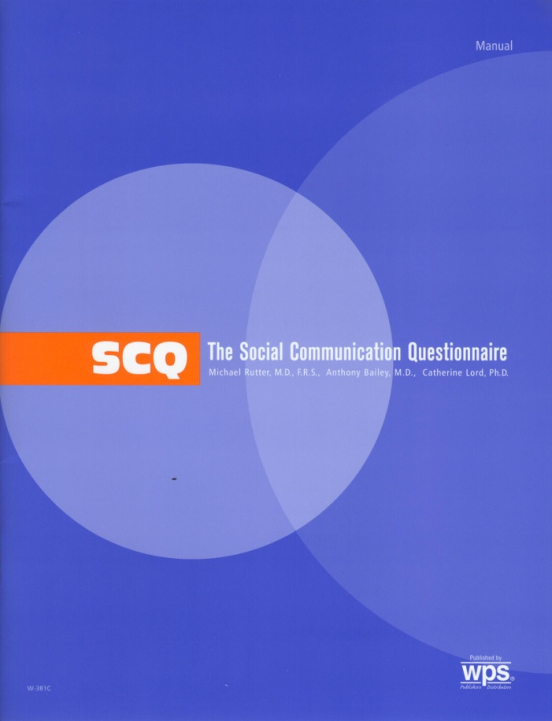
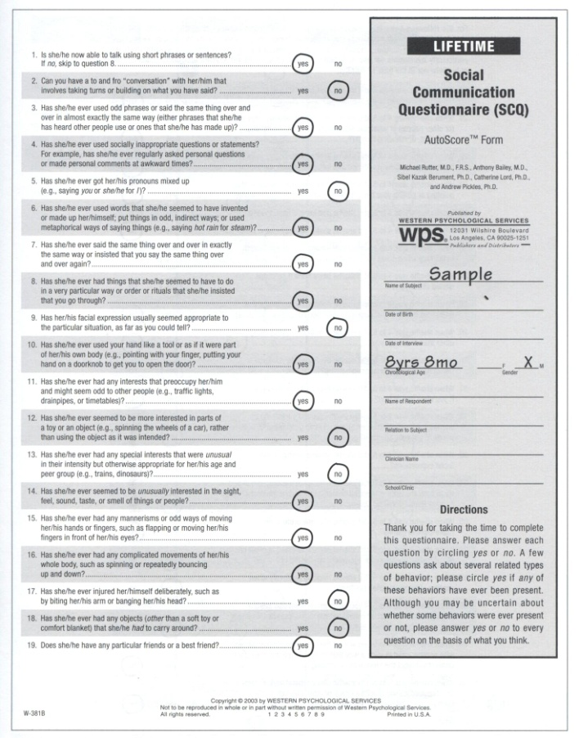
Screening:
School Aged Youth
Social Communication Questionnaire (SCQ)
Sample
Notes:
Berument, S. K., Rutter, M., Lord, C., Pickles, A., & Bailey, A. (1999). Autism screening questionnaire: Diagnostic Validity. British Journal of Psychiatry, 175, 444-451.
Rutter, M., LeCouteur, A., & Lord, C. (2003). Social Communication Questionnaire. Los Angeles, CA: Western Psychological Services.
An “AutoScore” protocol converts the parents’ Yes/No responses to scores of 1 or 0.

Slide 83
Screening:
School Aged Youth
Social Communication Questionnaire (SCQ)
  Two forms of the SCQ: a Lifetime and a Current form.
    Current ask questions about the child’s behavior in the past 3-months, and is suggested to provide data helpful in understanding a child’s “everyday living experiences and evaluating treatment and educational plans”
    Lifetime ask questions about the child’s entire developmental history and provides data useful in determining if there is need for a diagnostic assessment.
  Consists of 40 Yes/No questions asked of the parent.
  The first item of this questionnaire documents the child’s ability to speak and is used to determine which items will be used in calculating the total score.
Notes:
The first item of this questionnaire documents the child’s ability to speak and is used to determine which items will be used in calculating the total score (i.e., if the child has speech SCQ items 2 through 40 are used, and if the child does not items 4 through 40 are used).

Slide 84
Screening:
School Aged Youth
Social Communication Questionnaire (SCQ)
  An “AutoScore” protocol converts the parents’ Yes/No responses to scores of 1 or 0.
  The mean SCQ score of children with autism was 24.2, whereas the general population mean was 5.2.
  The threshold reflecting the need for diagnostic assessment is 15.
  A slightly lower threshold might be appropriate if other risk factors (e.g., the child being screened is the sibling of a person with ASD) are present.
Notes:
The manual reports that in the standardization sample the mean SCQ score of children with autism was 24.2, whereas the general population mean was 5.2.
To minimize the rate of false negative, the authors selected a score of 15 or higher as the threshold reflecting the need for diagnostic assessment.
However, they caution that a slightly lower threshold might be appropriate if other risk factors (e.g., the child being screened is the sibling of a person with ASD) are present.

Slide 85
Workshop Outline
Introduction
Case Finding
Screening
Diagnostic Evaluation
  DSM-5 Criteria
  Differential Diagnosis
  Health & Developmental Histories
  Indirect Assessment
  Direct Assessment
Psycho-educational Evaluation (Treatment)
Notes:
Here is my presentation outline (list workshop elements).

Slide 86
Diagnostic Evaluation:
DSM-5 Diagnostic Criteria [299.00 (F84.0)]
p. 50
Persistent deficits in social communication and social interaction across multiple contexts, as manifested by the following, currently or by history (examples ore illustrative not exhaustive; see text):
  Deficits in social-emotional reciprocity, ranging, for example, from abnormal social approach and failure of normal back-and-forth conversation; to reduced sharing of interests, emotions, or affect; to failure to initiate or respond to social interactions.
  Deficits in nonverbal communicative behaviors used for social interaction, ranging, for example, from poorly integrated verbal and nonverbal communication to abnormalities in eye contact and body language or deficits in understanding and use of gestures; to a total lack of facial expressions and nonverbal communication.
  Deficits in developing, maintaining, and understanding relationships, ranging for example, from difficulties adjusting behavior to suit various social contexts; to difficulties in sharing imaginative play or in making friends; to absence of interest in peers.
Notes:
At least 2 symptoms in this area.
299.00= ICD-9-CM code; F84.0 = ICD-10-CM code. IDC-10-CM codes are to be used starting October 1, 2014. CM = Clinical Modification. ICD-10 was recently released, but is not yet being used.
Must meet all three
Requires that current symptom severity be specified (“Specify current severity: Severity is based on social communication impairments and restricted, repetitive patters of behavior (See Table 2).
Three severity levels: “Requiring very substantial support,” “Requiring substantial support,” and “Requiring support.”

Slide 87
Diagnostic Evaluation:
DSM-5 Diagnostic Criteria
p. 50
Restricted, repetitive patterns of behavior, interests, or activities, as manifested by at least two of the following, currently or by history (examples are illustrative, not exhaustive; see text)
  Stereotyped or repetitive motor movements, use of objects, or speech (e.g., simple motor stereotypies, lining up toys or flipping objects, echolalia, idiosyncratic phrases).
  Insistence on sameness, inflexible adherence to routines, or ritualized patterns of verbal or nonverbal behavior (e.g., extreme distress at small changes, difficulties with transitions, rigid thinking patterns, greeting rituals, need to take same route or eat same food every day).
  Highly restricted, fixated interests that are abnormal in intensity of focus (e.g., strong attachment to or preoccupation with unusual objects, excessively circumscribed or perseverative interests).
  Hyper- or Hyporeactivity to sensory input or unusual interest in sensory aspects of the environment (e.g., apparent indifference to pain/temperature, adverse response to specific sounds or textures, excessive smelling or toughing of objects, visual fascination with lights or movement.
Notes:
At least 2 symptoms in this area.
Need to demonstrate two of the four
Requires that current symptom severity be specified (“Specify current severity: Severity is based on social communication impairments and restricted, repetitive patters of behavior (See Table 2).
Three severity levels: “Level 3 Requiring very substantial support,” “Level 2 Requiring substantial support,” and “Level 1Requiring support.”

Slide 88
Diagnostic Evaluation:
DSM-5 Diagnostic Criteria
pp. 50-51
Symptoms must be present in the early developmental period (but may not become fully manifest until social demands exceed limited capacities, or may be masked by learned strategies in later life).
Symptoms cause clinically significant impairment in social, occupational, or other important areas of current functioning.
These disturbances are not better explained by intellectual disability (intellectual development disorder) or global developmental delay. Intellectual disability and autism spectrum disorder frequently co-occur; to make comorbid diagnoses of autism spectrum disorder an intellectual disability, social communication should be below that expected for general developmental level.
Notes:
At least 2 symptoms in this area.
“Note: Individuals with a well-established DSM-IV diagnosis of autistic disorder, Asperger’s disorder, or pervasive developmental disorder no otherwise specified should be given the diagnosis of autism spectrum disorder. Individuals who have marked deficits in social communication, but hose symptoms do not otherwise meet criteria for autism spectrum disorder, should be evaluated for social (pragmatic) communication disorder.” (APA, 2013, p. 51)

Slide 89
Diagnostic Evaluation:
DSM-5 Diagnostic Criteria
pp. 50-51
Specifiers
  Social communication severity level AND Restricted, repetitive behaviors severity level
    Level 1, Level 2, Level 3.
  With or without accompanying intellectual impairment
    Separate estimates of verbal and nonverbal skill are necessary .
  With or without accompanying language impairment
    With impairment = “No intelligible speech (nonverbal),” “single words only,” or “phrase speech”
    Without impairment = “Speaks in full sentences” or “has fluent speech.”
    Receptive and expressive language skills should be considered separately
Notes:
Specify if:
With or without accompanying intellectual impairment
With or without accompanying language impairment
Associated with a known medical or genetic condition or environmental factors
(Coding note: Use additional code to identify the associated medical or genetic condition.)
Associated with another neurodevelopmental, mental, or behavior disorder
(Coding note: Use additional code to identify the associated neurodevelopmental, mental or behavioral disorder[s].)
With catatonia (refer to the criteria for catatonia associated with another mental disorder, pp. 119-120, for definition) (Coding note: Use additional code 293.89 [Fo6.1] catatonia associated with autism spectrum disorder to indicate the presence of the comorbid catatonia.)
The severity specifiers (see Table 2) may be used to describe succinctly the current symptomatology (which might fall below level 1), with the recognition that severity may vary by context and fluctuate over tie. Severity of social communication difficulties and restricted, repetitive behaviors should be separately rated. The descriptive severity categories should not be sued to determine eligibility for and provision of services; these can only be developed at an individual level and through discussion of personal priorities and targets.
Regarding the specified “with or without accompanying intellectual impairment,” understanding that (often uneven) intellectual profile of a child or adult with autism spectrum disorder is necessary for interpreting diagnostic features. Separate estimates of verbal and nonverbal skill are necessary (e.g., using untimed nonverbal tests to assess potential strengths in individuals with limited language).
To use the specifier “with or without accompanying language impairment,” the current level of verbal functioning should be assessed and described. Examples of the specific descriptions for “with accompanying language impairment’ might include no intelligible speech (nonverbal, single words only, or phrase speech. Language level in individuals “without accompanying language impairment” might be further described by speaks in full sentences or has fluent speech. Since receptive language may lag behind expressive language development in autism spectrum disorder, receptive and expressive language skills should be considered separately
The specified “associated with a known medical or genetic condition or environmental factor” should be used with the individual has a known genetic disorder (e.g., Rett syndrome, Fragile X syndrome, Down syndrome), a medical disorder (e.g., epilepsy,), or a history of environmental exposure (e.g., valproate, fetal alcohol syndrome, very low birth weight).
Additional neurodevelopmental, mental or behavioral conditions should also be noted (e.g., attention-deficit/hyperactivity disorder; developmental coordination disorder; disruptive behavior, impulse-control, or conduct disorders; anxiety, depressive, or bipolar disorders; tics or Tourette's disorder; self-injury; feeding, elimination, or sleep disorders.

Slide 90
Diagnostic Evaluation:
DSM-5 Diagnostic Criteria
pp. 50-51
Specifiers (continued)
  Associated with a known medical or genetic condition or environmental factors
    Genetic condition (e.g., Rett syndrome, Fragile X syndrome, Down syndrome)
    Medical condition (e.g., epilepsy),
    Environmental factor (e.g., valproate, fetal alcohol syndrome, very low birth weight).
  Associated with another neurodevelopmental, mental, or behavior disorder
    e.g., attention-deficit/hyperactivity disorder; developmental coordination disorder; disruptive behavior, impulse-control, or conduct disorders; anxiety, depressive, or bipolar disorders; tics or Tourette's disorder; self-injury; feeding, elimination, or sleep disorders.
  With catatonia
Notes:
Specify if:
With or without accompanying intellectual impairment
With or without accompanying language impairment
Associated with a known medical or genetic condition or environmental factors
(Coding note: Use additional code to identify the associated medical or genetic condition.)
Associated with another neurodevelopmental, mental, or behavior disorder
(Coding note: Use additional code to identify the associated neurodevelopmental, mental or behavioral disorder[s].)
With catatonia (refer to the criteria for catatonia associated with another mental disorder, pp. 119-120, for definition) (Coding note: Use additional code 293.89 [Fo6.1] catatonia associated with autism spectrum disorder to indicate the presence of the comorbid catatonia.)
The severity specifiers (see Table 2) may be used to describe succinctly the current symptomatology (which might fall below level 1), with the recognition that severity may vary by context and fluctuate over tie. Severity of social communication difficulties and restricted, repetitive behaviors should be separately rated. The descriptive severity categories should not be sued to determine eligibility for and provision of services; these can only be developed at an individual level and through discussion of personal priorities and targets.
Regarding the specified “with or without accompanying intellectual impairment,” understanding that (often uneven) intellectual profile of a child or adult with autism spectrum disorder is necessary for interpreting diagnostic features. Separate estimates of verbal and nonverbal skill are necessary (e.g., using untimed nonverbal tests to assess potential strengths in individuals with limited language).
To use the specifier “with or without accompanying language impairment,” the current level of verbal functioning should be assessed and described. Examples of the specific descriptions for “with accompanying language impairment’ might include no intelligible speech (nonverbal, single words only, or phrase speech. Language level in individuals “without accompanying language impairment” might be further described by speaks in full sentences or has fluent speech. Since receptive language may lag behind expressive language development in autism spectrum disorder, receptive and expressive language skills should be considered separately
The specified “associated with a known medical or genetic condition or environmental factor” should be used with the individual has a known genetic disorder (e.g., Rett syndrome, Fragile X syndrome, Down syndrome), a medical disorder (e.g., epilepsy,), or a history of environmental exposure (e.g., valproate, fetal alcohol syndrome, very low birth weight).
Additional neurodevelopmental, mental or behavioral conditions should also be noted (e.g., attention-deficit/hyperactivity disorder; developmental coordination disorder; disruptive behavior, impulse-control, or conduct disorders; anxiety, depressive, or bipolar disorders; tics or Tourette's disorder; self-injury; feeding, elimination, or sleep disorders.

Slide 91
Diagnostic Evaluation:
DSM-5 Diagnostic Criteria
pp. 47-48
Social (Pragmatic) Communication Disorder (SCD)
  Persistent difficulties in the social use of verbal and nonverbal communication.
  Deficits result in functional limitations in effective communication, social participation, social relationships, academic achievement, or occupational performance, individually or in combination.
  Onset of symptoms is in the early developmental period.
  Symptoms not attributable to another medical or neurological condition or to low abilities in the domains of word structure and grammar, and are not better explained by autism spectrum disorder, intellectual disability, global developmental delay, or another mental disorder
Notes:
Deficits in using communication for social purposes, such as greeting and sharing information, in a manner that is appropriate for the social context.
Impairment of the ability to change communication to match context or the needs of the listener, such as speaking differently in a classroom than on a playground, talking differently to a child than to an adult, and avoiding use of overly formal language.
Difficulties following rules for conversation and storytelling, such as taking turns in conversation, rephrasing when misunderstood, and knowing how to use verbal and nonverbal signals to regulate interaction.
Difficulties understanding what is not explicitly stated (e.g., making inferences) and nonliteral or ambiguous meanings of language (e.g., idioms, humor, metaphors, multiple meanings that depend on the context for interpretation). (APA, 2013, pp. 47-48)

Slide 92
Diagnostic Evaluation:
DSM-5 Diagnostic Criteria
pp. 55-56
Developmental Course
Typically recognized during the second year.
Loss of social or language skills
  Typically between 12-24 months
  Losses after age 2-years are rare (used to be called CDD).
Symptoms most marked in early childhood.
  Gains typically noted in later childhood
  A minority live/work independently as adults
Notes:
Such losses are rare in other disorders. Thus a red flag for ASD.

Slide 93
Diagnostic Evaluation:
DSM-5 Diagnostic Criteria
p. 57
Gender-Related Diagnostic Issues
ASDs appear to be more common among males than females.
  The rate is four times higher in males than in females.
  Females more likely to have intellectual disability.
Notes:
However, it is noted that females with ASDare more likely to exhibit more severe Mental Retardation.

Slide 94
Diagnostic Evaluation:
Differential Diagnosis
pp. 57-58
Rett Syndrome (Could be an “Associated with a known … genetic condition …” specifier) | Affects girls Head growth deceleration Loss of fine motor skill Awkward gait and trunk movement Mutations in the MECP2 gene After age 4-years most show improvement in social communication skills
Selective Mutism | Early language development not disturbed Social reciprocity not impaired Normal language in certain situations or settings No restricted patterns of behavior
Notes:
Finally, the ASD diagnostic requirements require that other conditions with similar symptoms be ruled out before an ASD diagnosis is made.
Research has also identified negative symptoms or deficits that differentiate autism from other developmental disorders.
The symptoms which are apparent in the 20- to 36-month age range include deficits in a) eye contact, b) orienting to name, c) joint attention (e.g., sharing or brining something to someone else attention), d) pretend play, e) imitation, and f) verbal and nonverbal language development.

Slide 95
Diagnostic Evaluation:
Differential Diagnosis
pp. 57-58
Language Disorders and SCD | No abnormal nonverbal communication No restricted patterns of behavior SCD when social-communication and social interaction difficulties are present
Intellectual Disability | Relative to developmental level, social interactions are not severely impaired No restricted patterns of behavior
Stereotypic Movement Disorder | Normal social communication and social interaction A comorbid condition when stereotypies cause self-injury

Slide 96
Diagnostic Evaluation:
Differential Diagnosis
pp. 57-58
ADHD | Distractible inattention related to external (not internal) stimuli Deterioration in attention and vigilance over time Comorbid when inattention/hyperactivity exceed that typical of developmental peers
Schizophrenia | Years of normal/near normal development Differentiate from the prodromal state, which may include social impairment and atypical interests/beliefs Symptoms of hallucinations/delusions
Notes:
Need to be aware of how person with ASD’s concrete interpretations can affect questioning. (e.g., “Do you hear voices when no one is there?” “Yes [on the radio]”)

Slide 97
Diagnostic Evaluation:
Health & Developmental Histories
Health history
Prenatal and perinatal risk factors
  Greater maternal age
  Maternal infections
    Measles, Mumps, & Rubella
    Influenza
    Cytomegalovirus
    Herpes, Syphilis, HIV
  Drug exposure
  Obstetric suboptimality
Questionniare available at:
http://www.csus.edu/indiv/b/brocks/Courses/EDS%20243/student_materials.htm
Notes:
The first step of the diagnostic assessment process is to review with parents their child’s developmental and health history.
Given that a developmental an health history is typically a part of any psycho-educational evaluation, it is important for all school psychologists to be aware of these factors.
While the available data has not provided conclusive evidence regarding the causal role for these factors in the development of ASD, they at the very least represent additive brain trauma to children already vulnerable for ASD and as such are important to consider and understand.
Drug exposure example = Thalidomide and Valproate (an anti-convulsant) when taken early in pregnancy have been reported to be associated with autism. In particular, Thalidomide when taken at 20 to 24 weeks gestation is correlated ASD risk.
Given the suggestion that there is some prenatal initiation of the pathophysiologic changes associated with ASD development, and that there is not a strong relationship between any one factor and ASD, one approach has been to look at summary measures of “optimality” of the pregnancy and delivery, and to consider “suboptimality” as supportive of a possible ASD diagnosis.

Slide 98
Diagnostic Evaluation:
Health & Developmental Histories
Health history
Postnatal risk factors
  Infection
    Case studies have documented sudden onset of ASD symptoms in older children after herpes encephalitis.
    Infections that can result in secondary hydrocephalus, such as meningitis, have also been implicated in the etiology of ASD.
    Common viral illnesses in the first 18 months of life (e.g., mumps, chickenpox, fever of unknown origin, and ear infection) have been associated with ASD.
  Chemical exposure?
  MMR?
Notes:
Recently the postnatal risk factors of chemical exposure and MMR vaccination have received some attention.
However, in both cases the available data does not support the hypothesis that these factors are associated with ASD and thus should not be given great diagnostic significance.
In particular, regarding MMR vaccinations results of an epidemiological study, which they suggest, “provides strong evidence against the hypothesis that MMR vaccination causes autism.”
“Epidemiological studies, however, have provided no evidence supporting a link between measles-mumps-rubella vaccination and ASD risk.”

Slide 99
Diagnostic Evaluation:
Health & Developmental Histories
Developmental Milestones
  Language development
    Concerns about a hearing loss
  Social development
    Atypical play
    Lack of social interest
  Regression
Notes:
The diagnostic evaluation should also collect information regarding early development.
In particular, questions should be asked regarding attainment of major language and social developmental milestones.
Given the lack of response to speech, it is not surprising for this history to include initial concerns that the child may have a hearing deficit.
Any indication of developmental regression in these areas would be of particular concern.
Other behaviors that are characteristic of ASD (e.g., atypical play, lack of social interest, repetitive behaviors) typically emerge as somewhat later concerns.

Slide 100
Diagnostic Evaluation:
Health & Developmental Histories
Medical History
  Vision and hearing
  Chronic ear infections (and tube placement)
  Immune dysfunction (e.g., frequent infections)
  Autoimmune disorders (e.g., thyroid problems, arthritis, rashes)
  Allergy history (e.g., to foods or environmental triggers)
  Gastrointestinal symptoms (e.g., diarrhea, constipation, bloating, abdominal pain)

Slide 101
Diagnostic Evaluation:
Health & Developmental Histories
Diagnostic History
  ASD is sometimes observed in association other neurological or general medical conditions.
    Mental Retardation (up to 80%)
    Epilepsy (3-30%)
      May develop in adolescence
      EEG abnormalities common even in the absence of seizures
    Genetic Disorders
      10-20% of ASD have a neurodevelopmental genetic syndrome
        Tuberous Sclerosis (found in 2-4% of children with ASD)
        Fragile X Syndrome (found in 2-8% of children with ASD)
Notes:
A diagnostic history should be gathered as ASD is sometimes observed in association other neurological or general medical conditions.
These conditions include encephalitis, phenylketonuria, tuberous sclerosis, and fragile X syndrome
10 to 20 percent of children with an ASD have a neurodevelopmental genetic syndrome.
Specifically, mental retardation is found in up to 80%, tuberous sclerosis is in 2 to 4 percent, and fragile X syndrome in 2 to 8 percent of children with ASD.
In particular epilepsy is found in 3 to 30 percent of children with ASD, with EEG abnormalities being common even in the absence of seizure disorders.
It is also significant to note that seizures may develop (particularly in adolescence) in as many as 25% of children with.

Slide 102
Diagnostic Evaluation:
Health & Developmental Histories
Family History
  Epilepsy
  Mental Retardation
  Genetic Conditions
    Tuberous Sclerosis Complex
    Fragile X Syndrome
    Schizophrenia
    Anxiety
    Depression
    Bipolar disorder
  Other genetic condition or chromosomal abnormality
Notes:
“Evidence from twin studies, familial aggregation, and rare chromosomal abnormalities provide a compelling argument for some substantive heritable component in ASD etiology. However, no specific genes have been implicated”
A family history of other conditions associated with ASD might also provide some support for and ASD diagnosis.
These conditions include inquired epilepsy, mental retardation, and conditions with a genetic basis (e.g., Tuberous Sclerosis Complex, Fragile X Syndrome, Schizophrenia, Anxiety, Depression, Bipolar disorder.

Slide 103
Diagnostic Evaluation
Indirect Assessment
  Interviews and Questionnaires/Rating Scales
    Easier to obtain
    Reflect behavior across settings
    Subject to interviewee/rater bias
Direct Assessment
  Behavioral Observations
    Can be more difficult and time consuming to obtain
    Reflect behavior within limited settings/times
    Not subject to interviewee/rater bias
Notes:
Indirect assessment involves obtaining data from caregivers (e.g., parents and teachers) about the student being assessed. It has the advantage of taping into the significant amount of experiences working with and observing the student typically possessed by caregivers. However, it is important to acknowledge the subjective nature indirect assessment. On some occasions caregivers have biased and/or inaccurate views of a student’s behavior. Thus, direct assessment (to be discussed next) is also an important element of any diagnostic assessment. Form the author’s applied school psychology experiences, the following rating scales and interview are offered as potentially valuable tools for use by the school psychologist who is attempting to diagnose an ASD.
Direct assessment involves obtaining data directly observing the student suspected to have an ASD. It has the advantage of being relatively objective and is not as easily influenced by biased and/or inaccurate caregiver perceptions of the student’s behavior. However, it is important to acknowledge that the behavior of students with ASD can be quite variable (from one situation to the next), thus the generalizability of this type of assessment data must always be questioned. Thus, the indirect assessments just discussed are also important elements of any diagnostic assessment. By questioning caregivers about the behaviors observed during a direct assessment, the examiner will be able to determine how typical is the obtained observational data. Form the author’s experiences as a school psychologist, the following direct assessment techniques are offered as potentially valuable tools for use by the school psychologist who is attempting to diagnose an ASD.

Slide 104
Diagnostic Evaluation
Indirect ASD Interview/Rating Scale Measures
  Gilliam Autism Rating Scale-2 (GARS)
  Autism Behavior Checklist (ABC)
  Asperger Syndrome Diagnostic Scale (ASDS)
  Autism Diagnostic Interview-Revised (ADI-R)
Direct ASD Observational Measures:
  Childhood Autism Rating Scales (CARS)
  Autism Diagnostic Observation Schedule (ADOS)
Notes:
BEST PRACTICE: Use both an ASD direct observational and an ASD interview or rating scale measure and combine it with all other information and data in report to assist in eligibility determination.

Slide 105
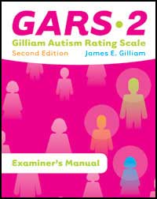
Diagnostic Evaluation:
Indirect Assessment
The Gilliam Autism Rating Scale 2nd ED. Gilliam, J. E. (2005). Gilliam autism rating scale (2nd ed.). Austin, TX: Pro-Ed.
        GARS-2

Slide 106
Diagnostic Evaluation:
Indirect Assessment
The Gilliam Autism Rating Scale, 2nd Ed. (GARS-2)
  New normative group: 1,107 individuals ages 3 to 22 reported to have autism
  42 items, 3 Subscales and an Autism Index (AI) Score
  Subscales: Social Interaction, Communication, and Stereotyped Behaviors assess current behavior
  A structured parent interview form replaces the Early Development subscale to investigate parent perceptions and observations.
  GARS-2 items have been rewritten for clarity and operationally defined in manual.
  New guidelines for interpreting scales and index.
  Includes “Instructional Objectives for Children Who Have Autism” to use GARS-2 for developing goals.

Slide 107
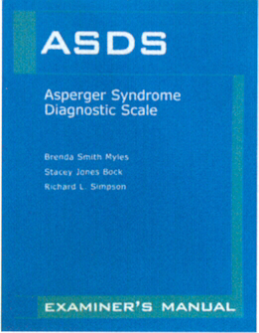
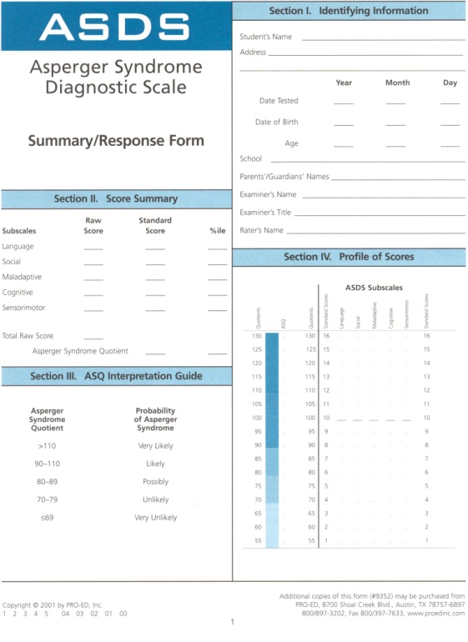
Diagnostic Evaluation:
Indirect Assessment
The Asperger Syndrome Diagnostic Scale (ASDS)

Slide 108
Diagnostic Evaluation:
Indirect Assessment
The Asperger Syndrome Diagnostic Scale (ASDS)
  Age range 5-18.
  50 yes/no items.
  10 to 15 minutes.
  Normed on 227 persons with Asperger Syndrome, autism, learning disabilities, behavior disorders and ADHD.
  ASQs are classified on an ordinal scale ranging from “Very Low” to “Very High” probability of Asperger’s Disorder. A score of 90 or above specifies that the child is “Likely” to “Very Likely” to have Asperger’s Disorder.
Notes:
The Asperger Syndrome Diagnostic Scale is a behavioral checklist designed to assist in the diagnosis of Asperger’s Disorder among individuals 5 through 18 years of age. Its 50 items are divided among five subtests (i.e., Language, Social, Maladaptive, Cognitive, and Sensorimotor), and are scored on a 2-point scale (with “0” corresponding to “Not Observed” and “1” corresponding to “Observed”). It is intended to be completed by a parent, teacher, or other caregiver who knows the individual well [i.e., someone who has had regular, sustained contact with the examinee for at least 2 weeks. Beyond having familiarity with the ASDS, no special training is required to administer or score this measure, and it is suggested most raters will be able to complete all subtests in 10 to 15 minutes.
Subtest raw scores are converted into standard scores, which are then summed and in turn converted to an Asperger Syndrome Quotient (ASQ). It is this score, the ASQ, which is recommended for use in helping to diagnose Asperger’s Disorder. Subtest standard scores are not recommended for this use. ASQs of 90 and above are associated with “Likely” to “Very Likely” probabilities of the subject being a person with an Asperger’s Disorder (the higher the score the greater the probability). Conversely, ASQs below 80 are associated with an “Unlikely” probability of this disorder.
The ASDS is considered to be psychometrically sound. It has been suggested to have “moderate to good reliability estimates.” However, some questions have been raised about the construction of the standardization sample (i.e., there apparently was no confirmation of the Asperger’s Disorder diagnoses).

Slide 109
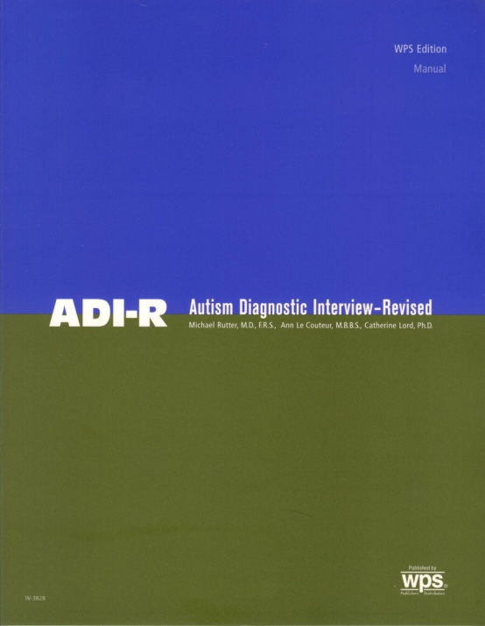
Diagnostic Evaluation:
Indirect Assessment
The Autism Diagnostic Interview-Revised (ADI-R)
  Rutter, M., Le Couteur, A., & Lord, C. (2003). Autism diagnostic interview-revised (ADI-R). Los Angeles, CA: Western Psychological Services.
Notes:
The Autism Diagnostic Interview – Revised (ADI-R) represents one of the more recently published tools for use in the diagnosis of ASD.
Along with the Autism Diagnostic Observation Schedule, the AID-R is currently considered the “gold standard” for the diagnosis of ASD .

Slide 110
Diagnostic Evaluation:
Indirect Assessment
The Autism Diagnostic Interview-Revised (ADI-R)
  Semi-structured interview
  Designed to elicit the information needed to diagnose autism.
  Primary focus is on the three core domains of autism (i.e., language/communication; reciprocal social interactions; and restricted, repetitive, and stereotyped behaviors and interests).
  Requires a trained interviewer and caregiver familiar with both the developmental history and the current behavior of the child.
  The individual being assessed must have a developmental level of at least two years.
Notes:
The ADI-R employs a semi-structured interview format to elicit the information needed to diagnose autism. It provides separate algorithms for diagnosis and treatment or educational planning (with the latter referencing the full developmental history and the former focusing on current behavior). The interviews primary focus is on the three core domains of autism (i.e., language/communication; reciprocal social interactions; and restricted, repetitive, and stereotyped behaviors and interests). The ADI-R requires a trained interviewer and caregiver familiar with both the developmental history and the current behavior of the child. According to Rutter et al. (2003):
… in everyday clinical practice, the material provided in chapters 2 and 3 [of the ADI-R manual], together with the WPS set of teaching videotapes, will provide a sufficient introduction to the ADI-R for professionals who have prior training and experience in conducting extended clinical interviews and in working with individuals with ASDs. (p. 1)
In addition, it is important to note that the individual being assessed must have a developmental level of at least two years.

Slide 111
Diagnostic Evaluation:
Indirect Assessment
The Autism Diagnostic Interview-Revised (ADI-R)
  The 93 items that comprise this measure takes approximately 90 to 150 minutes to administer.
  Solid psychometric properties.
    Works very well for differentiation of ASD from nonautistic developmental disorders in clinically referred groups, provided that the mental age is above 2 years.
    False positives very rare,
    Reported to work well for the identification of Asperger’s Disorder.
      However, it may not do so as well among children under 4 years of age.
  According to Klinger and Renner (2000): “The diagnostic interview that yields the most reliable and valid diagnosis of autism is the ADI–R” (p. 481).
Notes:
The 93 items that comprise this measure takes approximately 90 to 150 minutes to administer. This lengthy administration time represents one of the primary limitations of this tool. In addition it is important to reiterate that, as with all indirect assessments, the ADI-R is influenced by parental perceptions and agendas.
Examination of the ADI-R manual suggests that it has solid psychometric properties. The authors conclude that “…the ADI-R works very well for differentiation of ASD from nonautistic developmental disorders in clinically referred groups, provided that the mental age is above 2 years, 0 months”. Among the ADI-R’s domains of autistic behavior and diagnosis, interrater reliability and retest reliability have been described as “consistently convincing”. ASD false positives very rare, even when being used to differentially diagnose children with language disorders from those with high functioning ASD. The ADI-R algorithm is also reported to work well for the identification of Asperger’s Disorder. However, it may not do so as well among children under 4 years of age.

Slide 112
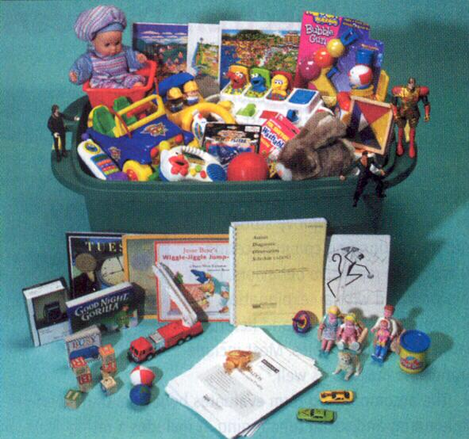
Diagnostic Evaluation:
Direct Assessment
The Autism Diagnostic Observation Schedule (ADOS)
  Lord, C., Rutter, M., Di Lavore, P. C., & Risis, S. Autism diagnostic observation schedule. Los Angeles, CA: Western Psychological Services.
Notes:
As was just mentioned the ADOS-G (Lord, Rutter, DiLavore, & Risi, 1999a, 1999b) is considered to be part of the “gold standard” in the diagnosis of ASD (Goodlin-Jones & Solomon, 2003).

Slide 113
Diagnostic Evaluation:
Direct Assessment
A standardized, semi-structured, interactive play assessment of social behavior.
  Uses “planned social occasions” to facilitate observation of the social, communication, and play or imaginative use of material behaviors related to the diagnosis of ASD.
Consists of four modules.
  Module 1 for individuals who are preverbal or who speak in single words.
  Module 2 for those who speak in phrases.
  Module 3 for children and adolescents with fluent speech.
  Module 4 for adolescents and adults with fluent speech.

Slide 114
Diagnostic Evaluation:
Direct Assessment
Administration requires 30 to 45 minutes.
Because its primary goal is accurate diagnosis, the authors suggest that it may not be a good measure of treatment effectiveness or developmental growth (especially in the later modules).
Psychometric data indicates substantial interrater and test-retest reliability for individual items, and excellent interrater reliability within domains and internal consistency.
Mean test scores were found to consistently differentiate ASD and non-ASD groups.

Slide 115
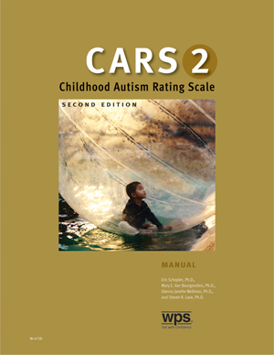
Diagnostic Evaluation:
Direct Assessment
The Childhood Autism Rating Scale, 2nd ed. (CARS2)
  Schopler, E.., Van Bourgondien, M. E., Wellman, G. J., & Love, S. R. (2010). The Childhood Autism Rating Scale (CARS). Los Angeles, CA: Western Psychological Services.
Notes:
At one time considered to the “strongest” objective scale for the diagnosis of ASD, the Childhood Autism Rating Scale is one of the most widely used diagnostic tools for children over 2 years of age.
Tuesday, November 23, 2010
Best Practice Autism Review: The Childhood Autism Rating Scale, Second Edition (CARS2)
The recently published Childhood Autism Rating Scale, second edition (CARS2), consists of two 15-item rating scales completed by the practitioner and a Parent/Caregiver Questionnaire. The Standard Version Rating Booklet (CARS2-ST) is equivalent to the original CARS and is used with children younger than 6 years of age and those with communication difficulties or below-average cognitive ability. The High-Functioning Version Rating Booklet (CARS2-HF) is an alternative for assessing verbally fluent children and youth, 6 years of age and older, with average or above intellectual ability. The Questionnaire for Parents or Caregivers (CARS2-QPC) is an unscored questionnaire designed to obtain pertinent developmental information from parents or caregivers. Both the CARS2-ST and CARS2-HF each include 15 items addressing the following functional areas:
Relating to People
Imitation (ST); Social-Emotional Understanding (HF)
Emotional Response (ST); Emotional Expression and Regulation of Emotions (HF)
Body Use
Object Use (ST); Object Use in Play (HF)
Adaptation to Change (ST); Adaptation to Change/Restricted Interests (HF)
Visual Response
Listening Response
Taste, Smell, and Touch Response and Use
Fear or Nervousness (ST); Fear or Anxiety (HF)
Verbal Communication
Nonverbal Communication
Activity Level (ST); Thinking/Cognitive Integration Skills (HF)
Level and Consistency of Intellectual Response
General Impressions
Items on the Standard form duplicate those on the original CARS, while items on the HF form have been modified to reflect current research on the characteristics of higher functioning children and youth with autism (HFA) or Asperger Syndrome. To complete the ratings on the CARS2-HF, the professional must have convergent information from MULTIPLE sources such as direct observation, parent and teacher interviews, prior assessments of cognitive functioning and adaptive behavior, and information from the Questionnaire for Parents or Caregivers (CARS2-QPC). Ratings are based not only on frequency of the behavior in question, but also on its intensity, atypicality, and duration. Rating values for all items are summed to produce a Total Raw Score. Each form includes a graph that allows the practitioner quickly convert the Total Raw Score to a standard score or percentile rank (based on a clinical sample of individuals diagnosed with autism spectrum disorders).
The psychometric properties of the CARS2-HF indicate a high degree of internal consistency and good interrater reliability. Validity information reports an overall discrimination index value of .93, with sensitivity and specificity values of .81 and .87, respectively. The HF form also demonstrates a relatively strong relationship with the “gold standard” Autism Disorder Observation Scale (ADOS).
The following are critical features of the CARS2-HF.
1. Parents and teachers should NOT be asked to complete the CARS2 forms. Only well-informed professionals should complete the ratings.
2. The CARS2 should NOT be used for screening in the general school-age population.
3. The practitioner must have a good understanding of the criteria for making the ratings and be in a position to collect information from multiple sources (direct observation, parent and teacher reports, prior assessments and clinical impressions).
4. The ratings from the CARS2 should be considered as only one part of a multimodal, multidisciplinary decision-making process in the identification of children with ASD.
5. Direct observation and a developmental history MUST always be included in the assessment process.
6. Scores on the CARS2 are interpreted relative to the level (severity) of autism-related behaviors compared to a clinical sample of individuals diagnosed with autism, NOT the typical individual.
In summary, The CARS2-HF represents an important alternative that will be welcomed by school-based professionals such as school psychologists and speech/language pathologists. It is a sensitive and reliable instrument that will find a place in the school-based professional’s assessment “Tool Box.” Given the dramatic increase in the numbers of students being referred for screening and assessment, the CARS2-HF is a useful instrument that helps quantify the level of symptom severity and importantly, assist with intervention and program planning. The CARS2-HF scores are particularly helpful in identifying Autism, Asperger's Disorder, Pervasive Developmental Disorder Not Otherwise Specified (PDD-NOS). Of course, the CARS2 is not intended to be and should not be used as the sole instrument in making diagnostic or classification decisions. An example of a comprehensive assessment battery can be found in “A Best Practice Guide to Assessment and Intervention for Autism and Asperger Syndrome in Schools.”
Schopler, E, Van Bourgondien, M. E., Wellman, G. J., & Love, S. R. (2010). Childhood autism rating scale, second edition. Los Angeles, CA: Western Psychological Services.
Helps to identify children with autism and determine symptom severity through quantifiable ratings based on direct observation
Ages :
2 years and up
Administration Time :
5 to 10 minutes
(after the information needed to make the ratings has been collected)
Format :
Two 15-item rating scales completed by the clinician (each designed for a different population); and an unscored Parent/Caregiver Questionnaire
Scores :
Cutoff scores, standard scores, and percentiles
Childhood Autism Rating Scale, Second Edition (CARS2)
by Eric Schopler, Ph.D., Mary E. Van Bourgondien, Ph.D., Glenna Janette Wellman, Ph.D., and Steven R. Love, Ph.D.
Since its original publication, the CARS has become one of the most widely used and empirically validated autism assessments. It has proven especially effective in discriminating between children with autism and those with severe cognitive deficits, and in distinguishing mild-to-moderate from severe autism.
Now a revised Second Edition expands the test's clinical value, making it more responsive to individuals on the "high-functioning" end of the autism spectrum--those with average or higher IQ scores, better verbal skills, and more subtle social and behavioral deficits. While retaining the simplicity, brevity, and clarity of the original test, the CARS2 adds forms and features that help you integrate diagnostic information, determine functional capabilities, provide feedback to parents, and design targeted intervention.
The CARS2 includes three forms:
Standard Version Rating Booklet (CARS2-ST)
Equivalent to the original CARS; for use with individuals younger than 6 years of age and those with communication difficulties or below-average estimated IQs
High-Functioning Version Rating Booklet (CARS2-HF)
An alternative for assessing verbally fluent individuals, 6 years of age and older, with IQ scores above 80
Questionnaire for Parents or Caregivers (CARS2-QPC)
An unscored scale that gathers information for use in making CARS2-ST and CARS2-HF ratings
The Standard and High-Functioning Forms
The CARS2-ST and CARS2-HF each include 15 items addressing the following functional areas:
Relating to People
Imitation (ST); Social-Emotional Understanding (HF)
Emotional Response (ST); Emotional Expression and Regulation of Emotions (HF)
Body Use
Object Use (ST); Object Use in Play (HF)
Adaptation to Change (ST); Adaptation to Change/Restricted Interests (HF)
Visual Response
Listening Response
Taste, Smell, and Touch Response and Use
Fear or Nervousness (ST); Fear or Anxiety (HF)
Verbal Communication
Nonverbal Communication
Activity Level (ST); Thinking/Cognitive Integration Skills (HF)
Level and Consistency of Intellectual Response
General Impressions
Items on the Standard form duplicate those on the original CARS, while items on the HF form have been modified to reflect current research on the characteristics of people with high functioning autism or Asperger's Syndrome.
The clinician rates the individual on each item, using a 4-point response scale. Ratings are based not only on frequency of the behavior in question, but also on its intensity, peculiarity, and duration. While this more nuanced approach gives you greater flexibility in integrating diagnostic information, it still yields quantitative results.
The Rating Booklets for both the Standard and HF versions are particularly convenient. They include space for clinical note-taking and documentation. They briefly describe each area rated, providing a reminder of rating criteria and a framework for explaining results to parents. And they list cutoff values so that you can see at a glance whether further evaluation is warranted.
Rating values for all items are summed to produce a Total Raw Score. Each form includes a graph that allows you to quickly convert the Total Raw Score to a standard score or percentile rank (based on a clinical sample of 1,034 individuals with autism spectrum disorders). The Manual provides guidelines for score interpretation, suggestions for intervention, and case examples.
The Questionnaire for Parents or Caregivers
The CARS2-QPC is an unscored form completed by the parent or caregiver of the individual being assessed. Its purpose is to give the clinician more information on which to base CARS2-ST or CARS2-HF ratings. Often the questionnaire serves as the framework for a follow-up interview, during which the clinician can clarify and interpret the responses provided by the parent or caregiver.
The areas covered by the CARS2-QPC include the individual's early development; social, emotional, and communication skills; repetitive behaviors; play and routines; and unusual sensory interests.
The Best Way to Inform and Support Diagnosis
The new CARS2 is extremely useful in identifying symptoms of autism.
It covers the entire autism spectrum, as defined by empirical research.
It is based on decades of use with thousands of referred individuals.
It assesses virtually all ages and functional levels.
It provides concise, objective, and quantifiable ratings based on direct behavioral observation.
Scores show a consistent, strong, positive, and specific relationship with autism diagnosis.
Ratings are reliable across time, settings, sources of information, and raters.
With a new form for higher-functioning individuals, a structured way to gather caregiver information, and guidelines linking scores to intervention, the CARS2 remains one of the best autism assessments available.

Slide 116
Diagnostic Evaluation:
Direct Assessment
Consists of two15-item rating scales completed by the practitioner and a Parent/Caregiver Questionnaire.
  The Standard Version Rating Booklet (CARS2-ST) used with children younger than 6 years of age and those with communication difficulties or below-average cognitive ability. 15 items duplicate those on the original CARS.
  The High-Functioning Version Rating Booklet (CARS2-HF) is used for assessing verbally fluent children and youth, 6 years of age and older, with average or above IQ. 15 items reflect characteristics of higher functioning autism.
  The Questionnaire for Parents or Caregivers (CARS2-QPC) is an unscored questionnaire designed to obtain pertinent developmental information from parents or caregivers.
Notes:
Tuesday, November 23, 2010
Best Practice Autism Review: The Childhood Autism Rating Scale, Second Edition (CARS2)
The recently published Childhood Autism Rating Scale, second edition (CARS2), consists of two 15-item rating scales completed by the practitioner and a Parent/Caregiver Questionnaire. The Standard Version Rating Booklet (CARS2-ST) is equivalent to the original CARS and is used with children younger than 6 years of age and those with communication difficulties or below-average cognitive ability. The High-Functioning Version Rating Booklet (CARS2-HF) is an alternative for assessing verbally fluent children and youth, 6 years of age and older, with average or above intellectual ability. The Questionnaire for Parents or Caregivers (CARS2-QPC) is an unscored questionnaire designed to obtain pertinent developmental information from parents or caregivers. Both the CARS2-ST and CARS2-HF each include 15 items addressing the following functional areas:
Relating to People
Imitation (ST); Social-Emotional Understanding (HF)
Emotional Response (ST); Emotional Expression and Regulation of Emotions (HF)
Body Use
Object Use (ST); Object Use in Play (HF)
Adaptation to Change (ST); Adaptation to Change/Restricted Interests (HF)
Visual Response
Listening Response
Taste, Smell, and Touch Response and Use
Fear or Nervousness (ST); Fear or Anxiety (HF)
Verbal Communication
Nonverbal Communication
Activity Level (ST); Thinking/Cognitive Integration Skills (HF)
Level and Consistency of Intellectual Response
General Impressions
Items on the Standard form duplicate those on the original CARS, while items on the HF form have been modified to reflect current research on the characteristics of higher functioning children and youth with autism (HFA) or Asperger Syndrome. To complete the ratings on the CARS2-HF, the professional must have convergent information from MULTIPLE sources such as direct observation, parent and teacher interviews, prior assessments of cognitive functioning and adaptive behavior, and information from the Questionnaire for Parents or Caregivers (CARS2-QPC). Ratings are based not only on frequency of the behavior in question, but also on its intensity, atypicality, and duration. Rating values for all items are summed to produce a Total Raw Score. Each form includes a graph that allows the practitioner quickly convert the Total Raw Score to a standard score or percentile rank (based on a clinical sample of individuals diagnosed with autism spectrum disorders).
The psychometric properties of the CARS2-HF indicate a high degree of internal consistency and good interrater reliability. Validity information reports an overall discrimination index value of .93, with sensitivity and specificity values of .81 and .87, respectively. The HF form also demonstrates a relatively strong relationship with the “gold standard” Autism Disorder Observation Scale (ADOS).
The following are critical features of the CARS2-HF.
1. Parents and teachers should NOT be asked to complete the CARS2 forms. Only well-informed professionals should complete the ratings.
2. The CARS2 should NOT be used for screening in the general school-age population.
3. The practitioner must have a good understanding of the criteria for making the ratings and be in a position to collect information from multiple sources (direct observation, parent and teacher reports, prior assessments and clinical impressions).
4. The ratings from the CARS2 should be considered as only one part of a multimodal, multidisciplinary decision-making process in the identification of children with ASD.
5. Direct observation and a developmental history MUST always be included in the assessment process.
6. Scores on the CARS2 are interpreted relative to the level (severity) of autism-related behaviors compared to a clinical sample of individuals diagnosed with autism, NOT the typical individual.
In summary, The CARS2-HF represents an important alternative that will be welcomed by school-based professionals such as school psychologists and speech/language pathologists. It is a sensitive and reliable instrument that will find a place in the school-based professional’s assessment “Tool Box.” Given the dramatic increase in the numbers of students being referred for screening and assessment, the CARS2-HF is a useful instrument that helps quantify the level of symptom severity and importantly, assist with intervention and program planning. The CARS2-HF scores are particularly helpful in identifying Autism, Asperger's Disorder, Pervasive Developmental Disorder Not Otherwise Specified (PDD-NOS). Of course, the CARS2 is not intended to be and should not be used as the sole instrument in making diagnostic or classification decisions. An example of a comprehensive assessment battery can be found in “A Best Practice Guide to Assessment and Intervention for Autism and Asperger Syndrome in Schools.”
Schopler, E, Van Bourgondien, M. E., Wellman, G. J., & Love, S. R. (2010). Childhood autism rating scale, second edition. Los Angeles, CA: Western Psychological Services.

Slide 117
Workshop Outline
Introduction
Case Finding
Screening
Diagnostic Evaluation
Psycho-educational Evaluation (Treatment)
  Testing Accommodations
  Behavioral Observations
  Specific Tests
  Psycho-educational Report Recommendations
Notes:
Here is my presentation outline (list workshop elements).

Slide 118

Psycho-educational
Evaluation:
Testing Accommodations
The core deficits of autism can significantly impact test performance.
  Impairments in communication may make it difficult to respond to verbal test items and/or generate difficulty understanding the directions that accompany nonverbal tests.
  Impairments in social relations may result in difficulty establishing the necessary joint attention.
Examiners must constantly assess the degree to which tests being used reflect symptoms of autism and not the specific targeted abilities (e.g., intelligence, achievement, psychological processes).
Notes:
Testing students with ASD requires special expertise, training, and experience to minimize the effects of autistic behavior on test validity.
The school psychologist must constantly assess the degree to which tests being used reflect symptoms of autism or the specific targeted abilities (e.g., intelligence, achievement, psychological processes).
For example, in the case of an IQ test (especially one with an emphasis on verbal abilities) examiners must constantly question whether obtained scores reflect cognitive potential, or the qualitative impairments in communication that are typical of autism.
To address these challenges examiners will often need to make testing accommodations.

Slide 119
Psycho-educational Evaluation:
Testing Accommodations
It is important to acknowledge that the autistic population is very heterogeneous.
There is no one set of accommodations that will work for every student with autism.
It is important to consider each student as an individual and to select specific accommodations to meet specific individual student needs.
Notes:
Before offering specific suggestions that might be appropriate for the student with ASD, it is important to acknowledge that the autistic population is very heterogeneous.
Thus, there is not any one set of accommodations that will work for every student.
In other words, it is important to consider each student as an individual and to select specific accommodations to meet specific individual needs.
With this preface in mind the following accommodations that might be helpful when testing the student with autism are offered.

Slide 120
Psycho-educational Evaluation:
Testing Accommodations
Prepare the student for the testing experience (environment).
Place the testing session in the student’s daily schedule (routine).
Minimize distractions.
Make use of pre-established physical structures and work systems.
Make use of powerful external rewards.
Carefully pre-select task difficulty.
Modify test administration and allow nonstandard responses.
Notes:
Prepare the student for the testing experience. Many students with ASD have great difficulty adjusting to environmental changes. Consequently, the novel testing room environment may make it difficult for the student to perform at his or her best. Thus, before assessing the student with autism it will be important to familiarize him or her with the examiner, the testing room, and the testing experience. This can be accomplished by having a few meetings with the student in the examiner’s testing room before beginning any formal assessment procedure (Loftin & Lantz, 2003). One alternative for the student who is extremely resistant to leaving the familiar classroom environment is to find a way to conduct the assessment in the classroom itself. Obviously, this would need to be done at a time when classroom distractions are at a minimum.
Place the testing session in the student’s daily schedule. Students with ASD also have difficulty adjusting to changes in routine. They may, for example, react with great distress if an expected activity does not occur at an expected time. Consequently, it is not unusual for testing sessions (which occur infrequently) to be a distressing disruption to the student’s routine. Given this possibility, once the student has become familiar and comfortable with the testing environment, the next important consideration is to make sure he or she knows exactly when the testing session(s) will take place. If the student is making use of a daily and/or weekly schedule, the testing session can be place on it giving the student the warning he or she needs that a session will take place.
Minimize distractions. Some students with ASD have unusual visual and auditory sensitivities. They may for example find certain sounds (e.g., a phone ringing, a pencil being sharpened, someone coughing) extremely distressing. Thus, before assessing the student it will be important to inquire about such sensitivities and to make appropriate environmental adjustments. In general, it would be a good idea to minimize all distractions (Loftin & Lantz, 2003). Another way to minimize disruption to the student’s daily routine is to shorten the testing sessions into smaller, more discrete segments. Doing so will also allow the student to adapt to the relatively novel testing procedures (Cummings, 2004).
Make use of pre-established physical structures and work systems. In addition to making use of a daily schedule, another way to minimize the disruption to routine that might be generated by the testing session, is to place the session within a pre-established physical structure and work system. For example, in a classroom that makes use of structured teaching techniques (e.g., Schopler, Reichler, & Lansing, 1980) testing could take placed in the pre-established one-on-one work area, and make use of an already developed individual work system. Such systems inform students how much testing will be done (for example, by placing selected test items in “to do” baskets), indicates when a testing item is completed (for example, by placing test materials in a “finished basket”), and specifies what will happen once testing is completed (Marcus, Flagler, & Robinson, 2001; Marcus, Lansing, & Schopler, 1993). As will be discussed next, this last element will help to facilitate the use of external motivation for engaging in testing.
Make use of powerful external rewards. Given the just mentioned challenges (i.e., sensory issues and difficulty adjusting to changes in environment and routine) it will not be surprising to find students with ASD unmotivated to perform in testing sessions. In fact, they may find it aversive. Thus, it will be important to consider how to reward test performance and increase test-taking motivation (Goodlin-Jones & Solomon, 2003). Specific strategies include the use of frequent reinforcement breaks (Koegel, Koegel, & Smith, 1997) and behavioral shaping (Siegel, Minshew, & Goldstein, 1996). One way to inform the student of pending reinforcement breaks is to place a desired task on the student’s daily schedule immediately after the testing session. In this way the student will be informed that once testing is completed (e.g., all test materials are in the “finished basked”) a desirable activity will immediately follow (Marcus et al. 2001; Marcus et al., 1993). Using this strategy it may be possible to classically condition positive feelings about test taking. The specific rewards selected may make use of some of the unusual and intense interests students with ASD have. For example, at the conclusion of testing the student may be allowed to count cars as the pass by the classroom window or review baseball statistics. Of course, as is the case with all efforts to use external rewards to influence behavior, it will be essential to ensure that the individual student finds the selected reinforcer reinforcing. In addition, parents and/or teachers should always be consulted about the appropriateness of the selected reinforcers.
Carefully pre-select task difficulty. Another strategy to maintain the student’s motivation is to alternate difficult tasks (typically language items) with easy tasks (e.g., visual-motor tasks; Loftin & Lantz, 2003; Marcus et al. 2001; Marcus et al., 1993). Data obtained from classroom observations, and parent and teacher interviews should inform the examiner regarding what kinds of tasks will be difficult for the student and what tasks will be easy. With this knowledge difficulty tasks can be followed by what is expected to be an easy task, which can help to maintain the student’s test taking motivation.
Modify test administration and allow nonstandard responses. Many of the just mentioned accommodations might be implemented without having to break standardized test administration and scoring procedures. Obviously, to the extent it is possible, standardized administrations are preferred. However, if it becomes necessary, changing test directions (e.g., simplifying, shortening, and/or repeating them), allowing the student to respond to the task in alternative ways (e.g., using a picture communication system), and/or allowing additional time to respond to test items would be appropriate (Marcus et al., 2001; Marcus et al., 1993). While such administrations will affect the examiner’s ability to compare the student’s test performance to those of students in the given standardization sample, such non-standard administrations can be very helpful in understanding the student’s relative pattern of strengths and weaknesses.

Slide 121
Psycho-educational Evaluation:
Behavioral Observations
Students with ASD are a very heterogeneous group, and in addition to the core features of ASD, it is not unusual for them to display a range of behavioral symptoms including hyperactivity short attention span impulsivity, aggressiveness, self-injurious behavior, and (particularly in young children) temper tantrums.
Observation of the student with ASD in typical environments will also facilitate the evaluation of test taking behavior.
Observation of test taking behavior may also help to document the core features of autism.
Notes:
As is the case with all psycho-educational assessments, behavioral observations are essential. Students with ASD are a very heterogeneous group, and in addition to the core feature of ASD, it is not unusual for them to display a range of behavioral symptoms including hyperactivity short attention span impulsivity, aggressiveness, self-injurious behavior, and (particularly in young children) temper tantrums (Hendren, 2003). Obviously, identification of these unique behavioral challenges will be important for educational program planning and may become targets for functional behavioral assessments.
Observation of the student with ASD in typical environments, such as the classroom, will also facilitate the evaluation of test taking behavior. From such observations judgments regarding how typical the students test taking behaviors were can be made and the validity of the obtained test results assessed. In addition to being used to assess the validity of test results, observation of test taking behavior may also help to document the core features of autism. For example, observation of communication abilities, eye contact with the examiner, and parent and/or teacher separation and reunification behaviors are among the behaviors that might be documented during the testing session.

Slide 122
Psycho-educational Evaluation:
Specific Tests
Choice of Assessment Instruments
Child’s level of verbal abilities.
Ability to respond to complex instructions and social expectations.
Ability to work rapidly.
Ability to cope with transitions during test activities.
In general, children with autism will often perform best when assessed with tests that require less social engagement and verbal mediation.
DSM-5’s specifiers will help you select the appropriate tests.

Slide 123
Psycho-educational Evaluation:
Specific Tests
Cognitive Functioning
Assessment of cognitive function is essential given that a significant percentage of students with ASD will also be mentally retarded.
IQ is associated with adaptive functioning, the ability to learn and acquire new skills, and long-term prognosis.
  Thus, level of cognitive functioning has implications for determining how restrictive the educational environment will need to be.
Notes:
Assessment of cognitive function is essential given that, with the exception of Asperger’s Disorder, a significant percentage (as high as 80 percent) of students with ASD will also be mentally retarded. The presence of mental retardation also has diagnostic implications as DSM IV-TR specifies that in the presences of severe to profound retardation will make it difficult to diagnosis Autistic Disorder.
In addition, to ruling in or ruling out mental retardation, the student’s level of cognitive functioning provides data important to educational program planning. For example, IQ is associated with adaptive functioning, the ability to learn and acquire new skills, and long-term prognosis. Thus, level of cognitive functioning has significant implications for determining how restrictive the educational environment will need to be. In addition, IQ test results can be helpful in the differential diagnosis among the various ASDs. Specifically, students with Rett’s Disorder typically have profound to severe IQ deficits, those with Childhood Disintegrative Disorder typically have severe deficits, those with Autistic Disorder typically have moderate deficits, and those with Asperger’s Disorder do not typically have any cognitive delay.

Slide 124
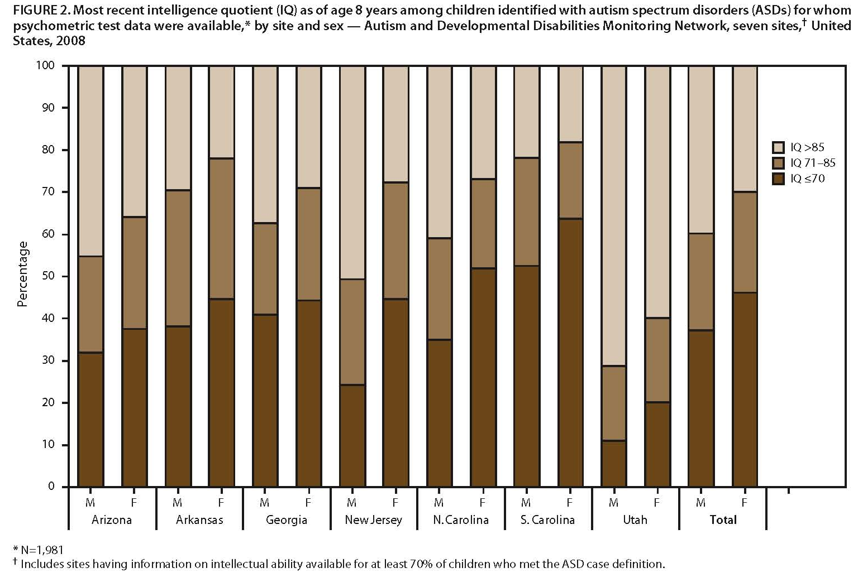
IQs of Children Aged 8 with ASD
CDC (2013)
Notes:
Intelligence quotient (IQ) of children aged 8 years with an autism spectrum disorder (ASD) for whom psychometric test data were available,* by site and sex (IQ) score-Autism and Developmental Disabilities Monitoring Network, 11 sites, United States, 2006
A report published by CDC in 2009, shows that 30-51% (41% on average) of the children who had an ASD also had an Intellectual Disability (intelligence quotient <=70). [Read article]

Slide 125
Psycho-educational Evaluation:
Specific Tests
Cognitive Functioning
A powerful predictor of ASD symptom severity.
However, given that children with ASD are ideally first evaluated when they are very young, it is important to acknowledge that it is not until age 5 that childhood IQ correlates highly with adult IQ.
  Thus, it is important to treat the IQ scores of the very young child with caution when offering a prognosis, and when making placement and program planning decisions.
  However, for school aged children it is clear that the appropriate IQ test is an “…excellent predictor of a student’s later adjustment and functioning in real life” (Frith, 1989, p. 84).
Notes:
Intelligence test performance is also a powerful predictor of ASD symptom severity, with higher IQ scores being associated with a lower degree of ASD symptoms. However, given that children with ASD are ideally first evaluated when they are very young (i.e., 2- to 3-years of age), it is important to acknowledge that it is not until age 5 that childhood IQ correlates highly with adult IQ.
Thus, it is important to treat the IQ scores of the very young child with caution when offering a prognosis, and when making placement and program planning decisions.
However, for school aged children it is clear that the appropriate IQ test is an excellent predictor of a student’s later adjustment and functioning in real life.
Filipek et al. (1999) suggest that it may be beneficial to conduct IQ testing before kindergarten entry to help with curriculum planning. In addition, such IQ test results can provide a baseline and serve as one way to measure intervention effectiveness.

Slide 126
Psycho-educational Evaluation:
Specific Tests
Cognitive Functioning
Regardless of the overall level of cognitive functioning, it is not unusual for the student being tested to display an uneven profile of cognitive abilities.
Thus, rather that simply providing an overall global intelligence test score, it is essential to identify these cognitive strengths and weaknesses.
At the same time, however, it is important to avoid the temptation to generalize from isolated or “splinter” skills when forming an overall impression of cognitive functioning, given that such skills may significantly overestimate typical abilities.
Notes:
Regardless of the overall level of cognitive functioning, it is not unusual for the student being tested to display an uneven profile of cognitive abilities.
Thus, rather that simply providing an overall global intelligence test score, it is essential to identify these cognitive strengths and weaknesses.
Doing so will assist educational planning (Filipek et al., 1999).
At the same time, however, it is important to avoid the temptation to generalize from isolated or “splinter” skills when forming an overall impression of cognitive functioning, given that such skills may significantly overestimate typical abilities.

Slide 127
Psycho-educational Evaluation:
Specific Tests
Cognitive Functioning
Selection of specific tests is important to obtaining a valid assessment of cognitive functioning (and not the challenges that are characteristic of ASD).
The Wechsler and Stanford-Binet scales are appropriate for the individual with spoken language.
Notes:
Selection of specific tests is important to obtaining a valid assessment of cognitive functioning (and not the challenges that are characteristic of ASD).
Goodlin-Jones and Solomon (2003) suggest that the Wechsler (2003) and Stanford-Binet (Roid, 2003) scales are appropriate for the individual with spoken language.

Slide 128
Psycho-educational Evaluation:
Specific Tests
Cognitive Functioning
On the other hand, for students who have more severe language delays measures that minimize verbal demands are recommended (e.g., the Leiter International Performance Scale – Revised, Raven Coloured Progressive Matrices)
Notes:
On the other hand, for students who have more severe language delays measures that minimize verbal demands are recommended. Goodlin-Jones and Solomon suggest that the Leiter International Performance Scale – Revised is a reasonable choice for assessing a child who has limited language ability or is nonverbal.

Slide 129
Psycho-educational Evaluation:
Specific Tests
Functional/Adaptive Behavior
Given that diagnosing mental retardation requires examination of both IQ and adaptive behavior, it is also important to administer measures of adaptive behavior when assessing students with ASD.
Other uses of adaptive behavior scales when assessing students with ASD are:
  Obtain measure of child’s typical functioning in familiar environments, e.g. home and/or school.
  Target areas for skills acquisition.
  Identifying strengths and weaknesses for educational planning and intervention
  Documenting intervention efficacy
  Monitoring progress over time.
Notes:
As was just mentioned, the majority of individuals with ASD also have mental retardation. Given that diagnosing mental retardation requires examination of both IQ and adaptive behavior, it is also important to administer measures of adaptive behavior when assessing students with ASD .
It is important to note that children with ASD have been shown to improve in all adaptive behavior domains (as measured by the Vineland Adaptive Behavior Scales; Sparrow, Balla, & Cicchetti, 1984) over time.
However, the rate of growth in the Communication and Daily Living Skills domains is related to initial IQ. The rate of growth in the Social Skills domain is independent of initial IQ.

Slide 130
Psycho-educational Evaluation:
Specific Tests
Functional/Adaptive Behavior
Profiles of students with ASD are unique.
  Individuals with only mental retardation typically display flat profiles across adaptive behavior domains
  Students with ASD might be expected to display relative strengths in daily living skills, relative weaknesses in socialization skills, and intermediate scores on measures of communication abilities.
To facilitate the use of the Vineland Adaptive Behavior Scales in the assessment of individuals with ASD, Carter et al. (1998) have provided special norms for groups of individuals with autism
Notes:
When interpreting the results of these scales it is important to keep in mind that the profiles of students with ASD are unique. While individuals with only mental retardation typically display flat profiles across adaptive behavior domains, students with ASD might be expected to display relative strengths in daily living skills, relative weaknesses in socialization skills, and intermediate scores on measures of communication abilities.
To facilitate the use of the Vineland Adaptive Behavior Scales in the assessment of individuals with ASD, Carter et al. (1998) have provided special norms for four groups of individuals with autism: (a) children under 10 with no verbal skills; (b) children under 10 with at least some verbal skills; (c) individuals above 10 with no verbal skills; and (d) individuals above 10 with at least some verbal skills. Use of these special norms have been suggested by Carter et al. to facilitate the use of the Vineland Adaptive Behavior Scales as a diagnostic tool given that individuals with ASD typically obtain Socialization scores much lower than would be expected given their mental age.

Slide 131
Psycho-educational Evaluation:
Specific Tests
Functional/Adaptive Behavior
Other tools with subtests for assessing functional/adaptive behaviors:
  Brigance Inventory of Early Development.
  Early Learning Accomplishment Profiles.
  Scales of Independent Behavior-Revised.
  AAMD Adaptive Behavior Scale.
  Learning Accomplishments Profile.
  Developmental Play Assessment Instrument.

Slide 132
Psycho-educational Evaluation:
Specific Tests
Social Functioning
Tools that provide an overview of social functioning (i.e., social needs and current repertoire)
  Vineland Adaptive Behavior Scales.
  Scales of Independent Behavior-Revised.
More specific information may be obtained from:
  Preschool curriculum assessments that contain social subscales.
  Battelle Developmental Inventory.
  Learning Accomplishment Profile.
  Michigan Scales.
  Assessment, Evaluation, and Programming System.
Notes:
Important to consider communication/play abilities.

Slide 133
Psycho-educational Evaluation:
Specific Tests
Language Functioning
Peabody Picture Vocabulary Test – Third Edition
Expressive One-Word Picture Vocabulary Test
  When interpreting the results of such measures, it is important to keep in mind that these tests may overestimate language abilities as they do not require sentence production or comprehension, nor do they assess social language or pragmatics.
  Also, in many higher functioning students with ASD receptive language may be lower than expressive language.
Notes:
A speech and language pathologist typically conducts a comprehensive examination of language functioning. However, there may be instances where the school psychologists needs to obtain estimates of expressive and receptive language, and Goodlin-Jones and Solomon (2003) recommend the Peabody Picture Vocabulary Test – Third Edition and the Expressive One-Word Picture Vocabulary Test for such use. When interpreting the results of such measures, it is important to keep in mind that these tests may overestimate language abilities as they do not require sentence production or comprehension, nor do they assess social language or pragmatics. Also, in many higher functioning students with ASD receptive language may be lower than expressive language.

Slide 134
Psycho-educational Evaluation:
Specific Tests
Psychological Processes
Helps to further identify learning strengths and weakness.
Depending upon age and developmental level, traditional measures of such processes may be appropriate.
It would not be surprising to find relatively strong rote, mechanical, and visual-spatial processes; and deficient higher-order conceptual processes, such as abstract reasoning.
While IQ test profiles should never be used for diagnostic purposes, it would not be surprising to find the student with Autistic Disorder to perform better on non-verbal (visual/spatial) tasks than tasks that require verbal comprehension and expression.
  The student with Asperger’s Disorder may display the exact opposite profile.
Notes:
The comprehensive psycho-educational evaluation of the student with ASD will also require the school psychologist to evaluate basic psychological process. Doing so will help to further identify learning strengths and weakness important to program planning. In addition, it is possible that the student may have a co-morbid learning disability that will require special educational intervention in its own right. Depending upon the student’s age and developmental level, traditional measures of such processes may be appropriate.
It would not be surprising to find the student with ASD to exhibit spared rote, mechanical, and visual-spatial processes and deficient higher-order conceptual processes, such as abstract reasoning. While IQ test profiles should never be used for diagnostic purposes, it would not be surprising to find the student with Autistic Disorder to perform better on non-verbal (visual/spatial) tasks than tasks that require verbal comprehension and expression. Conversely, the student with Asperger’s Disorder may display the exact opposite profile.

Slide 135
Psycho-educational Evaluation:
Specific Tests
Academic Achievement
Assessment of academic functioning will often reveal a profile of strengths and weaknesses.
  It is not unusual for students with ASD be hyperverbal/hyperlexic, while at the same time having poor comprehension and difficulties with abstract language. For others, calculation skills may be well developed, while mathematical concepts are delayed.
For students functioning at or below the preschool range and with a chronological age of 6 months to 7 years, the Psychoeducational Profile – Revised may be an appropriate choice.
For older, higher functioning students, the Woodcock-Johnson Tests of Achievement and the Wechsler Individual Achievement Test would be appropriate tools.
Notes:
A special education teacher typically conducts a comprehensive examination of academic functioning. However, there may be instances where the school psychologist’s needs to obtain estimates of achievement. As was the case for cognitive skills, assessment of academic functioning will often reveal a profile of strengths and weaknesses important to educational planning. Variability among achievement test scores is common. For example, it is not unusual for students with ASD to display signs of being hyperverbal and hyperlexic, while at the same time having poor reading comprehension and difficulties dealing with abstract language. For other students, calculation skills may be well developed, while mathematical concepts may be delayed .
For students functioning at or below the preschool range and with a chronological age of 6 months to 7 years, the PEP-R may be an appropriate choice. This measure is divided into two sections: one that assesses developmental functions (i.e., imitation, perception, fine and gross motor skills, eye-hand integration, and cognitive verbal and performance skills), and one that helps to identify unusual or atypical behaviors (i.e., relating and affect, play an interest in materials, sensory responses, and language abnormalities). For older, higher functioning students, the Woodcock-Johnson Tests of Achievement and the Wechsler Individual Achievement Test would be appropriate tools. However, Marcus et al. caution that formal achievement tests alone may not provide necessary information on the overall educational functioning of the student and that a curriculum-based evaluation might provide the most useful data for the autistic population.

Slide 136
Psycho-educational Evaluation:
Specific Tests
Emotional Functioning
65% present with symptoms of an additional psychiatric disorder such as AD/HD, oppositional defiant disorder, obsessive-compulsive disorder and other anxiety disorders, tics disorders, affective disorders, and psychotic disorders.
Given these possibilities, it will also be important for the school psychologist to evaluate the student’s emotional/behavioral status.
Traditional measures such as the Behavioral Assessment System for Children would be appropriate as a general purpose screening tool, while more specific measures such as The Children’s Depression Inventory and the Revised Children’s Manifest Anxiety Scale would be appropriate for assessing more specific presenting concerns.
Notes:
As the student with ASD matures, new symptoms and behavior that interfere with daily functioning may appear. ASD can be associated with a variety of other symptoms and 65% present with symptoms of an additional psychiatric disorder such as AD/HD, oppositional defiant disorder, obsessive-compulsive disorder and other anxiety disorders, tics disorders, affective disorders, and psychotic disorders (Hendren, 2003). Given these possibilities, it will also be important for the school psychologist to evaluate the student’s emotional/behavioral status. Traditional measures such as the Behavioral Assessment System for Children (Reynolds, & Kamphaus, 1998) would be appropriate as a general purpose screening tool, while more specific measures such as The Children’s Depression Inventory (Kovacs, 1992) and the Revised Children’s Manifest Anxiety Scale (Reynolds & Richmond, 1998) would be appropriate for assessing more specific presenting concerns.

Slide 137
Psycho-educational Evaluation:
Psycho-Educational Report Recommendations
From a review of the literature we have identified interventions often recommended when addressing some of the specific challenges associated with these disorders.
The slides that follow offer some of these recommendations (along with the accompanying background information) that we feel you might find useful when writing a psycho-educational report.
It is important to acknowledge that without a careful assessment of specific student needs this information will not be relevant.
However, following a comprehensive psycho-educational evaluation, and the identification of specific student needs, this information will be helpful in stimulating thinking about appropriate psycho-educational report recommendations for the student with autism.
Paper available at:
http://www.csus.edu/indiv/b/brocks/Courses/EDS%20243/student_materials.htm
Notes:
There is no single best treatment for all children with ASDs. However, well-planned, structured teaching of specific skills is very important. Some children respond well to one type of treatment while others have a negative response or no response at all to the same treatment. Before deciding on a treatment program, it is important to talk with the child’s health care providers to understand all the risks and benefits.
It is also important to remember that children with ASDs can get sick or injured just like children without ASDs. Regular medical and dental exams should be part of a child’s treatment plan. Often it is hard to tell if a child’s behavior is related to the ASD or is caused by a separate health condition. For instance, head banging could be a symptom of the ASD, or it could be a sign that the child is having headaches. In those cases, a thorough physical exam is needed. Monitoring healthy development means not only paying attention to symptoms related to ASDs, but also to the child’s physical and mental health, as well.

Slide 138
Psycho-educational Evaluation:
Psycho-Educational Report Recommendations
If the student is challenged by social situations, then the following intervention and support recommendations might be appropriate:
Notes:
A social story is a short story that explains a specific challenging social situation. The goal is to find out what is happening in a situation and why.

Slide 139
Psycho-educational Evaluation:
Psycho-Educational Report Recommendations
Provide interpretation of social situations as indicated. Specifically, the following are suggested:
  Make use of social stories.™
  A social story is a short story that explains a specific challenging social situation. The goal is to find out what is happening in a situation and why.
Gray & White (2002)

Slide 140
Psycho-educational Evaluation:
Psycho-Educational Report Recommendations
The following is an example of a social story:
When Other Students Get Upset
Sometimes other students get upset and cry. When this happens their teacher might try to help them. The teacher might try to help them by talking to them or holding them. This is okay. Sometimes when other students get upset and cry, it makes me upset and angry. I can use words to tell my teacher that I am upset. I can say, "That makes me mad!" or "I'm upset!“ It is okay to use words about how I feel. When I get upset I will try to use words about how I feel.

Slide 141
Psycho-educational Evaluation:
Psycho-Educational Report Recommendations
For more information about social stories go to
  http://www.thegraycenter.org/
  http://www.polyxo.com/socialstories/introduction.html
A variety of sample stories can be found at
  http://www.frsd.k12.nj.us/autistic/Social%20Stories/social_stories.htm

Slide 142
Psycho-educational Evaluation:
Psycho-Educational Report Recommendations
Use cartooning to illustrate the rules of challenging social situations.
For example, …
Myles & Simpson (2001)

Slide 143
Psycho-educational Evaluation:
Psycho-Educational Report Recommendations
Explain problematic social situations and in doing so let _________ know that there are specific choices to be made and that each choice has a specific consequence. Specific steps in this process are as follows:
  Help the _______ understand the problematic social situation (i.e., who was involved, what happened, etc.)
  Facilitate _______’s brainstorming of options for responding to the situation.
  Help _______ explore the consequences for each option identified.
  Help _______ identify the response that has the most desirable consequences.
  Develop and action plan.
  Practice the response to the problematic social situation by role playing, visualizing, writing a plan or talking it out with a peer.
Myles & Simpson (2001)

Slide 144
Psycho-educational Evaluation:
Psycho-Educational Report Recommendations
To address _______ ’s difficulty making friends, the following interventions are recommended:
  Establish structured activities with peers. These activities should have pre-assigned roles that can be practiced.
  Provide direct instruction on how to approach an individual or group.
  Provide direct instruction on the skills needed to interact with peers.
  Structure social opportunities around _______ ’s special interests

Slide 145
Psycho-educational Evaluation:
Psycho-Educational Report Recommendations
After a challenging social situation conduct a “social autopsy.” Such a conversation involves an examination and inspection of _______ ’s social errors to discover their causes, better understand the consequences of such errors, and to decide what can be done to prevent it from happening again.
Myles & Simpson (2001)

Slide 146
Psycho-educational Evaluation:
Psycho-Educational Report Recommendations
Identify specific social conventions that need to be taught and then provide direct instruction. Examples, of social conventions that _______ may need to be taught include the following (LIST SPECIFIC SOCIAL RULES THAT ASSESSMENT DATA SUGGESTS TO BE PROBLEMATIC. EXAMPLES FOLLOS):
  “Do not ask to be invited to someone’s party
  Do not correct someone’s grammar when he or she is angry.
  Never break laws – no matter what your reason.
  Do not touch someone’s hair even if you think it is pretty.
  Do not ask friends to do things that will get them in trouble.
  Do not draw violent scenes.
  Do not sit in a chair that someone else is sitting in – even if it is ‘your’ chair.
  Do not tell someone you want to get to know better that he or she has bad breath.”
Myles & Simpson (2001, p. 8).

Slide 147

Psycho-educational Evaluation:
Psycho-Educational Report Recommendations
Make use of _______ ’s special interests to develop “power cards” that facilitate understanding of social rules. (TRY TO LINK THE STUDENTS SPECIAL INTERESTS TO PROBLEMATIC SOCIAL SITUATIONS.) For example, make use of _______ ’s interest in automotive mechanics and provide him/her with the following card that can be placed on his/her desk and/or placed in his/her pocket.
 |  | Automotive mechanics and students both… listen to people when they tell them that something is wrong. ask good questions to make sure they understand the problem. try to solve problems.
Myles & Simpson (2001)

Slide 148
Psycho-educational Evaluation:
Psycho-Educational Report Recommendations
If the student has difficulties with expressive language, then the following might be appropriate:

Slide 149

Psycho-educational Evaluation:
Psycho-Educational Report Recommendations
Consider making use of a Picture Exchange Communication System (PECS).
PECS is a picture based communication system where the student gives a picture or symbol of a desired item in exchange for the item itself.
The intent of PECS is to assist the student in developing spontaneous communication. The following are examples of PECS symbols:
Frost & Bondy (1994)

Slide 150
Psycho-educational Evaluation:
Psycho-Educational Report Recommendations
Sample PECS IEP objectives can be found at http://www.pecsaustralia.com/downloads.php
PECS pictures and photos can be found at
www.childrenwithspecialneeds.com/downloads/pecs.html
Blank PECS image grids, and daily and weekly picture card schedule forms
www.do2learn.com/picturecards/forms/index.htm

Slide 151
Psycho-educational Evaluation:
Psycho-Educational Report Recommendations
For more information about PECS go to
    http://www.bbbautism.com/pecs_contents.htm
    http://www.polyxo.com/visualsupport/pecs.html

Slide 152
Psycho-educational Evaluation:
Psycho-Educational Report Recommendations
Specific PECS cards should include the following (AS INDICATED BY ASSESSMENT DATA):
  “Break” Cards that assist _______ in communicating when he/she needs to escape a task or situation.
  “Choice” cards that provide _______ some control by indicating a choice from a prearranged set of possibilities
  “All done” cards that assist _______ in communicating when he/she is finished with an activity or task.
  “Turn-taking” cards that can be used to visually represent and mark whose turn it is.
  “Wait” cards that can be used to visually teach the concept of waiting.
  “Help” cards that assist in teaching _______ to raise his/her hand to indicate the need for assistance.

Slide 153
Psycho-educational Evaluation:
Psycho-Educational Report Recommendations
If disruptive behavior problems are present, then following might be appropriate:

Slide 154
Psycho-educational Evaluation:
Psycho-Educational Report Recommendations
Functional behavioral assessment is recommended.

Slide 155
Psycho-educational Evaluation:
Psycho-Educational Report Recommendations
Students with autism frequently engage in disruptive behaviors to escape demands and gain or maintain access to perseverative items and activities. Thus, the focus of any functional assessment should include special attention to perseverative behaviors that might serve to obtain desirable sensory stimuli.
Reese et al. (2003)

Slide 156
Psycho-educational Evaluation:
Psycho-Educational Report Recommendations
Students with autism also frequently engage in disruptive behaviors to escape aversive sensory stimuli. Thus, the focus of any functional assessment should also direct attention to perseverative behaviors that might serve to escape from aversive sensory stimuli.
Reese et al. (2003)

Slide 157
Psycho-educational Evaluation:
Psycho-Educational Report Recommendations
If disruptive behavior problems are present and known to be related to perseverative activities, then following might be appropriate:
  Identify and decrease environmental and/or physiological conditions that are related to perseverative behavior.
  Determine if the behavior is an attempt to avoid aversive sensory stimulation or a strategy to obtain desirable sensory stimulation.
Reese et al. (2003)

Slide 158
Psycho-educational Evaluation:
Psycho-Educational Report Recommendations
If a student needs predictability (e.g., becomes anxious when new materials/activities are introduced), then the following might be appropriate:
  Employ “priming.” This involves showing the actual instructional materials that will be used in a lesson the day, evening, or morning before the given classroom activity is going to take place. Priming should be brief (10 to 15 minutes) and built into _______ ’s daily schedule and should take place in a relaxing environment.
Myles & Adreon (2001)

Slide 159
Psycho-educational Evaluation:
Psycho-Educational Report Recommendations
If disruptive behaviors appear to be related to anxiety and/or a desire to avoid aversive sensory stimulation, then the following might be appropriate:
  The problem (perseverative) behaviors appear to have a calming or organizing effect and might be related to anxiety. Thus, the following strategies are recommended as they appear to reduce anxiety (and in doing so may decrease the need for the perseverative behaviors):
    Establish predictable routines
    Use visual schedules to facilitate coping with change
    Practice alternative coping behaviors such as relaxation
Reese et al. (2003)

Slide 160
Psycho-educational Evaluation:
Psycho-Educational Report Recommendations
If disruptive behaviors appear to be related to obtaining desirable sensory stimulation, then the following might be appropriate:
  The problem (perseverative) behaviors appear to be positively reinforcing. Thus, the following strategies are recommended:
    Provide appropriate access to the desired sensory stimulation on a regular basis. Provide instruction on how to appropriately obtain the desired stimuli. This will decrease the need to engage in behaviors that have as their function obtaining the stimuli.
    Providing contingent access to the desired sensory stimulation may be used as a positive reinforcer for the completion of instructional tasks.
Reese et al. (2003)

Slide 161
Psycho-educational Evaluation:
Psycho-Educational Report Recommendations
If the student has weaknesses in social, language, attention, organizational, transitioning, and auditory processing, then the following might be appropriate:
  The instructional program should centers on an _______ ’s strengths (TYPICALLY ROTE MEMORY AND VISUAL PROCESSING), special interests, and needs. It may include the following:
    Visual schedules that depict the student’s daily routine
    Work systems
    Calendars to help the student understand when regularly scheduled events may occur
    To facilitate transitions, make use of visual cues that forewarn the student when something is going to end, stop or be all done. This assists in transitions.
    Place classroom rules in a visual form on the student’s desk.

Slide 162
Psycho-educational Evaluation:
Psycho-Educational Report Recommendations
If a student has reading fluency and/or comprehension difficulties, then the following might be appropriate:
  Highlighted text
  Study guides

Slide 163
Psycho-educational Evaluation:
Psycho-Educational Report Recommendations
If a student has written expression (e.g., handwriting) difficulties, then the following might be appropriate:
  When assessing _______ ’s content knowledge allow for verbal, instead of written responses.
  When completing written assignments allow _______ to use the computer instead of pen or pencil.
  Multiple-choice tests can be used instead of short answer to assess subject matter knowledge
  Allow _______ to create projects, rather than producing written reports.

Slide 164
Psycho-educational Evaluation:
Psycho-Educational Report Recommendations
If a student has difficulty with note taking, then the following might be appropriate:
  Provide _______ with a complete outline including the main idea and supporting details.
  Provide _______ with a skeletal outline that he/she can use to fill in details.

Slide 165
Treatments
Behavior and Communication Approaches
  Applied Behavior Analysis (ABA):
    Discrete Trial Training (DTT)
    Early Intensive Behavioral Intervention (EIBI)
    Pivotal Response Training (PRT)
    Verbal Behavior Intervention (VBI)
Notes:
Types of Treatments
The National Institute of Mental Health and the Autism Society of America suggest a list of questions parents can ask when planning treatments for their child.
There are many different types of treatments available. For example, auditory training, discrete trial training, vitamin therapy, anti-yeast therapy, facilitated communication, music therapy, occupational therapy, physical therapy, and sensory integration.
The different types of treatments can generally be broken down into the following categories: (a) Behavior and Communication Approaches , (b) Dietary Approaches , (c) Medication , and (d) Complementary and Alternative Medicine
Behavior and Communication Approaches
According to reports by the American Academy of Pediatrics and the National Research Council, behavior and communication approaches that help children with ASDs are those that provide structure, direction, and organization for the child in addition to family participation.
Applied Behavior Analysis (ABA)
A notable treatment approach for people with an ASD is called applied behavior analysis (ABA). ABA has become widely accepted among health care professionals and used in many schools and treatment clinics. ABA encourages positive behaviors and discourages negative behaviors in order to improve a variety of skills. The child’s progress is tracked and measured. There are different types of ABA. Following are some examples:
Discrete Trial Training (DTT)
DTT is a style of teaching that uses a series of trials to teach each step of a desired behavior or response. Lessons are broken down into their simplest parts and positive reinforcement is used to reward correct answers and behaviors. Incorrect answers are ignored.
Early Intensive Behavioral Intervention (EIBI)
This is a type of ABA for very young children with an ASD, usually younger than five, and often younger than three.
Pivotal Response Training (PRT)
PRT aims to increase a child’s motivation to learn, monitor his own behavior, and initiate communication with others. Positive changes in these behaviors should have widespread effects on other behaviors.
Verbal Behavior Intervention (VBI)
VBI is a type of ABA that focuses on teaching verbal skills.

Slide 166
Treatments
Behavior and Communication Approaches
  Other therapies that can be part of an ASD treatment program include:
    Developmental, Individual Differences, Relationship-Based Approach (DIR; also called “Floortime”)
    Treatment and Education of Autistic and related Communication-handicapped CHildren (TEACCH)
    Occupational Therapy
    Sensory Integration Therapy
    Speech Therapy
    The Picture Exchange Communication System (PECS)
Notes:
Other therapies that can be part of a complete treatment program for a child with an ASD include:
Developmental, Individual Differences, Relationship-Based Approach (DIR; also called “Floortime”)
Floortime focuses on emotional and relational development (feelings, relationships with caregivers). It also focuses on how the child deals with sights, sounds, and smells.
Treatment and Education of Autistic and related Communication-handicapped CHildren (TEACCH)
TEAACH uses visual cues to teach skills. For example, picture cards can help teach a child how to get dressed by breaking information down into small steps.
Occupational Therapy
Occupational therapy teaches skills that help the person live as independently as possible. Skills might include dressing, eating, bathing, and relating to people.
Sensory Integration Therapy
Sensory integration therapy helps the person deal with sensory information, like sights, sounds, and smells. Sensory integration therapy could help a child who is bothered by certain sounds or does not like to be touched.
Speech Therapy
Speech therapy helps to improve the person’s communication skills. Some people are able to learn verbal communication skills. For others, using gestures or picture boards is more realistic.
The Picture Exchange Communication System (PECS)
PECS uses picture symbols to teach communication skills. The person is taught to use picture symbols to ask and answer questions and have a conversation.

Slide 167
Treatments
Dietary Approaches?
Medication?
Complementary and Alternative Treatments?
Notes:
Dietary Approaches
Some dietary treatments have been developed by reliable therapists. But many of these treatments do not have the scientific support needed for widespread recommendation. An unproven treatment might help one child, but may not help another.
Many biomedical interventions call for changes in diet. Such changes include removing certain types of foods from a child’s diet and using vitamin or mineral supplements. Dietary treatments are based on the idea that food allergies or lack of vitamins and minerals cause symptoms of ASDs. Some parents feel that dietary changes make a difference in how their child acts or feels.
If you are thinking about changing your child’s diet, talk to the doctor first. Or talk with a nutritionist to be sure your child is getting important vitamins and minerals.
Medication
There are no medications that can cure ASDs or even treat the main symptoms. But there are medications that can help some people with related symptoms. For example, medication might help manage high energy levels, inability to focus, depression, or seizures. Also, the U.S. Food and Drug Administration approved the use of risperidone (an antipsychotic drug) to treat 5- to 16-year-old children with ASDs who have severe tantrums, aggression, and cause self-injury.
To learn more about medications and ASDs go to National Institute of Mental Health autism website.
Complementary and Alternative Treatments
To relieve the symptoms of ASDs, some parents and health care professionals use treatments that are outside of what is typically recommended by the pediatrician. These types of treatments are known as complementary and alternative treatments (CAM). They might include special diets, chelation (a treatment to remove heavy metals like lead from the body), biologicals (e.g., secretin), or body-based systems (like deep pressure).^{[3]}
These types of treatments are very controversial. Current research shows that as many as one third of parents of children with an ASD may have tried complementary or alternative medicine treatments, and up to 10% may be using a potentially dangerous treatment.^{[4]} Before starting such a treatment, check it out carefully, and talk to your child’s doctor.
To learn more about CAM therapies, go to the National Center for Complementary and Alternative Medicine Get the Facts webpage.

Slide 168
Treatment
CDE Program Quality Indicators
  http://www.cde.state.co.us/cdesped/download/pdf/AutismQualityIndicators.pdf

Slide 169
Additional Resources
Free materials from the CDC (great for parents)
  http://www.cdc.gov/ncbddd/autism/freematerials.html
    Growth Chart
    Milestones Card
    Resources Fact Sheet
    Developmental Screening Fact Sheet
    Autism Spectrum Disorders Fact Sheet
Notes:
http://www.cdc.gov/ncbddd/autism/quiz.html
How much do you know about ASDs? Test your knowledge...
Key = 1e, 2c, 3c, 4d, 5d/b, 6b, 7a, 8e, 9b, 10c
1. Which of the following are signs that a child might have an ASD?
a) The child does not respond to their name by 12 months b) The child does not point at objects to show interest (point at an airplane flying over) by 14 months c) The child does not play "pretend" games (pretend to "feed" a doll) by 18 months d) The child avoids eye contact and wants to be alone e) All of the above
2. Do people with ASDs have delayed language development?
a) Yes b) No c) Sometimes
3. At what age can an ASD be diagnosed?
a) 3 years b) 2 years c) 18 months d) 12 months
4. At what ages should all children be screened for developmental delays and disabilities during regular well-child doctor visits?
a) 9 months b) 18 months c) 2 years d) All of the above
5. Is there a cure for ASDs?
a) Yes d) No
6. Public early intervention treatment services through the Individuals with Disabilities Education Act (IDEA, Part C) are available for children of what age?
a) Birth – 2 years b) Birth – 3 years c) 2 – 4 years d) 3 – 5 years
7. Can you start treatment services before getting an ASD diagnosis?
a) Yes b) No
8. Which of the following are known risk factors that can make a person more likely to develop an ASD?
a) Genetics b) Poor parenting skills. c) Certain medical conditions, such as Fragile X syndrome and Down syndrome d) A, B, and C e) A and C only
9. Do ASDs occur equally in all racial, ethnic, socioeconomic, and gender groups?
a) Yes b) No
10. If you’re concerned that your child might have an ASD or other developmental problem, what should you do?
a) Talk to family and friends to see if they agree with your concerns b) Wait awhile to see if he or she grows out of it c) Talk to a health care provider, or your local early intervention program about your concerns d) Get started with treatment therapies

Slide 170
Assessment, Identification, and Treatment of Autism Spectrum Disorders at School
Stephen E. Brock, Ph.D., NCSP California State University, Sacramento NASP 2013 Summer Conference July 9, 2013 Cincinnati, OH

