Slide 1
PART 2: STRATEGIC ACTIONS: STRATEGY FORMULATION
CHAPTER 6 CORPORATE-LEVEL STRATEGY

Slide 2
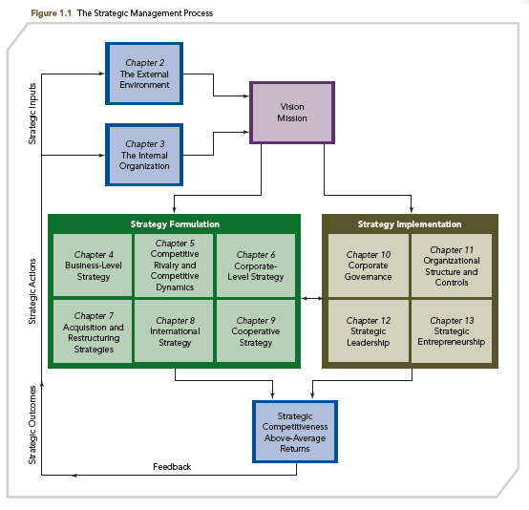
THE STRATEGIC MANAGEMENT PROCESS

Slide 3
KNOWLEDGE OBJECTIVES
● Define corporate-level strategy and discuss its purpose.
● Describe different levels of diversification with different corporate-level strategies.
● Explain three primary reasons firms diversify.
● Describe how firms can create value by using a related diversification strategy.

Slide 4
KNOWLEDGE OBJECTIVES
● Explain the two ways value can be created with an unrelated diversification strategy.
● Discuss the incentives and resources that encourage diversification.
● Describe motives that can encourage managers to over diversify a firm.

Slide 5
GENERAL ELECTRIC: THE QUINTESSENTIAL DIVERSIFIED FIRM
OPENING CASE
■ GE competes in 16 different industries: appliances, aviation, consumer electronics, electrical distribution, energy, entertainment, finance, gas, health care, lighting, locomotives, oil, software, water, weapons, and wind turbines
■ GE’s businesses are grouped in four divisions: GE Capital, GE Energy, GE Technology Infrastructure, and GE Home & Business Solutions

Slide 6
GENERAL ELECTRIC: THE QUINTESSENTIAL DIVERSIFIED FIRM
OPENING CASE
■ With more than 50 percent of its annual revenues stemming from its financial services, GE is the only company that was listed in the initial Dow Jones Industrial Average in 1896 that remains on it today.
Criticisms:
● Media control - GE has restricted NBC reporters from reporting on certain content that is critical of GE

Slide 7
GENERAL ELECTRIC: THE QUINTESSENTIAL DIVERSIFIED FIRM
OPENING CASE
Criticisms (cont’d):
● Poor environmental records of some of its businesses
● GE had reductions in stock value during the first decade of the twenty-first century
■ Today, a major player in the “clean energy” industry, GE is well-positioned to capitalize on emerging economies via a diversification strategy of mergers and acquisitions in Brazil and China

Slide 8
CORPORATE–LEVEL STRATEGY: WHAT BUSINESSES SHOULD A FIRM COMPETE IN?
IMPORTANT DEFINITION
TWO KEY ISSUES
1. In what product markets and businesses should the firm compete?
2. How should corporate headquarters manage those businesses?

Slide 9
CORPORATE–LEVEL STRATEGY: WHAT BUSINESSES SHOULD A FIRM COMPETE IN?
IMPORTANT DEFINITION
■ Specifies actions a firm takes to gain a competitive advantage by selecting and managing a group of different businesses competing in different product markets
■ Corporate-level strategies help companies select new strategic positions that are expected to increase the firm’s value
■ Firms can pursue defensive or offensive strategies that realize growth, and may have different strategic intents

Slide 10
CORPORATE–LEVEL STRATEGIES
IMPORTANT DEFINITIONS
■ MARKET DEVELOPMENT - moving into different geographic markets
■ PRODUCT DEVELOPMENT - developing new products and/or significantly improving on existing products
■ HORIZONTAL INTEGRATION - acquisition of competitors; horizontal movement at the same point in the value chain
■ VERTICAL INTEGRATION - becoming your own supplier or distributor through acquisition; vertical movement up or down the value chain

Slide 11
CORPORATE–LEVEL STRATEGY: ULTIMATE VALUE QUESTION
IMPORTANT DEFINITION
CORPORATE-LEVEL STRATEGY’S VALUE
■ Corporate-level strategy’s value is ultimately determined by the degree to which “the businesses in the portfolio are worth more under the management of the company than they would be under any other ownership”
■ A corporate-level strategy is expected to help the firm earn above-average returns by creating value

Slide 12
CORPORATE–LEVEL STRATEGY: DIVERSIFICATION
IMPORTANT DEFINITION
■ DIVERSIFICATION - growing into new business areas either related (similar to existing business) or unrelated (different from existing business); allows a firm to create value by productively using excess resources
■ The diversified firm operates in several different and unique product markets and likely in several businesses; it forms two types of strategies: corporate-level (or company-wide) and business-level (or competitive)
■ For the diversified corporation, a business-level strategy must be selected for each one of its businesses

Slide 13
CORPORATE-LEVEL STRATEGY
ONE
BUSINESS-
LEVEL
STRATEGY
A single-product market/single geographic location firm employs one business-level strategy and one corporate-level strategy identifying what or which industry the firm will compete in
SEVERAL BUSINESS-LEVEL STRATEGIES
A diversified firm employs a separate business-level strategy for each product market area in which it competes and one or more corporate-level strategies dealing with product and/or geographic diversity

Slide 14
CORPORATE–LEVEL STRATEGY: DIVERSIFICATION
IMPORTANT DEFINITION
PRODUCT DIVERSIFICATION - a primary form of corporate-level strategies; concerns the scope of the markets and industries in which the firm competes
■ The ideal portfolio of businesses balances diversification’s costs and benefits:
■ Reduction in profitability variability as earnings are generated from different businesses
■ Independence/flexibility to shift investments to those markets with the greatest returns

Slide 15
CORPORATE–LEVEL STRATEGY: DIVERSIFICATION
IMPORTANT DEFINITION
■ This chapter focuses on DIVERSIFICATION
■ VALUE CREATION: low – high levels of diversification
● The sharing of resources (the related constrained strategy)
● The transferring of core competencies across the firm’s different businesses (the related linked strategy)
● Managerial motives to diversify can actually destroy some of the firm’s value

Slide 16
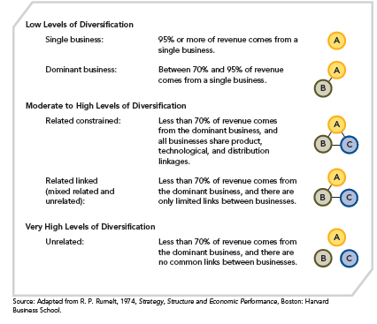
LEVELS OF DIVERSIFICATION
FIGURE 6.1
Levels and Types of Diversification

Slide 17
LEVELS OF DIVERSIFICATION
● Figure 6.1 defines five categories of businesses according to increasing levels of diversification
● Diversified firms vary according to their level of diversification and the connections between and among their businesses
● The single- and dominant-business categories denote relatively low levels of diversification; more fully diversified firms are classified into related and unrelated categories

Slide 18
LEVELS OF DIVERSIFICATION
A firm is related through its diversification when its businesses share links across:
■ PRODUCTS (goods or services)
■ TECHNOLOGIES
■ DISTRIBUTION CHANNELS
The more links among businesses, the more “constrained” is the relatedness of diversification
“Unrelated” refers to the absence of direct links between businesses

Slide 19
LEVELS OF DIVERSIFICATION
1. Low Levels
Single Business Strategy
Corporate-level strategy in which the firm generates 95% or more of its sales revenue from its core business area
EXAMPLE: WRIGLEY
Wm. Wrigley Jr. Company, the world’s largest producer of chewing and bubble gums, historically used a single-business strategy while operating in few product markets
2005: Wrigley employed the dominant-business strategy, when it acquired the confectionary assets of Kraft Foods Inc., including Life Savers and Altoids.
2008- Wrigley was acquired by Mars, a privately held global confection company.

Slide 20
LEVELS OF DIVERSIFICATION
1. Low Levels
Dominant Business Diversification Strategy
Corporate-level strategy whereby firm generates 70-95% of total sales revenue within a single business area
EXAMPLE: UPS
United Parcel Service (UPS) uses this strategy. UPS generates 60 percent of its revenue from its U.S. package delivery business and 22 percent from its international package business, with the remaining 18 percent coming from the firm’s non-package business

Slide 21
LEVELS OF DIVERSIFICATION
2. Moderate to High Levels
Related Constrained Diversification Strategy
Less than 70% of revenue comes from the dominant business
Direct links (i.e., share products, technology, and distribution linkages) between the firm's businesses
EXAMPLES:
Campbell Soup, Procter & Gamble, Merck & Company, The Publicis Groupe

Slide 22
LEVELS OF DIVERSIFICATION
2. Moderate to High Levels
Related Linked Diversification Strategy (mixed related and unrelated)
Less than 70% of revenue comes from the dominant business
Mixed: Linked firms sharing fewer resources and assets among their businesses (compared with related constrained), concentrating on the transfer of knowledge and competencies among the businesses
EXAMPLE: GE

Slide 23
LEVELS OF DIVERSIFICATION
3. Very High Levels: Unrelated
Less than 70% of revenue comes from dominant business
No relationships between businesses
EXAMPLES:
United Technologies, Textron, Samsung, and Hutchison Whampoa Limited (HWL)

Slide 24
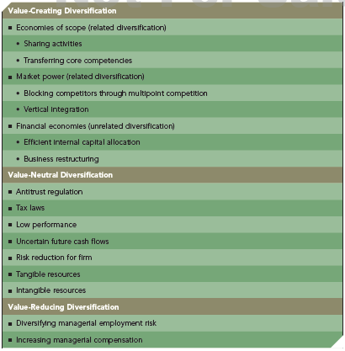
REASONS FOR DIVERSIFICATION
TABLE 6.1
Reasons for Diversification

Slide 25
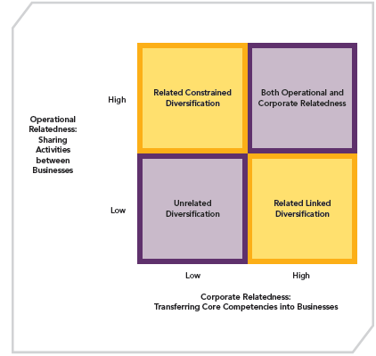
REASONS FOR DIVERSIFICATION
FIGURE 6.2
Value-Creating Diversification Strategies: Operational and Corporate Relatedness

Slide 26
VALUE-CREATING DIVERSIFICATION: RELATED CONSTRAINED AND RELATED LINKED DIVERSIFICATION
FIRM CREATES VALUE BY BUILDING UPON OR EXTENDING:
Resources
Capabilities
Core competencies

Slide 27
VALUE-CREATING DIVERSIFICATION: RELATED CONSTRAINED AND RELATED LINKED DIVERSIFICATION
PURPOSE: gain market power relative to competitors
ADVANTAGE: ECONOMIES OF SCOPE
Cost savings that occur when a firm transfers capabilities and competencies developed in one of its businesses to another of its businesses

Slide 28
VALUE-CREATING DIVERSIFICATION: RELATED CONSTRAINED AND RELATED LINKED DIVERSIFICATION
■ Operational relatedness in sharing activities
■ Corporate relatedness in transferring skills or corporate core competencies among units
The difference between sharing activities and transferring competencies is based on how the resources are jointly used to create economies of scope

Slide 29
VALUE-CREATING DIVERSIFICATION: RELATED CONSTRAINED AND RELATED LINKED DIVERSIFICATION
OPERATIONAL RELATEDNESS: SHARING ACTIVITIES
■ Can gain economies of scope
■ Share primary or support activities (in value chain), e.g., a primary activity such as inventory delivery systems, or a support activity such as purchasing
■ Risky as ties create links between outcomes
■ Related constrained share activities in order to create value
■ Not easy, often synergies not realized as planned

Slide 30
VALUE-CREATING DIVERSIFICATION: RELATED CONSTRAINED AND RELATED LINKED DIVERSIFICATION
CORPORATE RELATEDNESS: TRANSFERRING OF CORE COMPETENCIES
■ Complex sets of resources and capabilities linking different businesses through managerial and technological knowledge, experience, and expertise
■ Two sources of value creation
● Expense incurred in first business and knowledge transfer reduces resource allocation for second business
● Intangible resources difficult for competitors to understand and imitate, so immediate competitive advantage over competition

Slide 31
VALUE-CREATING DIVERSIFICATION: RELATED CONSTRAINED AND RELATED LINKED DIVERSIFICATION
CORPORATE RELATEDNESS: TRANSFERRING OF CORE COMPETENCIES
■ One way managers facilitate the transfer of corporate-level core competencies is by moving key people into new management positions
■ However, the manager of an older business may be reluctant to transfer key people who have accumulated knowledge and experience critical to the business’s success
■ Too much dependence on outsourcing can lower the usefulness of core competencies and thereby reduce their useful transferability to other business units in the diversified firm

Slide 32
VALUE-CREATING DIVERSIFICATION: RELATED CONSTRAINED AND RELATED LINKED DIVERSIFICATION
MARKET POWER
■ Relevant for:
●RELATED CONSTRAINED
●RELATED LINKED
■ Exists when a firm is able to sell its products above the existing competitive level, to reduce costs of primary and support activities below the competitive level, or both
■ Related diversification strategy may include:
● Vertical integration
Backward integration: a firm produces its own inputs
Forward integration: a firm operates its own distribution system for delivering its outputs
● Virtual integration

Slide 33
VALUE-CREATING DIVERSIFICATION: RELATED CONSTRAINED AND RELATED LINKED DIVERSIFICATION
MARKET POWER
■ Multimarket (or Multipoint) Competition
● Exists when two or more diversified firms simultaneously compete in the same product or geographic markets
EXAMPLE: GOOGLE (Strategic Focus)
■ Google is diversifying into new markets that allow it to engage in multipoint competition, e.g., competing with Microsoft and Apple in several markets

Slide 34
VALUE-CREATING DIVERSIFICATION: RELATED CONSTRAINED AND RELATED LINKED DIVERSIFICATION
MARKET POWER
■ MARKET POWER: while Google appears to be increasing its vertical integration, many manufacturing firms have been reducing vertical integration to gain market power
■ DEINTEGRATION: developing independent supplier networks - the focus of many manufacturing firms, such as Intel and Dell, and Ford and General Motors

Slide 35
VALUE-CREATING DIVERSIFICATION: RELATED CONSTRAINED AND RELATED LINKED DIVERSIFICATION
SIMULTANEOUS OPERATIONAL RELATEDNESS AND CORPORATE RELATEDNESS
■ The ability to simultaneously create economies of scope by sharing activities (operational relatedness) and transferring core competencies (corporate relatedness) is difficult for competitors to understand and learn how to imitate

Slide 36
VALUE-CREATING DIVERSIFICATION: RELATED CONSTRAINED AND RELATED LINKED DIVERSIFICATION
SIMULTANEOUS OPERATIONAL RELATEDNESS AND CORPORATE RELATEDNESS
■ Involves managing two sources of knowledge simultaneously:
Operational forms of economies of scope
Corporate forms of economies of scope
■ Many such efforts often fail because of implementation difficulties

Slide 37
VALUE-CREATING DIVERSIFICATION: RELATED CONSTRAINED AND RELATED LINKED DIVERSIFICATION
SIMULTANEOUS OPERATIONAL RELATEDNESS AND CORPORATE RELATEDNESS
■ If the cost of realizing both types of relatedness is not offset by the benefits created, the result is DISECONOMIES because the cost of organization and incentive structure is very expensive

Slide 38
VALUE-CREATING DIVERSIFICATION: RELATED CONSTRAINED AND RELATED LINKED DIVERSIFICATION
SIMULTANEOUS OPERATIONAL RELATEDNESS AND CORPORATE RELATEDNESS
EXAMPLE: Walt Disney Co.
■ Walt Disney Co. has been able to successfully use related diversification as a corporate-level strategy through which it creates economies of scope by sharing some activities and by transferring core competencies
■ Because this value creation can be difficult for investors to see, the value of the assets of a firm using a diversification strategy to create economies of scope often is discounted by investors

Slide 39
UNRELATED DIVERSIFICATION
Creates value through two types of FINANCIAL ECONOMIES
■ Cost savings realized through improved allocations of financial resources based on investments inside or outside firm
Efficient internal capital market allocation
■ Restructuring of acquired assets
Firm A buys firm B and restructures assets so it can operate more profitably, then A sells B for a profit in the external market

Slide 40
UNRELATED DIVERSIFICATION
EFFICIENT INTERNAL CAPITAL MARKET ALLOCATION
● In a market economy, capital markets allocate capital efficiently
● EQUITY - investors take equity positions (ownership) with high expected future cash-flow values.
● DEBT - debt holders try to improve the value of their investments by taking stakes in businesses with high growth and profitability prospects

Slide 41
UNRELATED DIVERSIFICATION
EFFICIENT INTERNAL CAPITAL MARKET ALLOCATION
INTERNAL CAPITAL MARKET
EXTERNAL CAPITAL MARKET
the gains that would accrue to shareholders from capital being allocated by the external capital market
In large diversified firms, capital distributions may generate gains from internal capital market allocations that
EXCEED

Slide 42
UNRELATED DIVERSIFICATION
EFFICIENT INTERNAL CAPITAL MARKET ALLOCATION
CONGLOMERATE DISCOUNT
■ This discount results from analysts not knowing how to value a vast array of large businesses with complex financial reports
■ Stock markets apply a “Conglomerate Discount” of 20% on unrelated diversified firms, which means that investors believe that the value of conglomerates is 20% less than the value of the sum of their parts
■ To overcome this discount, many unrelated diversifiers or conglomerates have sought to establish a brand for the parent company

Slide 43
UNRELATED DIVERSIFICATION
EFFICIENT INTERNAL CAPITAL MARKET ALLOCATION
ACHILLES’ HEEL
Financial economies are more easily duplicated by competitors than are gains from operational and corporate relatedness
This issue is less of a problem in emerging economies, where the absence of a “soft infrastructure” (including effective financial intermediaries, sound regulations, and contract laws) supports and encourages use of the unrelated diversification strategy
In emerging economies such as those in Korea, India, and Chile, research has shown that diversification increases the performance of firms affiliated with large diversified business groups

Slide 44
UNRELATED DIVERSIFICATION
RESTRUCTURING OF ASSETS
Restructuring creates financial economies
A firm creates value by buying, restructuring, then selling the restructured firms’ assets in the external market
An economic downturn can present opportunities but also some risks
Resource allocation decisions may become complex, so success often requires:
Focus on mature, low-technology businesses
Focus on businesses not reliant on a client orientation

Slide 45
UNRELATED DIVERSIFICATION
RESTRUCTURING OF ASSETS
Restructuring creates financial economies
A firm creates value by buying, restructuring, then selling the restructured firms’ assets in the external market
An economic downturn can present opportunities but also some risks
Resource allocation decisions may become complex, so success often requires:
Focus on mature, low-technology businesses
Focus on businesses not reliant on a client orientation

Slide 46
DIVERSIFICATION ADVANTAGES
RELATED DIVERSIFICATION
UNRELATED DIVERSIFICATION
FINANCIAL ECONOMIES
ECONOMIES OF SCOPE

Slide 47
VALUE-NEUTRAL DIVERSIFICATION: INCENTIVES AND RESOURCES
Different incentives to diversify exist, and the quality of the firm’s resources may permit only diversification that is value neutral rather than value creating.

Slide 48
VALUE-NEUTRAL DIVERSIFICATION: INCENTIVES AND RESOURCES
INCENTIVES TO DIVERSIFY
External incentives
■ Antitrust regulations
■ Tax laws
Internal incentives
■ Low performance
■ Uncertain future cash flows
■ Synergy and Firm Risk Reduction

Slide 49
EXTERNAL INCENTIVES TO DIVERSIFY
Antitrust Regulation
Antitrust laws in 1960s and 1970s discouraged mergers that created increased market power (vertical or horizontal integration)
Mergers in the 1960s and 1970s thus tended to be unrelated (conglomerate)
1980s: Relaxation of antitrust enforcement results in more and larger horizontal mergers
Late 1990s: Industry-specific deregulation spurred increased merger activity in banking, telecommunications, oil and gas, and electric utilities
Early 2000s: Antitrust concerns seem to be emerging and mergers are more closely scrutinized

Slide 50
EXTERNAL INCENTIVES TO DIVERSIFY (cont’d)
Antitrust Regulation
High tax rates on dividends cause a corporate shift from dividends to buying and building companies in high-performance industries
1986 Tax Reform Act
Reduced individual ordinary income tax rate from 50 to 28 percent
Treated capital gains as ordinary income
Thus created incentive for shareholders to prefer dividends to acquisition investments, as the 1986 Tax Reform Act diminished some of the corporate tax advantages of diversification
Tax Laws

Slide 51
INTERNAL INCENTIVES TO DIVERSIFY
Low Performance
High performance eliminates the need for greater diversification
Low performance acts as incentive for diversification
Firms plagued by poor performance often take higher risks (diversification is risky)

Slide 52
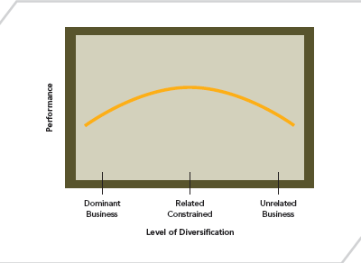
DIVERSIFICATION AND PERFORMANCE
FIGURE 6.3
The Curvilinear Relationship Between Diversification and Performance

Slide 53
INTERNAL INCENTIVES TO DIVERSIFY (CONT’D)
Low Performance
Diversification may be defensive strategy if the:
Product line matures
Product line is threatened
Firm is small and is in a mature or maturing industry
Uncertain Future Cash Flows

Slide 54
INTERNAL INCENTIVES TO DIVERSIFY (CONT’D)
Low Performance
Synergy exists when the value created by businesses working together exceeds the value created by them working independently
… But synergy creates joint interdependence between business units
A firm may reduce the level of technological change by operating in more certain environments—resulting in more related types of diversification
A firm may become risk averse, constrain its level of activity sharing, and forgo potential benefits of synergy—resulting in more unrelated types of diversification
Uncertain Future Cash Flows
Synergy and Risk Reduction

Slide 55
RESOURCES AND DIVERSIFICATION
A FIRM MUST HAVE BOTH:
Incentives to diversify
The resources required to create value through diversification—cash and tangible resources (e.g., plant and equipment)
Value creation is determined more by appropriate use of resources than by incentives to diversify

Slide 56
VALUE-REDUCING DIVERSIFICATION: MANAGERIAL MOTIVES TO DIVERSIFY
Top-level executives may diversify in order to diversity their own employment risk, as long as profitability does not suffer excessively
Diversification adds benefits to top-level managers but not shareholders
This strategy may be held in check by governance mechanisms or concerns for one’s reputation

Slide 57
VALUE-REDUCING DIVERSIFICATION: MANAGERIAL MOTIVES TO DIVERSIFY
MANAGERIAL MOTIVES TO DIVERSIFY
■ Managerial risk reduction
■ Desire for increased compensation

Slide 58
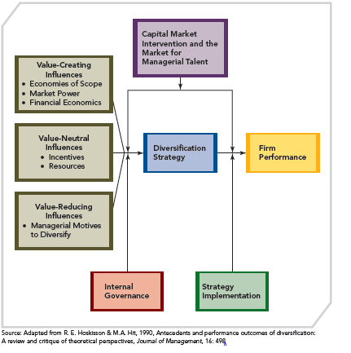
DIVERSIFICATION AND FIRM PERFORMANCE
FIGURE 6.4
Summary Model of the Relationship between Diversification and Firm Performance

