Slide 1
PART 2: STRATEGIC ACTIONS:
STRATEGY FORMULATION
CHAPTER 7 ACQUISITION AND RESTRUCTURING STRATEGIES

Slide 2
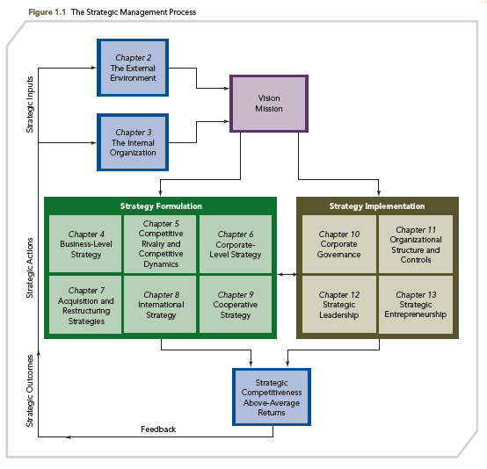
THE STRATEGIC MANAGEMENT PROCESS

Slide 3
KNOWLEDGE OBJECTIVES
● Explain the popularity of merger and acquisition strategies in firms competing in the global economy.
● Discuss reasons why firms use an acquisition strategy to achieve strategic competitiveness.
● Describe seven problems that work against achieving success when using an acquisition strategy.

Slide 4
KNOWLEDGE OBJECTIVES
● Name and describe the attributes of effective acquisitions.
● Define the restructuring strategy and distinguish among its common forms.
● Explain the short- and long-term outcomes of the different types of restructuring strategies.

Slide 5
TECHNOLOGY GIANTS’ ACQUISITION STRATEGIES AND THEIR OUTCOMES
OPENING CASE
■ Online social networks, such as Facebook, have caused Procter & Gamble (P&G) to reallocate their advertising resources away from television to more digital formats.
■ When Microsoft announced that it would acquire Skype Global S.A.R.L., the leading Internet telecommunications company for $8.5 billion, there were both positive and negative attributions about the deal in the media.

Slide 6
TECHNOLOGY GIANTS’ ACQUISITION STRATEGIES AND THEIR OUTCOMES
OPENING CASE
■ Because Skype was founded and headquartered outside the U.S. (Luxembourg), Microsoft was able to use cash that was not repatriated into the U.S. to pay for the deal, and in so doing, it avoided paying U.S. income tax.
■ The Skype investment seems to be a bargain; the $8.5 billion represents a cost of $14.70 per customer. Comparatively, when Skype was bought by eBay in 2005, it paid $45.60 per user.

Slide 7
TECHNOLOGY GIANTS’ ACQUISITION STRATEGIES AND THEIR OUTCOMES
OPENING CASE
CHALLENGES:
● Whether Microsoft will be able to utilize the service and integrate it into its focus on business customers relative to the consumer focus of Skype
● Whether Microsoft will be able to incorporate the Skype service into its various devices and software platforms

Slide 8
TECHNOLOGY GIANTS’ ACQUISITION STRATEGIES AND THEIR OUTCOMES
OPENING CASE
DEFENSIVE RATIONALE
● If Microsoft did not buy Skype, it may have ended up in the hands of a competitor such as Google, who might be able to use it to strengthen its ecosystem at the expense of Microsoft.
OFFENSIVE STRATEGY
● Google’s acquisition strategy is usually to acquire earlier-stage companies than Microsoft’s deal to acquire Skype. Google purchased YouTube for $1.6 billion in 2006.

Slide 9
TECHNOLOGY GIANTS’ ACQUISITION STRATEGIES AND THEIR OUTCOMES
OPENING CASE
■ Facebook has a somewhat different approach to acquisitions, having recently purchased Snaptu. Snaptu provides application software for services such as Facebook, Twitter, and LinkedIn, which allows these services to be featured on phones.
■ Facebook has made 11 acquisitions since 2007; however, almost none of the acquired companies’ services has survived as independent businesses.

Slide 10
TECHNOLOGY GIANTS’ ACQUISITION STRATEGIES AND THEIR OUTCOMES
OPENING CASE
■ Online commerce is moving into a consumer-oriented retail phase, of which firms such as Facebook and Amazon are seeking to take advantage.
■ Acquisitions are a quick way to move into the space that these tech giants see evolving, such as Microsoft seeking to broaden its communication base, Google expanding beyond search to experiment with new models of advertising, and Facebook’s attempts to learn from the human capital that they are able to acquire.

Slide 11
POPULARITY OF MERGER AND ACQUISITION STRATEGIES
Popular strategy in the U.S. for many years
Source of firm growth and above-average returns
Some believe that M&A strategies played a central role in the restructuring of U.S. businesses during the 1980s and 1990s and that they continue generating benefits in the twenty-first century

Slide 12
POPULARITY OF MERGER AND ACQUISITION STRATEGIES
Heavily influenced by external environment
Tight credit markets
Political changes in foreign countries’ orientation toward M&A
During the recent financial crisis, tightened credit markets made it more difficult for firms to complete “megadeals” (> $10 billion)
Then U.S. deals picked up in 2011, where “first-quarter deal volume rose 45% to $290.8 billion, compared with $200.6 billion” in 2010

Slide 13
POPULARITY OF MERGER AND ACQUISITION STRATEGIES
Cross-border acquisitions heighten during currency imbalances, from strong currency countries to weaker currency countries, such as the U.S.
Firms use M&A strategies to create value for all stakeholders
M&A value creation applies equally to all strategies (business-level, corporate-level, international, and cooperative)

Slide 14
POPULARITY OF MERGER AND ACQUISITION STRATEGIES
Can be used because of uncertainty in the competitive landscape
Increase market power because of competitive threat
Spread risk due to uncertain environment
Shift core business into different markets
Manage industry and regulatory changes
Intent:
Increase firm’s strategic competitiveness and value; historically returns are close to zero so it rarely works as planned

Slide 15
POPULARITY OF MERGER AND ACQUISITION STRATEGIES
M&A value creation is challenging
GOOD NEWS: Shareholders of ACQUIRED firms often earn above-average returns from acquisitions
BAD NEWS: Shareholders of ACQUIRING firms earn returns that are close to zero: In 2/3 of all acquisitions, the acquiring firm’s stock price fell immediately after the intended transaction was announced
This negative response reflects investors’ skepticism about projected synergies being captured

Slide 16
MERGERS, ACQUISITIONS, AND TAKEOVERS: WHAT ARE THE DIFFERENCES?
MERGER
Two firms agree to integrate their operations on a relatively co-equal basis
☞ There are few TRUE mergers because one firm usually dominates in terms of market share, size, or asset value
ACQUISITION
One firm buys a controlling, 100 percent interest in another firm with the intent of making the acquired firm a subsidiary business within its portfolio

Slide 17
MERGERS, ACQUISITIONS, AND TAKEOVERS: WHAT ARE THE DIFFERENCES?
TAKEOVER
Special type of acquisition strategy wherein the target firm did not solicit the acquiring firm's bid
HOSTILE TAKEOVER
Unfriendly takeover that is undesired by the target firm
RATIONALE FOR STRATEGY
Pre-announcement returns of hostile takeovers are largely anticipated and associated with a significant increase in the bidder’s and target’s share price

Slide 18
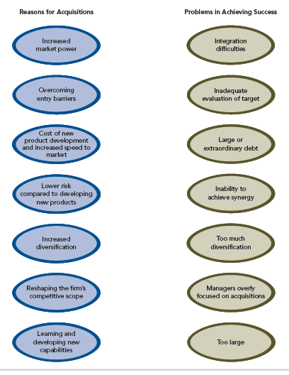
REASONS FOR ACQUISITIONS AND PROBLEMS IN ACHIEVING SUCCESS
FIGURE 7.1
Reasons for Acquisitions and Problems in Achieving Success

Slide 19
REASONS FOR ACQUISITIONS
Increased Market Power
Market Leadership results from Market Power
Factors increasing market power:
● The ability to sell goods or services above competitive levels
● Costs of primary or support activities are below those of competitors
● Size of the firm, resources, and capabilities to compete in the market and share of the market
● Purchase of a competitor, a supplier, a distributor, or a business in a highly related industry

Slide 20
REASONS FOR ACQUISITIONS
Increased Market Power
Market power is increased by:
●Horizontal acquisitions: other firms in the same industry
McDonald’s acquisition of Boston Market (successful?)
●Vertical acquisitions: suppliers or distributors of the acquiring firm
Walt Disney Company’s acquisition of Fox Family Worldwide
●Related acquisitions: firms in related industries

Slide 21
REASONS FOR ACQUISITIONS
Increased Market Power
Acquirer and acquired companies compete in the same industry
Firm’s market power is increased by exploiting:
Cost-based synergies
Revenue-based synergies
Acquisitions with similar characteristics result in higher performance than those with dissimilar characteristics
Horizontal Acquisitions
Similar characteristics:
Strategy
Managerial styles
Resource allocation patterns
Previous alliance management experience

Slide 22
REASONS FOR ACQUISITIONS
Increased Market Power
Horizontal Acquisitions
Acquisition of a supplier or distributor of one or more of the firm’s goods or services
Increases a firm’s market power by controlling additional parts of the value chain
Vertical Acquisitions

Slide 23
REASONS FOR ACQUISITIONS
Increased Market Power
Acquisition of a company in a highly related industry
Value creation takes place through the synergy that is generated by integrating resources and capabilities
Because of the difficulty in implementing synergy, related acquisitions are often difficult to implement
Horizontal Acquisitions
Vertical Acquisitions
Related Acquisitions

Slide 24
REASONS FOR ACQUISITIONS
Increased Market Power
Horizontal, Vertical, and Related Acquisitions
Acquisitions intended to increase market power are subject to:
Regulatory review
Analysis by financial markets

Slide 25
REASONS FOR ACQUISITIONS
Overcoming Entry Barriers
Entry Barriers
Factors associated with the market or with the firms operating in it that increase the expense and difficulty faced by new ventures trying to enter that market
Economies of scale
Differentiated products
Cross-Border Acquisitions
Acquisitions made between companies with headquarters in different countries
Are often made to overcome entry barriers
Can be difficult to negotiate and operate because of the differences in foreign cultures

Slide 26
REASONS FOR ACQUISITIONS
Cross-Border Acquisitions
In the current global competitive landscape, firms from other nations may use an acquisition strategy more frequently than firms in North America and Europe.
The Strategic Focus underscores the different approaches to cross-border acquisitions by Chinese, Indian, and Brazilian corporations.

Slide 27
REASONS FOR ACQUISITIONS
Cost of New Product Development and Increased Speed to Market
Internal development of new products is often perceived as high-risk activity.
Acquisitions allow a firm to gain access to new and current products that are new to the firm.
Compared with internal product development, acquisitions:
Are less costly
Have faster market penetration
Have more predictable returns due to the acquired firms’ experience with the products

Slide 28
REASONS FOR ACQUISITIONS
Lower Risk Compared to Developing New Products
Outcomes for an acquisition can be more easily and accurately estimated than the outcomes of an internal product development process.
Acquisition strategies are a common means of avoiding risky internal ventures and risky R&D investments.
Acquisitions may become a substitute for innovation, and thus should always be strategic rather than defensive in nature.

Slide 29
REASONS FOR ACQUISITIONS
Increased Diversification
Using acquisitions to diversify a firm is the quickest and easiest way to change its portfolio of businesses.
Both related diversification and unrelated diversification strategies can be implemented through acquisitions.
The more related the acquired firm is to the acquiring firm, the greater is the probability that the acquisition will be successful.

Slide 30
REASONS FOR ACQUISITIONS
Reshaping the Firm’s Competitive Scope
An acquisition can:
Reduce the negative effect of an intense rivalry on a firm’s financial performance.
Reduce a firm’s dependence on one or more products or markets.
Reducing a company’s dependence on specific markets alters the firm’s competitive scope

Slide 31
REASONS FOR ACQUISITIONS
Learning and Developing New Capabilities
An acquiring firm can gain capabilities that the firm does not currently possess:
Special technological capability
A broader knowledge base
Reduced inertia
Firms should acquire other firms with different but related and complementary capabilities in order to build their own knowledge base

Slide 32
PROBLEMS IN ACHIEVING ACQUISITION SUCCESS
Integration
Difficulties
Too Large
Inadequate
Target Evaluation
PROBLEMS WITH
ACQUISITIONS
Managers Overly Focused on
Acquisitions
Large or
Extraordinary Debt
Too Much
Diversification
Inability to
Achieve Synergy

Slide 33
PROBLEMS IN ACHIEVING ACQUISITION SUCCESS
● Acquisition strategies are not problem-free, even when pursued for value-creating reasons.
● Research suggests:
20% of all mergers and acquisitions are successful
60% produce disappointing results
20% are clear failures, with technology acquisitions reporting even higher failure rates

Slide 34
PROBLEMS IN ACHIEVING ACQUISITION SUCCESS
Greater acquisition success accrues to firms able to:
1. select the “right” target
2. avoid paying too high a premium (by doing appropriate due diligence)
3. integrate the operations of the acquiring and target firm effectively
4. retain the target firm’s human capital, as illustrated by Facebook’s approach described in the opening case

Slide 35
PROBLEMS IN ACHIEVING ACQUISITION SUCCESS
Integration Difficulties
Integration challenges include:
Melding two disparate corporate cultures
Linking different financial and control systems
Building effective working relationships (particularly when management styles differ)
Resolving problems regarding the status of the newly acquired firm’s executives
Loss of key personnel weakening the acquired firm’s capabilities and reducing its value

Slide 36
PROBLEMS IN ACHIEVING ACQUISITION SUCCESS
Inadequate Evaluation of Target
Due Diligence
The process of evaluating a target firm for acquisition
Ineffective due diligence may result in paying an excessive premium for the target company
Evaluation requires examining:
The financing of the intended transaction
The differences in culture between the firms
The tax consequences of the transaction
Actions necessary to meld the two workforces
BOTH the accuracy of the financial position and accounting standards used AND the quality of the strategic fit and the ability of the acquiring firm to effectively integrate the target

Slide 37
PROBLEMS IN ACHIEVING ACQUISITION SUCCESS
Large or Extraordinary Debt
Junk bonds: Financing option whereby risky acquisitions are financed with money (debt) that provides a large potential return to lenders (bondholders)
High debt (e.g., junk bonds) can:
Increase the likelihood of bankruptcy
Lead to a downgrade of the firm’s credit rating
Preclude investment in activities that contribute to the firm’s long-term success such as:
Research and development
Human resource training
Marketing

Slide 38
PROBLEMS IN ACHIEVING ACQUISITION SUCCESS
Inability to Achieve Synergy
Synergy: when assets are worth more when used in conjunction with each other than when they are used separately
Synergy is created by the efficiencies derived from economies of scale and economies of scope and by sharing resources (e.g., human capital and knowledge) across the businesses in the merged firm.
Firms experience transaction costs when they use acquisition strategies to create synergy
Firms tend to underestimate indirect costs when evaluating a potential acquisition

Slide 39
PROBLEMS IN ACHIEVING ACQUISITION SUCCESS
Inability to Achieve Synergy
Private synergy: when the combination and integration of the acquiring and acquired firms’ assets yields capabilities and core competencies that could not be developed by combining and integrating either firm’s assets with another company
Advantage: It is difficult for competitors to understand and imitate
Disadvantage: It is also difficult to create

Slide 40
PROBLEMS IN ACHIEVING ACQUISITION SUCCESS
Too Much Diversification
Diversified firms must process more information of greater diversity.
Increased operational scope created by diversification may cause managers to rely too much on financial rather than strategic controls to evaluate business units’ performances
Strategic focus shifts to short-term performance
Acquisitions may become substitutes for innovation

Slide 41
PROBLEMS IN ACHIEVING ACQUISITION SUCCESS
Too Much Diversification
Overdiversification
Related diversification requires more information processing than does unrelated diversification
Due to the additional information processing, related diversified firms become overdiversified with fewer business units than do unrelated diversifiers
Overdiversification leads to a decline in performance, after which business units are often divested
Even when a firm is not overdiversified, a high level of diversification can have a negative effect on its long-term performance

Slide 42
PROBLEMS IN ACHIEVING ACQUISITION SUCCESS
Managers Overly Focused on Acquisitions
WHY: MORE FUN TO MAKE THE DEALS THAN TO RUN THE COMPANY
Managers invest substantial time and energy in acquisition strategies in:
Searching for viable acquisition candidates
Completing effective due-diligence processes
Preparing for negotiations
Managing the integration process after the acquisition is completed

Slide 43
PROBLEMS IN ACHIEVING ACQUISITION SUCCESS
Managers Overly Focused on Acquisitions
Managers in target firms operate in a state of virtual suspended animation during an acquisition.
Executives may become hesitant to make decisions with long-term consequences until negotiations have been completed.
The acquisition process can create a short-term perspective and a greater aversion to risk among executives in the target firm.

Slide 44
PROBLEMS IN ACHIEVING ACQUISITION SUCCESS
Too Large
Additional costs and complexity of management may exceed the benefits of the economies of scale and additional market power, creating diseconomies of scope
More bureaucratic controls result from size:
Formal rules and policies ensure consistency of decisions and actions
Formalized controls often lead to relatively rigid and standardized managerial behavior
The firm may produce less innovation

Slide 45
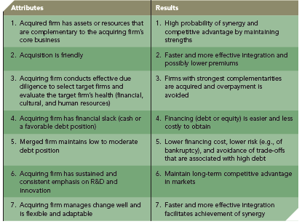
EFFECTIVE ACQUISITIONS
TABLE 7.1
Attributes of Successful Acquisitions

Slide 46
EFFECTIVE ACQUISITION STRATEGIES
Complementary Assets/Resources
Buying firms with assets that meet current needs to build competitiveness
Friendly Acquisitions
Friendly deals make integration go more smoothly
Deliberate evaluation and negotiations are more likely to lead to easy integration and building synergies
Due Diligence/Careful Selection Process
Maintain Financial Slack
Provide enough additional financial resources so that profitable projects may be capitalized upon rather than forgone

Slide 47
EFFECTIVE ACQUISITION STRATEGIES
Attributes
Results
Low-to-Moderate Debt
Merged firm maintains financial flexibility
Sustained Emphasis on Innovation
Continue to invest in R&D as part of the firm’s overall strategy
Flexibility
Has experience at managing change and is flexible and adaptable

Slide 48
RESTRUCTURING
A strategy through which a firm changes its set of businesses or financial structure
Failure of an acquisition strategy often precedes a restructuring strategy
Restructuring may occur because of changes in the external or internal environments
Restructuring strategies:
Downsizing
Downscoping
Leveraged buyouts

Slide 49
RESTRUCTURING
DOWNSIZING
DOWNSCOPING
Refers to divestiture, spin-off, or some other means of eliminating businesses that are unrelated to a firm’s core businesses
Reduction in the number of a firm’s employees and in the number of its operating units, but it does not change the essence of the business
A party buys all of the assets of a business, financed largely with debt, and takes the firm private
LEVERAGED BUYOUT

Slide 50
RESTRUCTURING
DOWNSIZING
DOWNSCOPING
Strategic
Tactical
Short-term
Long-term
Focus on core businesses
Cut labor costs
More positive effect on firm performance than downsizing
Acquisition failed to create anticipated value
Paid too much for target

Slide 51
RESTRUCTURING
Downsizing: a reduction in the number of a firm’s employees and sometimes in the number of its operating units
May or may not change the composition of businesses in the company’s portfolio
Typical reasons for downsizing:
Expectation of improved profitability from labor cost reductions
Desire or necessity for more efficient operations

Slide 52
RESTRUCTURING
Downscoping: a divestiture, spin-off or other means of eliminating businesses unrelated to a firm’s core businesses
A set of actions that causes a firm to strategically refocus on its core businesses and reduce the diversity of its business portfolio
May be accompanied by downsizing, but must avoid eliminating key employees
Smaller firm can be more effectively managed by the top management team

Slide 53
RESTRUCTURING
DOWNSCOPING AND GLOBALIZATION
U.S. firms use downscoping more frequently than do European companies
Conglomerate-building has been the trend in Europe, Latin America, and Asia
Some Asian and Latin American conglomerates have begun to adopt Western corporate strategies, i.e., refocusing on their core businesses
Downscoping has occurred simultaneously with globalization and market liberalization, which have greatly enhanced competition

Slide 54
RESTRUCTURING
Leveraged Buyouts (LBOs): one party buys all of a firm's assets in order to take the firm private (or no longer trade the firm's shares publicly)
● Private equity firm: firm that facilitates or engages in taking a public firm private
Significant amounts of debt may be incurred to finance the buyout
Immediate sale of non-core assets to pare down debt
● Can correct for managerial mistakes
Managers making decisions that serve their own interests rather than those of shareholders

Slide 55
RESTRUCTURING
LEVERAGED BUYOUTS (LBOs)
● Three types of LBOs
Management buyouts (MBOs)
Employee buyouts (EBOs)
Whole-firm buyouts
● MBOs, moreso than EBOs and whole-firm buyouts, lead to downscoping, increased strategic focus, and improved performance
● Why LBOs?
■ Protection against a capricious financial market
■ Allows owners to focus on developing innovations and bringing them to market
■ A form of firm rebirth to facilitate entrepreneurial efforts

Slide 56
RESTRUCTURING
LEVERAGED BUYOUTS (LBOs)
Considered a significant innovation in the financial restructuring of firms, HOWEVER, they can involve negative trade-offs:
■ First, the resulting large debt increases the firm’s financial risk, as is evidenced by the number of companies that filed for bankruptcy in the 1990s after executing a whole-firm LBO
■ A short-term and risk-averse managerial focus results in these firms failing to adequately invest in R&D and other core competency drivers
Most LBOs have been completed in mature industries where stable cash flows are possible

Slide 57
RESTRUCTURING
RESTRUCTURING OUTCOMES
Short-term
Reduced costs: labor and debt
Emphasis on strategic controls
Long-term
Loss of human capital
Performance: higher/lower
Higher risk

Slide 58
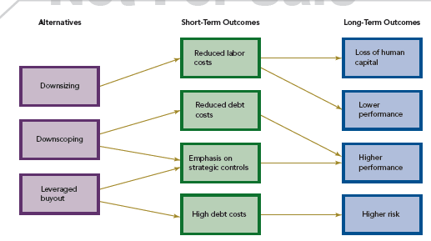
RESTRUCTURING
FIGURE 7.2
Restructuring and Outcomes

