Slide 1
Chem. 133 – 1/24 Lecture

Slide 2
Introduction
  Instructors:
    Roy Dixon (lecture)
    Justin Miller-Schulze (lab)

Slide 3
Class: Chemical Instrumentation
General Goals of Education (copied roughly from Dean several years ago):
  Jobs
  Career
  Skills
  Knowledge
  Member of Society
  Future Life-long Learner
Main focus will be on skills and knowledge, but sometimes it is worth looking at larger picture

Slide 4
Learning Objectives of Class
(Skills and Knowledge Set)
Learn how instruments work
Learn measures of instrument performance and what affects performance
Know common applications of instruments (e.g. how can we use an instrument to determine a compound’s concentration, identity or structure)
Connect instrument performance with method/sample/analyte demands

Slide 5
Roll Call and Adding Students
Class normally has 12 students
Currently 6 in class and 14 on waitlist
We will add 6 from waitlist
Demand is such that we would like to add a class F17 (but this can’t be guaranteed)
Adding students will be based on priority

Slide 6
Adding Students – cont.
Priority for Adding Students
  Students must have prerequisites
  BS Chem majors graduating S’17
  BS Chem majors graduating F’17 and non-BS Chem majors graduating S’17* and needing class (equal)
  Others graduating F’17
  *Will try to find alternatives to this class to keep grad date from being post-poned
Within each category, preference given to those higher on waitlist and for those on past waitlists
You may be asked to show evidence for your graduation date (I’m going off petitions to graduate)
Notes:
6

Slide 7
Handouts
Syllabus
Homework Assignment 1.1

Slide 8
Syllabus
Top 3 Items
Lab Class room = Sequoia 516, but will spend time in other instrument rooms too
Office hours
  can arrange meetings at other times
Internet Site
  Site listed is for lecture except grading and quiz keys
  SacCT (sec 1 and sec 2 sites) for keys, grading, and lab handouts

Slide 9
Syllabus
Text Books
  Harris (Quantitative Chemical Analysis)
    Main text
    We are using the 8th Edition (note: Chem 31 is now using 9th Edition)
  Rubinson and Rubinson (Contemporary Instrumental Analysis)
    Supplementary text book
    Copy placed in main office
    Used for electronics and NMR instruction
  Skoog et al. (Principles of Instrumental Analysis)
    Recommended for anyone interested in working as an analytical chemist

Slide 10
Grading
Lecture Component
Exams (44% of grade)
  2 midterms (see syllabus for dates)
  Comprehensive Final Exam
Quizzes (7% of grade)
  Roughly every 2 weeks unless near exam
  First will be next Thursday
Homework (4% of grade)
  Only a subset of problems will be turned in (Bold problems in first set)

Slide 11
Grading
Lab Component
Details explained by lab instructor
Lab Reports/Lab Practical (35% of grade)
Term Project (10% of grade)
Notes:
11

Slide 12
Topics
Electronics
  Emphasis on understanding multiple aspects of electronics for instruments
  Some topics will be covered qualitatively
Electrochemistry (fundamentals + qualitative understanding of ion selective electrodes)
Spectroscopy
  Fundamental sections (theory and spectrometer components)
  Specific types (UV-Visible, fluorescence, atomic, and NMR)
Mass Spectrometry
Chromatography
  Theory of separations, and main components
  GC and HPLC

Slide 13
Homework Set 1
Three subsets (1.1, 1.2, and 1.3)
Only Subset 1.1 is currently available (others will soon be posted online)
Bold Homework problems are graded; do not turn in other problems
Subsets should be done before quizzes
Solutions will be posted.

Slide 14
Today’s Lecture
Measures of Instrument Performance
Overview of Electronics
Electronic Definitions and Basic Laws
Notes:
14

Slide 15
In Lab Today
Data/Excel Basics
  covering here
Lab Safety
Notes:
15

Slide 16
Measures of Instrument or Method Performance
What is he talking about?
Example: method accuracy
Get class to come up with 7+ measures
Notes:
16

Slide 17
Electronics
Topics Covering
  Basic DC Circuits (Ohm’s Law, Power Law, Kirchhoff’s Laws + applications)
  Alternating Currents, Other Waveforms, and Fourier Transformation (lecture only)
  RC Circuits
  Diodes (lecture only)
  Signal Digitization (lecture only)
  Transducers (lecture only)
  Noise
Notes:
17

Slide 18
Electronics - Overview
Generic Instrument Block Diagram
Analog Electronics
Transducer
Analog Signal Processing
Exciter
sample
Digital to Analog (control)
Analog to Digital Conversion Board
Digital Electronics
Long-term Storage (Disk)
Digital Signal Processing
Memory
Signal Display

Slide 19
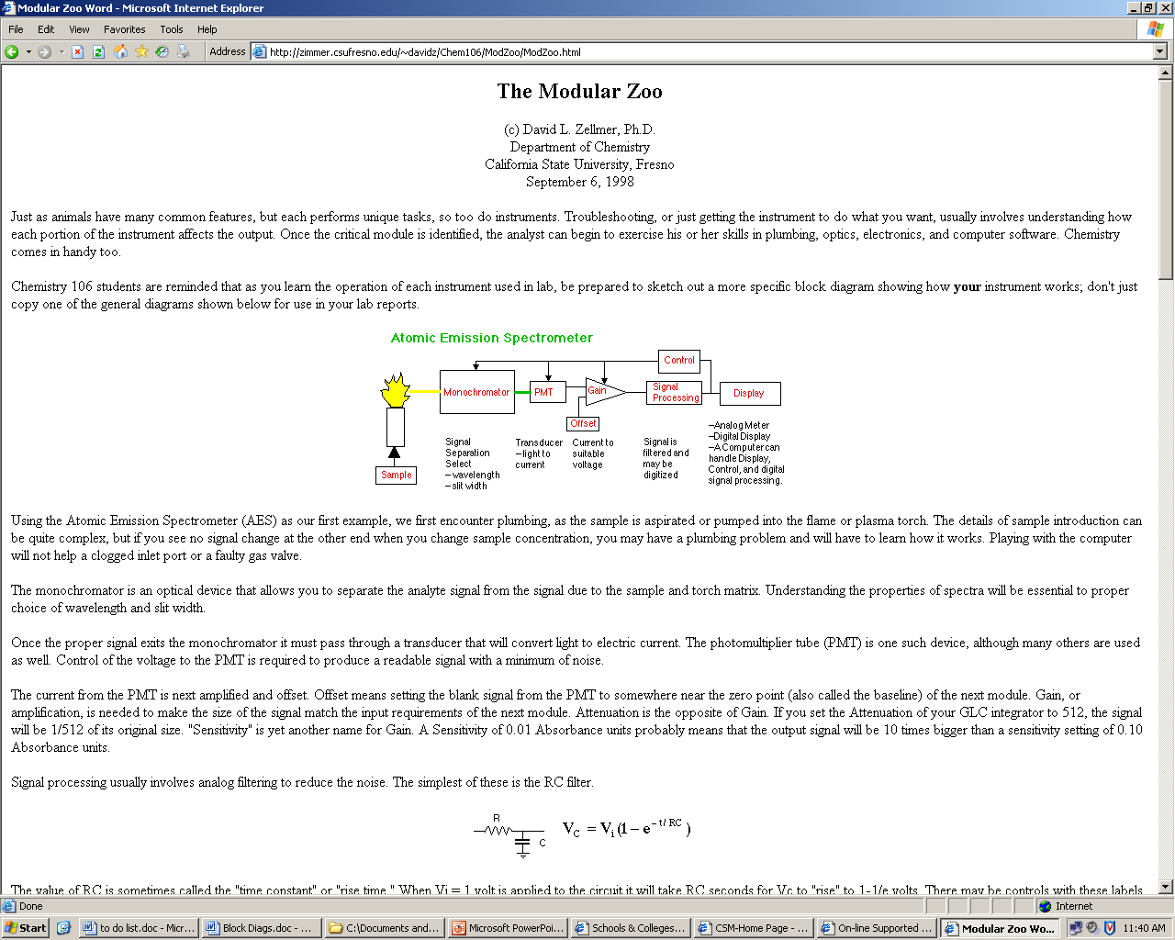
Electronics
Example Block Diagram for an Atomic Emission Spectrometer
From: David Zellmer, CSU Fresno
http://zimmer.csufresno.edu/~davidz/Chem106/ModZoo/ModZoo.html

Slide 20
Electronics
Go to Board to Cover: Definitions, Ohm’s Law, and Power Law

