Slide 1
Chem. 133 – 1/31 Lecture

Slide 2
Announcements
Website update
  Web version of homework Set 1 (now complete)
  I have posted solutions to Rubinson & Rubinson problems of set 1.1
  I will post a data set soon for HW 1.2 problem
Quiz 1 – on 2/2 (related to lecture and HW 1.1 set)
Additional Problems also due 2/2
Today’s Lecture
  Continued application of Kirchhoff’s laws
  AC and other time varying circuits
  Capacitors and RC circuits

Slide 3
Electronics
Applications of Kirchhoff’s Laws
  resistors in series and voltage divider (started last time)
  resistors in parallel
  more complicated circuits

Slide 4
Electronics
Alternating Current
DC = direct current (slowly varying voltage with time)
AC = alternating current (produced by many electric generators
In US 120V, 60 Hz is most common for AC outlet power
Voltage (or current)
time period
time
v = V_{peak}sinωt
frequency = 1/(time period)

Slide 5
Electronics
Alternating Current
Square wave
Sawtooth wave
Voltage
Voltage
time
time
Related waveforms

Slide 6
Electronics
Alternating Current
Superposition and Fourier Transforms
V_{net}(t) = V₁(t) + V₂(t)
Sine wave voltage → transforms to single frequency
See example
Fourier Transform (of infinite wave)
High frequency wave
low frequency wave
Sum (beat frequency)
Amplitude
frequency

Slide 7
Electronics
Alternating Current
Other Fourier Transform Examples
Example seen in NMR
Fourier Transform
Non-infinite decay wave
Finite Width

Slide 8
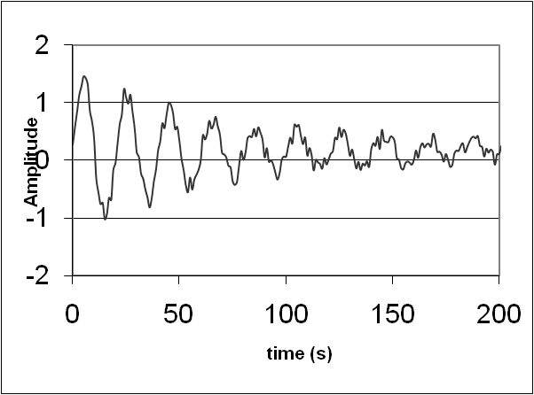
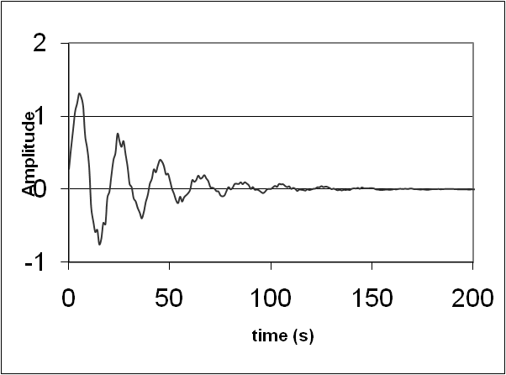
Electronics
Alternating Current – NMR Example – cont.
Most NMR FIDs look messier than shown
Due to a) multiple peaks and b) noisy signal which leads to noisier specra
To reduce the effect of the noise, it is common to increase the decay by multiplying the signal by an exponential decay function (Line Broadening in Bruker TopSpin software)
FID processed with exponential decay
Example of Noisier FID
Fourier Transform
signal rich region
Non-infinite decay wave
New spectrum has reduced noise but broader peak
noise rich region

Slide 9
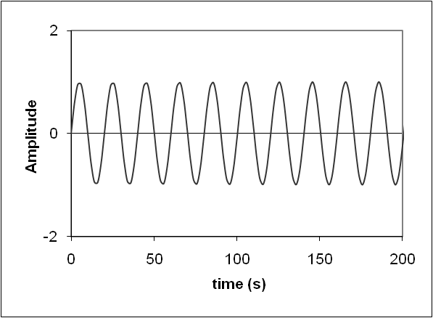
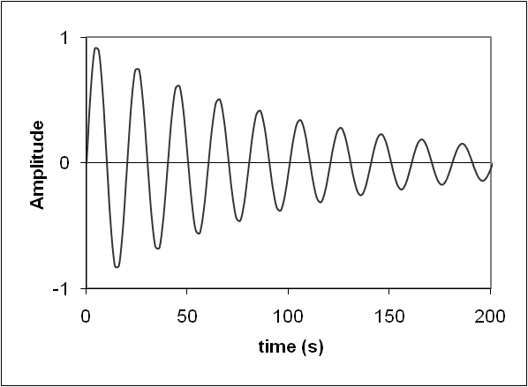
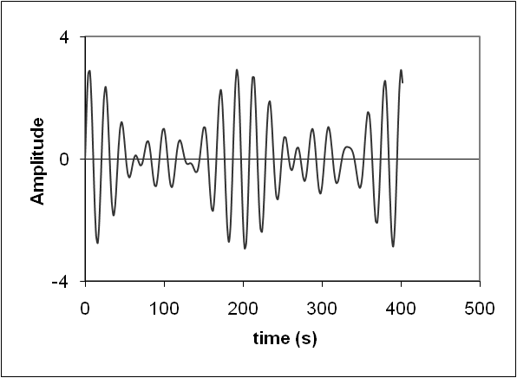
Electronics
AC/Fourier Transform Question
frequency
Which of the following signals when Fourier transformed will show the frequency pattern shown to the right?

Slide 10
Electronics
Capacitors
Capacitors are devices to store charge
  capacitors are plates with small gap between plates
  charge spreads out along plate inducing opposite charge to other plate
  no dc current across gap (gap is non-conductive)
5 V
Capacitance = C = q/V
In capacitors, C = constant

Slide 11
Electronics
Capacitors
motor
Uses of Capacitors
  Storage of charge to provided needed power
    Power supply may not supply enough power to start motor (start up power > running power)
    with capacitor, initial available I is high

Slide 12
Electronics
Capacitors
Use of Capacitors (continued)
  Analog data filter (RC filter – low pass type shown)
signal in
signal out
Reduction of high frequency noise (example is numerically done filter)

Slide 13
Electronics
RC Circuits
Before t = 0, switch in down position so V = 0 all parts but short segment
Switch
2) As switch is thrown (t = 0), charge travels through resistor to capacitor, but this takes time
5 V
V = 5V
3) After some time, the capacitor is fully charged and current drops to zero
An RC circuit consists of a resistor and capacitor in series
  You are responsible for quantitative understanding of behavior from step change in voltage (see below)

