Slide 1
Chem. 133 – 4/13 Lecture

Slide 2
Announcements
Homework 2.2 Additional Problems - Due
Quiz Today (after Announcements)
4/18 Lecture – will go back to rest of NMR (interpretation examples and instrumentation), then continue on Mass Spectrometry
Today’s Lecture
Mass Spectrometry (Harris Ch. 21)

Slide 3
Mass Spectrometry Introduction
Main information given
molecular weight
number of specific elements (based on isotope peaks)
molecular formula (with high resolution MS)
reproducible fragment patterns (to get clues about functional groups and/or arrangement of components or to confirm compound identity)

Slide 4
Mass Spectrometry Main Components to Instruments
Ionization Source (must produce ions in gas phase)
Separation of Ions (Mass Filter)
Detection of Ions
Note: most common instruments run in order 1 → 2 → 3, but additional fragmentation to generate different ions can occur after step 2
(1 → 2 → 1 → 2 → 3)
Common as chromatographic detector

Slide 5
Mass Spectrometry Overview of Component Types
Ionization Types
Type | Phase | Fragmentation
ICP | Liquid feed | Gives elements
Electron Impact (EI) | gas | lots
Chemical Ionization (CI) | gas | some
Electrospray (ESI) | liquid | very little
APCI | liquid | some
MALDI | solid | some
DESI | Portable | Very little

Slide 6
Mass Spectrometry Overview of Component Types
Separation Types (Ion Filters)
Type | Speed | Basis | Cost
Magnetic Sector | slow | Acceleration in magnetic field | moderate
Double Focusing | slow | Magnetic plus electric field | high
Quadrupole | fast | Passage through ac electric field | moderate
Ion trap | fast | Orbit in quadrupole | moderate
Time-of-Flight | very fast | Time to travel through tube | moderate
Newer High Resolution (FTICR*, orbitrap) | varies | Various, usually involving orbits | high
In addition, there are 2D MS, such as quadrupole - quadrupole
*FTICR = Fourier Transform Ion Cyclotron Resonance

Slide 7
Mass Spectrometry Overview of Component Types
Detectors
Type | Internal Amplifications? | Uses
Faraday Cup | No | Isotope Ratio MS
Electron Multiplier | Yes | Fairly Common
Microchannel plate | Yes | Higher end instruments
Induction | No | Used in FT-ICR

Slide 8
Mass Spectrometry Ion Source
Gas Phase Sources
Electron Impact
M + e⁻ → M^{*+} + 2e⁻
(electrons accelerated from hot filament source)
However, M^{*+} typically has extra energy and can undergo decomposition: M^{*+} → X⁺ + Y· (where X and Y are fragments)
Only the charged fragments are seen, but often if M ^{*+} → X⁺ + Y·, it also may form X· + Y⁺.

Slide 9
Mass Spectrometry Ion Source
EI Fragmentation Example:
+
charged fragment m/z = 43 (16 + 15 + 12)
charged fragment m/z = 77 (5*13 + 12)
note: stable fragments (77 ion), tend not to greatly fragment

Slide 10
Mass Spectrometry Ion Source
Fragmentation Example 2:
CH₂Cl₂⁺
CH₂Cl⁺ + Cl·
mass peak at 49 (and 51)
- observed
CH₂Cl· + Cl⁺
mass peak at 35 (and 37)
- not observed
Presence of ions also depends on their stability (Cl is electronegative so hard to form cation)

Slide 11
Mass Spectrometry Ion Source
Gas Phase Sources (cont.)
Chemical Ionization (CI)
“Softer” ionization technique
Results in less fragmentation
Possible in both negative and positive ion modes
Initial ionization like EI but in “reagent” gas
methane (+) mode shown below:
CH₄ + e⁻ → CH₄⁺ + 2e⁻
CH₄ + CH₄⁺ → CH₅⁺ + CH₃· (CH₅⁺ = [CH₄·H]⁺)
CH₅⁺ + M → MH⁺ + CH₄
major ion typically is M mass + 1

Slide 12
Mass Spectrometry Ion Source
Liquid Samples
Electrospray Ionization (ESI)
Liquid is nebulized with sheath gas
Nebulizer tip is at high voltage (+ or –), producing charged droplets
As droplets evaporate, charge is concentrated until ions are expelled
Efficient charging of polar/ionic compounds, including very large compounds
Almost no fragmentation, but multiple charges possible
For positive ionization, major peak is M+H peak (most common); or for multiply charged compounds, peak is [M+n]^{n+} where n = charge on ion
For negative ionization, M-1 peak is common
Adduct formation also is possible e.g. [M+Na]⁺
Nebulizing gas
High voltage
M+H⁺
+
+
Liquid in
+
+
+

Slide 13
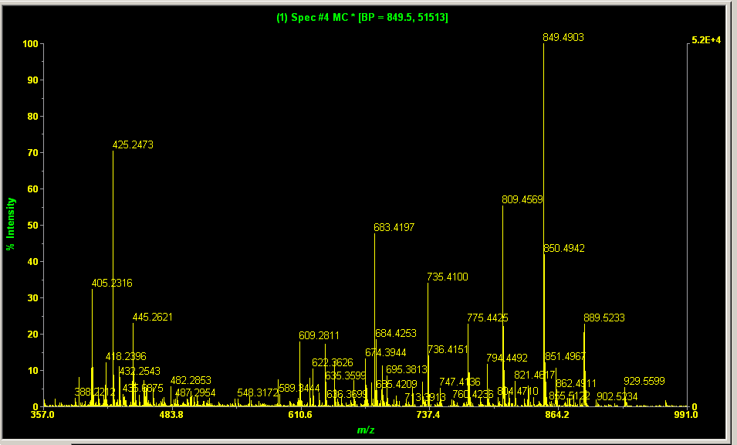
Mass Spectrometry Ion Source
ESI Example:
glycodendrimer core (courtesy of Grace Paragas)
C₃₀H₆₀N₁₄O₁₂ (sorry, no structure)
Mass = 808.451 or for M+H+: 809.459
First Hitachi “high resolution” ESI-MS sample – Full Spectrum
M+H+ peak
mass error = -2.6 ppm
(+/- 5 ppm needed)
Internal Standard: used for calibration

Slide 14
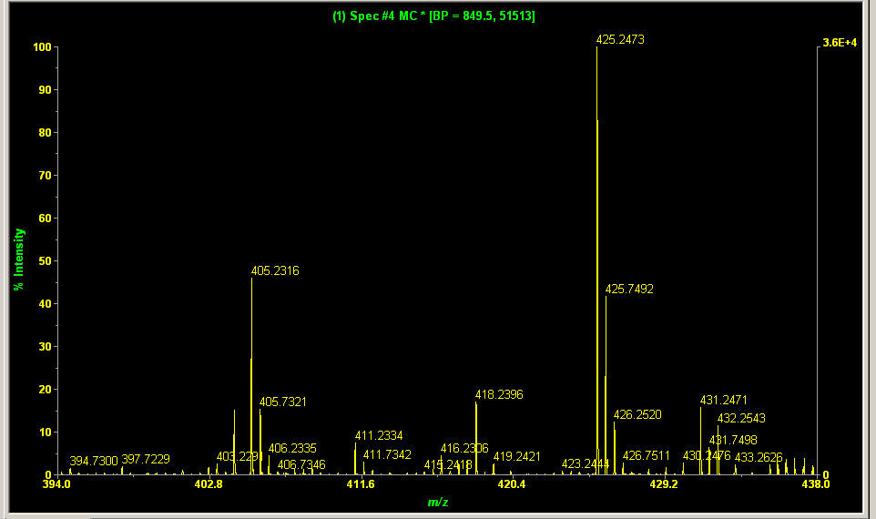
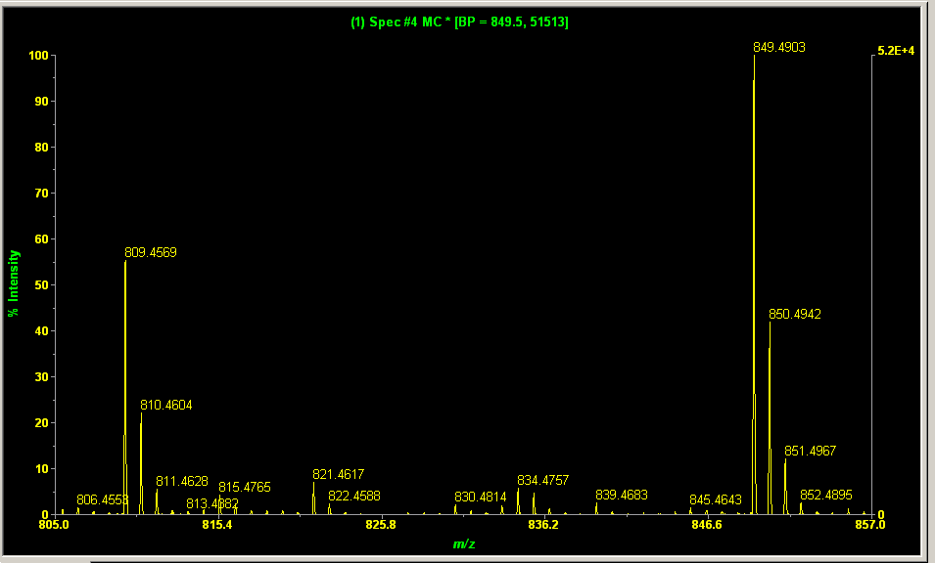
Mass Spectrometry Ion Source
ESI Example:
So if ESI results in no fragmentation, what are the other peaks?
425 peak = (M+H+Na+H₂O)/2
M+H and isotope peaks
M+41 = M+Na+H₂O
M+2H/2 peak = (808+2)/2 = 405
13C isotope peaks observed at +1/2 amu

Slide 15
Mass Spectrometry Ion Source
DESI – Desorption Electrospray Ionization
Use of Electrospray focused onto sample to produce ionization
Commonly used for remote MS analysis of untreated surface
Tip with electrospray is pointed toward sample with vacuum pick up line near by
Collisions of electrospray charged drops end up charging surface molecules
Resulting ions are picked up to mass spectrometer entrance
Electrospray source
vacuum line to mass analyzer
Mass Analyzer
M⁺
sample
Sample plate (electrically conductive)

Slide 16
Mass Spectrometry Ion Source
Ion Sources
For Liquids (continued)
Atmospheric Pressure Chemical Ionization
Liquid is sprayed as in ESI, but charging is from a corona needle nearby
- More restricted to smaller sized molecules
For Solids
Matrix Assisted Laser Desorption Ionization
Ionization from Laser
Samples normally doped with compound that absorbs light strongly (to cause intense heating/ionization)

Slide 17
Mass Spectrometry Ion Source
For Elemental Analysis
Inductively Coupled Plasma
Produces ions as well as atoms used in ICP-AES
Most sensitive method of elemental analysis
to mass analyzer
skimmer cone

Slide 18
Mass Spectrometry Questions
Which ionization method can be achieved on solid samples (without changing phase)
If one is using GC and concerned about detecting the “parent” ion of a compound that can fragment easily, which ionization method should be used?
For a large, polar non-volatile molecule being separated by HPLC, which ionization method should be used?
When analyzing a large isolated peptide by ESI-MS, multiple peaks are observed (at smaller than parent ion m/z numbers). What is a possible cause for this?
What ionization method should be used to analyze for lead (Pb) in a sample?

