Slide 1
CHEM133
Mass Spectrometry:
Lecture 1
4/13/2017

Slide 2
Announcements
Homework 2.2 Additional Problems - Due
Quiz Today (after Announcements)
4/18 Lecture – will go back to rest of NMR (interpretation examples and instrumentation), then continue on Mass Spectrometry
Tokmakoff Lecture (4/20/17, 10-11, Lobby Suite, University Union, 1st Floor)
Today’s Lecture
  Mass Spectrometry (Harris Ch. 21)

Slide 3
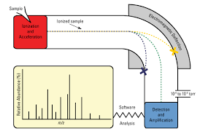
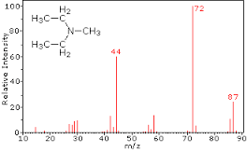
Mass Spectrometry
Introduction
One of the Major Branches of Analytical Chemistry (along with spectroscopy, chromatography, and electrochemistry)
Roles of Mass Spectrometry
  Qualitative analysis (less useful than NMR for true unknowns, but can be applied to very small samples)
  Quantitative analysis (often used for quantitative analysis)

Slide 4
Mass Spectrometry
Introduction
Main information given in MS analysis:
  molecular weight
  number of specific elements (based on isotope peaks)
  molecular formula (with high resolution MS)
  reproducible fragment patterns (to get clues about functional groups and/or arrangement of components or to confirm compound identity)

Slide 5
Mass Spectrometry
Main Components to Instruments
Ionization Source (must produce ions in gas phase)
Separation of Ions (Mass Filter)
Detection of Ions
Note: most common instruments run in order 1 → 2 → 3, but additional fragmentation to generate different ions can occur after step 2
(1 → 2 → 1 → 2 → 3)
MS very common as chromatographic detector

Slide 6
Mass Spectrometry
Overview of Component Types
Ionization Types
Type | Phase | Fragmentation
Inductively Coupled Plasma (ICP) | Liquid feed | Gives elements
Electron Impact (EI) | gas | lots
Chemical Ionization (CI) | gas | some
Electrospray (ESI) | liquid | very little
Atmospheric Pressure Chemical Ionization (APCI) | liquid | some
Matrix Assisted Laser Desorption Ionization (MALDI) | solid | some
Desorption Electrospray Ionization (DESI) | Portable | Very little

Slide 7
Mass Spectrometry
Overview of Component Types
Separation Types (Ion Filters/Mass Analyzers)
Type | Speed | Basis | Cost
Magnetic Sector | slow | Acceleration in magnetic field | moderate
Double Focusing | slow | Magnetic plus electric field | high
Quadrupole | fast | Passage through ac electric field | moderate
Ion trap | fast | Orbit in quadrupole | moderate
Time-of-Flight | very fast | Time to travel through tube | moderate
Newer High Resolution | varies | Various, usually involving orbits | high
In addition, there are 2-dimenional MS options (sometimes called MS/MS or tandem MS), such as quadrupole – quadrupole, or MS^{n}

Slide 8
Mass Spectrometry
Overview of Component Types
Detectors
Type | Internal Amplifications? | Uses
Faraday Cup | No | Isotope Ratio MS
Electron Multiplier | Yes | Fairly Common
Microchannel plate | Yes | Higher end instruments
Induction | No | Used in FT-ICR

Slide 9
Mass Spectrometry-GC Ionization (Gas Phase)
Electron Ionization (EI), also known as Electron Impact
A heated tungsten filament is used to produce electrons which “bombard” the analyte molecules, causing ionization through loss of an electron (for positive polarity MS):
M +e⁻ → M^{(*)+ •} + 2e⁻
However, M⁺ typically has extra energy and undergoes further decomposition/fragmentation: M*+ → X⁺ + Y• (where X and Y are fragments)
We only see the charged fragments, but often if M^{*+} → X⁺ + Y •, it also may form X • + Y⁺

Slide 10
Mass Spectrometry-EI

Slide 11
Mass Spectrometry
Ion Source
EI Fragmentation Example:
+
charged fragment m/z = 43 (16 + 15 + 12)
charged fragment m/z = 77 (5*13 + 12)
note: stable fragments (77 ion), tend not to greatly fragment

Slide 12
Mass Spectrometry
Ion Source
Fragmentation Example 2:
CH₂Cl₂⁺
CH₂Cl⁺ + Cl •
mass peak at 49 (and 51)
- observed
CH₂Cl • + Cl⁺
mass peak at 35 (and 37)
- not observed
Presence of ions also depends on their stability (Cl is electronegative so hard to form cation)

Slide 13
Mass Spectrometry
Ion Source
Gas Phase Sources (cont.)
  Chemical Ionization (CI)
    “Softer” ionization technique
    Results in less fragmentation
    Possible in both negative and positive ion modes
    Initial ionization like EI but in “reagent” gas
    methane (+) mode shown below:
    CH₄ + e⁻ → CH₄^{+ •} + 2e⁻
    CH₄ + CH₄^{+ •} → CH₅⁺ + CH₃ •
    CH₅⁺ + M → MH⁺ + CH₄
    major ion typically is M mass + 1

Slide 14
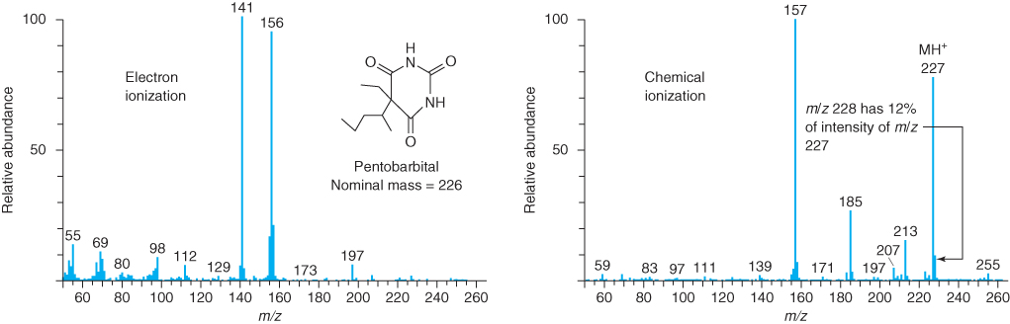
Mass Spectrometry-GC Ionization
EI spectrum results in more lower m/z fragments

Slide 15
Mass Spectrometry-HPLC Ionization
Electrospray Ionization
The HPLC eluent flows through a nebulizer, ions are in this solution (or that are formed in the solution) are guided into the MS region
Another soft ionization technique-produces molecular (or M+H⁺/M-H⁻) ions
Also may produce “doubly” or greater charged ions (i.e., multiply-charged species), which is more common for larger molecules (i.e., proteins and other biomolecules)

Slide 16
Mass Spectrometry
Ion Source
Liquid Samples
  Electrospray Ionization (ESI)
    Liquid is nebulized with sheath gas
    Nebulizer tip is at high voltage (+ or –), producing charged droplets
    As droplets evaporate, charge is concentrated until ions are expelled
    Efficient charging of polar/ionic compounds, including very large compounds
    Almost no fragmentation, but multiple charges possible
    For positive ionization, major peak is M+H peak (most common); or for multiply charged compounds, peak is [M+n]^{n+} where n = charge on ion
    For negative ionization, M-1 peak is common
    Adduct formation also is possible e.g. [M+Na]⁺
Nebulizing gas
High voltage
M+H⁺
+
+
Liquid in
+
+
+

Slide 17
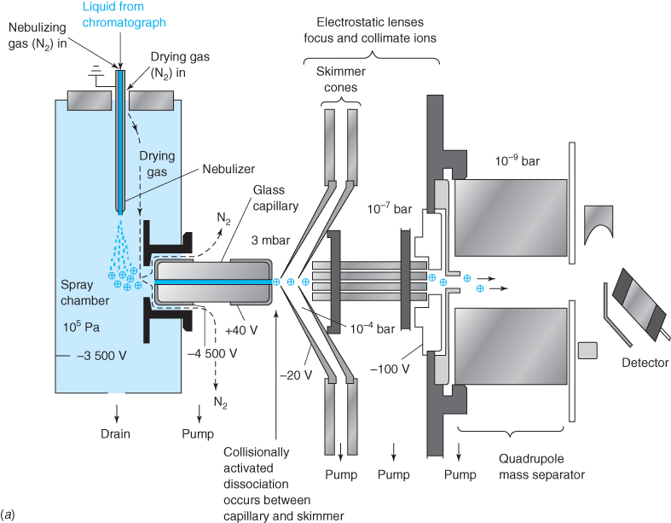
Electrospray
Ionization
(ESI)

Slide 18
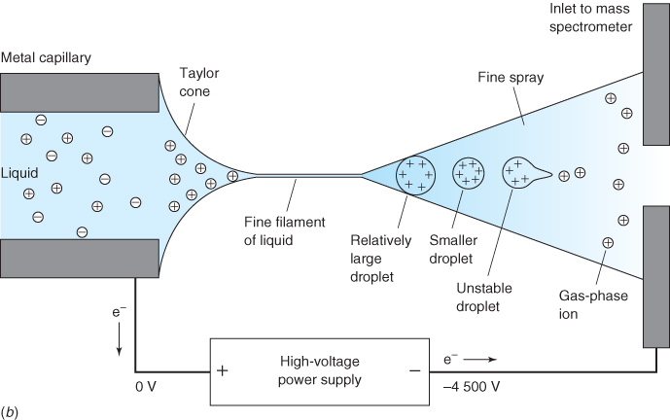
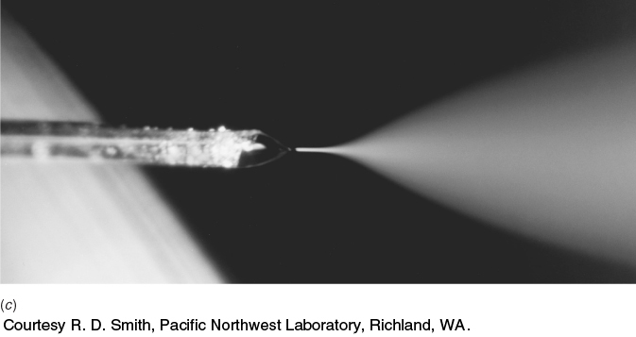
Electrospray Ionization (ESI)

Slide 19
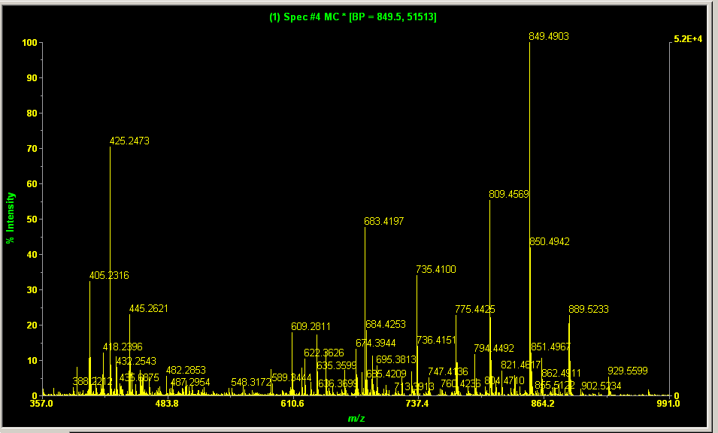
Mass Spectrometry
Ion Source
ESI Example:
  glycodendrimer core (courtesy of Grace Paragas)
  C₃₀H₆₀N₁₄O₁₂ (sorry, no structure)
  Mass = 808.451 or for M+H+: 809.459
First Hitachi “high resolution” ESI-MS sample – Full Spectrum
M+H+ peak
mass error = -2.6 ppm
(+/- 5 ppm needed)
Internal Standard: used for calibration

Slide 20
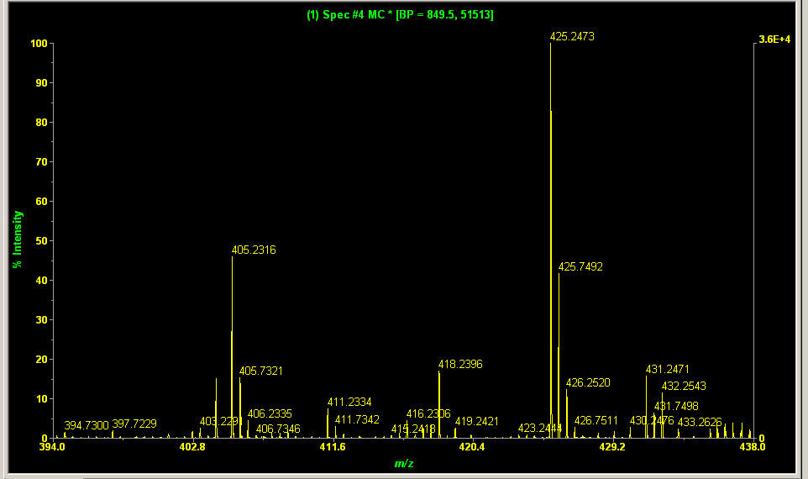
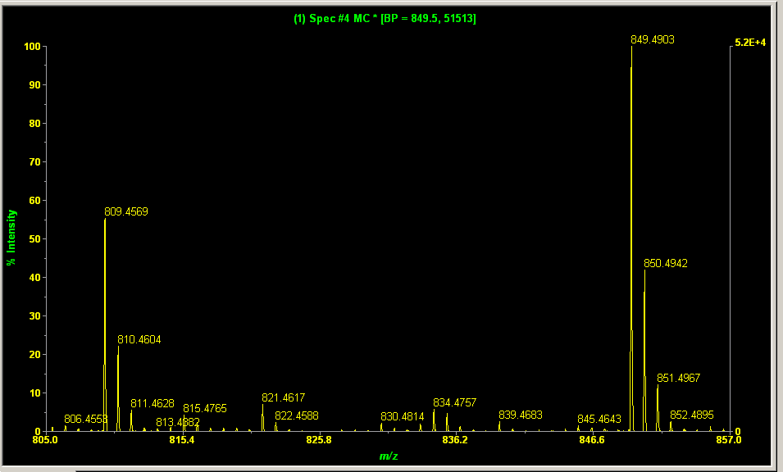
Mass Spectrometry
Ion Source
ESI Example:
  So if ESI results in no fragmentation, what are the other peaks?
425 peak = (M+H+Na+H₂O)/2
M+H and isotope peaks
M+41 = M+Na+H₂O
M+2H/2 peak = (808+2)/2 = 405
13C isotope peaks observed at +1/2 amu

Slide 21
Mass Spectrometry
Ion Source
DESI – Desorption Electrospray Ionization
  Use of Electrospray focused onto sample to produce ionization
  Commonly used for remote MS analysis of untreated surface
  Tip with electrospray is pointed toward sample with vacuum pick up line near by
  Collisions of electrospray charged drops end up charging surface molecules
  Resulting ions are picked up to mass spectrometer entrance
Electrospray source
vacuum line to mass analyzer
Mass Analyzer
M⁺
sample
Sample plate (electrically conductive)

Slide 22
Mass Spectrometry
Ion Source
Ion Sources
  For Liquids (continued)
    Atmospheric Pressure Chemical Ionization
      Liquid is sprayed as in ESI, but charging is from a corona needle nearby
      - More restricted to smaller sized molecules
  For Solids
    Matrix Assisted Laser Desorption Ionization
      Ionization from Laser
      Samples normally doped with compound that absorbs light strongly (to cause intense heating/ionization)

Slide 23
Mass Spectrometry
Ion Source
For Elemental Analysis
  Inductively Coupled Plasma
    Produces ions as well as atoms used in ICP-AES
    Most sensitive method of elemental analysis
to mass analyzer
skimmer cone

Slide 24
Mass Spectrometry Ionization
Questions
Which ionization method can be achieved on solid samples (without changing phase)?
MALDI
  If one is using GC-MS and concerned about detecting the “parent” ion of a compound that can fragment easily, which ionization method should be used?
CHEMICAL IONIZATION (CI)
  For a large, polar non-volatile molecule being separated by HPLC, which ionization method should be used?
ELECTROSPRAY IONIZATION (ESI, good for larger ionizable analytes)
  When analyzing a large isolated peptide by ESI-MS, multiple peaks are observed. What is a possible cause for this?
MULTIPLE PROTONS ATTACHED TO PEPTIDE
  What ionization method should be used to analyze for lead (Pb) in a sample?
INDUCTIVELY COUPLED PLASMA-Want to reduce analyte/sample to elemental components, single form

