Slide 1
Chem. 1B – 10/13 Lecture
See updates on slides 1, 2, 3, and 8

Slide 2
Announcements I
Exam 2: Two Weeks from Today (10/27)
Mastering
Some confusion if you pay detailed attention to text (will discuss today)
Lab:
Quiz 6 – on Exp 3 or 4 (pre-lab) plus solubility/complex ion
Lab Midterm and Exp 3 report on Wed./Thurs.
Note: Syllabus says Lab midterm is on Exp 1, 2, 5, and 7, but will also have questions related to pre-lab on Experiment 3

Slide 3
Announcements II
Today’s Lecture
Solubility – use for qualitative analysis (skipped last time)
Thermodynamics
Reviewing Ch. 6
Spontaneous Reactions
Entropy
Gibb’s Free Energy

Slide 4
Chem 1B – Aqueous Chemistry Solubility (Qualitative Analysis)
Mixtures of ions (anions or cations) can be separated by successive addition of counter ions that lead to selective precipitation
Example scheme in section 16.7 is for cations
Successive treatments typically start with mostly soluble anions (Cl⁻) and go to less and then less soluble anions (go to text figure – next slide)
Notes:
4

Slide 5
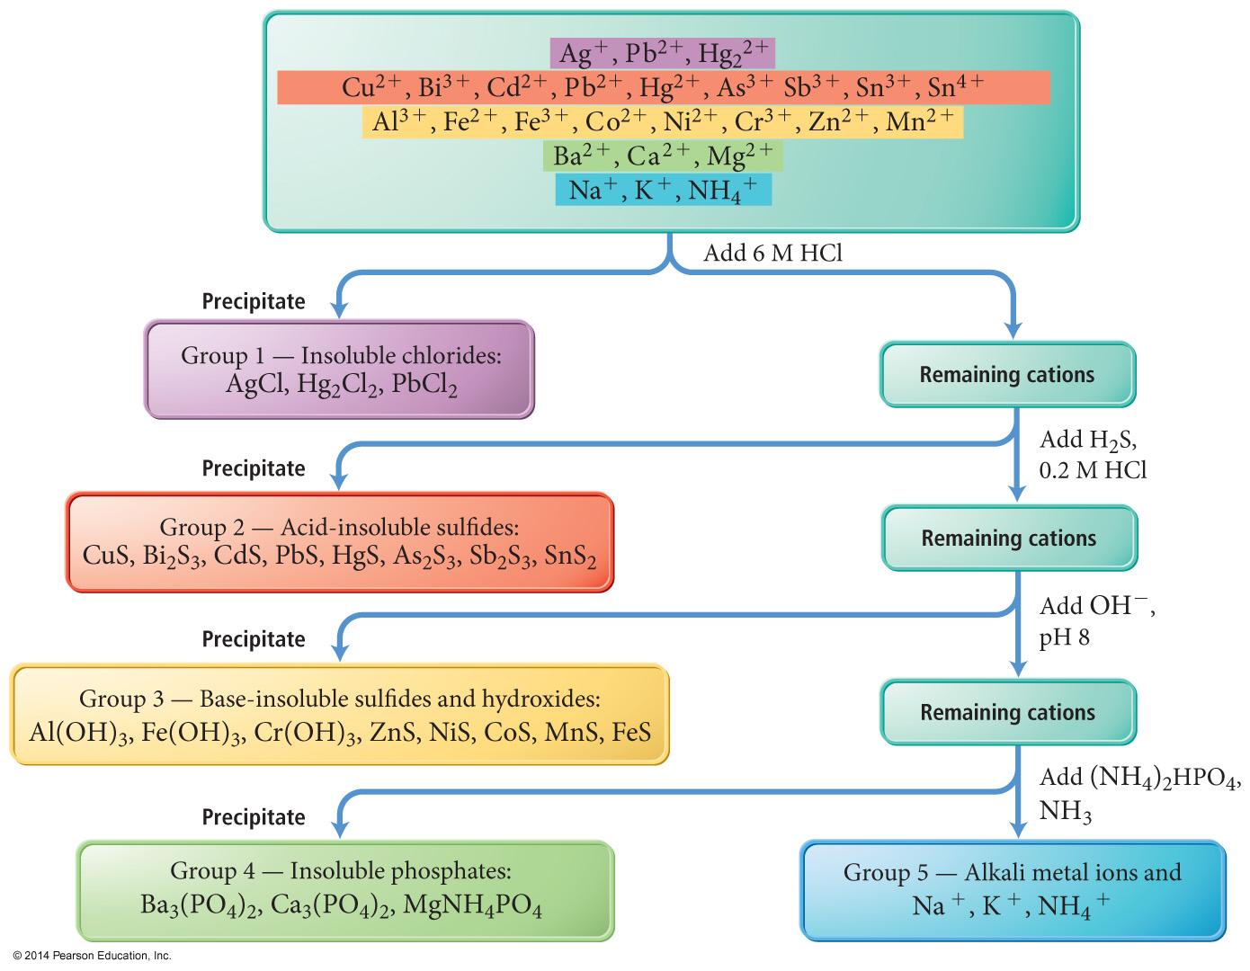
A General Qualitative Analysis Scheme
Figure 16.16 pg 118

Slide 6
Chem 1B – Aqueous Chemistry Solubility (Qualitative Analysis)
What is the difference between acid insoluble sulfides and base insoluble sulfides?
Main difference is value of K_{sp}
Examples: Cu²⁺ (acid insoluble) and Fe²⁺ (base insoluble)
K_{sp} = 1.27 x 10⁻³⁶ for CuS vs. 1.72 x 10⁻¹⁹ for FeS (Table 16.2)
Footnote at bottom of table explains K_{sp} is for the reaction:
CuS(s) + H₂O(l) ↔ Cu²⁺(aq) + HS⁻(aq) + OH⁻(aq)
NOTE: Mastering homework seems to not have seen the footnote – in their method of doing sulfide problems (which is based on a standard – and wrong reaction of e.g. NiS(s) ↔ Ni²⁺(aq) + S²⁻(aq) )
- Calculate solubility of Fe²⁺ and Cu²⁺ at pH = 0 and pH = 13 in 1 M HS⁻ (total S²⁻ concentration)
Notes:
6

Slide 7
Chem 1B – Thermodynamics Chapter 17
Chapter 6 – Review
Types of Energy:
kinetic energy (associated with motion)
potential energy (stored energy – e.g. ball at the top of a hill)
Chemical energy (a type of stored energy)
Heat (a molecular scale type of kinetic energy)
Conservation of Energy
Energy can change forms – but can not be created or destroyed
Notes:
7

Slide 8
Chem 1B – Thermodynamics Chapter 17
Chapter 6 – Review II
Systems and Surroundings
used to define energy transfers
example: system with reaction that produces heat (conversion from chemical energy) can heat surroundings
Enthalpy (H)
Energy related to heat
ΔH = q_{p} (heat in a constant pressure system)
Endothermic reaction means ΔH > 0, means heat from surrounding used for reaction
Exothermic reaction means ΔH < 0, means heat from reaction goes to surroundings
Notes:
8

Slide 9
Chem 1B – Thermodynamics Chapter 17
Chapter 17 – Overview
Spontaneous and Non-Spontaneous Processes:
Entropy: A measure of disorder
Gibbs Free Energy
Entropy and Gibbs Free Energy Changes Associated with Reactions
Relating Gibbs Free Energy to Equilibrium Constants
Notes:
9

Slide 10
Chem 1B – Thermodynamics Chapter 17 – Spontaneous Processes
Thermodynamical Definition of Spontaneous
A spontaneous process is one that will eventually occur (actually has nothing to do with speed of occurrance)
Examples of spontaneous processes:
freezing of water droplet at -5°C
dissolution of 0.1 moles of NH₄NO₃ in 1.0 L of water (solubility is much higher)
oxidation of Fe(s) in air
Non-spontaneous process: one that won’t occur without intervention
Notes:
10

Slide 11
Chem 1B – Thermodynamics Chapter 17 – Spontaneous Processes
Thermodynamical Definition of Spontaneous
Most, but not all, spontaneous processes are exothermic (e.g. H₂(g) + O₂(g) ↔ H₂O(l))
Non-spontaneous process: one that won’t occur without intervention
Example: splitting water to H₂(g) and O₂(g) (can be done through electrolysis, but then needs external energy)
Notes:
11

Slide 12
Chem 1B – Thermodynamics Chapter 17 – Entropy
Entropy
A few reactions that occur spontaneously are endothermic (e.g. NH₄NO₃(s) ↔ NH₄⁺(aq) + NO₃⁻(aq))
How can a process occur if it takes energy?
There must be some trade off that makes it likely to occur
Process is an increase in disorder (entropy)
For example, we can see that a desk will have a natural tendency to becoming disordered and that it takes energy to clean it
Notes:
12

Slide 13
Chem 1B – Thermodynamics Chapter 17 – Entropy
Entropy
The Second Law of Thermodynamics: For any spontaneous process, the entropy of the universe increases (ΔS_{univ} > 0)
Thus the natural tendency is for a process to occur if it increases entropy
This can explain why some reactions occur even if ΔH is positive such as:
NH₄NO₃(s) ↔ NH₄⁺(aq) + NO₃⁻(aq)
Notes:
13

Slide 14
Chem 1B – Thermodynamics Chapter 17 – Entropy
Entropy
A macroscopic analogy to entropy would be to have a box of 50 ping pong balls with half white and half black
Even if placed on two separate halves of the box, if the box were shaken to mix the balls, roughly half of each color would be expected in each half
v
v
final state
initial state
Notes:
14

Slide 15
Chem 1B – Thermodynamics Chapter 17 – Entropy
Entropy in Chemical Systems
From a molecular scale view, a system that appears more randomly assembled has higher entropy (can have more possible “states”)
Highly ordered Highly disordered
Low Entropy High Entropy
S = 0
Crystalline
solid (T = 0K)
Crystalline
solid (T > 0K)
Amorphous solid
liquid
gas
large compound
various small compounds
N₂O₄(g) vs.
2NO₂(g) vs.
2O₂ (g) + N₂(g) vs.
4O (g) + 2N(g)
note: gases shown are relative (still at higher entropy vs. liquids/solids)
Notes:
15

Slide 16
Chem 1B – Thermodynamics Chapter 17 – Entropy
Entropy Examples:
(Is ΔS > or < 0?)
H₂O(l) ↔ H₂O(g)
H₂O(s) ↔ H₂O(l)
NaCl(s) ↔ Na⁺(aq) + Cl⁻(aq)
2H₂(g) + O₂(g) ↔ 2H₂O(g)
N₂(g) + O₂(g) ↔ 2NO(g)
ΔS > 0
ΔS > 0
ΔS > 0
ΔS < 0
ΔS > 0
Determine the sign of entropy change for the following reactions:
Notes:
16

Slide 17
Chem 1B – Thermodynamics Chapter 17 – Entropy
Quantifying Entropy Changes (ΔS)
From 2nd Law of thermodynamics, we know ΔS_{univ} ≥ 0 and ΔS_{univ} = ΔS_{sys} + ΔS_{surr}
Thus for a process in which ΔS_{sys} < 0 (e.g. I₂(g) ↔ I₂(s)), we know ΔS_{surr} > 0
In our particular example, energy (or enthalpy) is evolved in the process (I₂(g) ↔ I₂(s))
we can set these equal in ΔS_{surr} = -q_{sys}/T or under constant pressure, ΔS_{surr} = - ΔH_{sys}/T
Notes:
17

Slide 18
Chem 1B – Thermodynamics Chapter 17 – Entropy
Quantifying Entropy Changes (ΔS) II
For a particular process, we also can look up standard entropy values (S°) for reactants and products (see Appendix II B)
These are under standard conditions (25°C/1 atm for gases/1 M for solutions)
Example: I₂(g) ↔ I₂(s)
S°(I₂(s)) = 116.14 J mol⁻¹ K⁻¹ and S° (I₂(g)) = 180.79 J mol⁻¹ K⁻¹ so for rxn ΔS° = 116.14 – 180.79 = -64.65 J mol⁻¹ K⁻¹
Notes:
18

Slide 19
Chem 1B – Thermodynamics Chapter 17 – Gibbs Free Energy
We have identified two processes generally (but not always) associated with spontaneous processes:
Exothermic processes (ΔH < 0)
Processes with an increase in entropy (ΔS > 0)
Is there a way in which we can always predict a reaction direction?
YES. We use the change in Gibbs Free Energy
Notes:
19

Slide 20
Chem 1B – Thermodynamics Chapter 17 – Gibbs Free Energy
Basis and Definition of Gibbs Free Energy:
Mathematical Basis for Gibbs Free Energy:
ΔS_{univ} = ΔS_{sys} + ΔS_{surr} and ΔS_{surr} = -ΔH_{sys}/T
This means ΔS_{univ} = ΔS_{sys} – ΔH_{sys}/T
or -TΔS_{univ} = ΔH_{sys} – TΔS_{sys} = ΔG
Definition of Gibbs Free Energy = G = H – TS
under constant T, ΔG = ΔH – TΔS
Notes:
20

