Slide 1
2-D (LC x LC) Chromatography
A High Pressure Liquid Chromatography (HPLC) technique
By Dina, Dustin & Rich Nov. 9th 2014 Fall CHE 230

Slide 2
Outline
Origins, Introduction, Background
  Peak Capacity Potential
  Basic Method
  Limitations to Peak Capacity
Advantages and Disadvantages
Applications #1, 2, & 3
Conclusions & Future Work

Slide 3
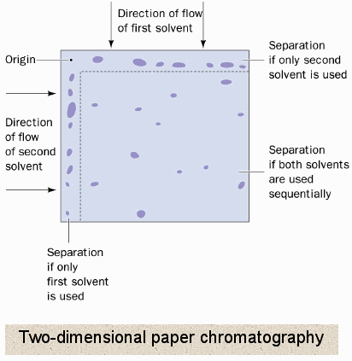
Origins – older than you might expect!
  Origins in 2-Dimensional Chromatography
  2-D Thin Layer Chromatography
  is more than ½ century old!
In 1978 Erni and Frei demonstrated the use of two columns with valve switching
between them (RP & SEC).
  considerably before GCxGC’s emergence.
Schoenmakers, P., Majors, R. E. LCGC North Am. 2008, 70.

Slide 4
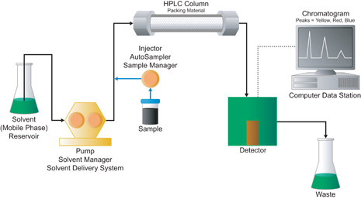
PEAK CAPACITY (n_{c}) of One Dimensional
Maximum number of peaks that can be separated with a specific resolution
Higher peak capacity - greater separation potential
http://www.waters.com/waters/en_US/How-Does-High-Performance-Liquid-Chromatography-Work%3F/nav.htm?cid=10049055&locale=en_US
Schoenmakers, P., Majors, R. E. LCGC North Am. 2008, 70.

Slide 5
Limitations of One Dimensional
Peak capacity of possibly 50
developments increased peak capacity to possibly 100 or 200 but…
  gradient elution
  higher pressures
  elevated temperatures
  monolithic columns
http://www.waters.com/waters/en_US/How-Does-High-Performance-Liquid-Chromatography-Work%3F/nav.htm?cid=10049055&locale=en_US
Schoenmakers, P., Majors, R. E. LCGC North Am. 2008, 70.

Slide 6
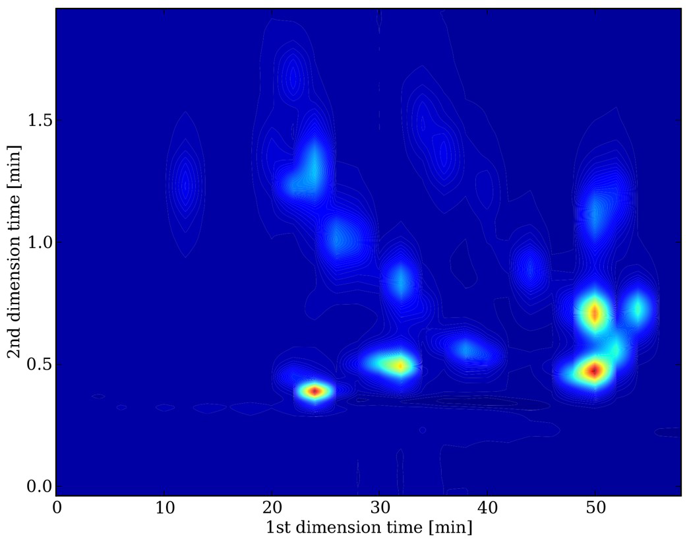
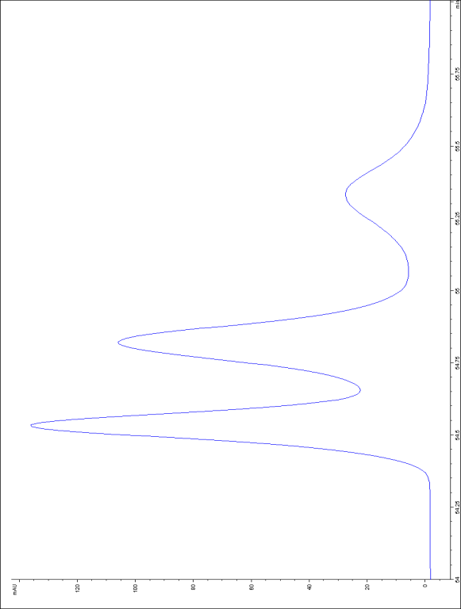
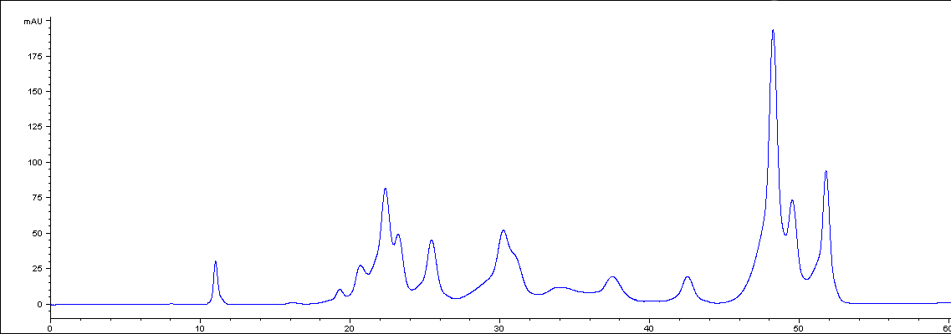
Second dimension
First
dimension
n_{c, tot} = ¹n_{c} x ²n_{c}
www.cosmoscience.org/.../Speaker%202-Some%20practical%20Aspects...

Slide 7
LC x LC – drastic increase in peak capacity possible
Potential for drastic increase in capacity and potential resolution – promising for complex samples
peak capacities of the two columns can be multiplied – product rule
peak capacity peak capacity peak capacity
Total 1st column 2nd column
so with first column capacity in range of 100s and second column in range of 10-20 - result can be peak capacities in the thousands
product rule
n_{c, tot} = ¹n_{c} ²n_{c}
=
x
x
Schoenmakers, P., Majors, R. E. LCGC North Am. 2008, 70.
Xiapong, L., Stoll, D., Carr, P. Anal. Chem. 2009. 81.LCGC North Am. 2008, 70.

Slide 8
Basic Requirements: LC x LC
  Basic 1D LC
  Add 2D
  Second column
  Second pump
  Switching valve between two columns
  Detector after second column
  Software for data processing
http://www.waters.com/waters/en_US/How-Does-High-Performance-Liquid-Chromatography-Work%3F/nav.htm?cid=10049055&locale=en_US

Slide 9
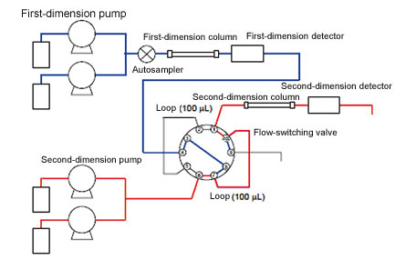
Two Dimensions Basic Parts: Two Columns and Two Pumps
Fractions moved from first column to second
First
pump
First
Column
optional
Second
Column
Second
pump
detector
Switching Interface
http://www.shimadzu.com/an/hplc/support/lib/lctalk/2dlc.html

Slide 10
Common Method: LC x LC
slow first-dimension (such as 1 hour or longer)
fractions collected in a loop of switching valve
fraction injected on second column - much faster time (minute or less)
while this fraction is analyzed
another collects in different loop to same the valve or to another valve
detection after second column
Schoenmakers, P., Majors, R. E. LCGC North Am. 2008, 70.

Slide 11
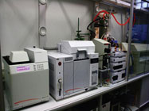
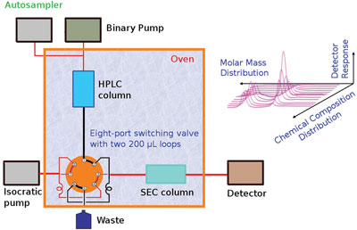
2-D LCxLC Experimental Set-up
http://www.americanlaboratory.com/914-Application-Notes/982-Characterization-of-Functionalized-Polyolefins-by-High-Temperature-Two-Dimensional-Liquid-Chromatography/

Slide 12
Peak Capacity
key quality descriptor of any LC separation
1-D LC peak capacity n_{c} is defined as maximum number of peaks with prescribed resolution
2-D LC peak capacity n_{c, tot} related to peak capacity of two underlying separations by
product rule n_{c, tot} = ¹n_{c, x} ²n_{c}
Bedani, F., Schoenmakers, P., Janssen, H. J. Sep. Sci. 2012, 35.

Slide 13
IDEAL PEAK CAPACITY n_{c, tot} = ¹n_{c} ²n_{c}
x
Assumes NO loss of peak capacity in the two separate columns
Completely Orthogonal – separated along two distinction dimensions
Optimization required to maximize that potential (details to follow)
Schoenmakers, P., Majors, R. E. LCGC North Am. 2008, 70.

Slide 14
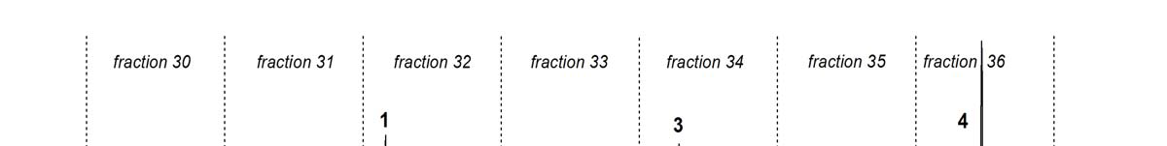
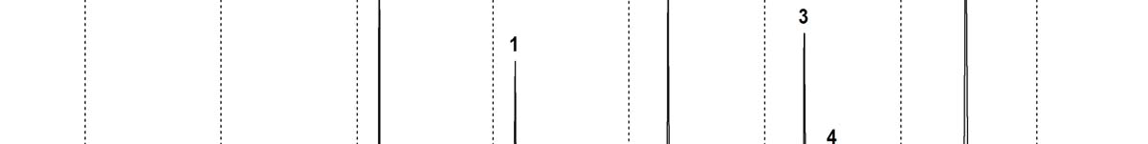
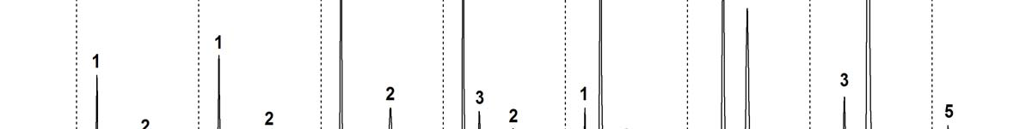
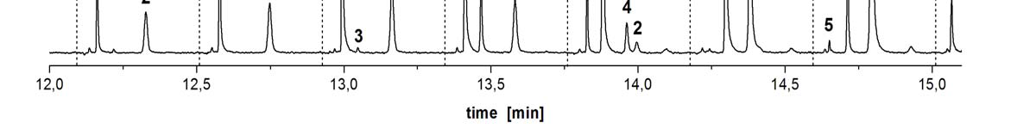
Fractions from first column collect in loop and injected on second column
www.cosmoscience.org/.../Speaker%202-Some%20practical%20Aspects...

Slide 15
Some loss of peak capacity (¹n_{c}) from first column – as sample is collected in loop prior to injection onto second column
Some loss of peak capacity (²n_{c})
due to peak broadening
based on injection volume onto second column
www.cosmoscience.org/.../Speaker%202-Some%20practical%20Aspects...

Slide 16
Ideal 2D Peak Capacity
2-D LC peak capacity n_{c, tot} related to peak capacity of two underlying separations by product rule
n_{c, tot} = ¹n_{c, x} ²n_{c}
but total peak capacity only if complete orthogonality and maintain independent resolving power of each column - meeting both requirement is complex.

Slide 17
Challenges to Optimization
complete orthogonality - challenging given absence of theories to maximize selectivity and sample complexity
maintain independent resolving power of each column
  undersampling of 1D and
  2D injection peak broadening

Slide 18
Effective 2-D Peak Capacity
[n_{c, tot}]_{eff} = ¹n_{c,} x ²n_{c} x 1α x 2 γ x ƒ
^{Correction factors} ^{account:}
¹α - 1D undersampling
²γ - 2D peak broadening
ƒ - orthogonality
Bedani, F., Schoenmakers, P., Janssen, H. J. Sep. Sci. 2012, 35.

Slide 19
¹α - 1D undersampling
transferring fractions of 1D to 2D leads to some recombination of already separated compounds
Sampling step between columns – depends upon the number of fractions
1D under sampling results in losses of ¹n_{c}

Slide 20
¹α - 1D undersampling
Correction factor (β) include the t_{s} (sampling time from 1D) and peak width 1D.
Complicated if you increase 1D sampling – decreases 2D elution time thus decreasing 2D peak capacity
Optimizing – 2 to 3.6 times std dev
  Compromises decrease due to undersampling 1D
  And decrease elution time for 2D (reduces peak capacity 2D)
Bedani, F., Schoenmakers, P., Janssen, H. J. Sep. Sci. 2012, 35.

Slide 21
²γ - 2D peak broadening
2D analysis time must equal the sampling time of 1D- samples sequentially analyzed
Increasing number of fractions of 1D collected decreases the allowable analysis time for 2D
Short 2D separations → lower peak capacity for 2D
Transfer volumes to 2D – if larger volumes injected onto second column → peak broadening
Bedani, F., Schoenmakers, P., Janssen, H. J. Sep. Sci. 2012, 35.

Slide 22
²γ - 2D peak broadening
2D variance due to injection depends upon 1F and 2F, the flow rates in each column and the retention factor at the inlet to 2D
Changing ratio of column diameters will change ratio of flow rates.
Focusing may occur if analytes in solvent of lower eluting strength than mobile phase – focused as a narrow band at top of second column and then pushed forward by the mobile phase
Bedani, F., Schoenmakers, P., Janssen, H. J. Sep. Sci. 2012, 35.

Slide 23
ƒ - orthogonality
Maximum peak capacity if both dimensions completely independent
Prediction based upon sample interaction with two stationary/mobile phases – retention and selectivity
Ideal – peaks equally dispersed over the entire field but only if retention factors completely independent such as mass, charge, or polarity

Slide 24
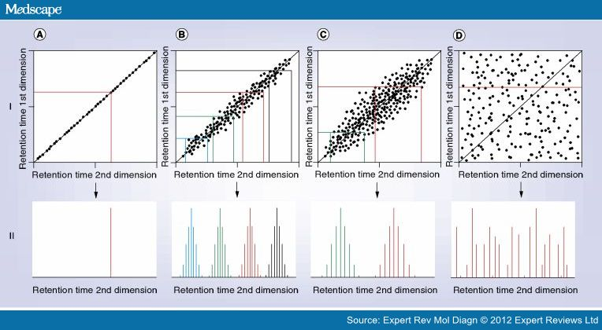
ORTHOGONALITY

Slide 25
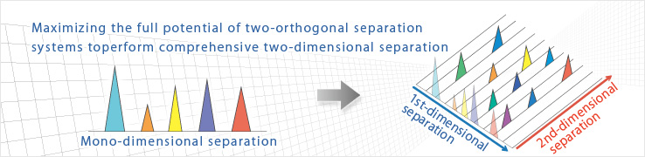
ƒ - orthogonality
http://www.shimadzu.com/an/hplc/nexera/e_index.html

Slide 26
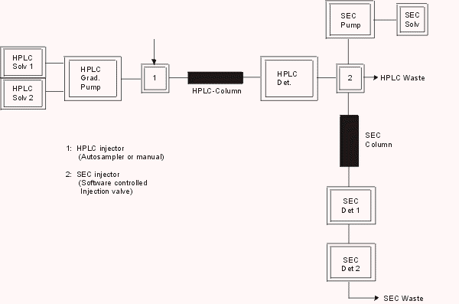
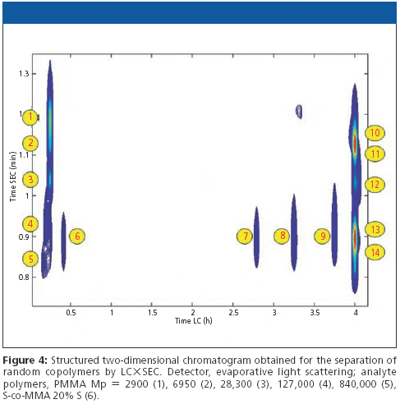
ORTHOGONALITY
horizontal (1D)- separation based upon chemical composition (RP)
vertical (2D) - separation based upon size of molecules (SEC)
allows separation on the entire plane- thus using the entire peak capacity
Schoenmakers, P., Majors, R. E. LCGC North Am. 2008, 70.

Slide 27
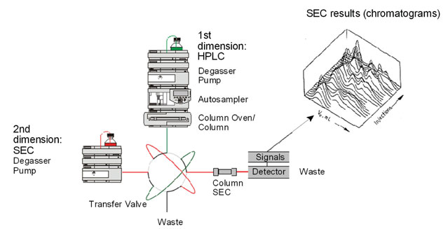
RP paired with SEC
http://www.sepscience.com/Techniques/LC/Articles/1378-/Analysis-of-Macromolecules-using-Two-Dimensional-Liquid-Chromatography

Slide 28
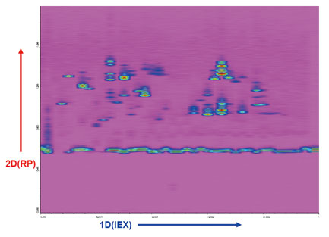
Second Example: IEX with RP
horizontal (1D)- separation ion exchange
vertical (2D) - separation based polarity (RP)
allows separation on the entire plane- thus using the entire peak capacity
http://www.shimadzu.com/an/hplc/support/lib/lctalk/2dlc.html

Slide 29
Comprehensive Two-Dimensional LC Analysis Example
Shimadzu example of a tryptic digest of bovine serum albumin using a comprehensive two-dimensional LC system. The sample was separated using an ion-exchange column (1 mm I.D.×50 mm long, 50 μL/min flow rate) as the first-dimension column and a reverse-phase column (2 mm I.D.×50 mm long, 600μL/min flow rate) as the second-dimension column.
The alignment of peaks in the vertical-axis (second-dimension) direction indicates separation of components in the second-dimension column that could not be separated in the first-dimension column. Therefore, it can be said that comprehensive two-dimensional LC is able to separate components at the second-dimension that could not be separated at the first-dimension.

Slide 30
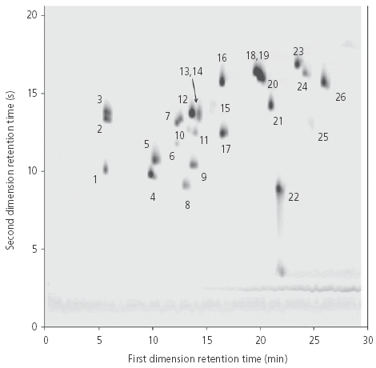
LC x LC Chromatogram
Quality Characteristics:
Fast
Good orthogonality
Resolution in 1-D maintained despite cutting.
2-4 fractions / peak for 2-D criteria.
How?
100’s of 2-D chromatograms are combined into a data matrix & displayed as a contour plot.
http://www.chromatographyonline.com/lcgc/Column%3A+Column+Watch/LCxLC-Comprehensive-Two-Dimensional-Liquid-Chromat/ArticleStandard/Article/detail/529357

Slide 31
Pros & Cons: LCxLC
Pros:
Resolution of complex mixtures
Increased peak capacity
  Results in increased separation potential
Sample dimensionality
Easily interpretable chromatograms
Improved separation
Improved resolution
Cons:
Slow in 1-D (~1hr) + 2-D time
Detectors
  complication compounded by dilution with UV det.
Software
  data collection and manipulation
Method optimization
  problems optimizing systems of opposite polarity.
  Theories to max. selectivity are absent.
  Undersampling, peak broadening
Mobile phase compatibility
No cryogenic modulation like GC
Complicated equipment
$.....a.k.a. HPLC

Slide 32
Applications
App #1- LCxLC Impact of Peak Description on Quantitation Abilities –Dustin
App #2- UHPLC and HT-UHPLC in the 2nd dimension –Dustin
App #3- Tandem DAD/QTOF-MS analysis of compounds in Chinese Herbal Medicines (CHM) –Rich

Slide 33
App #1-Dustin
Evaluation of the Impact of Peak Description on the Quantitative Capabilities of Comprehensive Two-Dimensional liquid Chromatography
Focusing on quantitation of polycyclic aromatic hydrocarbons (PAHs) by LC x LC
HALO fused-core C18 with 2.7 mm particle size, 150 mm x 4.6 mm (1st dimension)
Zorbax PAH column with 1.8 mm particle size, 100 mm x 4.6 mm (2nd dimension)
Difficulty with quantitation since needing a 2nd dimension:
2D descriptive integration, fully descriptive integration, select slices integration, manual integration, height/summed height
Advantages: Can optimize both precision and accuracy for quantitation
Disadvantages: Time-consuming, tedious, somewhat subjective, must have peaks slices manually integrated and summed, also won’t work for all LC x LC
1. Place, B.J., et al., Evaluation of the impact of peak description on the quantitative capabilities of comprehensive two-dimensional liquid chromatography. Journal of Chromatography A, 2014. 1368(0): p. 107-115.

Slide 34
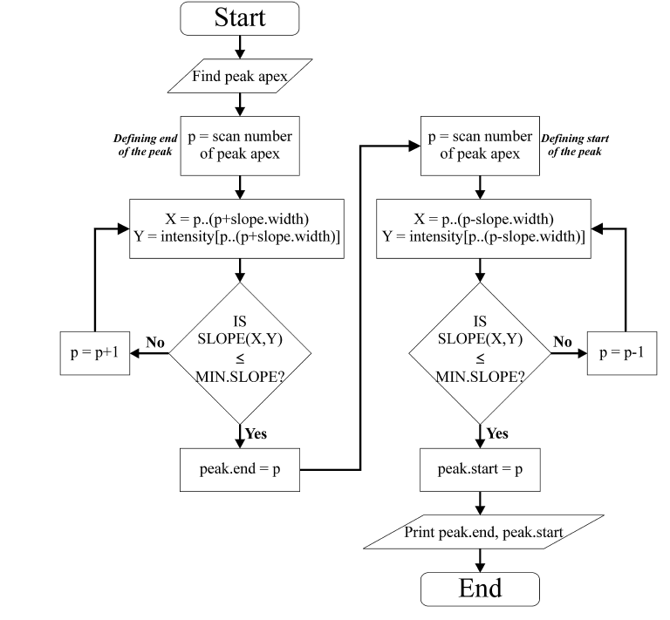
App #1
1. Place, B.J., et al., Evaluation of the impact of peak description on the quantitative capabilities of comprehensive two-dimensional liquid chromatography. Journal of Chromatography A, 2014. 1368(0): p. 107-115.

Slide 35
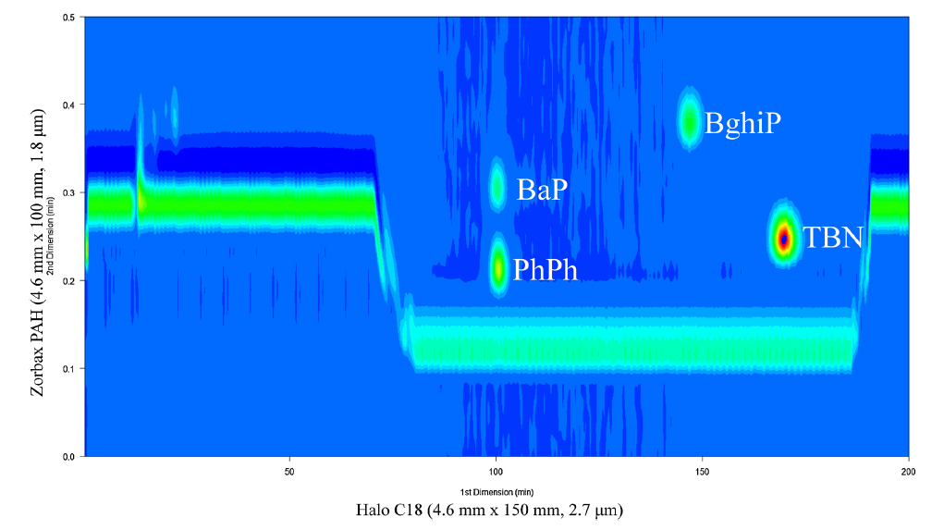
App #1
1. Place, B.J., et al., Evaluation of the impact of peak description on the quantitative capabilities of comprehensive two-dimensional liquid chromatography. Journal of Chromatography A, 2014. 1368(0): p. 107-115.

Slide 36
App #2-Dustin
Theoretical and Practical Interest in UHPLC Technology for 2D-LC
LC x UHPLC: for food analysis (compounds in wines, like phenolic compounds)
Advantages: small sample size: Peak capacity, corrected for under-sampling and orthogonality.
Disadvantages: If larger sample will cause under-sampling
UHPLC x UHPSEC: for polymer analysis (polyurethane and polymethacrylate)
Advantages: Short analysis time, info about relevant to assess the composition of the polymer, reduce the gradient time increase peak capacity
Disadvantages:
Sarrut, M., G. Crétier, and S. Heinisch, Theoretical and practical interest in UHPLC technology for 2D-LC. TrAC Trends in Analytical Chemistry, 2014. 63(0): p. 104-112.

Slide 37
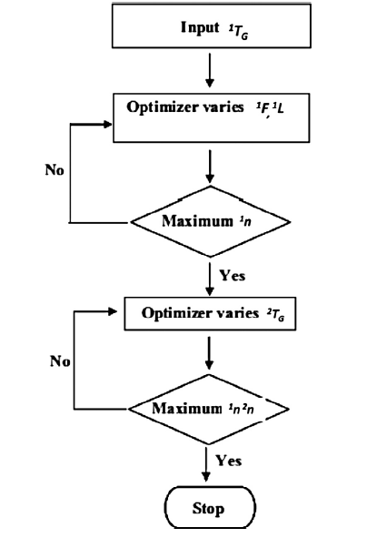
App #2-Dustin
Sarrut, M., G. Crétier, and S. Heinisch, Theoretical and practical interest in UHPLC technology for 2D-LC. TrAC Trends in Analytical Chemistry, 2014. 63(0): p. 104-112.

Slide 38
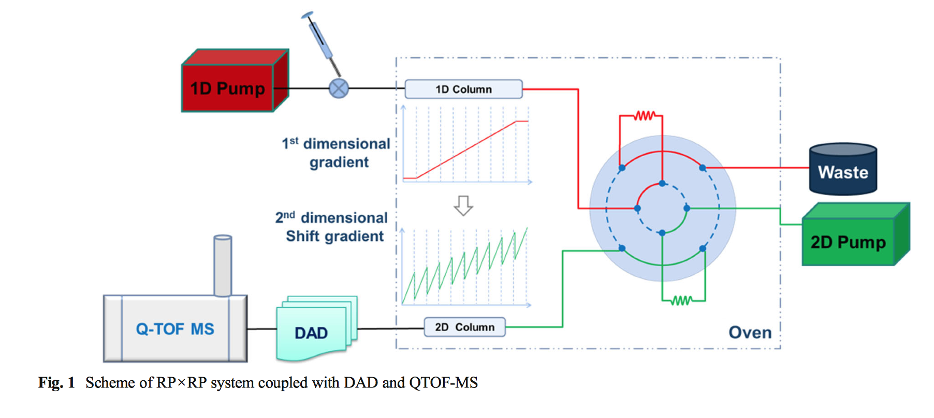
App #3-Rich
#8-10 Iridoid glycosides (IGs)
Chinese Herbal Medicines (CHM)
#1-7, 20 Flavonol glycosides (FGs)
Compounds of medium polarity analyzed after SPE extraction of strongly polar compounds. Ideal for RPxRP!
Luna CN/150x2mm/3.0μm
H₂O/MeOH
H₂O/ACN/0.05% FA/@2ml/min
C₁₈/50x3.0mm/2.6μm
Li, D.; Schmitz, O. J. Anal. Bioanal. Chem. 2014, Ahead of Print.
Notes:
R₁=OH, H, R₂=Glc, Glc-Gal, sambubioside, Rutinose, Glc-Gal-E-feruloyl, R₃=6-O-p-coumaroyl, feruloyl, 6-O-p-methoxycinnamoyl
How do they call this RP-RP? Based on the columns I would think its NP-RP…..isn’t a –CN column and normallike Stationary phase for NP?

Slide 39
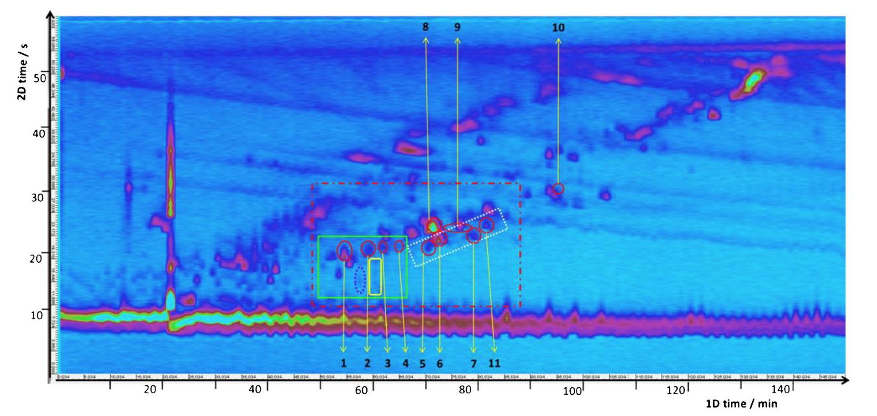
2-D Chromatogram-App #3
Iridoid glycosides #8-10
Novel acylated flavonol glycoside
Flavonoids #1-7, 11
Li, D.; Schmitz, O. J. Anal. Bioanal. Chem. 2014, Ahead of Print.

Slide 40
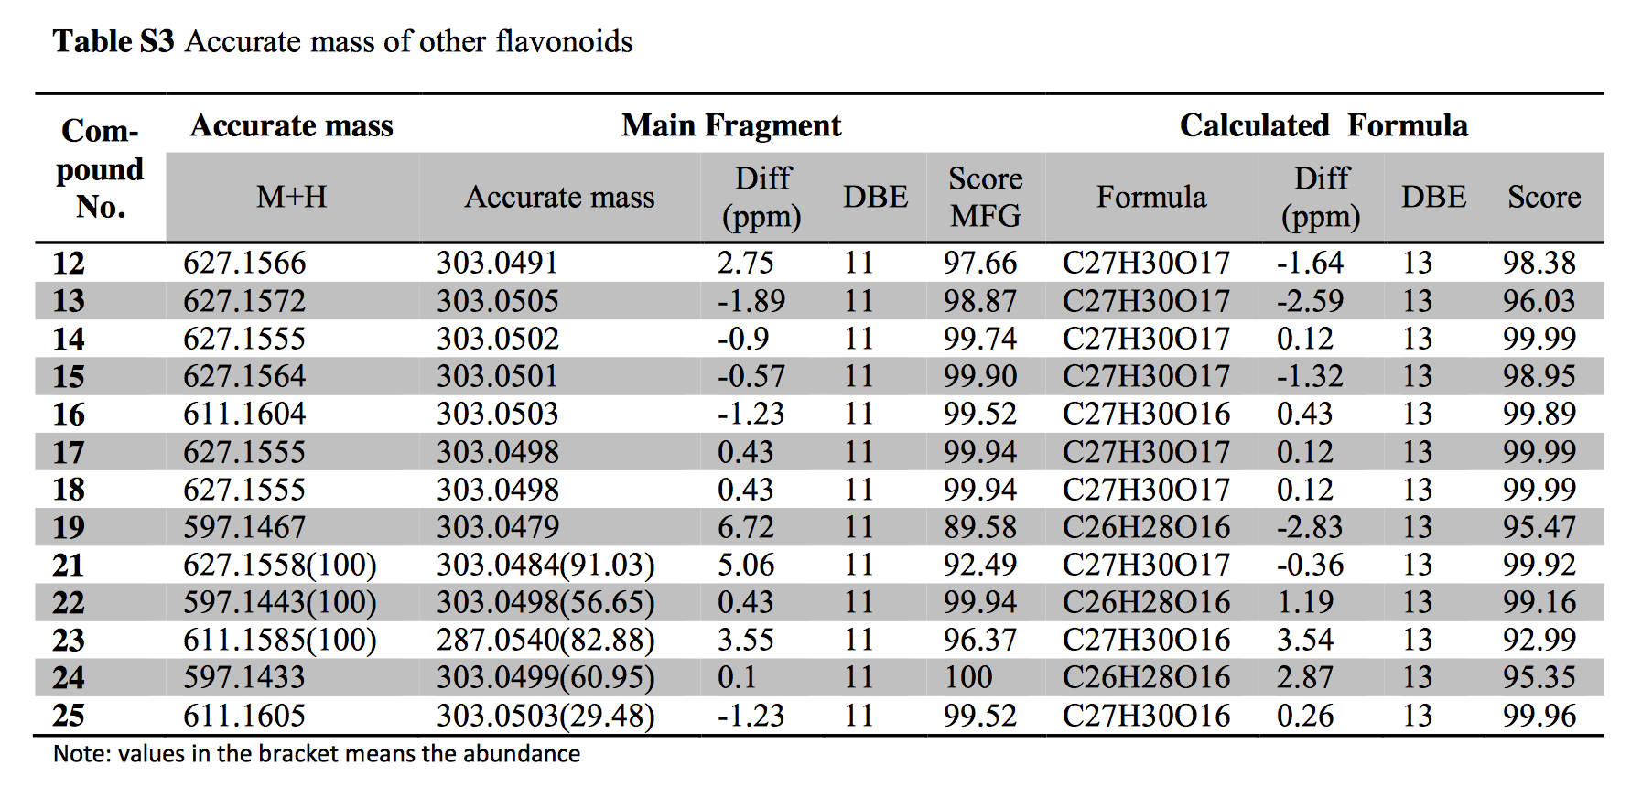
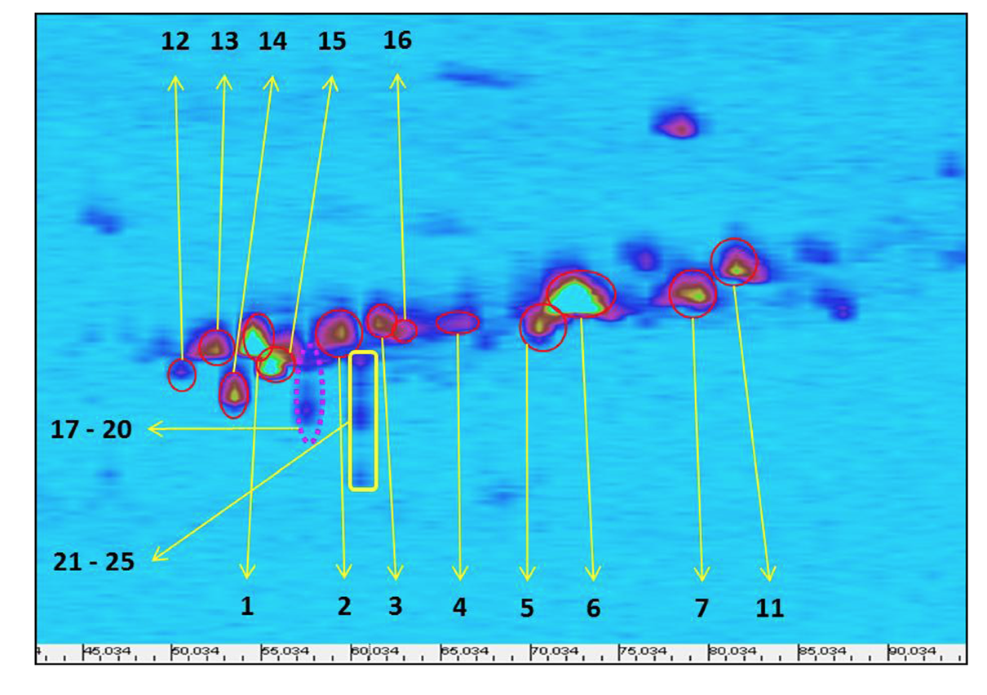
App #3-Zoomed-in Region
Li, D.; Schmitz, O. J. Anal. Bioanal. Chem. 2014

Slide 41
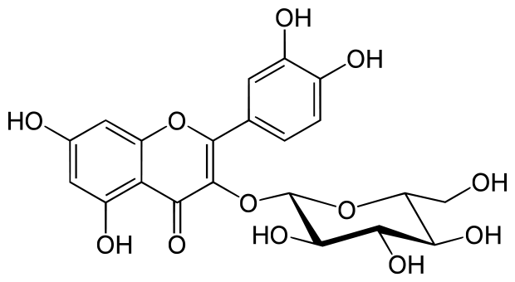
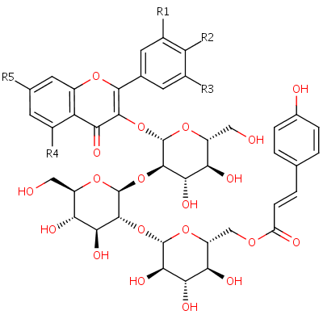
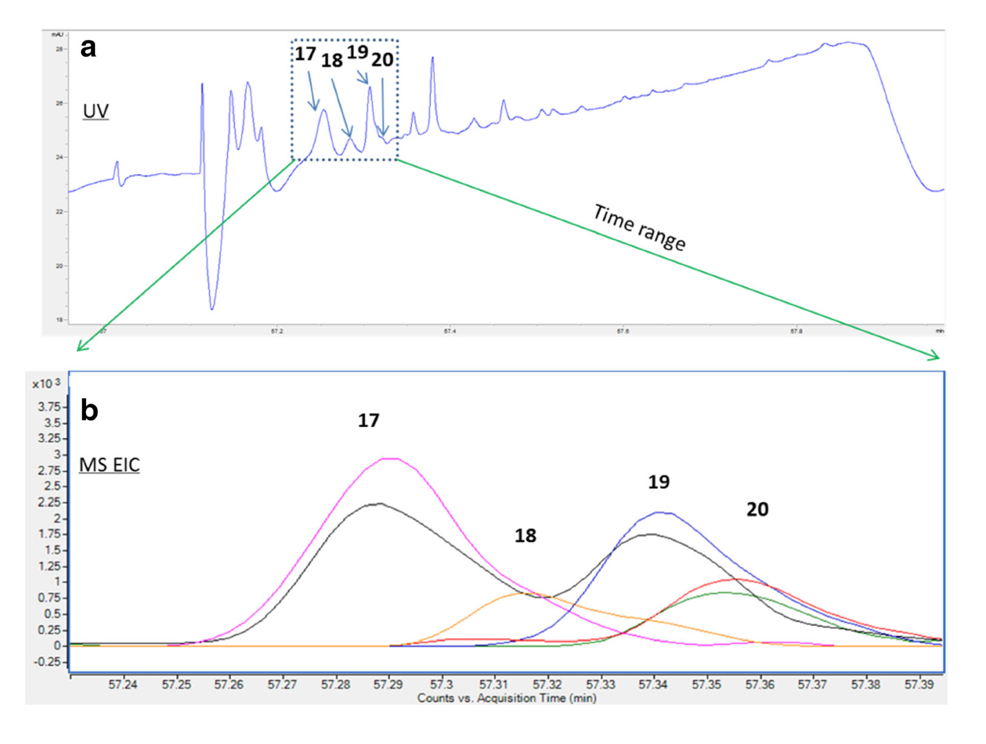
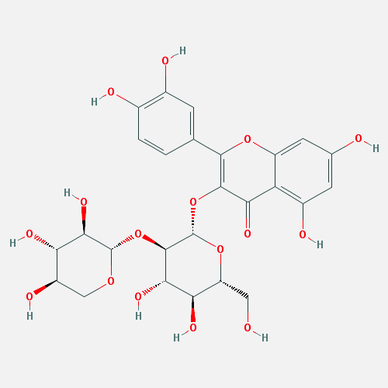
FGs UV Data
#17, isomer of #1 shown
#18 Novel Flavonol glycoside
UV @ 254 nm
MS EIC @ 56th min
#19, isomer of #2 shown
#20, 2 sugar moieties; Gal-Glc
Li, D.; Schmitz, O. J. Anal. Bioanal. Chem. 2014, Ahead of Print.

Slide 42
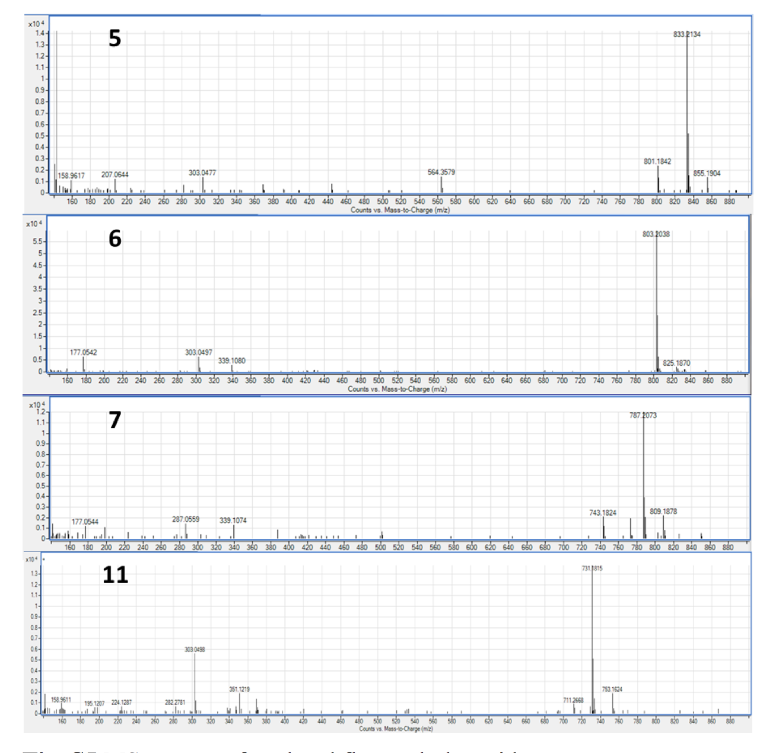
MS Data of Acylated FGs
Quercetin ion- characteristic ion of FGs @ m/z 303
Kaempferol @ m/z 287 by loss of sugar moieties.
FG was confirmed by UV-DAD
[M+H]⁺
? m/z 287 (product ion, not 303)
[M+Na]⁺

Slide 43
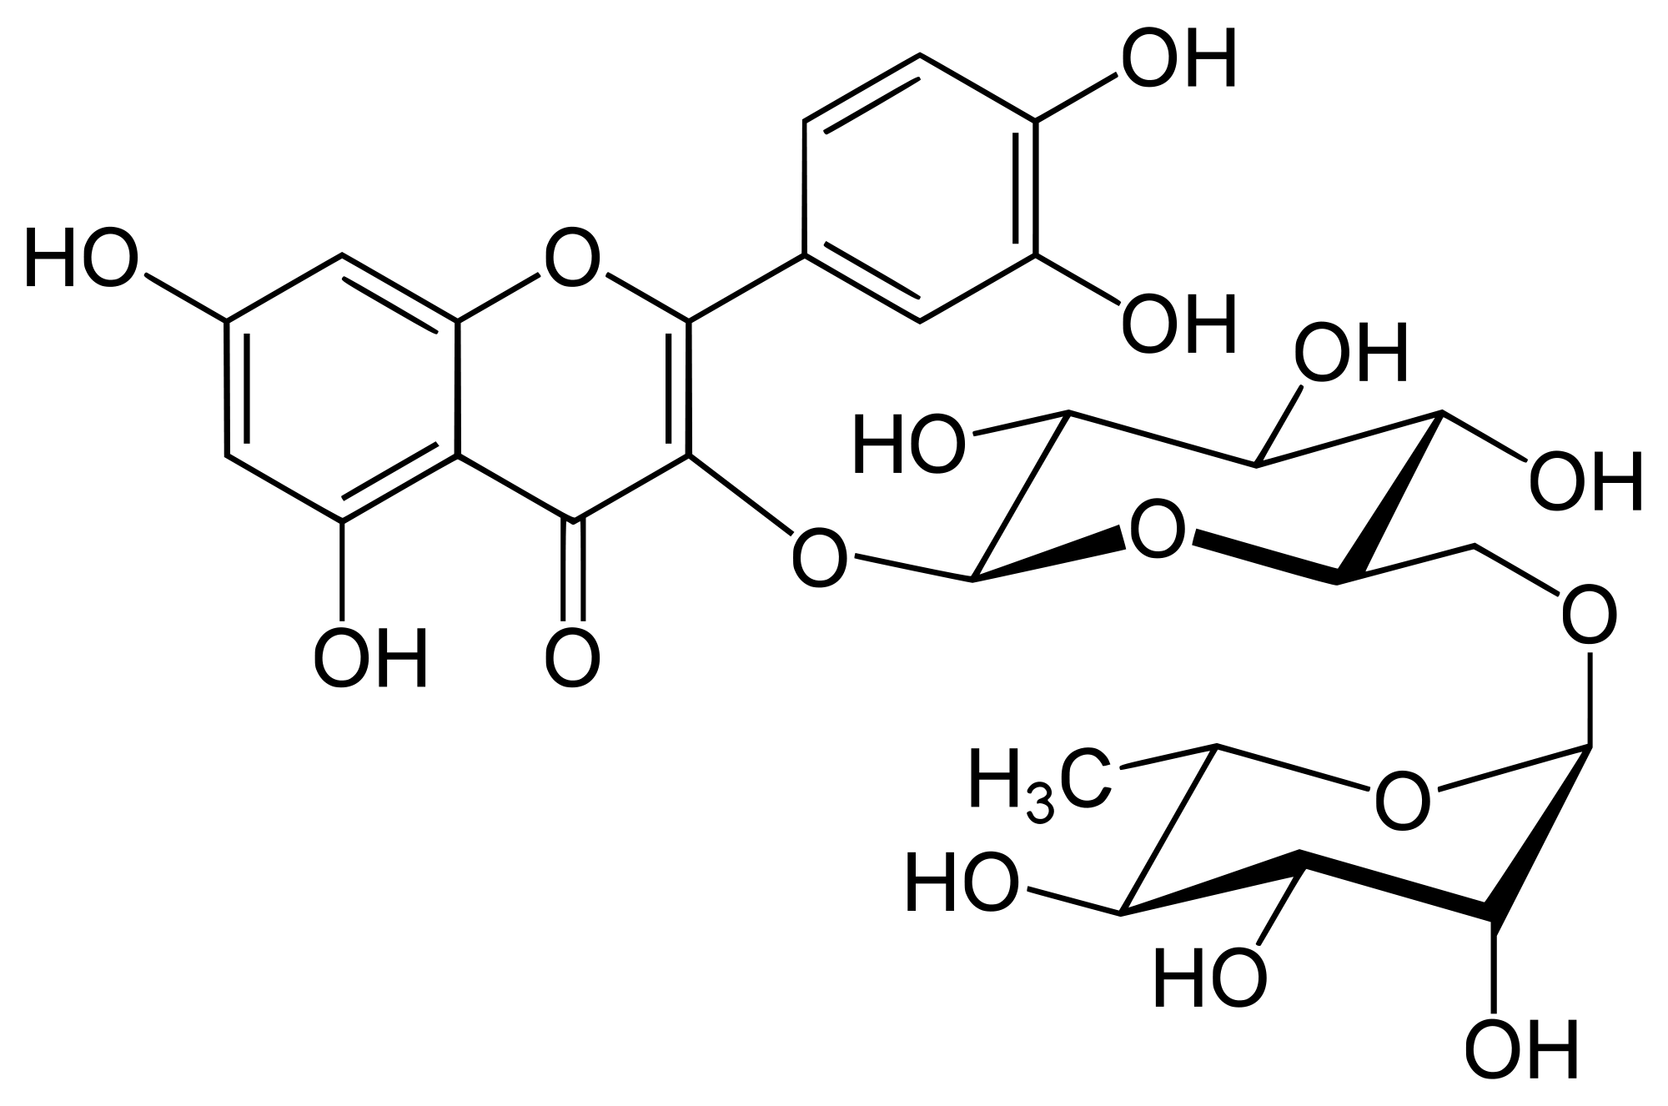
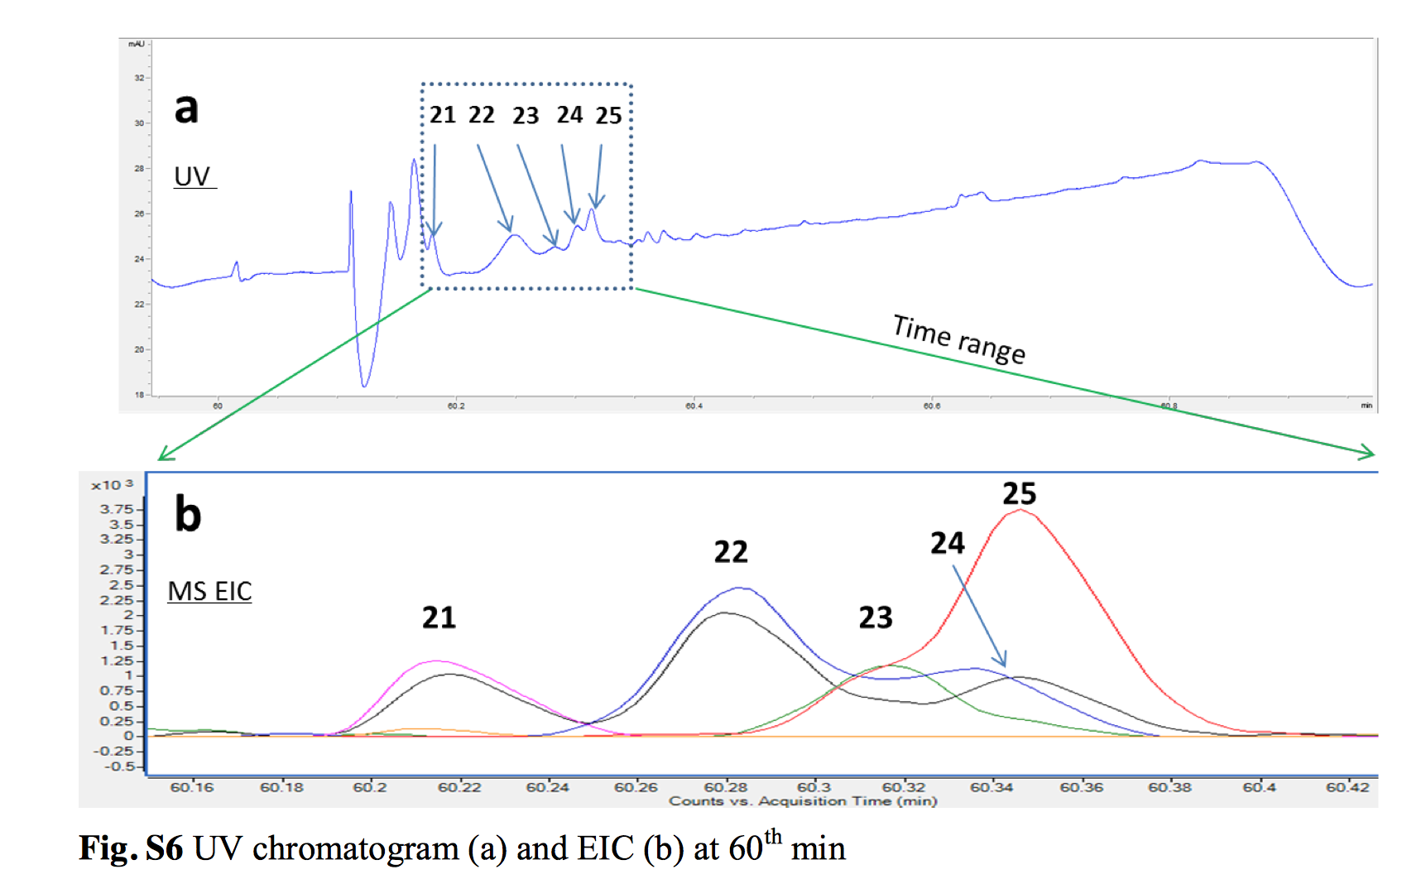
UV Data- FGs
All isomers of #1,2, 3 & 20:
#20
#2
#1
#3 Rutin
#20, 2 sugar moieties; Gal-Glc

Slide 44
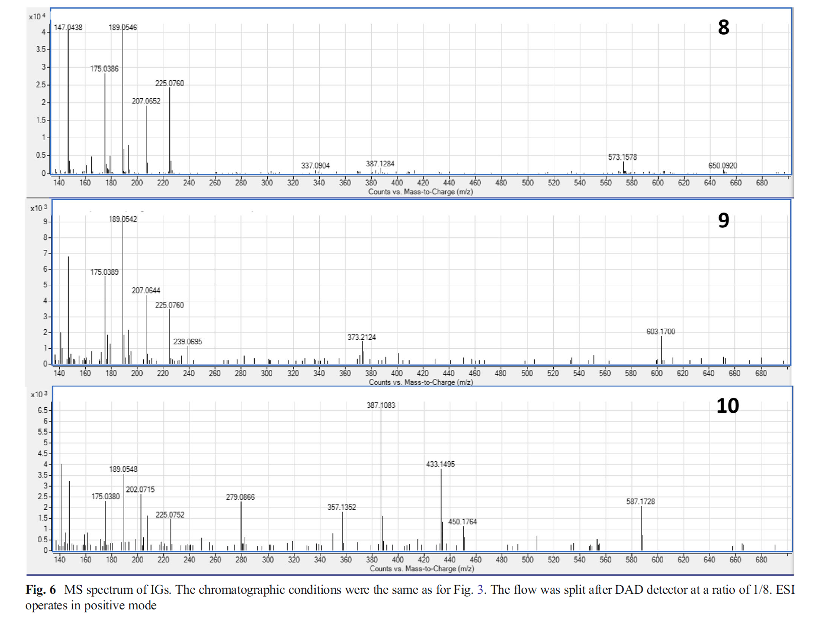
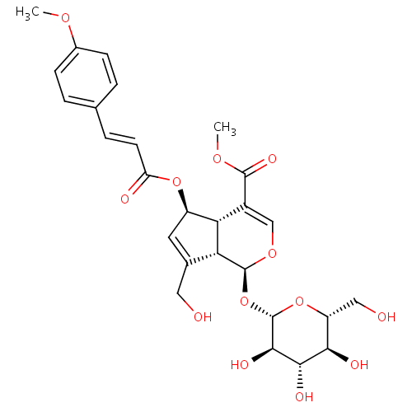
MS Data- Iridoid Glycosides (IGs)
I.D. of Acylated IGs by ESI-QTOF-MS in + ion mode
R₃ = alkyl group w/ 12 DBE
R₃= [coumaroyl]⁺ @ m/z 147
[M+Na]⁺ m/z 573
IG
6-O-feruloyl scandoside methyl ester
R₃= [feruoyl]⁺ @ m/z 177
[M+Na]⁺ m/z 603
6-O-p-methoxycinnamoyl scandoside methyl ester
C₂₇H₃₂O₁₃
R₃= [methoxycinnamoyl]⁺ @ m/z 161
[M+Na]⁺ m/z 587

Slide 45
Conclusions
2D LCxLC is expensive & complex but well worth the gain in separation potential & peak capacity for complex samples.
Increased peak capacity results in increased separation potential.
Peak description has an impact on quantitation in 2D LCxLC analysis of PAH’s & can be optimized.
The impact of different integration methods (5) on the quantitative abilities of LCxLC-UV was discussed.
  3-D chromatographic peaks can be quantified!

Slide 46
Conclusions
UHPLC in 2nd-D may be counterproductive to 1st-D and temp. elevations improve separation power but are evasive to samples and instrument.
Optimization: described by 3 conflicting criteria
  Effective peak capacity, analysis time in 2nd-D and frequency of sampling from the 1st dimension, method sensitivity….we need more tools!
LCxLC Tandem DAD/QTOF-ESI-MS for the analysis of CHM’s, showed superior resolving power & highly accurate mass measurements.
22 Flavonoids(FGs), 3 Iridoid glycosides (IGs) were characterized by QTOF-ESI-MS & confirmed by UV (DAD) w/ clear classification of FGs, acylated FGs, & IGs that were all shown in different regions of the LCxLC contour plot.
  Sample complexity less of an issue.

Slide 47
Future Work
Improve Optimization: limit undersampling & peak broadening while maximizing orthogonality
Explore peak description for 3-D chromatograms
Improve software
Explore additional options for tandem detection coupled with LCxLC for accurate compound identification….like DAD/Q-TOF-MS
Lower the cost of LCxLC systems
Decrease analysis runtime

Slide 48
Questions?

Slide 49
Appendix

Slide 50
Comprehensive On-line
Criteria to be called comprehensive
entire sample analyzed in both dimensions
and
resolution of first dimension maintained - despite cutting into limited number of fractions
Schoenmakers, P., Majors, R. E. LCGC North Am. 2008, 70.

Slide 51
Accomplishing Comprehensive
valve switching accomplishes the first - that is all of sample analyzed
second criteria maintaining peak capacity of both columns is more difficult –
  Fractions from first column injected onto second column – recombine in the loop of the valve
  Band broadening in the second column from first column injection
  Orthogonal separation
Schoenmakers, P., Majors, R. E. LCGC North Am. 2008, 70.

Slide 52
Optimization
Optimizing efficiency, selectivity, and resolution
Maximizing orthogonality
Dilution issues
Detector issues
Bedani, F., Schoenmakers, P., Janssen, H. J. Sep. Sci. 2012, 35.

Slide 53
Optimization
1D optimization
  efficiency-related theories choosing most suitable mobile flow rate and gradient program and characteristics of particle designs and columns
  selectivity/retention models focus on types and strengths fo interactions that contrail retention and selectivity
2D optimization
  more parameters involved
  plus changing parameter on one column can impact the other column plus dilution factor makes detection issues more critical
a unified theory for optimization is still lacking (2012)
Bedani, F., Schoenmakers, P., Janssen, H. J. Sep. Sci. 2012, 35.

Slide 54
GOAL of OPTIMIZATION
three quality descriptors
  Resolving power
  Time
  Detection limits – dilution an issue with two columns

Slide 55
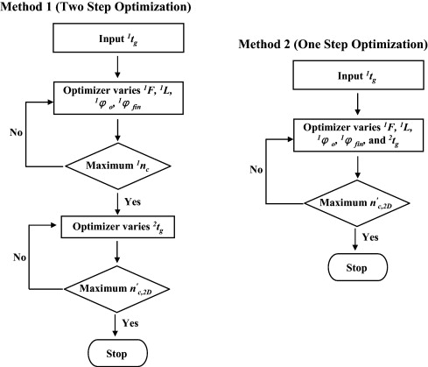
Fig. 1 Flow diagrams for method 1 (two step optimization) and method 2 (one step optimization) optimization. In method 1, the same conditions are used in the LC × LC system and then the effective LC × LC peak capacity of this system is further maximized by...
Haiwei Gu , Yuan Huang , Peter W. Carr
Peak capacity optimization in comprehensive two dimensional liquid chromatography: A practical approach
Journal of Chromatography A, Volume 1218, Issue 1, 2011, 64 - 73
http://dx.doi.org/10.1016/j.chroma.2010.10.096

Slide 56
A novel stop-flow two-dimensional liquid chromatography–mass spectrometry method for lipid analysis
Shuangyuan Wang, Jia Li, Xianzhe Shi¹ , Lizhen Qiao, Xin Lu, Guowang Xu,
Abstract
A novel on-line two dimensional liquid chromatography (2D LC) based on stop-flow mode coupled with electrospray ionization mass spectrometry (ESI–MS) method was established to separate lipids in human plasma. Hydrophilic interaction liquid chromatography (HILIC) in the first dimension and reversed-phase liquid chromatography (RP LC) in the second dimension were used to separate the lipids into six fractions based on their polar head groups and further into peaks based on aliphatic chains, respectively. A new stop-flow interface with a trap column and an extra make-up flow was designed to construct this system and trap the components eluted from the first dimension. Moreover, the same length of analytical columns and similar flow rates were used in the first and second dimensions. Therefore, the new stop-flow 2D LC system can avoid the sensitivity decrease caused by the dilution effect, which is the shortcoming of comprehensive 2D LC. Three hundred and seventy-two lipids were identified from plasma extract using this 2D LC coupled with ESI–MS in positive mode, and 88 more lipids were detected than one-dimensional RP LC analysis. Peak capacity of this stop-flow 2D LC was 415, which is similar to that of comprehensive 2D LC. The linearity, repeatability and sensitivity of this method were satisfactory, which demonstrated that this method was also suitable for quantitative analysis. All these results indicated that this on-line 2D LC method is powerful for qualitative and quantitative analysis of complex lipids
Journal of Chromatography A
2013 Volume 1321

Slide 57
Pros and Cons of LC x LC
Pros:
Fast runtime
Increased peak capacity
Sample dimensionality
Easily interpretable chromatograms
Improved separation
Improved resolution
Addition of MS yields quality 3-D separations
Cons:
Detectors
  complication compounded by dilution with UV
Software
  data collection and manipulation
Method optimization
  problems optimizing systems of opposite polarity
Mobile phase compatibility
No cryogenic modulation like GC
Complicated equipment
$

Slide 58
Applications
Quantitative LCxLC
UHPLC and (HT)-UHPLC in the 2nd dimension

Slide 59
Two ways to interface
Most common - continuous low-flow using the ten-port loop
Stop-flow method another option alternating high flow with no flow
Trapping column (packed loop) interface: sample fraction concentration (focusing), low extra-column band broadening, enhanced sensitivity.
Vacuum evaporation interface: coupling of NP-LC and RP-LC with immiscible mobile phases, evaporation of a low-boiling organic solvent from the 1st column effluent before releasing the sample in aqueous organic mobile phase to the RP-LC 2nd D.
Pavel

Slide 60
Interface between columns on-line 2D
transfer from first to second column
within the LC x LC system
rapid separation in second column so it is
ready to receive the next fraction
transfer of effluent from first to second column
  variety of methods
  focus comprehensive on-line
must be performed periodically in
fractions of uniform volume
Bedani, F., Schoenmakers, P., Janssen, H. J. Sep. Sci. 2012, 35.

Slide 61
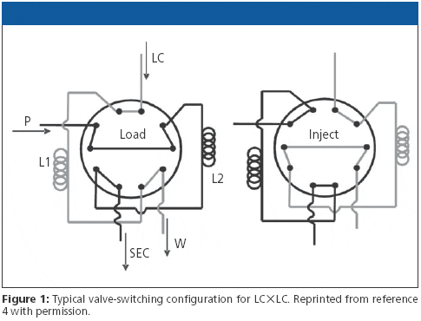
10-port Switching Valve
Injection onto 2nd column
1-D t_{R} is slow!!
Switch valve
Detector
Schoenmakers, P., Majors, R. E. LCGC North Am. 2008, 70.

Slide 62
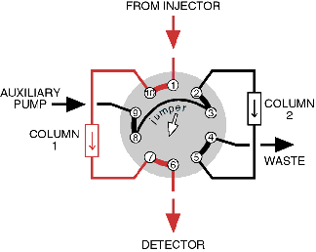

Slide 63
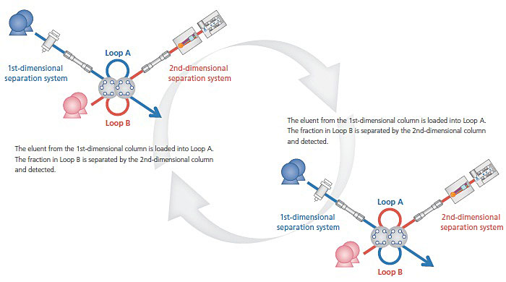
http://www.ssi.shimadzu.com/products/product.cfm?product=nexera-e_2

Slide 65
Fully automated on-line two-dimensional liquid chromatography in combination with ESI MS/MS detection for quantification of sugar phosphates in yeast cell extracts
A mass spectrometric quantitative assay was developed for the analysis of 10 sugar phosphates in the yeast Pichia pastoris. As a novelty, two-dimensional chromatography based on a fully automated heart-cutting LC-LC technique was introduced. Using a ten-port valve, ten fractions of the first chromatographic dimension, i.e. anion exchange chromatography (AEC), were transferred and separated by the orthogonal second dimension, i.e. separation on porous graphitized carbon. The chromatographic separation on the second dimension was optimized for each transferred fraction minimizing the separation time and ensuring complete removal of the salt constituents of the AEC eluents. The latter being crucial for electrospray mass spectrometric detection was confirmed by combining the LC-LC separation with on-line ICP-MS detection. These measurements showed that sodium elution was completed after 0.8 min. Consequently, an analysis time of 1 min per transferred peak was established. In this way, the excellent peak capacity given by ion exchange could be conserved in the second dimension at the same time enabling mass spectrometric detection. Sub-μM limits of detection could be obtained by the new LC-LC-MS/MS methods ranging between 0.03 and 0.19 μM for the investigated compounds (only 3GAP showed a LOD of 1 μM). The method was applied to the quantification of ten sugar phosphates in yeast extracts utilizing internal standardization with a fully labeled ¹³C yeast extract. Typically, the standard uncertainties for N = 3 replicates assessed by the LC-LC-MS/M
http://pubs.rsc.org/en/content/articlelanding/2014/an/c3an01930f#!divAbstract S set-up were <5%.
Klavins, K. et al
Analyst, 2014,139, 1512-1520

Slide 66
http://www.chromatographyonline.com/lcgc/article/articleDetail.jsp?id=487477&sk=&date=&pageID=7

