Slide 1
Field Flow Fractionation (FFF)
Presented By:
Sam Klinge & Luis Valdiviez

Slide 2
Outline
What is FFF?
History
Understanding the instrument
How is it used?
Types of FFF
Theory
Optimization
Instrumentation Coupling
Why is it used?
Practical application

Slide 3
A Historical perspective
FFF was first conceptualized in the 1960s by Calvin Giddings
basic model was then invented in 1966
A couple of decades were then required to gain a working base of FFF sub-techniques and to adapt instrumentation and procedures to experimental needs.
Since 1980s various types of FFF have been created for separating macromolecules
http://www.postnova.com/general-theory.html

Slide 4
What is FFF?
Family of elution techniques
Capable of separation and measurement
Based on field applied to fluid suspension
Separates particles based on mobility under force field
High resolution with separation over wide colloidal size range makes FFF unique: 1nm->100 μm
mass, size, density, charge, and diffusivity can be measured

Slide 5
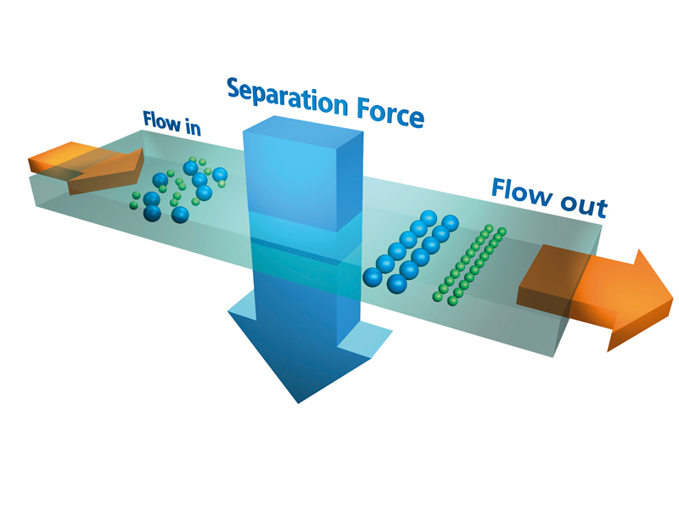
What is FFF?
type of separation that utilizes the interaction between the solute and the external force applied to the channel
only a mobile phase within this separation -no column is used in molecule separation
separation occurs primarily based on size and velocity but depending on the external force applied other factors also take effect
Each type off FFF has modification to separation process
http://www.postnova.com/general-theory.html

Slide 6
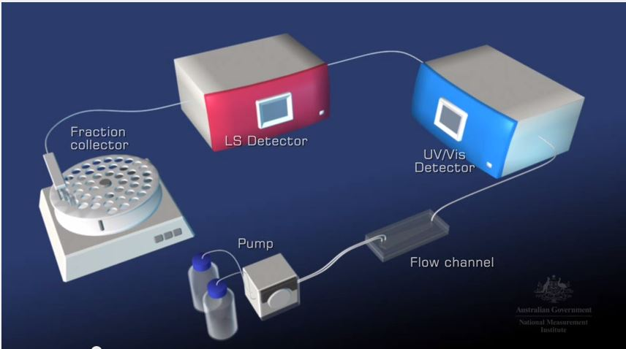
What is FFF?
Diagram of whole schematic

Slide 7
A Family of Instrumentation: Types of FFF
Flow FFF
Universal separation technique that can separate all kinds of macromolecules and particulates
Electrical FFF
An electrical field is applied to separate charged molecules within samples.
Asymmetric Flow FFF
Contains one semi-permeable membrane on the bottom wall of the channel. The cross flow is, therefore, created by the carrier liquid exiting the bottom of the channel. This offers an extremely gentle separation and an “ultra-broad” separation range
Lift-hyperlayer FFF
Free of wall particle disturbances, Flow rate has weakest dependence on diameter
Steric FFF
Larger particles elute first
http://www.postnova.com/general-theory.html

Slide 8
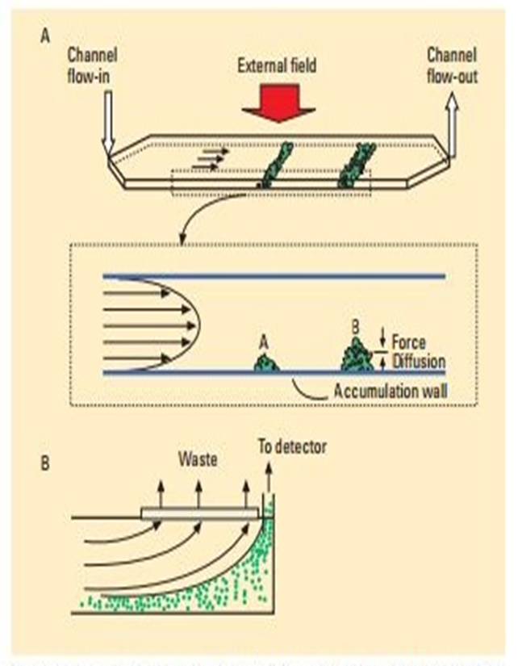
A Family of Instrumentation: Types of FFF
Sedimentation
http://www.postnova.com/general-theory.html

Slide 9
A Family of Instrumentation: Types of FFF
SPLITT
Thermal
http://www.postnova.com/general-theory.html

Slide 10
Fractograms
Sedimentation FFF
Thermal FFF
Giddings, J. C. (1993). Field-Flow Fractionation: Analysis of Macromolecular, Colloidal, and Particulate Materials. Science, 260(5113), 1456-1465. doi: 10.2307/2881513

Slide 11
Theory
Analytes are injected into the channel and are separated based on the field being applied hugging one side of the channel with a width of 1-10μm.
Because there is no packing material or interaction with a stationary phase the retention of analytes is related to a mean layers thickness and the channel thickness.
When different forces are applied F within the equation relates to the applied force.

Slide 12
Theory Basic equations
Retention relating to layer thickness l and channel thickness w
$$R=\frac{6l}{w}\left[\coth{\frac{w}{2l}−\frac{2l}{w}}\right]$$
Approximated simple form
$$R=\frac{6l}{w}$$
Layer thickness l given by gas constant R, Absolute temperature T and F
$$l=\frac{RT}{F}$$
Final simple equation
$$R=\frac{6RT}{Fw}$$

Slide 13
Optimization
Simultaneously alter field strength and flow rate
To increase resolution:
Increase field strength
Increase analysis time and possible sample loss
Reduced analysis time:
Increase flow rate
Decrease resolution

Slide 14
Making a great pair… Hyphenation
Myriad of detectors can be used in combination with FFF:
Optical detection
UV-visual absorption (UV), Fluorescence, Refractive Index(RI), Light Scattering (LS)*
Nuclear Magnetic resonance (NMR) and MS
Small-angle X-ray scattering (SAXS) and Inductively coupled plasma (ICP)
Electrospray ionization often coupled because of flow restrictions

Slide 15
Practicality Advantages
created for the explosive growth in the study and manipulation of macro-materials in many disciplines of science and technology demanding:
improved separation
greater range
Higher resolution
versatility
highly selective and fast
Allowing for simultaneous measurement, simplified coupling to other measurement devices, automation, ready fraction collection, applicability to diverse samples over a broad mass-size range, gentleness in separating delicate species, and flexibility in targeting specific problem areas.

Slide 16
Practicality Advantages
Is a continuous flow which can elute fractions to be detected and fractioned
Different types of fields can be incorporated into the design for different types of separation
New separation doesn’t require new flow but rather a new field.
Flows and fields can be changed quickly allowing for better separation of molecules
Really simple to use and reproducible
As a result, theory provides many useful guide-lines for experiment and it underlies a broad capability for measurement

Slide 17
Practicality Disadvantages
Must compromise between resolution and speed for optimization
Cost!
Little need for instrument (not many labs use)
Small production scale

Slide 18
Application A variety of uses
http://www.americanlaboratory.com/913-Technical-Articles/134639-Field-Flow-Fractionation-Supporting-Consumer-Safety-Evaluation-of-Silver-Nanoparticle-Applications-in-Food-Packaging-Polymers/

Slide 19
Application
Log of Molecular weight

Slide 20
Application Biological and Biomedical
Biopolymers
By using electrical FFF and Flow FFF Proteins are able to be separated
DNA and Bioparticles
Separated by both sedimentation FFF and flow FFF
Same separations techniques can be used for Viruses and mitochondria
Liposomes and emulsions
Using Sedimentation FFF and flow FFF to separate colloidals
Cells
Steric FFF is used to separate cells > 2um in diameter

Slide 21
Application Industrial and Environmental
Industrial Colloids and particles
Use of Sedimentation FFF is used here to determine size of particles and then fraction them off
Larger molecules such as Gold, Palladium, Silver, Copper uses sedimentation- steric FFF
Environmental materials
Use of sedimentation FFF has been used to separate colloids in river waters
Use with inductively coupled plasma MS to view elemental profiles
Synthetic polymers
Thermal FFF have been used to examine many lipophilic polymers
While Flow FFF is used for more water-soluble polymer analysis

Slide 22
References
Giddings, J. C. (1993). Field-Flow Fractionation: Analysis of Macromolecular, Colloidal, and Particulate Materials. Science, 260(5113), 1456-1465. doi: 10.2307/2881513
http://www.postnova.com/general-theory.html
Department of Chemistry, University of California, Riverside, CA 92521, USA.Analytical and Bioanalytical Chemistry (Impact Factor: 3.66). 05/2012; 404(4):1151-8. DOI: 10.1007/s00216-012-6069-5
http://depts.washington.edu/chemcrs/bulkdisk/chem429A_spr07/notes_FFF%20guest%20lecture.pdf
Wahlund, K.-G. (2013). Flow field-flow fractionation: Critical overview. Journal of Chromatography A, 1287(0), 97-112. doi: http://dx.doi.org/10.1016/j.chroma.2013.02.028

