Slide 1
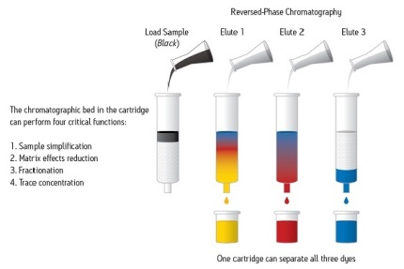
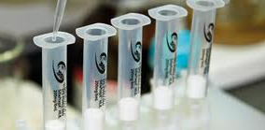
Or….so, when do we get to run the samples?
Solid Phase Extraction (SPE)
Prof. Justin P. Miller-Schulze, Ph.D.
CHEM 230
September 16 2014

Slide 2
Solid Phase Extraction (SPE)
What is SPE?
Types of SPE
Why do we have to do SPE?
SPE Method Development Example (s)

Slide 3
What is SPE?
Solid Phase Extraction is Liquid Chromatography (SPE is LC)
  We are forcing the analyte to make a decision between remaining attached to the stationary phase or going with the mobile phase
  In LC, this is upstream of a detector
  In SPE, this is upstream of subsequent sample processing steps

Slide 4
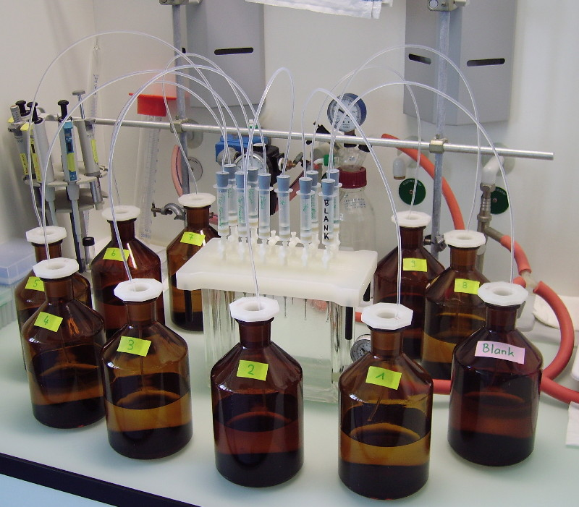
Vacuum line (with a trap, hopefully!) –this draws the water through the cartridges
Vacuum manifold-all the “extracted water” ends up here (combined)-if you wanted the “cleaned up” water, you would need a different set-up!
SPE “cartridges”: plastic tubes filled with specific mass (~250 mg) of a specific solid phase
Samples being extracted (in this case, aqueous water samples)

Slide 5
Example of Reversed-Phase SPE Steps

Slide 6
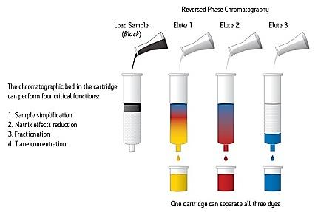
What is SPE-Loading
Sample (contains analytes and a bunch of other stuff)
The efficiency of the loading step (how many analyte molecules get “stuck” onto the stationary phase) is dependent on the polarity of the:
-Analytes
-Stationary phase
-Mobile phase
You can change all of these!
To Trap Non-polar analytes, you want….
Nonpolar stationary phase and polar mobile phase
Plastic or Glass cylinder
Frits (porous grate to keep solid phase from falling out)
To Trap Polar analytes, you want….
Polar stationary phase and nonpolar mobile phase
Solid Phase-
Can be reversed phase (i.e., C18),
Normal Phase (i.e., silica)
Cation or Anion exchange
(with + or – charge groups)

Slide 7
What is SPE-Elution
Elution Solvent
If reverse-phase, something like methanol, acetonitrile, etc (relatively polar organic solvent).
Retained compounds-either
undesired (interferences) or
desired (different analyte class from those eluted in elution 1/2/3)
Unretained compounds-analytes of interest in elution solvent matrix (subsequent concentration may be needed)

Slide 8
Vacuum line (with a trap, hopefully!) –this draws the water through the cartridges
Vacuum manifold-all the “extracted water” ends up here (combined)-if you wanted the “cleaned up” water, you would need a different set-up!
SPE “cartridges”: plastic tubes filled with specific mass (~250 mg) of a specific solid phase
Samples being extracted (in this case, aqueous water samples)

Slide 9
https://www.youtube.com/watch?v=D6SyHU6CcOU

Slide 10
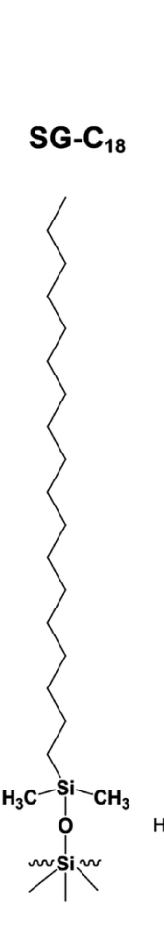


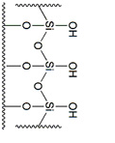
SPE Solid Phases
Reversed-Phase Groups
  C18 (most commonly used); best for trapping compounds with alkyl groups
  Phenyl: good for enhanced retention of aromatic compounds
  “Stronger” solvent is less polar
Normal-Phase Groups
  Cyano (-CN)
  Amino (-NH₂)
  Hydroxy (diol or SiOH)
  “Stronger” solvent is more polar

Slide 11
Advanced Extraction Techniques
Solid Phase Extraction
Ion Exchange Stationary Phases
  Sulfonate groups common for cation exchange
  Ammonium groups –NR₃⁺ common for anion exchange
  Trapping occurs in low ionic strength solvents; release occurs in high ionic strength
  Weak acids/bases need to be trapped in ion form but also can be released by pH adjustment

Slide 12
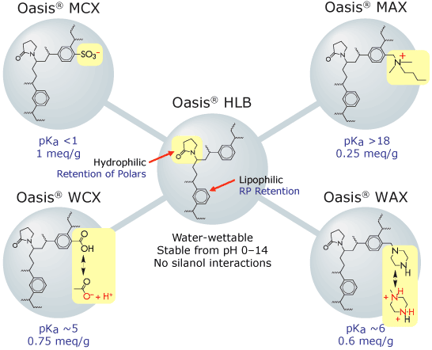
Strong-Cation Exchanger
Since functional group is strong(er) acid
RARELY NEUTRAL, MOSTLY NEGATIVE
Strong-Anion Exchanger
Since functional group is strong(er) base
RARELY NEUTRAL, MOSTLY POSITIVE
Weak-Cation Exchanger
Since functional group is weak acid
SOMETIMES NEUTRAL,
SOMETIMES NEGATIVE
Weak-Anion Exchanger
Since functional group is weaker(er) base
SOMETIMES NEUTRAL,
SOMETIMES POSITIVE
http://www.waters.com/waters/en_US/Oasis-Sample-Extraction-Products/nav.htm?cid=513209

Slide 13
Example Processing Steps for Cation Exchange
Analytes/Sample Matrix=
amphetamines (1º, 2º amines) in wastewater
Acidify Sample (To make amines +)
Load MCX cartridge (weak cation exchange)
Rinse with low pH organic (2% Formic Acid in methanol)
Elute with high pH organic (2% NH₄OH in methanol)
Concentrate under N₂
Slide Credit: Prof. Dan Burgard, University of Puget Sound

Slide 14
Why do we have to do SPE?
Any thoughts?

Slide 15
Why Do We Have To (or Want To) Do SPE?:
SPE can be used to enrich (increase the concentration of) trace chemical species
SPE can be used to remove interferences and simplify the matrix of the collected sample
  Complex sample matrices = urine, blood, serum, plasma, tissue, sediment…..
SPE can be used to reduce ion suppression in for techniques involving mass spectrometry detection
  Kind of a “sub-reason” of (2)
SPE can be used to separate the sample into different analyte classes
  Polar analytes can be analyze by LC-MS, non-polar analytes by GC-MS, etc.

Slide 16
SPE can be used to enrich (increase the concentration of) trace chemical species
  Enrich = Concentrate
  i.e., to INCREASE the concentration of the analyte
  In many applications (environmental sample analysis, pharmaceutical applications, biomonitoring, etc.) there is too little of the analyte present to directly analyze collected samples

Slide 17
SPE can be used to enrich (increase the concentration of) trace chemical species
  We can change some things about the methodology:
    Injection volume of method
    Volume of sample collected
    Volume of final extract
  These factors can make the necessary concentration factor less (i.e., you don’t need to concentrate as much)
  But everything is inter-related, and the method may or may not be amenable to modification
“Pay me now or pay me later…”

Slide 18


Contaminants of Emerging Concern in Puget Sound: A Comparison of Spatial and Temporal Levels and Occurrence
Justin P. Miller-Schulze, Alex Gipe, Derek Overman, Joel E. Baker
May 2 2014

Slide 19
Our CECs
CEC | Use/Application
Acetaminophen | Pain Reliever (Tylenol)
Atrazine | Herbicide
Caffeine | Stimulant
Carbamazepine | Anti-Seizure Medication
Cotinine | Nicotine Metabolite
Ethyl Paraben | Anti Microbial
Ethyl Vanillin | Artificial Flavoring
Ibuprofen | Anti-Inflammatory
Methyl Paraben | Anti Microbial
Mecoprop | Herbicide
Nicotine | Stimulant
Paraxanthine | Caffeine Metabolite
Ensulizole | UV Filter (Sunscreen Agent)
Propyl Paraben | Anti Microbial
Ractopamine | Feed Additive (Swine)
Sulfadimethoxine | Antibiotic (animal)
Sulfamethoxazole | Antibiotic (human)
Sulfamethazine | Antibiotic(animal)
Sucralose | Artificial Sweetener
Theobromine | Caffeine Metabolite/ Chocolate Ingredient
CECs are of interest due to their impact on human health, environmental health/ecotoxicology, or source tracing
Our suite of CECs was developed primarily with source tracing in mind, although a few have toxicological relevance

Slide 20
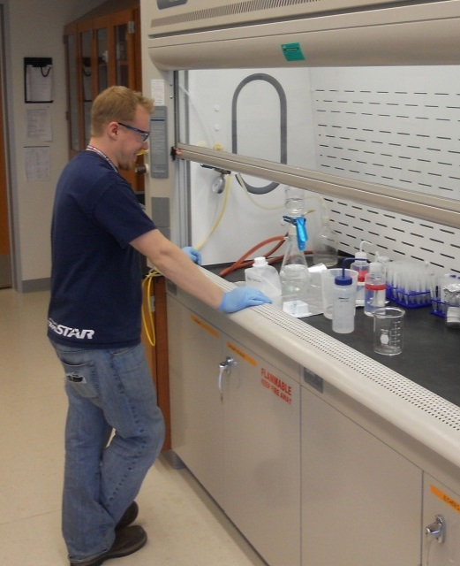
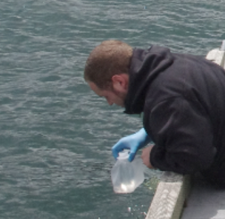
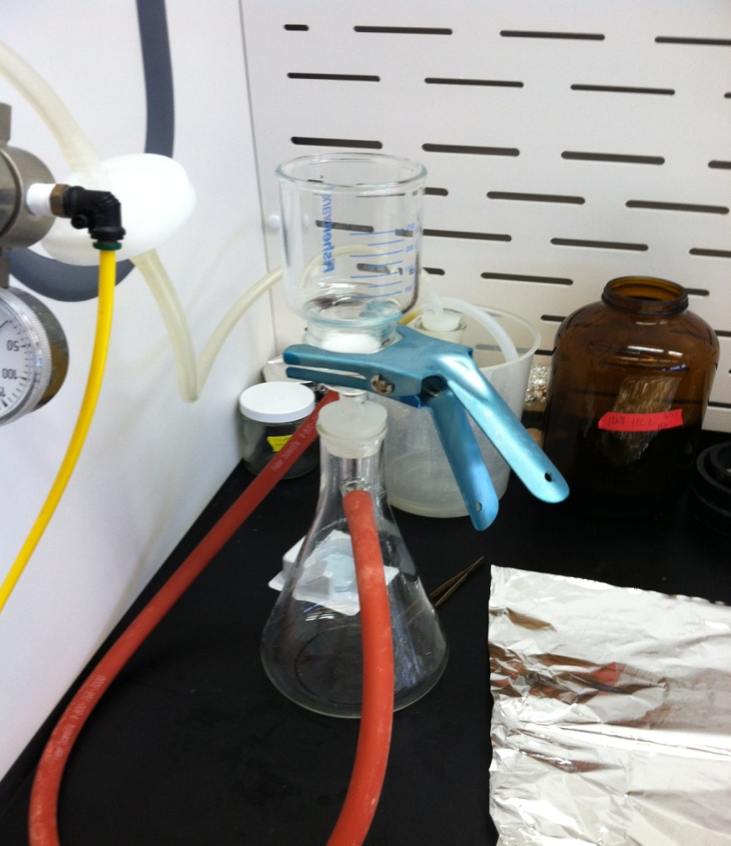
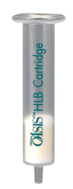
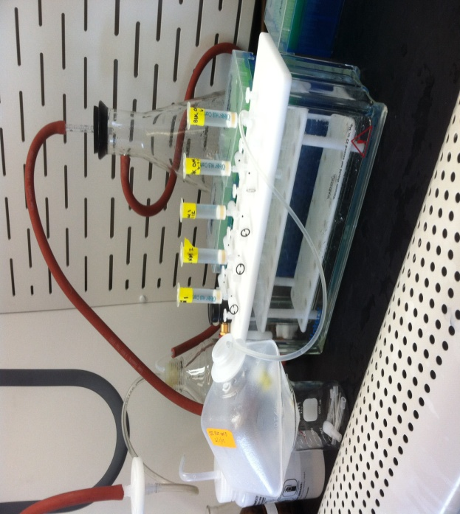
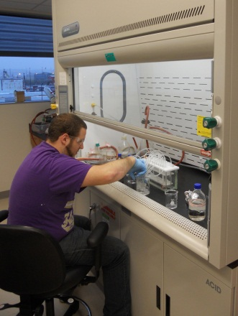
Filtration
pH
Spike w/ isotopically-labeled recovery surrogates
Filter (0.7, 0.45, 0.2 µm pore size in sequence)
removes dissolved matter and some biological material
Stabilize pH at
8 ± 0.1
Samples collected in 1liter LDPE cubitainers or 1250 ml glass bottles
Extraction
~18 samples = ~20 person-hours of lab time
Final
Sample Matrix
Preparation
Elution + Evaporation
150 µl sample is brought up to 1500 µl with pH = 2.8 acetic acid and spiked with 10 µl
Internal standard mixture
Measurement by HPLC-MS/MS
Samples are eluted with organic solvent (methanol and/or methanol/MTBE mixture) and then concentrated to ~150 µl
Extraction with nonpolar “Oasis HLB” solid phase extraction cartridge concentrates analytes and removes (some) sample matrix interferences

Slide 21
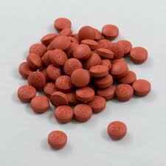

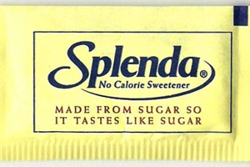
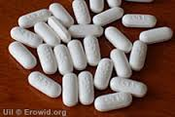
Typical concentrations of environmental tracers:
Parts per trillion or nanograms per liter (ng/L)
1 part per trillion corresponds to about 3 seconds in 100,000 years
OR
1 drop of water (50 µl) in 20 Olympic sized swimming pools
Some chemical tracers:
200 mg caffeine/cup of coffee
200 mg ibuprofen/tablet
325 mg acetaminophen/
Regular Strength Tylenol
(500 mg/ Extra Strength)
~50 mg sucralose/1 packet Splenda
SPE may be necessary to enrich the concentration of the analytes in the collected sample

Slide 22
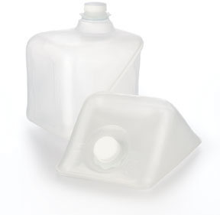
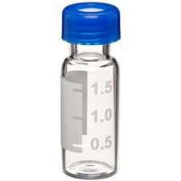
Sounds like a lot of work…and it is!
COLLECTED SAMPLE
But it’s necessary:
Because the concentrations of these EC Tracers in the environment should be ~1 ng/L or less.
The injection volume of our final extract is 20 µl-at a nominal environmental sample concentration of 1 ng/L, this pencils out to a 2 femtogram injection
1 fg = 1 x 10⁻¹⁵ grams
So, in order to see the levels present in mixed surface and/or groundwater, we need this 1000-fold concentration factor
Volume =
1000 ml
SAMPLE
EXTRACT
Volume =
1 ml

Slide 23
SPE can be used to enrich (increase the concentration of) trace chemical species
Example Limit of Detection of a Mass Spectrometry-based detector method (i.e., GC-MS):
1 pg on column
Example GC-MS injection volume:
2 µl
Typical concentration of environmental tracer in water:
1 ng/L
Two good test questions (to me at least):
  True/False: The concentration of this tracer is high enough to be detected at a concentration above the LOD with out enrichment?
  If the answer to (1) is FALSE, what is the necessary amount of enrichment for this sample?

Slide 24
Enrichment Sample Problem
  The method LOD for caffeine in surface water for an HPLC-MS/MS method is 25.00 ng/ml (concentration in the sample extract) What is the necessary amount of enrichment for this sample if 1250 ml of water is collected as a sample and the anticipated concentration range is 15.00-1300 ng/L in the samples?
  (The injection volume for this method is 15 µl)

Slide 25
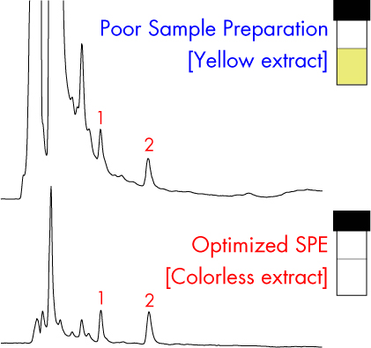
SPE can be used to remove interferences and simplify the matrix of the collected sample
Removal of interfering compounds by SPE (interferences stuck to SPE cartridge, and not eluted, or pass-through upon loading)
http://www.waters.com/waters/en_US/SPE---Sample-Enrichment-and-Purification-using-Solid-Phase-Extraction/nav.htm?cid=10083488

Slide 26
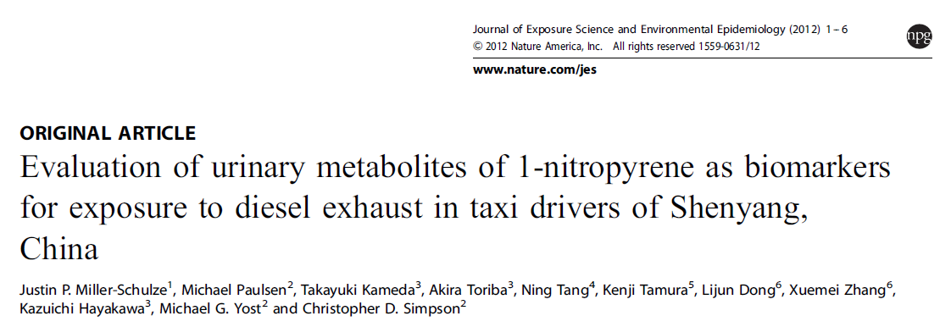
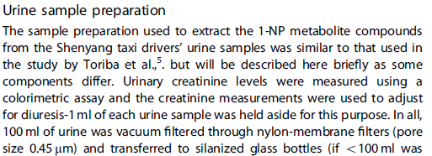
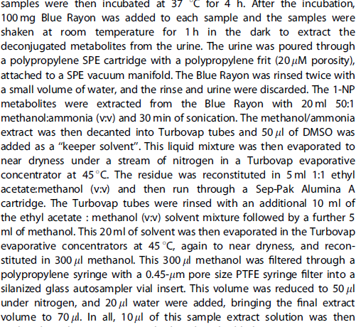
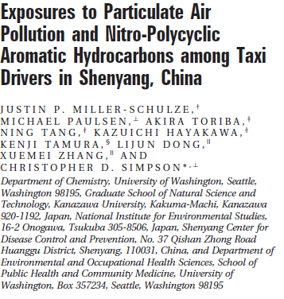
A Few (personally) Relevant Examples
SPE may be necessary to remove matrix interferences/simplify the sample matrix (as in a sample matrix of urine

Slide 27
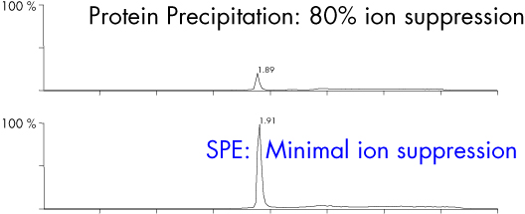
SPE can be used to reduce ion suppression in for techniques involving mass spectrometry detection
http://www.waters.com/waters/en_US/SPE---Sample-Enrichment-and-Purification-using-Solid-Phase-Extraction/nav.htm?cid=10083488

Slide 28
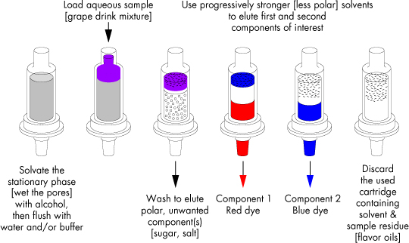
SPE can be used to separate the sample into different analyte classes
http://www.waters.com/waters/en_US/SPE-Method-Development/nav.htm?cid=10083845

Slide 29
SPE Issues/Specific Method Development Issues
Sometimes, you are looking for 4 of the same class of analytes
  Good for you!
Other times, you are looking for a variety of analyte classes: weak bases, weak acids, zwitterions, etc.
  I’m sorry…

Slide 30

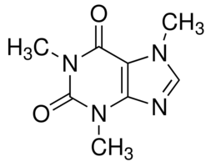
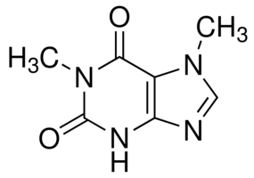
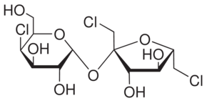
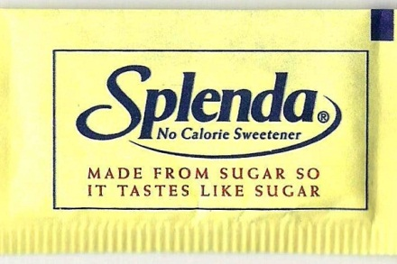
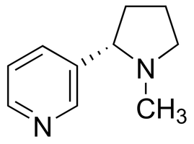
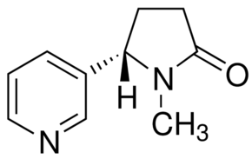
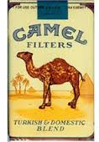
Wastewater
Tracers
Caffeine/Paraxanthine: Stimulant/stimulant metabolite
Sucralose: Low-calorie
sweetener
Nicotine/Cotinine: Stimulant/
stimulant metabolite

Slide 31
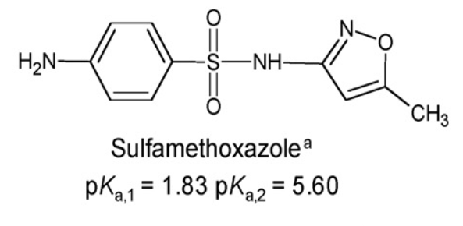
Sulfonamide Antibiotics
Sulfamethoxazole: Human and veterinary antibiotics
Sulfamethazine: Widely used veterinary antibiotic for meat-producing animals
Sulfadimethoxine: Veterinary antibiotic, approved for human use in some countries (Russia)

Slide 32
pKa Values
pKa 1
pKa 2
Sulfadimethoxine
pKa₁ = 2.13, pKa₂ = 6.08
1. McClure, E. L., Wong, C.S. J Chromatogr. A 1169, 2007, 53-62
2. Qiang, Z., Adams, C. Water Research, 38, 2004, 2874-2890

Slide 33
Filtration
pH
Spike w/ isotopically-labeled recovery surrogates
Filter (0.7, 0.45, 0.2 µm pore size in sequence)
removes dissolved matter and some biological material
Stabilize pH at
8 ± 0.1
Samples collected in 1liter LDPE cubitainers or 1250 ml glass bottles
Extraction
~18 samples = ~20 person-hours of lab time
Final
Sample Matrix
Preparation
Elution + Evaporation
150 µl sample is brought up to 1500 µl with pH = 2.8 acetic acid and spiked with 10 µl
Internal standard mixture
Measurement by HPLC-MS/MS
Samples are eluted with organic solvent (methanol and/or methanol/MTBE mixture) and then concentrated to ~150 µl
Extraction with nonpolar “Oasis HLB” solid phase extraction cartridge concentrates analytes and removes (some) sample matrix interferences

Slide 34
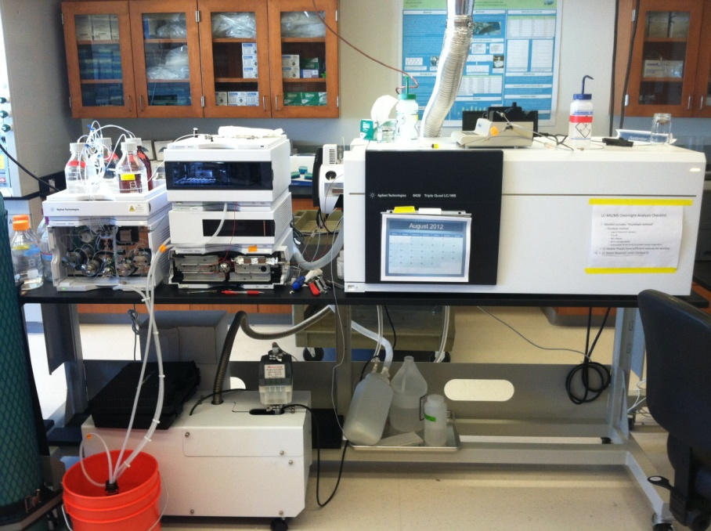
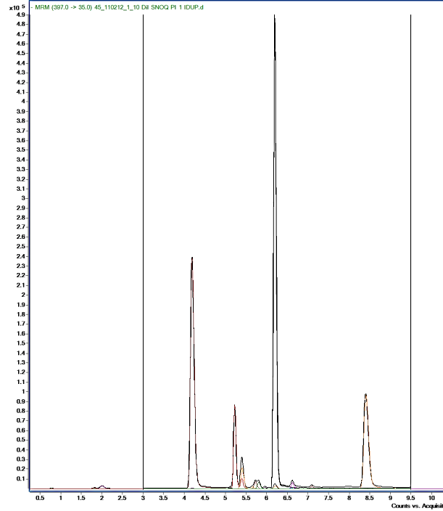
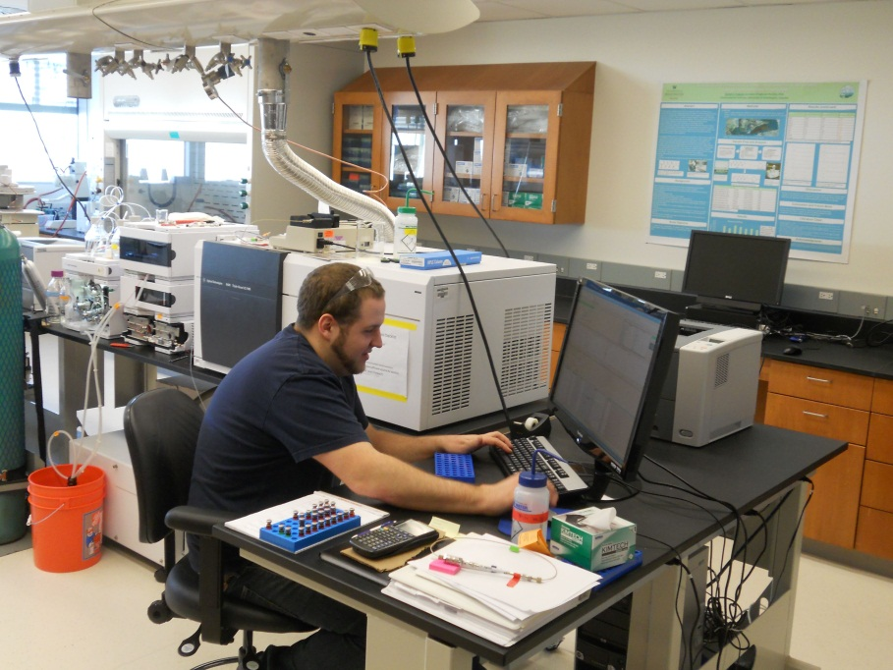
HPLC-MS/MS method:
20 µl injection volume
Agilent Zorbax
C18 Eclipse, 2.1 x 150 mm,
d_{p} = 3.5 µm
Gradient Elution
MS/MS (ESI-QqQ) detection
TIC

Slide 35
All recoveries in absolute percentage (no surrogate correction)
Some discrepancy between theory and experimental
High (relatively) spike level can mask issues….

Slide 36
Quantification by Surrogate Correction I
Add 10 ng d6 sucralose before processing
How do we know that we are analyzing everything that was in our sample?
In other words: How much do we lose in the extraction process?
To account for CEC loss during extraction, we use isotopically-labeled surrogates that are identical chemically, but differ in mass, from our CEC analytes:
Corrected Mass_{CEC} =
Calculated Mass_{CEC} / Fractional Recovery of Appropriate Surrogate
2. Calculate recovery of d6 sucralose (i.e., recovery = 50%)
3. Initial Result = 15 ng sucralose in sample
4. Corrected results = (15 ng/0.5)/water volume =
30 ng sucralose/Liter

Slide 37
Quantification by Surrogate Correction II
We have multiple labeled surrogates, but not enough for each CEC (d6 sucralose = 225$/1 mg)
So, we need to evaluate which labeled compounds work best as surrogates for each CEC
We do this by spiking a known amount of the CEC analytes into relevant sample matrices and calculating the accuracy of the recovery using each surrogate
  Accuracy threshold = >70%, <130% accuracy (± 30%)
“Best” surrogate = d5 Atrazine: 90% accuracy on average w/ least variability
Acetaminophen Spike + Recovery Data
 | Name | Raw % Recovery | d3 Vanillin Corrected % Recovery | d4 Propylparaben Corrected % Recovery | d4 Sulfamethoxazole Corrected % Recovery | d5 Atrazine Corrected % Recovery | d6 Sucralose Corrected % Recovery | d6 Theobromine Corrected % Recovery
DI Water Spikes, pH=8 | DI SPK 1 PH8 | 62 | 95 | 124 | 96 | 98 | 94 | 144
 | DI SPK 2 PH8 | 46 | 70 | 86 | 81 | 71 | 70 | 279
 | DI SPK 3 PH8 | 52 | 81 | 104 | 89 | 78 | 73 | 103
CUW Dock Water Spikes, pH = 8 | D. SPK 1 PH8 | 38 | 124 | 118 | 168 | 100 | 156 | 136
 | D. SPK 2 PH8 | 66 | 126 | 123 | 151 | 100 | 145 | 310
 | D. SPK 3 PH8 | 47 | 120 | 108 | 136 | 86 | 126 | 378
Hylebos Creek Water Spikes, pH= 8 | STREAM SPK 1 PH8 | 47 | 116 | 133 | 124 | 112 | 123 | 179
 | STREAM SPK 2 PH8 | 46 | 80 | 95 | 109 | 72 | 79 | 323
 | STREAM SPK 3 PH8 | 50 | 100 | 115 | 118 | 92 | 99 | 261
 | AVERAGE | 50 | 101 | 112 | 119 | 90 | 107 | 235
 | RSD(%) | 17 | 21 | 13 | 24 | 16 | 29 | 41

Slide 38
Conclusions/Wrap-Up
SPE is a widely applicable tool for sample pre-treatment that can make analysis of low-level analytes in complex matrices possible
The variety in SPE strategies gives you a variety of strategies to process their samples:
  Enrichment
  Clean-Up
  Fractionation
You can adjust the efficacy of all of these with some knowledge of the factors at work
  pH, pH, pH
  Mobile phase
  Stationary Phase

Slide 39
Seminar Advertisement
September 26 2014
Sequoia 338
1 PM
Contaminants of Emerging Concern: How Much is Out There, How Do We Measure Them, and Why Do We Care?

Slide 40
Acknowledgements-Thank You!
UWT/CUW Interns
Alex Gipe
Derek Overman
Donny Glaser
Jessica Maves Connor Bacon
Slides
Dr. Dan Burgard, University of Puget Sound
Dr. Roy Dixon, Sac State
Waters Corp.

