Slide 1
Micellar Electrokinetic chromatography
Diana Cheng and Stephanie Clark
November 25, 2014

Slide 2
Outline
Introduction and Background
Theory
Advantages
Disadvantages
Recent Applications
Conclusions

Slide 3
Introduction and Background (1)
Electrophoresis: separating charged molecules in an electric field
Two important phenomena
Thermal convection: interferes with separation
Free-zone electrophoresis suppresses convection through capillary rotation or use of a narrow-bore capillary (capillary zone electrophoresis, CZE)
Electroosmotic flow (EOF): caused by the charge on the inner capillary surface interacting with the applied field
Strong EOF moves all analytes toward the cathode with negatively charged capillary surface (neutral and alkaline)

Slide 4
Introduction and Background (2)
Micellar Electrokinetic Chromatography (MEKC) was developed as a mode of Capillary Electrophoresis (CE)
Particularly for neutral/non-charged molecules
First developed in 1982 (published 1984) by Terabe et al.
At that time, capillary GC offered >100000 theoretical plates, HPLC only offered ~5000
Adding surfactant to the buffer of CZE separated unionized compounds under neutral conditions
Successful separation lead to the conclusion that the surfactant formed a micelle which acted as a psuedostationary phase

Slide 5
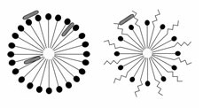
Introduction and Background (3)
Surfactant – contraction of “surface active agents”
Reduce surface tension
Form micelles at concentrations above critical micelle concentration
Most common surfactant in MEKC is SDS (sodium dodecyl sulfate)
Micelle – polar head, long hydrocarbon tail
Surface interaction
(ionic)
Surface interaction
(non-ionic)
Core interaction
(hydrophobic)
Ionic Micelle
Mixed Micelle
Cosurfactant interaction

Slide 6
Theory (1)
Separation is based on the micellar solubilization
The process of incorporating analytes onto/into the micelle
Selectivity (α) can be easily manipulated by changing the type(s) of surfactant(s) used
For hydrophobic analytes, organic solvents can by added to the solution for better partitioning into the aqueous phase
Extremely hydrophobic analytes are a challenge to separate

Slide 7
Theory (2)
Migration velocity of micelle
EOF velocity plus micelle electrophoretic velocity
v_{mc} – migration velocity
Vector quantity (positive toward cathode)
v_{eo} – EOF velocity
v_{ep}(mc) – electrophoretic velocity of the micelle
v_{eo} and v_{ep}(mc) usually have different signs
Assuming v_{eo} is positive and v_{ep}(mc) is negative, a large v_{eo} results in a positive v_{mc} value (micelles move toward cathode)

Slide 8
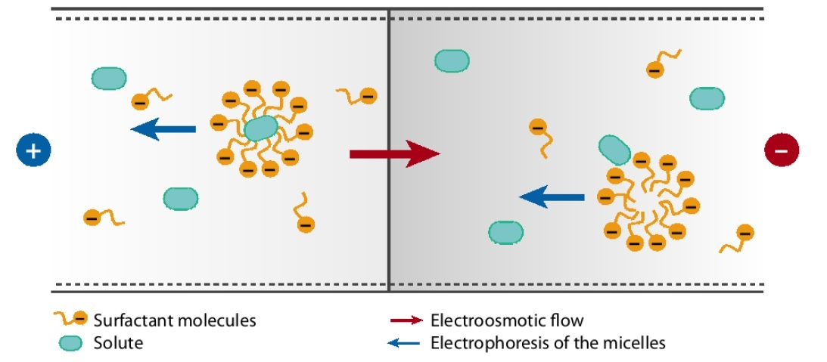
Theory (3)
MEKC schematic
Anode
Cathode

Slide 9
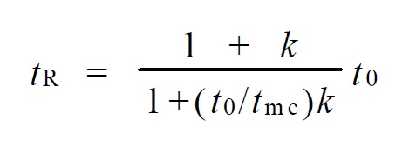
Theory (4)
Migration time is related to the familiar retention time
Analyte migration falls within range of EOF marker and micelle marker
k – retention factor
t_{r} – analyte migration time
t₀ – EOF marker migration time
t_{mc} – micelle marker migration time
“Chromatogram” is known as Electropherogram in MEKC
t₀ ≤ t_{r} ≤ t_{mc}

Slide 10
Theory (5)
t₀ ≤ t_{r} ≤ t_{mc}

Slide 11
Theory (6)
EOF marker
Neutral analyte that does not interact with the micelles
Same velocity as EOF
Gives t₀
Methanol
Micelle marker
Analyte that is fully incorporated into micelle
Same velocity as micelle
Gives t_{mc}
Sudan III (lipophilic dye)

Slide 12
Theory (7)
Resolution – similar to conventional
Extra term is the virtual capillary length term
Describes the actual zone in which micelles interact with analytes (corresponds to conventional column)
Length depends on migration time

Slide 13
Theory (8)
Plate number is not proportional to “column” or tube length
N = µV/2D
µ – electrophoretic mobility
V – applied voltage
D – molecular diffusion coefficient (not easy to modify)
What does this really mean?
Faster mobility and higher voltage = more efficient
High voltage has some restrictions due to thermal conductivity issues

Slide 14
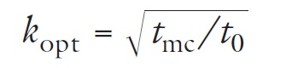
Theory (9)
Optimum k to maximize resolution
Retention factor is also described as:
Bottom line:
Increasing surfactant concentration increases k
Adding organic solvents decreases k

Slide 15
Detectors
Intrinsic difficulty with transitioning CE detectors to MEKC
Partitioning of analyte in micelles alter detection properties
Types of detectors
Laser-induced fluorescence (LIF) – common
“Solid choice” – Silva 2013 Review
Many analytes not inherently fluorescent, but fluorescein analogues/derivatives have been successful labeling agents
Good sensitivity
UV Absorbance – common
Short path length contributes to low concentration sensitivity
MS – not that great
Universal and sensitive
Expensive and not quite successfully coupled to MEKC
Electrochemical and conductimetric detectors
Better sensitivity, but not as universal or affordable as UV

Slide 16
Advantages
Can separate molecules too small for gel electrophoresis
Can separate both ionic and neutral compounds with high efficiency and short retention time unlike in CE
High separation efficiency
Minimal consumption of sample compared to HPLC since concentration is detected on ng/L scale
Ability to separate chiral compounds efficiently
Equipment cheaper than HPLC
High sensitivity in absolute amounts
Quicker than HPLC for separating complex samples

Slide 17
Disadvantages (1)
Limitation in detectors
MEKC-DESI-MS
Sensitivity not practical for real samples
MEKC/MS
Nonvolatile surfactants and chiral selectors contaminate ion source
In some studies, MEKC suffers from poor reproducibility of electroosomotic flow between samples

Slide 18
Disadvantages (2)
Can’t detect at low concentrations
First experiment conducted:
Maximum capillary volume of 1.8 µL
Injection volume estimated to be 12 nL
Short pathlength of light and small injection volumes give low concentration sensitivity
Sensitivity can be improved through preconcentration techniques like stacking or sweeping

Slide 19
Applications (1)
Medical Analysis
Determination and Quantification of Paclitaxel, morphine, and codeine in urine sample of patients with different cancer types (breast, head and neck, and gastric)
Advantages:
Separation of both neutral and ionic compounds at once
Quick sample preparation -- centrifugation and filtration
Robust – lack of external influences on results ( days, buffers, patients)
Rugged – lack of internal influences on results (buffer, SDS voltage, etc.)
Direct injection method with biological samples

Slide 20
Applications (2)
Food Analysis
Determination of procyanidins and other phenolic compounds in lentil samples (2001)
Determination of Amoxicillin, Ampicillin, Sulfamethoxazole, and Sulfacetamide in Animal Feed (2009)
Advantages
Ability to separate chiral compounds
Low solvent consumption (environmentally friendly)
Efficient separation
Relatively quicker compared to HPLC and GC
Cheaper
Chiral columns must be used for GC – more expensive

Slide 21
Applications (3)
Environmental Analysis
Determination of anti-inflammatory drugs in river water
Advantages:
Detection in ng/L scale
Separation of several analytes in short time
Sensitive
Pharmaceutical Analysis
Ability to separate complex mixtures (natural products, crude drugs) with high resolution
Results from study show separation of 26 analytes in 30 minutes with well resolved baseline.
Another study showed separation of 17 amino acid derivatives within 15 minutes
Separation of vitamins and antibiotics
Higher selectivity seen with MEKC method than CZE
Shorter analysis time with MEKC than CZE

Slide 22
Conclusions
Effective separation of neutral molecules
Inexpensive equipment
Selectivity easily manipulated through various combinations of surfactants and organic solvents
Finding the right combination can be difficult
Could be more widely used if better detector interfaces are developed

Slide 23
References (1)
(1) Terabe, S. Annu. Rev. Anal. Chem. 2009, 2, 99.
(2) Rodriguez, J.; Castaneda, G.; Contento, A. M.; Munoz, L. J. Chromatogr. A 2012, 1231, 66.
(3) Otsuka, K.; Terabe, S. J. Chromatogr. A 2000, 875, 163.
(4) Quirino, J. P.; Terabe, S. Science (Washington, D. C.) 1998, 282, 465.
(5) Poole, C. F.; Poole, S. K. J. Chromatogr. A 1997, 792, 89.
(6) Terabe, S. Anal. Chem. 2004, 76, 240A.
(7) Nishi, H.; Terabe, S. J. Chromatogr. A 1996, 735, 3.
(8) Silva, M. Electrophoresis 2011, 32, 149.
(9) Silva, M. Electrophoresis 2013, 34, 141.
(10) Molina, M.; Silva, M. Electrophoresis 2002, 23, 3907.
(11) Silva, M. Electrophoresis 2009, 30, 50.
(12) Muijselaar, P. G.; Otsuka, K.; Terabe, S. J. Chromatogr. A 1997, 780, 41.
(13) Kim, J.-B.; Terabe, S. J. Pharm. Biomed. Anal. 2003, 30, 1625.

Slide 24
References (2)
(14) Nishi, H. J. Chromatogr. A 1997, 780, 243.
(15) Pappas, T. J.; Gayton-Ely, M.; Holland, L. A. Electrophoresis 2005, 26, 719.
(16) Wang, P.; Ding, X.; Li, Y.; Yang, Y. J. AOAC Int. 2012, 95, 1069.
(17) Rosen, M. J.; 4th ed.. ed.; Kunjappu, J. T., ebrary, I., Eds.; Hoboken, N.J. : Wiley: Hoboken, N.J., 2012, p 1.
(18) Terabe, S. Procedia Chem. 2010, 2, 2.
(19) Jorgenson, J. W.; Lukacs, K. D. Anal. Chem. 1981, 53, 1298.
(20) Terabe, S.; Otsuka, K.; Ichikawa, K.; Tsuchiya, A.; Ando, T. Anal. Chem. 1984, 56, 111.
(21) Cifuentes, A.; Bartolomé, B.; Gómez‐cordovés, C. ELECTROPHORESIS 2001, 22, 1561.
(22) Maijó, I.; Borrull, F.; Aguilar, C.; Calull, M. Journal of Liquid Chromatography & Related Technologies 2012, 35, 2134.
(23) Injac, R.; Kocevar, N.; Strukelj, B. Croat. Chem. Acta 2009, 82, 685.

Slide 25
Acknowledgements
Dr. Dixon
Chemistry 230 class and fellow graduate students

Slide 26
Questions

