Slide 1
Solid-Phase Microextraction for HPLC
December 2, 2014 Chris Peery

Slide 2
Outline
Introduction
Theory
Advantages/Disadvantages
Applications
Conclusions

Slide 3
Introduction (Context)
Most pesticides are organic compounds with various functional groups, which may cause geometrical and optical isomers
Pesticides differ in their polarity, degree of ionization, and solubility in water.
When sprayed in the environment, pesticides undergo degradation and decomposition but some may be persistent enough to still be considered harmful

Slide 4
Introduction (Context)
For this reason, analysis of pesticides is essential but can be difficult for the following reasons:
Pesticides need to be analyzed at very low concentrations
Analytical standards need to have levels of analyte comparable to concentration found in real samples
Sample preparation for analysis should not add to environmental pollution
Traditional techniques are time and solvent-consuming

Slide 5
Introduction (Background)
Solid-phase microextraction is a relatively new technique developed by Pawliszyn and Associates at the University of Waterloo
Method involves equilibrium sorption of analytes onto a small microfiber (made of fused-silica optical fiber coated with hydrophobic polymer)
Analytes either in air (headspace SPME) or in water (direct immersion SPME) approach equilibrium according to their affinity to the solid phase

Slide 6
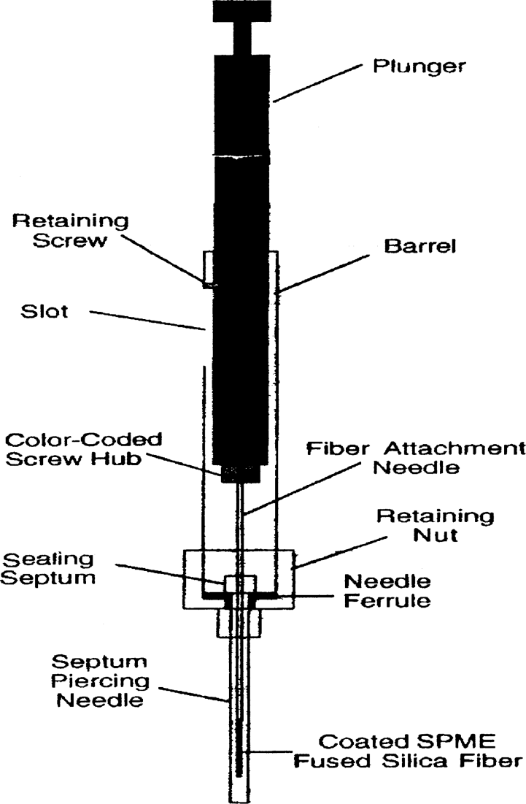
Introduction (Background)

Slide 7
Theory (Design)
SPME is a modified syringe-like instrument
Fused silica fiber is small and cylindrical and is connected to a stainless steel tubing
Silica fiber is coated with thin film of several polymeric stationary phases
Fiber is reusable and replaceable

Slide 8
Theory (How it works)
Fiber is drawn into syringe needle, and lowered into a septum-sealed vial by pressing the plunger
Choice of fiber coating depends on analyte
Fiber should be cleaned in desorption chamber of HPLC before use
Cleaned fiber is exposed to sample matrix for specific amount of time, and analyte is adsorbed to the fiber coating

Slide 9
Theory (Improved Extraction)
Solubility of analyte can be decreased by addition of salt to liquid samples, improving headspace extraction and the overall partition coefficient
Internal cooling of fiber allows for temperature increases of sample to increase vapor density of analyte
Derivatization is accomplished by analyte conversion to another compound through reaction with a selected reagent, making the analyte for favorable for SPME extraction

Slide 10
Theory (Hyphenation)
SPME can be coupled with HPLC using a special six-port interface developed by Pawliszyn and sold by Supelco
Type of fiber chosen based on polarity of analyte and time required for desorption
Time required for desorption is given by time=L²/2D where L is the thickness of coating and D is the diffusion coefficient of the analyte

Slide 11
Advantages
Simplicity of setup
Doesn’t cost very much
Easy to use (including placement of fiber into sample)
Preconcentration and extraction steps are fast
Require smaller amounts of samples and solvents than other techniques
Can be placed in interphase of an unmodified HPLC
Portable (due to small size)
Hyphenation with HPLC allows analysis of semi volatile and nonvolatile organic compounds in water.

Slide 12
Disadvantages
Fibers are unstable and have low durability in strong organic solvents
Appropriate fiber selection essential for efficient extraction of particular analytes
Careful control of plunger movement and timing needed for proper adsorption and desorption
Plunger is small and requires finesse
Loss of analyte in field sampling is a concern
Needle opening of SPME device should be sealed using a septum and/or keeping the needle cold.

Slide 13
Applications
Analysis of Carbamates (insecticides) used to combat ants, cockroaches, wasps and other pests.
Advantages:
In-tube SPME easily coupled with HPLC autosampler for analysis of Carbamates
Very efficient extraction of polar and thermally labile analytes
In-tube method is simple, effective, reproducible, and sensitive

Slide 14
Applications (Continued)
Analysis of organometallic pesticides (typically fungicides)
Advantages:
In-tube SPME and HPLC can be coupled with quadruple mass spec for determination of trimethyllead (TML) and triethyllead (TEL) species of fungicide.
Complete separation and detection of TML and TEL can be accomplished in under 5 minutes
Precision was greater than 5% and LOD’s were 11.3 ng/ml and 12.6 ng/ml for TML and TEL

Slide 15
Conclusions
Hyphenation of SPME with HPLC is a relatively new method that allows analysis of low volatility analytes that are difficult to determine by GC
Hyphenation technique is quick and simple but may fail to provide adequate results when working with analytes that are thermally unstable
SPME-HPLC has high potential as a real time extraction technique, especially in-tube SPME, and can be considered an extraction method for the future

Slide 16
References
J. S. Aulakh , A. K. Malik , Varinder Kaur & Philippe Schmitt-Kopplin (2005) A Review on Solid Phase Micro Extraction—High Performance Liquid Chromatography (SPME-HPLC) Analysis of Pesticides, Critical Reviews in Analytical Chemistry, 35:1, 71-85, DOI: 10.1080/10408340590947952
C. L. Arthur and J. Pawliszyn, Solid phase microextraction with thermal desorption using fused silica optical fibers. Anal. Chem. 62 (1990):2145–2148.
J. Chen and J. Pawliszyn, Solid phase coupled to high-performance liquid Chromatography. Anal. Chem. 67 (1995):2530–2533.

