Slide 1
Chem. 253 – 4/15 Lecture

Slide 2
Announcements I
HW Set 3 Posted on My C253 Website (just 3.1 so far)
No Group Assignment This Week
Next Week’s Group Assignment on Climate Change
Today’s Lecture (Climate Change – Ch. 5)
Next Lecture on Alternative Fuels

Slide 3
Climate Change - Overview
Earth’s Radiation Balance
Effect of Greenhouse Gases
Other Sources of Climate Change
Temperature Record and Expected Future

Slide 4
Climate Change - Radiation Balance
For a planet with a constant temperature, energy in = energy out (F_{S} = F_{L})
Energy in = light from sun (short wave = F_{S})
Energy out = light from earth (long wave = F_{L})
Energy of light reaching and leaving a given location on earth is not constant
Light energy reaching earth goes from ~0 (night for half of earth) to S₀ (= 1370 W m⁻² = “solar constant” = equator at noon on equinox)
From Seinfeld and Pandis (1998)
Notes:
Add Seinfeld and Pandis Plot

Slide 5
Climate Change - Radiation Balance
To be balanced, πR_{Earth}²S₀ = 4πR_{Earth}²S_{E} or S_{E} = S₀/4 (assuming all light reaching earth stays in earth)
This is further complicated by light reaching earth being reflected back to space (clouds, sand, and snow are “whiter” than lava, oceans and forests)
The fraction of incoming light reflected = albedo ~ 0.3 for the whole earth (now F_{S}
= (1 – A)πR_{Earth}²S₀) with A = albedo
From Seinfeld and Pandis (1998)
Notes:
Add Seinfeld and Pandis Plot

Slide 6
Climate Change - Radiation Balance - Blackbodies
Both the sun and the earth are imperfect “blackbody emitters” where the energy emitted and wavelength of light depend on temperature
Emitted light reaches a max at: λ_{max} (in μm) = 2897/T
Based on temperatures of the Sun’s surface and the Earth’s surface, λ_{max}(sun) ~ 0.6 μm and (Earth) ~ 10 μm
Note: actual λ_{max} observed from above earth is for light emitted from atmosphere
From Baird and Cann, 2012
Notes:
Add Seinfeld and Pandis Plot

Slide 7
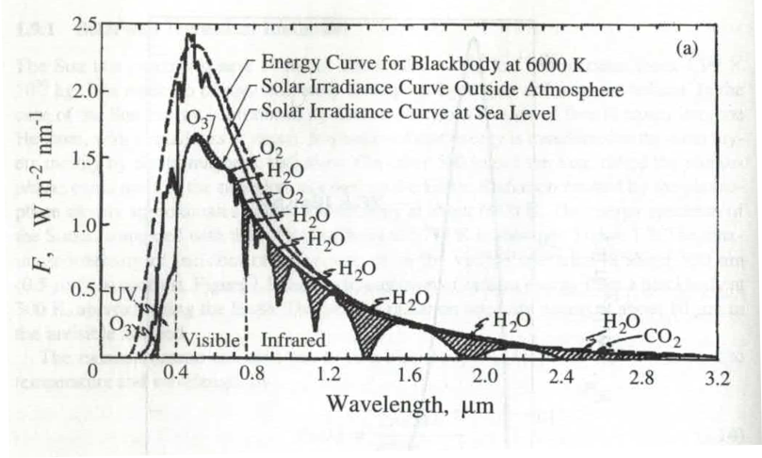
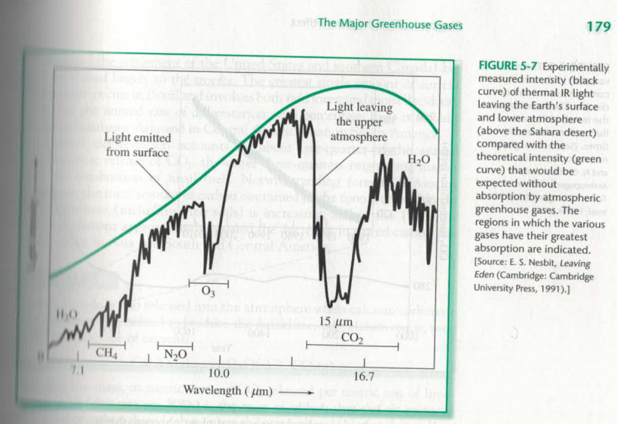
Climate Change - Radiation Balance – Absorption of Light
Besides solar light being absorbed at the surface or reflected, some light is absorbed in the atmosphere
While atmospheric absorption of solar light is small (~20% of incoming flux), a much larger fraction of light leaving the Earth absorbs light (in the infrared region)
Absorption of light emitted by Earth is basis of greenhouse effect
From Baird and Cann, 2012
Seinfeld and Pandis, 1998
Notes:
Add Seinfeld and Pandis Plot

Slide 8
Climate Change - Radiation Balance
Emission of light from the Earth depends strongly on temperature: F_{L} = kT⁴ where k = Stephan-Boltzmann constant (= 5.6 x 10⁻⁸ W m⁻² K⁻⁴)
Thus, about 2X more light is emitted from the tropics (e.g. T ~ 300 K) than polar regions (T ~ 250 K)
The most prevalent gas molecules (N₂, O₂, and Ar) are incapable of absorbing IR light (only heteroatom diatomic molecules can absorb light)
However, other trace gases (CO₂, H₂O, CH₄) can and do absorb efficiently in the IR region.
This and IR emission from the upper atmosphere (which is cooler) reduce the earth’s emission flux and heat the earth
Notes:
Add Seinfeld and Pandis Plot

Slide 9
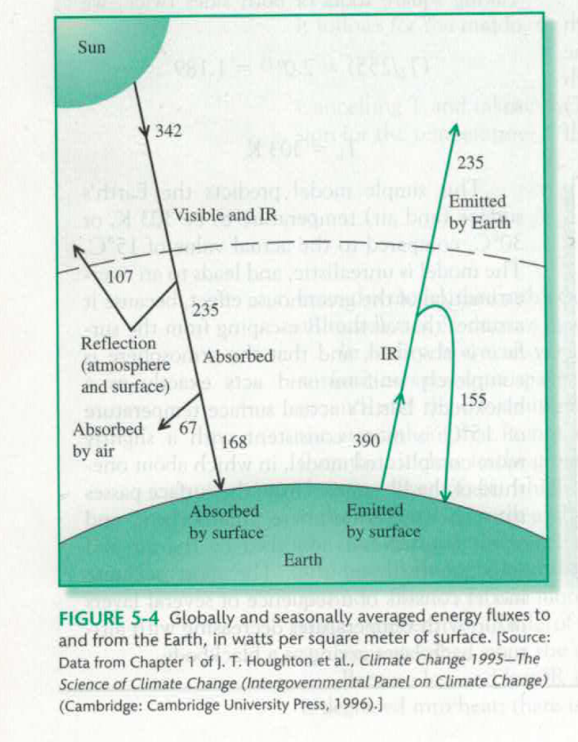
Climate Change - Radiation Balance
Averaged Energy Balance
As greenhouse gases increase, the fraction of surface emitted energy leaving earth (235/390 in figure) decreases
However, incoming (342 – 107) and outgoing energy (235) must remain balanced
As a result, increased temperature (greenhouse warming) and surface emitted energy (390) are required
Baird and Cann (text)
Notes:
Add Seinfeld and Pandis Plot

Slide 10
Climate Change - Radiation Balance
Climate can be affected by the following changes:
- changes to S_{o} (solar strength)
- changes to A (albedo)
- changes to absorption of outgoing radiation (greenhouse effect)
- changes to feedbacks or sensitivity (change in temperature per change in energy forcing)

Slide 11
Climate Change - Radiation Balance - Questions
Given that distance between Mars and the sun is 50% greater than the distance between the Earth and the sun and that the solar constant proportional to the inverse square of the distance, calculate the average temperature of Mars assuming an albedo of 0 and of 0.2.
Is the assumption of an average temperature (above) reasonable?
Why would an isothermal atmosphere (one where temperature is constant with height) result in greater IR losses?
If water is a strong greenhouse gas, would we expect that regions of high humidity are generally warmer than regions of low humidity (all other conditions equal)? Why might this not be the case?

Slide 12
Climate Change - Greenhouse Gases
To be an effective greenhouse gas, a molecule must:
- absorb light in the infrared region (must have dipole moment for vibration mode)
- 3 modes of vibration for CO₂ shown
O=C=O
O=C=O
O=C=O
Symmetric vibration not allowed

Slide 13
Climate Change - Greenhouse Gases
Molecules must absorb light in the right regions
- roughly 7 to 25 μm region
- however, in some regions (5 to 7 and 13 to 17 μm), essential no light from surface makes it to space due to current gases present
- for this reason, CO₂ is less effective as a greenhouse gas (at least for additional CO₂)

Slide 14
Climate Change - Greenhouse Gases
Spectral Saturation: see how going from “1” to “10” leads to close to a 10X increase in area vs. going from “10” to “50”
From Wallace and Hobbs, 1977

Slide 15
Climate Change - Greenhouse Gases
Molecules absorbing light in the “IR window” regions are more effective
Additional CO₂ is not as effective as additional N₂O (absorbs at 7.5 to 9 μm) on a forcing per ppm basis
From Girard (old text)
Notes:
Show plot from p. 100 of Girard

Slide 16
Climate Change - Greenhouse Gases
H₂O as a greenhouse gas
- the molecule responsible for the most greenhouse effect heating
- the third most prevalent molecule in the atmosphere (on average, but composition is variable)
- direct anthropogenic sources are insignificant (at least outside of deserts and the stratosphere)
- also responsible for cooling through increasing albedo (in clouds) so normally kept separate from other greenhouse gases
- water vapor is important indirectly as planet heating increases water vapor (this is covered under feedbacks)

Slide 17
Climate Change - Greenhouse Gases
Gas | Mixing |  | % Change | Lifetime | Relative
 | Ratio | units | per year | years | Efficiency
CO₂ | 400 | ppm | 0.4 | 10 to 200 | 1
CH₄ | 1800 | ppb | variable | 12 | 23
N₂O | 323 | ppb | 0.2 | 120 | 206
CFC-11 | 0.26* | ppb | -0.52* | 45 | 4600
Data from Baird and Cann + other sources * non-current source

Slide 18
Climate Change - Greenhouse Gases
Carbon Dioxide
- anthropogenic sources:
- combustion of fossil fuels (long term problem)
- deforestation (short term problem)
- cement production (CaCO₃ → CaO + CO₂(g)) (short term problem)
- carbon dioxide sinks
- uptake by plants and by surface layer of ocean (short- term storage)
- uptake to sediments or minerals (long-term storage)

Slide 19
Climate Change - Greenhouse Gases
CO₂ Concentrations (from Baird and Cann text)
Notes:
Add fig. From p. 95 in Girard

Slide 20
Climate Change - Greenhouse Gases
Methane
Natural sources: termites, swamps, animal emissions
Anthropogenic sources:
natural gas production/distribution
changes in agricultural practices
Sinks:
reaction with OH radical
transport to stratosphere
Indirect Effects: stratospheric water, OH and O₃ concentration changes

Slide 21
Climate Change - Greenhouse Gases
METHANE
Pre-industrial concentration of ~750 ppb
Was increasing rapidly (~3%/year) until 1990s
Rate slowed to no change, but has started to rise again

Slide 22
Climate Change - Greenhouse Gases
Chlorofluorocarbons
- Strong greenhouse gases
- Have long lifetimes
- Only anthropogenic sources
- Indirect effects (loss of stratospheric ozone offsets some of the warming)

Slide 23
Climate Change Summary of Effects – Greenhouse Gases
From IPCC Fifth Assessment Report (2014)

Slide 24
Climate Change - Some Questions – cont.
Why are CH₄ and N₂O more effective greenhouse gases than CO₂?
If OCS were found to have significant anthropogenic emissions, what would you want to know about it before assessing if it could be a greenhouse gas?
CO is not a very effective greenhouse gas, but it can affect two other greenhouse gases. What gases does it affect indirectly and why?

Slide 25
Climate Change - Other Effects on Climate
Categories
Tropospheric Ozone (non-well mixed greenhouse gas)
Stratospheric Ozone (loss causes cooling)
Land Use Changes (affects uptake of CO₂ and albedo)
Light Scattering Aerosol
Light Absorbing Aerosol
Indirect Effects of Aerosol

Slide 26
Climate Change - Other Effects on Climate
Tropospheric Ozone
Anthropogenic emissions have lead to increase
Increases are heterogeneous, plus hard to determine pre-industrial concentrations
Stratospheric Ozone
Loss in Stratosphere leads to cooling (more loss of energy out to space)
However, loss of stratospheric ozone also leads to greater UV absorption (and heating) in troposphere
As ozone loss is reversed, some heating may occur

Slide 27
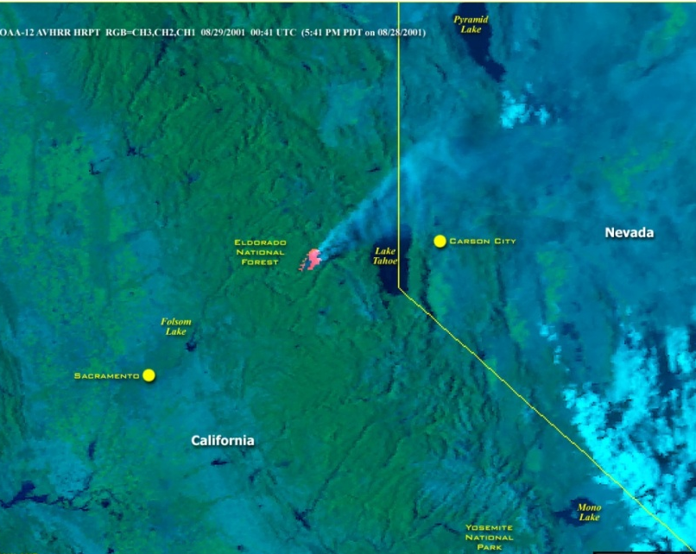
Climate Change - Other Effects on Climate
Aerosol Effects – Light Scattering Aerosol
As was discussed previously in visibility, aerosol particles of diameter 0.2 to 1 μm is very efficient in scattering light
A significant fraction is scattered in the backwards direction, so this effectively increases planetary albedo
Increase in albedo leads to cooling
Notice how smoke from Star fire is whiter vs. forest background

Slide 28
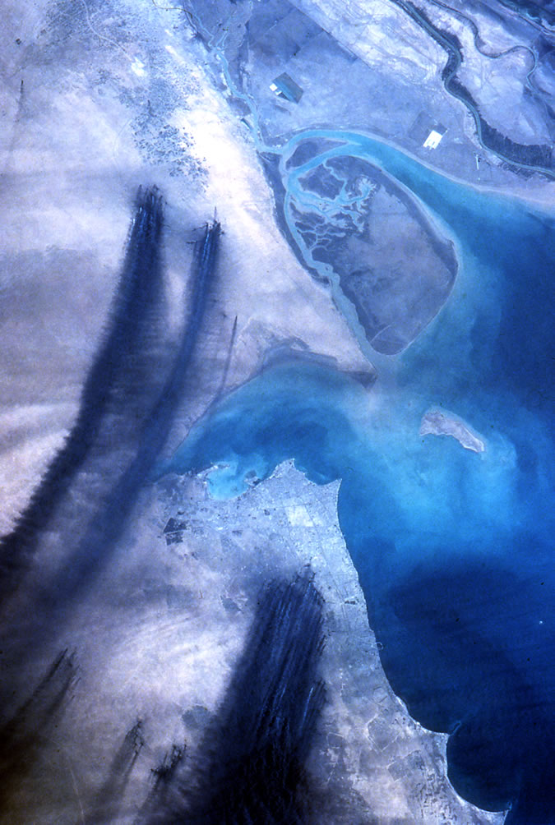
Climate Change - Other Effects on Climate
Aerosol Effects – Light Absorption
Most aerosol constituents do not absorb significantly in the visible region (where light is most prevalent)
A big exception is soot (elemental carbon emitted in inefficient combustion)
Soot clouds lead to atmospheric warming (even if cooling the surface over short-term)
Notice how smoke from Kuwait oil fires is black vs. desert background
http://www.lpi.usra.edu/publications/slidesets/humanimprints/slide_16.html

Slide 29
Climate Change - Other Effects on Climate
Indirect Effect of Aerosols
One type is through modification of cloud reflectivity
Clean Case:
fewer but larger droplets
Polluted Case:
more but smaller droplets

Slide 30
Climate Change - Other Effects on Climate
Indirect Effect of Aerosols
Larger droplets reflect light more poorly per g of cloud water
Polluted clouds look whiter from space
Ship tracks are indicative of localized pollution
Most apparent where: clouds are normally clean and with thin clouds (thick clouds have high albedos regardless)
Source: http//www-das.uwyo.edu/~geerts/cwx/notes/chap08/contrail.html

Slide 31
Climate Change -Net Effect of Aerosol Particles
For a while, it was thought aerosol effects were close to equal (but opposite in sign) as greenhouse gas effects
Significance of aerosols has decreased (as well as an increase in significance of soot – including deposition on snow)
Other issue is residence time (short for aerosols and ozone, long for greenhouse gases)
Reducing pollution would lead to an increase in warming in the short term

Slide 32
Climate Change - More Questions
Do all aerosol particles lead to atmospheric cooling?
The greenhouse effect from long-lived species will be nearly uniform around the globe, but what about effects from ozone and from aerosol particles?
Increased soil dust emissions (e.g. from overgrazing in desert regions) should cause cooling. What minimizes this effect vs. emission of particles from sulfur emissions or from biomass combustion?

Slide 33
Climate Change - Temperature Record and Expected Future
How do we go from W m⁻² flux change to ΔT?
Simple way is through Flux dependence on T
However, this ignores some “feedbacks” which make climate less stable
Example is increased T increases water vapor which increases net greenhouse effect
A doubling of the W m⁻² flux to ΔT ratio is expected because of feedbacks
Sensitivity is a measure of ΔT expected to change in CO₂ concentration (or equivalent greenhouse gases) and is not well known (even though flux change is well predicted)

Slide 34
Climate Change - Temperature Record and Expected Future
Temperature record (looking at ΔT vs. climate mean) shows strongest increase from about 1975
Short-term variability affects record (due to El Niños and volcanic eruptions)
Foster and Rahmstorf, Environ. Res. Lett, 2011
Shows removal of variability due to El Niño, solar variability, and volcanic eruptions
From IPCC Fifth Assessment Report (2014)

Slide 35
Climate Change - Temperature Record and the Future
Changes Besides Mean Air Temperatures
Greater warming observed at higher latitudes
Decrease in diurnal and annual temperature changes
Loss of sea ice (in Arctic with slight increase in Antarctic) and glaciers
Increase in sea-level (from expansion of water and decrease of glacial ice)
Changes to hydrology (more rain, less snow, greater evaporation)

Slide 36
Climate Change Some more questions
Which temperatures are rising faster, daytime or nighttime temperature?
Why would an increase in precipitation be expected?
List two consequences of global warming besides changes in temperature?

