Slide 1
Chem. 253 – 4/22 Lecture

Slide 2
Announcements I
Pass back Exam 2 (ave = 59) + last HW
Turn in HW3.1 (Non-collected Problem Solutions already posted)
Group Assignment on Climate Change
Today’s Lecture Topics:
Climate Change – review of last week’s material
Climate Change – parts not covered last time (Effects of aerosols, feedbacks and sensitivity)
Fossil and Alternative Fuels (See website for pages from text)

Slide 3
Announcements II
New Homework Assignment (will be posted shortly and includes updated reading assignment)
Next Week: Guest Lecturer – Dr. Kellen-Yuen on Green Chemistry
Some of the Alternative Fuels Lecture will be Postponed until 5/6

Slide 4
Climate Change - Review
Earth’s Radiation Balance
Solar Flux In (mainly visible) = Earth’s IR Flux Out
F_{S}(1 – A)/4 = F_{E} and F_{E} = σT⁴ (blackbody emission flux)
Equation Excludes Additional Trapping of Outgoing IR by Greenhouse Gases

Slide 5
Climate Change - Review
Trapping of Outgoing IR
Occurs by molecules capable of absorbing IR
CO₂, H₂O, CH₄, N₂O, etc. (all triatomic molecules and heteronuclear diatomics)
Major gases (N₂, O₂, and Ar) don’t absorb IR
Atmospheric IR absorption (and re-emission at lower T) results in less lost to space and warmer surface temperatures = greenhouse effect
Trapping efficiency is low for most prevelant IR absorbers - CO₂ and H₂O (due to near complete absorbance at specific wavelengths)

Slide 6
Climate Change - Review
Climate can be affected by the following changes:
- changes to S_{o} (solar strength)
- changes to A (albedo)
- changes to absorption of outgoing radiation (greenhouse effect)
as well as:
- changes to feedbacks or sensitivity (not covered yet)

Slide 7
Climate Change - Other Effects on Climate
Categories
Tropospheric Ozone (non-well mixed greenhouse gas)
Stratospheric Ozone (loss causes cooling)
Land Use Changes (affects uptake of CO₂ and albedo)
Light Scattering Aerosol
Light Absorbing Aerosol
Indirect Effects of Aerosol
covered last time
covering tonight

Slide 8
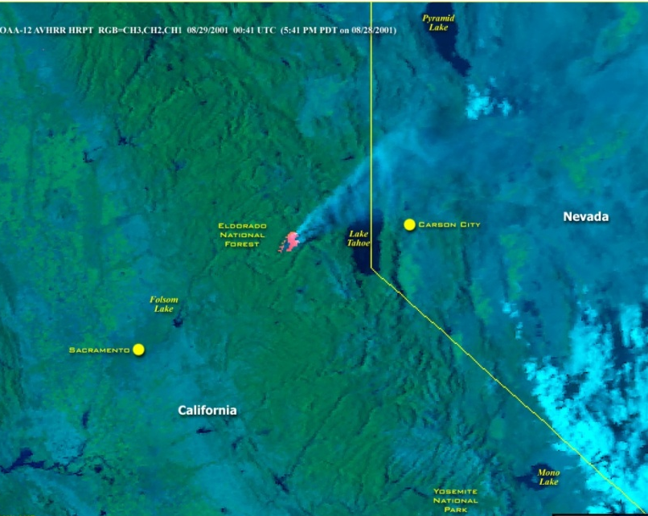
Climate Change - Other Effects on Climate
Aerosol Effects – Light Scattering Aerosol
As was discussed previously in visibility, aerosol particles of diameter 0.2 to 1 μm is very efficient in scattering light
A significant fraction is scattered in the backwards direction, so this effectively increases planetary albedo
Increase in albedo leads to cooling
Notice how smoke from Star fire is whiter vs. forest background

Slide 9
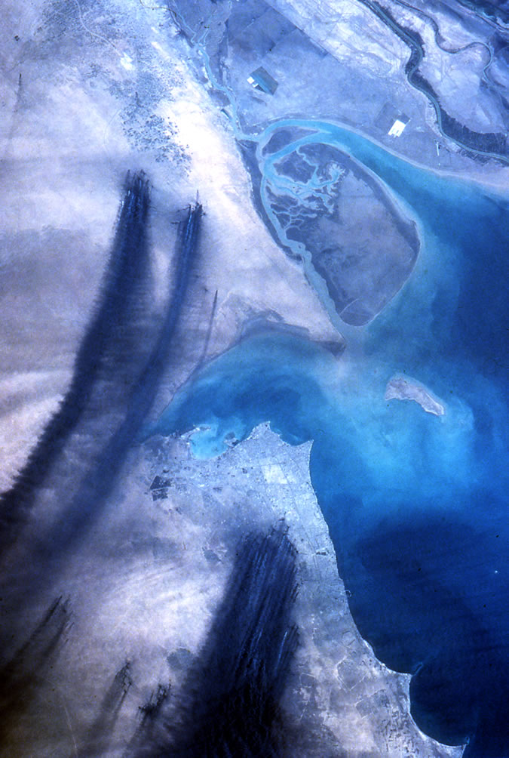
Climate Change - Other Effects on Climate
Aerosol Effects – Light Absorption
Most aerosol constituents do not absorb significantly in the visible region (where light is most prevalent)
A big exception is soot (elemental carbon emitted in inefficient combustion)
Soot clouds lead to atmospheric warming (even if cooling the surface over short-term)
Notice how smoke from Kuwait oil fires is black vs. desert background
http://www.lpi.usra.edu/publications/slidesets/humanimprints/slide_16.html

Slide 10
Climate Change - Other Effects on Climate
Indirect Effect of Aerosols
One type is through modification of cloud reflectivity
Clean Case:
fewer but larger droplets
Polluted Case:
more but smaller droplets

Slide 11
Climate Change - Other Effects on Climate
Indirect Effect of Aerosols
Larger droplets reflect light more poorly per g of cloud water
Polluted clouds look whiter from space
Ship tracks are indicative of localized pollution
Most apparent where: clouds are normally clean and with thin clouds (thick clouds have high albedos regardless)
Source: http//www-das.uwyo.edu/~geerts/cwx/notes/chap08/contrail.html

Slide 12
Climate Change -Net Effect of Aerosol Particles
For a while, it was thought aerosol effects were close to equal (but opposite in sign) as greenhouse gas effects
Significance of aerosols has decreased (as well as an increase in significance of soot – including deposition on snow)
Other issue is residence time (short for aerosols and ozone, long for greenhouse gases)
Reducing pollution would lead to an increase in warming in the short term

Slide 13
Climate Change - More Questions
Do all aerosol particles lead to atmospheric cooling?
The greenhouse effect from long-lived species will be nearly uniform around the globe, but what about effects from ozone and from aerosol particles?
Increased soil dust emissions (e.g. from overgrazing in desert regions) should cause cooling. What minimizes this effect vs. emission of particles from sulfur emissions or from biomass combustion?

Slide 14
Climate Change - Temperature Record and Feedback’s
How do we go from W m⁻² flux change to ΔT?
Simple way is through Flux dependence on T (F_{S} = σT⁴)
However, this ignores “feedbacks”
Feedbacks can be positive (increased T increases water vapor which increases net greenhouse effect)
Feedbacks can also be negative (increased T increases water vapor which can increase clouds and albedo)
The main causes of the greenhouse effect also are non-linear in the manner of negative feedback: doubling CO₂ does not double IR absorption and a 10% increase in trapped IR leads to a 2.5% increase in absolute T (due to T⁴ behavior)
A doubling of the ratio of W m⁻² flux to ΔT is expected because of net positive feedbacks
Sensitivity is a measure of ΔT expected to change in CO₂ concentration (or equivalent greenhouse gases) and is not well known (even though flux change is well predicted)

Slide 15
Climate Change - Temperature Record and Feedback’s
Temperature record (looking at ΔT vs. climate mean) shows strongest increase from about 1975
Short-term variability affects record (due to El Niños and volcanic eruptions)
Foster and Rahmstorf, Environ. Res. Lett, 2011
Shows removal of variability due to El Niño, solar variability, and volcanic eruptions
From IPCC Fifth Assessment Report (2014)

Slide 16
Climate Change - Temperature Record and Feedback’s
Changes Besides Mean Air Temperatures
Greater warming observed at higher latitudes
Decrease in diurnal and annual temperature changes
Loss of sea ice (in Arctic with slight increase in Antarctic) and glaciers
Increase in sea-level (from expansion of water and decrease of glacial ice)
Changes to hydrology (more rain, less snow, greater evaporation)

Slide 17
Climate Change Some more questions
Which temperatures are rising faster, daytime or nighttime temperature?
Why would an increase in precipitation be expected?
List two consequences of global warming besides changes in temperature?

Slide 18
Break for Group Activity
Name | Group
Aliriagwu,Desmond Ahaoma | 1A
Tran,Thao Thanh | 1B
Hayes-Ranns Jr,Donald Prescott | 1C
Otto,Austin J | 2A
Cheng,Diana Jenny | 2B
Prasad,Ashna Payal | 2C
Beckemeyer,Addison James | 3C
Luis V | 4A
Dimas,Dustin Andres | 4B
Martinez,Christian | 4C
Bellini,Leonard V | 5A
Gorrie,Emily | 5B
Brookins,Richard Cannan | 5C
Thai,Dai Thuy Trang | 6A
Williams,Nicholas Denis | 6B
Agurto,Michelle Ivonne | 6C

Slide 19
Energy Use and Fuels - Overview
Chapter 6 Covers Energy Use (with primary emphasis on climate effects)
Energy Requirements
Fossil Fuel Types and Uses
Negative Effects of Fossil Fuels
Chapter 7 Covers Alternative Fuels
Biomass as a Source
Biofuels
sugar-based fuels
lipid-based fuels
other renewable fuels

Slide 20
Energy Use and Fuels - Energy Needs and Sources
Uses of Energy
transportation fuels
domestic heating
domestic electricity
manufacturing
agriculture
Different Uses have Different Requirements
depends whether it is distributed or produced/used locally
For example, “dirty” fuels (e. g. coal) are more useful for electricity production, than domestic heating or transportation due to reduced costs with large scale pollutant removal

Slide 21
Energy Use and Fuels - Energy Needs and Sources
Energy Sources
Fossil Fuels
Coal
Oil/Oil produced fuels
Natural gas and related fuels
Renewable Energy
Hydropower
Renewables (Wind/Solar)
Nuclear Energy

Slide 22
Energy Use and Fuels - Fossil Fuels
Coal
Most readily available (largest known reserves)
Mostly for electricity production (Coal-fired powerplants)
Also limited use in certain industry and for domestic heating
“Dirty” fuel (S and trace metals present) can lead to air pollution problems – but in electricity production, exhaust clean-up is common
Poor fuel in terms of energy efficiency (low J energy per CO₂ generated from combustion)
Rarely used for transportation fuel

Slide 23
Energy Use and Fuels - Fossil Fuels
Natural Gas – Composition
Main component is methane
Other components are small hydrocarbons (ethane to butane), and contaminants (water, H₂S)
Due to differences in boiling points, separation/clean up is not hard, with ethane to butane used as source chemical or fuel
Methane is most desirable for minimal air pollution
Other gases (e.g. propane) tend to be poor for air pollution due to leaks and reactivity (less reactive than gasoline, but leaks tend to be more significant)
Combustion of methane and related fuels are very energy efficient (more energy per mole CO₂ produced) vs. coal or other fossil fuels
Methane leaks are significant because methane is a greenhouse gas

Slide 24
Energy Use and Fuels - Fossil Fuels
Natural Gas – Uses and Sources
Increasing in importance
Used for electricity generation and for domestic heating
Propane is a distributed fuel (cooking/water heating)
Conventional natural gas is easily mined, but somewhat limited in abundance
Shale gas recovery has become cost effective recently
Growth has been due to desirability of fuel and increased supply
Rarely used for transportation fuel (can be used, but needs expensive engine modifications, and energy density is low)

Slide 25
Energy Use and Fuels - Fossil Fuels
Oil – Sources
Due to its heavy use in transportation fuel, oil has a longer history of use (vs. known reserves)
It is increasingly difficult to mine (easy sources are less prevalent)
Harder to use sources (shale oil) are being increasingly tapped
Oil – Uses
Distillation yields a variety of products (lighter fraction includes gasoline, middle fraction is diesel, and heavier fractions for oils)

Slide 26
Energy Use and Fuels - Fossil Fuels
Oil – Uses
A major use is fuel production for transportation
Oil also has been used for electricity production
Is clean relative to coal, but dirty vs. natural gas
Also intermediate in terms of energy efficiency

Slide 27
Energy Use and Fuels - Fossil Fuels
Carbon Dioxide Removal
Instead of worrying about using fossil fuels, a strategy to avoid atmospheric CO₂ increases is to capture and remove CO₂ in combustion exhaust
Capture typically involves using a base to trap CO₂ as carbonate
Most capture approaches involve recycling, allowing production of a high CO₂ content liquid while regenerating the base
Removal must involve storage where leaks to the atmosphere are minimal (deep ocean and deep underground)
High pressure is also needed to provide the density (as liquid, supercritical fluid or hydrate)

Slide 28
Energy Use and Fuels - Fossil Fuels - Questions
Which type of fossil fuel is particularly bad in terms of CO₂ emissions (low energy provided per mole CO₂ emitted)? Which type is particularly good in this respect?
What is the main source of transportation fuels?
Which fuels contribute most significantly to ozone production?
Why can’t we simply substitute one fuel for another? For example, if natural gas in cheap and releases less carbon dioxide, why not use it for transportation?

Slide 29
Energy Use and Fuels - Biofuels
Rationale for Use
Q. While all carbon-based fuels will release CO₂, what is the advantage with respect to controlling CO₂ concentrations to using a bio-based fuel?
A. The main advantage is if the carbon originates from plant material, when plants regrow, they will reabsorb emitted CO₂. In principle, this would mean there is no net CO₂ production.
Limits to Use
Plants fix carbon dioxide using sunlight to produce organic compounds
CO₂ + H₂O → CH₂O (biomass) + O₂ (unbalanced)
The above reaction converts sunlight to chemical energy, but is not super efficient (power density = 0.6 W m⁻²)
A very significant fraction of the Earth’s surface would need to be devoted to biofuel needs to meet total transportation demand

Slide 30
Energy Use and Fuels - Biofuels
Types
Direct use Fuels:
Combustion of wood for heating, cooking or electricity production
Limited Practical Use (due to pollution and limited resources)
Sugar Based Fuels
Ethanol from Sugar
Ethanol from Starch
Ethanol from Cellulose
Other fuels
Lipid Based Fuels
Direct use of oils
Biodiesel

