Slide 1
Green Chemistry: What is it? How do you know it when you see it?
Chem 253
April 29th
Dr. Kellen-Yuen

Slide 2
Chemistry as an Industry
Chemical manufacturing worldwide value of $1.5 trillion (1998)
Value of US chemical shipments $811 billion (2013)
Notes:
Tip: Add your own speaker notes here.

Slide 3
Organic Chemistry
Plastics, fuels, pharmaceuticals, dyes, fabrics, agricultural and other chemicals
Our lifestyles are almost unimaginable without the products of modern industrial production
Notes:
Tip: Add your own speaker notes here.

Slide 4
Chemistry can be a problem
Atmospheric Pollution
VOCs
Greenhouse Gasses / Climate Effects
Ozone layer depletion
Photochemical smog (NOx and SOx)
Aqueous Pollution
Industrial and Urban waste
Fertilizers, Pesticides, Insecticides
Solvents, Detergents, etc
Solid Pollution
Industrial solids which can’t be reused
Nuclear and radioactive waste
Chemical residues

Slide 5
One Specific Example
Pesticides (insecticides, herbicides, fungicides)
kill unwanted organisms
1 billion kg used in North America alone
Both Home and Commercial use
Examples: DDT, Metolachlor, Atrazine, Malathion
Persistant Organic Pollutants (POPs)
Not water soluble, accumulate in organics/biomass, transfer into fish, people, etc
Often not metabolized by fish, just accumulates in fatty tissue (Biomagnification)

Slide 6
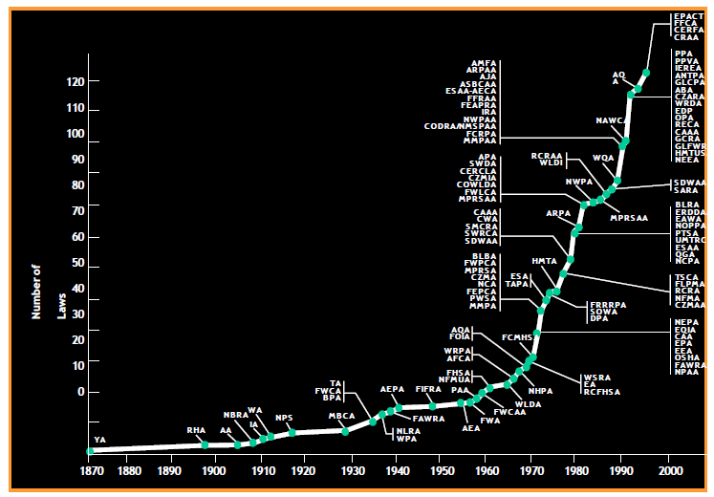
Growth in regulation laws
Notes:
Tip: Add your own speaker notes here.

Slide 7
What’s a Chemist to do?
Green Chemistry

Slide 8
What is Green Chemistry?
“The utilization of a set of principles that reduces or eliminates the use or generation of hazardous substances in the design, manufacture, and application of chemical products”
Anastas, P.T.; Warner, J.C. “Green Chemistry: Theory and Practice,” Oxford University Press: Oxford, 1998
EPA focus since 1991
Green Chemistry Institute
Founded in 1997
Joined ACS in 2001

Slide 9
12 Principles of Green Chemistry
It is better to prevent waste than to treat or clean it up
Synthetic methods should be designed to maximize the incorporation of all materials used in the process into final product
Wherever practicable, synthetic methods should be designed to use/generate substances of little or no toxicity to health and environment
Chemical products should be designed to preserve efficacy of function while reducing toxicity.
Use of auxiliary substances should be avoided
Energy requirements should be minimized and reactions carried out at ambient temp and pressure
Notes:
Tip: Add your own speaker notes here.

Slide 10
12 Principles of Green Chemistry
A raw material feedstock should be renewable
Unnecessary derivatization should be avoided (protecting/deprotecting, blocking groups, etc)
Catalytic reagents are better than stoichiometric
Chemical products should be designed so that at the end of their function they do not persist in the environment and instead break down into innocuous degradation products
Analytical methods need to be further developed to allow for real-time, in-process monitoring and control
Substances used in a chemical process should be chosen to minimize the potential for chemical accidents
Notes:
Tip: Add your own speaker notes here.

Slide 11
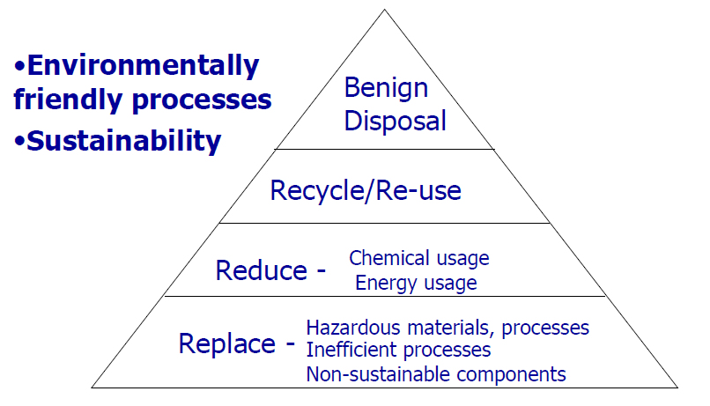
What is Green Chemistry?
hgarcia@qim.upv.es

Slide 12
Chemical Hazards
Many types of hazards
Carcinogens, mutagens, teratogens, tumorogens, corrosives, lachrymators, irritants
Chronic vs Acute
Acute often leads to immediate and dramatic health consequences
Chronic is often more problematic in environment
Chronic effects often long-lasting
LD₅₀

Slide 13
It’s all in the Dosage
Substance | LD₅₀ (mg/kg)
Water | 180, 000
Sugar | 35,000
Sodium Chloride | 3,750 | Slightly hazardous
Caffeine | 130 | Moderately hazardous
Sodium Cyanide | 15 | Highly hazardous
Arsenic Trioxide | 15 | Highly hazardous
Aflatoxin (moldy grains) | 10 | Highly hazardous
Sarin (nerve gas) | 0.4 | Extremely Hazardous
Tetanus toxin A | 5 x 10⁻⁶ | Extremely Hazardous
Botulinium toxin | 3 x 10⁻⁸ | Extremely Hazardous

Slide 14
Sources of Information about Hazards
Safety Data Sheets (SDS or MSDS)
On-line, for example Sigma Aldrich website
Hazardous Chemicals Database
Toxnet (toxicology data network)
http://toxnet.nlm.nih.gov/
CDC International Chemical Safety Cards (ICSC)
http://www.cdc.gov/niosh/ipcs/icstart.html
Hazardous Laboratory Chemicals: Disposal Guide—CRC Press
Notes:
Tip: Add your own speaker notes here.

Slide 15
So, how can you measure “green”?
Hazard analysis
Risk factors
Number of Toxic reagents
LD₅₀ comparisons

Slide 16
So, how can you measure “green”?
Atom Economy
Way to calculate the efficiency of utilization of atoms provided by the starting materials /reagents
Since mass ~ MW, can also use total masses in this calculation

Slide 17
So, how can you measure “green”?
Example:
Percent yield: (0.0930 / 0.100) * 100% = 93%
AE: [12.67 / (17.1 +10.2) ] * 100% = 46.4%
Note: since one reagent was used in excess, this lowers overall economy of the reaction

Slide 18
So, what do you do to make the Chemistry “greener”?
Use “scrubbers” to remove VOCs and other gaseous wastes
Treat waste water to remove toxins
More efficient incinerators to destroy toxins
Treat wastes in general to lower toxicity
Minimize the generation of toxic waste
But all of these are responses--none proactively improve the reactions being conducted

Slide 19
First, know your reaction

Slide 20
What can you do?

Slide 21
Change the Reagents--Pesticides
Natural insecticides
Pyrethrins
from chrysanthemum flowers
Harpin Technology
Bacterial protein which causes plants natural defense mechanisms to kick in
Causes a response which kills cells at the point of attack
Creates a physical barrier to further entry of a pathogen
Won’t cause immunity response in pest.
Made from modified E coli through fermentation—no chemical synthesis
Requires 70 % less than typical pesticide applications

Slide 22
Change the Reagents--Pesticides
Targeted insectides
Diacylhydrazins
Cause insects in their larval stage to think they are still shedding their cuticle
Caterpillars stop eating
GMOs

Slide 23
Change the Reagents-New Routes
Biological Catalysis / Reagents

Slide 24
Change the Solvents
Typical issues with organic solvents
Volatility (exposure and release issues)
Flammability
Explosion Hazard / Flash points (particularly ethers)
Toxicity
Ozone depletion (halogenated solvents like CFCs)
Storage / Handling /Disposal
A favorite target for “greening” a reaction

Slide 25
Change the Solvents-Existing Options
Use the greenest of the conventional solvents
Low toxicity / environmental hazards
Less volatile liquids
Recycle
Popular choices:
Ethanol, Isopropyl Alcohol, Polyethers (diglyme), Ethyl Acetate
WATER

Slide 26
Change the Solvents-New Approaches
Fluorous Phase
Supercritical fluids
Ionic Liquids
No Solvent

Slide 27
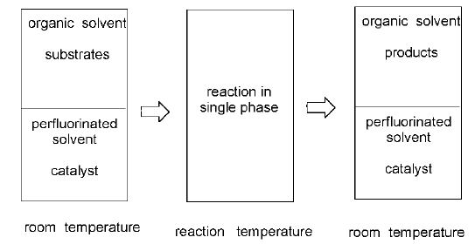
Change the Solvents-Fluorous Phase
Hydrofluorocarbons (HFCs)
Designed to replace CFCs
No Chlorines, therefore no damage to ozone layer

Slide 28
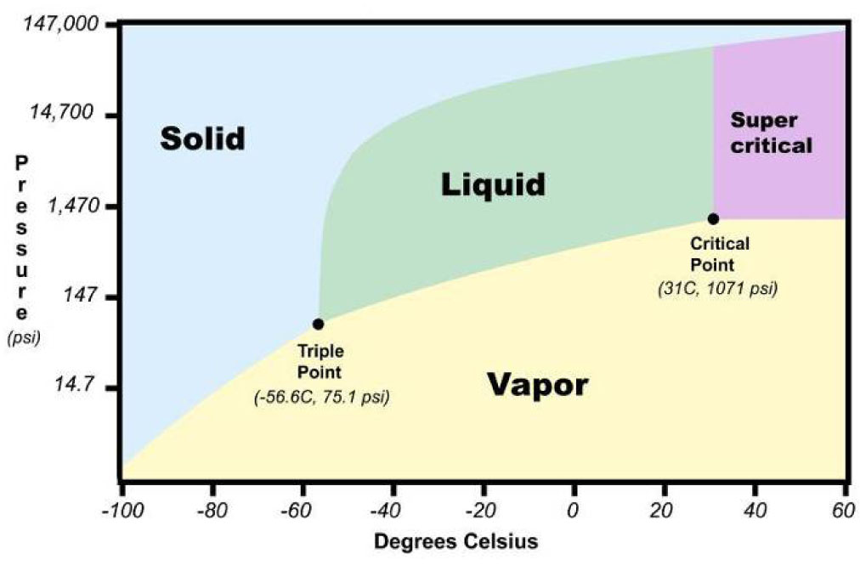
Change the Solvents-Supercritical fluids
CO₂ liquefies under pressure
replaces PERC for dry cleaning (Cl₂C=CCl₂)
VOC, carcinogen, ground water contaminant
Supercritical CO₂ (73 atm, 31ºC)
Decaffeination of coffee
Low viscosity and polarity
Penetrates like a gas
Dissolves small organics
Use of surfactants can help (micelles)

Slide 29
Change the Solvents-Ionic Liquids
Ions tend to have high MP (ex: Na Cl, 801 ºC)
ILs are made of bulky ions with dispersed charges and large non-polar regions
low vapor pressure (unlike VOC solvents)
Cheap, recyclable, non-flammable, and heat tolerant
good for microwave heating

Slide 30
Change the Energy Requirements
Microwave heating
Speed (lower energy costs)
Directly heat sample (less energy required)
Efficient Heating of Smaller Samples
High Temperatures (in sealed vials)
“Microwave Effect”
Two methods of heating
Dipolar polarization – polar molecules oscillate with electric field; collisions produce heat
Conduction – ions/conductive molecules move in field causing polarization; resistance produces heat

Slide 31
The Three R’s
Recovery
Solvents, spent reagents, catalysts
Reuse /Recycle
Reuse = useable without further purification (catalysts)
Recycle = processing or purification needed before using (solvents)
Regenerate
Most commonly when reagent is attached to a solid support
Chemically treated to regenerate the reagent
AmPAC Fine Chemicals: racemization of undesired enantiomer

Slide 32
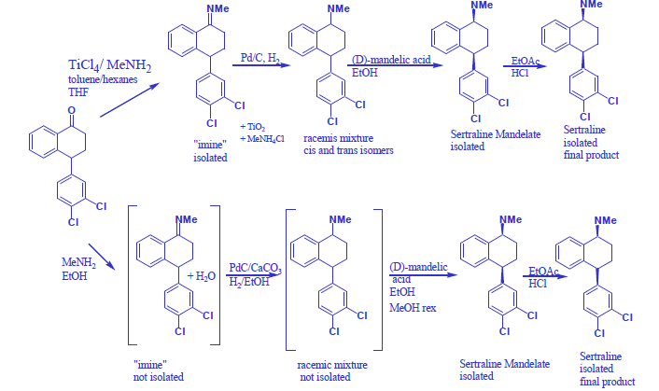
Examples of Green Chemistry: Sertraline

Slide 33
Examples of Green Chemistry
Click Chemistry—Triazole Synthesis

Slide 34
Examples of Green Chemistry
Joosten, et. al. Eur. J. Org. Chem 2005, 3182-3185.
30 sec, 30%
~98%

Slide 35
Examples of Green Chemistry
Polymers
60 billion kg of oil-based feedstocks are used to make 27 billion kg of plastics/polymers each year
PET (polyethylene terephthalate)–plastic bottles and cloth
Polyethylene—trash/grocery bags
polystyrene—packing foam, drink cups to appliances and furniture
Recycling of PET (only ~25%) generally can’t go back into bottles, but is often used for fibers (carpets and clothing)

Slide 36
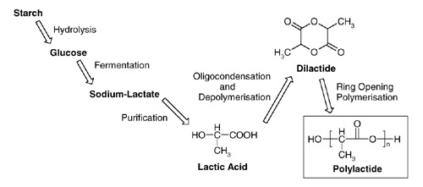
Examples of Green Chemistry
Polylactic acid (PLA)

Slide 37
Examples of Green Chemistry
Polylactic acid (PLA)
Made from corn and sugar beets
Goal is to use waste biomass for this fuel
Renewable source, less fossil fuel required in production, natural fermentation requires no organic solvent, high yields, recyclable, compostable

Slide 38
Green Chemistry--Conclusions
Synthesis should be done in an environmentally friendly and sustainable manner
Many approaches to improving syntheses:
Reagents, catalysts, solvents, procedures, energy,
Recovery, Recycle, Regenerate

