Slide 1
Chem. 31 – 9/11 Lecture

Slide 2
Announcements I
Turn in today
  Corrected diagnostic quiz (Sect 4)
Quiz 1 – Key posted; returned in labs
Today’s Lecture – Error and Uncertainty (Ch. 3)
  Accuracy and precision in measurements
  Propagation of uncertainty
    Overview
    In addition/subtraction
    New rules for significant figures
    Multiplication/Division

Slide 3
Announcements II
– Propagation of uncertainty (cont.)
    Exponents
    Mixed Operations

Slide 4
Accuracy and Precision
Accuracy is a measure of how close a measured value is to a true value
Precision is a measure of the variability of measured values
Precise, but not accurate
Poor precision (Accuracy also not great)
Precise and Accurate

Slide 5
Accuracy and Precision
Accuracy is affected by systematic and random errors
Precision is affected mainly by random errors
Precision is easier to measure

Slide 6
Accuracy and Precision
Both imprecise and inaccurate measurements can be improved
Accounting for errors improves inaccurate measurements (if shot is above and right aim low + left)
Averaging improves imprecise measurements
rough ave of imprecise shots
aim here

Slide 7
Propagation of Uncertainty
What does propagation of uncertainty refer to?
It refers to situations when one or more variables are measured in order to calculate another variable
Examples:
  Calculation of volume delivered by a buret:
    V_{buret} = V_{final} – V_{intial}
  Note: uncertainty in V_{buret} can be calculated by uncertainty in V_{initial} and V_{final} or by making multiple readings to get multiple values of V_{buret} (and then using the statistics covered in Chapter 4)
  Calculation of the volume of a rectangular solid:
    V_{object} = l·w·h
  Calculation of the volume of a cube
  V_{object} = l³
  Calculation of the density of a liquid:
    Density = m_{liquid}/V_{liquid}
Go to Board to go over examples
V_{initial}
V_{final}
l
h
w

Slide 8
Propagation of Uncertainty
Real Rules for Sig Figs
When a value and uncertainty are calculated (from propagation or from statistics):
  Uncertainty has 1 sig fig
  Value goes to same last digit as uncertainty
Example: answer = 3.871 + 0.092 g/L
Hundredths place
3.87 +
0.09

Slide 9
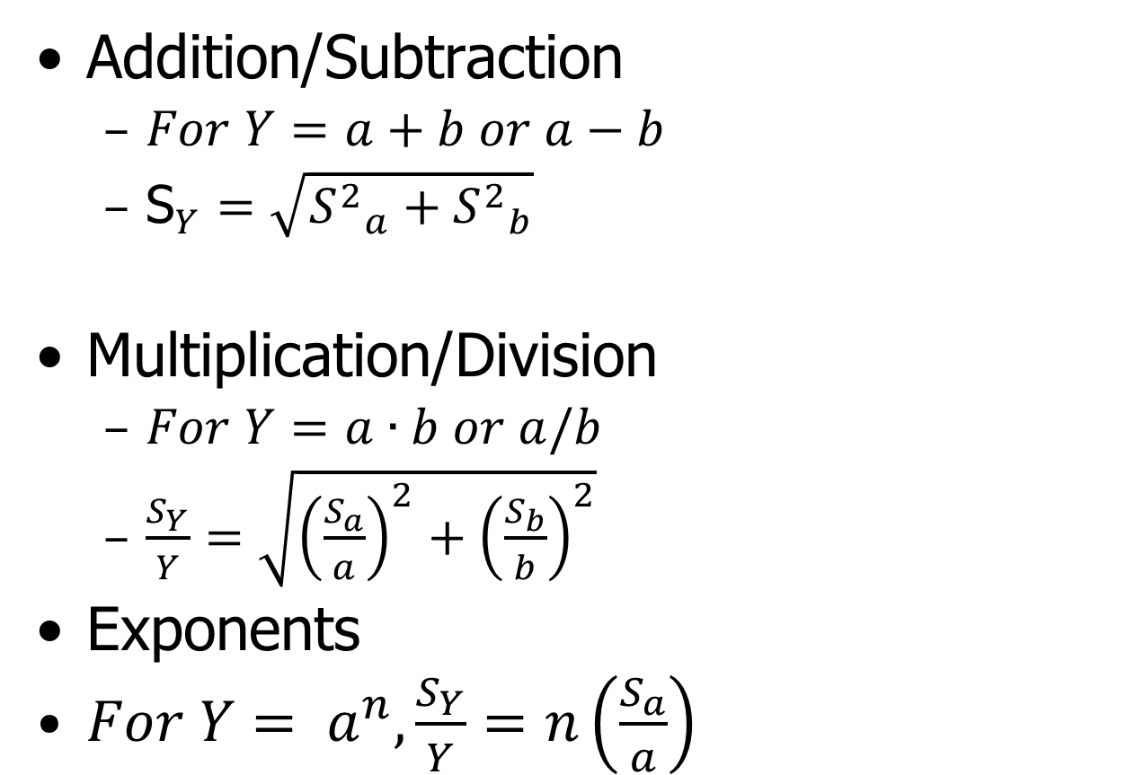
Propagation of Uncertainty
Equations (will be given on Exams)
Addition/Subtraction
  $For Y=a+b or a−b$
  ${\text{S}}_{Y}=\sqrt{{S^{2}}_{a}^{}+{S^{2}}_{b}^{}}$
Multiplication/Division
  $For Y=a∙b or a/b$
  $\frac{S_{Y}}{Y}=\sqrt{{\left(\frac{S_{a}}{a}\right)}^{2}+{\left(\frac{S_{b}}{b}\right)}^{2}}$
Exponents
$For Y= a^{n}, \frac{S_{Y}}{Y}=n\left(\frac{S_{a}}{a}\right)$

Slide 10
Chapter 4
Calculation of Average and Standard Deviation
Average
Standard Deviation
Note: You are welcome to use function keys on your calculator to calculate average and standard deviation

