Slide 1
Chem. 31 – 9/13 Lecture

Slide 2
Announcements I
Next Monday (9/18)
  Science II Groundbreaking Ceremony
    10:30 to 11:00 – hope you can attend
    so postponing lecture start until 11:10
  I will be involved in other parts as well (so you will have Dr. Miller-Schulze as guest lecturer)
First Lab Report (Pipet and Buret Calibration)
  Scheduled due 9/18
  Making due 9/20 because we haven’t covered 95% confidence interval yet
  See Appendix III (and lab instructor) about what is to be turned in (report form, data, and plot)

Slide 3
Announcements II
Today’s Lecture
  Propagation of uncertainty (Chapter 3) – cont. from last time
    Exponents (volume of cube)
    Mixed Operations (density of liquid)
  Gaussian Statistics and Calibration (Chapter 4)
    Mean value and standard deviation
    Gaussian distributions for populations
    Application to measurement statisticsZ-value problems - % between limits
    Confidence Intervals (start to this if time)

Slide 4
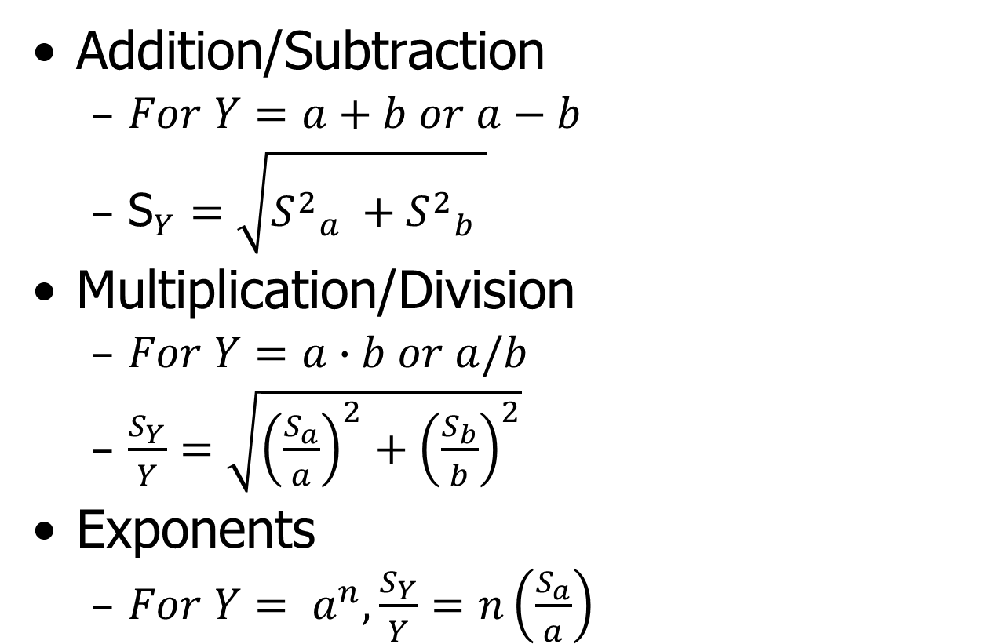
Propagation of Uncertainty
Equations (will be given on Exams)
Addition/Subtraction
  $For Y=a+b or a−b$
  ${\text{S}}_{Y}=\sqrt{{S^{2}}_{a}^{}+{S^{2}}_{b}^{}}$
Multiplication/Division
  $For Y=a∙b or a/b$
  $\frac{S_{Y}}{Y}=\sqrt{{\left(\frac{S_{a}}{a}\right)}^{2}+{\left(\frac{S_{b}}{b}\right)}^{2}}$
Exponents
  $For Y= a^{n}, \frac{S_{Y}}{Y}=n\left(\frac{S_{a}}{a}\right)$

Slide 5
Chapter 4
Calculation of Average and Standard Deviation
Average
Standard Deviation
Note: You are welcome to use function keys on your calculator to calculate average and standard deviation

Slide 6

Chapter 4 – Gaussian Distributions
MMP = methylmannopyranoside = interal standard added at a conc. of 5.00 ppm
Gaussian Distributions are often observed when sample size gets large
Example 1: repeated measurement of MMP conc.
Sample vs. Population:
Sample mean population mean
μ
Sample standard population standard
deviation deviation
S σ
As sample size increases:
→ μ
and S → σ
μ
S
Also note that mean values vary less than individual measurements (see 4 measurement means)
$${S_{x}>S}_{\overline{x}}$$

Slide 7
Chapter 4 – Gaussian Distributions

Slide 8
Chapter 4 – Gaussian Distributions
Second Example: Mass Spectrometer Measurements (x-axis is mass to charge ratio or mass for +1 ions)

Slide 9
Chapter 4 – Gaussian Distributions
Idealized distribution occurs as n →∞
Math for Gaussian Distribution:
Normalized Gaussian Distribution:
μ = 0 and σ = 1
Use of Normalized Gaussian Distribution:
Area under curve gives probability of finding value between limits

Slide 10
Chapter 4 – Gaussian Distributions
Examples:
- ∞ < Z < ∞ Area = 1
Since curve is symmetrical,
0 < Z < ∞ Area = 0.5
0 < Z < 1.5 Area = 0.433
(See Table 4-1 in text)
Note: non-normal distributions can be converted to normal distributions as follows: Z = (x - μ)/σ
Notes:
10

Slide 11
Chapter 4 – Gaussian Distributions
Now for limit problems – example 1 – population statistics:
A lake is stocked with trout. A biologist is able to randomly sample 42 fish in the lake (and we can assume that 42 fish are enough for proper – Z-based statistics).
Each fish is weighed and the average and standard deviation of the weight are 2.7 kg and 1.1 kg, respectively.
If a fisherman knows that the minimum weight for keeping the fish is 2.0 kg, what percent of the time will he have to throw fish back? (assuming catching is not size-dependent)
1st part: convert limit (2.0 kg) to normalized (Z) value:
Z = (x – μ)/σ 2nd part: use Z area to get percent
Notes:
11

Slide 12
Chapter 4 – Gaussian Distributions
Limit problem – example 2 – measurement statistics:
A man wants to get life insurance. If his measured cholesterol level is over 240 mg/dL (2,400 mg/L), his premium will be 25% higher. His level is measured and found to be 249 mg/dL. His uncle, a biochemist who developed the test, tells him that a typical standard deviation on the measurement is 25 mg/dL. What is the chance that a second measurement (with no crash diet or extra exercise) will result in a value under 240 mg/dL (e.g. beat the test)?
Notes:
12

Slide 13
Graphical view of examples
Equivalent Area
Desired area
Table area
X-axis
240
249
Notes:
13

Slide 14
Chapter 4 – Calculation of Confidence Interval
Confidence Interval = x + uncertainty
Calculation of uncertainty depends on whether σ is “well known”
When σ is not well known (covered later)
When σ is well known (not in text)
  Value + uncertainty =
Z depends on area or desired probability
At Area = 0.45 (90% both sides),
Z = 1.65
At Area = 0.475 (95% both sides), Z = 1.96 => larger confidence interval
Notes:
14

