Slide 1
Chem. 31 – 9/18 Lecture

Slide 2
Announcements I
[Introduce Self]
Pipet Calibration Lab Reports – now due 9/20
Quiz 2 – On 9/20 (those of you with points under Quiz 2 in SacCT – should have been in Lab Procedures Quiz column)
Today’s Lecture
  Gaussian Statistics (Chapter 4)
    Z-based limit testing
    Confidence Intervals (Z-based and t-based)
    Statistical Tests (F-test, t-tests) [let me know how far you get on these]

Slide 3
Chapter 4 – Gaussian Distributions
Now for limit problems – example 1 – population statistics:
A lake is stocked with trout. A biologist is able to randomly sample 42 fish in the lake (and we can assume that 42 fish are enough for proper – Z-based statistics).
Each fish is weighed and the average and standard deviation of the weight are 2.7 kg and 1.1 kg, respectively.
If a fisherman knows that the minimum weight for keeping the fish is 2.0 kg, what percent of the time will he have to throw fish back? (assuming catching is not size-dependent)
1st part: convert limit (2.0 kg) to normalized (Z) value:
Z = (x – μ)/σ 2nd part: use Z area to get percent
Notes:
3

Slide 4
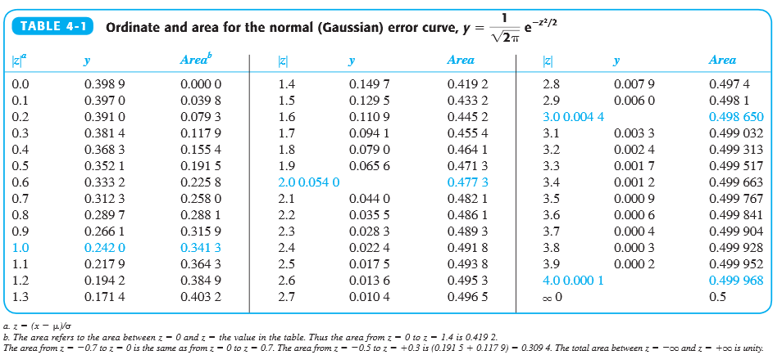
4-1: Area Under the Gaussian Distribution

Slide 5
Chapter 4 – Gaussian Distributions
Limit problem – example 2 – measurement statistics:
A man wants to get life insurance. If his measured cholesterol level is over 240 mg/dL (2,400 mg/L), his premium will be 25% higher. His level is measured and found to be 249 mg/dL. His uncle, a biochemist who developed the test, tells him that a typical standard deviation on the measurement is 25 mg/dL. What is the chance that a second measurement (with no crash diet or extra exercise) will result in a value under 240 mg/dL (e.g. beat the test)?
Notes:
5

Slide 6
Graphical view of examples
Equivalent Area
Desired area
Table area
X-axis
240
249
Notes:
6

Slide 7
Chapter 4 – Calculation of Confidence Interval
Confidence Interval = x + uncertainty
Calculation of uncertainty depends on whether σ is “well known”
When σ is not well known (covered later)
When σ is well known (not in text)
  Value + uncertainty =
Z depends on area or desired probability
At Area = 0.45 (90% both sides),
Z = 1.65
At Area = 0.475 (95% both sides), Z = 1.96 => larger confidence interval
Notes:
7

Slide 8
Chapter 4 – Calculation of Uncertainty
Example:
The concentration of NO₃⁻ in a sample is measured 2 times and found to give 18.6 and 19.0 ppm. The method is known to have a constant relative standard deviation of 2.0% (from past work). Determine the concentration and 95% confidence interval.
Notes:
8

