Slide 1
Chem. 31 – 9/27 Lecture

Slide 2
Announcements
Exam 1 – on Oct. 4th
  Next Week on Wednesday
  Will Cover Ch. 1, 3, 4, and parts of 6 (6-1 and 6-2)
  Review of topics on Monday
  Possible Help Session Monday?
Water Hardness Lab – Now due 10/2
Today’s Lecture
  Gaussian Statistics (Chapter 4)
    Dealing with poor data
    Value of data averaging
    Least Squares Regression (if time)

Slide 3
Dealing with Poor Quality Data
If Grubbs test fails, what can be done to improve precision?
  design study to reduce standard deviations (e.g. use more precise tools)
  make more measurements (this may make an outlier more extreme and should decrease confidence interval)
  can also discard data based on observation showing error (e.g. loss of AgCl in transfer resulted in low % Cl for that trial)
Notes:
3

Slide 4
Signal Averaging
For some type of measurements, particularly where they are made quickly, averaging many measurements can improve the sensitivity or the precision of the measurement
Example 1: NMR
1 scan
25 scans

Slide 5
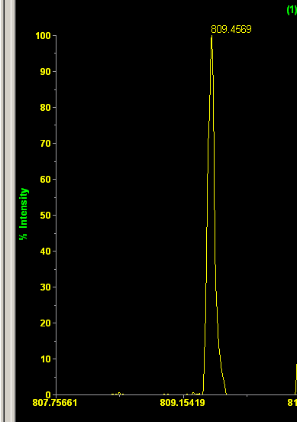
Signal Averaging
Example 2: High Accuracy Mass Spectrometry
To confirm molecular formula, error in mass should be < 5 ppm (for mass = 809 amu, error must be < 0.004 amu)
However, S_{mass} = 0.054 amu
Can requirement be met?
Yes S_{mean mass} = S_{mass}/√n
What value is needed for n to meet 5 ppm requirement 95% of time?
Note: also requires accurate calibration
Measured Mass = 809.4569 amu
Example compound: expected mass = 809.4587 amu
To meet 5 ppm limit, meas. mass = 809.4547 to 809.4628

Slide 6
Calibration
For many classical methods direct measurements are used (mass or volume delivered)
Balances and Burets need calibration, but then reading is correct (or corrected)
For many instruments, signal is only empirically related to concentration
Example Atomic Absorption Spectroscopy
  Measure is light absorbed by “free” metal atoms in flame
  Conc. of atoms depends on flame conditions, nebulization rate, many parameters
  It is not possible to measure light absorbance and directly determine conc. of metal in solution
  Instead, standards (known conc.) are used and response is measured
Light beam
To light Detector
Notes:
6

Slide 7
Method of Least Squares
Purpose of least squares method:
  determine the best fit curve through the data
  for linear model, y = mx + b, least squares determines best m and b values to fit the x, y data set
  note: y = measurement or response, x = concentration, mass or moles
How method works:
  the principle is to select m and b values that minimize the sum of the square of the deviations from the line (minimize Σ[y_{i} – (mx_{i} + b)]²)
  in lab we will use Excel to perform linear least squares method
Notes:
7

Slide 8
Example of Calibration Plot
Best Fit Line Equation
Best Fit Line
Deviations from line
Notes:
8

Slide 9
Assumptions for Linear Least Squares Analysis to Work Well
Actual relationship is linear
All uncertainty is associated with the y-axis
The uncertainty in the y-axis is constant

Slide 10
Calibration and Least Squares
- number of calibration standards (N)
N Conditions
Must assume 0 response for 0 conc.; standard must be perfect; linearity must be perfect
Gives m and b but no information on uncertainty from calibration
Methods 1 and 2 result in lower accuracy, undefined precision
Minimum number of standards to get information on validity of line fit
Good number of standards for linear equation (if standards made o.k.)
More standards may be needed for non-linear curves, or samples with large ranges of concentrations

Slide 11
Use of Calibration Curve
Mg Example:
An unknown solution gives an absorbance of 0.621
Use equation to predict unknown conc.
y = mx + b
x = (y – b)/m
x = (0.621 + 0.0131)/2.03
x = 0.312 ppm
Can check value graphically
Calibration “Curve”

Slide 12
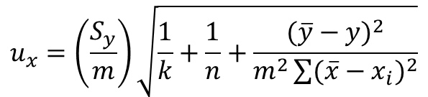
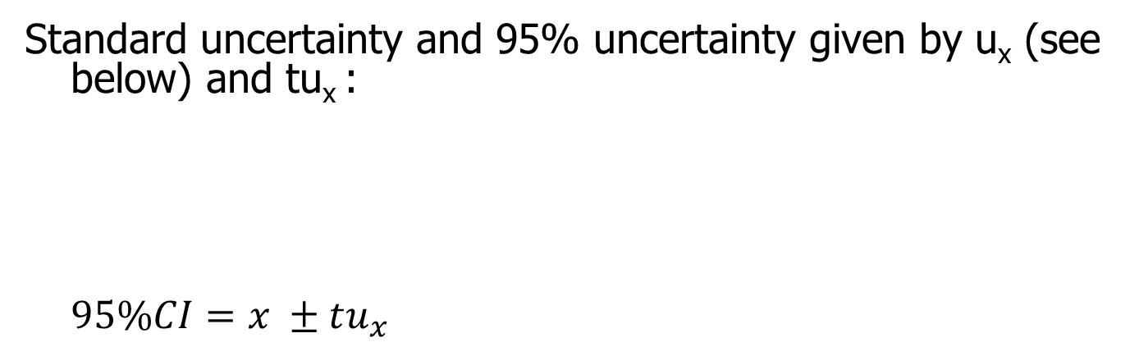
Use of Calibration Curve
- Uncertainty in Unknown Concentration
Standard uncertainty and 95% uncertainty given by u_{x} (see below) and tu_{x} :
$$95\%CI=x ±tu_{x}$$
$$u_{x}=\left(\frac{S_{y}}{m}\right)\sqrt{\frac{1}{k}+\frac{1}{n}+\frac{({\overline{y}−y)}^{2}}{m^{2}\sum{{(\overline{x}−x_{i})}^{2}}}}$$
Notes on equation: m = slope, S_{y} = standard error in y
n = #calibration stds k = # analyses of unknown, x_{i} = indiv std conc., y = unknown response
The biggest factors are S_{y} and m
Note: t is for n – 2 degrees of freedom (and 95% confidence)

Slide 13
Use of Calibration Curve
Additional Problem 2:
Use Excel methods to:
Determine m and b (can also get S_{y} using LINEST function)
Determine unknown concentration (x) for given response (y)
Determine quantities needed to calculate uncertainty (n, mean y, Σ(x_{i} – mean x)²)
Determine standard uncertainty (u_{x}) and 95% uncertainty in unknown conc.

Slide 14
Use of Calibration Curve
- Quality of Results
Quality of Results Depends on:
  Calibration Results
    R² value (measure of variability of response due to conc.)
    Reasonable fit
  Range of Unknown Concentrations
    next slide
Better fit by curve

Slide 15
Use of Calibration Curve
- Quality of Results
Range of Standards (0.02 to 0.4 ppm)
Quality of Results Depends on:
  Calibration Results
    on last slide
  Range of Unknown Concentrations
    Extrapolation outside of range of standards should be avoided
    Best concentration range
Relative Uncertainty
Absolute Uncertainty
Best Range: upper 2/3rds of standard range
Notes:
15

Slide 16
Calibration Question
A student is measuring the concentrations of caffeine in drinks using an instrument. She calibrates the instruments using standards ranging from 25 to 500 mg/L. The calibration line is:
  Response = 7.21*(Conc.) – 47
  The response for caffeine in tea and in espresso are 1288 and 9841, respectively. What are the caffeine concentrations? Are these values reliable? If not reliable, how could the measurement be improved?

