Slide 1
Chem. 31 – 11/6 Lecture

Slide 2
Announcements I
Co/Cr Lab Report
  Now Due 11/13
Exam 2
  On Wed., 11/8
  Same format as Exam 1 (bring scantron)
  Will Cover Chapters 6 (except 6-1), 7 (except calculation of conc. during precipitation titrations), Ch. 18, and Ch. 23 (sect. 1-3 – except relative retention)

Slide 3
Announcements II
Today’s Lecture
  Chapter 23 – Chromatography
    Transport and Retention – finish section
  Review for Exam
  More Chromatography (if time)
    Relative Retention

Slide 4
Chromatography
Definition Section – Partition and Retention
Since the fraction of time a solute molecule spends in a given phase is proportional to the fraction of moles in that phase,
k = (time in stationary phase)/(time in mobile phase)
Experimentally, k = (t_{R} – t_{M})/t_{M}
Note: t’_{R} = t_{R} – t_{M} = adjusted retention time

Slide 5
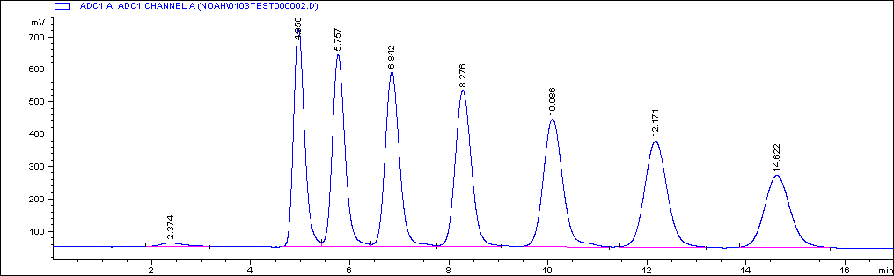
Chromatography
Reading Chromatograms
1st peak, t_{R} = 4.958 min.; k = (4.958 - 2.374)/2.374 = 1.088

Slide 6
Chromatography
What do all these Parameters Mean?
Large k value (or K value) means analyte prefers stationary phase
“Adjusting k (or K)” - in GC:
  k value will depend on volatility and polarity (analyte vs stationary phase)
  More volatile compound elutes first (if polarity is the same)
  k value adjusted by changing T (most common)
  higher T means less retention (lower k and K)

Slide 7
Chromatography
What do all these Parameters Mean? II
Adjusting k – in HPLC
  k value will depend on analyte vs. mobile phase and stationary phase polarity
  Oldest type (= Normal phase) stationary phase is polar and mobile phase is non-polar
  Most common type (= Reversed phase) has non-polar stationary phase and polar mobile phase
  k value adjusted by changing mobile phase polarity
  k value is decreased by making mobile phase more like stationary phase (= using “stronger” eluent)
  In reversed phase HPLC, less polar mobile phase means less retention
analyte
more polar
less polar
water
stationary phase
methanol

Slide 8
Chromatography
What do all these Parameters Mean? III
Retention Factor is a more useful measure of partitioning because value is related to elution time
Compounds with larger K, will have larger k, and will elute later
Practical k values
  ~0.5 to ~10
  Small k values → overlapping peaks likely
  Large k values → must wait long time

Slide 9
Chromatography
More Questions
A chemist is analyzing samples by normal phase HPLC using a mobile phase containing 90% hexane and 10% 2-propanol (2-propanol is the more polar solvent). The analysis is taking too long. How can she decrease k values?
From the chromatogram to the right, calculate k_{X}.
unretained peak
X Y

Slide 10
Review for Exam 2
  Chapter 6
    Definitions of changes in Enthalpy, Entropy and Free Energy plus predictions given reaction
    Be able to calculate ΔG from ΔH and ΔS
    Be able to determine K from ΔG° or visa versa
    Be able to predicts shift in equilibrium due to changes in conditions (Le Châtelier’s Principle)
    Solubility Product Problems* (solubility in water and solubility with common ion, precipitation, selective precipitation)
  Complex Ions (Definition of Lewis acids and bases, what complex ions are, understanding formation reactions, problems at equilibrium*)

Slide 11
Review for Exam 2
  Chapter 6 – cont.
  Acids/Bases (Bronsted-Lowry definition, products in water, pH scale, conversion between pH and [H⁺]*, strong acids, strong bases, weak acids, weak bases, ionic compounds as bases/acids/neutrals, polyprotic acids conversion between K_{a} and K_{b}*)
Chapter 7
  How to do basic titration calculations* (use titrations to calculate e.g. equivalence volume or unknown concentrations)
  Titration definitions (titrant, equivalence point, end point, standardization titrations, analyte titrations, back titrations)

Slide 12
Review for Exam 2
  Chapter 7 – cont.
  Practical titration requirements
  Be able to solve back titration problems*
  Qualitatively understand precipitation titrations work with mixed ion solutions
  Qualitatively understand how titrations work with mixed ion solutions
  Qualitatively understand how concentrations and K_{sp} affect titration shape
Chapter 18
  Some wave-like and particle like properties of light
  How to convert between light energy, wavelength, wavenumber, and frequency*

Slide 13
Topics on Exam 2
Chapter 18 – cont.
  How to relate absorption and emission of light to changes in energy levels
  What type of interactions occur in different regions of the electromagnetic spectrum
  Use of Beer's law*
  Limitations to Beer’s Law
  Spectrometer Components
Chapter 23
  How to use Partition Equation for extractions*
  How acid – base reactions affect partitioning

Slide 14
Topics on Exam 2
Chapter 23 – cont.
  How to use Partition Equation for extractions*
  How acid – base reactions affect partitioning
  Main components of chromatographs
  Two phases in chromatography + how mobile phase defines type of chromatography
  How stationary phase is “attached” to column
  Relationships between flow rate, volume and time*
  Partition equation in chromatography*
  Relationship between partition coefficient (K) and retention factor (k)*

Slide 15
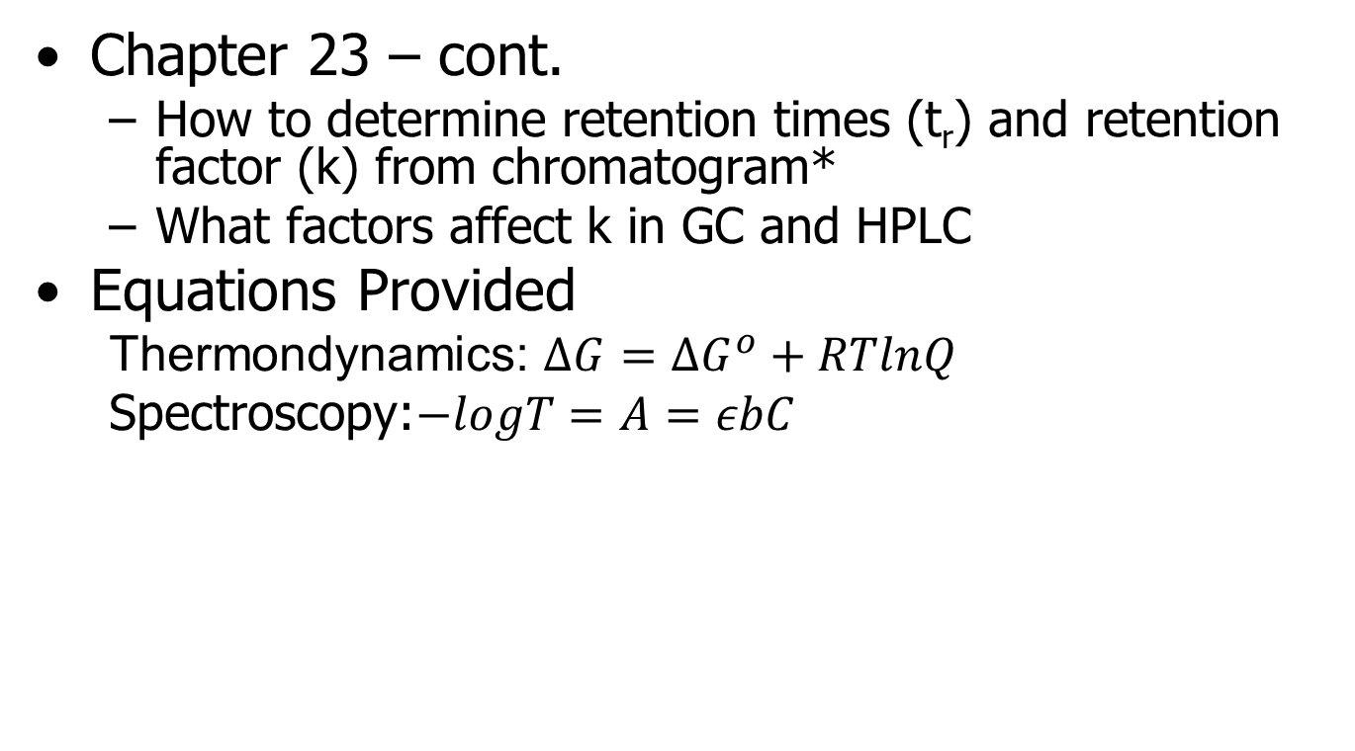
Topics on Exam 2
Chapter 23 – cont.
  How to determine retention times (t_{r}) and retention factor (k) from chromatogram*
  What factors affect k in GC and HPLC
Equations Provided
  Thermondynamics: $∆G=∆G^{o}+RTlnQ$
  Spectroscopy:$−logT=A=εbC$

Slide 16
Chromatography
Definition Section – Relative Retention
For a separation to occur, two compounds, A and B must have different k values
The greater the difference in k values, the easier the separation
Relative Retention = α = k_{B}/k_{A} (where B elutes after A) = measure of separation ease = “selectivity coefficient”
α value close to 1 means difficult separation

Slide 17
Chromatography
Reading Chromatograms
Determination of parameters from reading chromatogram (HPLC example)
α (for 1st 2 peaks) = k_{B}/ k_{A} = t_{RB}’/ t_{RA}’ = (5.757 – 2.374)/(4.958 – 2.374) = 1.31

Slide 18
Chromatography
What do all these Parameters Mean?
Relative Retention
α values
  Can “adjust” value by choosing column (HPLC or GC) that is more “selective” for one compound than another or change the solvent (HPLC) to one which “dissolves” one compound better than another
  example: on a non-polar column, diethyl ether (K_{ow} = 6.8, bp = 34.6°C) and methanol (K_{ow} = 0.15, bp = 64.7°C) are observed to partially co-elute giving a small α value.
  switching to a polar column will increase retention of methanol (stronger interaction with new column) and decrease retention of diethyl ether (weaker interaction with new column), increasing α.
  with HPLC, it is often possible to change the eluent to increase α. Recent example: reversed phase separation with acetonitrile and water lead to poor C16:0/C18:1 separation (for biodiesel characterization). Switching organic to methanol lead to improvement. [show on next slide]

