Slide 1
Supercritical Fluid Extraction
By
Nicole Adams
and
Morgan Campbell

Slide 2
Outline
History and Background
Theory
Advantages
Disadvantages
Applications
Conclusions

Slide 3
History
First reported as high-pressure gas chromatography (HPGC) before HPLC in 1962.
1966 first use of supercritical CO₂ as mobile phase
Used a UV absorption detector with a quartz cell equipped with a gas-liquid separator
1968- used a SFC system with a mechanical backpressure regulator that could control pressure independent of flow rate. Basic prototype of modern packed column SFC.
1970- development allowed pressure programming, gave a gradient.
Overshadowed by development of HPLC in late 60’s and 70’s.
1980’s led to commercialization of SFC instruments
  Open tubular columns-more like GC
  Packed columns-more like LC.
  Developed chiral separations
1990’s- use of SFC as preparative separation
2000’s- demands for ”green chemistry” has led to more interest in SFE
  Advances in column and mobile phase chemistry allowed separations of more polar molecules
1

Slide 4
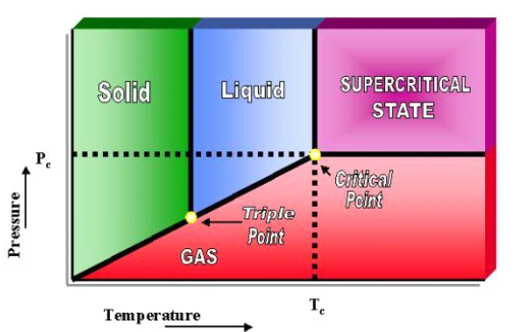
Supercritical Fluid
Critical point represents the pressure and temperature conditions under which phase such as liquid and gas cease to exist.

Slide 5
Supercritical Fluid Characteristics
Has density and solvent power similar to that of a liquid solvent but the viscosity and diffusivity of the same order of magnitude as gases
SCF moves like a gas and dissolves substrates similar to a liquid

Slide 6
Supercritical Fluid Extraction
The separation of chemicals which are mixed with a supercritical fluid to form a mobile phase which is subjected to pressures and temperatures near or above the critical point for the purpose of enhancing the mobile phase solvating power.
Typically, CO₂ is used as the supercritical fluid. CO₂ is first in vapor form then compressed into a liquid prior to becoming supercritical, where extraction occurs.
Supercritical CO₂:
Critical temperature = 30.9˚C
Critical pressure = 73.8 bar
Critical density = 0.467 gm/ml

Slide 7
Modifiers
Co-solvents that are added to CO₂ to enhance extraction efficiency
Usually 1 to 10% of methanol or ethanol is added to expand the extraction range to include more polar lipids
Organic modifiers can increase the complexity of the experimental model that determines SCF extraction parameters

Slide 8
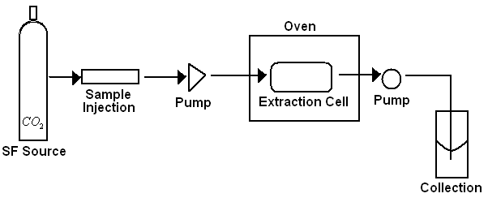
SFE Apparatus
The necessary apparatus for a SFE setup is simple. Figure depicts the basic elements of a SFE instrument, which is composed of a reservoir of supercritical fluid, a pressure tuning injection unit, two pumps (to take the components in the mobile phase in and to send them out of the extraction cell), and a collection chamber.

Slide 9
Static Mode
Equilibrium state between the solute and the solvent is achieved before any sample is taken out to analyze the solubility.
Static method carries out the equilibrium process in many ways that include recirculation of the solvent, agitation by the magnetic stirrer, or simply trapping the solvent in the equilibrium cell for some time
In the static extraction experiment, there are two distinct steps in the process:
  The mobile phase fills the extraction cell and interacts with the sample.
  The second pump is opened and the extracted substances are taken out at once.

Slide 10
Dynamic extraction mode
In dynamic extraction, the second pump sending the materials out to the collection chamber is always open during the extraction process.
Thus, the mobile phase reaches the extraction cell and extracts components in order to take them out consistently.

Slide 11
Characteristics of SCF
Density: the ratio of the mass of an object to its volume
Solubility: the maximum amount of a substance that will dissolve in a given amount of solvent at a given temperature to form a stable solution
Viscosity: the resistance of a liquid to flow
Diffusivity: the ability of a molecule to mix with a substance by random molecular motion

Slide 12

Theory-Density
Determines the intermolecular forces for packing of molecules in the solvent around the molecules of solute. This behavior determines solvation.
Retention behavior is also related to the density of the mobile phase, which is provided by the Equations of state (EOS)
EOS are relationships that connect the pressure, volume, and the temperature of a given mass of a fluid.
Where M is the molecular weight, R the universal gas constant, and Z the compressibility factor. Z = Z(P,T), which is given by the EOS

Slide 13

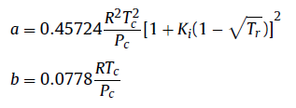


Equation of State
There are multiple EOS equations that are very complex. Usually pressure programs help determine what equation is the best fit for the experimental parameters. An example is the Peng-Robinson EOS
but the volumetric mass must be calculated numerically.
Therefore, the easiest way to derive Z as a numerical solution based on this EOS is from the equation
Where ω is the acentric factor, which can be found in tables

Slide 14
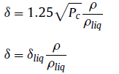
Solubility
Solvent power of a SCF depends on its structure, polarity and its density
Solubility parameter
of a dense gas can be
estimated by:
Where ρ/ρ_{liq} is the ratio of the density of the dense gas to that of the liquid at its boiling point.
Solubility increases with higher temperatures because of higher vapor pressures but this is offset because ρ decreases with increased temperatures and lower ρ values decrease solubility
Initial stages of SCF extraction are governed by the distribution coefficients of the solute between the dense fluid-phase and the sample matrix
  therefore controlled by solubility

Slide 15

Viscosity
Low viscosity enables easy penetration of the SCF in porous solids
Viscosity of CO₂ is about one order of magnitude smaller than those of typical liquid organic solvents
Critical viscosity can be determined by:
Where M is molecular weight, η_{c} is in micropoise, P_{c} in atm,
T_{c} in K, and V_{c} in ml/mol
Viscosity of a SCF essentially depends on its density which is a function of the pressure and the temperature

Slide 16
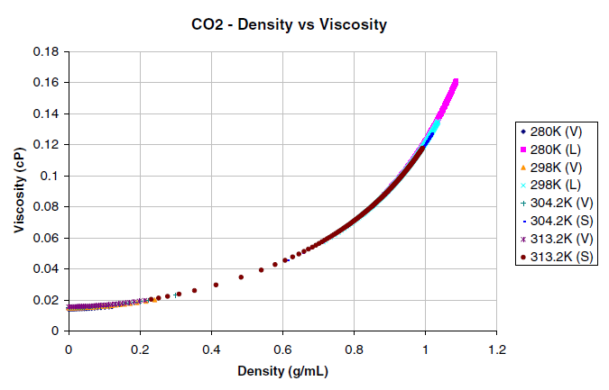
Viscosity and Density
Viscosity of carbon dioxide as a function of its density at different temperatures.
This confirms that viscosity of a fluid , subcritical, critical or supercritical depends essentially on its density but depends little on the temperature alone.

Slide 17
Diffusivity
SC CO₂ has values that are more typical of gases than those of the liquid state
Increased diffusivity of an SCF as compared to those of liquid, results in high mass transfer rates
Self-diffusion coefficient of SC CO₂ is 1-2 orders of magnitude greater than those of dissolved substances in the usual solvents
Later stages of SCF extraction are governed by diffusion-controlled process
  therefore controlled by mass transfer

Slide 18
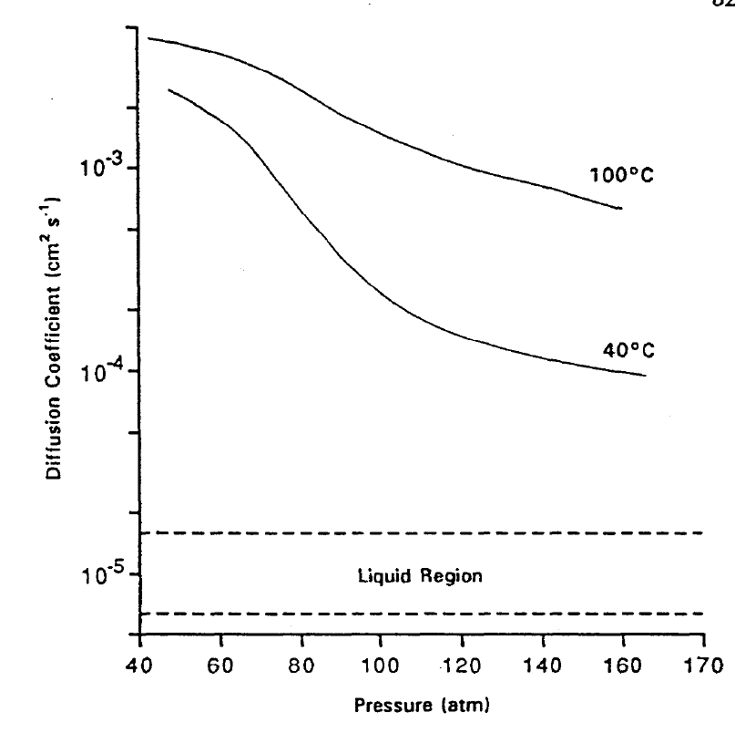
Diffusion Coefficients

Slide 19
Sample Matrix Influences
Particle size and shape
Surface area and porosity
Moisture content
Changes in morphology
Sample size
Extractable levels

Slide 20
Advantages
“Green Chemistry”
Can use MS, FID, UV (particularly PDA in packed columns), ESLD
Can use gradients of CO₂, modifiers, density, pressure, temperature
With modifiers, can analyze a wide range of analytes
Can be used for analytical and preparative separations
All three parameters-pressure, temperature, modifier content- can independently or cooperatively control retention
CO₂ is cheap, non-toxic, non-flammable, transmits in the UV, readily available, and a gas at room temperature
Much less use of organic solvents-good for EPA and storage/disposal of such solvents
CO₂ use as a solvent protects lipid samples against oxidative degradation.
1-2, 8-10

Slide 21
Disadvantages
Cost-both of equipment and training to operate machine
Programming required to optimize results
Equipment must be able to handle very high pressures/temperatures
Cannot use refractive index detection because of high back pressure required by SFE
Polar analytes are comparatively difficult to separate than non-polar analytes unless a modifier is used, making the process less “green”
Due to temperature/pressure/”green” requirement limits, CO₂ is the only really practical supercritical fluid solvent
SFE is not generally selective enough to isolate specific analytes from the matrix without further clean-up/resolution from co-extracted species
1-2, 8-10

Slide 22
Applications
Chiral separations most successful application in SFE (including analyte and preparative separations, has been around longest)
Extraction of caffeine from coffee beans, tea leaves
Metals recovery from solids/liquids
Food toxicology and ecotoxicology
Solvent removal and new drug delivery formulations (used as an anti-solvent)
Natural pesticides
De-nicotinization of tobacco
Food preservatives
Herbal medicines
Isolation of natural products
2, 8-10

Slide 23
Applications (1)
Supercritical CO₂ extraction of Eucalyptus leaves oil
Advantages:
  Extracted a wide range of components-not only volatile oils but high molecular weight compounds.
  1,8-cineole (primary desired extract) content was 46.19%
  Extraction only took 60 minutes, compared to Soxhlet (8 hours) or hydrodistillation (5 hours)
  Did not have degradation of water sensitive compounds in oil due to partial hydrolysis
  No solvent residue present in finished product
8

Slide 24
Applications (2)
SFE CO₂ extraction of bioactive compounds from microalgae and volatile oils from aromatic plants
Advantages:
    It is possible to obtain pure oil fraction on the second column while trapping waxes on first column
    Extraction of bioactive compounds and volatile oils done without use of organic solvents
    Microalga had 72g/kg hydrocarbons extracted without contamination by chlorophyll
    These hydrocarbons can replace paraffinic and natural waxes in production of masks for cosmetic industry-free of toxic solvents
    70% of carotenoid content extracted, used as food colorant
    Composition of extracted volatile oils from pennyroyal yielded 80% pulegone (used as flavoring agent, in perfumery, and aromatherapy. Similar to peppermint and camphor) and 9% menthone (related to menthol),
    Extraction of compounds from Satureja montana L. (winter savory) had 15 fold higher amounts of thymoquinone (vs. extraction done with hydrodistillation). Thymoquinone has anticancer, antioxidant and anti-inflammatory properties, as well as a neuroprotective effect against Alzheimer’s disease.
9

Slide 25
Application (3)
SFE of heavy metals from sand and sewage sludge
Advantages:
  Lack of solvents = environmentally acceptable
  Morphology and structure matrix is retained
  Use of a chelating agent (Acetyl acetonate -dissolves in CO₂) allowed removal of Cu, Cr, Ni, Pb and Zn
  In comparison with traditional methods (BCR, Tessier, etc) it is much faster
  Avoids analytical difficulties that are encountered with sequential extraction methods
  Uses less harsh conditions than SbWE
  One extraction removes 30-50% metals present
10

Slide 26
Conclusions
SFE is a relatively “green” process, little to no solvent in final products
CO₂ can be recycled and reused
In comparison to hydrodistilation and Soxhlet extraction, SFE takes less time to extract desired compounds with less use of organic solvents.
Adjustments of pressure/temperature/modifiers can help select for specific analytes
To more fully develop SFE as a general use tool; it needs to be cheaper, be able to be more automated, have general lab instrumentation interface
International Symposium on Supercritical Fluids (ISSF) held every three years-next held in San Francisco in May 2015

Slide 27
References
1. Saito, M. J. BioSci. Bioeng. 2013, 115, 590
2. Sairam, P. et al. Asian J.Res.Pharm.Sci. 2012, 2, 112
3. Mantell, C., Casas, L. and et al. 2013. Supercritical Fluid Extraction. In
Separation and Purification Technologies in Biorefineries; Ramaswamy,
S., Ed.; John Wiley & Sons. 2013; pp 79-98.
4. Guiochon, G., Tarafder, A., J. Chrom. A. 2011. 1218, 1037
5. Rice University. Basic Principles of Supercritical Fluid Chromatography and
Supercritical Fluid Extraction. http://oer.equella.com/ (accessed.
December 1 2014).
6. Voutsas, Epaminondas. Supercritical Fluid Extraction. In Food Engineering
Handbook: Food Process Engineering; Varzaka, T., Tzia, C., Ed.; CRC Press: Florida, 2014; pp
287-318
7. King, J. In Analytical Supercritical Fluid Chromatography and Extraction, Proceedings of
Chromatography Conferences, Inc.; Lee. M., Markides, K. Ed. Provo, Utah, 1990; pp 313-
362.
8. Zhao, S. Dongke, Z. Separ. Purific. Tech. 2014, 133, 443
9. Palavra, A.M.F. et al. J. Supercrit. Fluids. 2011, 60, 21
10. Yabalak, E. Gizir, A.M. J. Serb. Chem. Soc. 2013, 78, 1013
11. Fornari, T. et al., J. Chrom. A. 2012, 1250, 34

