Slide 1
Introduction to Risk and return
Chapter 5

Slide 2
Learning Objectives
LO1: The risk-return relationship
LO2: Computing the return on a single asset
LO3: Evaluating the risk of holding a single asset
LO4: Computing the expected return for a portfolio of assets
LO5: Evaluating the risk of a portfolio of assets

Slide 3
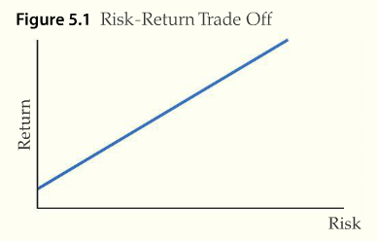
The Risk-Return Relationship
Risk
  Is determined by the uncertainty of future cash flows
  This uncertainty is the result of factors peculiar to each asset

Slide 4
The Risk-Return Relationship
Investors identify an asset’s risk
Investors subsequently establish a price that compensates them for holding an asset with that level of risk
As risk increases so does the investor’s required return
Investors must be compensated to hold risky assets
Notes:
Investors base their expectations of both risk and return on past performance and what is currently going on in the economy, industry, the firm, etc.

Slide 5
The Risk-Return Relationship
Portfolio risk is harder to measure
Portfolio of assets
  A collection of group of assets
Modern portfolio theory
  The theory that all investors hold a portfolio of assets called the market portfolio and that risk is measured by the correlation of an asset to this portfolio.
    The relationship between risk and return is captured by the CAPM relationship
Notes:
Explain it video p. 5.1.3

Slide 6


L02: Computing the Return on a Single Asset
Computing simple returns
  Holding period return (HPR)
    consists of earnings from dividends paid, plus the return appreciation or capital gain in the stocks price
  or
Notes:
Eq. 5.1, and 5.2 on p. 5.2.2

Slide 7

Computing Simple Returns
The first part of this equation is called capital gain, while the second part is the dividend yield
  HPR equals the sum of capital gain and dividend yield
Notes:
Make sure that the students understand the difference between holding period returns and annual returns. A holding period can be a few hours or several years, and HPRs may not be comparable as a result.

Slide 8
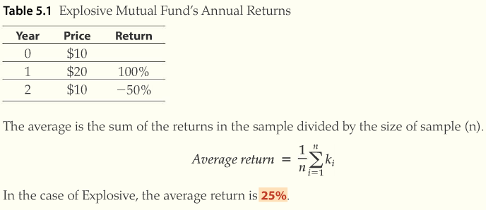
Average Versus Compound Average
Arithmetic average return
  The return calculated where compounding is ignored
Notes:
Eq. 5.3 on p. 5.2.3

Slide 9

Average Versus Compound Average
Compound (geometric) average return
  The return computed that recognizes the interest or earning are paid on accumulated interest or earnings. It is also called geometric return
Notes:
Eq. 5.4 on p. 5.2.4

Slide 10
Risk and Randomness
Random Variables
  Variables with no identifiable relationship between each other
  Objects that have more than one possible outcome and for which the magnitude of the outcomes is uncertain beforehand
  The possible outcomes are known as states of nature

Slide 11
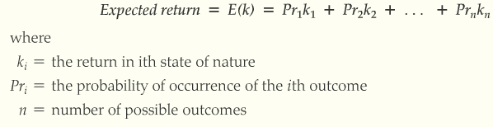
Computing Expected Returns
Expected returns reflect the expectations given different possible random outcomes
Notes:
Eq. 5.5 on p. 5.2.6
Explain it video on 5.2.6 concerning expected returns

Slide 12
LO3: Evaluating Risk of Holding a Single Asset
Standard Deviation
  A popular statistical measure that quantifies the dispersion around the expected value
  Used to calculate degree of risk
Computing the risk of a single asset
  Standard Deviation is a viable method of calculating risk
  Greater standard deviation equals greater risk
Notes:
This is easier to illustrate graphically and will become clear in a few slides (Slide 17).

Slide 13
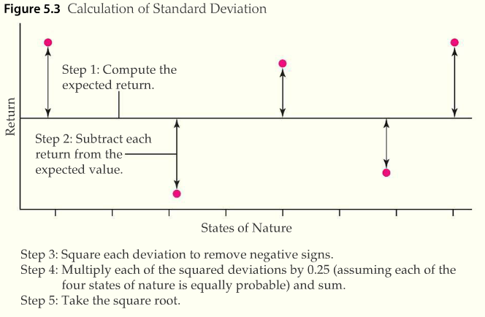
Computing the Risk of a Single Asset
Notes:
Explain it! Video clip for 5.3 on p. 5.3.2

Slide 14
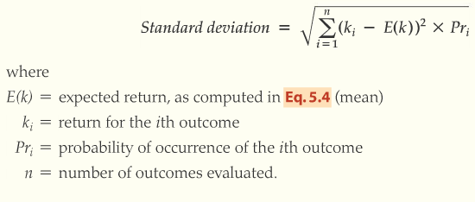
Computing the Standard Deviation
Notes:
This is the formula for SD (Eq. 5.6) that features on page 5.3.3.

Slide 15
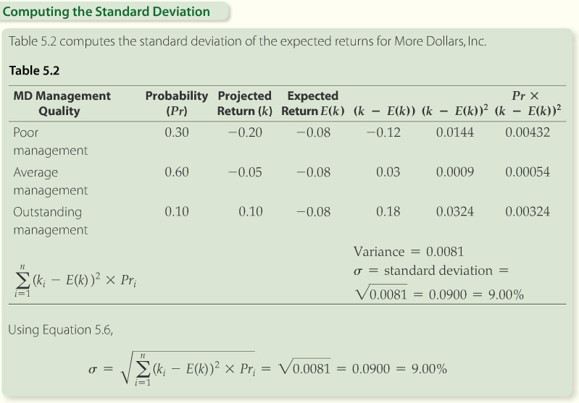
Computing the Standard Deviation
Notes:
Example and Solution tools on p. 5.3.4

Slide 16
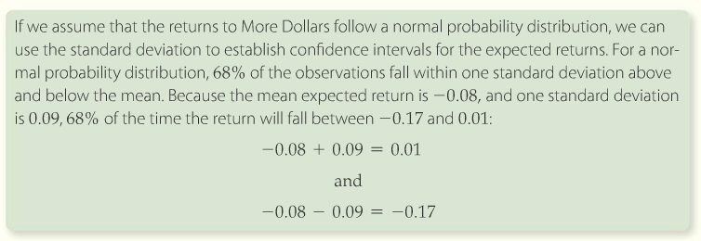
Computing the Standard Deviation

Slide 17
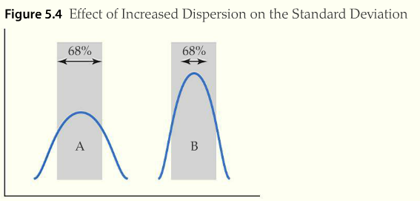
Computing the Standard Deviation
Notes:
Explain it! Video on p. 5.3.6

Slide 18
LO4: Computing the Expected Return for a Portfolio of Assets
A portfolio is a collection of assets
Portfolios can include real estate, stocks, gold, bonds, etc.
The portfolio return is simply a weighted average so the first step is to determine the weights
Notes:
The weights are just the dollar fraction you have invested in each asset.

Slide 19

Portfolio Weights
How to compute the asset weights for your portfolio
  Portfolio weights
    The amount invested in asset i divided by the total amount invested in the portfolio
Notes:
Eq. 5.7 on p. 5.4.2

Slide 20
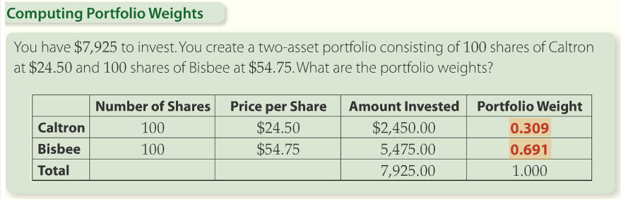
Computing Portfolio Weights
Notes:
Solution tools on p. 5.4.2

Slide 21
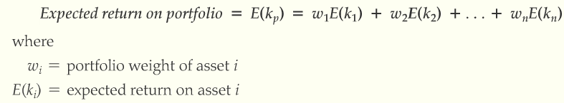
Computing Expected Return
Computing expected return with unequal amounts invested in multiple securities
Notes:
The expected return is a simple weighted average; this formula is from p. 5.4.3.

Slide 22
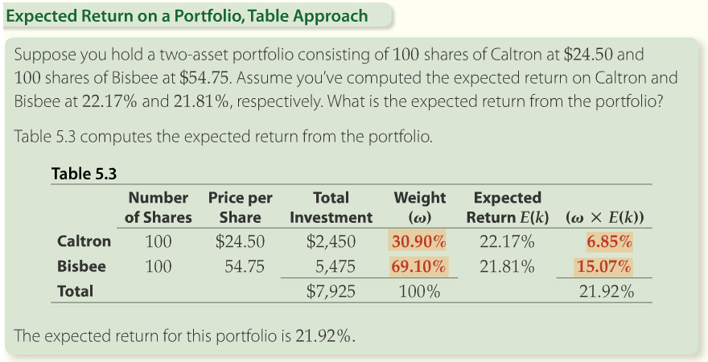
Computing Expected Return
Notes:
Solution Tools on p. 5.4.4

Slide 23
LO5: Evaluating the Risk of a Portfolio of Assets
Modern Portfolio Theory shows us that, if we combine assets that are not highly correlated, we can reduce risk.
For example, if one asset is moving up while the other is moving down, these two assets can at least partially offset each other.
Measuring how closely assets are correlated becomes important in constructing a portfolio.

Slide 24
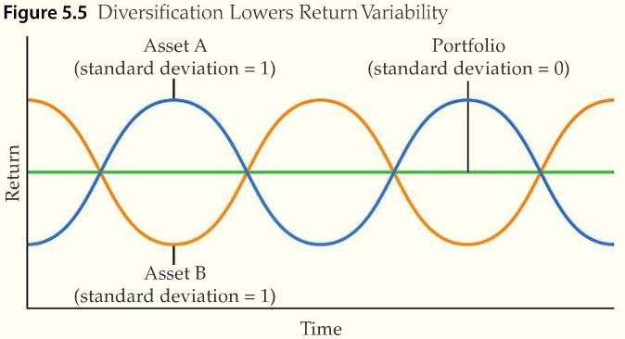
Evaluating the Risk of a Portfolio of Assets
Correlation
  A relationship between observations, in which the movement over time of one item is related to the movement of another
  Here’s an example of perfectly negatively correlated returns
Notes:
Note that Asset A and Asset B move in a mirror image and exactly smooth returns if we have 50% of our portfolio invested in each asset.

Slide 25
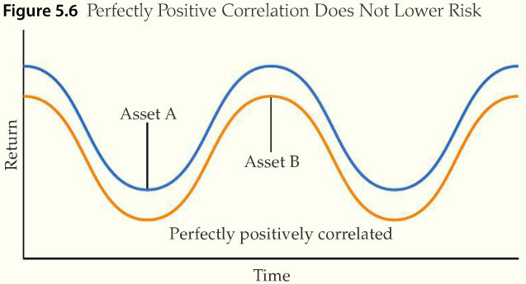
Correlation
Perfectly positively correlated returns
Notes:
Note that Asset A and Asset B move in unison, so the risk (variation in portfolio returns) still exists.

Slide 26
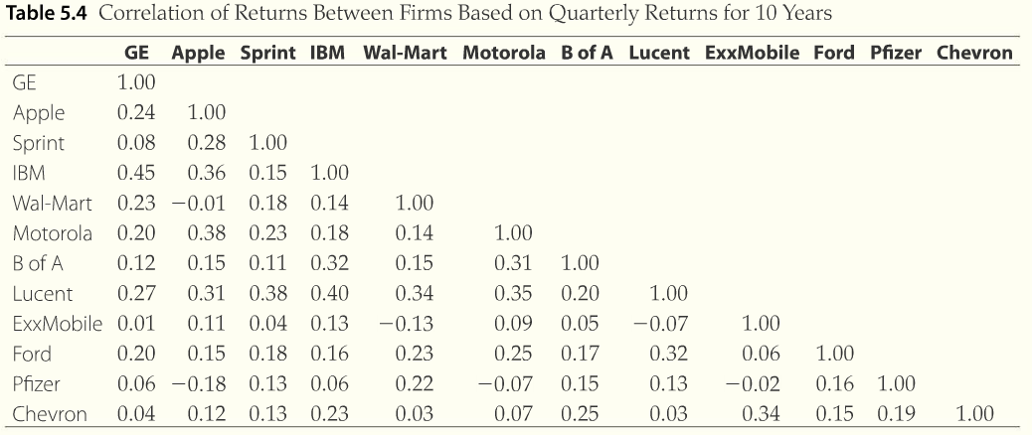
Diversification
Notes:
Explain it! Video for Table 5.2 on p. 5.5.4. Identify the assets that you would get the most risk reduction benefit from combining. They are the ones with the lowest correlation coefficients.

Slide 27
As we add more stocks to a portfolio the total risk is reduced but cannot be totally eliminated.
σp
Unsystematic risk = asset specific
Systematic ≡ Market = β
5
30
Assets

Slide 28
Conclusion about Diversification
Diversification can reduce risk
  Risk can never be completely eliminated
Holding multiple risky investments in a portfolio is less risky than each single investment
Assets that are not highly correlated generate the best risk reduction
Notes:
Modern Portfolio Theory (MPT) will be discussed more in the next chapter.

Slide 29
Portfolio Theory
Chapter 6

Slide 30
Learning Objectives
LO1: Learn about diversification
LO2: Learn about non-diversifiable risk
LO3: Learn about the relationship between non-diversifiable risk and return

Slide 31
LO1: Diversification
Diversification
  The act of giving something variety
  In the context of investing, diversification manages the risk of a portfolio by including a variety of assets
Standard deviation of a two-asset portfolio
Notes:
Explain it! Video on how diversification reduces risk on p. 6.1.1.
Eq. 6.1 can be found on the same page.

Slide 32
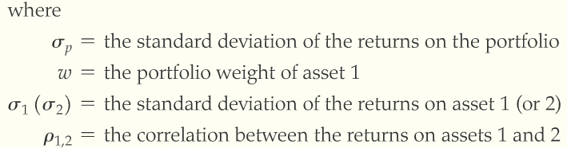
Portfolio Standard Deviation
Notes:
Equation 6.1 on p. 6.1.1 of text. Be sure to emphasize how combining assets efficiently can reduce risk.

Slide 33
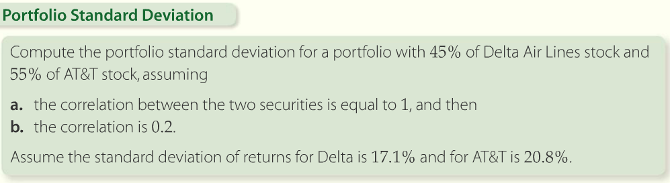
Portfolio Standard Deviation
Notes:
Example 6.1 on page 6.1.2

Slide 34
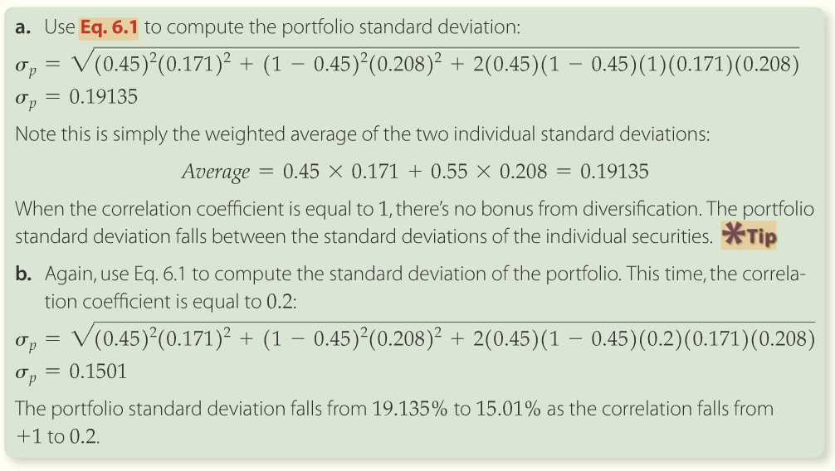
Portfolio Standard Deviation
Notes:
Solution tools on p. 6.1.3. Note how the correlation between the two assets can make a substantial change in the portfolio risk.

Slide 35
Types of risk
Non-diversifiable risk
  Risk that cannot be eliminated through diversification
  Also called systematic risk, and market risk
  Measured by beta
Diversifiable risk
  Risk that can be eliminated through diversification
  Also called unsystematic risk, and firm-specific risk
Notes:
Eq. 6.2 on p. 6.1.6
Explain it! Video on p. 6.1.6
Make sure to point out that rational investors will diversify since they can eliminate some risk.

Slide 36
The Market Portfolio
Naïve diversification
  The strategy of investing equal amounts of money in a portfolio of randomly selected stocks
  Not the most effective approach to portfolio creation
Efficient set
  The set of all efficient portfolios across all levels of standard deviation
  Harry Markowitz derived a formula for solving for portfolio weights for each of the portfolios in the efficient set
Risk-free asset
  An asset with no variation in return and no risk of default
  The standard deviation is zero
  The correlation of risk-free returns with the returns of any other asset is zero
Notes:
Highlight that investors can combine assets into an efficient portfolio and either;
Reduce risk and hold return constant, or
Increase return and hold risk constant, or
Increase return and reduce risk

Slide 37
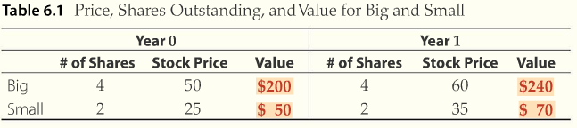
The Market Portfolio
Market portfolio
  The value-weighted portfolio that includes every risky asset in the capital markets.
Hypothetical construction of the market portfolio when there are only 2 assets
Notes:
Table 6.1 illustrates how the market portfolio would be constructed if there were only 2 assets in the world; the table is taken from p. 6.1.9.

Slide 38

The Market Portfolio
Value-weighted portfolio
  In a value-weighted portfolio the portfolio weights are equal to the value of each asset relative to the total value of the assets in the portfolio
Sharpe’s model
  Predicts every investor in the capital market has a portfolio with 80% of Big and 20% of Small
  Each investor’s portfolio return is equal to the return on the market portfolio
Notes:
Example from p. 6.1.10

Slide 39
The Market Portfolio Proxy
Stock market index
  Statistical indicator showing the relative value of a basket of stocks compared to their value in a base year
  Measures the ups and downs of the stock market
  Serves as a useful proxy for the market portfolio
Exchange traded fund
  Seeks to achieve the same return as a particular market index
  Unlike indexed mutual funds ETF’s can be traded within a day, shorted, and can be purchased on margin

Slide 40
L02: Systematic Risk
Marginal risk
  Equal to the covariance between the returns on the asset and the market portfolio
Beta
  Measure of systematic risk generated by the capital asset pricing model (CAPM)
  Equal to the covariance of returns between the asset and the market portfolio divided by the variance of returns of the market
  Measures the amount of systematic risk in a given asset
Notes:
Extremely important topic. I usually mention that several Nobel Prizes were awarded for Modern Portfolio Theory and the CAPM. This drives the point home.

Slide 41

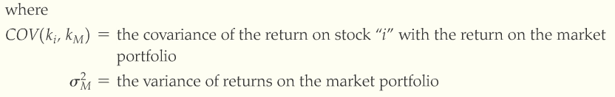
Beta
Notes:
Equation 6.3 from page 6.2.1

Slide 42
Beta
To estimate beta
  Graph the returns on a specific asset (Stock Y) against the returns on the market portfolio (S&P 500 index)
  The slope of the line of best fit (ordinary least squares regression line) is beta
  The line of best fit, when the return of an asset is plotted against the return on the market portfolio, is also called the characteristic line

Slide 43
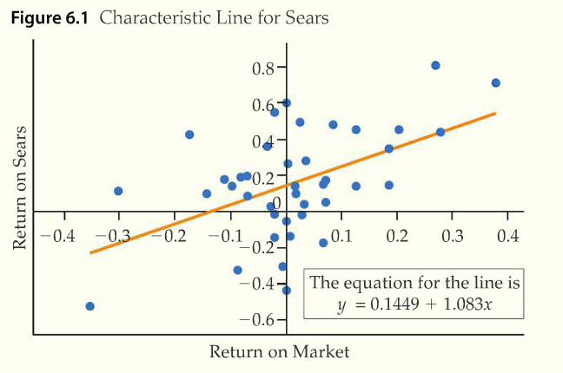
Beta
Notes:
Graph from p. 6.2.4. The slope of the line of best fit is the beta for Sears.

Slide 44
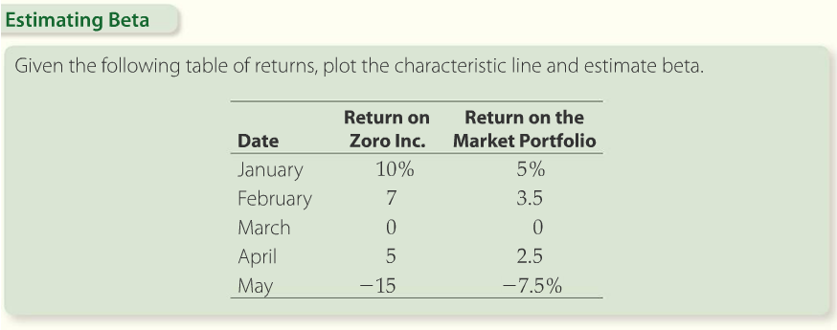
Estimating Beta
Notes:
Example 6.2 from p. 6.2.5

Slide 45
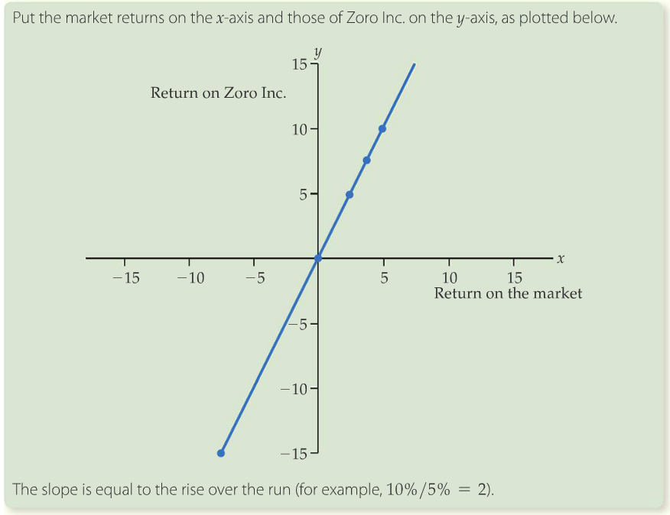
Beta
Notes:
Solution Tools on p. 6.2.6

Slide 46

Properties of Beta
The market’s beta is equal to 1
The risk free asset’s beta is equal to 0
Portfolio beta
  The weighted average of the individual betas
Notes:
Students need to commit these to memory. If beta >1 then the asset is riskier than the market. If beta<1 then the asset is less risky than the overall market. The CAPM makes it easy to immediately have some idea of an asset’s risk.

Slide 47
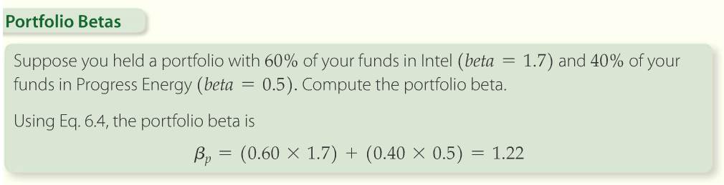
Portfolio Beta
Notes:
Betas are also much easier to work with than standard deviations. The portfolio beta is simply a weighted average of each asset’s beta. Example from p. 6.2.10.

Slide 48
LO3: Equilibrium Risk and Return
Portfolio possibility line
  Shows all of the risk and return combinations that can be achieved by forming two-asset portfolios with the risk-free asset and a risky asset
  Buying on the margin extends this line
  All asset combinations will plot on this line
  The slope of this line is called the Treynor Index

Slide 49
Treynor Index
Treynor Index
  The ratio of the return premium for an asset to its systematic risk (beta)
  The return premium is the difference between the expected return on an asset and the return on the risk-free asset
  Named after Jack Treynor
  Allows you to rank stocks based on return per unit of risk
  Let’s look at an example and then add borrowing to the equation
Notes:
Higher Treynor Indices are better since it measure the amount of return per unit of risk.

Slide 50
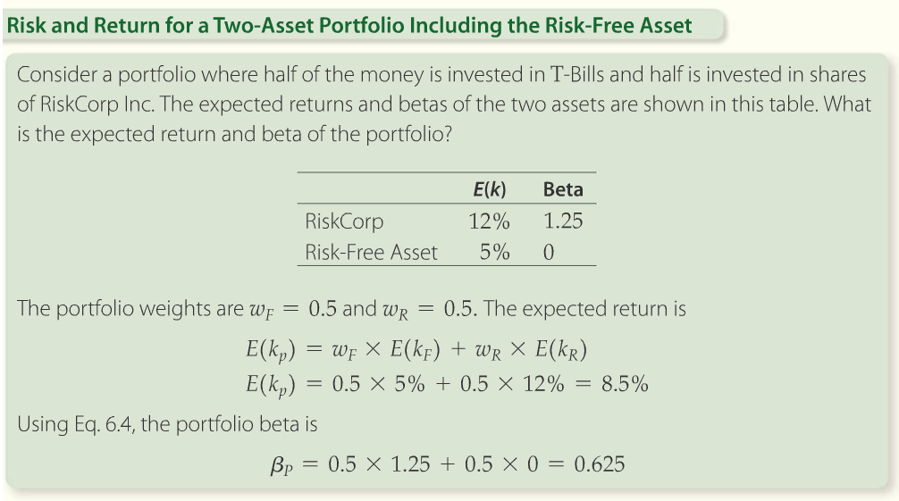
Portfolios with the Risk-Free Asset
Notes:
Example 6.4 from p. 6.3.2

Slide 51
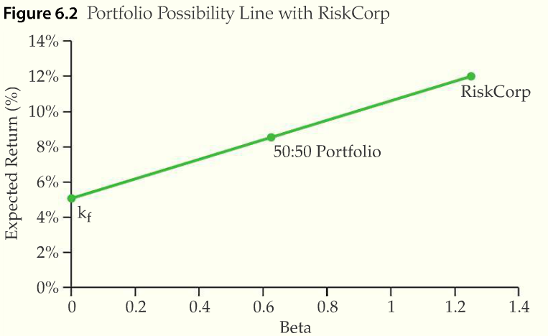
Portfolios with the Risk-Free Asset
Notes:
Graph from p. 6.3.3

Slide 52
Addition of Borrowing to Portfolio
Buying on margin
  Borrowing to buy more than you can afford with your own money
Borrowing by issuing T-Bills
  Long T-Bills
    A trading position in which an asset (T-Bills) is bought and owned with the expectation that it can be sold at a higher price
    Opposite of short position
  Short T-Bills
    A trading position in which an asset is sold with the expectation that it can be bought back at a lower price
    Opposite of long position

Slide 53
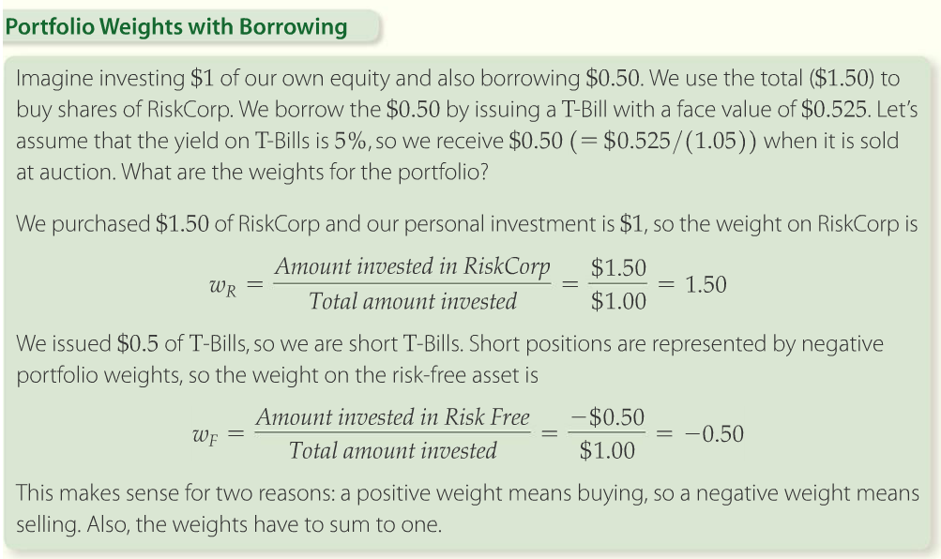
Addition of Borrowing to Portfolio
Notes:
Solution Tools on p. 6.3.5

Slide 54
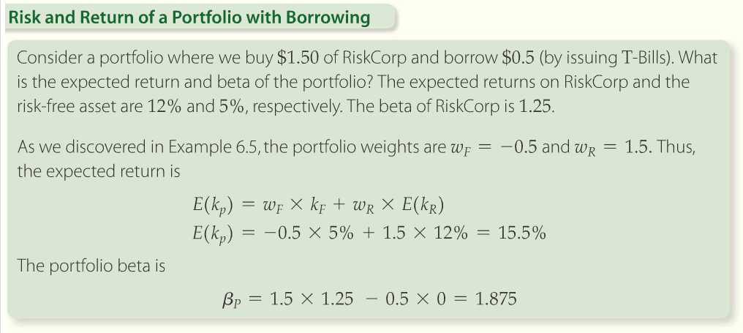
Addition of Borrowing to Portfolio
Notes:
Solution Tools on p. 6.3.7

Slide 55
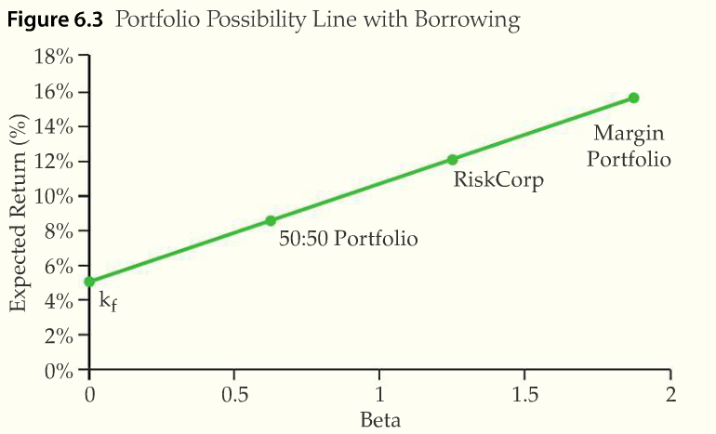
Addition of Borrowing to Portfolio
Notes:
Explain it! Video on p. 6.3.8. Notice we’ve been able to extend the PPL with borrowing.

Slide 56
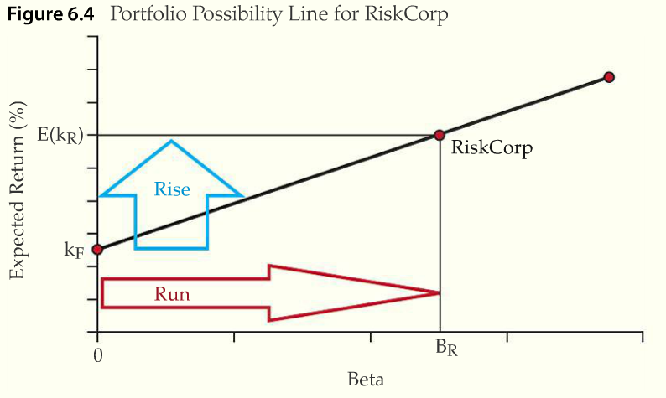
The Treynor Index
Notes:
From p. 6.3.11.

Slide 57

The Treynor Index
The formula for the Treynor Index is
The Treynor Index measures the excess of the asset’s return over the risk-free return
  Excess return is also called the risk premium
Notes:
Eq. 6.5 from p. 6.3.12 of text

Slide 58
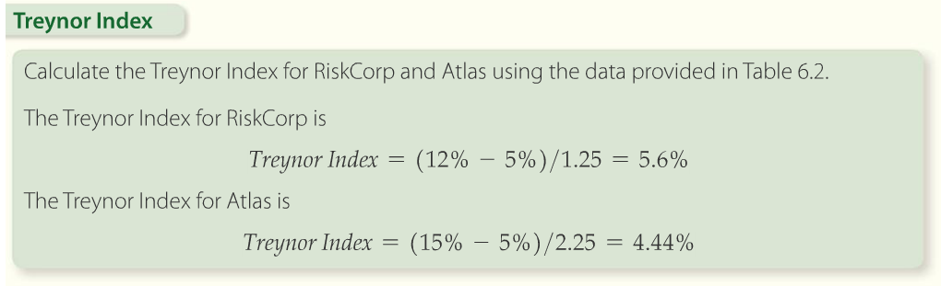
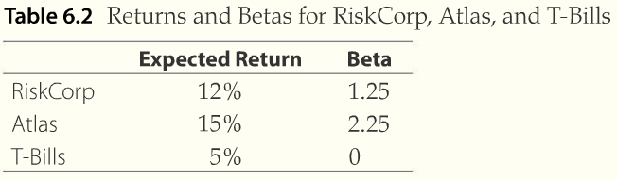
Market Equilibrium
Notes:
Solution Tools on p. 6.3.13. Remember, higher is better since that means the asset is generating more returns per unit of risk.

Slide 59
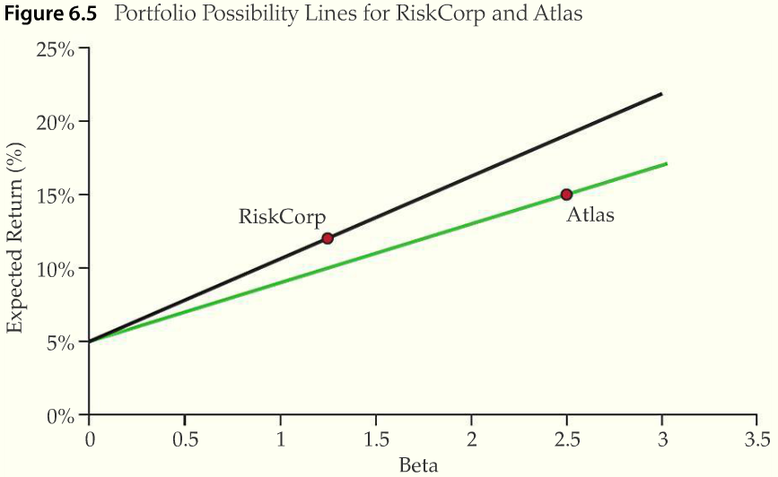
Market Equilibrium
Notes:
Note that RiskCorp is a steeper line (i.e. higher Treynor Index), so is the best option.

Slide 60
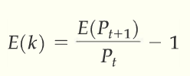

Market Equilibrium
Capital market equilibrium
  Ignoring dividends and assuming that the future is fixed, we can express the return as
The security market line
  The market portfolio’s Treynor Index is
Notes:
Eq. 6.6 on p. 6.3.15. As investors buy higher Treynor Index stocks, they push returns down until all stocks should have the same Treynor Index.

Slide 61
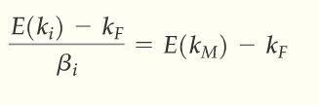

Market Equilibrium
The beta of the market portfolio is equal to 1
  If all securities have the same Treynor Index
  Using the CAPM we can estimate the expected rate of return on any security “I”
Notes:
Eq. 6.8 on p. 6.3.16
Eq. 6.9 on p. 6.3.17
Solving this equality for expected return yields the CAPM.

Slide 62
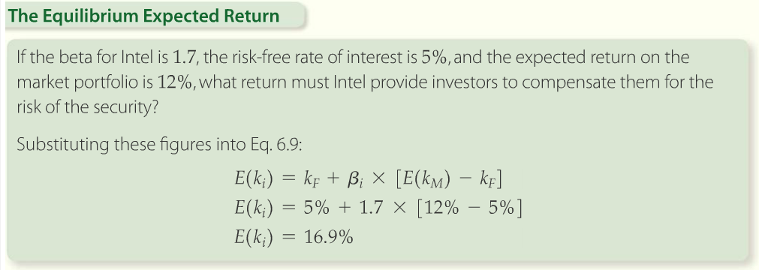
CAPM
Notes:
Solution Tools for Example 6.8 on p. 6.3.17. Shows how to use the CAPM to calculate an expected return.

Slide 63
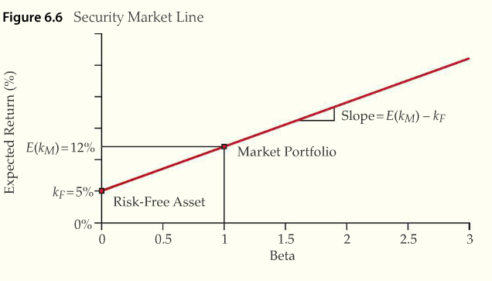
Market Equilibrium
Security market line (SML)
  The graph of the CAPM equation
Notes:
Explain it! Video and Explore It! on p. 6.3.18

Slide 64
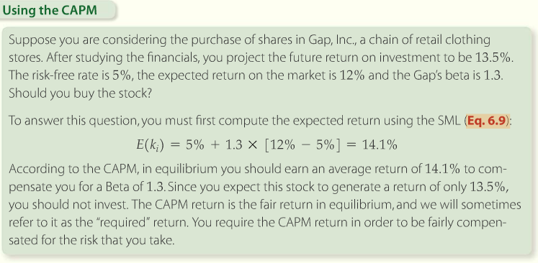
Market Equilibrium
Notes:
Solution tools on p. 6.3.19. Another example of the CAPM.

Slide 65
Interest rates and bonds
Chapter 7

Slide 66
Learning Objectives
LO1: Zero coupon bond features and markets
LO2: Zero coupon bond yields and pricing
LO3: Coupon bond features and markets
LO4: Coupon bond yields and pricing
LO5: Coupon bond price properties

Slide 67
Interest Rates and Bonds
Fixed income securities
  A class of securities that pay a fixed income (interest) to the holder
  The class includes bonds
Bonds
  A debt security, like an IOU
  Bond issuers borrow money from bond investors
  The issuers agrees to repay the principal amount of the loan on maturity date
  Represent loans from the holder to the issuer

Slide 68
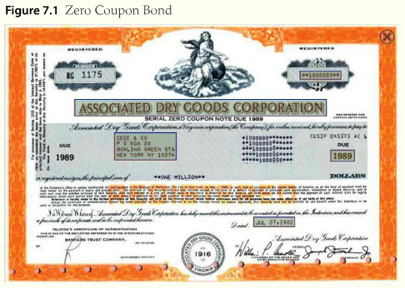
LO1: Zero Coupon Bond Features and Markets
Features of a zero coupon bond
Notes:
Interactive graphic on p. 7.1.1

Slide 69
Zero Coupon Bond Markets
Zero coupon bond
  A bond that does not pay coupons
  The holder pays a price that is less than face value, and receives face value at maturity
Money market
  The market for bonds with a maturity of less than 1 year
Bankers acceptance
  Short-term unsecured debt instrument issued by a non-financial corporation but guaranteed by its bank
Commercial paper
  A short term, unsecured debt instrument issued by corporations

Slide 70
Zero Coupon Bond Markets
T-Bills
  Bonds issued by the U.S. government that have maturities of 91 days, 182 days, or 52 weeks.
  T-Bills are zero coupon bonds, known as treasury bills
Mutual funds
  Professionally managed pool of money
  A portfolio of securities

Slide 71

LO2: Zero Coupon Bond Yields and Pricing
Zero coupon bond yields
  Promises the holder a fixed sum of money at a fixed future date
Notes:
Figure 7.2 on page 7.2.1.

Slide 72

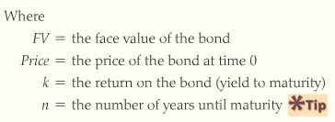

Zero coupon bond yields
Future value formula:
Notes:
Equations 7.1 and 7.2 from pages 7.2.1 and 7.2.2.

Slide 73
Zero coupon bond yields
Yield to maturity (or yield)
  An estimate of the annual return an investor will earn if they buy a bond and hold it to maturity
  Also known as the return
Treasury spot rates
  The yield on a default-free zero coupon treasury where the yield is quoted for the immediate settlement
  There is almost no risk that U.S. govt. will fail to pay its obligations

Slide 74
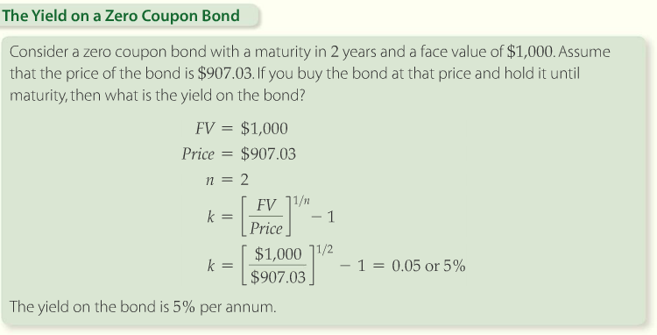
Zero coupon bond yields
Calculator Solution
PV = -907.03
n = 2
FV = 1000
Comp i = 5
Notes:
Solution Tools on p. 7.2.3

Slide 75
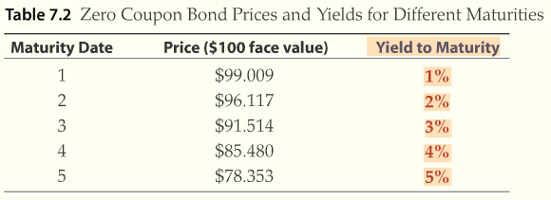
The Term Structure of Rates and the Yield Curve
Term structure of interest rates
  Yields across different maturities
Notes:
Table 7.2 from page 7.2.4.

Slide 76
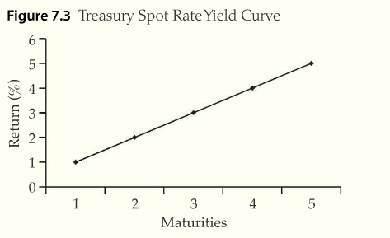
The Term Structure of Rates and the Yield Curve
Yield curve
  A graphical representation of the term structure
  A graph of yields (y) against time to maturity (x)
Notes:
Figure 7.3 from p.7.2.5.

Slide 77
Determinants of the shape of the yield curve
Normal yield curve
  An upward sloping yield curve
Inverted yield curve
  Downward sloping yield curve
Factors that determine position and slope of the spot rate yield curve
  Real interest rates
  Inflation
  Maturity preference
  Default risk
  Liquidity

Slide 78
Determinants of the shape of the yield curve
Real rate of interest
  The rate that would prevail if there was no inflation
Nominal rate of interest
  The observed rate of interest
  If inflation is zero, then the real rate equals the nominal rate

Slide 79
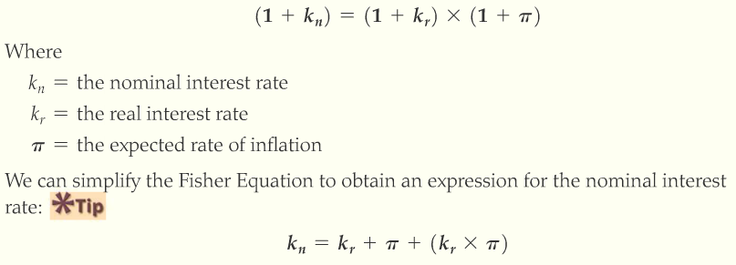
Determinants of the shape of the yield curve
Relationship between the nominal rate and the real rate
Notes:
Equations 7.3 and 7.4 from p. 7.2.7.

Slide 80
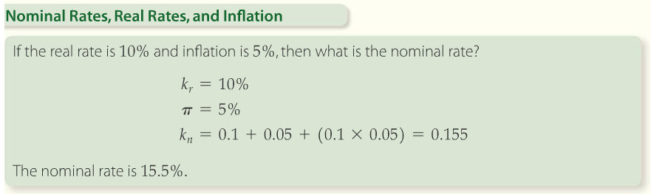
Determinants of the shape of the yield curve
Notes:
Solution Tools on p. 7.2.8

Slide 81
Determinants of the shape of the yield curve
Consumer price index
  The consumer price index (CPI) is an indicator of the relative level of consumer prices
  It is obtained by comparing the cost of a fixed basket of goods and services to the cost of that basket in the base year
  Used to measure inflation
Expectations and monetary policy
  Long-term bond yield are the geometric average of the expected intermediate bond yields
  Future rates are based current expectations of future inflation

Slide 82
Determinants of the shape of the yield curve
Overnight interest rates
  The Federal Reserve implements monetary policy largely by targeting the overnight rate
  Used to affect the level of short-term interest rates
Maturity preference theory
  Bond investors prefers short maturities, so long-term bond yields incorporate a premium to compensate investor for the disutility of holding them
Maturity risk premium (MRP)
  The premium incorporated in long-term bond yields to compensate investors who prefer shorter maturities

Slide 83
Determinants of the shape of the yield curve
Interest rate risk
  The risk of capital loss on a bond investment
    If interest rates rise, then bond prices fall
    For an investor who has to sell a bond before maturity, an increase in interest rate will cause capital loss
Reinvestment rate risk
  The risk that rates in the future will fall and thus reduce the future value of a bond investment
Default risk
  Default means the failure to fulfill an obligation
  Default is the major risk associated with corporate and foreign government bonds
Notes:
Maturity preference theory suggests that investors are more worried about interest rate risk than reinvestment rate risk.

Slide 84
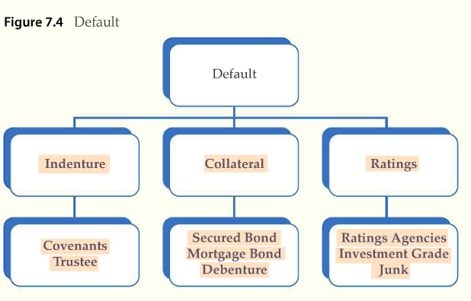
Determinants of the shape of the yield curve
Notes:
Investors are also concerned about default risk. Figure 7.4 taken from p. 7.2.12.

Slide 85
Default
Indenture
  The agreement between the issuer of a bond and the bondholders
Collateral
  Assets that are pledged as security for the loan
Ratings
  Bond ratings help investors predict the probability of default
Covenants
  Conditions that the issuer must meet
Trustee
  A trust company is often appointed to represent the bondholders
Notes:
All terms related to bond issuance that provide some indication of bond safety or provide safeguards against default.

Slide 86
Default
Secured bond
  If a bond has collateral, then it is called a secure bond
Mortgage bond
  A bond secured with land is called a mortgage bond
Debentures
  Unsecured bonds are called debentures
Rating agencies
  Debt rating agencies rate the debt offered by firms

Slide 87
Default
Investment grade
  The term used to refer to bonds from issuers with a rating of BBB (Baa) or higher
Junk
  The term used to refer to bonds with a grade of BB (Ba) or lower
Default risk premium
  A component of bond yield which compensates the bond holder for the possibility that the issuer might default
Yield spread
  Difference in yields provides indication of extra compensation needed for risk
Notes:
Investors require additional compensation to hold more risk. Higher interest rates provide that compensation.

Slide 88
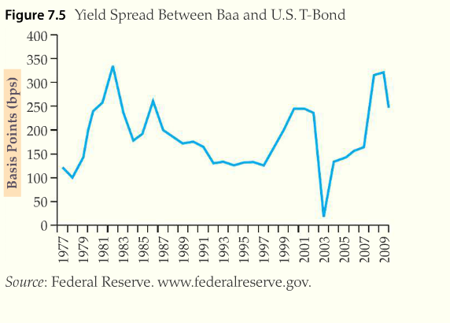
Yield Spread
Notes:
Sample yield spreads from p. 7.2.13.
Compensation for risk varies over time.

Slide 89
Liquidity
Liquidity
  The ease with which an asset can be converted to cash
  NYSE listed stocks are liquid assets
  Real estate is illiquid
Liquidity risk premium (LRP)
  A component of a bond yield which compensates the bond holder for the potential costs in selling the bond
  The difference in yields of illiquid and liquid bonds

Slide 90
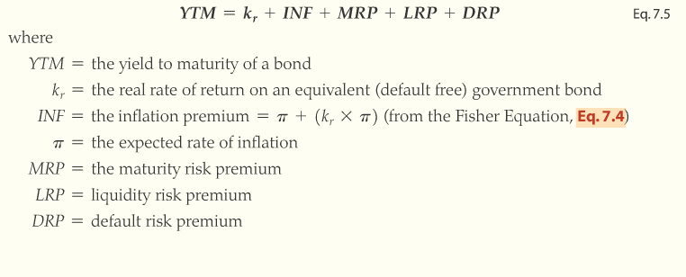
Yield to Maturity
Notes:
Eq. 7.5 on p. 7.2.15. YTM is the interest rate that incorporates all factors that impact interest rates.

Slide 91

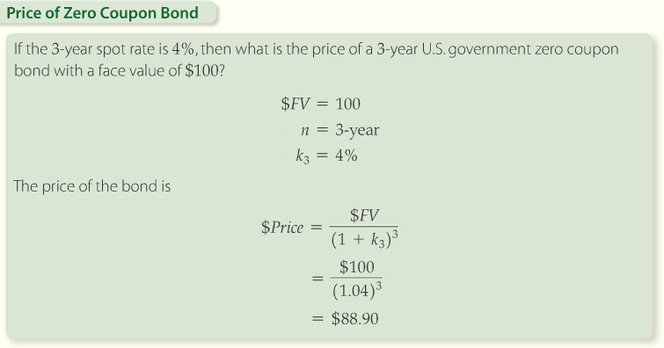
Zero Coupon Bond Pricing
Calculator Solution
FV = 100
n = 3
i= 4
Comp PV = $88.90
Notes:
Solution Tools and Eq. 7.6 on p. 7.2.18

Slide 92
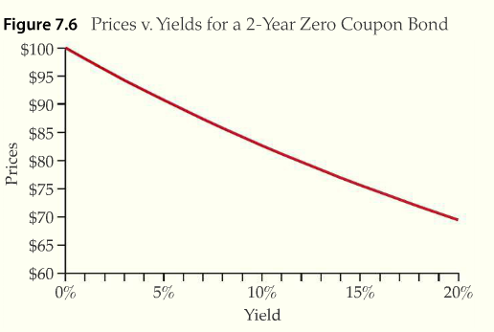
Inverse Relationship Between Bond Prices and Yields
Notes:
Explain it! Video on p. 7.2.20. As yields go up, bond prices fall (and vice versa).

Slide 93
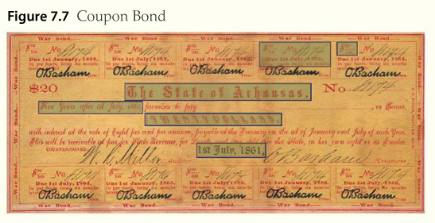
LO3: Coupon Bond Features and Markets
Coupon bond
  A debt instrument which pays periodic interest payments to the holder (coupons) and pays the final lump-sum (face value) at maturity
Notes:
Interactive coupon bond on p. 7.3.1

Slide 94
Features of a Coupon Bond
Convertible bond
  Allows the holder of the bond to convert the face amount into a fixed number of a common shares at any time before its maturity
Callable bond
  The issuer has the right to force early redemption of the bond
Foreign bond
  The issuer in a particular country and is denominated that country’s currency
Floating rate bonds
  Variable coupon bond
  LIBOR rate (London Interbank Offer Rate)
    A benchmark rate for floating rate bonds

Slide 95

Coupon Bond Issuers
Notes:
Table 7.3 from page 7.3.3 shows the various issuers of coupon bonds over time.

Slide 96

Coupon Bond Market
Bond market
  The market for coupon and zero coupon bonds
Notes:
Table 7.4 shows trading volume for bonds on U.S. exchanges; taken from 7.3.4.

Slide 97

Bond Price Reporting
Notes:
Screen shot of bond price quotes from p. 7.3.5 of text

Slide 98
LO4: Coupon Bond Yields and Pricing
Coupon bond cash flows
  Coupon bonds pay the holder annual coupons, (C), as well as the face value, (FV), at maturity
Coupon rate
  The annual dollar value of the coupons divided by the face value of the bond

Slide 99

Relationship Between Coupon and Zero Coupon Bond Prices

Slide 100

Relationship Between Coupon and Zero Coupon Bond Prices
Notes:
Solution tools on p. 7.4.3

Slide 101

Relationship Between Coupon and Zero Coupon Bond Prices
The law of one price
  Asserts that two identical securities which are sold in two different markets must sell at the same price
Notes:
Equations 7.7 & 7.8 on p. 7.4.3

Slide 102


Yield-to-Maturity
Notes:
Eq. 7.9 on p. 7.4.4
Eq. 7.10 on p. 7.4.5

Slide 103


Yield-to-Maturity
Notes:
Solution Tools on p. 7.4.6

Slide 104
Yield-to-Maturity
Yield-to-maturity is approximately equal to the return that the bond holder will earn if she pays the price and holds the bond to maturity
The yield-to-maturity calculation implicitly assumes that intermediate coupons can be reinvested at the solution rate, or 2.976% in the previous example
The yield-to-maturity can only be calculated if the bond price is known

Slide 105

Pricing a Coupon Bond Given the Yield-to-Maturity
Notes:
Example 7.6 from p. 7.4.9

Slide 106

Pricing a Coupon Bond Given the Yield-to-Maturity
Notes:
Solution Tools on p. 7.4.10

Slide 107

Semi-Annual Coupon Bonds
To find the semi-annual coupon, divide the annual coupon payment by two since only half of the annual payment is paid each 6 months
Discount the semi-annual coupons with the semi-annual yield. To find yield for one-half of the year, we divide the annual yield by two
Finally, double the number of periods since there will be two coupon payments per year
Notes:
Eq. 7.12 on p. 7.4.12

Slide 108

Semi-Annual Coupon Bonds
Notes:
Example 7.7 Solution Tools on p. 7.4.13

Slide 109

Semi-Annual Coupon Bonds
Notes:
Example 7.7 continued; p. 7.4.14

Slide 110
LO5: Coupon Bond Price Properties
Premium
  An expression used to refer to a coupon bond that trades for a price that is more than its face value
Discount
  A term used to refer to a coupon bond that trades for a price that is less than its face value
Interest rate risk
  The risk of capital loss on a bond investment. If interest rises, bond prices fall

Slide 111

Premiums and Discounts
Notes:
Example 7.8 Solution Tools on p. 7.5.2

Slide 112

Bond Prices and Interest Rates Move Inversely
Notes:
Explain it! Video on p. 7.5.5
Shows how bond prices move inversely with interest rates.

Slide 113

Longer Maturity Bonds Have More Interest Rate Risk
Interest rate risk increases with maturity, as you can see in Table 7.6
Notes:
From p. 7.5.8

Slide 114

Bonds with Low Coupon Rates Have More Interest Rate Risk
As you can see low coupon bonds move more when rates change
Notes:
Table 7.7 from p. 7.5.13

Slide 115

Bond Price Changes Over Time
Capital gain yield
  The percentage change in an assets price
Coupon yield
  The annual coupon expressed as a percentage of the bonds price
Notes:
Eq. 7.14 on p. 7.5.15

Slide 116

Bond Price Changes Over Time
Notes:
Figure 7.10 from p. 7.5.17.
Note that, as maturity approaches, bond prices will converge toward par value.

Slide 117
Stock valuation and market efficiency
Chapter 8

Slide 118
Learning Objectives
LO1: Understand the primary features of stock and the stock market
LO2: Find the value of a preferred share
LO3: Find the value of a common share
LO4: Understand the efficient market hypothesis

Slide 119
Stock Markets Components
Stocks (shares)
  Securities issued by incorporated companies
Public company
  A company that sells shares of stock to the public
Private company
  A company where the ownership of shares are held by a limited number of stockholders ands whose shares are not available to the public
Notes:
Define these so that students understand the difference.

Slide 120
Stock Markets
Primary market
  The market where securities are traded for the first time and
Initial public offering (IPO)
  Where a firm first offers shares to the public and the firm becomes a public company
Seasoned offering
  An issue of stock that was offered in the past and has been traded since
Secondary market
  Where trading that follows or is subsequent to the IPO occurs
Notes:
I usually spend quite a bit of time here discussing the IPO process. Students often do not understand that a firm receives no money from secondary market transactions, so you can emphasize the secondary market is still important to financial managers since it provides an assessment of their performance (i.e. are they maximizing stock price?).

Slide 121

Stock Markets – Listing example
Notes:
Go through these quotes with the students so they understand how to read the information. Taken from p. 8.1.2

Slide 122
Trading Stocks
Long position
  An investment where ownership is taken before the security is sold
  The usual form investments take
Short position
  The investor initially borrows the security and sells it
  Later the security is bought back to repay the loan
  Profits occur when the stock price falls
Notes:
Spend some time talking about shorts. Students are often confused by shorting stock.

Slide 123
Trading Stocks
Market order
  Order to buy or sell that is to be executed as soon as possible at the best price obtainable
Limit order
  Conditional order to buy or sell
  The investor specifies a price in the order, and order is filled if the asset price is equal to the specified price or better
Margin
  The amount of money provided by the investor
  Buying on margin means borrowing money to make an investment
Notes:
Students have often not traded stock and need to understand the various types of orders. I usually use some dot.com horror stories about market orders executing at prices far higher than expectations. There were a number of lawsuits about this issue during that time.

Slide 124
LO2: Preferred Shares
Preferred stock has some characteristics of debt and some characteristics of equity
Typically has no maturity date and pays dividends, but has no voting rights
Typically pays cumulative dividends that have preference in over common dividends
Receives preference over common stock if firm is liquidated
Is typically not as volatile as common stock
Notes:
Discuss some of these differences

Slide 125
LO2: Preferred Shares
Dividends
  Periodic distributions of cash made by a firm to its stockholder, usually paid quarterly
Cumulative dividends
  Dividend payments accumulate in arrears and all skipped payments must be paid prior to any common stock dividend distribution
Par value
  The stated value of the security that is not dependent on the market value. Dividend is often expressed as a % of par.
Notes:
Discuss the cumulative feature in detail

Slide 126

Preferred Shares
Notes:
Interactive graphic on p. 8.2.2

Slide 127

Valuation of Preferred Stock
Formula for the present value of perpetuity
Notes:
Equation 8.1, p. 8.2.3

Slide 128

Valuation of Preferred Stock
Notes:
Solution Tools on p. 8.2.3

Slide 129
LO3: Common Shares
Residual claimants
  Having a claim on all assets and income after all liabilities have been met
  In the case of liquidation of the firm they receive liquidation value
Liquidation value
  The value the firm will bring if the assets are sold, after subtracting all liabilities owned
Stock repurchases
  The repurchase of stock by a firm from its existing stockholders
  It is a method to distribute cash without paying dividends

Slide 130

Common Shares
Notes:
Interactive graphic on p. 8.3.2

Slide 131

Common Shares
The valuation of common stock using discounted cash flows
  To value the stock, find present value of the expected cash flows
Notes:
Eq. 8.2 on p. 8.3.3

Slide 132

Valuation of Common Stock
Notes:
Solution Tools on p. 8.3.4

Slide 133

Generalized Dividend Valuation Model
Generalized dividend valuation model
  A model used to compute the value of stock that assumes its price is the present value of all future cash flows
  The generalized formula for stock can be written as
Notes:
Eq. 8.3 on p. 8.3.5

Slide 134

Generalized Dividend Valuation Model
The generalized dividend model is rewritten as
Constant Growth Model
  A model for computing the value of stock that assumes dividends grow at a constant rate forever and that the price is the present value of these dividends
Notes:
Eq. 8.4 on p. 8.3.6

Slide 135

Generalized Dividend Valuation Model
Constant growth model
Notes:
From p. 8.3.8

Slide 136

Constant Growth Model
Constant growth model equation
This model is useful for finding the value of stock if:
  Dividends are assumed to continue growing at a constant rate forever
  The growth rate is assumed to be less than the required returned on equity
Notes:
Eq. 8.6 on p. 8.3.8

Slide 137


Calculating the Dividend Growth Rate
Example dividend stream
Computing for growth
Notes:
Eq. 8.7 on p. 8.3.10

Slide 138

Calculating the Dividend Growth Rate
Notes:
Solution Tools on p. 8.3.11

Slide 139

Computing the Required Return
If a company pays dividends that grow at a constant rate, we can solve for required return
Notes:
Eq. 8.8 on p. 8.3.12

Slide 140

Computing the Required Return
Dividend yield
  Equal to the required return on equity
Return is equal to profit due to price appreciation plus the dividend

Slide 141
Computing the Required Return
High yield stocks
  Pay out a large portion of their net earnings as dividends
Zero or low yield
  Retain all or most of their earnings and reinvest them in the company
Required versus expected return
  Required return is what is needed to compensate for the risk
  Expected return is projected actual return by the security

Slide 142
Nonconstant Growth Model
For companies where dividends grow at a nonconstant rate, we value the shares using a three step method
  Determine the dividend expected at the end of each year during the nonconstant growth period.
  Estimate the constant growth rate and use it to price the dividend stream that begins after the nonconstant growth period
  Find the present value of the non-constant dividends and add the sum to the present value of the price found in step 2

Slide 143

Nonconstant Growth Model
Notes:
Solution Tools on p. 8.3.17

Slide 144

Nonconstant Growth Model

Slide 145

Nonconstant Growth Model
Notes:
Solution Tools on p. 8.3.19

Slide 146

Nonconstant Growth Model

Slide 147


Price Earnings Valuation Method
Price/earnings ratio (P/E)
  Can be used to estimate the value of a firms stock
  Rearrange and multiply by earning per share (EPS) to yield an estimate of the (fair) stock price
Notes:
Eq. 8.9 and Eq. 8.10 on p. 8.3.22

Slide 148

Price Earnings Valuation Method
Notes:
Solution Tools on p. 8.3.23

Slide 149
LO4: The Efficient Market Hypothesis
Efficient market
  One where securities are priced fairly at all times and where new information is rapidly reflected in the price
  Adjusts prices rapidly and accurately
  Must function competently
Inefficient market
  Adjusts prices slowly and not every unit of a particular type is priced the same

Slide 150
The Efficient Market Hypothesis
The Efficient Market Hypothesis (EMH) is based on the combined effect of:
  Many competitive investors
  All with the same goal of locating securities that provide the highest risk-adjusted return
  All willing and able to take advantage of new, changing conditions

Slide 151

Stocks Follow a Random Walk in Efficient Markets

Slide 152
Market Efficiency - Anomalies
Size effect
  The size effect was that smaller firms tend to have higher risk adjusted returns than large firms
January effect
  The January effect found that returns in January tended to be greater than in other months
Momentum effect
  When stocks went either up or down significantly they tend to go too far and then correct over the next several trading periods
Weekend effect
  The weekend effect found that stock prices tend to fall from closing Friday to closing on Monday

Slide 153
What Market Efficiency Means to Decision Making
Do not try to outsmart the market
  If markets are efficient, to outsmart it you have to know more than everyone else
  Don’t trade short term aimed at beating the market
Do not waste money or time looking for good deals
  The best investment strategy is to buy securities with the intention of holding them for long periods of time

