Slide 1
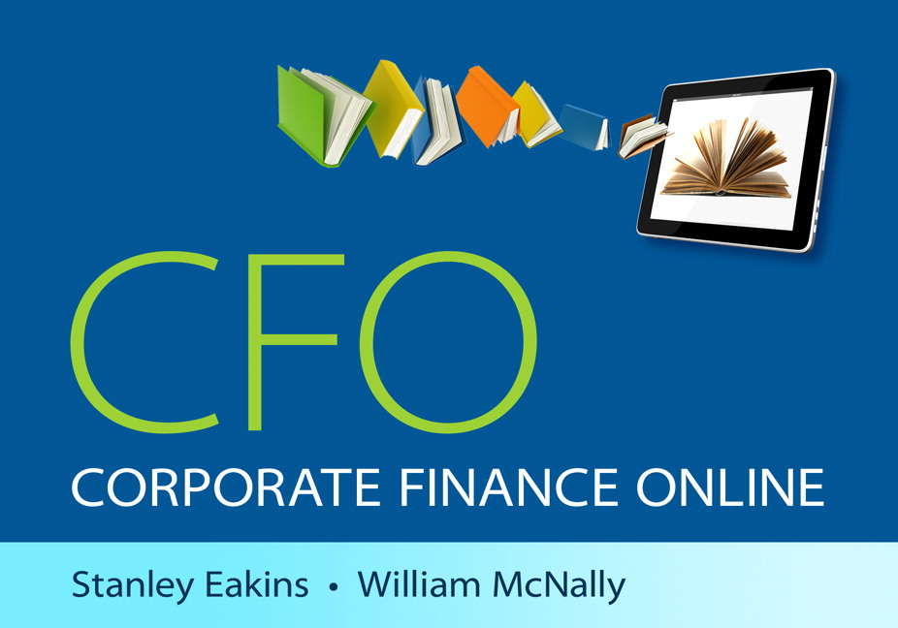
You will find all of the overheads used in class within the CFO online Text

Slide 2
Introduction to Finance

Slide 3
Learning Objectives
LO1: Learn the features of CFO
LO2: Learn about the World of Finance
LO3: Learn about the Financial System
LO4: Learn about the Structure and Governance of Corporations
LO5: Learn 5 Principle Themes of Finance

Slide 4



LO1: Introduction to CFO
Concise Narrative
“Explain it” Icon offers additional information
A variety of “Explain it” videos
Actively learn a concept using the “Explore it” icon
Notes:
Show the students examples of each tool so they understand the additional information available to them. (1.1.1 of the text contain live examples).

Slide 5




Solution Tools
Excel® templates available for most problems
Videos to show problem setup
Videos to show how to use Excel template
Videos to show calculator solutions
Notes:
Show the students how to use the various solution tools to learn about how problems can be set up and solved. (Page 1.1.3 of the text have live examples of these solution tools.)

Slide 6
LO2: Four Facets of Finance
Academic Finance
Business Finance
Careers in Finance
Personal Finance
Notes:
Spend some time discussing the various financial perspectives and careers in each field. The ExplainIt! on page 1.2.1 explains these four facets in an entertaining manner. (Run time: 5:05.)

Slide 7
LO3: Financial System
Financial markets
  Encompasses securities including stocks and bonds
  Exist physically and virtually
Money Market
  Securities that mature in less than one year
Capital Market
  Securities that mature in more than one year

Slide 8
LO3: Financial System cont…
Primary Market
  First issuance of security
Secondary Market
  Investors trade securities after issuance
  2 types of secondary markets
    Auction markets
      Markets trade in a physical or virtual location
    Dealer Markets
      Multiple dealers willing to buy or sell
Notes:
Discuss how financial markets are critical to economic growth. Also emphasize the importance of secondary markets in providing liquidity to investors.

Slide 9
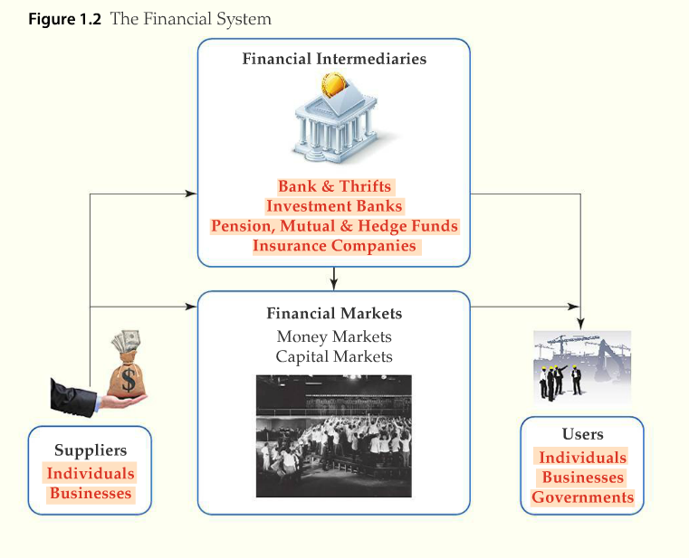
Financial System
Notes:
From page 1.3.3 of text. You can relate this graph to the circular flow model your students should have studied in Principles of Economics so they can see the big picture view of the financial markets.

Slide 10
Money Markets
In a Money Market securities
  Are short term,
  Are highly liquid (easy to sell), and
  Mature in less than 1 year from their issue date
Money Market Mutual Funds
  Individual investors buy units of MMMFs
Treasury Bills
  The government funds a large portion of the U.S. debt by issuing T-Bills

Slide 11
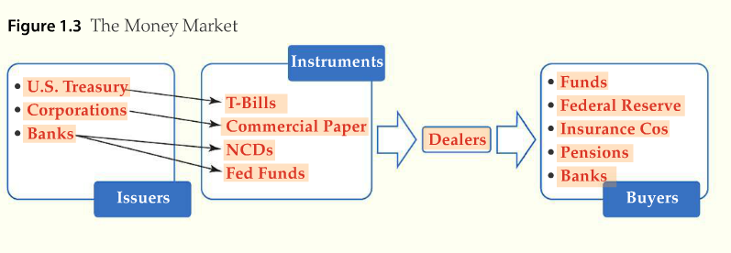
Money Markets
Notes:
From page 1.3.5 of text. Make sure students are familiar with the various types of money market instruments.

Slide 12
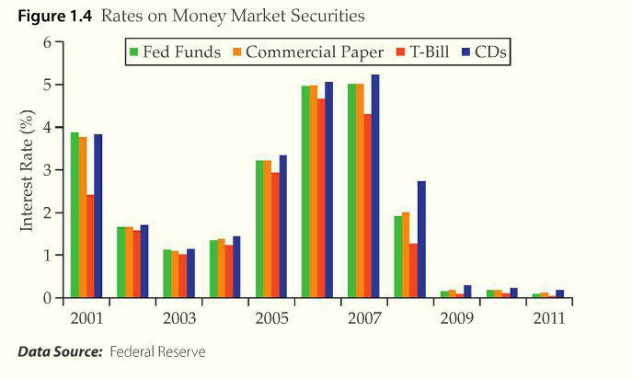
Money Markets
Notes:
From page 1.3.6 of text

Slide 13
Capital Markets
Securities have an original maturity greater than one year
Principal securities are bonds and stocks
Securities traded on the capital market fund long-term investments
Notes:
Make sure students understand the distinction between the money markets and the capital markets.

Slide 14
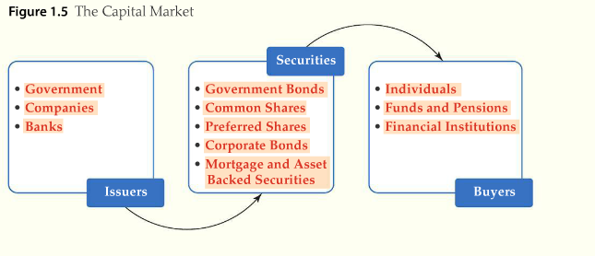
Capital Markets
Notes:
From page 1.3.8 of text

Slide 15
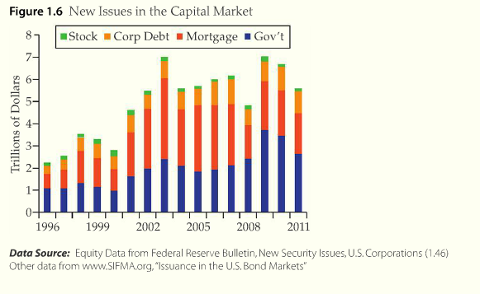
Capital Markets
Notes:
From page 1.3.9 of text

Slide 16
Primary and Secondary Markets
Primary Markets
  Securities are offered for sale for the first time
  Intermediated by investment banks
  First time security offering is an Initial public offering (IPO)
Secondary Markets
  Securities traded after the initial sale
Notes:
Make sure students understand that the firm only receives cash in the primary market. All secondary market transactions are merely trades between investors.

Slide 17
Auction Markets
New York Stock Exchange (NYSE)
Chicago Mercantile Exchange (CME)
Moving away from physical trading floors and into electronic limit order books.
  Limit orders-trade specific quantity or price
  Market orders-matched and posted with limit orders
Notes:
Discuss the various types of markets

Slide 18
Dealer Markets
Over-the-counter (OTC) markets
  Trading usually occurs of the telephone or by computer
  Dealer holds an inventory and posts bid and ask prices
NASDAQ (National Association of Securities Dealers Automated Quotation)
  Computerized dealer market for stocks
Notes:
Continue discussion of various market types.

Slide 19
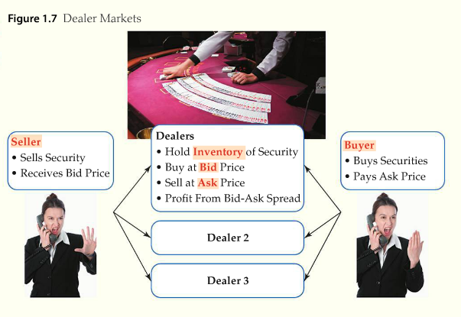
Dealer Markets
Notes:
From page 1.3.13 of text. Discuss how this process works or show videos.

Slide 20
The Role of Secondary Markets
Provides means for investors to tailor their investment horizons
Example: sell shares according to personal financial needs

Slide 21
Characteristics of Secondary Markets
Accurate pricing of stocks
  Both the buyer and seller want the price to be fair
Liquidity
  The ease at which an asset can be converted to cash

Slide 22
Liquidity
Liquidity is critical for capital formation
Investors would be less likely to buy primary market securities if an active secondary market did not provide liquidity
Liquid markets allow for rapid asset valuation
Notes:
Discuss the importance of liquidity again.

Slide 23
LO4:Corporate Governance
Governance
  The way an organization is formed, structured, and controlled
3 basic forms of business organization
  Sole proprietorship
  Partnership
  Corporations
Notes:
The next slide allows you to cover these 3 forms in detail.

Slide 24
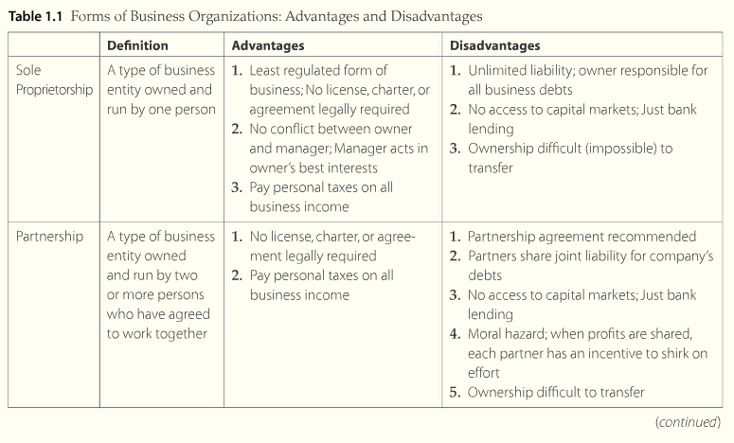
Forms of Business Organizations
Notes:
From page 1.4.2 of text. Discuss the advantages and disadvantages of each form.

Slide 25
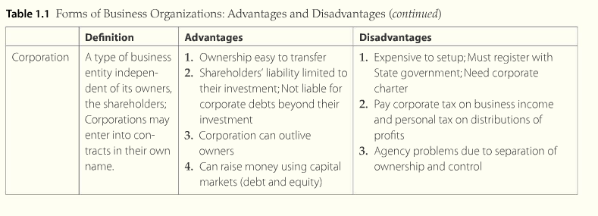
Forms of Business Organizations

Slide 26
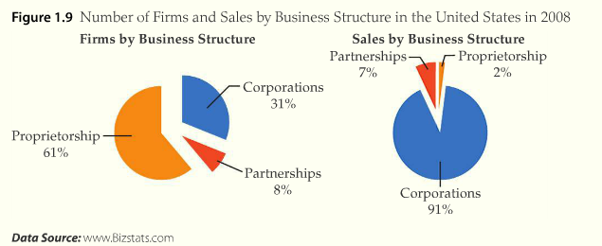
Forms of Business Organizations
Notes:
From page 1.4.4 of text. Discuss the number of firms and sales volume of each type of organizations.

Slide 27
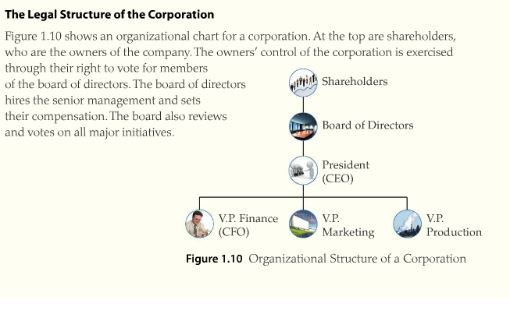
Corporations and Governance
Notes:
From page 1.4.5 of text. Discuss this diagram and how companies are organized.

Slide 28
Corporations and Governance
Goals of Financial Management
  Maximizes the interest of the owner
  Maximize shareholder wealth for corporations
The common law requires
  Fiduciary Duty to the corporation from board members
    A duty of care, loyalty, and good faith
  No one stakeholder group has legal primacy over any other
Notes:
Spend some time on the importance of shareholder wealth maximization and how it achieves other “good” goals at the same time.

Slide 29
Corporations and Governance
Principal-Agent Problem
  All individuals act in their own interest
  Managers use corporate resources to benefit themselves but not necessarily shareholders
  Firms incur agency costs as a result
Principal-Agent Problem: Contractual Remedies
  Executive compensation plans
  Executive stock and stock options
Notes:
Discuss the remedies of the principal-agent problem and show how compensation and stock options align interests.

Slide 30
Corporations and Governance
Principal-Agent Problem: Government Regulation
  Sarbanes-Oxley Act (SOX)
SOX 5 key provisions
  Mandate internal procedures to ensure accurate financial disclosure
  Disclosure of all material off-balance sheet activities
  Supervision from a committee of outside directors
  CEOs and CFOs must certify financial statements
  Stiffened penalties for fraudulent disclosure
Notes:
Discuss Enron, WorldCom, Tyco or other high profile example of agency problems.

Slide 31
LO5: Five Keys to Success in Finance
Time Value of Money
Risk and Return
Efficiency, Arbitrage, and Law of One Price
Cash is King
Transactions Costs and Information Matter
Notes:
Briefly discuss each issue; most will be covered in later chapters in greater detail.

Slide 32
Efficiency, Arbitrage and Law of one Price
Efficient markets hypothesis
  The market prices securities fairly at all times and that new information is rapidly reflected in the price
Law of one price
  Two equivalent investments that trade in different markets must have the same price
Arbitrage
  Trading strategy that involves the simultaneous purchase and sale of an identical commodity or security in two different markets
Notes:
Cover in greater detail at your discretion.

Slide 33
Transactions Costs and Information Matter
Information asymmetry
  Information is not distributed evenly across economic agents
    Shareholders
    Bondholders
    Bankers
    Managers
  Unusual arrangements are often caused by information asymmetry or agency costs
Notes:
Discuss how each group might not have access to the same information.

Slide 35
Financial Statement and ratio analysis
Chapter 2

Slide 36
Learning Objectives
LO1: Know the Three Financial Statements Needed
for Financial Analysis
LO2: Know the Goals of Financial Statement Analysis
LO3: Perform Financial Statement Analysis

Slide 37
LO1: The Financial Statements
The Balance Sheet
  Provides the details of the accounting identity
    Assets = Liabilities + Owners’ equity
    Or,
    Investments = Investments paid for with debt + Investments paid for with equity
  A Financial snapshot of the firm
  Analysts can identify changes in the firm over time
Notes:
Spend some time discussing how financial managers use the balance sheet. The students’ exposure to date has been focused on how the sheets are created by accountants.

Slide 38
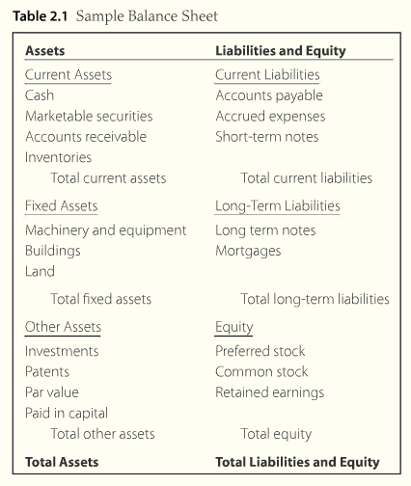
The Balance Sheet
Notes:
From page 2.1.2

Slide 39
The Balance Sheet
Assets generate income
  Listed on the left hand side of the balance sheet
  No reason to hold an asset that does not produce income
Financing the assets
  Listed on the right hand side of the balance sheet
  By adjusting the mix of debt and equity the lowest cost of financing can be achieved

Slide 40
The Income Statement
Tells how the firm has performed over a period of time
The first section reports the results of operating activities or income
  Includes sales minus expenses
The second section reports financing activities

Slide 41
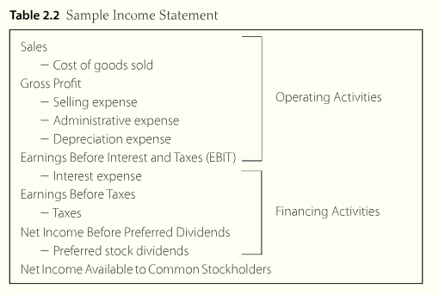
The Income Statement
Notes:
From page 2.1.4 of the text. Make sure students understand the distinction between operating and financing activities.

Slide 42
Statement of Cash Flows
Provides a summary of operating, investment and financing cash flows, and reconciles them with changes in cash and marketable securities during the period of concern
Provides insight that is not readily available from other financial statements

Slide 43
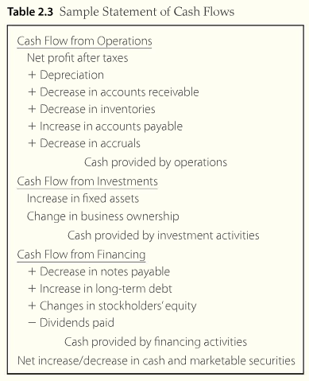
Statement of Cash Flows
Notes:
From page 2.1.6 of the text. Go through the 3 major sections in detail and discuss how the statement of cash flows is critical for planning periods of cash shortage and cash surplus.

Slide 44
LO2: The Goals of Financial Analysis
Identify Company Weakness
  Early identification of problems is crucial to a firms success
Identify Company Strengths
  Allows firms to enhance strengths and maximize potential
Notes:
A good manager needs to know the firm inside and out. Ratio analysis can pinpoint areas that need additional work and areas that can be left alone for the time being.

Slide 45
LO3: Financial Statement Analysis
Cross Sectional Analysis
  Comparison of one firm to other similar firms
Sources of cross sectional information include:
  Value Line
  Risk Management Association
  Dun and Bradstreet
Time Series Analysis
  Evaluation of a firm’s financial performance over time, utilizing financial ratio analysis

Slide 46
The Ratios – 5 primary categories
Profitability ratios
Liquidity ratios
Activity ratios
Financing ratios
Market ratios
Notes:
Briefly introduce the 5 main categories and explain there are hundreds of ratios, but that we will only focus on the most common ratios.

Slide 47
Profitability Ratios
Profitability ratios relate to profit margins and the earnings of the firm
Measure how effectively the firm uses its resources to generate income
Provide analysts and managers with additional information on firm performance
Notes:
Generating profits is the only thing that keeps a firm in business long-term.

Slide 48
Profitability Ratios
Return on Equity (ROE)
  Tells what the firm earns on every dollar of equity
Return on Assets (ROA)
  Measures profit per dollar of assets
Gross Profit Margin
  The gross profit earned on each dollar of sales
Operating Profit Margin
  Measures only profits earned on operations
Net Profit Margin
  Percentage of each sales dollar that remains after all costs have been deducted
Notes:
Spend some time explaining why each of these ratios gives us a different perspective on firm profitability.

Slide 49
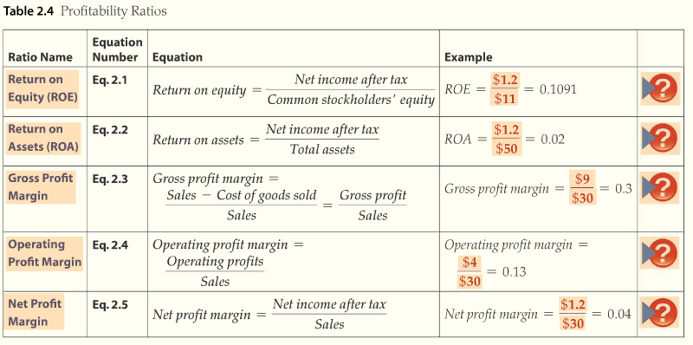
Profitability Ratios
Notes:
From page 2.3.5 of text.

Slide 50
Liquidity Ratios
Examine how able a firm is to pay its current liabilities
Current Ratio
  Measure of the firm’s ability to meet its short term obligations
Quick Ratio
  Similar to current ratio, with inventory subtracted from current assets
Notes:
Commonly used by lenders to determine ability to repay debt.

Slide 51
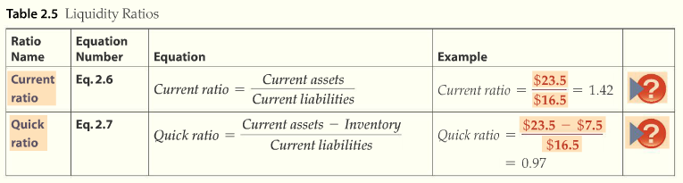
Liquidity Ratios
Notes:
From page 2.3.7 of text.

Slide 52
Activity Ratios
Used to measure the speed with which various accounts are converted to sales or cash
Inventory turnover
  Measures how many times per year the inventory is completely sold
Accounts receivable turnover
  Number of times per year accounts receivable is paid and replaced
Total asset turnover
  How much in sales is generated for every dollar of assets
Average collection period
  Average length of time it takes for the firm to collect on its credit sales
Notes:
Show how each can be interpreted differently and could provide an indication of good or bad management practices. Also, make sure students understand how these vary substantially based on industry, and how age of assets can impact certain ratios.

Slide 53
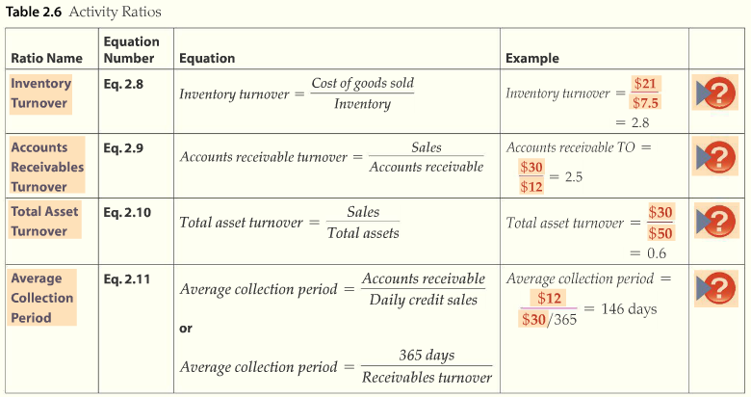
Activity Ratios
Notes:
Taken from page 2.3.9 of text.

Slide 54
Financing Ratios
Measure the degree to which a firm is leveraged
Debt ratio
  Proportion of assets financed by debt
Debt equity ratio
  Shows the relationship between the suppliers of long -term debt and equity
Times interest earned ratio (TIE ratio)
  Measures the firm’s ability to meet its interest payments
Notes:
Discuss how leverage varies from industry to industry and can depend on stability of cash flows.

Slide 55
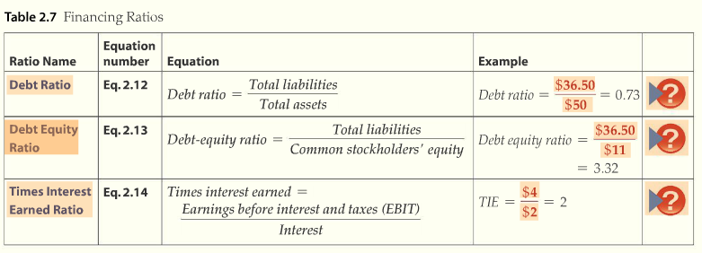
Financing Ratios
Notes:
Taken from page 2.3.11 of text.

Slide 56
Market Ratios
Based on the firm’s security price
Earning per share (EPS)
  Reports the net income per share of common stock
Price earnings (PE)
  The amount investors are willing to pay for $1 of income by the firm
Market to book
  Measures how the market values the firm
Notes:
Discuss each of these with examples of interpretation.

Slide 57
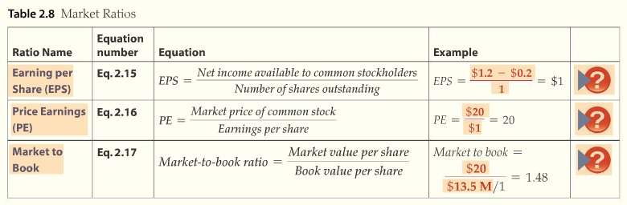
Market Ratios
Notes:
From page 2.3.13 of text.

Slide 58
Common-Sized Financial Statements
Financial statements that have every line converted into a ratio by dividing income statement data by total sales and balance sheet data by total assets
Specialized type of ratio analysis in which the denominator of every ratio is total assets or total sales
Makes benchmarking easier
Notes:
Allows comparison with other firms in our industry to use for benchmarking. Show some comparisons with other firms.

Slide 59
Du Pont Ratio Analysis
A method of financial analysis that provides a framework for dissecting a firm’s financial statements and assessing its financial condition
Return on Equity results from a trade-off between margin, volume and leverage
A firm can change its ROE by adjusting one of three components
  It can have high turnover of product
  It can have large margins on each sale
  It can be highly leveraged
Notes:
The next slide allows you to discuss each component.

Slide 60

Du Pont Ratio Analysis
The Du Pont analysis computes the ROE as the product of margin, turnover, and leverage
We can rewrite the Du Pont relationship using the ratio formulas
Notes:
Show an example so students can see how the ROE of a particular firm is the product of profit margin, asset turnover, and leverage.

Slide 61
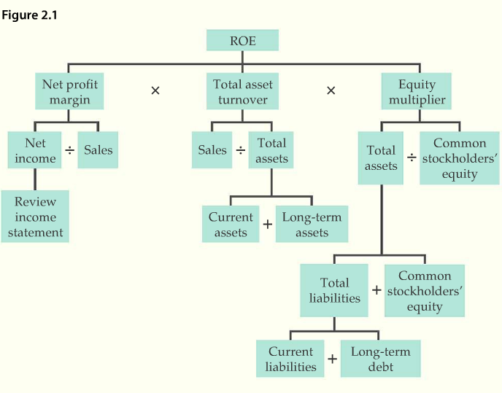
Du Pont Ratio Analysis
Notes:
From 2.3.17 of text. Explain these relationships and how the Du Pont Analysis can be used to identify ways to increase profits.

Slide 62
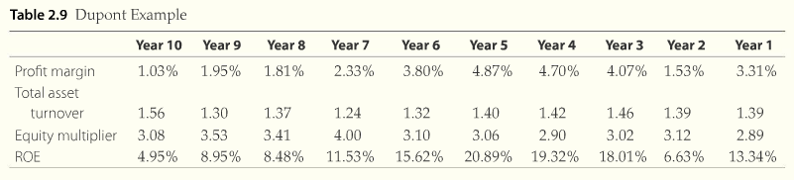
Du Pont Ratio Analysis
Notes:
Taken from page 2.3.18 of text. Point out that the firm’s ROE issues are the result of fluctuations in profit margin. Now you can investigate in depth and see why it is lower and more volatile.

Slide 63
Putting the Ratios to Work
The financial analysis of a firm should include the following steps -
  Analyze the economy in which the firm operates
  Analyze the industry in which the firm operates
  Analyze the competitors that currently challenge the firm
  Analyze the strengths and weaknesses of the firm, using common-sized statements and ratios
Notes:
Discuss how we use ratios in practice and how they can aid managers in creating greater efficiency and higher profits.

Slide 64
Putting the Ratios to Work
Ratio interaction
  The effect one ratio has on another
  Ex: If sales fall, inventory turnover will also fall if inventory is constant
Reading between the lines
  Ratios do not often tell the whole story
  Ratios will provide flags that analysts must investigate to find the truth
Notes:
Be cautious about interpretation. Ratios only point toward areas where we need to dig deeper and see if there are improvements to be made.

Slide 65
Putting the Ratios to Work
  Let’s look at a real company that is traded on the New York Stock Exchange!
Notes:
Be cautious about interpretation. Ratios only point toward areas where we need to dig deeper and see if there are improvements to be made.

Slide 67
Time value of money (Tvm)
Chapter 3

Slide 68
Learning Objectives
LO1: Introduction to Time Value of Money
LO2: Find the Future of Value of a Sum
LO3: Find the Present Value of a Sum

Slide 69
LO1: Introduction to TVM Concepts
Understanding the Time Value of Money is one of the most important concepts you will learn in this course
You will also learn the distinction between simple interest and compound interest
Over time, compounding will generate “miraculous” returns
Notes:
Make sure the students understand how they can apply these concepts to their personal life.

Slide 70
1. Future Value of Single Sum
?
-$
-PV
i
N
CPT
FV

Slide 71
2. Future Value of an Annuity
?
-$
-$
-$
Today
-PMT
i
N
CPT
FV

Slide 72
3. Sinking Fund
$
?
?
?
Today
FV
i
N
CPT
PMT

Slide 73
4. Present Value Single Payment
$
?
-FV
i
N
CPT
PV

Slide 74
5. Present Value of the Annuity
?
$
$
$
PMT
i
N
CPT
PV

Slide 75
6. Amortized Loans
$
?
?
?
PV
i
N
CPT
PMT

Slide 76
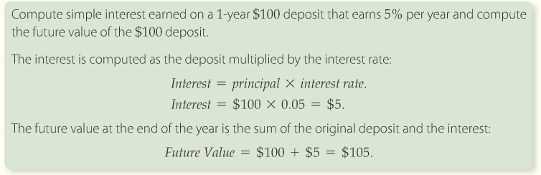
Simple Interest and One-Period Future Value
You can use the following formula to calculate future value:
Notes:
See page 3.1.2 for solution and explanation

Slide 77
Simple Interest and One-Period Future Value
Principal or present value (PV)
  Original deposit or initial amount
Quoted rate, nominal rate or APR (i)
  The interest rate
  Assume interest rate is annual unless otherwise stated
Future Value (FV)
Simple interest
  Only one period interest in earned
Compound interest
  Multi-period future value
Notes:
Explain each term and also show the calculator abbreviations for each.

Slide 78
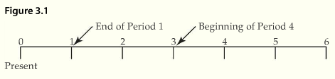
The Timeline
A horizontal line on which time zero is the leftmost end and future periods are shown as you move to the right
Notes:
Emphasize how important it is to use a timeline to identify the timing of the cash flows. It becomes particularly important as the complexity increases.

Slide 79

The Timeline
Inflows
  Cash you receive
  Has a positive sign (+)
Outflows
  Cash you spend
  Has a negative sign (-)
Notes:
Assumption is that cash flows occur at the end of a period unless otherwise stated.

Slide 80
LO2: Future Value of a Single Sum
Compound interest
  Future value over multiple periods
With compound interest, you earn interest on accrued interest in successive periods
Annual compounding
  Compounding interest calculated with a compounding interval of one year
Notes:
Compound interest and simple interest will yield the same result if using annual compounding for only one year.

Slide 81
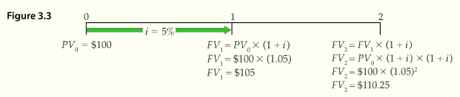
Compound Interest
Future value over one year
  The formula for computing the balance after one period is
  Using $100 as the present value at a 5% interest rate
Notes:
Walk the students through this example.

Slide 82


Compound Interest
Future value over two years
  Computing the balance after two periods
  We can simplify these calculations by noting FV₁ is equal to PV₀ X (1 + i) and substituting
Notes:
Show how the formula is just an algebraic simplification.

Slide 83
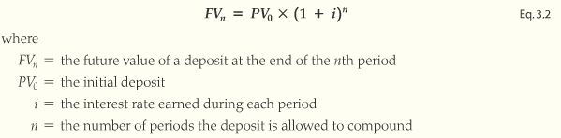
Compound Interest
Future value over multiple years
Notes:
Other TVM formulas are derived from this formula, so this is a good one to memorize.

Slide 84
Compound Interest
Suppose your grandmother gave you $1,000 when you graduated from high school. Instead of spending it, you decided to invest it and to not touch the balance for 40 years, until you retire. If you managed to earn 10% annually, what is the future value of your investment?
Notes:
See page 3.2.4 for solution tools

Slide 85
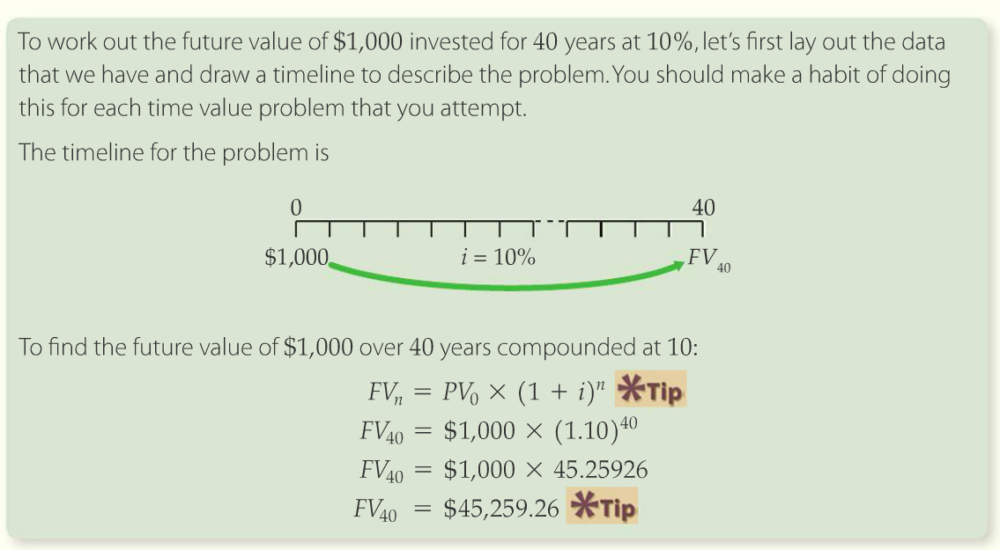
Solution
Notes:
See page 3.2.4 for solution tools

Slide 86

Compound Interest
Calculating interest earned
  To find interest earned, we subtract the principal (the original amount) from the ending balance

Slide 87
Compounding Rules of Thumb
Future balance increases if periods and/or interest rates increase
Compound interest theory applies to any growth
  Population growth
  Sales growth
  Dividend growth
  Etc.
Any length of period can be used
  Time period is called the compounding period or the conversion period
Notes:
There are numerous applications for compound growth rates. Have the class brainstorm some uses if you have time.

Slide 88
Future Value of Mixed Streams
Mixed stream cash flows
  A number of different cash flows received over time
To calculate future of mixed streams
  Compute the FV of each cash flow separately and find the sum
  Calculating retirement futures is a good example of this

Slide 89
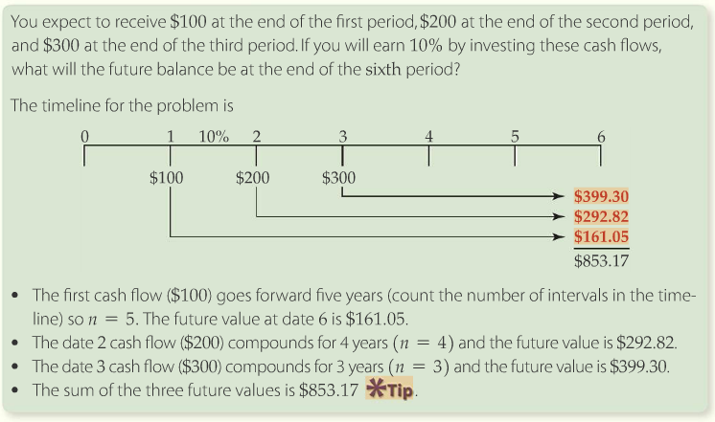
Future Value of Mixed Streams
Notes:
Taken from page 3.2.8 of text; the Solution Tools on that page show how to work this problem.

Slide 90
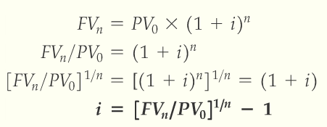
Solving the Interest Rate
Notes:
Eq. 3.3 on p. 3.2.9

Slide 91
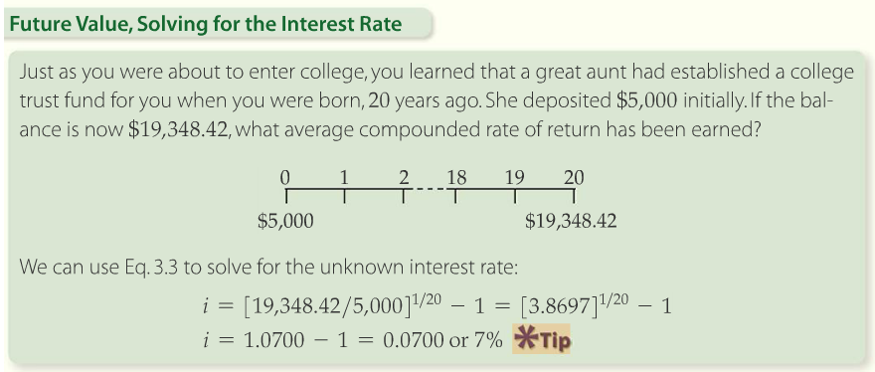
Solving the Interest Rate
Using Calculator: PV = -$5000; FV = $19348.42; n = 20; compute I = 7%
Notes:
Solution Tools p. 3.2.9. We will need to solve for the interest rate or rate of growth many times, and then use that rate to forecast the future value of some variable.

Slide 92
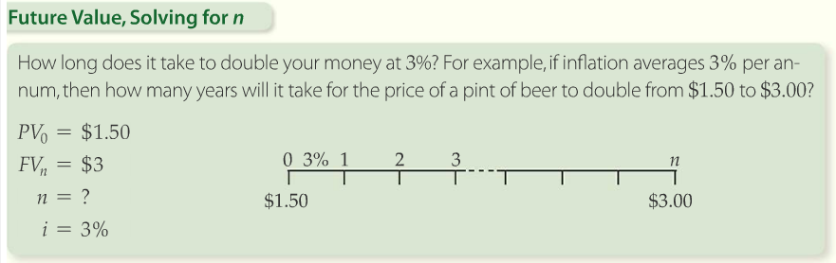
Solving for the Number of Periods
(minus)
Notes:
Solution Tools on p. 3.2.10. You can introduce the Rule of 72 for any problems that “double” your money.

Slide 93
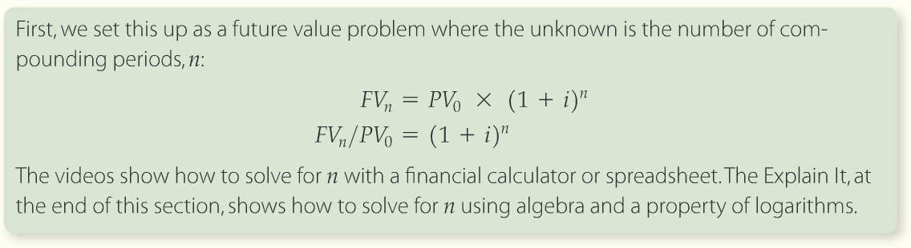
Solving for the Number of Periods
Notes:
Explain It and Explore It on p. 3.2.11. Applications for these tools include determining how many years before you can achieve a goal, such as retirement, down payments, etc.

Slide 94
Future Value with Non-Annual Compounding
To calculate a future with non-annual compounding
  Define m as the number of compounding periods in the year.
  For example with semi-annual compounding, m = 2
  Always match the interest rate to the length of the compounding period. If there are m compounding periods, then the periodic rate for each period is i/m.
  For example if the interest rate is 12%, then the semi-annual periodic rate is 6%, the quarterly rate is 3%, and the monthly rate is 1%
  Periodic rate is the rate of interest that prevails over a compounding period.
Notes:
Emphasize these conversions to the students. Errors are typically the result of misunderstanding how to adjust interest rates and time periods to reflect multiple compounding periods.

Slide 95

Future Value with Non-Annual Compounding
Calculating a future non-annual compounding cont…
  Always adjust the number of periods by multiplying the number of years by the number of compounding periods per year. For example, 5 years (n=5) with semi-annual compounding (m=2) is 10 periods (n x m)
  Multiple Compounding periods per year is expressed as Eq. 3.4:
Notes:
Eq. 3.4 on p. 3.2.12

Slide 96
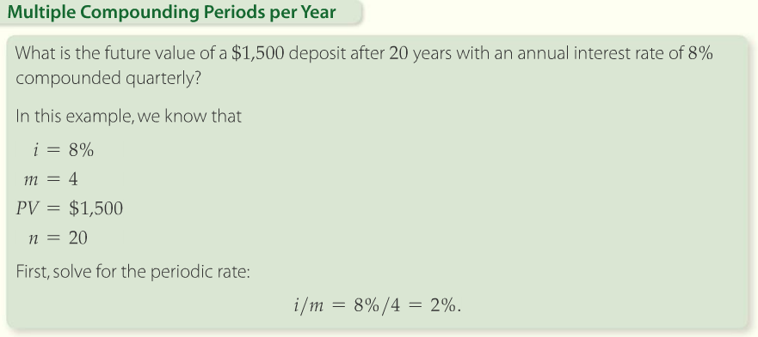
Future Value with Non-Annual Compounding
Notes:
Solution Tools on p. 3.2.12

Slide 97
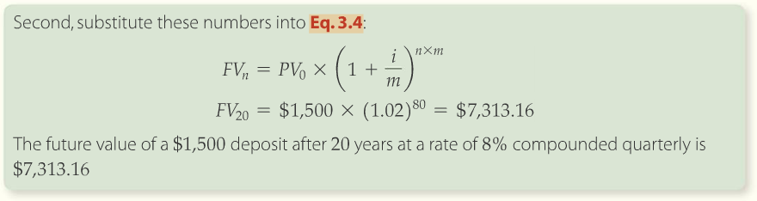
Future Value with Non-Annual Compounding
Compounded quarterly, the FV is $7,313.16
However, the FV with annual compounding is only $6,991.44
Notes:
Solution tools on p. 3.2.12

Slide 98
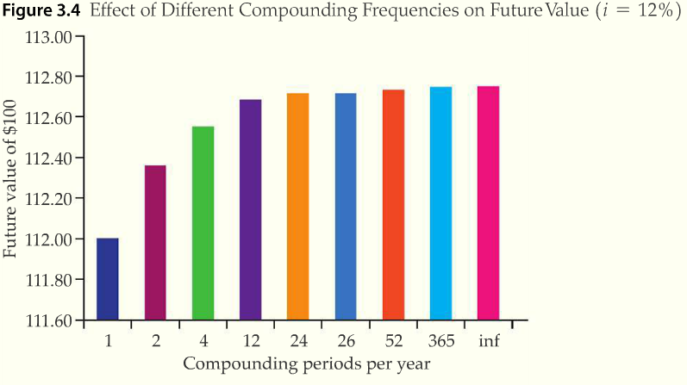
Future Value with Non-Annual Compounding
Notes:
From page 3.2.14 of text. Explain how compounding frequency can change FV significantly.

Slide 99
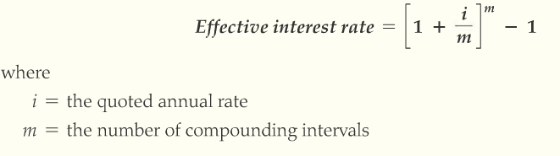
Effective Interest Rate
Effective interest rate (EIR)
  The rate you actually earn on your investment after taking into account the compounding frequency
Determining EIR
Notes:
Eq. 3.5 on p. 3.2.15. Sometimes called EAR or effective annual rate.

Slide 100
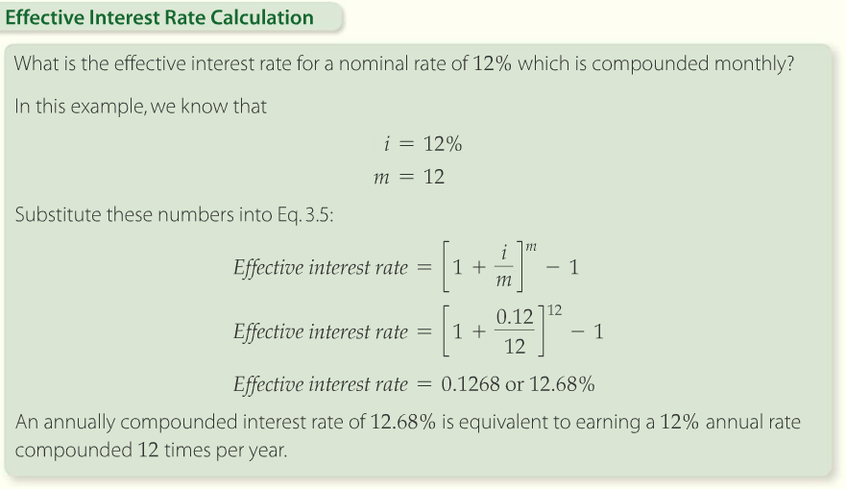
Effective Interest Rate
Notes:
From page 3.2.16

Slide 101
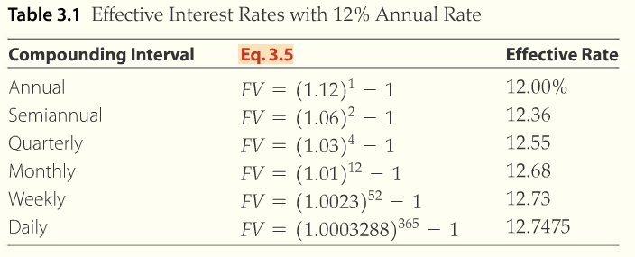
Effective Interest Rate
Notes:
Provides a clear example of how more frequent compounding increases returns or EIR.

Slide 102


LO3: Present Value of a Sum
The present value equation
  By rearranging the future value equation we get;
  And dividing both sides by ( 1 + i )^{n}
  The term 1/(1 + i )^{n} is called the present value interest factor (PVIF)
Notes:
Eq. 3.6 on p. 3.3.1

Slide 103
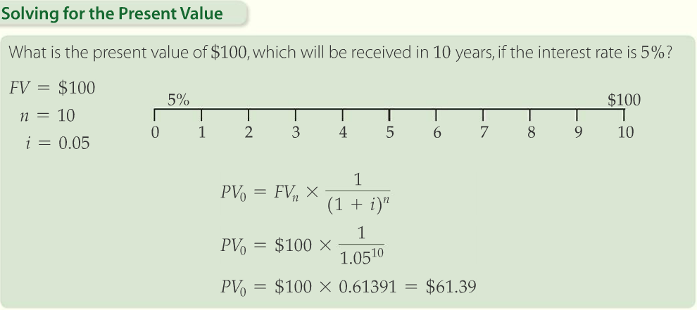
The Present Value Equation
Notes:
Solution tools on p. 3.3.2

Slide 104
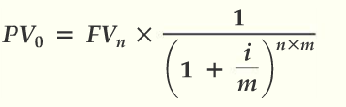
The Present Value Equation
Present value with non-annual compounding
  The formula for non-annual compounding
Notes:
Eq. 3.7 on p. 3.3.3

Slide 105
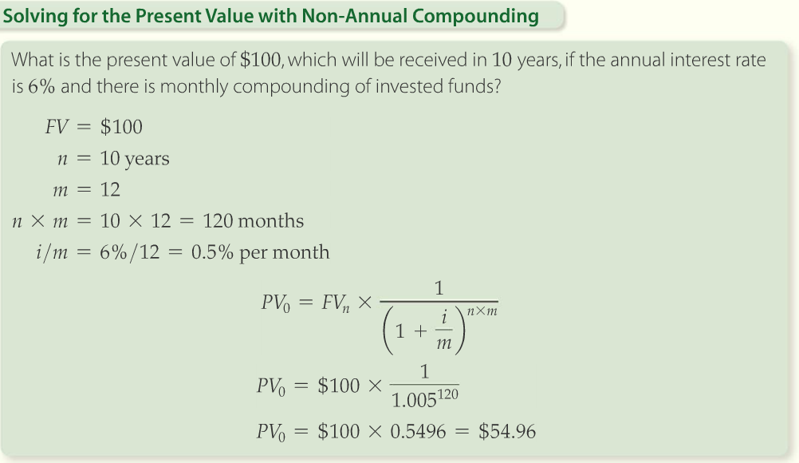
The Present Value Equation
Notes:
Solution tools on p. 3.3.3

Slide 106
The Present Value Equation
Insights on present values
  The present value factor is the inverse of the future value factor
  If interest rates are zero, then future values are equivalent to present values
  Interest rates and the present value are inversely related.
    As interest rates rise PVs fall and vice versa
  The process of computing the present value of a future sum is called discounting
Notes:
This TVM tool will be used more than the others when we get to capital budgeting and evaluating investment options for the firm.

Slide 107
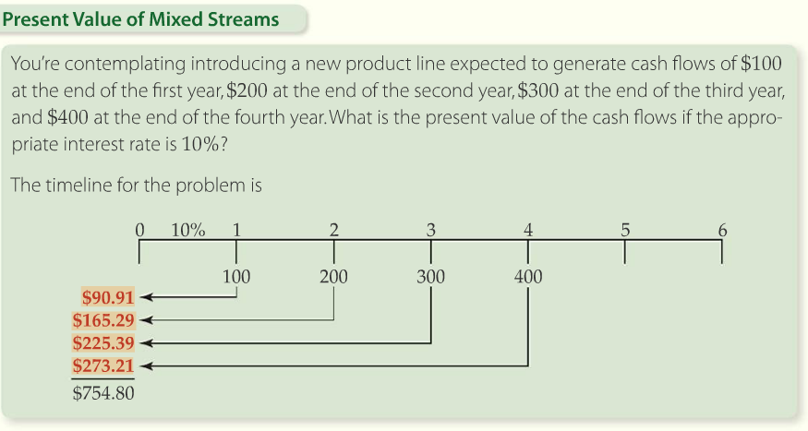
Present Value of a Mixed Stream Cash Flow
Notes:
Solution Tools on 3.3.5.

Slide 108
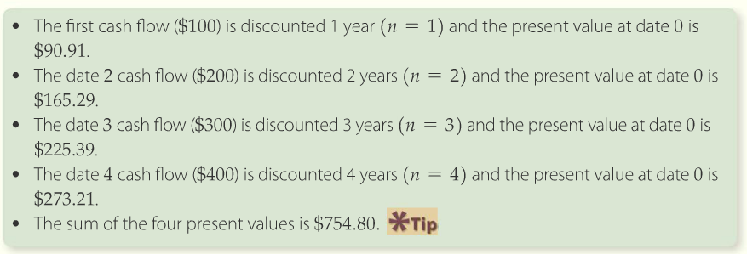
Present Value of a Mixed Stream Cash Flow

Slide 109
Using Present Values to Value Assets
What does it mean that the present value of $100 to be received in 1 year is $90.91?
  It means you’re indifferent to receiving either cash flow:
    the $90.91 today or $100 in one year
  If you have a present value of a future sum, you can exactly match that future sum by investing the PV equivalent at the discount rate
  It is the current value of a promised payment in the future

Slide 110
Using Present Values to Value Assets
Discounted Cash Flow (DCF)
  The valuation methodology whereby the value of an asset is equal to the present value of the asset’s cash flows;
  Same as fundamental value
  The primary valuation methodology presented in CFO
How to find the DCF of a business asset
  Identify the cash flows that result from owning the asset
  Determine what discount rate is required to compensate the investor for “the risk” of holding the asset
  Find the present value of the cash flow estimated in step 1 using the discount rate determined in step 2
Notes:
This process is the heart of financial management and shareholder wealth maximization.

Slide 112
Annuities and loans
Chapter 4

Slide 113
Learning Objectives
LO1: Find the future value of streams of payments
LO2: Find the present value of streams of payments
LO3: Find solutions to advanced TVM problems
LO4: Understand balloon and amortized loans

Slide 114
LO1: Future Value of Streams of Payments
Annuity
  A stream of equal periodic cash flows
    Series of equal payments made at equal intervals
    Can be inflows or outflows
Ordinary annuity
  An annuity for which the payments occur at the end of each period
Annuity due
  An annuity for which the payments occur at the beginning of each period
Notes:
List some examples such as car payments, saving $200 a month every month for retirement, etc.

Slide 115
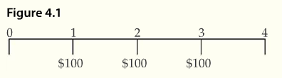
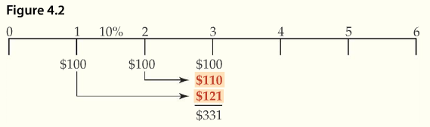
Future Value of an Ordinary Annuity
Future balance after 3 years of 3 annual $100 deposits
Notes:
Emphasize the importance of using a timeline to plot your cash flows. As the problems become more complex, this habit will be critical.

Slide 116
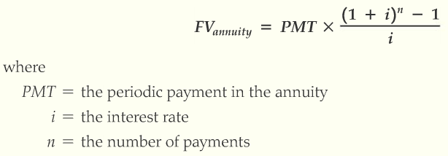
Future Value of an Ordinary Annuity
Future value of an ordinary annuity can be expressed as
This equation simplifies to
Notes:
Eq. 4.1 on p. 4.1.4

Slide 117

Future Value of an Ordinary Annuity
Future value interest factor for an annuity (FVIFA)
Formula 4.1 and 4.2 are interchangeable
Notes:
Formula 4.2 on p. 4.1.4

Slide 118
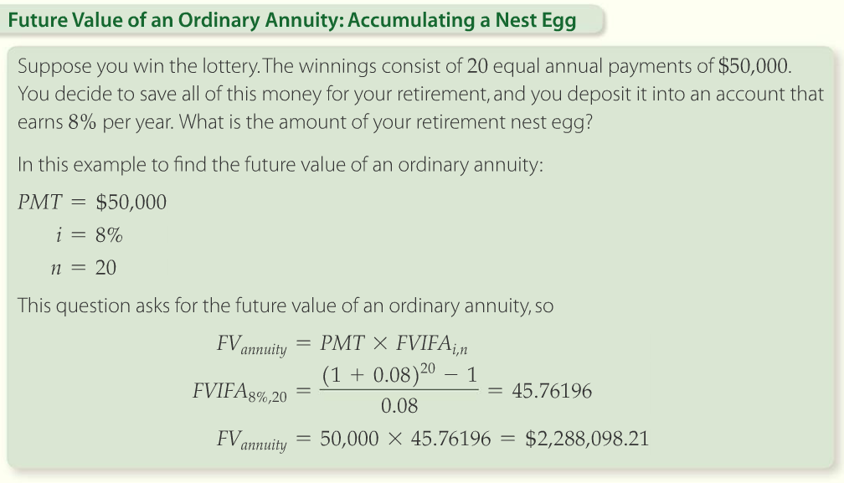
Future Value of an Ordinary Annuity
Notes:
Solution tools on p. 4.1.5

Slide 119
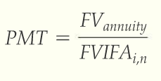
Future Value of an Ordinary Annuity
Payments to accumulate a future balance
  Can be found using the following equation
Notes:
Taken from 4.1.6

Slide 120

Future Value of an Ordinary Annuity
Notes:
Solution Tools on p. 4.1.7

Slide 121
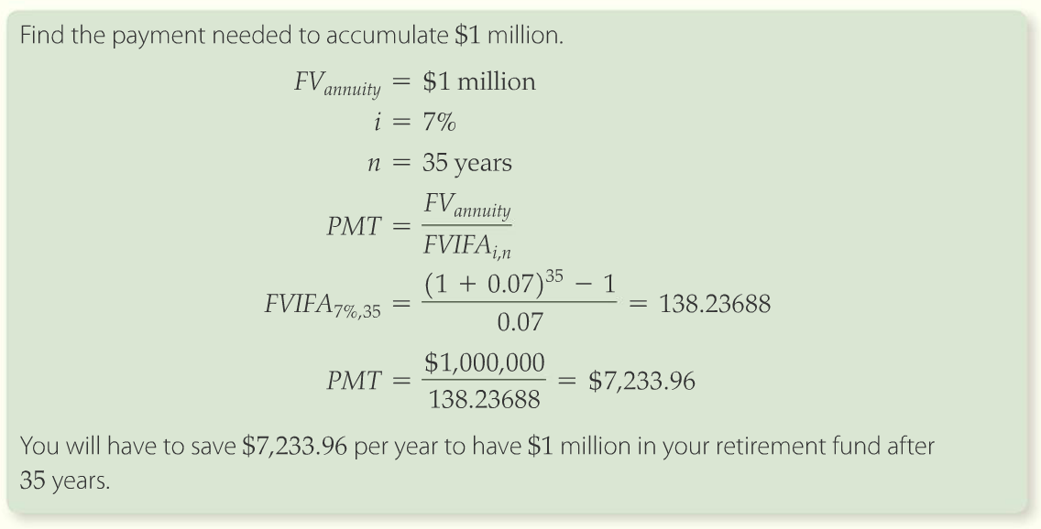
Future Value of an Ordinary Annuity
Notes:
From page 4.1.7. Solution Tools on this page also show how to work this problem.

Slide 122
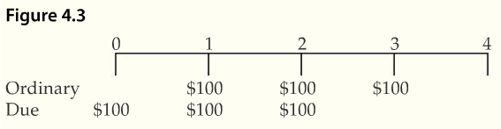


Future Value of an Annuity
Ordinary annuity versus annuity due
The future value on an annuity due is calculated using this equation
Simplified using the future value interest factor
Notes:
Eq. 4.3 on p. 4.1.11

Slide 123
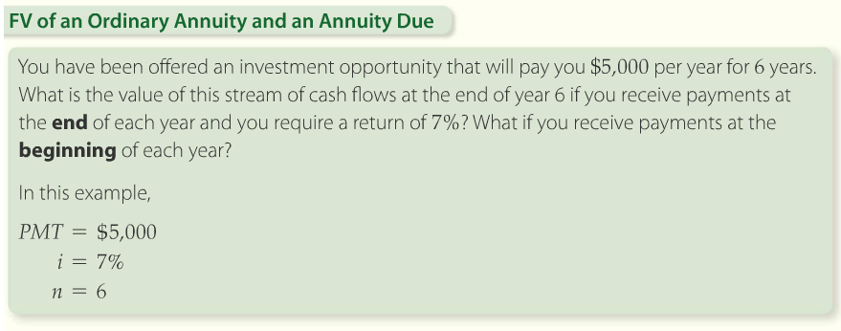
Future Value of an Ordinary Annuity and an Annuity Due
Notes:
From page 4.1.11. Solution Tools on this page also show how to work this problem.

Slide 124

Future Value of an Ordinary Annuity and an Annuity Due
Notes:
From page 4.1.12

Slide 125


LO2: Present Value of Streams of Payments
Present value of an ordinary annuity
  What is the present value of $100 per year paid at the end of each year at 10% interest?

Slide 126


Present Value of Ordinary Annuity
The general expression for the present value of an annuity is represented by the following equation
  The solution to the equation can be written as
Notes:
Eq. 4.4 on p. 4.2.2

Slide 127

Present Value of an Ordinary Annuity
Using the identity of the present value interest factor for an annuity (PVIFA) to rewrite the equation
Notes:
Eq. 4.5 on p. 4.2.3

Slide 128

Present Value of an Ordinary Annuity
Notes:
Solution Tools on p. 4.2.3

Slide 129

Present Value of an Ordinary Annuity
Present value of the annuity from the point of view of the lottery corporation
Notes:
This timeline presentation shows why you should be indifferent between $316.99 lump sum, or 4 equal payments of $100 over time

Slide 130

Finding the Rate of Return
Supposed you’ve saved $562,889 and want to withdraw $50,000 per year for 30 years. What rate of return would you need to earn?
solve for i
Solving for i is a trial and error process that is easier with a financial calculator. See Solution tools on page 4.2.6 for detailed solution instructions.
Notes:
Solution Tools on p. 4.2.6

Slide 131

Present Value of an Annuity Due
Finding the present value of an annuity equation

Slide 132

Present Value of an Annuity Due
Notes:
Solution tools on p. 4.2.8

Slide 133

Present Value of a Level Perpetuity
Perpetuity
  A stream of fixed payments paid at regular time intervals that goes on forever
  Taken from the word perpetual, meaning continual or everlasting
Equation for present value of perpetuity
Notes:
Preferred stocks are the best example of a perpetuity since they pay a fixed dividend, typically every quarter, and they have no maturity date.

Slide 134

Present Value of a Level Perpetuity
The cash flows from a level perpetuity with a $100 payment
Notes:
Let’s look at this example on page 4.2.10 of CFO.

Slide 135

Present Value of a Level Perpetuity
Notes:
From page 4.2.11

Slide 136
LO3: Help with Advanced TVM Problems
Equation of value
  An equality between cash inflows and outflows after they have been accumulated or discounted to a common point in time
Focal date
  A common point in time to which we bring all payments so that an equation of value can be obtained

Slide 137
Tips for Solving TVM Problems
Review the information given in the problem and jot down what is known
Draw a timeline
Select a focal date
Determine whether cash flows are lump-sums or annuities
Determine the compounding frequency of the problem and decide whether the cash flows are beginning or end of period
Notes:
These basic steps, outlined on page 4.3.2, should be used for ALL time value of money problems. Tell the students to LEARN THEM!

Slide 138

Imbedded Annuities
Imbedded annuity
  An annuity within a cash flow stream that includes other payments other than the series of fixed payments
Deferred annuity
  A series of equal payments that does not begin immediately, but rather at some future date

Slide 139

Imbedded Annuities
To solve for present value of mixed cash flow, we find the PV of the annuity, then add the PV of any other cash flows
First apply the present value method to the annuity
Notes:
Tell the students to view each cash flow, or annuity series, as a separate problem. Find the PVs and then sum them up to get the overall answer.

Slide 140

Imbedded Annuities
Next find the value at time zero
Step 1; discount the value of the three-period annuity to the end of period 1
Step 2; discount the present value of the annuity back to time 0.

Slide 141

Imbedded Annuities
Notes:
Solution tools on p.4.3.5

Slide 142
LO4: Loans
Balloon loan
  A loan where zero or low payments are due, while the loan is outstanding and the balance is due at maturity
Amortized loan
  A loan where the borrower repays the loan with level and regular periodic payments. Each payment incorporates a blend of interest and principal repayment. The payments are applied first to the interest and the remainder is applied to principal.

Slide 143
Balloon Loans
A loan where principal and interest are paid at the end of the loan term
Notes:
Eq. 4.8 on p. 4.4.1

Slide 144

Balloon Loans
Notes:
From page 4.4.2

Slide 145


Amortized Loans
Loans where interest and principal are repaid with a constant series of payments
Rearranged to solve for payments
Notes:
Eq. 4.9 and 4.10 on p. 4.4.4

Slide 146

Amortized Loans
Notes:
From page 4.4.5

Slide 147
Amortized Loans
Interest on amortized loan payments comes in two forms -
  Each payment contains interest
  The lender receives the payments before the end of the term and therefore can earn interest by investing them
The future value of the amortized loan payments is only equal to the balloon payment if the lender can reinvest intermediate payments at the loan rate.
  This is called reinvestment rate assumption

Slide 148

Amortized Loans
Notes:
From 4.4.6

Slide 149

Amortized Loans
Notes:
Solution tools on p. 4.4.7

Slide 150

Amortized Loans
Notes:
This is an example of an amortization schedule. Note the payment is the same, yet each year a different amount goes toward interest and principal reduction.

Slide 151
End of Quiz 1 Material

