Slide 1
Investment Fundamentals
Topic 3
Establishing an Investment Program

Slide 2
Planning
1. Assessing Current Financial Conditions
  a. The Personal Balance Sheet
  b. The Personal Income Statement
  c. Relationship between the two statements
  d. Assessing your current position
2. Establishing Financial Goals
3. Budgeting for Goal Achievement

Slide 3
Investment Goals and Plans
1. Key Factors
  a. Return
  b. Risk
  c. Taxes
2. Providing Needed Liquidity
  a. Liquidity
  b. Three reasons for having liquid
  assets on hand
3. Quantifying Investment Goals

Slide 4
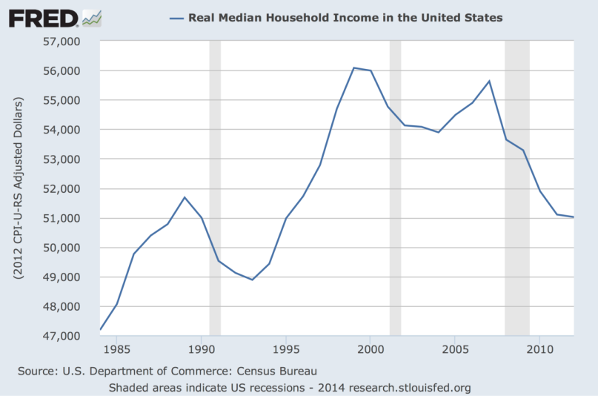
Personal Debt (Financial Bondage)
  1. In 1960:
  Average median income was approximately $6,700 and 8% was paid in direct taxes including Social Security. Home costs amounted to 22% of net income.
  2. In 2014:
  Average median income was approximately $52,200 and 42% was paid in direct federal, social security and state taxes, plus other local (sales, gas, property, and excise taxes). Home costs amounted to 40% of net income.

Slide 5
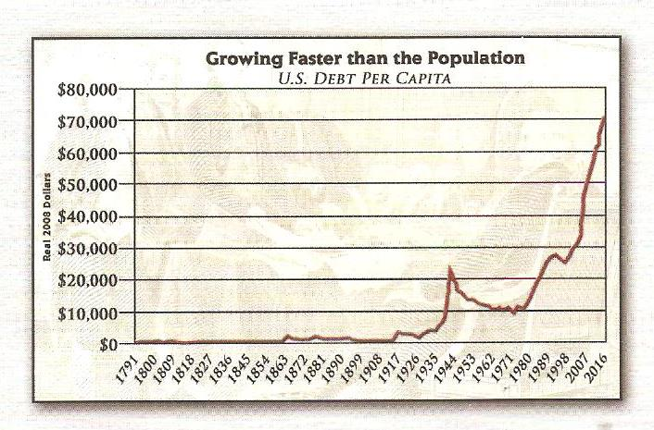

Slide 6

Help!
http://www.usdebtclock.org

Slide 7

https://www.youtube.com/watch?v=bx_LWm6_6tA

Slide 8
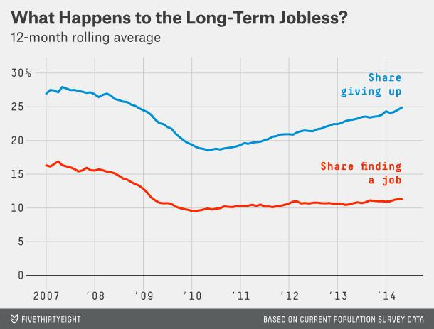
Only about 11 percent of the long-term jobless find jobs each month, little better than in the depths of the recession. Moreover, even those who do find jobs are often able to find only part-time or short-term work.
If they aren’t finding jobs, what’s happening to the long-term unemployed? They’re dropping out of the labor force altogether. As the chart below shows, the share of the long-term jobless who are giving up their job searches has been rising steadily, even as the job-finding rate has remained largely flat. (Not shown on the chart are the more than 50 percent who remain unemployed.)
Many long-term unemployed are simply giving up. More than one-third will be out of the labor force a year later, meaning they’re neither working nor looking for work. Most of them say they no longer even want a job, suggesting they’re unlikely to return to the job market in the future.

Slide 9
FINANCIAL BONDAGE DROWNING IN DEBT
“The Rich rule over the poor, and the borrower becomes the lenders slave.”
- Proverbs 22:7
“If you’re smart, you don’t need debt. If you’re dumb, it’s poisonous.”
- Warren Buffett
“If you’re thrifty you don’t need debt. If you’re stupid, it’s all you’ve got”.
- Prof. Kuhle

Slide 10
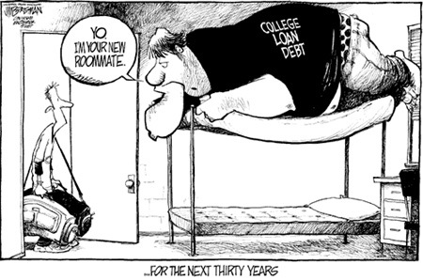

Slide 11
Symptoms of Financial Bondage
1. Overdue Bills
2. Worrying over investments.
3. “Get-Rich-Quick” Attitude; Those who attempt to make money fast usually fail.
4. No desire for gainful employment and a sense of being overwhelmed
5. Being Deceitful; Shading the truth about a financial product you may be selling

Slide 12
Symptoms of Financial Bondage
6. Being Greedy; Always wanting more than you have to the exclusion of family members
7. Trying to keep up with the Jones
8. Not meeting family needs
9. Over commitment to work
10. Financial resentment

Slide 13


Slide 14
Red Flags
Retirement Accounts
  Private retirement accounts are beneficial because they form voluntary savings, and the majority of these funds are reinvested in the economy.
  However, these same funds are an attractive solution to solve the solvency problems of Social Security and Medicare/Medicaid.

Slide 15
Red Flags (continued)
Social Security in 1991:
  $269 billion went to retirement benefits
  $105 billion went to Medicare
  $28 billion went back to the general fund
  Total: $402 billion
  For year 2014--$863 BILLION
  In 1960 there were 14 workers for every retiree. In the year 2014 it will be 1.2 to 1.

Slide 16
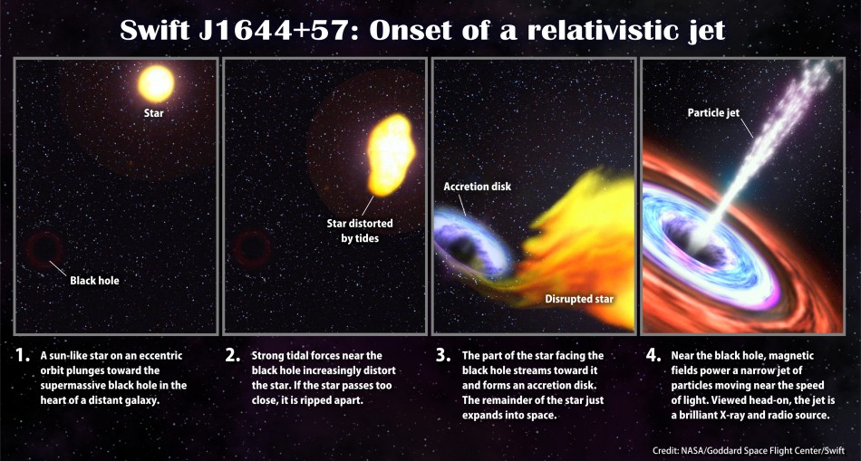
Social Security: Our Black Hole
Black Hole
Social Security is not sustainable over the long term at current benefit and tax rates. In 2010, the program paid more in benefits and expenses than it collected in taxes and other noninterest income, and the 2013 Trustees Report projects this pattern to continue for the next 75 years. The Trustees estimate that the trust fund reserves will be exhausted by 2033. At that point, payroll taxes and other income will flow into the fund but will be sufficient to pay only about 75% of program costs. As reported in the 2013 Trustees Report, the projected shortfall over the next 75 years is 2.72% of taxable payroll. Fast Facts & Figures About Social Security, 2014. What this is basically saying is that the Social Security system is now officially running at a deficit forecasted from now for the next 75 years.

Slide 17
Introduction
I. Typical American
II. Managing Your Financial Affairs
III. Overview of Managing
Process

Slide 18
Introduction (continued)
A. Establish Your Financial
Goals
B. Get Started Now By:
  1. Paying Yourself First
  2. Finding Dollars to Save
  3. Emergency Fund
C. The Power of Compound
Interest--Make it Work for You

Slide 19
Introduction (continued)
D. Buying the Right Life Insurance
E. Beating Uncle Sam
F. Investing for the Future--Using Common Stocks

Slide 20
The Secret of Investing:
Compound Interest
When asked “What is the greatest achievement of human civilization?” Albert Einstein answered, “The greatest achievement of human civilization must be compound interest.” This is the most important thread in the fabric of investing.
The Parable of the Grain of Wheat illustrates the power of compound interest.
Everything we talk about in this course will be related as to how we can harness the power of compound interest.

Slide 21
Let’s say we have two investors, Mr. Bonds and Mr. Stocks. Each has $100,000. Mr. Bonds invests his money in bonds yielding 7%. Mr. Stocks invests his in quality stocks that pay an average of 3% in dividends, however, their appreciation over time, is over 8%. In order for Mr. Stocks to have the same income as Mr. Bonds he must sell part of his portfolio each year. Mr. Stocks will have $111,000 at the end of the first year ($3,000 + $8,000). He has received $3,000 in dividends so he must sell $4,000 to match the income of Mr. Bonds (i.e. $7,000). This will leave Mr. Stocks with a portfolio value of $104,000 instead of $100,000 as Mr. Bonds has. Over a twenty year time period Mr. Stocks portfolio will be worth between $300,000 - $400,000, while Mr. Bonds remains at $100,000. Ah! but someone says, “Yeah, but what if the big one hits and the market crashes.” Well, during the depression of the 1930’s the solvency of many bonds were in serious doubt. Those companies that failed often had nothing to give there bondholders. As the interest payments could no longer be met, many additional bondholders understood what true risk was.

Slide 22
Compound Interest: Another Example
Suppose we have two investors, investor A and investor B. Assume each has $100,000 and can each average 15% per year. Further assume that the investment horizon is 20 years. Assume investor A makes only one trade and holds it for 20 years. Assume investor B, on the other hand, makes just one trade per year and pays the taxes on the capital gains (average of 34%). In twenty years, Investor B will have a portfolio worth approximately $660,000. Investor A’s portfolio will be worth close to $2,000,000. Obviously, the ideal investment is the one which will yield double digit returns in the long-run and one you would not have to sell for liquidity. Therefore, the task is to find the growth company that keeps growing all the way to the twentieth year. Remember, our goal is to maximize the power of compound interest. The only way to do so is to buy and hold for a long time.

Slide 23
The Typical American
American’s save less than 5.0% of their disposable Income. The average for other industrial countries is over 10%.
60% of all retiring Americans do so on $16,000 per year or less.
27% of all retiring Americans do so on income between $16,000 to $20,000.
Only 13% of all retiring Americans retire on an annual income greater than $20,000 per year.
The average death benefit paid in 2013 was $9,850.

Slide 24

THE TAX SYSTEM EXPLAINED IN COFFEE
Suppose that every day, ten men go out for COFFEE AND CONVERSATION and the bill for all ten comes to $100...
If they paid their bill the way we pay our taxes, it would go something like this...
  The first four men (the poorest) would pay nothing.
  The fifth would pay $1.
  The sixth would pay $3.
  The seventh would pay $7.
  The eighth would pay $12.
  The ninth would pay $18.
  The tenth man (the richest) would pay $59.
The ten men drank COFFEE every day and seemed quite happy with the arrangement, until one day, the owner threw them a curve ball. "Since you are all such good customers," he said, "I'm going to reduce the cost of your daily coffee bill by $20". Unlimited coffee for the ten men would now cost just $80.
The group still wanted to pay their bill the way we pay our taxes. So the first four men were unaffected. They would still drink for free. But what about the other six men? How could they divide the $20 windfall so that everyone would get his fair share?
They realized that $20 divided by six is $3.33. But if they subtracted that from everybody's share, then the fifth man and the sixth man would each end up being paid to drink THEIR COFFEE.

Slide 25

THE TAX SYSTEM EXPLAINED IN COFFEE
So, the owner suggested that it would be fair to reduce each man's bill by a higher percentage the poorer he was, to follow the principle of the tax system they had been using, and he proceeded to work out the amounts he suggested that each should now pay.
At a bill of $80, in order to follow the principle of the tax system they had been using, and he proceeded to work out the amounts he suggested that each should now pay.
  Now, the first four men along with the fifth would pay nothing.
  The sixth now paid $2 instead of $3 (33% saving).
  The seventh now paid $5 instead of $7 (28% saving).
  The eighth now paid $9 instead of $12 (25% saving).
  The ninth now paid $14 instead of $18 (22% saving).
  The tenth now paid $49 instead of $59 (16% saving).

Slide 26

THE TAX SYSTEM EXPLAINED IN COFFEE
Each of the six was better off than before. And the first four continued to drink for free. But, once outside the bar, the men began to compare their savings. "I only got a dollar out of the $20 saving," declared the sixth man. He pointed to the tenth man AND SAID, "but he got $10!“ "Yeah, that's right," exclaimed the fifth man. "I only saved a dollar too. It's unfair that he got ten times more benefit than me!“ "That's true!" shouted the seventh man. "Why should he get $10 back, when I only got $2? The wealthy get all the breaks!” "Wait a minute," yelled the first four men in unison, “we didn't get anything at all. This new tax system exploits the poor!” The nine men surrounded the tenth and beat him up.
The next night the tenth man didn't show up for COFFEE AND CONVERSATION so the nine sat down and had their COFFEE without him. But when it came time to pay the bill, they discovered something VERY important. They didn't have enough money between all of them for even half of the bill!

Slide 27
THE TAX SYSTEM EXPLAINED IN COFFEE
And that, my dear students is exactly how our tax system AND how the current administration works. It is called class warfare – pitting the rich against the middle class and poor. The people who already pay the highest taxes will naturally get the most benefit from a tax reduction. Tax them too much, attack them for being wealthy, and they just may not show up anymore. In fact, they might start drinking coffee overseas, where the atmosphere is somewhat friendlier. For those who understand this, no explanation is needed. For those who do not understand, no explanation is possible because you never will get it.

Slide 28
Here is what happened on January 1st 2014:
Top Income Tax bracket went from 35% to 39.6%
Top Income Payroll Tax went from 37.4% to 52.2%
Capital Gains Tax went from 15 % to 28%
Dividend Tax went from 15% to 39.6%
Estate Tax went from 0% to 55%
These taxes were all passed under the Affordable Care Act, otherwise known
as Obama Care.

Slide 29


Taxing the Rich:
Economics or Politics?

Slide 30

Remember Who Pays the Most
Income % of Total Personal Income
Taxes Paid
Top 1% 41%
Top 10% 71%
Top 50% 98%
From 2014 IRS Data

Slide 31
Facts About the National Debt
If you were alive when Jesus Christ was born and you spent one million dollars every single day since that point in time, you still would not have spent one trillion dollars by now.

Slide 32
Facts About the National Debt
It took more than 200 years for the U.S. national debt to reach 1 trillion dollars. In 1986, the U.S. national debt reached 2 trillion dollars. In 1992, the U.S. national debt reached 4 trillion dollars. In 2005, the U.S. national debt doubled again and reached 8 trillion dollars. Now the U.S. national debt is over the 18 trillion dollar mark. How long can this kind of exponential growth go on before a day of reckoning?

Slide 33
Facts About the National Debt
If Bill Gates gave every single penny of his fortune to the U.S. government, it would only cover the U.S. budget deficit for 15 days.

Slide 34
Facts About the National Debt
Today, the government debt to GDP ratio in the United States is well over 100 percent. A recently revised IMF policy paper entitled “An Analysis of U.S. Fiscal and Generational Imbalances: Who Will Pay and How?” projects that U.S. government debt will rise to about 400 percent of GDP by the year 2050.

Slide 35
Facts About the National Debt
The United States already has more government debt per capita ($58,000)
than Greece, Portugal, Italy, Ireland or Spain does. At this point, the United States government is responsible for more than a third of all the government debt in the entire world.

Slide 36
Facts About the National Debt
It is being projected that the U.S. national debt will surpass 23 trillion dollars in 2016. Mandatory federal spending surpassed total federal revenue for the first time ever in fiscal 2011. That was not supposed to happen until 50 years from now.

Slide 37
Facts About the National Debt
Between 2007 and 2010, U.S. GDP grew by only 4.26%, but the U.S. national debt soared by 61% during that same time period.
The U.S. government has total assets of 2.7 trillion dollars and has total liabilities of 18 trillion dollars. The liabilities do not even count 4.7 trillion dollars of intra-governmental debt that is currently outstanding.
U.S. households (as a segment of the economy) are now actually receiving more money directly from the U.S. government than they are paying to the government in taxes.

Slide 38
Facts About the National Debt
The U.S. government is wasting your money on some of the stupidest things imaginable. For example, in 2011 the National Institutes of Health spent $592,527 on a study that sought to figure out once and for all why chimpanzees throw poop.

Slide 39
Facts About the National Debt
The official government debt figure does not even account for massive unfunded liabilities that the U.S. government will be hit with in the years ahead. According to the the U.S. government is facing a future "fiscal gap" of more than 200 trillion dollars.

Slide 40
Facts About the National Debt
Obama care is going to cause our debt to balloon in size as well. It is being projected that Obama care will add more than 2.6 trillion dollars to the U.S. national debt over the first decade alone.
So where are we going to get all this money?
We can't keep spending money that we do not have. We have got to prioritize. Every single category of government spending needs to be cut.
But instead we feel like we can keep ripping off future generations of Americans and that we will always be able to get away with it.
What we have done to our children and our grandchildren is beyond criminal.

Slide 41
Managing Your Own
Financial Affairs
You Have the Ability
  America is still the land of opportunity even with a 42% average tax burden. You have the right to succeed or fail in business and investment.
You Need a Roadmap
  You must have a specific blueprint that outlines and details where you are and where you want to go.
There are Six Fundamental Steps in the Managing Process

Slide 42
The Personal Financial Management Process
Steps:
  1. Establish Your Financial Goals
  2. Get Started Now--
  3. Let Time and Compound Interest Work
  for You
  4. Buy Right Life Insurance
  5. Beat Uncle Sam With a Retirement Plan
  6. Invest for the Future Using Common
  Stocks

Slide 43
1. Establish Your
Financial Goals
How Much Will You Make in Your
Lifetime?
  Income Earnings
  $20,000 $ 800,000
  $25,000 $1,000,000
  $30,000 $1,200,000
  $40,000 $1,600,000
  $60,000 $2,400,000
  $80,000 $3,200,000

Slide 44


A Retirement Example
From This to This
(In forty years)

Slide 45
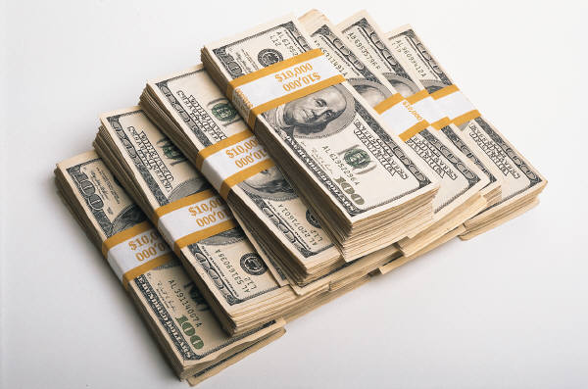
1. Establish Your
Financial Goals (continued)
Assuming an average income of $50,000 per year, how much do you need at retirement?
We make the assumption that you will need approximately 80% of your disposable income upon retirement ($40,000 per year for 20 years).

Slide 46
Establish Your
Financial Goals (continued)
Assume you would like to retire in 40 years on the equivalent of $40,000 in today’s purchasing power.
  1) Assume CPI is equal to 7.04 in 40 years
  (equivalent to 5% inflation)
  2) Therefore your income must be
  $40,000 * 7.04 = $281,600
  3) Assume you want a 20 year annuity at age 65 that
  pays $281,600 per year. You must have $2,103,395.
  4) Therefore, over the next 40 years you must save
  $2,742 per year assuming a return of 12% per year.
  The monthly equivalent is $228.50 or 6.9% of
  disposable income.

Slide 47

Establish Your
Financial Goals (continued)
Sources of Additional Income
  1) Reassess your priorities through a budget
    Disposable Income Less Expenses = Available Discretionary Income
  2) Adjust Your Lifestyle
  3) Earn Additional Income
  4) Realign Your Expenses
  5) Avoid CREDIT

Slide 48
2. Get Started Now
A. Time Value of Money
  $1,000 invested Every Year Has a Value of:
  % 20yrs 30yrs 40yrs
  5% $ 33,066 $ 66,439 $ 120,800
  10% $ 57,275 $ 164,494 $ 442,593
  12% $ 72,052 $ 241,333 $ 767,090
  15% $102,444 $ 434,745 $1,779,090
  20% $186,688 $1,181,882 $7,343,858

Slide 49

2. Get Started Now (continued)
B. Begin Your Savings With a Lump-
Sum
  Assume you started with a $5,000 lump-sum plus $1,000 per year. At 10% after 40 years you would have $668,890.
C. Pay Yourself First
  Take 10% of Your Disposable
  Income and Start a Savings Plan.

Slide 50

2. Get Started Now (continued)
D. Start an Emergency Fund
  Should eventually be the equivalent of 6 months income in a liquid account such as a Money Market Mutual Fund or Capital Growth Fund
E. Savings Priorities
  1) Emergency Fund
  2) Retirement Program
  3) Investment Fund

Slide 51

4. Buy the Right Life Insurance
A. Purpose of Life Insurance
B. What are You Paying For?
C. What Should You Buy?
  Therefore never buy whole life insurance
  Never buy life insurance as an investment
  Buy term insurance

Slide 52
4. Buy the Right Life Insurance
D. Responsibility
  1. High Responsibility:
    a. Dependents
    b. Debt/Credit
    c. Mortgage
    d. Age
  2. Low Responsibility:
    a. Few Dependents
    b. Little Debt
    c. Mortgage Paid
    d. “Golden” Years

Slide 53
4. Buy the Right Life Insurance (continued)
Life Insurance Coverage
High Protection Needs
$
Low Protection Needs
Wealth
25 Age 65

Slide 54
4. Buy the Right Life Insurance (continued)
E. Never Buy Any Kind of Cash Value Insurance
F. Never Buy Life Insurance as an Investment/Income
G. Solution -- Buy Term and Save
the Difference in an IRA

Slide 55
Types of Insurance
1. Term Insurance -- Buy Protection
Only
  Level Premium, decreasing protection
  Rising Premium, level protection
  Rising Premium, decreasing protection
  Features:
    1) Renewable every 5 or (best) 10 years
    2) Convertible into a cash value policy

Slide 56

Protection Profile
$100,000
PROTECTION
25 Age 65

Slide 57
Types of Insurance (continued)
2. Whole Life
  a. Premiums payable to death
  b. Combines protection and savings plan
  c. Provides living (borrowing) and death benefits
  d. Alternatives at retirement:
    Continue protection
    Take cash settlement
    Convert to an annuity

Slide 58
Protection Profile
$100,000
Protection
60%
of
F.V.
Cash Value
25 Age 65

Slide 59
Whole Life Policy vs. Term plus IRA
1. $100,000 whole-life policy costs $1200/yr.
2. Buy 5/10 year renewable, decreasing term
3. Save difference in a Mutual Fund at 6% per year

Slide 60
Whole Life Policy vs. Term plus IRA (continued)
Face Amt. Annual Difference
Age Term Prem. $1200-Premium Estate
25-29 $100,00 $390 $ 810 $104,565
30-34 94,000 362 838 104,832
35-39 88,000 416 784 106,914
40-44 80,000 496 704 109,274
45-49 68,000 600 600 110,550
50-54 52,000 660 540 111,975
55-59 32,000 610 590 115,572
60 -0- -0- 1200 113,020
61-64 -0- -0- 1200 157,984
At age 65: $157,984
All Cash

Slide 61
Whole Life Policy has:
Cash Value = $57,300
Protection = $42,700
Total = $100,000

Slide 62

Beat Uncle Sam With a Retirement Plan
1. Which Plan do you qualify for?
  a. 401K
  b. TSA
  c. IRA
  d. Keogh
  e. 403b

Slide 63

Beat Uncle Sam With a Retirement Plan (continued)
2. Without IRA
  $27,000 Before Tax
  - 6,750 (25% Bracket)
  $20,250 After Tax
  - 2,000 Investment
  $18,250 Spendable Income

Slide 64
Beat Uncle Sam With a Retirement Plan (continued)
3. With IRA
  $27,000 Before Tax
  - 2,000 IRA
  $25,000 Taxable Income
  - 6,250 (25% Bracket)
  $18,750 Spendable Income
  Note: You should never have more than 40% of your retirement wealth in a sponsored government program. The younger you are the less you should have in a government program.

Slide 65
Review Questions:
What are the key factors in establishing investment goals and plans?
Assume you are currently earning $80,000 per year and will retire in 20 years. If you feel you can live on 80% of your salary during retirement and you further assume you will live for 25 years after you retire, how much of a lump sum must you have in 20 years when you retire to meet these goals?
What is the difference between whole life insurance and term insurance?
It is always better to begin a savings plan with a lump-sum and then a consistent periodic investment, why?
Term insurance can be purchased at least three different ways, what are they?
What is the greatest achievement of human civilization?
Explain what the meaning of the parables: 1) The Grain of Wheat and 2) The Master and the Slave.

Slide 66
End of
Topic 3

