Slide 1
ECONOMY

Slide 2
The Cornerstones of Sound Investing
The basic ideas of investing are to
look at stocks as businesses,
use market fluctuations to your
advantage, and
3) seek a margin of safety.
That’s what Ben Graham taught us years ago, and a hundred years from now they will still be the cornerstones of sound investing.

Slide 3
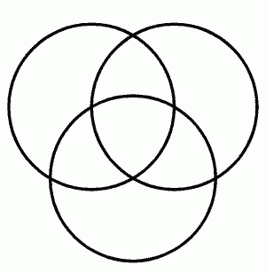
understanding
application
Wisdom
knowledge

Slide 4
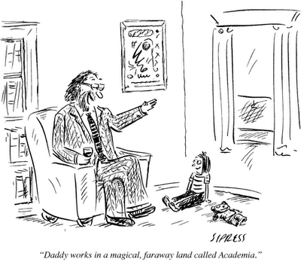
What the Typical Economics Professor Tells His Children

Slide 5
ECONOMICS
Al Jolson - Brother can you spare a Dime - YouTube
“Thrift comes too late when you find it at the bottom of your purse”
- Seneca

Slide 6
Economics
Study of the allocation of scarce resources which include land, labor, and capital (including human)
Assumes Individuals are rational
Assumes Individuals act in self-interest
Unlimited wants, finite resources
Macro and Micro economics
Concept of Adam Smith’s invisible hand

Slide 7
I am for doing good to the poor, but...I think the best way of doing good to the poor, is not making them easy in poverty, but leading or driving them out of it. I observed...that the more public provisions were made for the poor, the less they provided for themselves, and of course became poorer. And, on the contrary, the less was done for them, the more they did for themselves, and became richer.

Slide 8

The Economy in 50 Words

Slide 9
“A wise and frugal government, which shall leave men free to regulate their own pursuits of industry and improvement, and shall not take from the mouth of labor the bread it has earned – this is the sum of good government.”
-Thomas Jefferson

Slide 10
“Specie [gold and silver coin] is the most perfect medium because it will preserve its own level; because, having intrinsic and universal value, it can never die in our hands, and it is the surest resource of reliance in time of war.” ~Thomas Jefferson to John Wayles Eppes, 1813

Slide 11
“Paper is poverty,… it is only the ghost of money, and not money itself.”~ Thomas Jefferson in a Letter to Edward Carrington, 1788

Slide 12
The $5,000 bill featuring a portrait of President James Madison went into press and circulation in 1934 and remained legal tender for public use until 1969.
It cannot be doubted that a paper currency, rigidly limited in its quantity to purposes absolutely necessary, may be made equal and even superior in value to specie. But experience does not favor a reliance on such experiments. Whenever the paper has not been convertible into specie, and its quantity has depended on the policy of Government, a depreciation has been produced by an undue increase, or an apprehension of it.
-James Madison
Chief architect of the Constitution

Slide 13
The Cause of the 2008 Financial Crisis
GO TO: http://crisisofcredit.com/
Debt

Slide 14




Pension Fund has $1B to lend
10% interest
GM needs to borrow $1 billion
How can we make a deal?
$1 Billion
The Pension Fund can only invest in AA rated and above.
GM is only rated BB by Moody’s
GM pays AIG 1% for insuring the loan
AIG has a AA rating and agrees to insure the payments.
CREDIT DEFAULT SWAP (CDS)
Notes:
General Motors needs to borrow $1 Billion and the CALPERS Pension fund has the $1 Billion to loan. The problem is that GM only has a BB credit rating from Moody’s and CALPERS can only buy securities of firms & institutions that have a AA rating or higher. So how can GM borrow the money. They can actually SWAP their loan for a CREDIT DEFAULT insurance policy offered by AIG. In effect the rating on the loan becomes that of AIG since they have insured it. See if you can spot the fatal error in this type (CREDIT DEFAULT SWAP) that can create added risk.

Slide 15
Economy

Slide 16
Economics
Production Possibility Frontier
The PPF represents the point where an economy is most efficiently producing it’s goods and services, and hence allocating it’s resources most efficiently.
The PPF indicates that there are limits to production, so a society must decide which combination of goods and services it must produce in order to maximize benefits (satisfaction or utility) for the entire society.

Slide 17
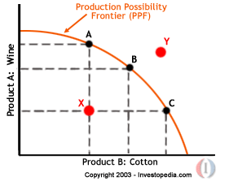
Production Possibility Frontier
Notes:
Points A, B, and C are achievable points of production for this country. Point Y is not achievable because this country does not have the resources to get to point Y at this time. The combination of wine and cotton which will ultimately be produced is a function of that country’s policy and demand for those products in the world market.

Slide 18
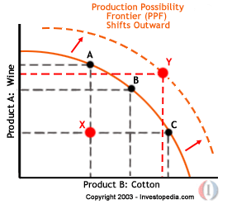
Production Possibility Frontier
Notes:
Points A, B, and C are achievable points of production for this country. Point Y is not achievable because this country does not have the resources to get to point Y at this time. The combination of wine and cotton which will ultimately be produced is a function of that country’s policy and demand for those products in the world market. The only way to get tp Y is through investing and producing more.

Slide 19
Production Possibility Frontier
Opportunity Cost: this is the value of what is foregone in the way of goods and services produced, when we decide to produce or purchase something else.

Slide 20
Production Possibility Frontier
Specialization and Comparative Advantage:
If a country (or company) focuses on producing many of the goods and services it needs it may be “sub- optimizing.” By specializing in one thing it can focus on what it does best and use their resources more efficiently. This can lead to a comparative advantage for a country and a company under various circumstances.

Slide 21
Production Possibility Frontier
Absolute Advantage:
An absolute advantage occurs when a
country or company has better quality
resources or a technological advantage
over its competitors.

Slide 22
Production Possibility Frontier
Absolute Advantage:
An absolute advantage occurs when a
country or company has better quality
resources or a technological advantage
over its competitors.

Slide 23
Social Security
Social Security may look different than you imagine. Expect to see these changes in the coming years:
--Raising the Social Security retirement age. This will happen to those further away from collecting benefits. It has to. We are all living longer. Expect full and partial benefit collection ages to be moved back three to five years.
--Means testing. This is so logical it’s hard to understand why it isn't being done already. Those individuals fortunate enough to generate a significant amount of income during their retirement years will not be eligible to collect a Social Security benefit. Remember, the Social Security program was started as a safety net and was not meant to be an integral part of every American's retirement program.

Slide 24
Social Security
--Incentives to continue working. Most experts agree that the majority of baby boomer retirees will need to work during their retirements. We just haven't saved enough. Eliminating the Social Security payroll tax of 12.4% for older workers and removing the earnings test for early retirees are two changes likely to be made.
--Longevity indexing. Since we are all living longer, adjusting our Social Security benefits to account for our longer life spans is an idea likely to gain traction. Longevity indexing is a nice way of saying that monthly benefits will probably be lower for all of us.
--Adjustments to the payroll tax. There are employer- and employee-paid components of the Social Security payroll tax. There is also a limit on the amount of compensation taxed. Eliminating the compensation cap and/or increasing the rate are adjustments that may be made. This could mean less take home pay for many during their earning years.

Slide 25
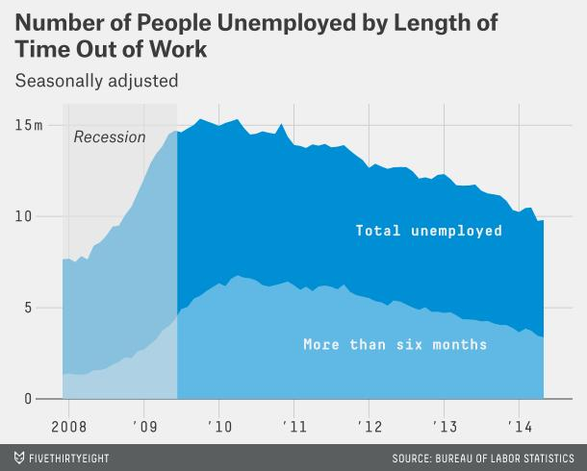
6/5/14
The recovery reached a milestone in May: The U.S. economy finally has more jobs than when the recession began in December 2007.
But don't get too excited, though. This was, at best, a symbolic achievement. The U.S. has added 6 million working-age adults since 2007. Adjust for population growth and we've seen hardly any recovery at all. And while employment may be back to prerecession levels, unemployment isn't even close.

Slide 26
Definition
To insure the uninsured we first make the insured uninsured and then make them pay more to be insured again so the original uninsured can be insured for free.

Slide 27


Slide 28
The Solar thing just got a little more
interesting... REALLY!
The Tonopah Solar Company in Harry Reid's Nevada is getting a $737 million loan from Obama's D.O.E.
The Project will produce a 110 Megawatt Power System, and employs l45 Permanent Workers.
That's costing us just $16 million per Job.
One of the Investment Partners in this endeavor is
Pacific Corporate Group (PCG).
The PCG Executive Director is Ron Pelosi, who
is the brother to Nancy 's Husband.
Brought to you by the MOST Transparent Administration ever, HA-HA.
EVERY AMERICAN SHOULD KNOW HOW THEIR MONEY IS BEING STOLEN.
I do not like this kind of HOPE!
I do not like it, NOPE, NOPE, NOPE.

Slide 29
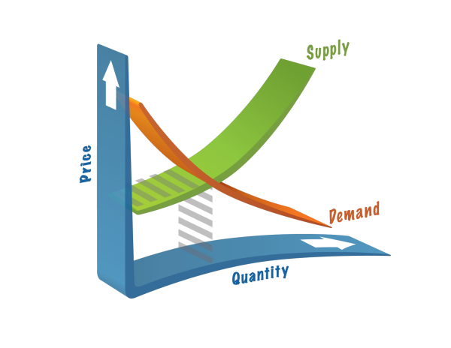
Demand: refers to how much of a product or service is desired by buyers.
Supply: refers to how much of a product or service the market can offer.
Notes:
The law of demand states that, if all other factors remain equal, the higher the price of a good, the less people will demand that good. In other words, the higher the price, the lower the quantity demanded.
The law of supply demonstrates the quantities that will be sold at a certain price. But unlike the law of demand, the supply relationship shows an upward slope. This means that the higher the price, the higher the quantity supplied. Producers supply more at a higher price because selling a higher quantity at a higher price increases revenue.
Time is important to supply because suppliers must, but cannot always, react quickly to a change in demand or price.

Slide 30
Equilibrium
When supply and demand are equal (i.e. when the supply function and demand function intersect) the economy is said to be at equilibrium. At this point, the allocation of goods is at its most efficient because the amount of goods being supplied is exactly the same as the amount of goods being demanded. Thus, everyone (individuals, firms, or countries) is satisfied with the current economic condition. At the given price, suppliers are selling all the goods that they have produced and consumers are getting all the goods that they are demanding.

Slide 31
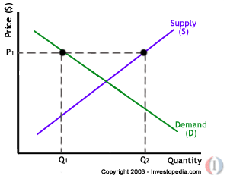
Supply and Demand
Disequilibrium
Disequilibrium occurs whenever the price or quantity is not equal to P* or Q*.
At price P1 the quantity of goods that the producers wish to supply is indicated by Q2. At P1, however, the quantity that the consumers want to consume is at Q1, a quantity much less than Q2. Because Q2 is greater than Q1, too much is being produced and too little is being consumed. The suppliers are trying to produce more goods, which they hope to sell to increase profits, but those consuming the goods will find the product less attractive and purchase less because the price is too high.

Slide 32
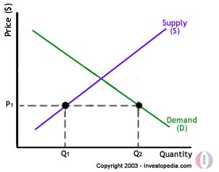
Supply and Demand
Excess Demand
Excess demand is created when price is set below the equilibrium price. Because the price is so low, too many consumers want the good while producers are not making enough of it. In this situation, at price P1, the quantity of goods demanded by consumers at this price is Q2. Conversely, the quantity of goods that producers are willing to produce at this price is Q1. Thus, there are too few goods being produced to satisfy the wants (demand) of the consumers. However, as consumers have to compete with one other to buy the good at this price, the demand will push the price up, making suppliers want to supply more and bringing the price closer to its equilibrium.

Slide 33
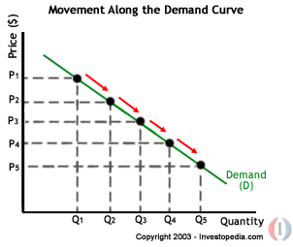
Supply and Demand
Movement
A movement refers to a change along a curve. On the demand curve, a movement denotes a change in both price and quantity demanded from one point to another on the curve. The movement implies that the demand relationship remains consistent. Therefore, a movement along the demand curve will occur when the price of the good changes and the quantity demanded changes in accordance to the original demand relationship. In other words, a movement occurs when a change in the quantity demanded is caused only by a change in price, and vice versa.

Slide 34
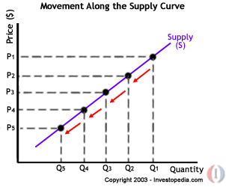
Supply and Demand
Like a movement along the demand curve, a movement along the supply curve means that the supply relationship remains consistent. Therefore, a movement along the supply curve will occur when the price of the good changes and the quantity supplied changes in accordance to the original supply relationship. In other words, a movement occurs when a change in quantity supplied is caused only by a change in price, and vice versa.

Slide 35
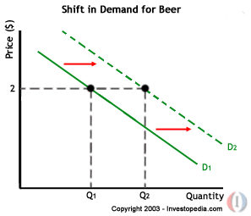
Supply and Demand
Shift
A shift in a demand or supply curve occurs when a good's quantity demanded or supplied changes even though price remains the same. For instance, if the price for a bottle of beer was $2 and the quantity of beer demanded increased from Q1 to Q2, then there would be a shift in the demand for beer. Shifts in the demand curve imply that the original demand relationship has changed, meaning that quantity demand is affected by a factor other than price. A shift in the demand relationship would occur if, for instance, beer suddenly became the only type of alcohol available for consumption.

Slide 36
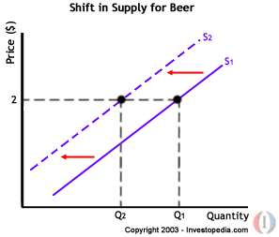
Supply and Demand
Conversely, if the price for a bottle of beer was $2 and the quantity supplied decreased from Q1 to Q2, then there would be a shift in the supply of beer. Like a shift in the demand curve, a shift in the supply curve implies that the original supply curve has changed, meaning that the quantity supplied is effected by a factor other than price. A shift in the supply curve would occur if, for instance, a natural disaster caused a mass shortage of hops; beer manufacturers would be forced to supply less beer for the same price.

Slide 37
Elasticity
The degree to which a demand or supply curve reacts to a change in price is the curve's elasticity. Elasticity varies among products because some products may be more essential to the consumer. Products that are necessities are more insensitive to price changes because consumers would continue buying these products despite price increases. Conversely, a price increase of a good or service that is considered less of a necessity will deter more consumers because the opportunity cost of buying the product will become too high.

Slide 38

A good or service is considered to be highly elastic if a slight change in price leads to a sharp change in the quantity demanded or supplied. Usually these kinds of products (commodity type products) are readily available in the market and a person may not necessarily need them in his or her daily life. On the other hand, an inelastic good or service is one in which changes in price witness only modest changes in the quantity demanded or supplied, if any at all. These goods tend to be things that are more of a necessity to the consumer in his or her daily life.
HIGHLY ELASTIC

Slide 39
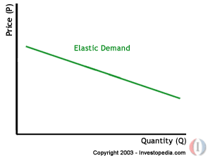
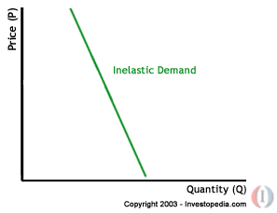
The demand curve is a negative slope, and if there is a large decrease in the quantity demanded with a small increase in price, the demand curve looks flatter, or more horizontal. This flatter curve means that the good or service in question is elastic.
Meanwhile, inelastic demand is represented with a much more upright curve as quantity changes little with a large movement in price.
Elastic
Inelastic

Slide 40
2. Amount of income available to spend on the good - This factor affecting demand elasticity refers to the total a person can spend on a particular good or service. Thus, if the price of a can of Coke goes up from $1 to $1.25 and income stays the same, the income that is available to spend on coke, which is $3, is now enough for only two rather than three cans of Coke. In other words, the consumer is forced to reduce his or her demand (consumption) of Coke. Thus if there is an increase in price and no change in the amount of income available to spend on the good, there will be an elastic reaction in demand; demand will be sensitive to a change in price if there is no change in income.

Slide 41
3. Time - The third influential factor is time. If the price of cigarettes goes up $2 per pack, a smoker with very few available substitutes will most likely continue buying his or her daily cigarettes. This means that tobacco is inelastic because the change in price will not have a significant influence on the quantity demanded. However, if that smoker finds that he or she cannot afford to spend the extra $2 per day and begins to kick the habit over a period of time, the price elasticity of cigarettes for that consumer becomes elastic in the long run.

Slide 42
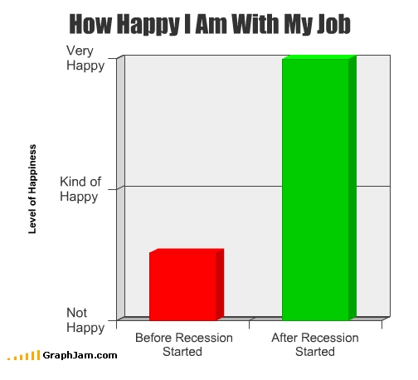
Utility
Utility is an abstract concept rather than a concrete, observable quantity. The units to which we assign an “amount” of utility, therefore, are arbitrary, representing a relative value. Total utility is the aggregate sum of satisfaction or benefit that an individual gains from consuming a given amount of goods or services in an economy. The amount of a person's total utility corresponds to the person's level of consumption. Usually, the more the person consumes, the larger his or her total utility will be. Marginal utility is the additional satisfaction, or amount of utility, gained from each extra unit of consumption

Slide 43

Although total utility usually increases as more of a good is consumed, marginal utility usually decreases with each additional increase in the consumption of a good. This decrease demonstrates the law of diminishing marginal utility. Because there is a certain threshold of satisfaction, the consumer will no longer receive the same pleasure from consumption once that threshold is crossed. In other words, total utility will increase at a slower pace as an individual increases the quantity consumed.

Slide 44
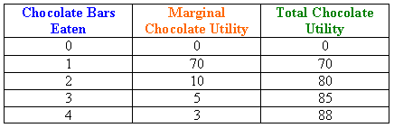
Take, for example, a chocolate bar. Let's say that after eating one chocolate bar your sweet tooth has been satisfied. Your marginal utility (and total utility) after eating one chocolate bar will be quite high. But if you eat more chocolate bars, the pleasure of each additional chocolate bar will be less than the pleasure you received from eating the one before - probably because you are starting to feel full or you have had too many sweets for one day.
This table shows that total utility will increase at a much slower rate as marginal utility diminishes with each additional bar. Notice how the first chocolate bar gives a total utility of 70 but the next three chocolate bars together increase total utility by only 18 additional units.

Slide 45

The Personal Investment Process (In Theory)
  Consumption and Utility
U(Co)
Co
(Consumption)

Slide 46
Current Consumption
vs. Future Consumption
C1
C11
A
B
I3
C
I2
C12
I1
C0
C01
C02
Points A, B, and C on I₁ all provide the individual with the same total utility of consumption.
  Therefore: U(C11 + C01) = U(C12 + C02)

Slide 47
Current Consumption and Investment depend on:
  - Current Consumption Utility
  - Future Consumption Utility
  - Future Expected Income
  - The Investment Rate of Return
  - The Investment Risk

Slide 48
The GOAL of an Investor...
... is to MAXIMIZE the total of all
present and future UTILITY
derived from current and
future consumption. This means
investing for maximum return (double digit).

Slide 49
Review
Economics is best described as the study of humans behaving in response to having only limited resources to fulfill unlimited wants and needs.
Scarcity refers to the limited resources in an economy. Macroeconomics is the study of the economy as a whole. Microeconomics analyzes the individual people and companies that make up the greater economy.
The Production Possibility Frontier (PPF) allows us to determine how an economy can allocate its resources in order to achieve optimal output. Knowing this will lead countries to specialize and trade products amongst each other rather than each producing all the products it needs.

Slide 50
Review
Demand and supply refer to the relationship price has with the quantity consumers demand and the quantity supplied by producers. As price increases, quantity demanded decreases and quantity supplied increases.
Elasticity tells us how much quantity demanded or supplied changes when there is a change in price. The more the quantity changes, the more elastic the good or service. Products whose quantity supplied or demanded does not change much with a change in price are considered inelastic.
Utility is the amount of benefit a consumer receives from a given good or service. Economists use utility to determine how an individual can get the most satisfaction out of his or her available resources.

Slide 51
Review
Market economies are assumed to have many buyers and sellers, high competition and many substitutes. Monopolies characterize industries in which the supplier determines prices and high barriers prevent any competitors from entering the market. Oligopolies are industries with a few interdependent companies. Perfect competition represents an economy with many businesses competing with one another for consumer interest and profits.

