Slide 1
Navigating the New Standards
Judi Kusnick
Sacramento State University
kusnickje@csus.edu

Slide 2
Where can I find all the materials from this workshop?
http://www.csus.edu/indiv/k/kusnickj/index.html
Look for the link to Holy Trinity Standards training -But not until Monday!

Slide 3
Lots of new standards
Common Core – ELA (CCSS – ELA)
Common Core – Math (CCSS – Math)
Next Generation Science Standards (NGSS)
English Language Development

Slide 4
Intersections
Sense-making
Constructing explanations
Arguing from evidence
Expository reading and writing in the service of learning
Student talk

Slide 5
Or more simply…
Kids figure things out and justify their thinking.
Kids communicate their thinking confidently and effectively.

Slide 6
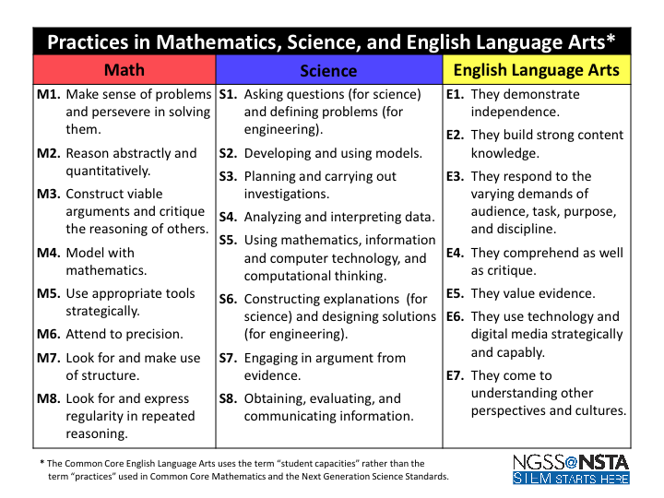

Slide 7
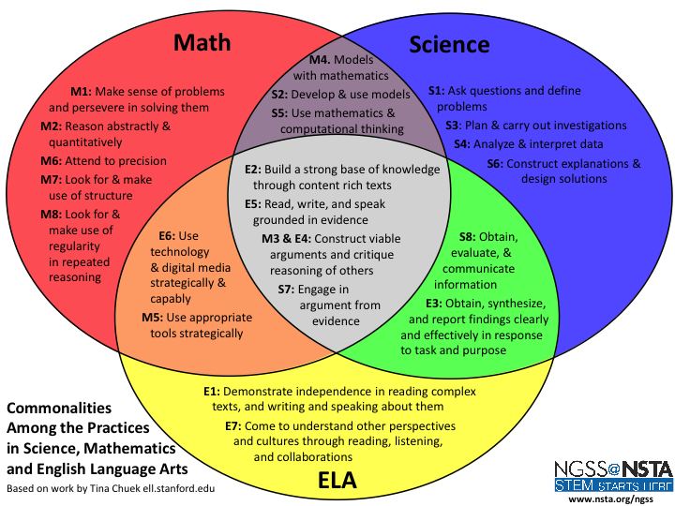

Slide 8
Today’s goals
Experience what instruction based around sense-making feel like.
See some tools for stimulating student thinking and writing
Use some tools for managing student talk
So most of our session will be doing some exemplary lessons, and then debriefing them.

Slide 9
A bit about talk
In traditional classrooms, teachers talk and students listen.
Lots of evidence now tells us that’s not the most effective path to student learning
In the new standards world, teachers need to talk differently, and need to be skilled in managing productive student talk.
So pay attention to how I’m talking and how I’m managing how you are talking.

Slide 10
Now let’s do some sense-making in science

Slide 11
What’s our goal here?
Provide an example of a science lesson where kids figure stuff out, with literacy and dialogue strategies integrated throughout.
Provide a sample of teacher talk that encourages student engagement.
Give you some ideas for inserting strategies that address Common Core standards (S&L, R, W) and engaging science strategies into your lessons.

Slide 12
Rules of Engagement
Be considerate and respectful in language and tone.
Make sure everyone has a chance to express their ideas.
Begin speaking by paraphrasing what the last speaker said, then transition to your comments.
Try not to steal anyone’s “Aha!” moment by telling them your answers—instead, ask questions that will help guide the person to these ideas.
Notes:
3 minutes in

Slide 13
Let’s try it.
Groups of 4 people.
Read the Doogie & Kyle scenario
Think silently about their ideas. Who do you agree with more?
Notes:
3 minutes to read and think
2 mins for instructions

Slide 14
Time to process
We’ll use a Structured Think Pair Share protocol
Draw a chart like this:
THINK
PAIR
Listen to your partner and record their ideas here.
Your ideas go here.
SHARE
Talk with your partner to come to some common understanding, and write your joint ideas here.
Notes:
12:55

Slide 15
Preassessment: Agree/Disagree
Find your Thinking About Electricity handout.
Read each statement. Mark agree, disagree, it depends or not sure.
Then write a short sentence about your thinking.
Do all three statements without discussion.

Slide 16
Paraphrase Passport
First person talks for one minute.
Next person paraphrases, then talks about their own idea.
Continue around the circle (paraphrase ONLY the person before you, NOT the whole circle)
When it comes back to the first person, she paraphrases the last person.
Notes:
5 mins.
15 mins in.

Slide 17
Reactions to paraphrasing?
Reactions to A&D?

Slide 18
Now let’s investigate
Batteries and Bulbs handout
First, assign roles in the group of 4.
  Recorder/Reporter
  Questioner
  Materials Manager/Resource Monitor
  Facilitator/Encourager
Explicit roles increase participation and equity.
Notes:
2 mins.

Slide 19
Ready to explore!
Your group will get two bags, one per pair. Please do not pool the two bags for the whole group yet. Each bag has:
  2 batteries
  2 holiday lights
  1 piece of wire
Your job: figure out what the rules are in lighting up the light bulbs.
You have 10 minutes to work.
Record the rules on your whiteboard.
Notes:
3 mins to explain – 20 mins in.

Slide 20
Remember…
Resource Monitor/ Materials Manager gets the stuff and tidies up.
Recorder/Reporter (or their designee) writes your rules on the whiteboard and reports for the group (or designates someone)
Facilitator makes sure everyone gets to handle the materials, and that everyone is contributing.
Questioner asks the group questions to keep the inquiry on track.

Slide 21
What rules did we find?
One end of the wire on positive end and one end on the negative side of the battery | Circular pathway from battery through wire to light bulb through wire to battery
Has to be touching metal to metal | Battery must be working
Light bulb cannot be burnt out | More batteries for more bulbs
Wire to connect from light bulb to battery | One strand of wire worked as well as the entire strand The more batteries, the brighter the bulb
Notes:
5 min debrief – 30 mins in.

Slide 22
Now you get to ask the question
Think about the Doogie & Kyle problem:
  One string of lights was plugged in but no bulbs lit up.
  One string had all the bulbs but one lit up.
  Kyle thought a broken bulb made the whole string not light up
  Doogie thought the electricity in the dark string had gotten used up.
Notes:
5 mins for instructions

Slide 23
Ask a question that will help us solve this problem
You can use the materials you have plus:
  More bulbs
  More batteries
  Different sizes of batteries
  Extra wire
  ???? Whatever we can scrounge
On half your whiteboard, write your question and draw the experiment you plan to run. Show it to me to get your new stuff.

Slide 24
As you experiment…
Record your observations on the other half of the board.
Write a first-draft explanation of what you think is happening.
Remember, everyone gets to use the materials and contribute ideas.
You have 10 minutes to play.
Notes:
45 mins in

Slide 25
What can we add to our rules now?
Notes:
5 min – 50 mins in

Slide 26
Now let’s do some reading
Find your text on series and parallel circuits.
Feel free to use the highlighters as you read.
Look for answers to these questions:
  How are the wires arranged in each kind of circuit?
  Does the electricity travel all on the same path or on different paths?
  What happens if a light bulb in the circuit burns out?
Notes:
5 mins to read

Slide 27
Now let’s process the reading
In your group, use the graphic organizer to sort out these ideas:
  Things that are true of just series circuits
  Things that are true of just parallel circuits
  Things that are true of both kinds of circuits
Notes:
5 mins to do GO – 60 mins in

Slide 28
Did you already make each kind of circuit?
In your group make one series circuit with more than one light bulb.
In your group, make one set of parallel circuits with more than one light bulb.
Are all the rules the same for both kinds of circuits?
Notes:
DON”T DO THIS – just show it to them

Slide 29
Now we’re ready to school Doogie and Kyle
Write a letter to Doogie and Kyle solving their problem with the holiday lights.
Use the graphic organizer to build your arguments.
We’re not going to write the final letter – just talk it through in your group.
Notes:
5 mins.

Slide 30
Now let’s deconstruct the lesson
Engaging Science
Productive Dialogue
Purposeful Reading
Meaningful Writing

Slide 31
Deconstructing the Lesson
Engaging Science | Productive Dialogue | Purposeful Reading | Meaningful Writing
Context in real life problem | Roles | Graphic Organizer | Graphic Organizer
Anticipatory set (A&D) to activate prior knowledge | Rules of engagement | Guiding questions | Persuasive writing
Guided inquiry (student-centered discourse) | Structured Think-Pair-Share | Informational text | Arguments with evidence
I do one, you do one | Paraphrase Passport | Text-based evidence | Writing to learn as well as formal writing

Slide 32
Now let’s think about this lesson, NGSS & CCSS
Find your Practices handout.
Which of the practices did you do in this lesson?

Slide 33
Finally let’s think about the teacher talk in this lesson

Slide 34
Traditional teacher talk
Initiation-Response-Evaluation
  Maya, what’s the capital of South Dakota?
  Pierre?
  Good
What is IRE good for?
  Controlling discourse
  Keeping the conversational floor
What is IRE NOT good for?
  Encouraging expansive student talk
  Opening up the conversation

Slide 35
What was the teacher talk like during Batteries and Bulbs?
Sometimes no talk – just eavesdropping on student talk
Sometimes observations rather than questions
Sometimes questions the teacher doe not already know the answer to
Praise for thinking rather than correct answers

Slide 36
Next Up – Social Studies lesson
What does it look like when kids figure stuff out from text?
Ideas for processing reading
Integrating reading, dialogue and writing

Slide 37
A conversation
Ariel and Yesina are reading about the Gold Rush and its effects on California
Ariel: I’m really glad they discovered gold in California. If there had been no Gold Rush in California, it would be really different than it is today.
Yesina: I agree it would be different, but I think California might have been a better place to live if the Gold Rush never happened.

Slide 38
Give One, Get One
Let’s brainstorm some ideas about the issue that Ariel and Yesi raise.
On the top row of your Give One, Get One form, write three ideas you have about how the Gold Rush made California a better or worse place to live.
Now you will find three eye-contact partners to swap ideas with.

Slide 39
Now let’s read
Find your Gold Rush text and the Text Dependent Questions handout.
Read p. 241 using the Summary Protocol:
  Everyone reads the first paragraph silently.
  The first person leads the group in summarizing that paragraph in one sentence.
  Read the next paragraph silently.
  The next person leads the summary discussion.
  Continue to the end of the page.
  The product should be a written summary that the group has agreed upon.

Slide 40
Now the text-dependent questions
As a group, answer the first four questions (Remembering, Understanding, Applying and Analyzing).
Use the Summary Protocol to read p. 255.
As a group, answer the last question (Evaluating). Use the Talking Stick Protocol:
  Everyone puts a pen in the middle of the table.
  To talk, pick up your pen, talk, and put your pen in front of you.
  No one talks for a second time until all the pens have been picked up.
  Then you can have an unstructured discussion.

Slide 41
Writing Piece
Yesi and Ariel think that their local history museum needs more information about how the Gold Rush affected the different groups of people who lived here.
Imagine you are a descendent of someone who lived through the Gold Rush – you can choose whatever ethnicity you would like for this assignment.
Write a paragraph that the museum could use in their exhibit about how the Gold Rush affected your ancestor.

Slide 42
Deconstruct!
What ELA student capacities does the lesson address?
What dialogue strategies did you see?
What reading strategies did you see?
What writing strategies?

Slide 43
Structuring formal writing:
Communication Triangle
In the real world, every piece of expository writing has:
  Author with a real-life role
  Audience with a real-life need
  Format for delivering the information
Think about these kinds of writing and identify the role of the writer, the need of the audience, and the format:
  Morning newspaper
  Environmental Impact Report
  Text message on your phone

Slide 44
Informal writing (writing to learn)
Challenge Statement –
asks student to take a stance and supply evidence

Slide 45
Agree/Disagree – NOT just a true/false question
How can you find out?
Odd One Out – NOT just a multiple choice question

Slide 46
Now a little math…
Let’s help Rosa with her table problem.

Slide 47
Rosa needs a way to predict how many seats she will need for any particular number of triangular tables stuck together.

Slide 48
Task #1: Counting seats
Everybody gets their own problem – you get the number of tables, and you count how many seats it will take.
Pay attention to how you are counting the seats.
Post your Table/Seat slips on the top of your chart paper.
Let’s find out how many different ways of counting people used.

Slide 49
How did you count?

Slide 50
Task #2: Finding a pattern
Do you see a pattern in the number of seats? Why do you think that pattern occurs?
Structured Think-Pair-Share
Talking Stick – discuss in your group
If you want to revise your thinking, write your new ideas in that box.

Slide 51
Testing your pattern
Choose 1, 2, or 3 more tables from your group’s envelope.
You will add these tables to your long row, but first…
PREDICT how many seats you new longer row will take.
Now count. Was your prediction right?
In your group – add your group’s explanation of the pattern to your chart paper.

Slide 52
Task #3 Writing an Equation
T = the number of tables
S = the number of seats
Write an equation that describes the pattern. Put it on the bottom of the chart paper.

Slide 53
Task #4: Bigger Tables
Can you predict how many seats will fit on a wider table shaped like this as you make it longer?
Write an equation for your prediction.
Does it make a difference if you put the tables this way?

Slide 54
Help Rosa communicate with her employees
Now that Rosa has a way to predict how many seats to use with any number of tables, she needs a way to communicate this to her employees. She would like them to know the reasoning as well, so they are more likely to use the rule.
Make a sign for Rosa’s storage room that tells employees how many seats to use, and explains why it will work.

Slide 55
Let’s deconstruct one last time.
What standards of mathematical practice did we address?
What ELA standards did we address?
What tools did we use to manage student talk?

Slide 56
Where can I find all the materials from this workshop?
http://www.csus.edu/indiv/k/kusnickj/index.html
Look for the link to Holy Trinity Standards training -But not until Monday!
For Science in the River City workshops:
http://www.csus.edu/mase

