Slide 1
Card Tricks, Game Shows and how to look like you have ESP
Math Club Talk
December 4, 2013
Michelle Norris
CSUS Department of Mathematics and Statistics

Slide 2
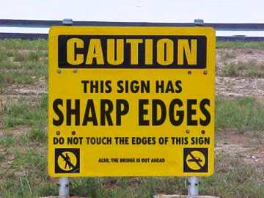

Slide 3
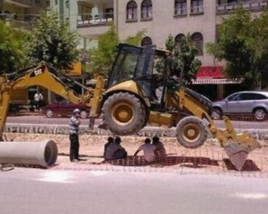
Nothing as mundane as safety should interfere with a tea break

Slide 4
Funny opening joke
Q: How many mathematicians does it take to screw in a light bulb?
A1: None. It's left to the reader as an exercise.
A2: None. A mathematician can't screw in a light bulb, but he can easily prove the work can be done.

Slide 5
Outline
Brainteasers
3-cards trick
5 coins trick
Detecting real sequences of coin flips
Markov chain sequence trick
Monty Hall problem
Detecting real sequences of coin flips, Part II

Slide 6
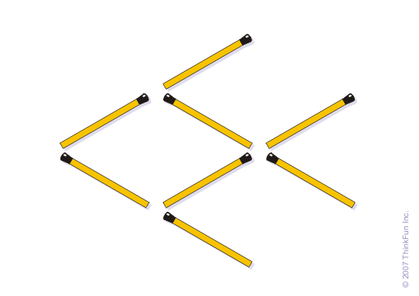
Brainteaser 1
Make the fish swim in the opposite direction by moving only 3 matchsticks

Slide 7
Brainteaser 2
You have sealed the ninth of nine identical parcels of precisely equal weights, only to discover that your diamond ring has accidentally fallen into one of the packages. You don’t want to unwrap every parcel. Can you work out how to find the parcel containing the ring with just two weighings on a balance scale?

Slide 8
Brain Teaser 3
You will be given 12 toothpicks. You need to make corrals to enclose 6 farm animals. Each animal must have its own corral and be fully enclosed. Is this possible? (You aren’t allowed to break the toothpicks and toothpicks must be placed end-to-end.)

Slide 9
Card Trick
I will demonstrate a card trick
Try to figure out why the trick works

Slide 10
Try the Card Trick
Student 1 picks out 3 cards, writes them down, keeps them
With remaining cards, student 2 makes stacks of 14,15,15 and 5 cards from left to right (face down)
Student 1 places one card on the stack of 14, cuts the next stack to stack 1 and places the next card on stack 2. Then cuts stack 3 to stack 2 and puts the last card on stack 3
Student 2 stacks rightmost pile on top of 2nd to rightmost pile, and continues this stacking to the left
Student 2 divides card – up, down, up, down…
Keep dividing “down” pile until there are 3 cards left

Slide 11
Why does the card trick work?
Give hints.
  BUY MORE DECKS OF CARDS, TAKE OUT JOKERS

Slide 12

Coin trick
Toss 5 coins. While the magician is looking away
  flip as many pairs of coins as you want
  cover any single coin with your hand
  I will guess the covered coin
Try to figure out why it works
You try the coin trick in pairs.

Slide 13
Detecting Real sequences of coin flips
Split the participants into 4 groups. After I leave the room,
  2 groups each make up a “fake” sequence of 100 coin flips
  2 groups toss coins to get actual sequence of 100 coin flips
Use 0=tails and 1=heads, each group writes their sequence on the board without identifying how it was constructed.
Come get me and I will identify which sequences are real and which are fake.

Slide 14
Sequence trick
Randomly generated order for two shuffled decks of cards:
"Q" "K" "5" "6" "2" "K" "7" "5" "J" "2" "J" "7" "Q" "7" "8"
"2" "K" "4" "7" "4" "Q" "J" "4" "A" "K" "3" "7" "3" "4" "Q"
"9" "10" "6" "6" "3" "10" "7" "5" "5" "10" "2" "5" "8" "8" "2"
"3" "9" "J" "A" "3" "5" "4" "A" "2" "3" "A" "9" "K" "J" "Q"
"6" "6" "8" "A" "8" "Q" "10" "8" "2" "10" "A" "K" "9" "J" "10"
"2" "Q" "J" "J" "8" "8" "5" "7" "A" "6" "7" "4" "4" "A" "9"
"9" "10" "K" "K" "4" "10" "Q" "3" "9" "5" "9" "6" "3" "6"
Start by choosing a random number,n, between 1 and 6. This is the card you start with in the sequence.
Find the nth card and note its value (J,Q,K count as 10 and Aces are 1), move that many cards down the list to get your next card, note the value of this card and move that many cards down the list to get the next card
Keep repeating this process until you move off the end of the list, your “score” is the value of the last card before you moved off the list. Remember your score.
Why does this trick work?

Slide 15
The Monty Hall Problem
From the game show Let’s Make a Deal which aired in the 1970’s
How to play:
http://www.grand-illusions.com/simulator/montysim.htm
Is it better to switch doors or stay with the original door chosen?

Slide 16
Play the Monte Hall Game
We will play the game to see which strategy is better
Choose a volunteer to play
http://www.grand-illusions.com/simulator/montysim.htm

Slide 17
The Monty Hall Game
Which strategy seems to work better?
What is the probability of winning under each strategy?

Slide 18
The Monty Hall Controversy
From Wikipedia
“It [the Monty Hall Problem] became famous as a question from a reader's letter quoted in Marilyn vos Savant's "Ask Marilyn" column in Parade magazine in 1990 (vos Savant 1990a). Vos Savant's response was that the contestant should switch to the other door. (vos Savant 1990a)”
“Many readers of vos Savant's column refused to believe switching is beneficial despite her explanation. After the problem appeared in Parade, approximately 10,000 readers, including nearly 1,000 with PhDs, wrote to the magazine, most of them claiming vos Savant was wrong (Tierney 1991). Even when given explanations, simulations, and formal mathematical proofs, many people still do not accept that switching is the best strategy (vos Savant 1991a). Paul Erdős, one of the most prolific mathematicians in history, remained unconvinced until he was shown a computer simulation confirming the predicted result (Vazsonyi 1999).”

Slide 19
Detecting unusual proportions
If a fair coin is tossed 25 times, is it unusual to get 72% heads? 0.60 heads?
If a fair coin is tossed 100 times, is 65% heads unusual? 55% heads?
How about 1000 tosses? What range do we expect the percent of heads to be in?

Slide 20
Detecting unusual sample proportions
COMPUTERIZED DRAWING GLITCH STRIKES ARIZONA LOTTERY
Aug. 20, 2013, http://www.lotterypost.com/news/265143
Pick 3 is an Arizona Lottery draw game in which players pick three numbers and can win a prize up to $500. Tickets cost $1 each and drawings are held every day, Monday through Saturday.
On Aug. 5, the Arizona Lottery discovered there was an issue in the Pick 3 programming code that prevented the numbers eight and nine from being drawn in certain positions between June 10 and Aug. 3.
  For one lottery number, what is the probability of not getting an 8 or 9 in the first position?
  Suppose there were 49 draws, is it very likely to never get an 8 or a 9 in the first position?
  Approximately, what percent of the time should the first number generated be an 8 or a 9?

Slide 21
Thanks to the Math Club for inviting me to speak!

