Slide 1
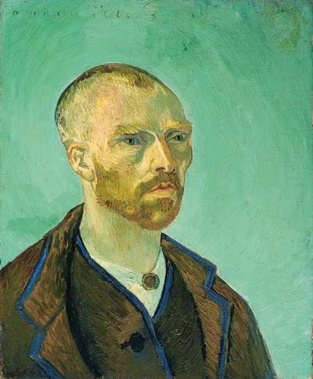
Vincent Van Gogh, Dutch Post-Impressionist / Expressionist, 1853-1890 (37 years)
Vincent Van Gogh, Self-Portrait
Dedicated to Paul Gauguin, 1888
35 years old (as a Buddhist monk)

Slide 2
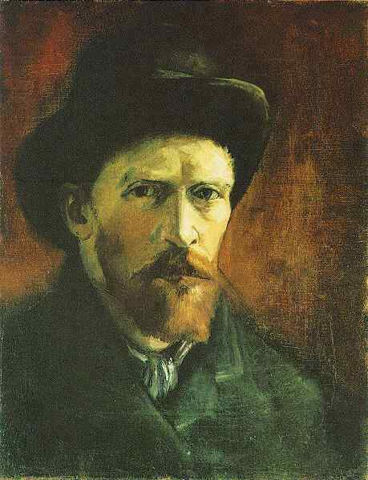
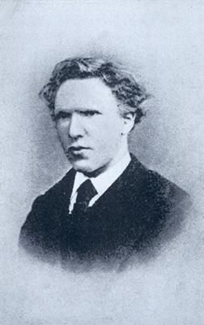
Vincent Van Gogh, Self Portrait with Dark Felt Hat, 43 x 33 cm., Paris, Spring, 1886
Van Gogh at 18 (1871)

Slide 3
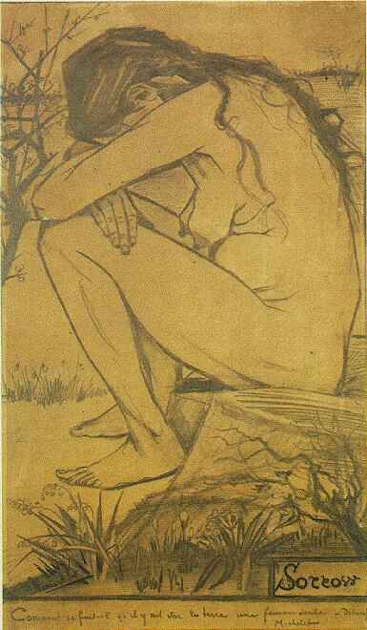
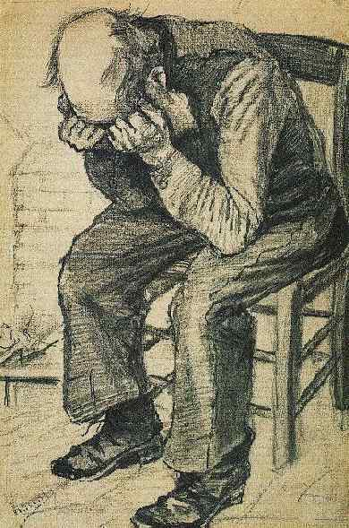
(left) Van Gogh, Sorrow (Clasina Hoornik, called “Sien”) 1882 (right) Worn Out, 1882, both drawn in The Hague

Slide 4
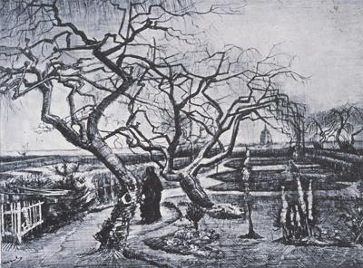
Van Gogh, Garden of the Presbytery at
Nuenen, pen and pencil, 1884 (Van Gogh was in Nuenen 1883-5)

Slide 5
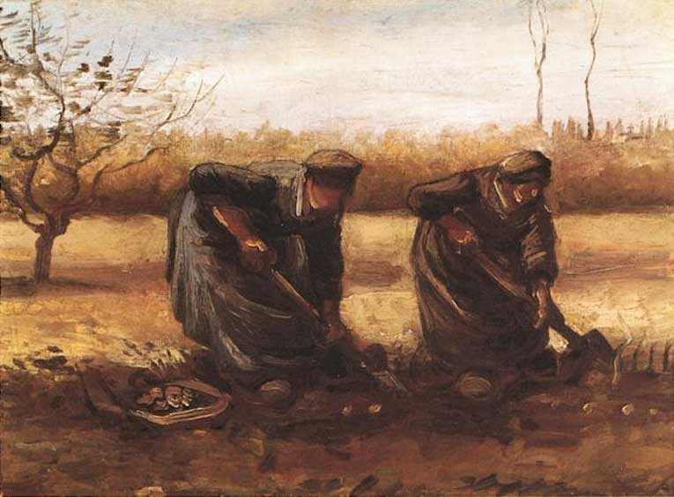
(left) Vincent Van Gogh, Two Peasant Women Digging Potatoes, Nuenen, The Netherlands,1885 (right) Jean-François Millet (French, 1814-1875) Gleaners, oil, 1857

Slide 6
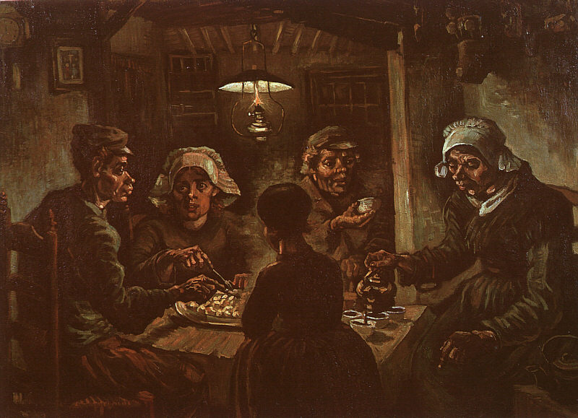
Van Gogh, The Potato Eaters, April 1885, oil, 72 x 93 cm.
I have tried to emphasize that these people eating their potatoes in the lamplight, have dug the earth with those very hands they put in the dish, and so it speaks of manual labor, and how they have honestly earned their food.
Van Gogh, 1885

Slide 7
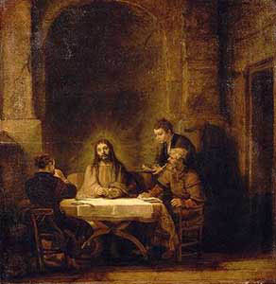
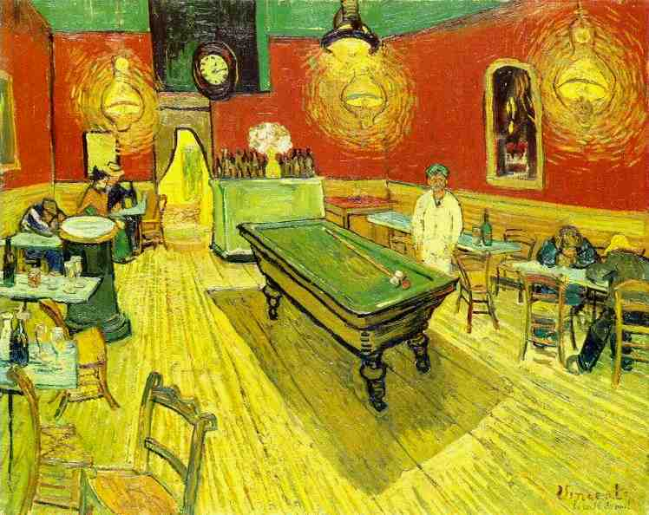
With its calculated “ugliness” and religious overtones, The Potato Eaters (1885) is also an homage to Rembrandt's The Supper at Emmaus (1648) in the Louvre
Note: steaming potatoes and lamp create
A halo effect around the child, the roof beams
recession is an expressive use of perspective
to suggest divine rays, small print of the
Crucifixion behind the young man. These
Effects appear again in later paintings, such
as The Night Café, Arles: Summer, 1888

Slide 8
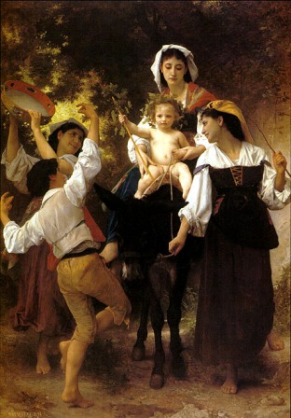
Van Gogh, Potato Eaters, 82 x114 cm
Nuenen: April,1885. Primitivism
Adolphe William Bouguereau
(French Academic Painter,
Home from the Harvest, 1878

Slide 9
Vincent Van Gogh in Paris
February, 1886, Van Gogh arrives in Paris and stays for two years with his brother Theo in Montmartre where he meets the artists of the avant-garde and immerses himself in the new painting.

Slide 10
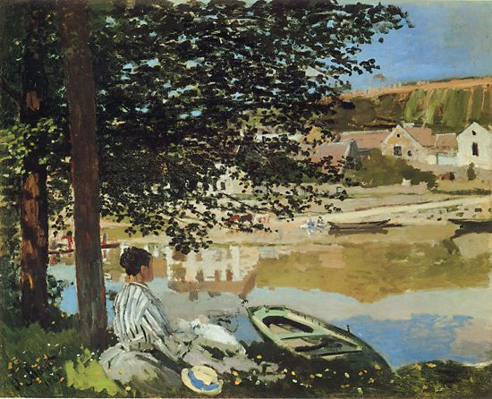
The broken brushstrokes of bright spring colors as well as the choice of subject – a view of the Seine on the outskirts of Paris – mark the transformative influence of Impressionism on Van Gogh following his move to Paris. Compare Van Gogh’s 1887 painting with a 1868 composition by Claude Monet
Claude Monet, (French, 1840-1926) On the Bank of the Seine, Bennecourt
1868, oil on canvas
Van Gogh, Fishing in Spring, the Pont de Clichy
(Asnières), 1887, oil on canvas

Slide 11
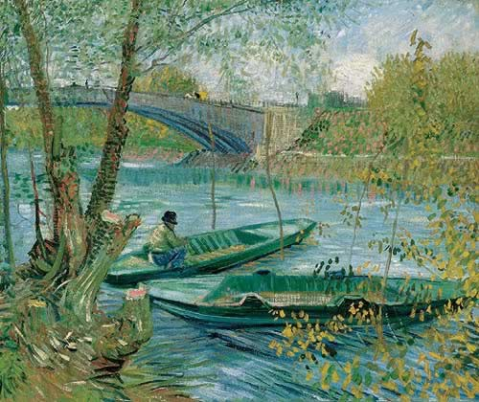
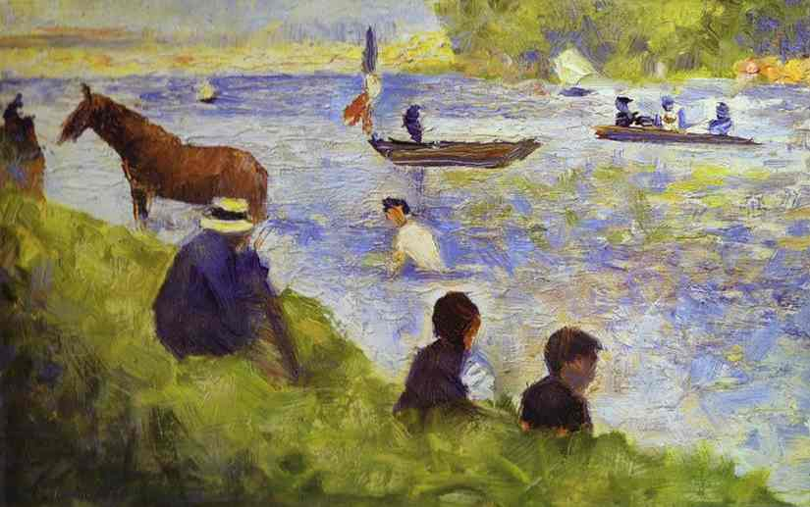
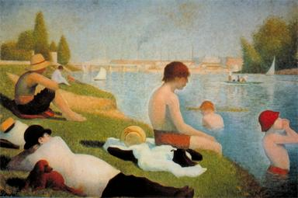
Compare the Van Gogh Impressionist painting and a study by Neo-Impressionist Georges Seurat.
Georges Seurat, Horse and Boat.
(Study for Bathers at Asnières). c.1883-84
Van Gogh, Fishing in Spring, the Pont de Clichy (Asnières), 1887
Georges Seurat, Bathers at Asnières

Slide 12
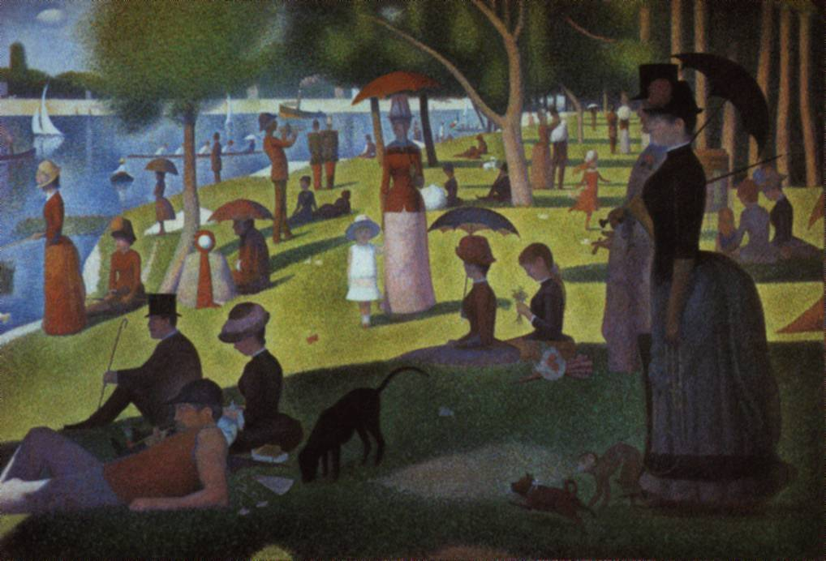
In May 1886 Vincent van Gogh saw the 8th (last) Impressionist Exhibition, which included Georges Seurat’s Neo-Impressionist masterpiece, Sunday Afternoon on the Island of the Grande Jatte, 1884

Slide 13
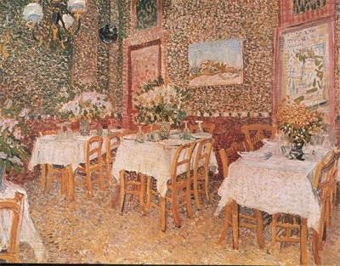
Van Gogh, Interior of a Restaurant, 1887, Paris,
short-lived experiment with pointillist technique

Slide 14
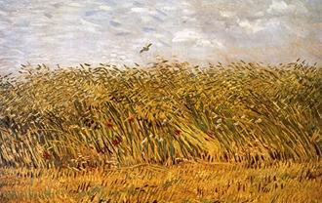
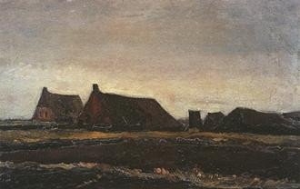
Compare Van Gogh pre-Paris 1883 (left), and in Paris 1887 (right)
Van Gogh, Wheatfields, 1887
Van Gogh, Farmhouses, 1883

Slide 15
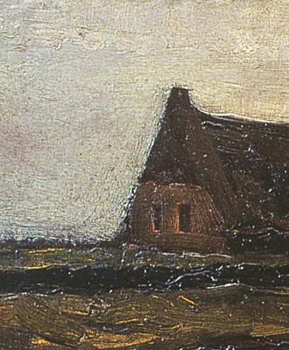
Compare Van Gogh’s brushstrokes 1883 (left) and 1887 (right)

Slide 16
Japonisme Vincent van Gogh was influenced by ukiyo-e woodblock prints

Slide 17
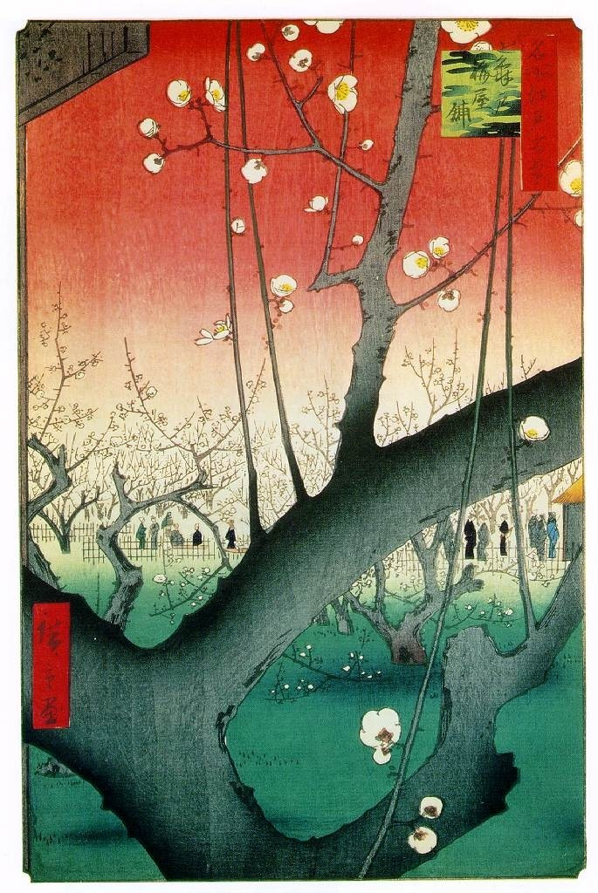
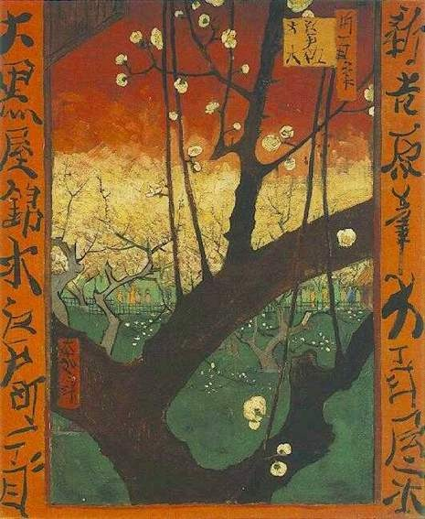
Hiroshige Ando, Plum Estate,
Kameido, 1857, woodblock print
Van Gogh, Plum tree in Bloom (after Hiroshige), oil on canvas, 1887 (Paris)
The Montmartre gallery of Samuel Bing was next door to Théo van Gogh’s Paris
apartment. Bing kept thousands of Japanese prints in stock. Vincent became an avid collector of ukiyo-e prints.

Slide 18
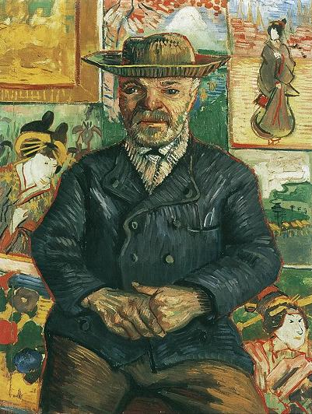
Vincent van Gogh, Portrait of Père Tanguy, 1887-88, oil on canvas Japonisme and emergent Expressionism

Slide 19
Hiroshige Ando, Plum Estate,
Kameido, 1857, woodblock print
Van Gogh, Plum tree in Bloom (after Hiroshige), oil on canvas, 1887 (Paris)
The Montmartre gallery of Samuel Bing was next door to Théo van Gogh’s Paris
apartment. Bing kept thousands of Japanese prints in stock. Vincent became an avid collector of ukiyo-e prints.

Slide 20
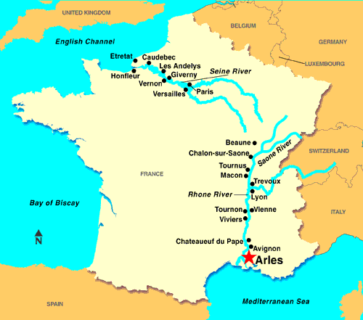
Van Gogh in Arles (1888–1889)

Slide 21
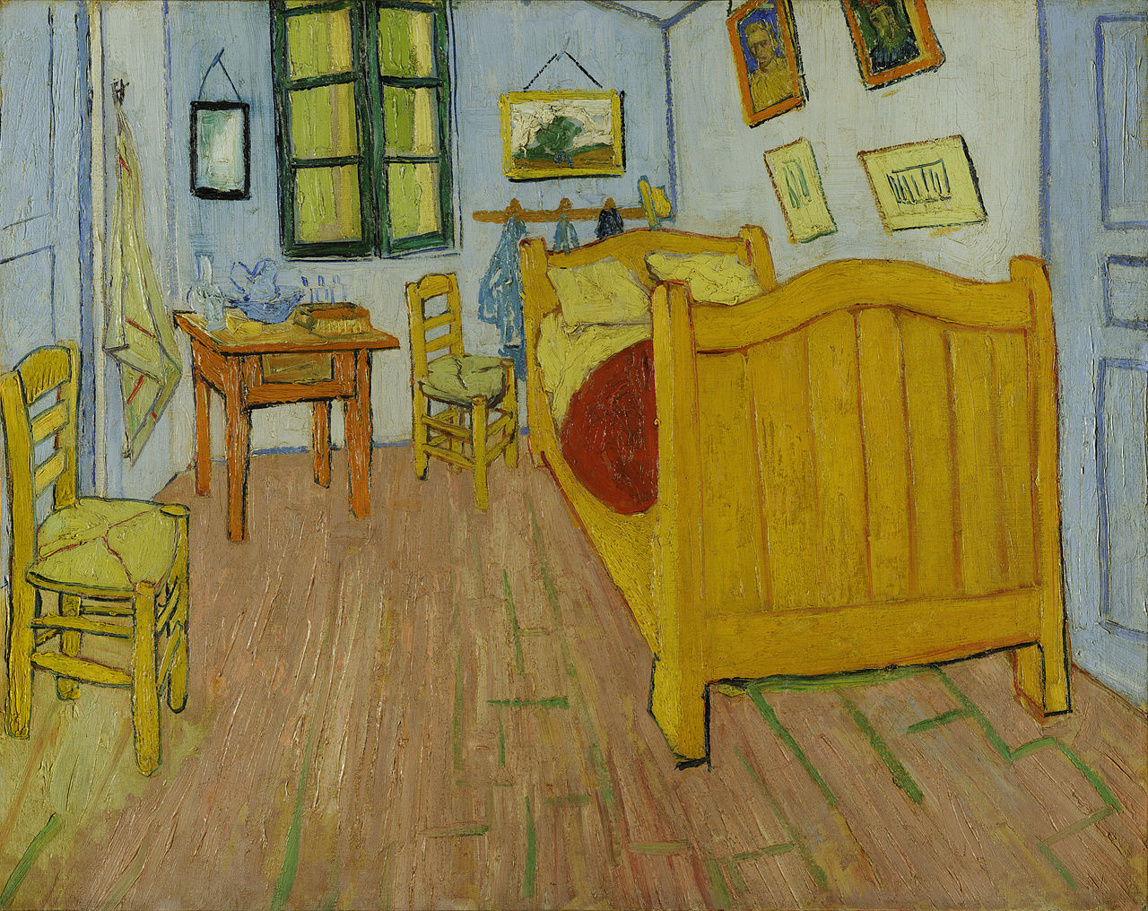
Vincent van Gogh, Bedroom at Arles, 1888, 28.3 × 35.4” Van Gogh Museum, Amsterdam
http://smarthistory.khanacademy.org/van-goghs-the-bedroom.html
https://www.google.com/culturalinstitute/asset-viewer/the-bedroom/KwF-AdF1REQl6w?projectId=art-project

Slide 22
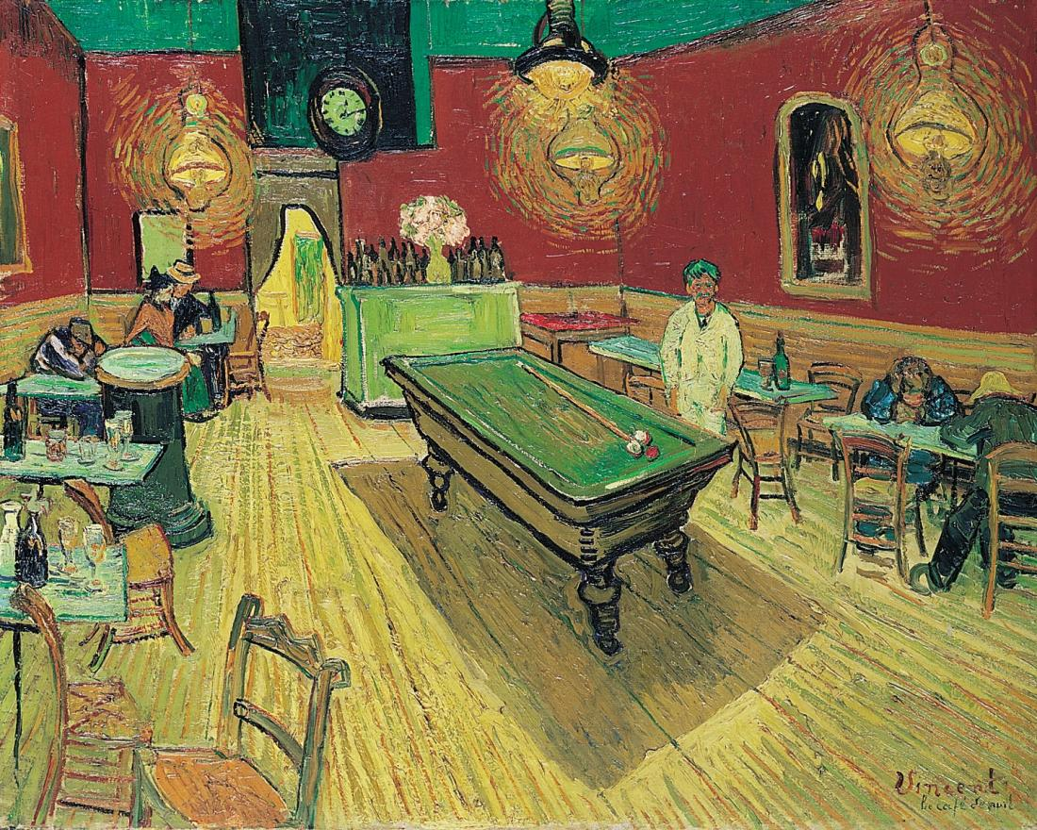
VINCENT VAN GOGH, The Night Café, 1888. Oil on canvas, approx. 2’ 4 1/2” x 3’. “A place where one can ruin oneself, go mad, or commit a crime.” Painted just before Gauguin’s arrival in Arles at the same time Paul Gauguin was painting The Vision after the Sermon in Pont Aven. The two were corresponding by letter, many through Theo van Gogh.

Slide 23
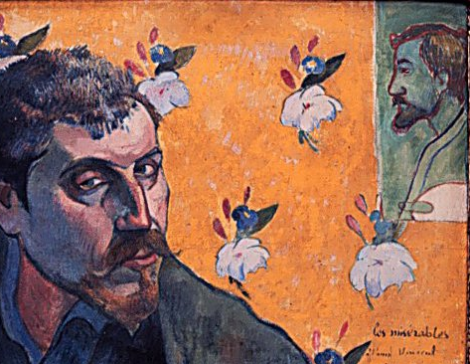
Friendship Portraits These two intense personalities lived together in Vincent’s Yellow House in Arles from October 23 to December 26, 1888
Paul Gauguin, Les Misérables, self-portrait
dedicated to Vincent, 1888, (painted in Pont
Aven and brought to Arles) 40 years old
Vincent Van Gogh, Self-Portrait as a
Buddhist Monk, dedicated to Paul Gauguin
1888, (Arles) 35 years old

Slide 24
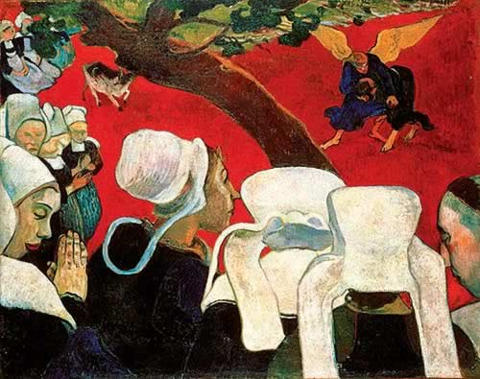
The expressive psychological power of modernist perspective and color. For Van Gogh the saturated vermilion and color contrasts conveyed the dissolute atmosphere of the café, the “terrible passions of humanity.” For Gauguin the unnatural palette conveyed the quasi-mystical state of the Breton women’s imagination
Vincent an Gogh, The Night Café, 1888
Paul Gauguin, Vision After the Sermon:
Jacob Wrestling with the Angel, 1888

Slide 25
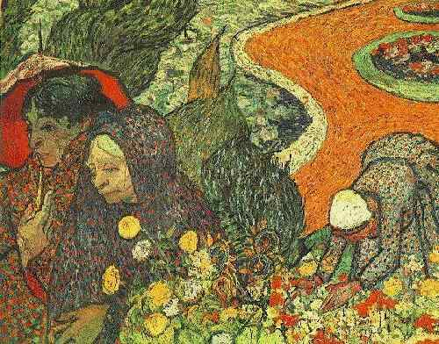
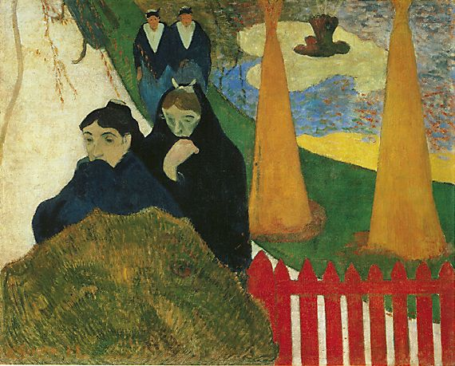
Van Gogh, Memory of a Garden at Etten
1888
Gauguin, Women of Arles, 1888

Slide 26
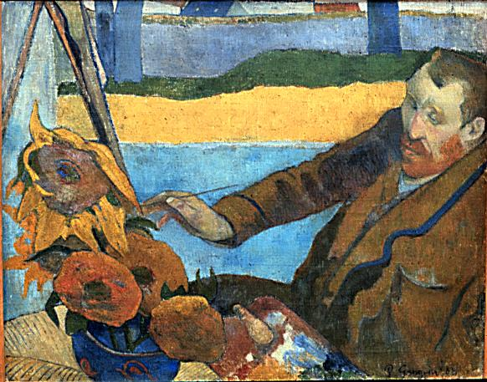
Paul Gauguin, Vincent van Gogh Painting Sunflowers, 1888
“It is certainly I, but it’s I gone mad”
(Van Gogh’s response to Gauguin upon seeing this painting)

Slide 27
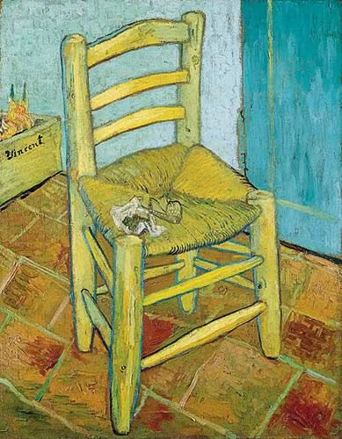
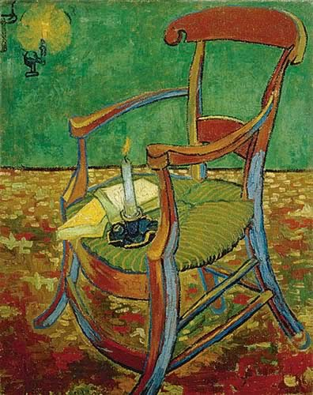
Van Gogh, Vincent’s Chair, 1888-9
Van Gogh, Gauguin’s Chair (with Candle)
December,1888

Slide 28
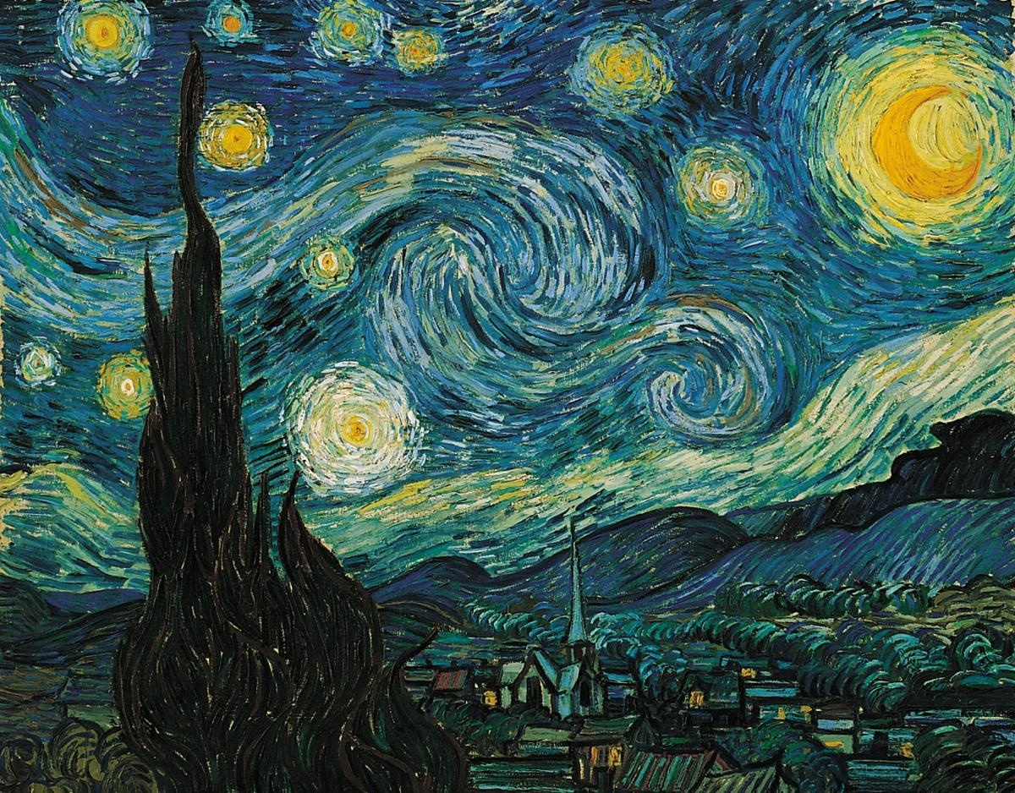
VINCENT VAN GOGH, Starry Night, 1889. Oil on canvas approx. 2’ 5” x 3’ 1/4”. Museum of Modern Art, New York

Slide 29
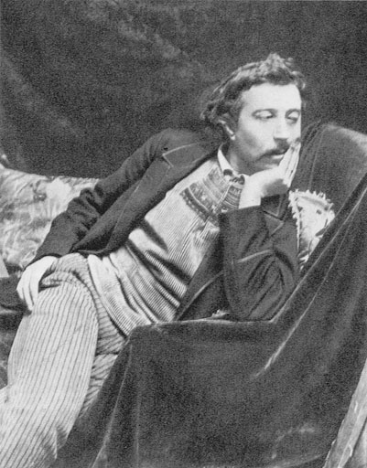
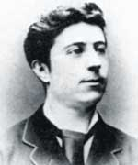
Paul Gauguin in 1873 at 25 years
In 1890 at 42 years

Slide 30
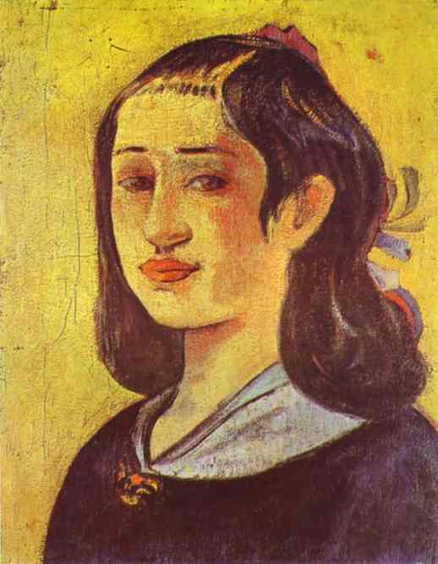
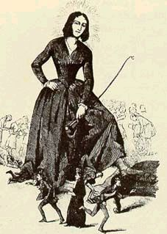
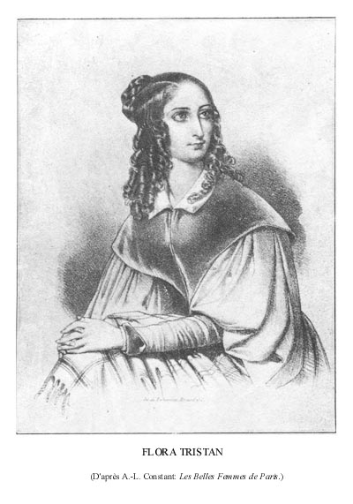
Flora Tristan (1803 - 1844) grandmother of Paul Gauguin, a socialist writer and activist, one of the founders of modern feminism. Her father, Mariano Tristán y Moscoso, was an Arequipa-born Peruvian colonel of the Spanish Navy, and her mother, Anne Laisney, a Frenchwoman. Her parents met in Bilbao, Spain during her father's stay there. Tristan wrote best selling Peregrinations of a Pariah about her travels to Peru.
Political cartoon lampooning
Tristan’s feminism, c. 1830
Gauguin, Portrait of the
Artist’s Mother (Aline), 1894

Slide 31
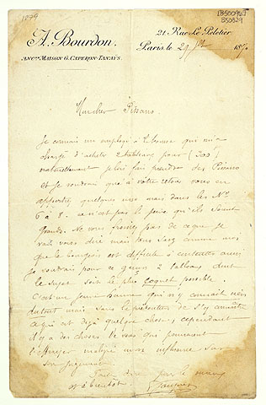
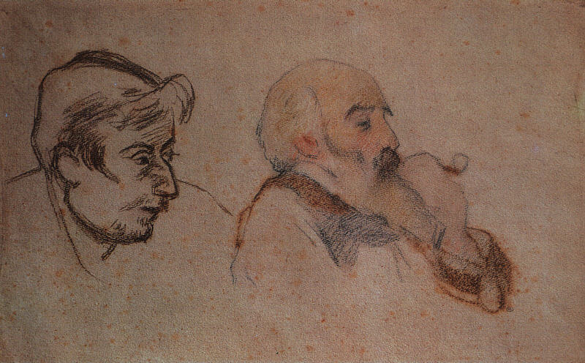
(Jacob) Camille Pissarro (1830-1903), an artist whose friendship and support provided encouragement for both Gauguin and Van Gogh Letter from Gauguin to Camille Pissarro, July 29, 1879 My dear Pissarro, I know an employee at the stock exchange who has asked me to buy two paintings for him for 300 F. Naturally, I intend to suggest some Pissarros to him and so upon your return, I would like for you to bring over a few, but in the 6 by 8 format–there is no need for them to be large. Don't be offended by what I am going to say, but you know as well as I do that the middle classes are difficult to please, so I would like this young man to have two paintings whose subjects are as pretty as possible. He is a young man who knows nothing at all about art, and does not pretend otherwise which is already something; however, some of your works could frighten him despite my influence on his judgment. So act for the best and see you soon. P Gauguin
Portrait of Camille Pisarro by Gauguin (right)
Portrait of Paul Gauguin by Pissarro (left)
1879-83, chalk on paper, Musée d’Orsay

Slide 32
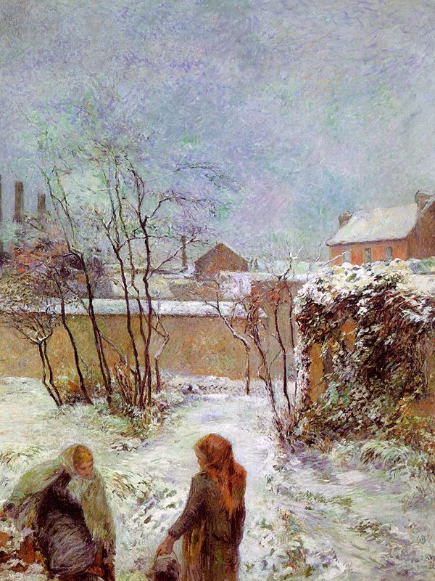
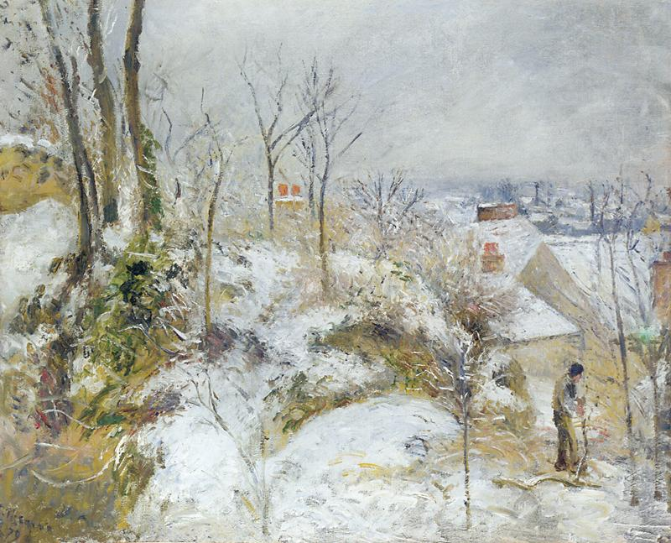
Paul Gauguin (left), The Garden in Winter, rue Carcel, 1883, oil on canvas, private collection Camille Pissarro (right), Rabbit Warren at Pontoise, Snow, 1879, oil on canvas, Chicago Institute of Fine Art
Gauguin’s Impressionist paintings adopted
Pissarro’s subject matter and thin, straw like
brushstroke.

Slide 33
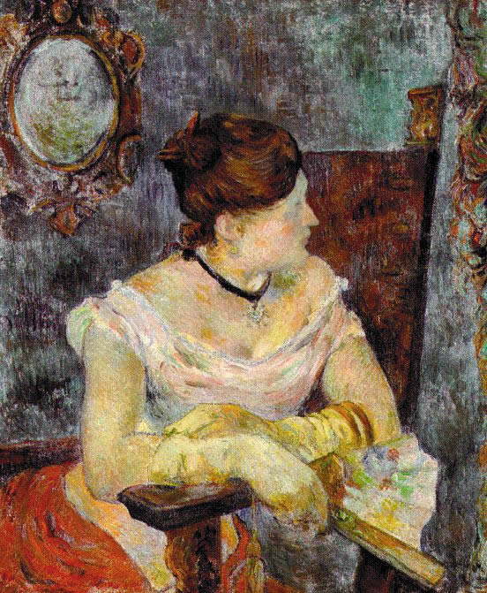
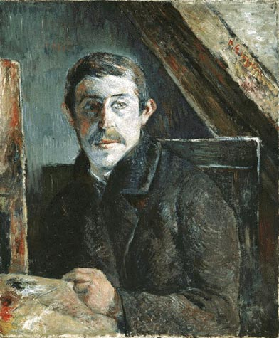
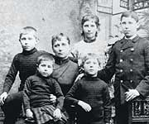
1882 Stock Market Crash
Gauguin, Mette in an Evening
Dress, 1884
Paul Gauguin, Self Portrait, 1885
in Copenhagen, “Everyday I ask
myself if I mustn’t go to the attic and
put a rope around my neck.
Mette Gauguin and the
five children, c. 1885

Slide 34
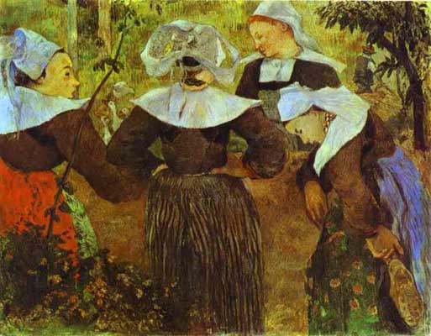
Paul Gauguin assumed the role of renegade (maudit) artist in 1885 Paul Gauguin, Four Breton Women Gossiping, 1886 First trip to Pont Aven – 4 months. Brittany’s peasant types were a pre-industrial subject that suited Gauguin’s emerging Primitivism

Slide 35
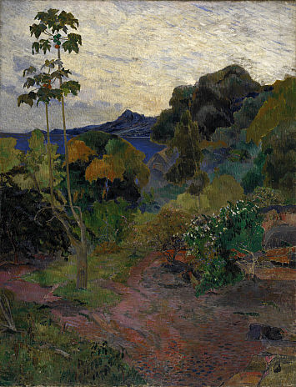
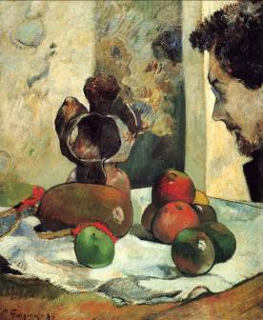
Paul Gauguin, (left) Portrait of Charles Laval in Profile, 1886 (right) Martinique Landscape, 1887 Gauguin and Laval left for Panama and Martinique in 1886 and spent several months until illness forced them to return to France.
I had a decisive experience in Martinique.
It was only there that I felt like my real
self, and one must look for me in the works
I brought back from there rather than those
from Brittany, if one wants to know who
I am. Paul Gauguin (1890)

Slide 36
Paul Gauguin, Vision After the Sermon: Jacob Wrestling with the Angel, 1888

Slide 37
Friendship Portraits These two intense personalities lived together in Vincent’s Yellow House in Arles from October 23 to December 26, 1888
Paul Gauguin, Les Misérables, self-portrait
dedicated to Vincent, 1888, (painted in Pont
Aven and brought to Arles) 40 years old
Vincent Van Gogh, Self-Portrait as a
Buddhist Monk, dedicated to Paul Gauguin
1888, (Arles) 35 years old

Slide 38
The expressive psychological power of modernist perspective and color. For Van Gogh the saturated vermilion and color contrasts conveyed the dissolute atmosphere of the café, the “terrible passions of humanity.” For Gauguin the unnatural palette conveyed the quasi-mystical state of the Breton women’s imagination
Vincent an Gogh, The Night Café, 1888
Paul Gauguin, Vision After the Sermon:
Jacob Wrestling with the Angel, 1888

Slide 39
Van Gogh, Memory of a Garden at Etten
1888
Gauguin, Women of Arles, 1888

Slide 40
Paul Gauguin, Vincent van Gogh Painting Sunflowers, 1888
“It is certainly I, but it’s I gone mad”
(Van Gogh’s response to Gauguin upon seeing this painting)

Slide 41
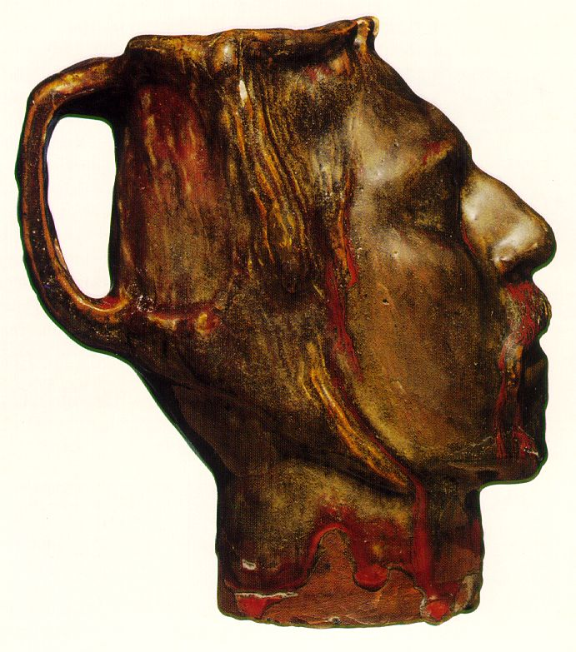
Multiple allusions – Symbolism, Primitivism - and self-identification with Van Gogh’s post-ear-cutting identity a saint or Christ-like (here bloody and earless) figure martyred to his art as to a faith.
Moche portrait jug, Peru, c.700 CE
Gustave Moreau, Orpheus (mythical martyr of Western culture), 1865, French Symbolist
Gauguin, Self-portrait Jug, 1889, 7 5/8”, glazed stonewear. Created several weeks after leaving Arles.

Slide 42
Gauguin gives the Savior his own features and the red hair of van Gogh, making an explicit self-identification with Christ and Van Gogh’s myth. Gauguin’s distanced, anthropological attitude toward religious subjects is gone.
Paul Gauguin, Agony in the Garden, 1889
Gauguin, Letter to Van Gogh
November 1889

Slide 43
Paul Gauguin, Self-portrait with Halo, 1889, oil on wood, 31x20“

Slide 44
PAUL GAUGUIN, Where Do We Come From? What Are We? Where Are We Going?, 1897. Oil on canvas, 4’ 6 13/ 16” x 12’ 3”. Museum of Fine Arts, Boston Symbolism and Primitivism

Slide 45
Symbolism: Fin de Siècle Europe
Flight from modernity, Primitivist critique of European culture, reaction against 19th century mechanistic Positivism: the dominant faith in science and technology.
Objective “realism" is rejected for the representation of personal symbols, memory, imagination, and dreams to evoke a sympathetic understanding of the artist's “Idea” in the viewer, just as music does.
"Art has gone through a long period of aberration caused by physics, chemistry, mechanics, and the study of nature....Artists, having lost all their savagery, went astray on every path."
Gauguin

Slide 46
Paul Gauguin, Mallarmé (Nevermore), lithograph for publication in one of many symbolist literature & art magazines,1891

Slide 47
Gauguin instructed his follower, Paul Séruzier : "How do you see these trees? They are yellow. So, put in yellow; this shadow, rather blue, paint it with pure ultramarine; these red leaves; put in vermilion.“ "Remember that a painting, before being a battle horse, a nude woman or any anecdote, is essentially a plane surface covered with colors assembled in a certain order." (Nabis artist, Maurice Denis)
Paul Sérusier (French Post-Impressionist
(Nabis), Talisman, 1888, oil on wood

