Slide 1
Introduction
From the Modern to the Post-Modern after WW II

Slide 2
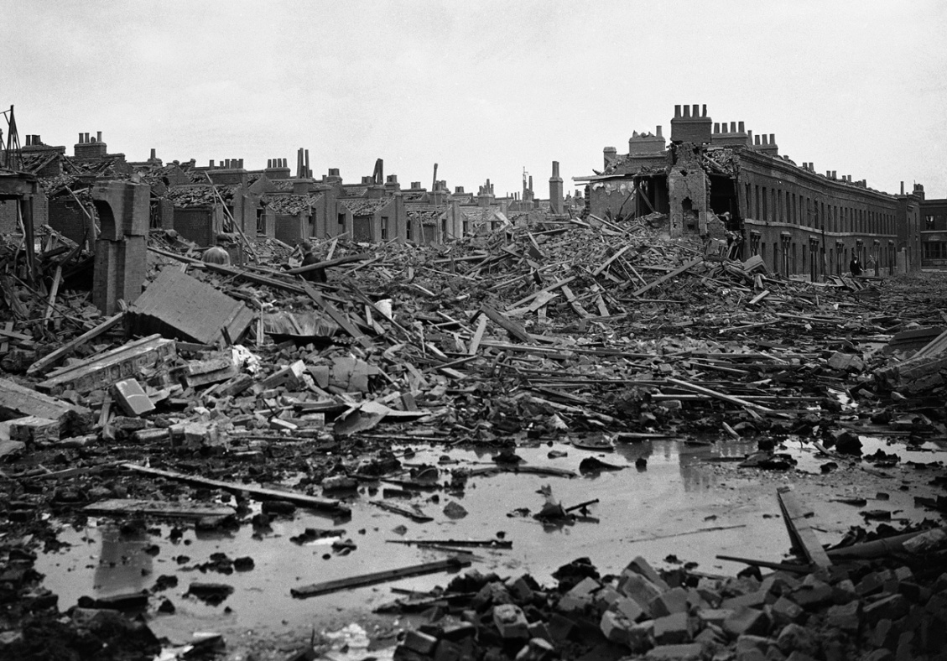
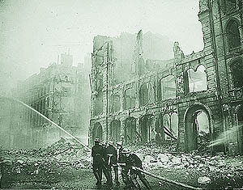
The Nazi (National Socialist) Blitz of London between 7 September 1940 and 21 May 1941 killed 40,000 people. The bombing of civilian populations by both sides was ceaseless throughout the war.

Slide 3
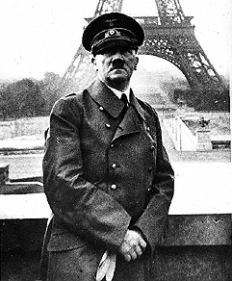
German Führer Adolph Hitler (1889-1945)
Hitler poses with the Eiffel Tower on June 23, 1940
The Fall of Paris marks “the end” of Modernism

Slide 4
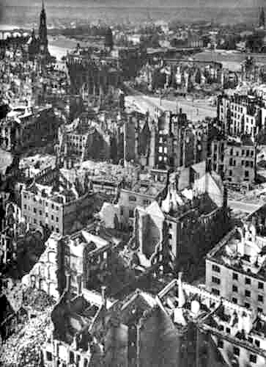
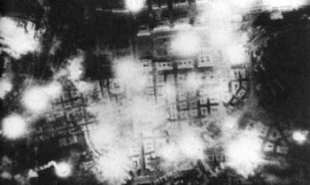
Soviet bombing of Berlin, August 11, 1941
Dresden, September 1945
after fire bombings by British &
American air forces – 30,000 deaths

Slide 5
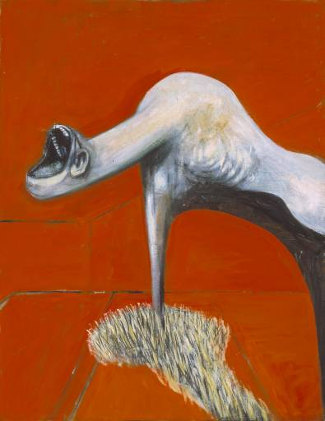
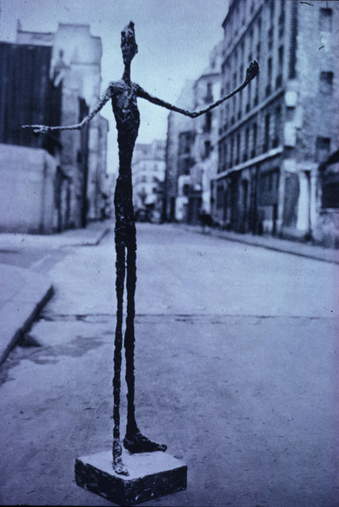
(left) Francis Bacon (British), panel from Three Studies for a Crucifixion, 1947
(right) Alberto Giacometti (Swiss), Pointing Man, 1947
Europe after the War: Existentialist Expressionism

Slide 6
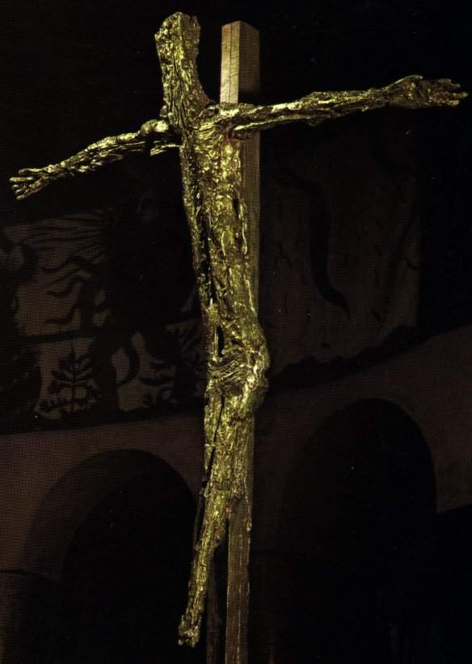
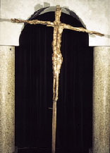
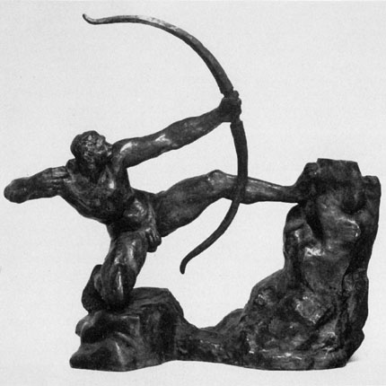
Germaine Richier (French, 1904-1959) Crucified Christ, 1950, Notre-Dame de Tour Grâce d'Assy, France. Post-humanist?
(below right) Compare Richier’s teacher, Emile-Antoine Bourdelle, Hercules, 1909. What became of the heroic human body in Western art in the hands of the WWII generation? Why?

Slide 7
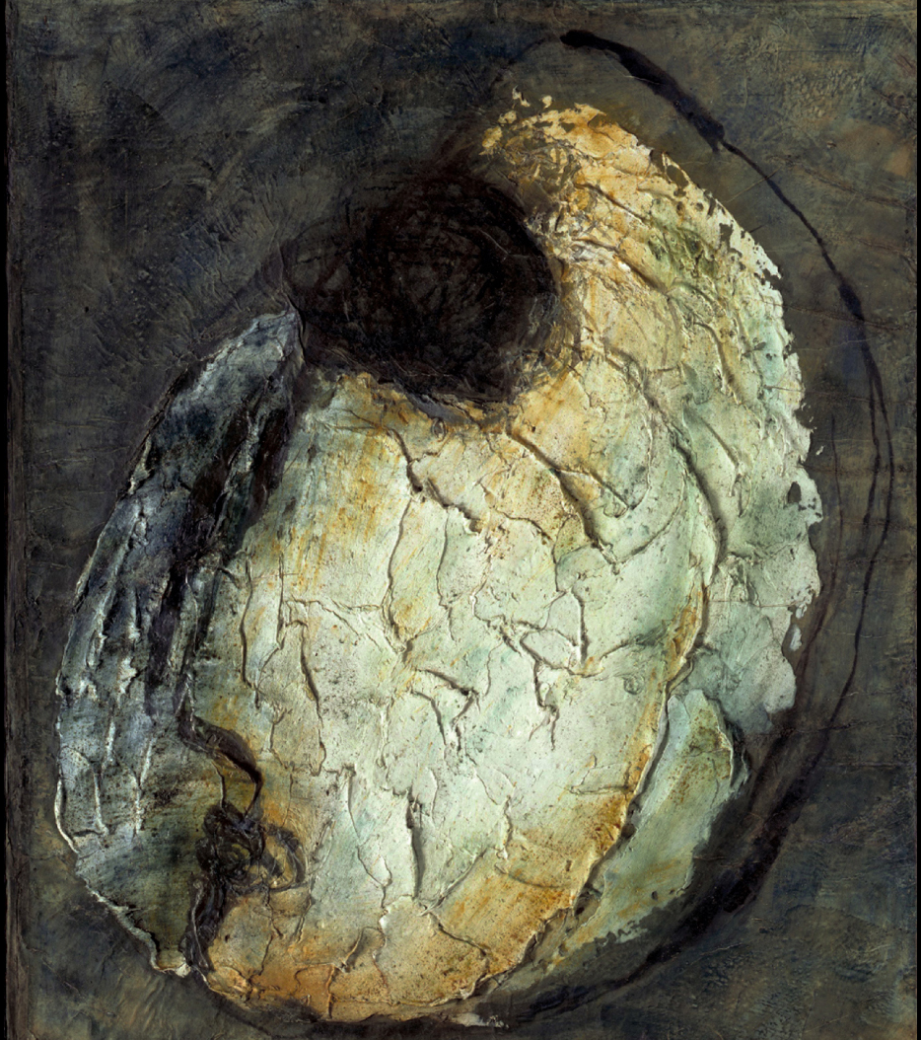
Jean Fautrier (French, 1898-1964) Head of a Hostage #1, 1944. Oil and pigments on paper mounted on canvas, 25 x 21"
“These paintings addressed the most important issue of their time, epitomizing a 'new human resolve'
against the horrors of war."
- Jean Fautrier

Slide 8
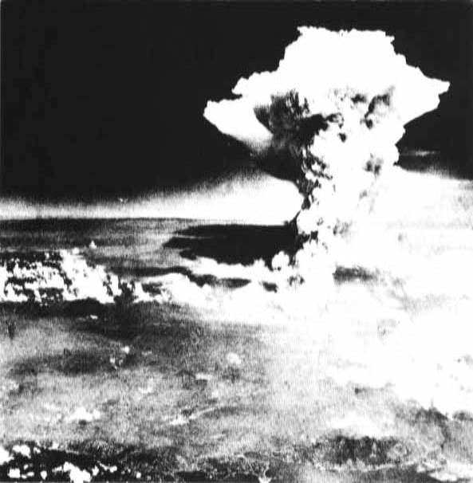
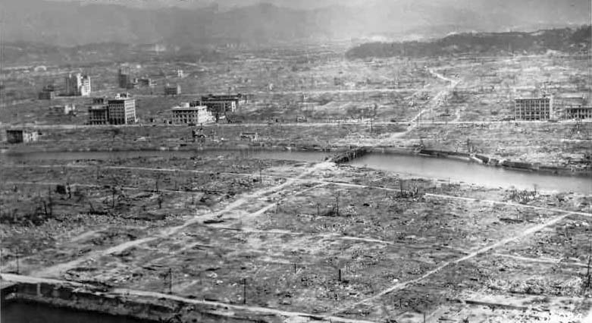
American hydrogen bombing of Hiroshima, Japan, August 6, 1945
The total estimated human loss of life caused by World War II was roughly 72 million people. The civilian toll was around 47 million. The Allies lost about 61 million people, and the Axis lost 11 million.
Aftermath of Hiroshima bomb – estimated 170,000 deaths

Slide 9
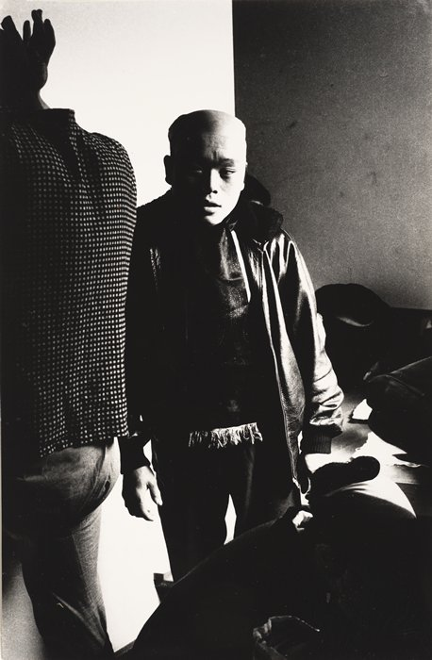
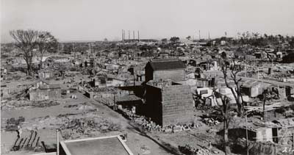
Daidō Moriyama (Japanese, b. 1938), Hiratsuka, 1966; gelatin silver print, 10 9/16 in. x 6 15/16 in. Collection SFMOMA. On view at the Crocker in The Provoke Era exhibition until February 1
Hiratsuka after the 1945 bombing by US Army Air force, which destroyed half of the city

Slide 10
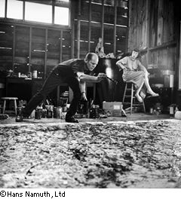
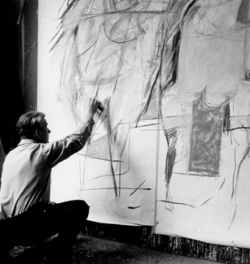
Post WW II: New York becomes the capital of the art world
(left) Jackson Pollock (1912-1956) painting, 1950
(right) Willem de Kooning (1904–97) painting Woman I, 1951
“Action Painting”

Slide 11
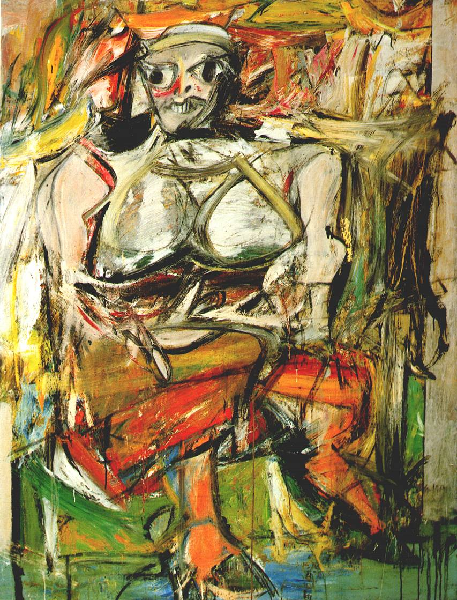
Willem de Kooning, Woman I, 1950-2 http://www.moma.org/explore/multimedia/audios/278/3106

Slide 12
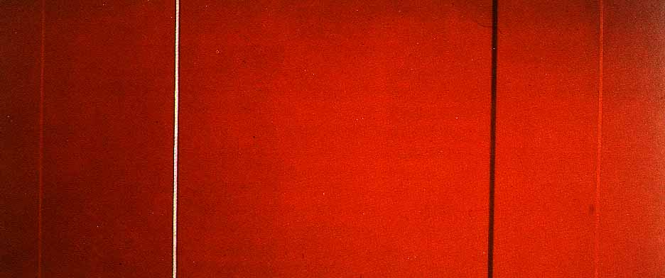
Barnett Newman, Vir Heroicus Sublimus, 1950-51, o/c, c. 8’/ 18’ MoMA

Slide 13
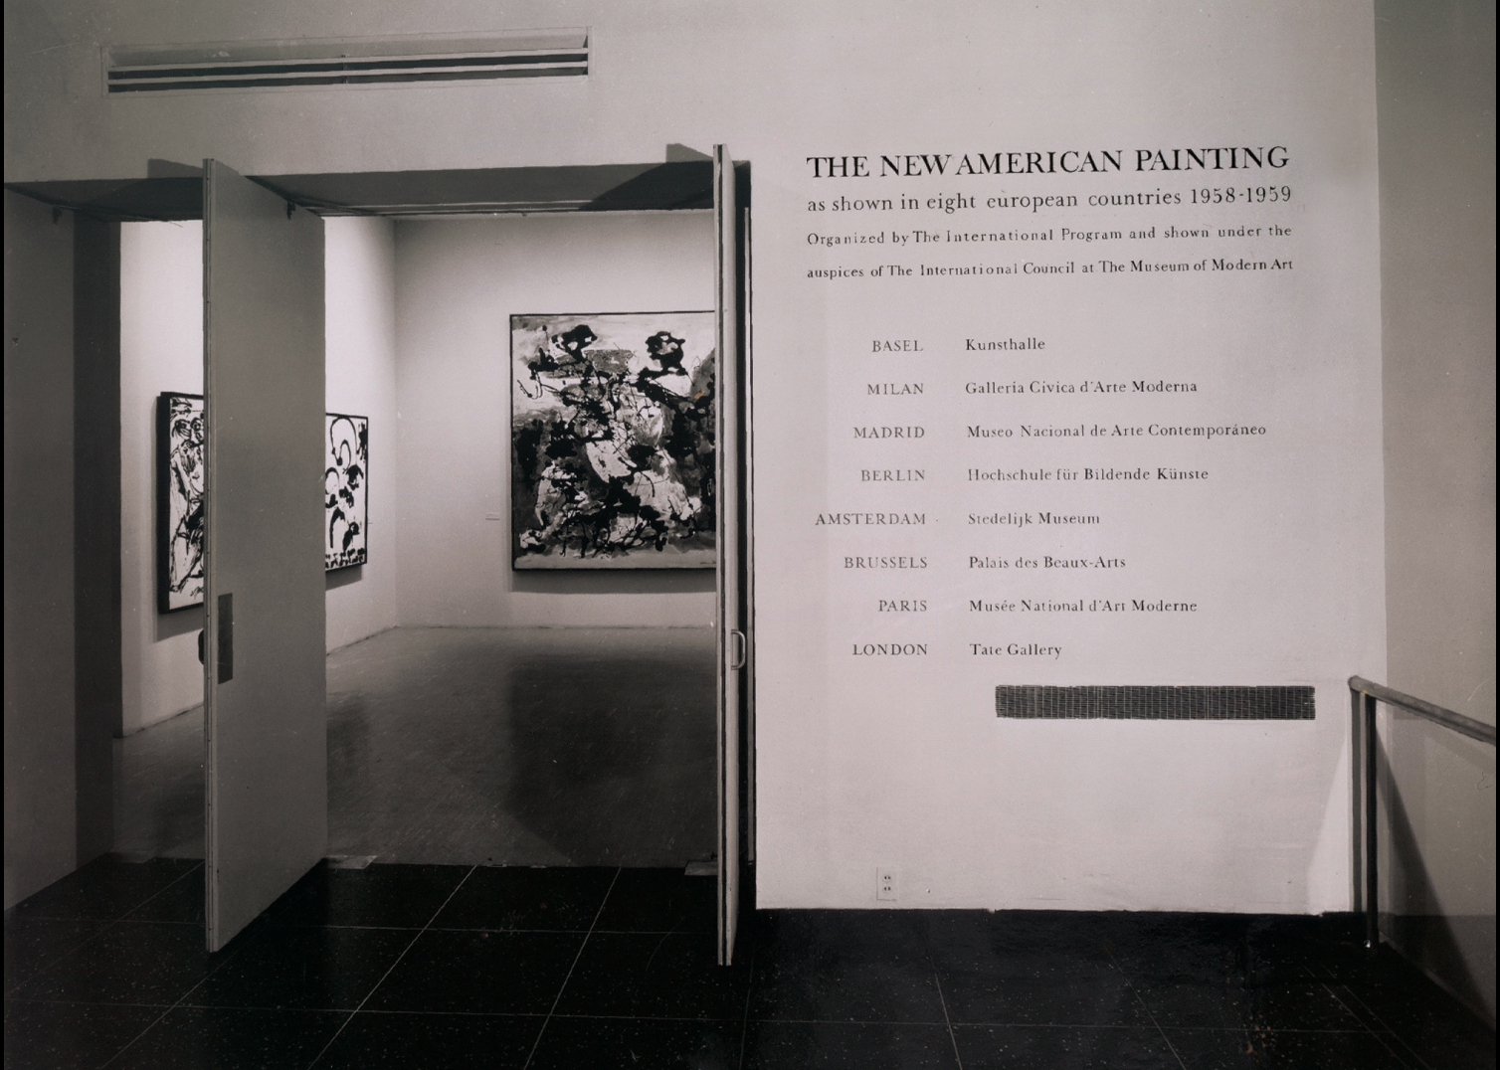
Installation view of the exhibition, The New American Painting as shown in eight European countries 1958–1959, The Museum of Modern Art, New York

Slide 14
“It seems to be the law of modernism – thus one that applies to almost all art that remains truly alive in our time – that the conventions not essential to the viability of a medium be discarded as soon as they are recognized.”
Clement Greenberg (American art critic, 1909-94)
“American-Type Painting,” 1955

Slide 15
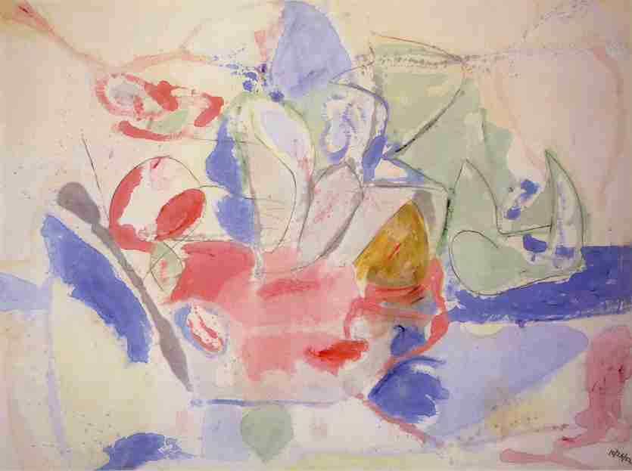
Helen Frankenthaler (US, b. 1928), Mountains and Sea,
1952, charcoal and oil on unprimed canvas, 7’2” x 9’9”
“Post-Painterly abstraction,” Greenbergian formalism,
“late “Modernist” painting

Slide 16
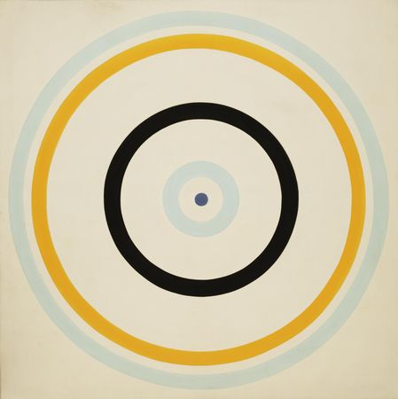
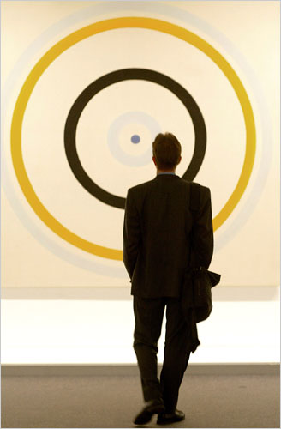
Kenneth Noland (US, 1924-2010) Turnsole, 1961, synthetic polymer paint on unprimed canvas, 7' 10 1/8" x 7' 10 1/8“

Slide 17
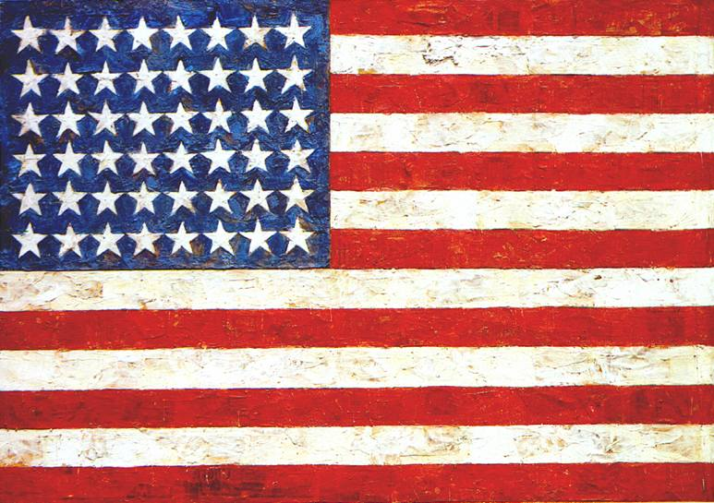
Jasper Johns (US, b.1930), Flag. 1954–55, encaustic, oil, and collage on fabric mounted on plywood (three panels) 42 1/4 x 60 5/8" MoMA NYC. Literal, conceptual painting. Parodic gestures of Abstract Expressionism are congealed in wax, thus contradicting and reifying the aesthetic of individualism.
Johns’ flags and targets, numbers and letters were “things the mind already knows . . . things that were seen and not looked at, not examined.”

Slide 18
“Half a century of formalist indoctrination was being brought to a close”
Leo Steinberg on the art of Jasper Johns

Slide 19
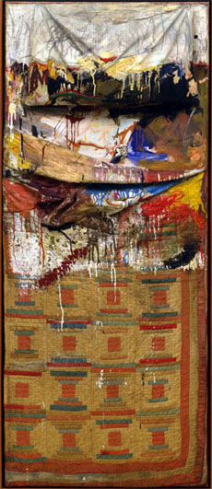
Robert Rauschenberg, Bed, 1955. Combine painting: oil and pencil on pillow, quilt, and sheet on wood supports, 6' 3 1/4" x 31 1/2" x 8" Gift of Leo Castelli. Neo-Dada, horizontal production and vertical display, like Pollock
The art market as we know it began with the 1973 sale of artworks from the Scull Collection. A work by Robert Rauschenberg the Sculls bought for $900 in 1956 sold for $43,762,500 in 1973.

Slide 20
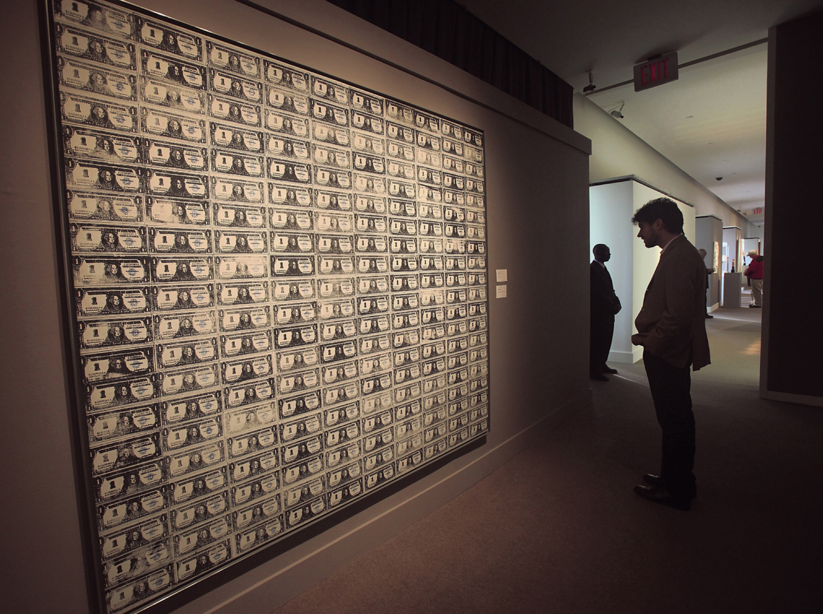
Andy Warhol, 200 One-Dollar Bills, 1962. Silkscreen ink and pencil on canvas, 80 x 92”

