Slide 1
Strategic Goals 2022-23
Information Resources & Technology

Slide 2
IRT Vision Statement
Strategic | Resources intentionally allocated and aligned with mission and strategic campus goals.
Trusted | Communicate, consult, and be transparent; focus on relationships and the end user experience.
Partner | Position IRT as a collaborative peer and consistently deliver value.
Enterprise Technology | Reliable, managed, governed solutions for campus.
Leadership | Think and act beyond the request; use our expertise to influence and guide the design and delivery of the best decisions, outcomes, and experiences.
We are the trusted source for enterprise technology leadership at Sacramento State.

Slide 3
IRT Mission Statement
Information Resources & Technology (IRT) partners with Faculty, Staff, and Students to provide essential information technology services that support mission critical activities and innovative technology solutions that facilitate the accomplishment of strategic campus goals at Sacramento State.

Slide 4
IRT Culture
Our Guiding Principles
Value Our Customers and Community Customer focused, IRT acts in the best interests of our students, faculty, staff and the community.
Respect and Trust Dependable, reliable and equal partner, not always the provider, focused on collaboration and communication.
Empower Our Employees Every employee is valued and we create an inclusive environment where employees thrive, grow, and innovate. Entrust employees with appropriate decision-making authority.
Operational Excellence IRT innovates to improve its quality of service and provide highly reliable systems, promoting industry standards.
A culture of collaboration and belonging, employees are encouraged to coach and trust each other. We focus on building processes and nurturing effective relationships,
and breaking down silos within IRT and across the University.

Slide 5
IRT Strategic Goals 2022-2023
Division Strategic Goals
1 | Support and Innovate within Campus Imperatives
2 | Mature Digital Transformation Strategies to Improve Student Success/Experience
3 | Unification and Standardization of University IT Practices and Service Management
4 | Expand Internal and Cross-Functional Data-Driven Decision Making
5 | Adopt, operationalize, and advance DEI and anti-racism initiatives as individuals and as stewards serving our University community

Slide 6
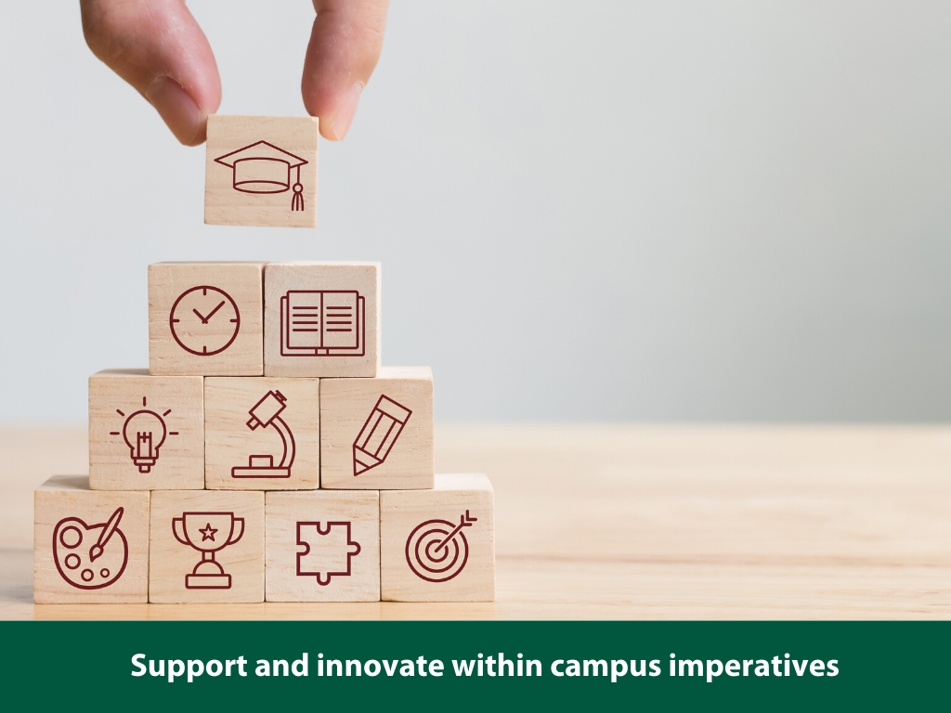

Slide 7
1
 | Support and Innovate within Campus Imperatives
Strategies | Achievement Indicators
Provide and partner to support critical services for teaching, learning and student success. | Championing a holistic student lifecycle approach, and providing an optimal student IT experience.
Support campus philanthropic efforts, providing secure platforms, applications and data analytics. | Provide excellent technology support for campaigns and fundraising.
Provide and partner to support inclusive technology in everything we do, including workforce. | Community involvement; integrating technology into the community.
Find innovative ways to participate in and support Anchor University objectives. | Increased participation in public safety initiatives.
Secure information assets, people and support public safety. | Provide an information asset security model that supports confidentiality, integrity and availability.

Slide 9
 | Mature Digital Transformation Strategies to Improve Student Success/Experience
2
Strategies | Achievement Indicators
Improve the student experience and reduce administrative barriers through standardized workflows, improved digital forms, and eliminating redundant applications. | Increase integration and use of standard workflows to remove administrative barriers.
Enhanced records management and retention solutions to support administrative efficiencies. | Transition critical operations to electronic records management systems supporting automated retention.
Partner with campus divisions to define and implement personalized digital communication channels to facilitate seamless and equitable access to critical information and services. | Develop a portal and communication roadmap which includes CRM-based communication channels in a unified platform, including mobile and Chatbot.
Improve student success outcomes by championing and socializing eLearning technologies, instructional design practices, and providing digital technology support. | Explore digital literacy training and optimized online educational resources, digital media, and instructional technology resources. Develop a strategy and roadmap based on capacity and infrastructure.

Slide 11
 | Unification and Standardization of University IT Practices and Service Management
3
Strategies | Achievement Indicators
Improve current information technology service management delivery through implementation of a defined roadmap of common service definitions, process workflows, service level agreements (SLA’s) and platform updates in a continuous improvement cycle. | IT Service Management implementation roadmap is developed and socialized.
Offer training and development opportunities to all University IT staff to define a common baseline for IT processes and service delivery value to the University community. | University IT staff have been provided the opportunity to train/are trained on IT service delivery best practices.
Document campus IT services and expectations, develop SLAs. | Formalized and documented IT practices, service definitions, and SLA agreements are in place and in practice with defined measures of success by the University IT community.
Implement roadmap with defined standardized service and IT practices. | Unified campus standardization of IT incident/problem management, escalation, resolution, root cause analysis practice: Change/configuration management/control. Unified campus service management design and delivery practices. Updated/improved service support delivery content platforms for greater ease of access to services by the University community.
Improve understanding and transparency of IT costs and assets. | University IT Assets, procurement, and costs are tracked and managed with increased transparency to the University community.

Slide 12
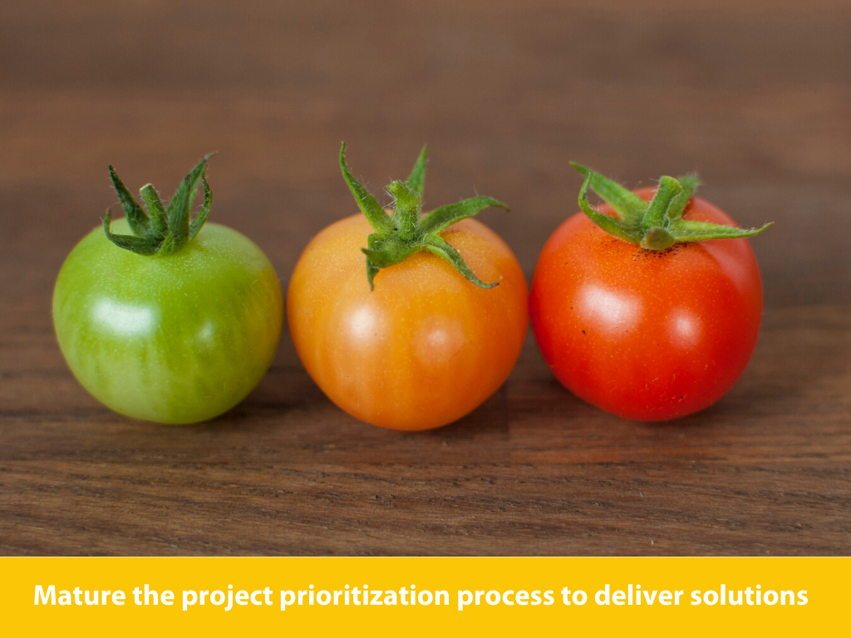

Slide 13
 | Expand Internal and Cross-Functional Data-Driven Decision Making
4
Strategies | Achievement Indicators
Develop metrics and dashboards to highlight our contributions and the effectiveness of our tools and resources. | Identified and published key performance indicators in all IT areas, improved service delivery and return on investment (ROI).
Measure value and return on investment to improve the high-level decision-making process. | Improved information assets that reflect the necessary relevance, validity, and timeliness of data.
Utilize survey and customer feedback to understand our success, gaps, and future needs. | Improved delivery of tools and services as measured through customer feedback.
Notes:
To support these areas of focus, we need to hear from you. We’ll be more effective by asking ourselves how we can improve operations, processes, how we work together.
Data driven – query ourselves (IRT staff is our most expensive tool)

Slide 15
5
 | Adopt, operationalize, and advance DEI and anti-racism initiatives as individuals and as stewards serving our University community
Strategies | Achievement Indicators
Build bridges to support awareness, understanding, empathy, and allyship with various diverse social backgrounds, cultures, and lived experiences. | Time, space, and resources to explore intersections and support, supported by DEI-related frameworks such as ROLLAP (reach out, listen, learn, act, persist) are created through the IT Diversity Council.
Create an environment where all staff feel supported to grow, participate, and develop as leaders. | IRT staff utilize time and support and have participated in division and campus DEI+ efforts (convocations, DEI+ events, hiring committees, committee/working groups, etc.).
Proactively support and promote the Anti-Racism and Inclusive Campus Plan. | An active IRT DEI, Anti-Racism, and inclusive action plan is created and being implemented.
Lead efforts to continuously improve tools and services to be more inclusive and accessible through the use of Universal Design for Learning (UDL) principles. | Improved integration of accessibility and inclusive practices within University tools and services through alternative forms of representation, action and expression, and engagement.
Create and foster a culture that supports equitable and inclusive practices related to recruitment, retention, and promotion. | Regular IRT division communication re: hiring, promotion, leadership, and advancement opportunities, as well as transparency on decision-making criteria and processes.
Notes:
To support these areas of focus, we need to hear from you. We’ll be more effective by asking ourselves how we can improve operations, processes, how we work together.
Data driven – query ourselves (IRT staff is our most expensive tool)

