Slide 1
Sabbatical Leave Information Session April 27 & 30, 2020
George I. Paganelis, Chair
Sabbatical Leave Committee
(916) 278-4361 - paganelis@csus.edu
Paul Hofmann, Associate Vice President ​
International Programs & Global Engagement ​
(916) 278-4868 – paul.hofmann@csus.edu​
Jackie Kernen, Manager of Academic Personnel ​
Office of Faculty Advancement​
(916) 278-7415 – jkernen@csus.edu
Office of Faculty Advancement
(916) 278-2913 – faculty.advancement@csus.edu

Slide 2
Purpose of Sabbatical Leaves
Provide a benefit to the CSU through research, scholarly and creative activity, instructional improvement or faculty retraining;
Enhance teaching effectiveness, enlarge scholarly usefulness, and strengthen and develop an institution's academic program.

Slide 3
Rules Governing Sabbatical Leaves
Article 27 of the Collective Bargaining Agreement (CBA) governs CSU policy on sabbatical leaves (https://www2.calstate.edu/csu-system/faculty-staff/labor-and-employee-relations/Documents/unit3-cfa/article27.pdf);
27.10b: Sabbaticals available annually on each campus determined by taking 12% of the number of full-time faculty eligible to apply;
27.15: A sabbatical of two (2) semesters or two (2) or three (3) quarters may be implemented within a two (2) consecutive year period, subject to the recommendations of the Sabbatical Leave Committee and the appropriate administrator and the approval of the President;
NOTE: Sabbaticals are a faculty right, but must be earned through a competitive process since there aren’t enough for all faculty who apply.
The Completely Revised Sabbatical Leave Policy of California State University, Sacramento conforms to and elucidates Article 27 (https://www.csus.edu/umanual/acad/ACA-0149.htm).
Notes:
Sabbaticals are a faculty right, but must be earned through a competitive process since there aren’t enough for all eligible faculty.

Slide 4
Highlights of the Revised Sabbatical Leave Policy
Comprehensive; addresses issues/circumstances that have arisen in recent years;
Improved clarity regarding roles and responsibilities, application process; provision of sabbaticals, and evaluative criteria;
Addition of mechanism for requesting recusals in case of conflict of interest;
Addition of opportunity for applicant to respond to each level of review prior to provost’s final decision;
More robust requirements for sabbatical final reports.

Slide 5
Application Process (§4.0-4.6)

Slide 6
Sabbatical Leave Committee (SLC) (Formerly Professional Leave Committee (PLC))
Eight elected members, one from each college and the university library;
Members serve staggered three-year terms;
The SLC reviews sabbatical applications and sorts them into the three categories “non meritorious,” “meritorious,” and “most meritorious.”

Slide 7
Criteria for Evaluating Sabbatical Leave Applications: Appropriateness (§5.0-5.1)
Appropriate activities can include any of the following (not in any ranked order):
A course of study leading to increased mastery of the applicant's own field, or the development of an additional area of specialization within his/her field, or the development of a new field of specialization;
A plan for professionally beneficial travel, which will enable the applicant further to develop his/her knowledge, skill, or expertise in a discipline or area of specialization within a discipline;
Professional development project/activity;
Pursuit of a scholarly, research, or creative project/activity;
Study or experience designed to improve curricula or teaching effectiveness;
Study or experience designed to improve professional practice.
Note: Implicit in each of the above categories is the standard that the project/activity is of a sufficient scope or nature that it cannot be undertaken during normal workload assignment.

Slide 8
Criteria for Evaluating Sabbatical Leave Applications: Benefit (§5.2)
Sabbatical leave projects should demonstrate clear promise of producing results beneficial to any of the following (not in any ranked order):
Students;
Development of the profession or a discipline within the profession;
The University;
And/or the faculty member as a teacher, scholar, or professional practitioner.

Slide 9
Criteria for Evaluating Sabbatical Leave Applications: Practicability (§5.3)
Practicability:
Objectives of the proposed project are both clearly defined and realistically achievable, as evidenced by the applicant’s background relative to the proposed project/activity, preparatory work undertaken or in planning, timelines for the completion of the project/activity, etc.;
Consult the Sabbatical Policy (§5.3.1-5.3.2) if your project activity involves human or animal subjects.

Slide 10
Ranking of Sabbatical Applications (§6.0-6.4)
“Non Meritorious”: Proposals that do not meet the stated criteria in one or more ways (e.g., unclear, do not rise above normal workload, little or poorly-articulated benefit, etc.);
“Meritorious”: Proposals that are judged to be of substantial quality according to stated criteria and are recommended for approval;
By campus policy, meritorious proposals are ranked in order of accrued service from initial eligibility or subsequent eligibility since last sabbatical;
“Most Meritorious”: Proposals judged to be of highest clarity, substance, practicability, benefit, etc. and are recommended for approval before the meritorious proposals.
By campus policy, no more than 25% of sabbatical applications are to be judged in this category.

Slide 11
Accrued Service Illustrated (§6.2)
Definition: “Accrued service is defined as years of service in whole numbers at or beyond the six-year eligibility threshold, as per § 4.1.1 [of the policy], at the start of the academic year of the requested sabbatical leave period. Thus, those with the most years of accrued service beyond the six-year minimum shall be ranked at the top of the meritorious list down to those with the fewest years of accrued service.”
Accrued Service Illustrated
Year of Last Leave | OR | Year of Hire (without Credit)¹ | Sixth Year of Completed Service (Eligible) | Years of Accrued Service (beyond Eligibility) in 2021-2022
2014-2015 |  | 2015-2016 | 2020-2021 | 0
2013-2014 |  | 2014-2015 | 2019-2020 | 1
2012-2013 |  | 2013-2014 | 2018-2019 | 2
etc. |  | etc. | etc. | etc.
¹ If hired with credit, adjust the sixth year of completed service by the number of years of credit given.

Slide 12
Recent Sabbatical Application Statistics

Slide 13
Sabbatical Proposal Format (see handout and/or OFA Web site)
URL of Format Guidelines: https://www.csus.edu/academic-affairs/faculty-advancement/_internal/_documents/sabbatical-proposal-format.pdf.
Document Format:
12 point font; 1-inch margins; double-spaced; non-sexist language consistent with leading style guides.
Proposal Sections:
Part I: Abstract (150 words max.)
Part II: Proposal Body (nine pages max.)
Sabbatical Objectives
Background and Significance of Proposed Sabbatical Activities
Benefit of Proposed Sabbatical
Practicability of Proposed Activities
Part III: Date of your last sabbatical/difference-in-pay leave (if applicable)
Part IV: Appendices (if applicable; no length limit; not counted as part of proposal body)

Slide 14
Tips for Submitting a Competitive Sabbatical Application
Audience: Write for a general academic audience (think undergraduate) and avoid jargon (or explain it if you must include it);
Remember that only one member of the SLC is even from your same college, let alone dept.;
Clarity: Be clear and concise about your objectives, the benefits of your proposal, and the feasibility of accomplishing your stated objectives;
A timeline of activities, including pre- and post-sabbatical activities, is very helpful;
Language: Carefully proofread your application to correct any typos, grammatical errors, etc.;
Have a colleague review your application for readability.

Slide 15
Tips for Submitting a Competitive Sabbatical Application (Cont’d)
Specificity: Provide an appropriate level of detail outlining:
Scope and nature of the project and methods to be used;
Significance of your project;
IRB review for projects that involve the use of human subjects; IACUC review for animal subjects;
Preparatory work done;
Arrangements made;
Potential venues for publication, book under contract, etc.;
Why your proposed project/activity rises above normal workload;
Your ability to be successful if a new undertaking/direction;

Slide 16
Tips for Submitting a Competitive Sabbatical Application (Cont’d)
Complexities: Anticipate/address potential questions and concerns from your reader:
Backup plan if your project is contingent on external funds/grants, etc. (see §4.2; 6.3);
Ambitious project for the sabbatical period requested;
Direct costs involved in the completion of the project;
Other unusual circumstances (be clear and forthright about these).

Slide 17
Tips for Submitting a Competitive Sabbatical Application (Cont’d)
Appendices: Examples of appropriate documents to include:
Bibliography/works cited, tables, graphs, or other illustrative material supporting the narrative, including URLs to on-line content;
Invitation letters to guest teach at a university;
Book contract;
Letter(s) confirming the award of a grant or other funding;
Letter(s) from scholars with whom the applicant is collaborating on a project;
Contingency plan (for those sabbaticals that are contingent on an event such as getting a grant, external funding, acceptance into a program, etc.);
Contingency plan can be a portion of the original proposal or entirely new proposal formatted similar to original proposal.

Slide 18
Tips for Submitting a Competitive Sabbatical Application (Cont’d)
Appendices: Examples of documents NOT to include:
Manuscripts, lengthy reports, book chapters or other work in progress;
CV/résumé;
General letters of recommendation.

Slide 19
Tips for Submitting a Competitive Sabbatical Application (Cont’d)
Schedule a visit to OFA to consult past examples of “most meritorious” sabbatical applications;
Applications from other disciplines may provide useful insights too.

Slide 20
Sabbatical Final Reports (§7.0)
Final Reports:
A sabbatical leave final report describing accomplishments during the leave and/or modifications of original aims shall be submitted by the faculty member to the OFA no later than the last day of the semester of return from a sabbatical leave (excluding summer). A signed, approved sabbatical leave final report must be on file in the OFA in order for a faculty member to be eligible for subsequent sabbatical leaves.

Slide 21
Thank you! Questions? George I. Paganelis, Chair, SLC 916-278-4361 paganelis@csus.edu

Slide 22
International Opportunities During Sabbatical

Slide 23
Types of Opportunities
Teaching at a Partner Institution
Institutions with MoUs
Exchange Partners
Fulbright Programs (https://www.cies.org)
Core U.S. Scholar Program
Fulbright IEA Seminars
Develop a Faculty-Led Study Abroad Program

Slide 24
Sacramento State Partners
Sweden
Gothenburg University
South Korea
Konkuk University *
Kyung Hee University *
Busan University of Foreign Studies *
Hankuk University of Foreign Studies *
Taiwan
National Chengchi University
National Changhua University of Education
Tamkang University

Slide 25
Sacramento State Partners
United Kingdom
Middlesex University
Leeds Beckett University
Oxford Brookes University
Germany
Flensburg University
Cologne School of Business *
Costa Rica
UNIBE (Universidad de Iberoamerica) *

Slide 26
Sacramento State Partners
France
Strasbourg University *
MICEFA
Australia
Edith Cowan University
University of Technology, Sydney
China
Hangzhou Normal University
Shenyang Normal University
Thailand
Chulalongkorn University

Slide 27
Sacramento State Partners
China
Beijing Foreign Studies University
Beijing Union University
Hangzhou Normal University *
Shenyang Normal University *
Japan
Ehime University
Yokohama National University
Shinshu University

Slide 29
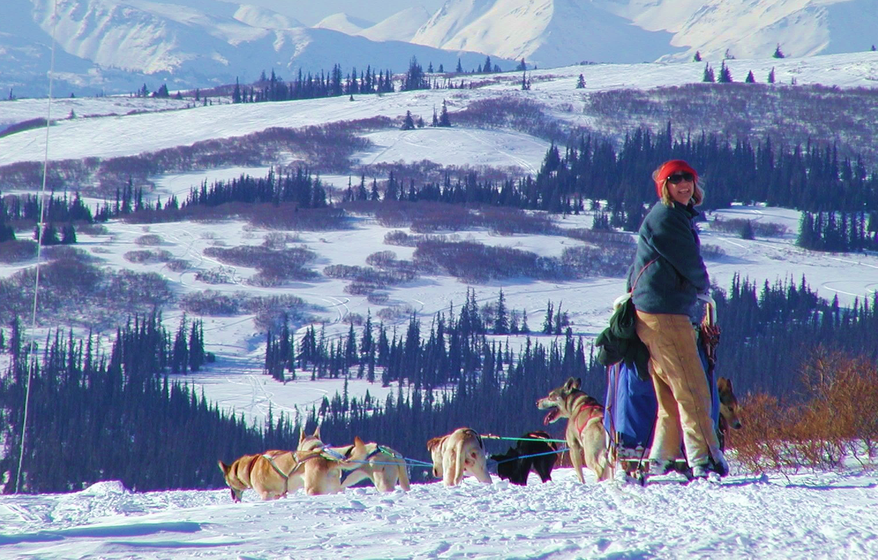
INTRODUCTION
The Fulbright Program
Established 1946 to expand and strengthen the relationships between the people of the United States and citizens of the rest of the world
Sponsored by U.S. Department of State’s Bureau of Educational and Cultural Affairs and administered by the Institute of International Education’s Council for International Exchange of Scholars (CIES)
Notes:
Photo Caption: Left- Dr. Joseph Withey, Associate Professor of English, East Carolina College, Greenville, North Carolina, discussing a planned book on Burmese dancing and dramatics with Kenneth Sein, one of Burma's leading dancers, during his Fulbright Research Scholar grant from July 1960-June 1961. Right: Linda Chamerlain, Adjunct Professor at the University of Alaska and Director/Public Health Scientist, Alaska Family Violence Prevention Project, was a 2014-2016 Fulbright Arctic Scholar.

Slide 30
INTRODUCTION
Fulbright in Numbers
380,000+ Fulbrights awarded since 1946 800
U.S. Scholar grants annually
160
Participants countries
37
Heads of State or Government
59 Nobel Laureates
82
Pulitzer Prize recipients
71
MacArthur Fellows
16
Presidential Medal of Freedom recipients

Slide 31
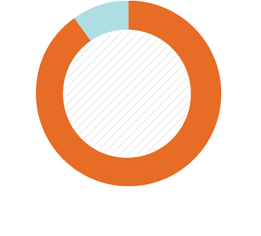
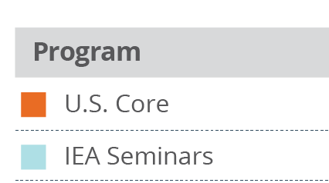
U.S. SCHOLAR PROGRAM
Fulbright U.S. Scholar Program
Core Fulbright U.S. Scholar Program
International Education Administrator Seminars
Collaborative Research
10%
90%
Percentage of U.S. Scholars
2017-2018

Slide 32
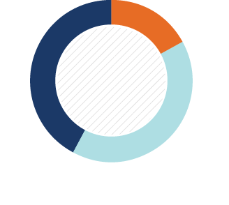
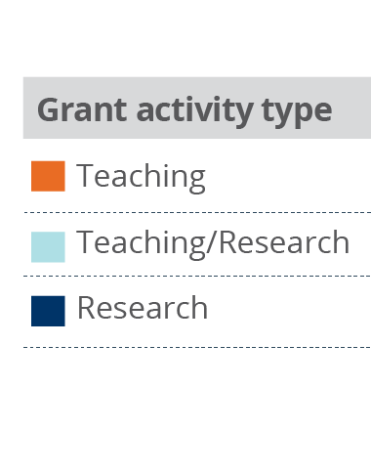
U.S. SCHOLAR PROGRAM
Core Fulbright U.S. Scholar Program
Supports teaching and/or research for three to 12 months
Programs active in +125 countries
For faculty, administrators and professionals
Open to all disciplines
Apply to specific award with proposed project
Application deadline: August 1
Variety of host institutions
42%
17%
Percentage of U.S. Scholar Activity
2017-2018
41%

Slide 33
U.S. SCHOLAR PROGRAM
Eligibility for U.S. Scholar Programs
U.S. citizenship
Degree as required by award
Ph.D. or other terminal degree may be required
Many awards are open to applicants with a Masters and professional or academic experience
Open to professionals and artists outside academia with recognized standing and substantial accomplishments
Teaching experience as required by award
New policies on previous Fulbright Scholar grants and waiting periods between grants
Notes:
Degree as required by award
Ph.D. or other terminal degree may be required
Many awards in the Core Program are open to applicants with a Masters and professional or academic experience

Slide 34
U.S. SCHOLAR PROGRAM
Core Fulbright Program Process
What do you want to do and/or where do you want to go?
Develop project and identify location
Apply
Peer Review and Selection
1
2
3
4
5

Slide 35
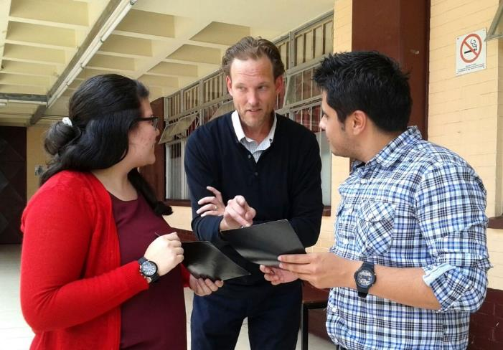
U.S. SCHOLAR PROGRAM
Application Resources
Fulbright Scholar Program website and Catalog of Awards
Apply
Application and Application Instructions
Application Guidelines, Project Statement Guidance and Samples
Learn
Webinars
The Fulbright Scholar Blog
Connect
MyFulbright

Slide 36
U.S. SCHOLAR PROGRAM
Application Components
Application Form
Project Statement
Curriculum Vitae or Resume
Letters of Reference
Additional components, depending on award
Course Outlines or Syllabi (for teaching awards)
Select Bibliography (for research awards)
Language Proficiency Report
Letter of Invitation
Supplemental materials for applicants in the Arts, Architecture, Writing and Journalism
Notes:
The project statement is your opportunity to lay out your proposed project specifics in as much detail as possible. Why Fulbright and why this country/institution/organizations?
Focus on what you plan to do; the specific courses you plan to teach/the methods and goals of your research
Outcomes from the grant - impact on hosts, home institution and you
How adaptable are you? How well will you deal with challenging situations?

Slide 37
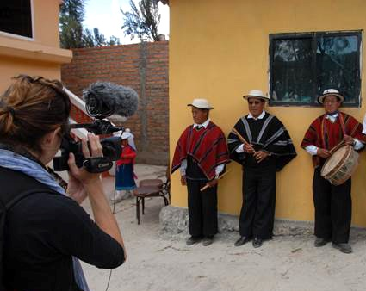
U.S. SCHOLAR PROGRAM
Project Statement
Your opportunity to lay out your proposed project specifics in as much detail as possible
Why Fulbright and why this country/institution/organizations?
Focus on what you plan to do; the specific courses you plan to teach/the methods and goals of your research
Outcomes from the grant - impact on hosts, home institution and you
How adaptable are you? How well will you deal with challenging situations?

Slide 38
U.S. SCHOLAR PROGRAM
Affiliations and Invitations
Host Institution:
If a host is identified, it will be found under Location in the Catalog
When a host is not identified, there are several resources to help find an affiliation:
International office on your campus
U.S. and Visiting Fulbright Scholar Directory
Review award description for suggested hosts or resources
Letter of Invitation:
Non-binding expression of interest from proposed host abroad
Should come from person with whom you will be collaborating
Should be on host institution letterhead

Slide 39
U.S. SCHOLAR PROGRAM
Submitting a Competitive Application
Address the Fulbright goal of promoting mutual understanding
Why you are interested in a Fulbright and why in your proposed host country
Professional expertise and skills you can offer; benefits to the host institution and host country; exchange of knowledge and experience
Cultural diplomacy; demonstrated flexibility, adaptability
Outcomes, impact, and multiplier effect
for your professional development, home campus, students, field at large; for your host institution
future collaborations; linkages: personal, professional, institutional; plans for sustaining relationships
internationalizing campus and curriculum

Slide 40
U.S. SCHOLAR PROGRAM
Review Process and Timeline
AUG.
Program staff conduct technical reviews for completeness
SEPT.
Discipline-specific committees review applications
SEPT. –
EARLY NOV.
U.S. peer review committees discuss applications for a single geographical region
NOV. – JAN..
Applicants notified of status - Recommended applications are sent to host countries and to the J. William Fulbright Foreign Scholarship Board
FEB. – MAY
Grantees notified of final approvals
MAY – JUNE
Grant packets sent to grantees

Slide 41
Application Process & Addt’l Info
Eligibility
Duration and Salary
Additional/Outside Employment
Return Service Requirement
Submission of Proposal
Deadlines to Apply
Process of Consideration
Sabbatical Leave Report Requirement
Resources
Who to contact

Slide 42
Eligibility to Take Leaves
First Sabbatical
6 years full-time credited service (CBA Article 27.2)
Served full-time for six (6) years at that campus in the preceding seven (7) year period prior to the leave
Example: Hired Fall 2017
Year 1 – 2017-18
Year 2 – 2018-19
Year 3 – 2019-20
Year 4 – 2020-21
Year 5 – 2021-22
Year 6 – 2022-23 eligible to apply for sabbatical to be taken during the 2023-24 academic year
Subsequent Sabbatical
6 years full-time credited service since last Sabbatical
NOTE: Credit toward tenure (2 years max) is also credited toward first Sabbatical eligibility period.
NOTE: Professional leave without pay (1 year max) can be credited toward sabbatical eligibility period.

Slide 43
Duration & Salary
Academic Year faculty/librarian/counselor:
One semester at full salary (6 pay checks)
Two semesters at one-half (50%) of full salary (12 pay checks)
12 month faculty/librarian/counselor:
Four months at full salary
Eight months at one-half (50%) of full salary
Department Chair:
Faculty employees serving as department chairs will not receive the department chair stipend while on sabbatical leave
For a split position with both academic year and 12-month components:
The higher appointment time base will normally be used to establish whether the faculty unit employee is placed into an academic year position or a 12-month position for the sabbatical.
Upon request of the faculty unit employee and approval of the appropriate administrator, a faculty unit employee whose majority appointment is on a 12-month basis may be assigned to an academic year position for the sabbatical

Slide 44
Additional/Outside Employment
Additional/outside employment while on Sabbatical/DIP Leave must be pre-approved by the President (or designee) Article 27.18 & 28.14. The Sabbatical/DIP applications contain a place to preliminarily indicate the nature of the employment, the approximate amount of compensation, the time involved, and whether the employment enhances the proposed activity or is completely separate.
A formal request must be submitted to the Office of Faculty Advancement (OFA) with the recommendations of the department chair and dean at the time of application or as soon thereafter that a faculty is aware of pending additional/outside employment. OFA will forward to the Provost (President’s designee) for consideration and final decision. Notification of the decision will be sent to the requesting faculty.
http://www.csus.edu/acaf/faculty/docs/facultydocs/sabb-dip_additional-or-outside-employment.pdf

Slide 45
Return Service Requirement
Faculty are required to render service to Sacramento State upon return from a Sabbatical leave at the rate of one semester of service for each semester of leave.
Note: Failure to provide this return service prior to separation or retirement could result in the faculty member being required to pay back the salary received while on Sabbatical leave.
Note: At the time of application a List of Assets or a Promissory Note is required as a guarantee of repayment in case the service return requirement is not fulfilled (CBA 27.9).

Slide 46
Submission of Proposal
Sabbatical Leave Applications
Are only accepted online at: http://web1.irt.csus.edu/campus_forms/sabbatical/
The following items are required as a part of the application process and are to be submitted electronically with the on-line application:
Proposal
A signed fully approved copy of your last Sabbatical report from your previous leave (if applicable)
Department statement as to the effect on the curriculum and the operation of the department should the leave be granted
Note: Samples of “Best” sabbatical proposals are maintained in the Office of Faculty Advancement, Sacramento Hall Room 155, ext. x82913, faculty.advancement@csus.edu. Please contact our office to arrange a time to review the proposals.

Slide 47
Deadlines to Apply
Sabbatical Leaves
Sabbatical Application Deadline: TBD - anticipated to be last Friday of September 2020

Slide 48
Process of Consideration for Sabbatical
Department provides a statement regarding the possible effect on the curriculum and the operation of the department should the sabbatical be granted. Article 27.6
Dean/appropriate administrator considers (1) statement from the Department, (2) budget implications/other campus program needs, and (3) applies the criteria and ranking described in 5.0-6.4 of the campus policy and provides recommendation. (Article 27.7)
Sabbatical Leave Committee (SLC) (Article 27.5) provides recommendation applying the criteria and ranking described in 5.0-6.4 of the campus policy.
Provost and Vice President for Academic Affairs (President’s designee) considers recommendations as noted in items above and makes final decision. Article 27.8
Provost and Vice President for Academic Affairs (President’s designee) shall respond in writing to all applicants, Dean/Department and the SLC regarding approval/denial.

Slide 49
Sabbatical Leave
Report Requirement
Unit 3 employees who take a Sabbatical Leave are required to submit a leave report within one semester of their return. The report is submitted to the Office of Faculty Advancement and then sent forward for review by the SLC/Provost. Faculty will be notified and provided a copy of the report with final decision and appropriate signatures.
The SLC meets twice per year (September and April) to review reports.
The report form is available on-line at:
https://www.csus.edu/academic-affairs/faculty-advancement/_internal/_documents/sabbatical_report.pdf

Slide 50
Resources
https://www2.calstate.edu/csu-system/faculty-staff/labor-and-employee-relations/Documents/unit3-cfa/article27.pdf
https://www.csus.edu/umanual/acad/ACA-0149.htm
https://www2.calstate.edu/csu-system/faculty-staff/labor-and-employee-relations/Documents/unit3-cfa/article28.pdf
https://www.csus.edu/umanual/acad/ACA-0148.htm
OFA website with Sabbatical & Difference-In-Pay Leave information, workshop presentations and Benefits FAQ’s available at: https://www.csus.edu/academic-affairs/faculty-advancement/internal/sabbatical.html#Sabbatical_Leaves

