Slide 1

Expenditure Transfer 101
Monday, November 16, 2020
Accounting Services

Slide 2

EXPTX Training Agenda
What is an Expenditure Transfer?
Types of Expenditure Transfer Requests
Who can submit an EXPTX Request (Delegation of Authority)
How to submit an EXPTX Request (OnBase Form & Email)
Quarterly Reporting Review & Deadlines
Tips & Tricks
Resources & Future Trainings
Poll Evaluation

Slide 3
What is an Expenditure Transfer?
Basic definition: Moving a posted expense from one chartstring to another
  You’ve identified an expense that was charged to the wrong fund, department, account, or without a class code, project code, etc.
    Last resort correction when a PO or voucher amendment is not an option, or you’ve missed the deadline to reconcile the Procard statement
    To correct a Campus Cost Recovery (CCR) chargeback when the service provider is not able to correct them via the CCR process
    To correct fund for travel expenses initiated in Concur
  You want to split an expense between multiple chartstrings
  You want to reclassify an expense, e.g., change from Supplies and Services (660003) to I/T Software (616003)

Slide 4
Types of Expense-to-Expense Requests:
Full Transfer
    Move entire expense that was posted to the wrong fund, department, account, or without a class code, project code, etc., to correct chartstring
Cost Share
    Split an identified expense between two or more chartstrings, e.g., supplies and services shared between two different courses within a college/department

Slide 5
Other Types of Transfer Requests:
Cost Recovery (Service Provider Use Only)
    Used for service provider chargebacks.
    Account codes used are restricted to 617xxx for expense and 580094 or 580095 for reimbursement
Transfer of Prior Year expenses
    Move an expense that occurred in a prior year
    The Excel Expenditure Transfer Request Form must be completed and submitted to Accounting Services, as OnBase only retrieves current year transactions

Slide 6
Other Types of Transfer Requests:
Revenue Transfers
    Used to correct revenue transactions
    Use Excel Revenue Transfer Request Form and not OnBase
Sponsorships
    Provide funding to other departments in support of mutually benefitting events
    Use Excel Sponsorship Transfer Request form and cost recovery account codes

Slide 7

Expenditure Transfer (EXPTX) Form
Request
No.
DOA
Faster Posting
24/7 Status Check
Auto-population of fields
Fewer keystrokes
Emails
FDW
Eliminates the need for Supporting Documentation from FDW, Financial Summary as of Period
Sends emails to the requestor & all selected DOAs
Assigns a request # for each submission for ease of tracking in OnBase, CFS and FDW
Allows all staff to virtually view the form & the status anytime, 24 hours a day 7 days a week
Automates interface resulting in a faster posting turnaround time

Slide 8
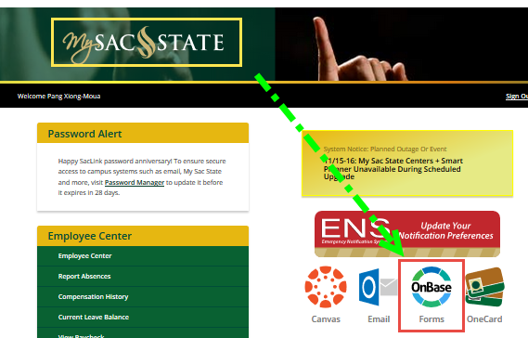


Access (EXPTX) Form
Do you have Expenditure Transfer Delegation of Authority (ET DOA)?
  To check the current list of DOAs navigate to CMS >Sac Delegation of Authority>View Delegation of Authority>Delegation Inquiry
To access the form log in to My Sac State>Staff Services>My Forms>Expenditure Transfers or follow this link, https://onbase.csus.edu/unity/forms/ExptTransfers.aspx. Open the form in the Chrome browser for full automation functionality.

Slide 9
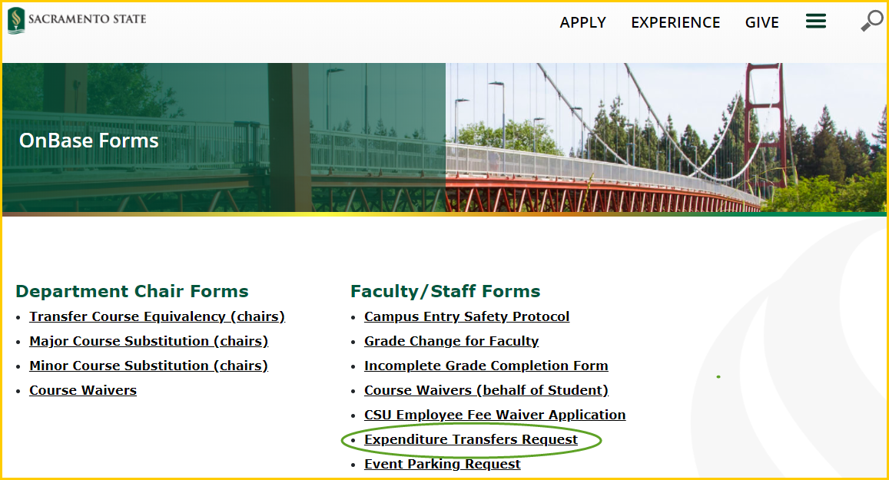
Access (EXPTX) Form

Slide 10
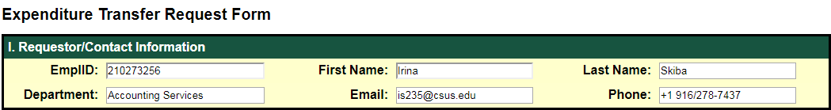
Step by Step Instructions:
Section I
Requestor/Contact Information
      All auto-populated fields from campus directory
      Fields are locked to preserve the security of the DOA
      Requires log in with My Sac State credentials

Slide 11
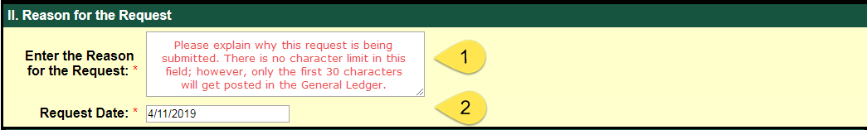
Step by Step Instructions:
Section II
Reason for the Request
  Enter a detailed explanation for the transfer
  The first 30 characters will get posted in CFS, but enter as much detail as possible
  The request date will auto-populate with the current date

Slide 12
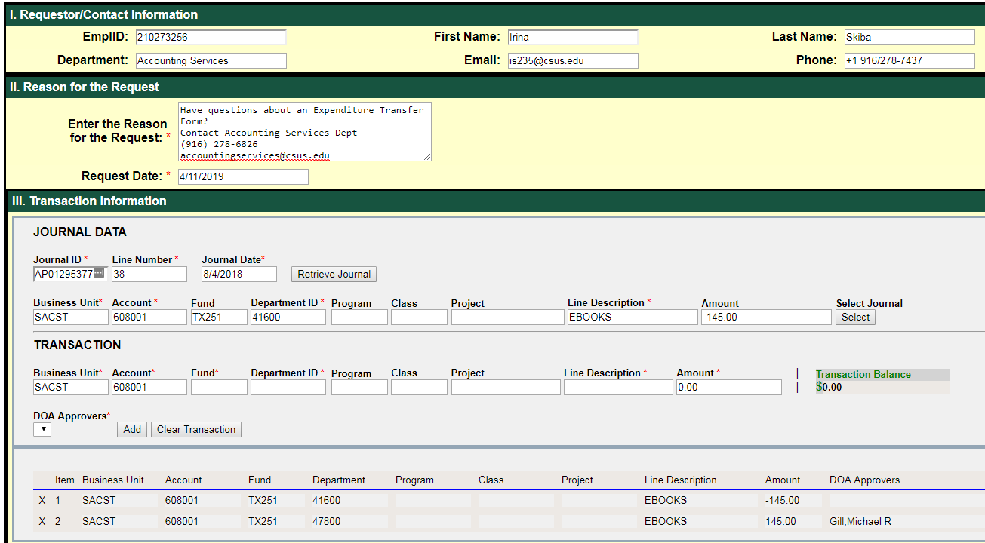
Step by Step Instructions:
Section III
Notes:
Section III: Transaction Information
Enter Journal ID & Journal Line Number and click “Retrieve Journal” button
The chartstring associated with the journal ID and the line number will auto-populate and reverse the sign for the amount
Press “Select” to advance to Transaction area for editing
For full transfer requests click “Add” to move the original chartstring to the journal entry area on the very bottom
For partial transfer requests modify the amount in Transaction area first, then select “Add”
You may choose to customize the line description within the 30 character limit
Enter the offsetting chartstring where the charge will be going in the Transaction area
Select the DOA(s) from the dropdown
Ensure that Transaction Balance is “0” and then “Submit” the form

Slide 13

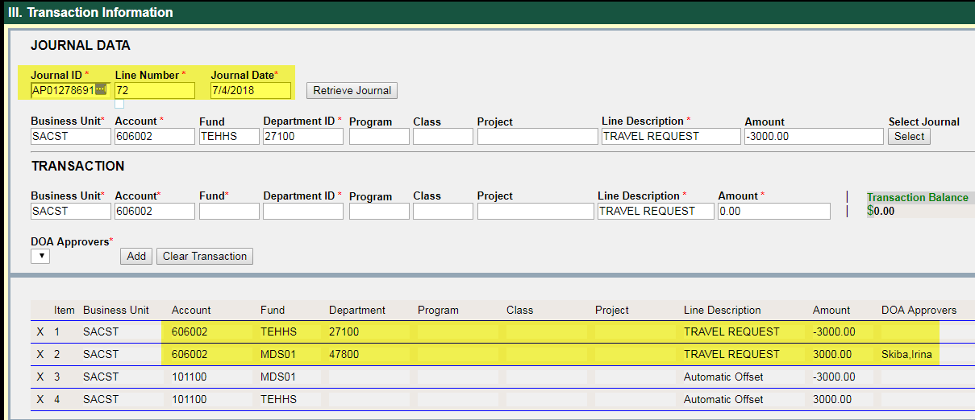
Example: Full Amount Transfer
Notes:
Full Amount Transfer:
Correcting a Dept ID for a travel charge.
The total cost of the expense was $3,000. Full amount is being transferred to 606002 MDS01 47800. Different fund auto-populated a cash offset (101100).

Slide 14
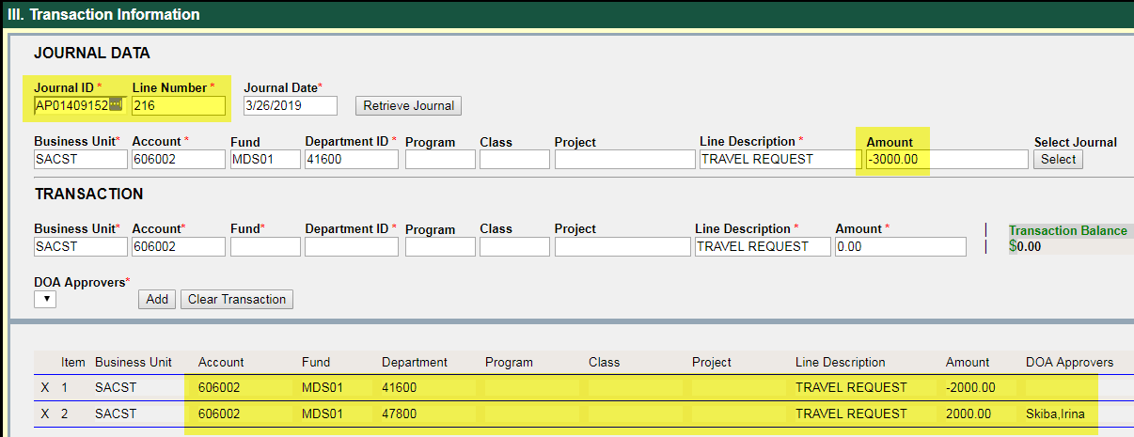
Example: Cost Share
Notes:
Cost Share (partial amount):
Library allocates a portion of Travel charge to Accounting Services
The total cost of the expense was $3,000. A partial amount ($2,000) is being transferred to 606002 MDS01 47800.

Slide 15
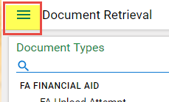
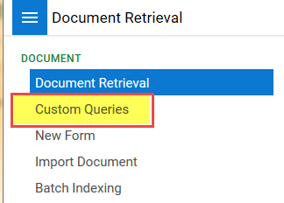
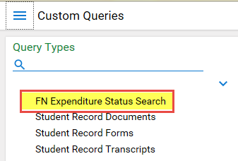
Check Status 24/7
All staff on campus have access to view submitted OnBase EXPTX Requests, 24/7.
Go to https://onbase.csus.edu to open the form in Custom Queries.
  Document Retrieval>Custom Queries>FN Expenditure Status Search.
  List of searchable fields:
    Employee ID
    Requestor’s First Name, Last Name
    Department ID
    Request No.
    Journal ID
    Journal Line Number
    Journal Date
    Request Date
    Project Code
    Fund Code
    Program Code
    Class Code
*** Note: Opened forms stop the workflow, so don’t forget to close the form after viewing!***

Slide 16
Form Tips & Tricks
Use Caps Lock for all fields in order to trigger auto-population, dropdown and retrieval of journal data.
Don’t hover over the fields during the entry. Move the mouse away from the field. Navigate through the fields by pressing “Tab” after done typing.
Business Unit: Transfers within SACST business unit only. No SAFDN expenditure transfers to be submitted via OnBase.
Cash Offset (101100): Transfers between two or more Fund Codes will have an itemized cash offset line automatically inserted. This is needed for the upload.
DOA: Select the staff who is aware of the request in each department. If the transfer is split to multiple departments a DOA staff must be selected for each.
Submit button will only be un-highlighted when all required fields are filled out all the audit rules are met.
Clear Form button clears all fields in Sec II & III and allows data to be re-entered.
Can I save the form? No, but the form doesn’t expire unless the window is closed.

Slide 17
Form Tips & Tricks
Audit & Validation Rules enforced by OnBase Form:
  The form will verify that the expense already exists in CFS/FDW/UDW at the time when Retrieve Journal is clicked. The form will not allow submissions for non-posted journals.
  Quarterly submission deadlines are enforced. OnBase will check the request date, journal date and the quarterly deadline. All late requests must be justified via email.
  MDR01 must have a reimbursed activity class code that begins with “0” and ends with “A”.
  Accounts with 601xxx, 603xxx are for salary, and will be reviewed by the Budget Office first once the form is submitted.
  The net amount/transaction balance for each request should always equal zero.
Email notifications to the requestor & all DOAs
  Submission Confirmation includes request no., requestor name, journal ID, line#, journal date and reason for the request.
  Denial if applicable (departments have 30 days to fix the request with Accounting)
  Posted to General Ledger confirmation includes the request no. and journal ID

Slide 18
Form Tips & Tricks
Timing difference effects on OnBase Form
  University Datawarehouse (UDW) integration allows original charge auto-population
    Updates are 2 days behind from the real time data posted in CFS
    Submit requests at least 2 days after the charge is posted in CFS
      Ex: If the journal date was 4/20/2019 you may submit a request beginning with 4/22/2019
  Financial Datawarehouse (FDW) allows to view the posting
    Updates are 1 day behind from the real time data posted in CFS
    Search requests 1 day after the charge is posted in CFS
      Ex: Email received notifying of the request posting = check FDW next day
Late requests: Email justification to accountingservices@csus.edu and include the request #.
Create IRT Service Now ticket if there are any problems with the OnBase form
https://www.csus.edu/irt/
Concur travel requisitions currently default to MDS01. If needed, please make corrections to the chartstring prior to approving the travel claim for reimbursement.

Slide 19
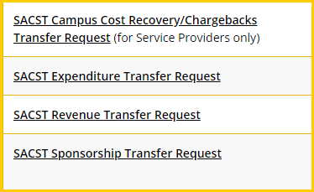
For non-expenditure transfers, please use one of the Excel transfer forms available on the ABA Forms webpage under Accounting Services under Accounting.
The completed Excel form is submitted to accountingservices@csus.edu
Excel Transfer Forms

Slide 20

University Foundation at Sacramento State (UFSS) expenditure transfers cannot be processed via OnBase
An Excel transfer request form has to be completed and submitted to ufssaccounting@csus.edu
The form is available on the ABA Forms webpage under University Foundation at Sac State (UFSS)
UFSS Excel Transfer Form

Slide 21
EXPTX Tips & Tricks
Submit EXPTX Monthly
Federal Work Study EXPTX are not allowed
  Accounts: 602001 and 602002
  For questions please contact Jennifer Barrett, x86020 or barrettj@csus.edu
Construction related EXPTX
  For all construction related questions and requests, please contact Hai Ly, x87230 or via email lyht@csus.edu
  Expenditures in claimable funds must be moved via voucher adjustment (e.g. DMxxx, DCDxx). Refer these to LaVerne Simmons-Barnett, x87009 or via email barnettl@csus.edu
Payroll EXPTX
  Salary and benefit expenses, account codes beginning with 601xxx or 603xxx
  Contact the Budget Office to determine if corrections can be made via LCD Adjustment or EXPTX Transfer

Slide 22
EXPTX Tips & Tricks
MDR01 must have a reimbursed activity class code, 0xxxA
When filling out the OnBase Form, Do Not use any special characters, including commas, in Section III as these will prevent the form from uploading in CFS.
Non MDS01 funds must have enough Cash (101100) available to cover the expense
Do not move an expense (617xxx) posted via the Cost Recovery process to another expense account. Please contact the service provider first to correct any errors.

Slide 23
EXPTX Tips & Tricks
  Watch the Debits and Credits: Credit the original expense to move it from the original chartstring, and Debit the expense to the correct chartstring. Note: It’s possible to move a credit to an expense, in which case the opposite will apply.
  Cash Posting Order (CPO) journal entry corrections must be submitted to Accounting Services (accountingsevices@csus.edu) for review and processing. [JE#: xx009, xx099, Source: CPO]
  Speedcharts can be set up as needed for reoccurring charges. To set up a speedchart, send a request to accountingservices@csus.edu

Slide 24

Expenditure Transfer Request Deadlines
Posted Expenses | Transfer Request Submission Deadlines *
1st QTR: July-September | Last business day in October
2nd QTR: October-December | Last business day in January
3rd QTR: January- March | Last business day in April
4th QTR: April – June | Please refer to Year-End Dept Deadlines on Accounting Services Website
* Valid justification must be included with late submission requests

Slide 25
Resources
EXPTX Form
Financial Summary as of Period Data Warehouse Guide
Accounting Services website
CMS & CFS Access (CARS)

Slide 26
Please complete the poll survey. Additonal comments may be sent to accountingservices@csus.edu
Questions ?
Next training is schedule for Monday, December 14, 2020, 2-4 pm. Sign up located on ABA-Financial Services website
https://www.csus.edu/administration-business-affairs/financial-services/
Thank you!

