Slide 1
CENTRAL RECEIVING STOCK RECEIVED REPORT
New OnBase online form submission for Sacramento State.

Slide 2
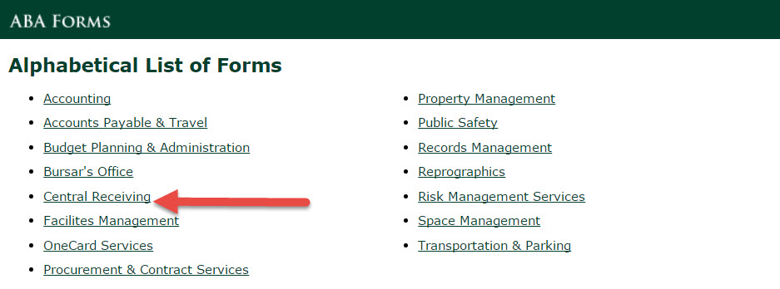
http://www.csus.edu/aba/forms.html

Slide 3
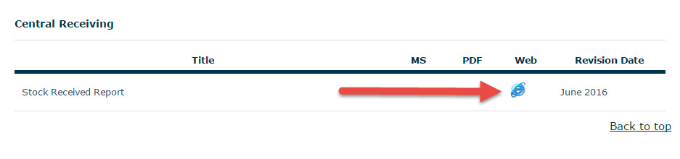
http://www.csus.edu/aba/forms.html#Central_Receiving

Slide 4
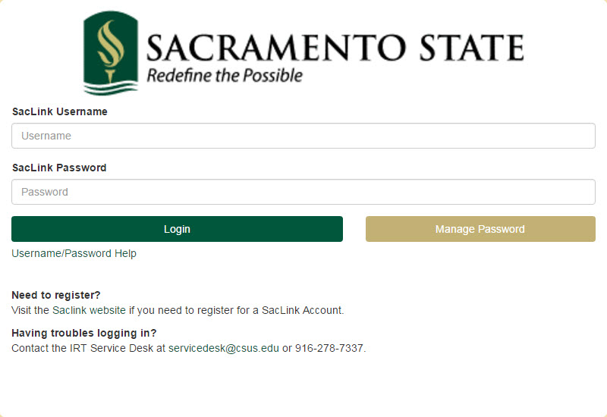
Login using your SacLink credentials

Slide 5
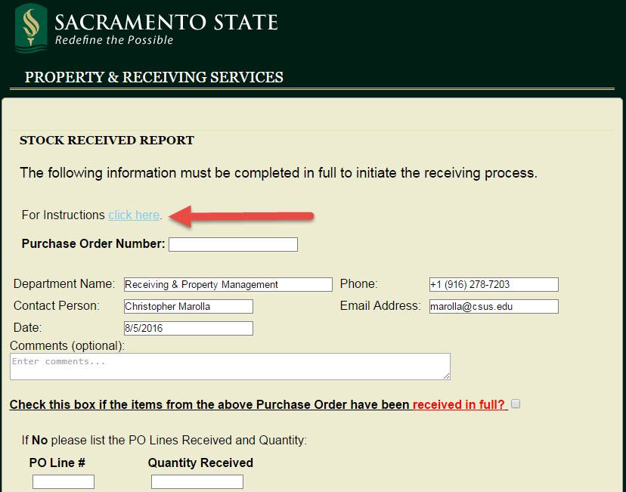
Instruction can be found http://www.csus.edu/aba/central-receiving/stock-received-reports.html

Slide 6
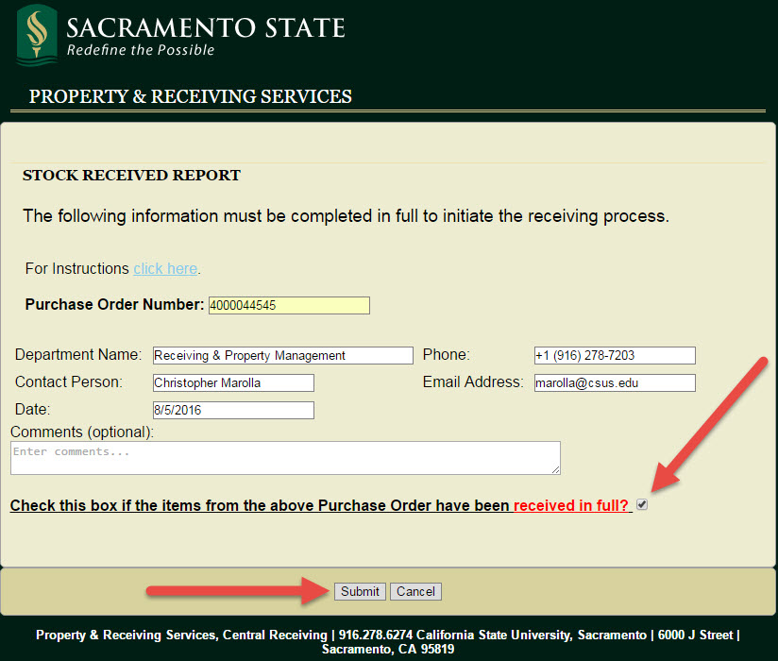
Enter your PO number
If PO is complete check the box and click submit

Slide 7
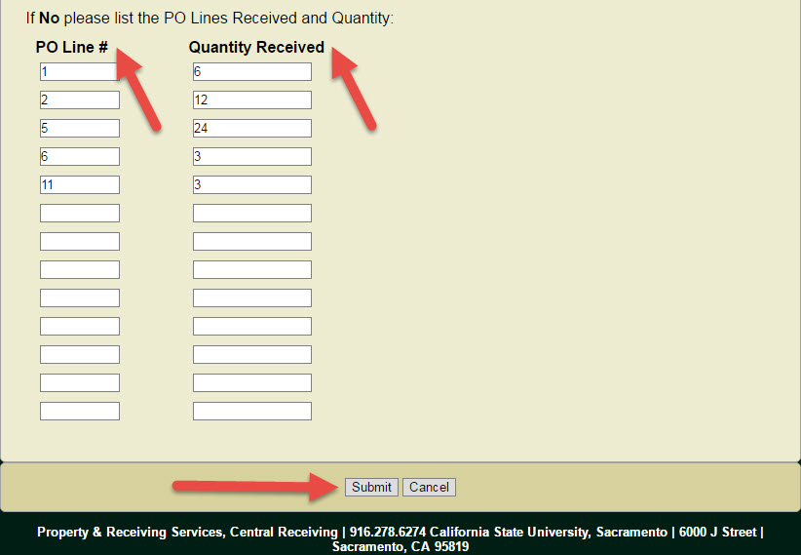
If incomplete enter line number and quantity then click submit

Slide 8
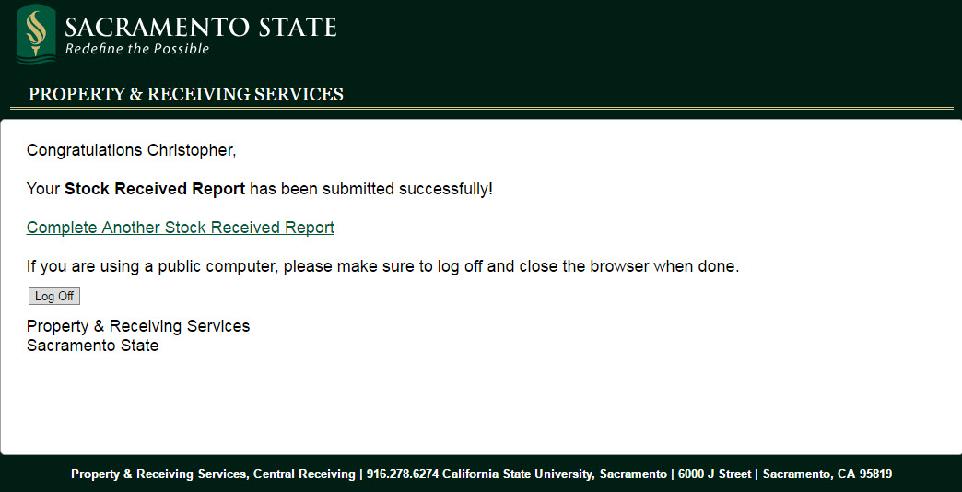
Success!!!

Slide 9
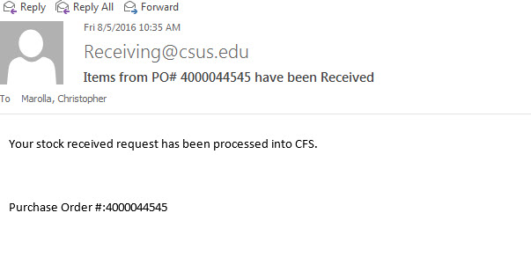
You will be notified

Slide 10
QUESTIONS?
Chris Marolla
Property & Receiving Services
Phone 87203 marolla@csus.edu

