Slide 1
CSUBUY: Procure-to-Pay (P2P)
Demo Series: IT
Presenter: Rachael Gipson, Cal Poly Humboldt
Notes:
Speaker: Sara
Hello and welcome to the CSU Systemwide CSUBUY Procure-to-Pay — or P2P — Demo Series.
We’re excited to have you join us as we continue preparing for the rollout of CSUBUY P2P across all CSU campuses.
CSUBUY P2P is a comprehensive, systemwide solution designed to streamline and standardize the full procure-to-pay process. This powerful tool brings together multiple functions under one platform, including:
Supplier self-registration and access to a systemwide shared supplier database
Requisition entry and purchase order issuance
Receipt tracking and payment processing
And a centralized location for routing and collecting all necessary financial and compliance approvals
By integrating these capabilities, CSUBUY P2P supports greater efficiency, transparency, and consistency in our procurement and payment activities across the CSU system.
Today’s session is one in a series of demos that aim to give you an early look — a peek behind the curtain — at various parts of the new system. To respect your time and ensure clarity, we’re breaking down the different functions of P2P into focused demo sessions. Please keep in mind that this is not a training session — these demos are for general exposure only. Formal, hands-on training will be provided closer to your campus’s go-live date.
Each demo will follow the same webinar format and will be recorded. Recordings will be available on your campus's CSUBUY P2P website for those unable to attend live.
The Q&A feature will remain open throughout today’s session, and we’ll do our best to answer as many questions as possible. At the end of the demo, we’ll also share the name and contact information for your campus lead, so you know who to reach out to with questions or follow-up needs.
Once again, thank you for being here — let’s get started.

Slide 2
Introduction
Timeline
Demo
Key Objectives and Takeaways
Q & A
Agenda
Notes:
Speaker: Sara
Here’s what we’ll cover in today’s session. We’ll start with a brief introduction to CSUBUY, then review the overall project timeline and current status. We’ll provide some context for compliance approvers in the new P2P system and then move into the demo itself.

Slide 3
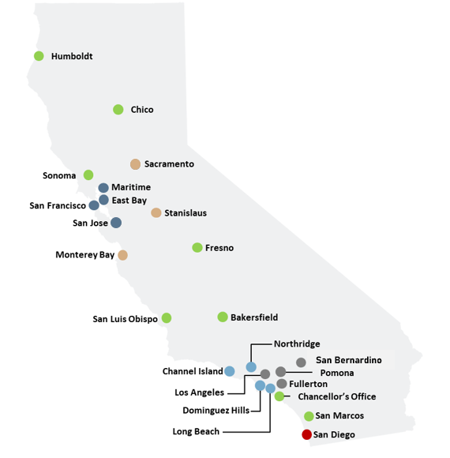
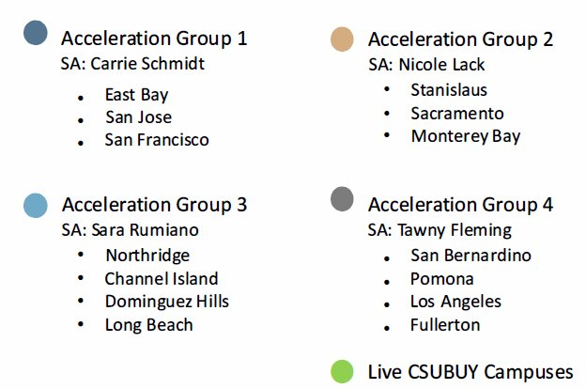
Strategic Advisors
Notes:
Speaker: Sara
To support the CO CORE team with the P2P implementation, the non-live campuses have been organized into regional groups, with each group assigned a Strategic Advisor. The Strategic Advisors are Carrie Schmidt, Nicole Lack, myself — Sara Rumiano — and Tawny Fleming. Each of us brings extensive experience and expertise in procure-to-pay processes, and we are here to help guide and support campuses throughout their implementation journey. Note the live campuses are shown with green dots.
The first two CSU campuses successfully went live with P2P in October 2023, marking a major milestone in this systemwide transformation. Since then, two additional waves have continued the momentum, bringing more campuses onto the platform. With the introduction of the Chancellor’s multi-university collaboration initiative, the timeline for full implementation has been accelerated. As a result, the remaining campuses are now scheduled to go live by early 2026, ensuring that the entire CSU system benefits from a unified, modern procure-to-pay solution.

Slide 4
CSUBUY P2P:
Project Vision & Goals Review
Notes:
Speaker: Tawny
Before we dive into functionality, let’s take a moment to review the vision and goals of CSUBUY P2P. Understanding the ‘why’ helps us better understand the design and decisions that have shaped this project.

Slide 5

CSUBUY P2P: Vision
It is the implementation of strategic, standardized procurement processes that allows for the elimination of manual touchpoints and steps resulting in efficiencies through automation, risk mitigation and cost savings for the California State University
Notes:
Speaker: Tawny
Our vision for CSUBUY P2P is to standardize procurement processes across the CSU, reduce manual steps, and drive efficiencies through automation. Ultimately, this means saving time, reducing risk, and lowering costs.

Slide 6
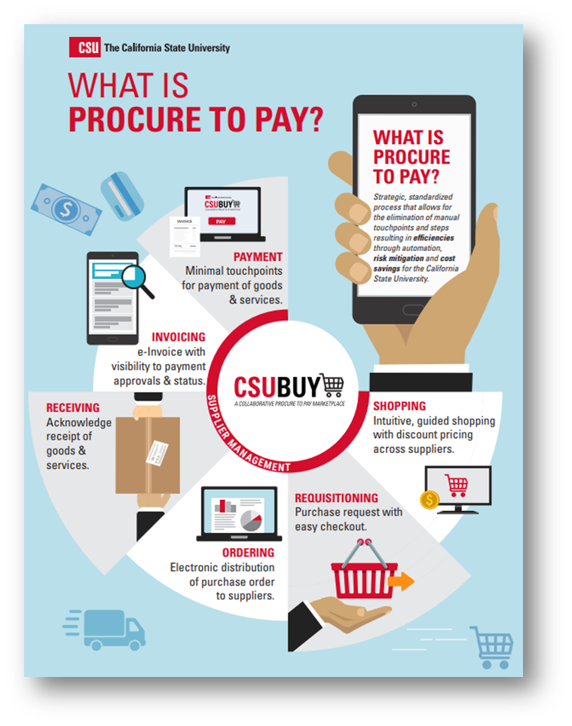
CSUBUY P2P: Objectives
Develop a systemwide platform that integrates disparate data and processes into one streamlined solution
Implement an intuitive and easy to use solution
Create visibility to preferred and sustainable suppliers and guide end users to contracted suppliers.
Drive process efficiency through integration and automation to reduce manual work
Improve compliance and reduce costs
Notes:
Speaker: Tawny
The objectives of P2P are centered around creating a streamlined, integrated platform that simplifies and enhances how we manage procurement and payments across the CSU system.
The graphic on this slide visually represents the entire procure-to-pay lifecycle and the key functions that P2P supports. Starting with shopping for goods and services — users can engage in purchasing with access to preferred, contracted, and sustainable suppliers. This flows into requisitioning, ordering, and receiving, all of which are handled in a centralized environment with fewer manual steps. The process concludes with invoicing and payment, emphasizing automation, minimal touchpoints, and visibility throughout.
What’s important to understand is that P2P will replace many of the fragmented, campus-specific tools and manual workflows currently in use. It consolidates supplier management (including supplier self-registration and a shared systemwide supplier database), requisition creation, purchase order (PO) issuance, receipts, and invoice processing — all into one cohesive system.
While P2P will integrate with PeopleSoft CFS, allowing for necessary financial synchronization, the day-to-day work will take place within the P2P platform. For example, users will initiate and approve requisitions, manage POs, and review receipts and invoices all within P2P. To keep these demos digestible, we are breaking down the full functionality of P2P into multiple demo sessions, each highlighting different aspects of the platform.

Slide 7





CSUBUY P2P: Benefits
Streamline Procurement and Payment Processes: Consolidate disparate data and processes into a single stream​​lined electronic solution, increasing automation to reduce manual inefficiencies
Improve User Experience: For both suppliers and internal customers, CSUBUY P2P will offer an intuitive and simplified experience.
  Suppliers will benefit from electronic receipt of PO’s and submission of invoices, timely payment and self-service access to check invoice approval and payment status.
  Internal Customers will have easy shopping and check out, access to order and payment status, and a single tool for reconciliation of purchases and payments
Better Data Quality for Decision Making: Improve reporting capabilities, enabling CSU to better identify shared suppliers and leverage negotiating power to drive cost savings.
Increased Visibility: One consolidated P2P system will increase access to data and information for both CSU employees and our suppliers, enabling cross campus visibility in key areas.
Continuous Improvement: CSUBUY P2P drives forward the strategic, systemwide focus on continuous improvement to increase efficiency and effectiveness throughout the organization.​
Notes:
Speaker: Carrie
The P2P platform offers a range of valuable benefits. For suppliers, it ensures timely payments and provides convenient self-service tools to track invoice and payment status. For internal users, it streamlines the purchasing experience and automatically routes requisitions and purchase orders to include all necessary financial and compliance approvals. The new P2P platform will replace the current CSUBUY Marketplace that requires a PCard to complete transactions, so it will also reduce the amount of monthly transactions that will need to be reconciled.
At a systemwide level, the platform enhances data quality, increases visibility across campuses, and supports our ongoing commitment to operational efficiency, accountability, and strategic improvement.

Slide 8

CSUBUY: Acceleration Timeline
Resource Planning & Campus Assessments
Acceleration Implementation
Deployment &
Hypercare
DOA Enhancements & Integration Build
DOA Production Readiness & Promotion
Production Readiness Activities
Notes:
Speaker: Carrie
This slide shows our high-level timeline. The 14 campuses that are part of this acceleration project are currently in the implementation phase, with readiness and deployment activities scheduled through early 2026.

Slide 9
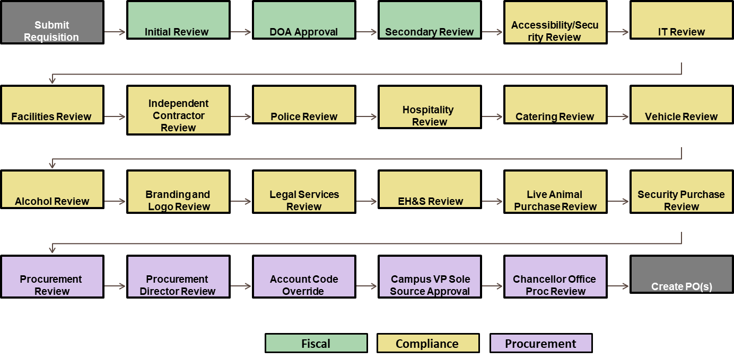
CSUBUY P2P: Requisition Workflow Steps
Notes:
Speaker: Carrie
This slide shows the options for requisition workflow in CSUBUY P2P, from submitting a request to creating the purchase order. The process includes key reviews for fiscal approval, compliance checks—like IT, facilities, and legal—and finally, procurement authorization. Each step is triggered based on the details of the requisition, helping ensure accuracy, policy alignment, and accountability before any purchase is finalized.

Slide 10
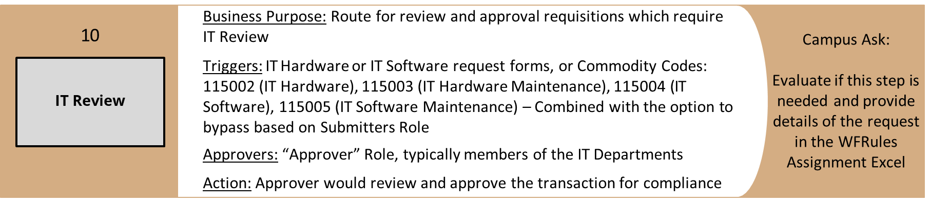
CSUBUY P2P: Requisition Workflow Triggers – IT Compliance
Notes:
Speaker: Sara
This slide shows how requisitions flow through the IT compliance review process. The review is triggered when a requester submits either an IT Hardware or IT Software request form; or if the listed commodity codes are used. The important point here is that IT plays a critical role in ensuring compliance before a requisition can move forward.

Slide 11

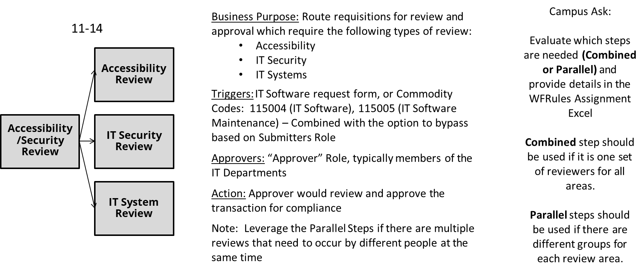
CSUBUY P2P: Requisition Workflow Triggers – IT Compliance
Notes:
Speaker: Sara
This step is triggered whenever a requisition involves IT software requests or the listed commodity codes. Campuses have the ability to select if they would like a single Accessibility/Security Review, or to have three separate but parallel reviews for: Accessibility, IT Security, and IT System. The goal is to ensure that anything technology-related gets the right level of oversight before moving forward.

Slide 12
CSUBUY P2P: Configuration Disclaimer
All functional materials, recommendations, and application configurations have been defined by the CSUBUY P2P Core Project Team based on best practice, initial requirements and specific insights from the live campuses. The configuration shown today is in our Test Site. You may see functionality that are in pending review by various user groups and may be subject change.
Notes:
Speaker: Tawny
Please keep in mind that this demo is being shown in the current test site the campus specific configuration. You may see functionality that is still pending the P2P Core Project Team's review and campus user acceptance testing so your campus specific final configuration is subject to change.

Slide 13
CSUBUY P2P:
IT Overview
Notes:
Speaker: Carrie
Now we’re going to shift into the IT portion of today’s session. This will lay the foundation for understanding what you’ll see in the demo.

Slide 14

Activity
Previous vs. Current State
How Notification Are Received Email In P2P (flag in top right corner) In P2P Approvals Queue
Reviewing Where to Go into the Form How to See Questions Answered What to Review - Policy and Compliance How to Comment (How to Add People to Comments)
Action Approve Return
DEMO
Notes:
Presenter

Slide 15
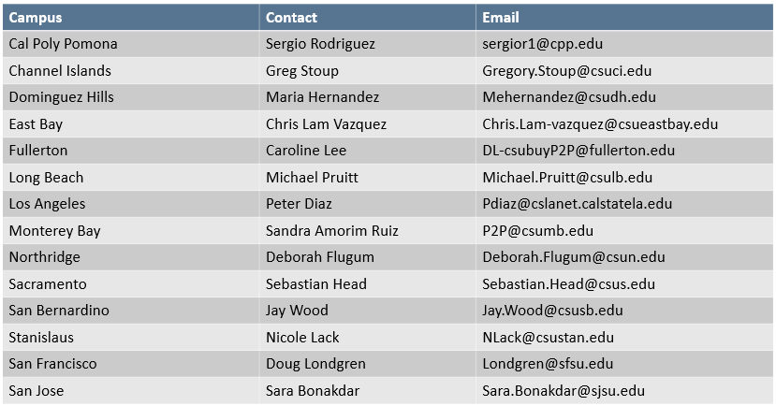
CSUBUY P2P: Campus Contact
Notes:
Speaker: Sara
Thank you for you for your attendance today. If you have questions about the P2P project on your campus, please direct your inquiries to your local campus contact listed here.

