Slide 1
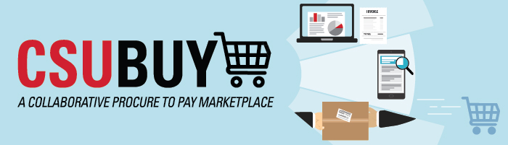
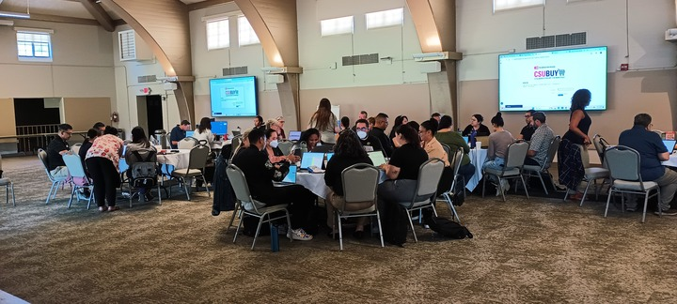




Procure-to-Pay (P2P) Objectives
Implement strategic, standardized process
Increase efficiencies by eliminating manual touchpoints
Mitigate risk and increase cost savings
63%
p2p.calstate.edu
Configuration
Completed Campus Security Roles and Permissions
Configured CFS and CSUBUY in Preparation for UAT
Validated and Tested Setup for UAT
Delegation of Authority (DOA)
Designed and Built DOA Module and Integrations
Supplier
Sent Supplier Invitation Announcement to Campus
Attended Supplier Onboarding Training
Training and Demos
Conducted End User and Admin Approver Demos
(> 2,000 attendees)
Reviewed and Modified Training Documentations for UAT
Attended User Acceptance Testing (UAT) In-Person Workshops
User Acceptance Testing (UAT) San Jose (North)
September 5-9
Channel Islands (South)
September 15-18
Recently Completed
UAT
Campus completion of UAT Scripts & Signoff
Configuration
Analysis of Campus Roles
Training and Demos
Operational In-Person Campus Trainings
Campus End User and Approver Training Strategies
Communicate Campus Cutover Strategy
Configuration
Participate and Complete UAT Test Scripts & Business Processes
Refining Roles and Permissions Based on Testing
Validate and Test Configuration Change Requests
Delegation of Authority (DOA)
Complete DOA Import File
Attend DOA360 Training
Run Sample DOA Import
Supplier
Complete Supplier Analysis and Cleanse for All BU SetIDs
Send Supplier Round 1 Invitation Announcements and Invites
Extend CSU Network Suppliers to Acceleration Campus
Training and Demos
Conduct End User and Admin Approver Demos
Communicating to Campus Stakeholder Groups
(meetings, website, portal announcements)
Coming Soon
In Progress
Risks
Resource constraints with multiple competing priorities (CSUBUY, Concur, CHRS Upgrades)
Project communication to campus stakeholders

