Slide 1
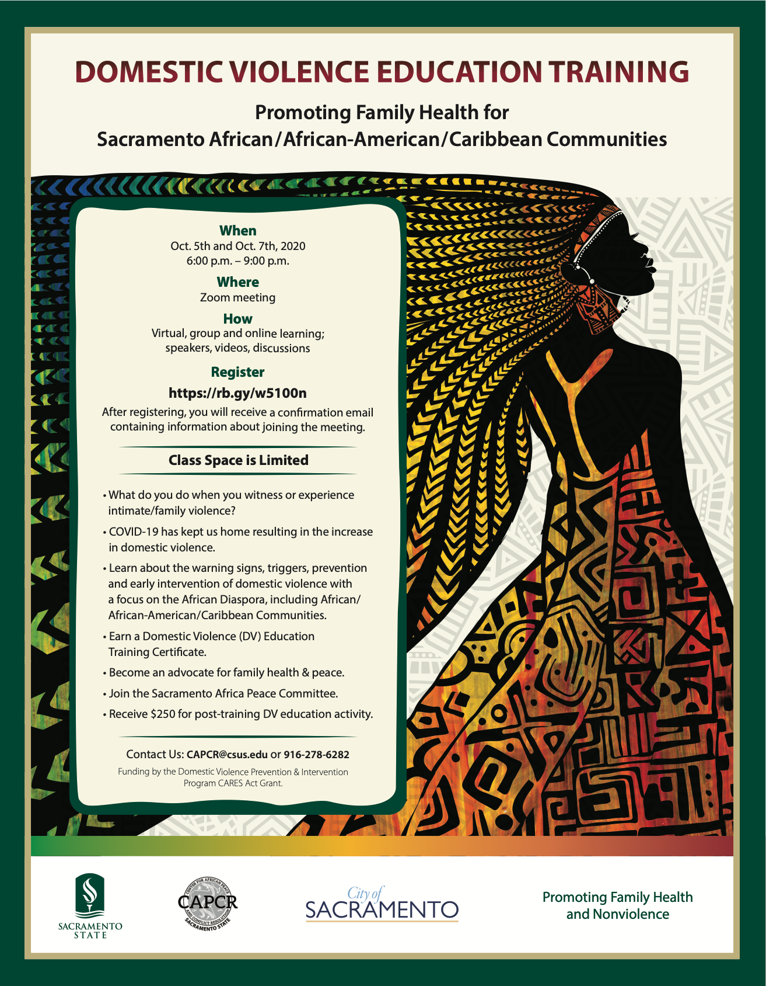
Community Educator Training October 19, 2020. 6-7 pm
Welcome
Review Key Concept from Initial DV Training
Formulating Prevention and Responses
Healing Responses
Wellness, journaling, therapy,
Restorative Justice Orientation
6 min. video
Planning for Communities Educators
Communities of Interest
Specific Aims/Plans

Slide 2
How to educate About DV… What to do if SOMEONE YOU KNOW IS BEING ABUSED?
Information on use of our services under this contract here
Notes:
Guadalupe

Slide 3
Victim Focused Response to DV
Therapy
Self-Care Checklist
Safety Planning
Affirmations
Journaling
Notes:
Haggins

Slide 4
THERAPY
If you feel that therapy might be helpful, sooner is always better. Therapy can be beneficial for everyone because it’s a place where you can learn increased self-awareness, clarify your goals and look at the choices in front of you.
Counseling sessions provide a safe and confidential environment for survivors to express their feelings, thoughts and fears. Counselors are nonjudgmental third-party advisors who listen and can help survivors work through the things that they are experiencing.
Entering counseling does not necessarily mean that you are mentally ill or can’t cope on your own. Therapy is about how much you’re putting in place to support yourself in healing and succeeding.
Speaking with a trauma specialist can help survivors to deal with their remaining anxiety and find ways to relieve that stress. These specialists can help to process traumatic memories or experiences so that it is possible to move on. They can also aid survivors in learning to regulate their strong emotions like fear and anger.
A good match between therapist and client is one of the most powerful healing factors in a therapeutic relationship. Look for someone who makes you feel heard, understood, safe and comfortable.
https://www.thehotline.org/help/help-for-survivors/
Notes:
Haggins

Slide 5
SELF-CARE CHECKLIST
Relationship to Self: Take time for yourself and your own interests. Remember to do what makes you the happiest. Here are a few ways you can attend to your personal well-being.
Get
Get enough sleep
Attend
Attend to personal hygiene
Exercise
Exercise or physical activity
Take
Take deep breaths during the day
Make
Make time for self-reflection
Read
Read a book
Set
Set boundaries with toxic or negative people
Allow
Allow yourself to cry
Meditate
Keep a journal
Try an artistic activity
Take deep breaths during the day
Solve a puzzle or brain teaser
Do something new
Listen to music
Give yourself positive affirmations
https://www.loveisrespect.org/content/self-care-checklist/
Notes:
Haggins

Slide 6
Domestic Violence Safety Planning
What is a DV Safety Plan?
A safety plan is a personalized, practical, plan that includes ways to remain safe while in a relationship, planning to leave, or after you leave.
Safety planning involves how to cope with emotions, tell friends and family about the abuse, take legal action and more.
A good safety plan will have all the information you need and is tailored to your unique situation and circumstances, and it will help walk you through different scenarios.
When making a safety plan, it is important to remember to outline things that may seem obvious because in moments of crisis your brain does not function the same way when you are calm. Having a safety plan laid out in advance can help you protect yourself in those stressful moments.
https://www.thehotline.org/help/path-to-safety/
Notes:
Haggins

Slide 7
AFFIRMATIONS AND JOURNALING
Affirmations: Praise yourself for accomplishments, little or big, and counter any negative self-talk with positive mantras or affirmations.
Becoming aware of what you think and say about yourself can help shift negative thoughts.
Journaling: Writing about difficult, even traumatic, experiences appears to be good for health on several
levels - raising immunity and other health measures and improving life functioning.
Tips for Journaling:
Find a serene, quiet spot
Allow your thoughts to flow
Set a realistic time
Choose specific days/times
https://www.apa.org/research/action/writing
https://www.thehotline.org/help/help-for-survivors/
https://www.breakthecycle.org/blog/journaling-tool-healing
Notes:
Haggins

Slide 8
Restorative vs. Punitive Responses
Notes:
Teiahsha

Slide 9
RJ Black Men’s Circle – Insert 6-minute video here
Notes:
Teiahsha

Slide 10
Discussion Group
How can your community engage Black men and women in supporting family health, especially those who are causing harm using DV?

Slide 11
VIOLENCE INTERRUPTERS
Violence Interrupters are community advocates that commit to do the following:
Learn about facts, risks, and protective factors, educate themselves and their community.
Speak out against the societal and cultural norms that may be contributing to family violence.
Encourage others to speak up and break the stigma behind family violence.
Practice healthy relationship behaviors and encourages community to do so as well.
Spread awareness of available resources for those experiencing family violence.
Reassure survivors that they are not alone.
https://betterwaycampaign.org/?gclid=CjwKCAjw4_H6BRALEiwAvgfzqwtwzT__69CmoDA7AmTn6iJ1AUadFVjiadFO4b767H5vUS9rCc9o-RoCO-MQAvD_BwE
Notes:
Teiahsha

Slide 12
KEY DOMESTIC VIOLENCE RESOURCES
NOTE: This list of domestic violence resources is intended to provide information on critical resources. This is not an
endorsement of the services of the programs that the listed agencies and/or organizations provide. In an emergency,
please contact 911.
African-American Mental Health Providers:
Website: http://aamhp.com/contact-us/
Phone: 916- 691-1190
Services: Provides a director or providers that are licensed, registered, and/or certified to practice in the State of California. The directory of mental health providers includes the following: social workers, psychologist, psychiatrist, and family therapist.
California Coalition Against Sexual Assault:
Website: http://www.calcasa.org
Phone: 916-446-2520
Services: “The California Coalition Against Sexual Assault (CALCASA) provides leadership, vision and resources to rape crisis centers, individuals and other entities committed to ending sexual violence.” See http://www.calcasa.org/about/mission-values-philosophy/.
California Partnership to End Domestic Violence:
Website: https://www.cpedv.org
Phone: 1-800-799-7233
Services: “The California Partnership to End Domestic Violence (the Partnership) is California’s recognized domestic violence coalition, representing over 1,000 advocates, organizations and allied groups throughout the state. Through our public policy, communications and capacity-building efforts, we align prevention and intervention strategies to advance social change. We believe that by sharing expertise, advocates and policy-makers can end domestic violence. For nearly 40 years, we have inspired, informed and connected all those concerned with this issue, because together we’re stronger. ”See https://www.cpedv.org
California Secretary of State – Safe at Home:
Website: https://www.sos.ca.gov/registries/safe-home
Phone: 1-877-322-5227
Services: ”Safe at Home offers victims of domestic violence, stalking, sexual assault, human trafficking & elder and dependent abuse, as well as reproductive health care workers, a substitute mailing address to receive first class, certified, and registered mail.” See https://www.sos.ca.gov/registries/safe-home.
Notes:
Tiangay

Slide 13
KEY DOMESTIC VIOLENCE RESOURCES CONT’D
California Victim Compensation Board:
Website: https://victims.ca.gov
Phone: 916-491-3600
Services: “The California Victim Compensation Board (CalVCB) can help pay bills and expenses that result from violent crime. Victims of crime who have been injured or have been threatened with injury may be eligible for help.” See https://victims.ca.gov.
A Community of Peace:
Website: https://acommunityforpeace.org
Phone: 916-728-7210
Services: “A Community For Peace is a state certified trauma-informed social justice crisis center serving children and adult survivors of domestic violence and sexual assault.” See https://acommunityforpeace.org. Programs and services include the following: emergency shelter, education and training program, counseling, and legal services. Women’s Empowerment:
Family Justice Center:
Website: http://www.hopethriveshere.org
Phone : 916-875-4673
Services: Mobile legal and mental program, safety planning, counseling, VOICES (a committee of survivors who volunteer to empower and educate other survivors), and Camp Hope America (nationwide camping and camping initiative geared towards children exposed to domestic violence).
Foundation for Peaceful Communities:
Website: https://afoundationforpeace.org/about-the-foundation/
Phone: 916-728-5613
Services: “Foundation for Peaceful Communities promise is to grow healthy communities by developing and supporting social renewal projects and enterprises that empower underserved and high-risk populations, so that they can thrive, contribute and participate in the peace and well-being of our greater society.” See https://afoundationforpeace.org/about-the-foundation/.
Notes:
Tiangay

Slide 14
KEY DOMESTIC VIOLENCE RESOURCES CONT’D
ManAlive Sacramento Inc.:
Website: http://www.no2violence.com/about-us
Phone: 1-877-662-8465
Services: Offers a “Batterer's Accountability and Advocacy Re-education Program.”
Mary’s House:
Website: https://sacloaves.org/maryhouse
Phone: 916-446-0874
Services: Offers day-time hospitality services for women and children.
My Sister’s House:
Website: http://www.my-sisters-house.org
Phone: 916-428-3271
Services: Provides and offers several services and programs, including a 24-hour support hotline, safe haven shelter program, women to work program, counseling sessions, healing through art, parenting classes, and a #MeToo Sexual Assault Survivor Support Group
The National Domestic Violence Hotline:
Website: https://www.thehotline.org
Phone: 1-800-799-7233
Services: Call the hotline to speak with a nonjudgmental advocate who can help you identify signs of abuse, create a safety plan, and provide information regarding domestic violence programs.
Notes:
Tiangay

Slide 15
KEY DOMESTIC VIOLENCE RESOURCES CONT’D
Sacramento Food Bank & Family:
Website: https://www.sacramentofoodbank.org
Phone: 916-456-1980
Services: Provides the following services and programs: food, clothing, adult learning, computer and technology classes, parent education classes, immigration and refugee legal services, and utilities assistance. Mary’s House:
A Safe Place:
Website: https://www.asafeplace.org
Phone: 1-510-536-7233
Services: The following programs and services are provided: 24-hour emergency shelter, community mental health services, community education and health outreach, domestic violence and volunteer training, teen dating violence prevention, professional development, and disaster preparedness.
Saint John’s Program for Real Change:
Website: https://saintjohnsprogram.org
Phone: 916-453-1482
Services: Provides shelter and the following services: mental health services, supportive services, career education, on-the-job-training, and mental health respite services.
Superior Court of Sacramento – Domestic Violence and Elder Abuse Resource Services:
Reporting Abuse:
Adult Protective Services: Phone: 916-874-9377 Website: https://cdss.ca.gov/reporting/report-abuse
Child Protective Services: Phone: 916-875-5437 Website: https://dcfas.saccounty.net/CPS/Pages/Emergency-Response/GI-EmergencyHotline.aspx
Domestic Violence Restraining Order: Information on how to file a domestic violence restraining order: https://www.saccourt.ca.gov/restraining-orders/domestic-violence.aspx
Red Women Rising:
Website: http://redwomenrising.org/directory
Phone: 1-800-399-6789
Services: “The Red Women Rising Project is dedicated to uplifting the voices of Urban Indian survivors of domestic violence and sexual assault through increasing awareness around Urban Indian women’s domestic violence issues and enhancing survivors' access to domestic violence services.” See http://redwomenrising.org/directory.
Notes:
Tiangay

Slide 16
KEY DOMESTIC VIOLENCE RESOURCES CONT’D
Victims of Crime Center:
Website: https://1800victims.org/contacts/
Phone: 1-800-842-8647
Services: The Victims of Crime Center operates a hotline, provides information and referrals, provides legal research for service providers, publishes and distributes brochures on victim’s rights, and may be able to offer limited legal representation determined on a case-by-case basis.
Weave Inc.:
Website: https://www.weaveinc.org
Phone: 916-920-2952
Services: “WEAVE is the primary provider of crisis intervention services for survivors of domestic violence and sexual assault in Sacramento County. Through a multi-disciplinary effort with Sacramento County, law enforcement, the Commercially Sexually Exploited Children Court, Child Protective Services, and the District Attorney’s Office, WEAVE also provides 24/7 response, outreach and services for victims of sex trafficking.” See https://www.weaveinc.org
Wellspring Women’s Center:
Website: https://www.wellspringwomen.org
Phone: 916-454-9688
Services: “Wellspring Women’s Center in Sacramento’s Oak Park neighborhood, nurtures the innate goodness and personal self-esteem of women and their children. We serve nearly 200 women and children each weekday and offer four different programs: the Nutritious Meal Program, the Children's Corner Program, the Safety Net Services Program, and the Women's Wellness Program.” See https://www.wellspringwomen.org.
Women’s Empowerment:
Website: https://womens-empowerment.org
Phone: 916-341-0730
Services: “Women’s Empowerment educates and empowers women who are experiencing homelessness with the skills and confidence necessary to get a job, maintain a healthy lifestyle, and regain a home for themselves and their children.” See https://womens-empowerment.org. Programs include the following services: job readiness and empowerment, child development center, paid job training, and graduate services.
Notes:
Tiangay

Slide 17
Community Infusion PLAN
Breakout groups of 4 to 5 members
10-minute session
Explore communities where they educators may make presentations
What is needed in your community in DV training?
Report back
Notes:
Teiahsha

Slide 18
Next Steps… Education service plan for Community Educators
Population of interest to educate…
Specific focus of your education efforts
Basis of the culturally specific issues affecting DV
Where will education efforts occur?
When is the optimal time to conduct the education?
How will you conduct the training?
With whom will you complete the efforts?

