Slide 1
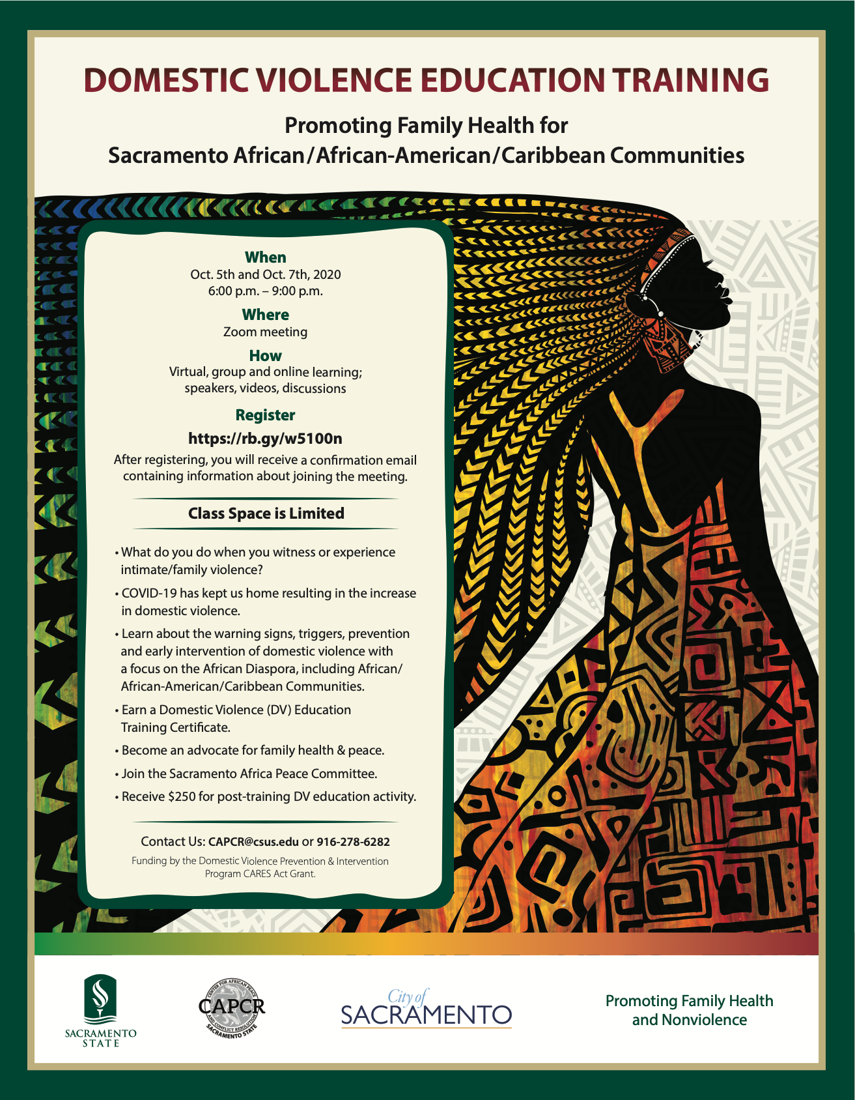
Notes:
Reception Music – Teiahsha to settle people starting at 6:00 and ending at 6:05 pm

Slide 2
Welcome and Introductions
Welcome to the Domestic Violence Education Training course
Primary focus on Black people; people of African descent
Warning signs
Triggers
Prevention
Early Intervention
Cultural interactions
Demographic challenges in identification of domestic abuse and reporting abuse
Class understanding
Abuse, domestic violence, intimate partner violence takes many shapes and forms
Grounding
Notes:
Dr. Bankhead to welcome and provide general introduction to the class – Introduction of Dr. Uwazie for general conceptualization of the project and introduction of the team

Slide 3
Cares Domestic Violence Grant
Promoting Family Health for People of African Descent in the Sacramento area. With funding from the Domestic Violence Prevention & Intervention Program CARES Act, City of Sacramento.
Notes:
Uwazie

Slide 4
Project Team
Project Director: Dr. Ernest Uwazie
Lead Trainer: Dr. Teiahsha Bankhead
Service Delivery Coordinator: Dr. Krishna Guadalupe
Project Assessment/Evaluation: Drs. Marlyn Jones & Data Barata
Legal Specialist: Tiangay Kemokai, Esq.
Co-trainers: Drs. Gebaynesh Gashaw Gant, Rola Tomori, and Kaylene Richards-Ekeh
Admin. Assistants: Toni Tinker & Destiny Effiong
Case Intake Specialist: Jamieson Daley

Slide 5
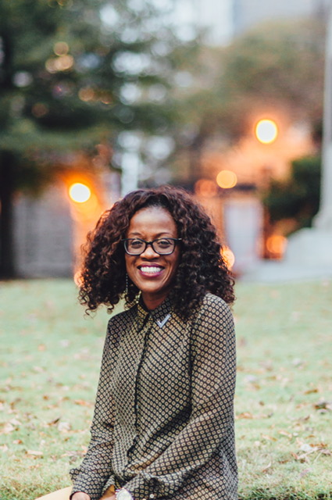
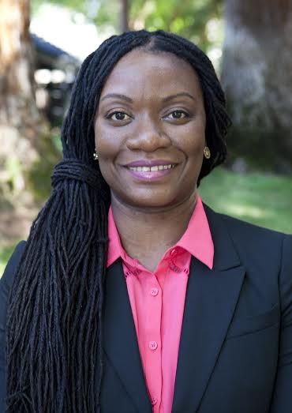
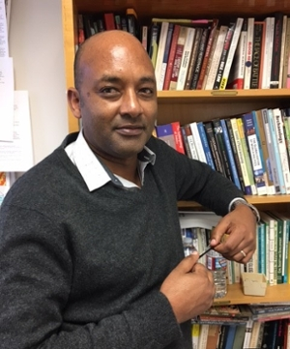
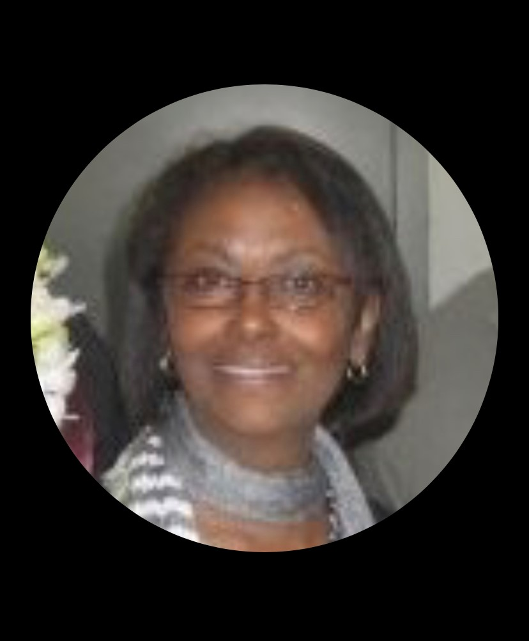
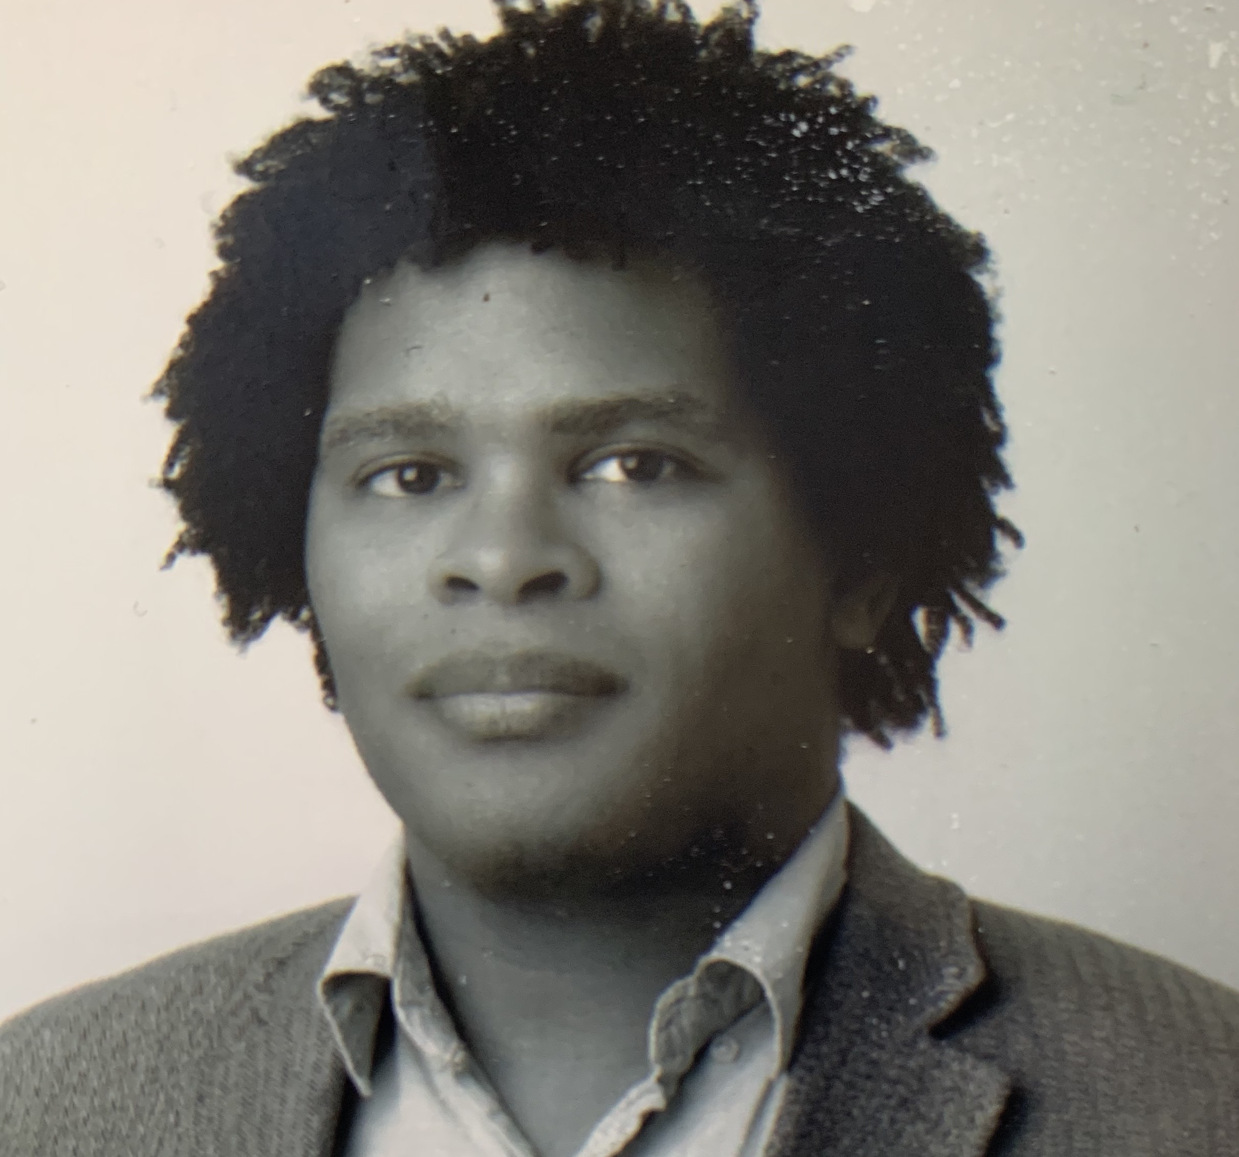
Notes:
Uwazie

Slide 6
Training/break out Co-facilitators:
Mr. Edrine Ddungu
Dr. Michael Orji
Dr. Victor Dike
Mr. Gustav Antwi
Mr. Michael Houston
Ms. Janice Wisdom

Slide 7
Guest Speakers:
Dr. Ali Meatchem
Dr. Kristee Haggins
Dr. Elizabeth Mukiibi
Attorney Rebecca Ihejirika
Ms. Franca Umeh
Ms. Jamilia Land
Ms. Tracie Stafford
Dr. Danielle Slakoff
Dr. Jocelyn Garrick
Bijon Barnes
Dr. NaNotchka Chumley
Ms. Natachi Mez

Slide 8
Welcome:
Project Goal: Promote Family health through DV preventive education through the Afrocentric model of Ubuntu & restorative justice
Objectives: Create awareness-what, why, and how?
Become educated for self empowerment and proper intervention
Serve as DV community educator
Join CAPCR’s Sacramento Africa Peace Committee team

Slide 9
Note:
The ruins of a nation begin from the family- African proverb
I want my marriage. I just want the beating to stop!- African female lawyer participant at the 1995 UN Women’s Conference in China
Select first 40 DV trainees to receive $250/each for post DV education activity (1-2 hrs), October-November 30, 2020.

Slide 10
Structure and Organization of the Course
Meeting Dates and Times
Reading and Video Materials
Between Class Meeting Course Work
Celebration of Culture
Class Agreements
Confidentiality
Notes:
Teiahsha

Slide 11
Why a training on DV in Black communities during the COVID-19 pandemic…
Black are people more likely to contract COVID-19, get sick and die from it because of a host pre-existing conditions that make us more vulnerable based on physical proximity and medical vulnerability
Similarly, we are socially more vulnerable because of the intersections of racism, sexism, classism and immigration status that create conditions of isolation and put us at greater risk for domestic violence, especially during this time.
More isolated as a result of COVID-19 because we have less access to multiple technological devices, internet bandwidth and household privacy than our white counterparts.
Notes:
Teiahsha

Slide 12
What do we know about Black people and DV disparities?
An estimated 29.1% of African American females are victimized by intimate partner violence in their lifetime.
Approximately 40% of California women experience physical intimate partner violence in their lifetimes.
Intimate partner violence is 35% higher among Black females than that of white females.
African American women are 3 times more likely than white women to experience death as a result of domestic violence – while they make up 8% of the general population, 22% of domestic violence-related homicides impact African American women.
17% uptick this March 2020, compared to last March 2019.
United Nations Secretary-General António Guterres says there has been a “horrifying surge” in domestic violence globally since COVID-19 lockdown policies took effect.
https://www.capradio.org/articles/2020/04/06/as-stay-at-home-order-increases-risk-of-domestic-violence-resources-remain-available-for-victims/
Notes:
Teiahsha

Slide 13
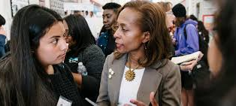
Jocelyn Freeman Garrick, MD Deputy Director Alameda County EMS
Highland Hospital, Emergency Room Physician
Director of COIVD-19 testing and response for Alameda County
Notes:
Teiahsha

Slide 14
Video from Dr. Freeman Garrick
Notes:
Teiahsha

Slide 15
Culture & Issues of DV with Black People
Black Cultural Values
Challenges Related to Black DV
Collective identity
Family and primary unit
Interdependence (financial reliance)
Spirituality
“God is in control”
Humans are not in control
Traditional gender roles
Reliance on informal systems
Suspicious of formal institutions (police, welfare)
Respect for elders
Success is determined by relationships, children, wisdom, years of life
Identifying DV
Do not identify DV because of family system issues
Reporting DV
Fear of police and related institutional power
Financial dependence
Reliance on multiple incomes for survival
Gender roles
Expectations for female subordination and/or suffering
Family integration vs. departure
Fear of destruction of family and marriage
Notes:
Teiahsha

Slide 16
African and African American Profiles on DV
Recent African immigrant - She might be a recent immigrant, traditional African cultural norms regarding gender roles, power, authority, autonomy.
African American - Young unmarried, financially dependent, codependent, pregnant.
Black LGBTQI - He might be closeted to family and community, physically large, masculine, ashamed, afraid of police intervention, misconduct and abuse
Notes:
Tomori

Slide 17
Jamilia Land – Personal Story
Notes:
Tomori

Slide 18
Domestic Violence (DV) Definition
Domestic violence - pattern of abusive behavior in any relationship that is used by one partner to gain or maintain power and control over another intimate partner.
Partner uses physical violence, coercion, threats, intimidation, isolation and emotional, sexual, economic, or other forms of abuse to control and change the behavior of the other partner.
Domestic violence not only affects those who are abused, but also has a substantial effect on family members, friends, co-workers, witnesses, and the community at large.
Women experience domestic violence irrespective of socioeconomic status, race, ethnicity, religious affiliation and sex.
https://www.cityofsacramento.org/Police/Resources/Domestic-Violence
Notes:
Tomori

Slide 19
DEFINING ABUSE WHEEL
Verbal/Psychological Abuse
Sexual Abuse
Unwanted sexual activity or
contact with the use of force, threats,
or taking advantage of a person without
their consent.
Name-calling
Brainwashing
Humiliating
POWER
AND
CONTROL
Physical/Intimidation Abuse
Economic Abuse
Physical Abuse: Any act which causes physical harm as a result of unlawful physical force.
Preventing partner from getting or keeping
a job
Making partner ask for money
Giving partner an allowance
Taking partner’s money
Withholding access to money
Intimidation: arousing fear by using
looks, gestures, actions; destroying property,
abusing pets, displaying weapons.
Loosely adapted from: https://www.thehotline.org/is-this-abuse/abuse-defined/power-and-control-wheel/
Notes:
Tomori

Slide 20
Types of Domestic Abuse CPS – Franca Umeh
What happens when CPS is called in most families of ethnic minority as a result of domestic violence? Example African
The Services CPS offer through Community agencies and the need for more community services.
I will talk about my experience working with African families and myself as a victim.
Domestic Violence is not only physical
Some forms are overlooked or not recognized by certain people as types of abuse
It can take different forms
Physical
Emotional
Financial
Sexual
Verbal
Notes:
Umeh

Slide 21
Verbal/Psychological Abuse The use of words to demean, frighten, or control another person. Verbal abuse is psychological violence.
Withholding: refusing to listen, denying the other’s feelings, and refusing to share their feelings
Countering: consistently voicing an opinion that is different than their partner or family member, preventing real discussion
Discounting: discounting partner’s or family member’s feelings, thereby denying their reality and experience
Joking: Using joking as a means to belittle partner or family member, often related to intelligence, personality, or appearance
Blocking and Diverting: refusing to communicate with partner or family member, by changing the subject, withholding information, or changing the subject
Accusing and Blaming: blaming partner or family member for negative feelings
Judging and Criticizing: making statements that indicate a lack of acceptance
Trivializing: making comments which makes partner or family member feel insignificant
Undermining: making comments to take the air out of something partner or family member is interested in or feeling, interrupting partner or family member, or implying they are inadequate.
Threatening: using partner’s or family member’s fears or threatening pain or loss.
Name-calling: calling partner or family member names or using terms of endearment masked in sarcasm.
Forgetting: manipulating partner or family member by denying something occurred; for example, a promise.
Ordering: commanding partner or family member to do something instead of asking.
Denial: refusing to recognize verbal abusiveness
Abusive Anger: expressing anger to make partner or family member feel bad and person committing the abuse feel good.
https://morneaulaw.com/2020/03/29/verbal-abuse-defined-recognizing-whether-it-affects-you/
Notes:
Umeh
Characteristics of Verbal/Psychological Abuse:
Directed towards a person’s nature or ability
Causes hurt and/or confusion
Discounts one’s feelings or attempts to make one doubt their reality
Name-calling, angry outbursts, brainwashing

Slide 22
Financial & Sexual Abuse
Financial/Economic: Maintaining control over financial resources, withholding access to money, or attempting to prevent a victim or survivor from working and/or attending school in an effort to create financial dependence as a means of control. Being forced to choose between staying in abusive relationships and poverty or even homelessness
Sexual Abuse: Unwanted sexual activity or contact with the use of force, threats, or taking advantage of a person without their consent, including marital rape, incest, and sexual assault.
Adapted from https://www.apa.org/topics/sexual-abuse
Adapted from: https://ncadv.org/blog/posts/quick-guide-economic-and-financial-abuse
Notes:
Umeh
Economic abuse can take many forms, including employment-related abuse, preventing the victim from accessing existing funds, coerced debt, and more.

Slide 23
Physical Abuse Actions
Emotional Abuse Activities
Push, shove, slap, punch, bites
Extreme jealousy
Prohibits spending time with family and friends
Throws objects
Locks person out of the house
Abandons person in dangerous situations
Ties a person up
Threatens a person with physical abuse
Requires permission before doing things
Does not help when sick or disabled
Ignores feelings
Ridicules
Insults the other person’s gender
Belittles vales and beliefs
Disapproves consistently of the person
Criticizes without ever providing compliments
Makes all important decisions
Threatens regularly to leave the person
Refuses to allow the partner to work
Abuses pets and other animals
Notes:
Umeh

Slide 24
Financial Abuse Behaviors
Sexual Abuse Actions
Does not help to support the person or their family financially
Uses partner for money
Denies partner access to financial information
Does not allow partner to earn own money
Gives partner an allowance
Takes and spend money partner earns
Does partner’s banking even though the partner wants to
Asks partner to justify all of their purchases
Controls income and/or assets
Denies partner money for necessities
Treats partner as a sexual object
Makes partner wear sexual clothing against their will
Criticizes partner sexually
Touches partner when and where they don’t want to be touched
Withholds sex and/or affection
Calls partner undesirable and derogatory names during sex
Shows sexual interest in others in public
Has had affairs with other people
Forces partner to have sex
Commits sadistic sexual acts
Notes:
Umeh

Slide 25
Symptoms of Abuse
Pattern of behavior to obtain and maintain power and control over an intimate partner.
Can manifest through symptoms in 4 general areas;
Detachment
Physical symptoms
Cognition
Emotions
Examples of symptoms include:
Anxiety, being easily startled and jumpy, panic attacks, change in appetite (up or down), fatigue, sleep difficulties, difficulty concentrating, reliving abuse in mind, flashbacks of the abuse, hopelessness, nightmares, emotional upset, feeling emotionally numb, guilty about abuse, on guard, irritable
Notes:
Umeh

Slide 26
African Immigrant family dynamics presentation
By Dr. Elizabeth Mukiibi
Notes:
Mukiibi

Slide 27
Topics of Research
Everyone appreciates that there isn’t a single type of family, each family is different but there are some general features.
From my research on African immigrant children’s academic achievement and African immigrant women’s work trajectory. In which I used interviewing and observation methods.
some characteristics and general features about family dynamics have came up.
Many of these features are apparent in our communities and please feel free to add on as the presentation moves along.
Notes:
Mukiibi

Slide 28
The dynamics of African families depends on many factors including how they got into the country, their status in the country, whether they have children or not, the nature of work they do.
Earlier immigrants came as students and were mostly men
Different groups came as refugees displaced due to political, social and economic instability in the countries of origin in Africa
Of late immigrants increasingly women are coming looking for better life and may or may not be refugees.
All these families face different stressors in society
Can participants place themselves in the groups that are relevant to their reasons for coming to this country?
Notes:
Mukiibi

Slide 29
Stressors faced by immigrant families
There are many stressors faced by African immigrant families in the US
One major factor is “culture shock”, The Us tends to be a very fast paced economy where most African countries are not as fast paced, the change can be very stressful to the immigrant family.
Gender roles with regard to Household responsibility for male and females change.
different work hours, lack of affordable house help for working couples.
Discrimination in the larger society
What kind of culture shock did you experience?
Notes:
Mukiibi

Slide 30
The highly educated families with well paying jobs face stressors that tend to be job related and their children’s welfare. they have to work harder to keep their jobs that are sought after by the white citizens who feel that these should be their jobs and are constantly undermining the immigrant workers.
Tensions arise not related to finances but to assimilation or adaptation.
Those who are married and have children are limited to flexible jobs they can do while raising their families, due to the lack of affordable child care, and the need for money to survive.
All these factors are complicated by the intersectionality of race, gender, class and language proficiency which these African immigrants face on a daily basis.
Has anyone in the audience faced these tensions?
Notes:
Mukiibi

Slide 31
Job related stressor
Many immigrants end up working minimum wage jobs which require putting in a lot of hours, but also nights which is different from the hours worked in many African countries.
These frustrations are then taken in the home and can result in misunderstandings at home.
Due to competition many African immigrants are constantly attending school to improve their skills, which adds to the pressures in the family
Have any of the participants felt this kind tension?
Notes:
Mukiibi

Slide 32
Raising children
The African way of disciplining children which may include corporal punishment is considered a form of child abuse
That creates a lot of freedom for the children to do whatever they want as they know the parents many not be in a position to punish them
These families face the clash of cultures between generations as the African raised parents are intent on following African culture and discipline, while the children adopt to the American way of life as first generation Americans.
Some of the parents are too busy making ends meet that the children are left on their own, which gives children a lot of unsupervised freedom. In Africa couples rely on the large extended family and cheaper child care system to survive.
The African way of socializing the children is transformed leading to uneasy relationships.
Notes:
Mukiibi

Slide 33
Gender roles and family dynamics
Again we see the culture shock when we examine gender roles in many African immigrant communities in America.
It has been found that black African immigrant women were more likely to be in labor force than their white counterparts (Yanyi K. Djamba. Center for Demographic Research, Auburn University at Montgomery)
As both the women and men spend time at work the men are expected to help with the children and around the house. Many men have had to adjust to these expectations, which were not part of their roles in Africa.
This can be a major source of tension in the family.
Notes:
Mukiibi

Slide 34
Cultural shock and Assimilation theory: Gordon’s dimensions
Most groups have adapted to Anglo core culture through: (white middleclass and protestant)
Cultural assimilation requires a change of cultural patterns to those of the core society.
There has been some Marital assimilation leading to significant intermarriage
Identification assimilation has been gradual where the immigrant parents retain most of the African culture but the children may decide to be fully assimilated, even failing to learn the African languages.
Notes:
Mukiibi

Slide 35
Solutions
The effects of culture shock can be reduced by the community one finds that is already established, they can be helpful if they are welcoming and organized to offer such assistance. The problem is many immigrants do not have such anchor immediately/as soon as they arrive.
The type of information an immigrant family receives once they are here, some African communities have been here long enough, have organized themselves, and are able to offer support others are very new and unsure.
Notes:
Mukiibi

Slide 36
Challenges brought about by our separation from those groups that know the system due to our misguided perception of them.
We are not aware that all blacks are seen in the same way by the White majority that runs the country and the system with which we are less familiar.
There is a need to build bridges to connect the African and the African American community and learn from and about each other and the system.
Notes:
Mukiibi

Slide 37
The reason for talking about assimilation is the fact that as immigrants we try hard to fit in as we interact with citizens whether at school or work.
Also we encounter the same hostilities and discrimination that African Americans do with the added problem that we do not understand the system very well when we first move here.
When we get back home to our families we bring these challenges and stressors with us into our homes and we sometimes see our spouses as sounding boards or scapegoats. Forgetting that we are all new to the system.
The whole concept of assimilation implies that the only good American are those that can assimilate rapidly and in Anglo- conformity fashion. Some have done that others have resisted.
Notes:
Mukiibi

Slide 38
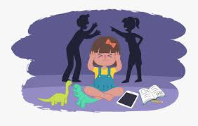
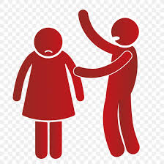
Notes:
Mukiibi

Slide 39
Relationship Between Violence and Culture Dr. Gashaw-Gant
Notes:
Gashaw-Gant

Slide 40
Traditional Values Condon Abuse
Denial
Is the most contributing factor
Engaging in any of the abuses but community members telling the individual that is abused,
You are ok
Telling victim:-Oh you got a beating and laughing about it
Telling victim you are ok, let the abuser do what he/she needs,
Telling victim: stop nagging him/her
Community members jealousy of the couple initiates abuse
Notes:
Gashaw-Gant

Slide 41
Community and Family Values
Community and family disapproval of divorce
A woman is responsible for making a marriage work
Forcing a woman is a marker for masculinity
If wife was unfaithful and he could regain some of this honor through the use of violence
Women should be quiet and submissive
Gender role differences contribute to relationship conflict
Telling victim:-Oh you got a beating and laughing about it
Telling victim you are ok, let the abuser do what he/she needs,
Telling victim: stop nagging him/her
Community members jealousy of the couple initiates abuse
Notes:
Gashaw-Gant

Slide 42
CULTURAL & SOCIAL INFLUENCERS
Traditional beliefs that men have a right to control, or discipline women through physical means
Tradition of relying on inner strength “ I can make it work no matter what” by women
Clergy ignoring the problem
because they see the man as the head,
Nor comfortable to deal with the abuse
A man has a right to assert power over a woman and is socially superior
A man has a right to “correct” or discipline female behavior
Reporting abuse is disrespectful, shameful, doe not have of social support
Notes:
Gashaw-Gant

Slide 43
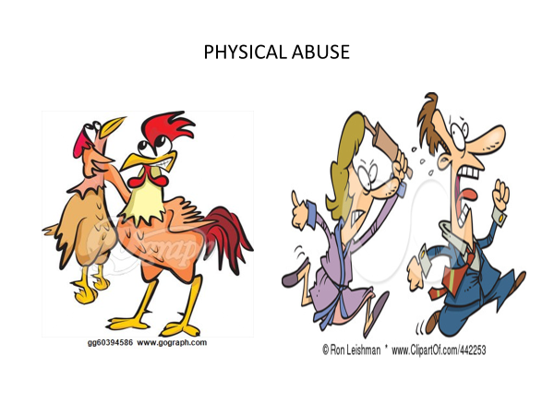
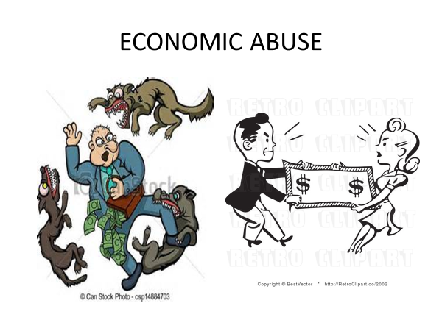
Types of Abuse
Notes:
Gashaw-Gant

Slide 44
How can you help victims of Domestic Violence
Acknowledge
No judgement
Be supportive
Encourage
No your limits
Notes:
Gashaw-Gant

Slide 45
Black DV Breakout Group
Breakout groups to discuss checklist
Groups of 4 to 5 people
10-minute discussion session
In the Black community, how often does domestic violence show up?
What are the current responses?
Report Back
Notes:
Teiahsha

Slide 46
Things to do before next class:
Consider Black community areas of need
Reading
Article #1
Article #2
Video
Slackoff - if not already viewed
Poetry- to close out the session – Natachi Mez
Notes:
Teiahsha - End with a Poem

Slide 47
End of Day 1
Notes:
Poem by Natachi Mez

Slide 48
Notes:
Teiahsha

Slide 49
Welcome to Day 2 of DV Training
Session 1
Made case for need for training
High rates of DV during COVID-19
Definitions of Abuse
Personal stories
Session 2
Myths of Victims
Diverse populations impacted by DV
Perpetrator Profiles
Restorative vs. Punitive Solutions
Community Education Planning
Notes:
Teiahsha

Slide 50
Negotiating Cultural Differences
Male turn out
Powerfully connected to these issues
Life or death
Culture is the lens through which we can see or be blind to abuse
African cultural values and impacts
Power and control
Use gender or culture to exercise power over others
What you are learning in the chat….

Slide 51
Describe Black family health? How do we promote it?

Slide 52
Myths of Victims
Low self-esteem, lack confidence, no self-worth
Underprivileged, from low SE class
Not well educated or intelligent, lack college degree
Weak, timid, vulnerable, powerless
Naïve, innocent, gullible
Easy to take advantage of, too trusting
Tolerant of violent behavior, conditioned to accept violence
Grew up in violent households
Hurt by previous partners
Fit a cultural stereotype or image of being passive, docile, submissive
Abused as a child by father or dominant, influential male
Drawn to domineering macho man, pattern of attracting abusive men into life
Hurt by previous partners
Prefer to be with abusive men instead of being single
Enjoy being dominated and controlled by a man
Believe you deserve to be abused
Wish to serve her husband and wait on him like a servant
Accept that husband should make all decisions about home, finances, career, etc.
Notes:
Teiahsha

Slide 53
Domestic Violence in African/African- American LGBTQ+ Groups
M. Ali Meatchem, Psy.D.
Meatchem.com
Notes:
Meatchem

Slide 54
Who are the people we’re referring to?
Sibling
Friend
Administrator
Spouse
Housed/ Unhoused
Able/ Disability Status
Notes:
Meatchem

Slide 55
Notes:
Meatchem

Slide 56
Disparities in Rates of IPV
Human Rights Campaign Foundation’s LGBTQ Intimate Partner Violence and COVID-19 report indicates increased risk of violence:
Experiences of rape, physical violence, or stalking:
44% of lesbians and 61% of bisexual women vs. 35% of heterosexual women.
19% of African- American respondents vs. 6% of non- LGBTQ Caucasian respondents have experienced physical dating violence.
Notes:
Meatchem

Slide 57
Disparities in Rates of IPV (cont’d)
Review of research (Brown & Herman, 2015)
Most studies found that across the lifetime, rates of IPV are as high or higher for the LGBT population than the general population.
Bisexual women are 2.6 times more likely to report having experienced intimate partner sexual violence than their hetero female counterparts.
Results vary across studies, but one study showed 26.9% of gay men experienced IPV across the lifetime, and 12.1% experienced IPV in the past year.
Notes:
Meatchem

Slide 58
Barriers to Help
Barriers to seeking and/or getting help that are unique to gender identity and sexual orientation include (Brown & Herman, 2015):
Legal definitions of domestic violence may exclude same- gender couples
Dangers of being “outed” when seeking help, which includes risk of rejection and isolation from family, friends, and society.
LGBT- specific or LGBT-friendly assistance resources being either not available or not known.
Potential homophobia or transphobia from service provider staff.
Lacking confidence in effectiveness and sensitivity of law enforcement officials and courts for LGBT people.
Shelters tend not to be used because they are feared off- limits by LGBT people.
Notes:
Meatchem

Slide 59
Bibliography
Brown, TNT, Herman, JL (2015). Intimate Partner Violence and Sexual Abuse Among LGBT People
Centers for Disease Control and Prevention. Intimate Partner Violence: Consequences. http://www.cdc.gov/violenceprevention/intimatepartnerviolence/consequences.
Centers for Disease Control and Prevention. Behavioral Risk Factor Survellance System:
https://www.cdc.gov/violenceprevention/intimatepartnerviolence/riskprotectivefactors.html
Kozuch, E (2020). HRC Report Shows that LGBTQ People are More Likely to be Victims of Interpersonal Violence.
Williams Institute Report summary: https://williamsinstitute.law.ucla.edu/publications/ipv-sex-abuse-lgbt-people/
Full report: https://williamsinstitute.law.ucla.edu/wp-content/uploads/IPV-Sexual-Abuse-Among-LGBT-Nov-2015.pdf
Notes:
Meatchem

Slide 60
Bijon Barnes Personal Story Video
Notes:
Teiahsha

Slide 61
Breakout Group
How is domestic violence in the LGBTQ Black community acknowledged and responded to in your community?

Slide 62
Dr. Chumley – Presentation Q & A
Notes:
Chumley

Slide 63
Common Traits and Types of Abusive Partners
Jealousy
Control
Lifestyle patterns
Abusive behavior
Pressures for sex
Blames others for their problems
Verbally dominant
Resists change, unwilling to compromise, inflexible
Sense of entitlement
Notes:
Richards

Slide 64
COMMON TRAITS OF ABUSIVE PARTNER SCALE
Jealousy: accuses partner of cheating; jealous of time spent with family or friends; stalking
Controlling behavior: questions whereabouts under the guise that they are concerned about partners safety
Quick involvement: know each other for less than six months before marriage, engagement, or cohabitating
Unrealistic expectations: expects partner to meet all their needs or to be the perfect spouse
Isolation: cut off from all resources (family, friends, etc.
Cruelty to animals or children
Blames others for problems
Blames others for feelings
Hypersensitivity: easily insulted
Verbal abuse: name-calling, degrading, vulgar
Dr. Jekyll and Mr. Hyde: sudden changes in mood
Rigid sex roles: (mostly applies to heterosexual males): expects woman to serve him
Playful use of force in sex: uses sulking or anger to manipulate partner to have sex; idea of rape is exciting
Exerts economic control: controls money and access to resources
Engages in manipulative parenting: uses children to gain power and control over partner
Loosely adapted from: https://www.thehotline.org/healthy-relationships/relationship-spectrum/
Loosely adapted from: https://www.calverthealth.org/personalhealth/crisisintervention/batter.htm
Notes:
Richards

Slide 65
Abusive Partner Archetypes
The Player
Macho
Flirtatious, possessive, disrespectful toward women
Treat like a sex object
Dominating/Mr. Right
Entitled, arrogant, condescending
Ultimate authority on everything
Demanding, threatening, intimidating, aggressive, manipulative
The Victim/Mr. Sensitive
Plays the victim
Constantly misunderstood, bullied by everyone
Complains life in general is unfair
Blames others for problems
Notes:
Richards

Slide 66
CULTURAL & SOCIAL NORMS THAT MAY INFLUENCE ABUSE
Traditional beliefs –
Men have a right to control, or discipline women through physical means
A man has a right to assert power over a woman and is socially superior
Physical violence is an acceptable way to resolve conflicts, and reporting abuse is disrespectful
Cultural degradation of women.
Community and family disapproval of divorce
A woman is responsible for making a marriage work
Grown up with it, that is all they know
Women should be quiet and submissive
Divorce is not attainable
Gender role differences contribute to relationship conflict
Notes:
Richards

Slide 67
Other influences/reasons for abuse
Changes in gender roles and responsibilities.
As women became financially independent, men seek to decrease sense of financial impotence and to regain control through violence.
The more independent women were, the more likely they were to experience both psychological and physical abuse from their partners.
Demographic influence
High likelihood of DV amongst married couples with low income relationships in which the male partner is either underemployed or unemployed, or when a couple is living in a poor neighborhood.
https://www.ncbi.nlm.nih.gov/pmc/articles/PMC3666039/
Notes:
Richards

Slide 68
Distinguishing Between Black Cultural Orientations and Abuse or Denial Considerations
Black Cultural Issues
Denial of Abuse
Collectivist culture and identity
Focus on family as central/core identity
Focus on spirituality
Statistically Black people are less economically privileged in a racist society
Respect for elders
Acceptance of male dominance and control to the extent that control and abuse are normalized
Belief that faith will deliver an abused person from abuse which then fosters helplessness
More economically dependent on intimate partners who made provide or control financial resources
More difficult to spot and respond to abuse of an elder due to deferential relationships between younger people and elders
Notes:
Tomori

Slide 69
Adaptive vs. Maladaptive Coping
Adaptive
Maladaptive
Reflection, journaling
Counseling support
See something, say something
Ask for support
Safety planning
Access resources
Appropriate intervention
Self-care
Affirmations
Silence and secrecy
Avoidance
Hope it will go away
Denial
Give them one more chance without taking action
Enduring pain
Notes:
Tomori

Slide 70
What makes it difficult for Black members to report abuse?
Acceptance of abuse as the norm
Mistrust of law enforcement due to a continued history of violence targeting African American communities is a large factor for why many African American victims of violence do not file police reports.
Religious convictions and a fear of shame or rejection from the church may contribute to their remaining in an abusive relationships
Some women may feel because of their religious beliefs they must impart forgiveness for their abusers’ behavior and endure the abuse due to religious obligations under Christian doctrine.
Limited legal and lengthy options for immigrant women to safely leave their abusers.
Threat of deportation or a refusal to follow through on completing on-going permanent residence and/or naturalization application as a means of cont
Limited-English proficiency and understanding of access and ways to get help.
http://www.ywcasandiego.org/assets/files/YWCAUSA_WOC_FactSheet.pdf
Notes:
Tomori

Slide 71
What makes it difficult for Black members to report abuse?
Limited legal and lengthy options for immigrant women to safely leave their abusers.
Threat of deportation or a refusal to follow through on completing on-going permanent residence and/or naturalization application as a means of cont
Limited-English proficiency and understanding of access and ways to get help.
Religious convictions and a fear of shame or rejection from the church may contribute to their remaining in an abusive relationships
Some women may feel because of their religious beliefs they must impart forgiveness for their abusers’ behavior and endure the abuse due to religious obligations under Christian doctrine.
http://www.ywcasandiego.org/assets/files/YWCAUSA_WOC_FactSheet.pdf
Notes:
Tomori

Slide 72
Rebecca Ihejirika: Lawyer
OVERVIEW:
1. WHAT IS DOMESTIC VIOLENCE? - Legal definition and brief explanation.
2. PARTIES IN A DOMESTIC VIOLENCE MATTER - Victim/Protected party and Perpetrator/Restrained party.
3. NEXT STEPS FOR THE VICTIM - Medical intervention, Third party/Familial support, Law enforcement and Legal assistance/the Courts.
4. NEXT STEPS FOR THE PERPETRATOR - Legal assistance and online resources, Third party/Familial support.
5. IMPACT OF DOMESTIC VIOLENCE ON PARTIES AND IMMEDIATE FAMILY/CIRCLE - legal, emotional, physical, relationships, economic and social.
6. DOMESTIC VIOLENCE PREVENTION - Counseling, separation/divorce
INFLUENCES AFFECTING DOMESTIC VIOLENCE REPORTING AND OUTCOME:
A. CULTURAL - seen as shameful and to be hidden; seen as the norm.
B. GENDER DYNAMICS - male victim as against female victim.
C. GUILT AND FEAR - regarding consequences of reporting.
Notes:
Ihejirika

Slide 73
Steps used in resolution among Black communities:
1. Use of family members—May be favorable to men and leave women unsupported. Focus is urge to stay and work it out.
2. Use of people outside immediate family such as elders in the community or religious leaders (cultural/social community).
Step 3: Use of resources outside of the community such as the police, seeking an order of protection, or reluctantly entering a domestic violence shelter.
4. Formal use of the Judicial system.
Notes:
Teiahsha

Slide 74
BLACK COMMUNITY RESPONSES
Respect - Each individual should be respected regardless of gender or circumstance. Respect is demonstrated by patience, care and holding one's partner in high regard not abusive language, actions, or threats.
Collective work and responsibility - The community has a responsibility to work on eradicating this problem and helping our people to find solid mechanisms of fortifying healthy and stable relationships. The resolution revolves around both breaking the silence and communal recognition of the problem.
Inherent goodness - We believe that every person has the ability to change. Those that are abusive need to recognize their behavior and seek assistance to change.
https://cdn.ymaws.com/www.nabsw.org/resource/resmgr/position_statements_papers/domestic_violence_position_p.pdf
Notes:
Teiahsha

Slide 75
Restorative vs. Punitive Responses
Notes:
Teiahsha

Slide 76
RJ Black Men’s Circle – Insert 6-minute video here
Notes:
Teiahsha

Slide 77
Breakout Group
How can your community engage Black men in supporting family health, especially those who are causing harm using DV?

Slide 78
Tracie Stafford

Slide 79
WHAT TO DO IF YOU OR SOMEONE YOU KNOW IS BEING ABUSED?
Information on use of our services under this contract here
Dr. Guadalupe
Notes:
Guadalupe

Slide 80
Victim Focused Response to DV – Dr. Haggins
Therapy
Self-Care Checklist
Safety Planning
Affirmations
Journaling
Notes:
Haggins

Slide 81
THERAPY
If you feel that therapy might be helpful, sooner is always better. Therapy can be beneficial for everyone because it’s a place where you can learn increased self-awareness, clarify your goals and look at the choices in front of you.
Counseling sessions provide a safe and confidential environment for survivors to express their feelings, thoughts and fears. Counselors are nonjudgmental third-party advisors who listen and can help survivors work through the things that they are experiencing.
Entering counseling does not necessarily mean that you are mentally ill or can’t cope on your own. Therapy is about how much you’re putting in place to support yourself in healing and succeeding.
Speaking with a trauma specialist can help survivors to deal with their remaining anxiety and find ways to relieve that stress. These specialists can help to process traumatic memories or experiences so that it is possible to move on. They can also aid survivors in learning to regulate their strong emotions like fear and anger.
A good match between therapist and client is one of the most powerful healing factors in a therapeutic relationship. Look for someone who makes you feel heard, understood, safe and comfortable.
https://www.thehotline.org/help/help-for-survivors/
Notes:
Haggins

Slide 82
SELF-CARE CHECKLIST
Relationship to Self: Take time for yourself and your own interests. Remember to do what makes you the happiest. Here are a few ways you can attend to your personal well-being.
Get
Get enough sleep
Attend
Attend to personal hygiene
Exercise
Exercise or physical activity
Take
Take deep breaths during the day
Make
Make time for self-reflection
Read
Read a book
Set
Set boundaries with toxic or negative people
Allow
Allow yourself to cry
Meditate
Keep a journal
Try an artistic activity
Take deep breaths during the day
Solve a puzzle or brain teaser
Do something new
Listen to music
Give yourself positive affirmations
https://www.loveisrespect.org/content/self-care-checklist/
Notes:
Haggins

Slide 83
Domestic Violence Safety Planning
What is a DV Safety Plan?
A safety plan is a personalized, practical, plan that includes ways to remain safe while in a relationship, planning to leave, or after you leave.
Safety planning involves how to cope with emotions, tell friends and family about the abuse, take legal action and more.
A good safety plan will have all the information you need and is tailored to your unique situation and circumstances, and it will help walk you through different scenarios.
When making a safety plan, it is important to remember to outline things that may seem obvious because in moments of crisis your brain does not function the same way when you are calm. Having a safety plan laid out in advance can help you protect yourself in those stressful moments.
https://www.thehotline.org/help/path-to-safety/
Notes:
Haggins

Slide 84
AFFIRMATIONS AND JOURNALING
Affirmations: Praise yourself for accomplishments, little or big, and counter any negative self-talk with positive mantras or affirmations.
Becoming aware of what you think and say about yourself can help shift negative thoughts.
Journaling: Writing about difficult, even traumatic, experiences appears to be good for health on several
levels - raising immunity and other health measures and improving life functioning.
Tips for Journaling:
Find a serene, quiet spot
Allow your thoughts to flow
Set a realistic time
Choose specific days/times
https://www.apa.org/research/action/writing
https://www.thehotline.org/help/help-for-survivors/
https://www.breakthecycle.org/blog/journaling-tool-healing
Notes:
Haggins

Slide 85
VIOLENCE INTERRUPTERS
Violence Interrupters are community advocates that commit to do the following:
Learn about facts, risks, and protective factors, educate themselves and their community.
Speak out against the societal and cultural norms that may be contributing to family violence.
Encourage others to speak up and break the stigma behind family violence.
Practice healthy relationship behaviors and encourages community to do so as well.
Spread awareness of available resources for those experiencing family violence.
Reassure survivors that they are not alone.
https://betterwaycampaign.org/?gclid=CjwKCAjw4_H6BRALEiwAvgfzqwtwzT__69CmoDA7AmTn6iJ1AUadFVjiadFO4b767H5vUS9rCc9o-RoCO-MQAvD_BwE
Notes:
Teiahsha

Slide 86
KEY DOMESTIC VIOLENCE RESOURCES
NOTE: This list of domestic violence resources is intended to provide information on critical resources. This is not an
endorsement of the services of the programs that the listed agencies and/or organizations provide. In an emergency,
please contact 911.
African-American Mental Health Providers:
Website: http://aamhp.com/contact-us/
Phone: 916- 691-1190
Services: Provides a director or providers that are licensed, registered, and/or certified to practice in the State of California. The directory of mental health providers includes the following: social workers, psychologist, psychiatrist, and family therapist.
California Coalition Against Sexual Assault:
Website: http://www.calcasa.org
Phone: 916-446-2520
Services: “The California Coalition Against Sexual Assault (CALCASA) provides leadership, vision and resources to rape crisis centers, individuals and other entities committed to ending sexual violence.” See http://www.calcasa.org/about/mission-values-philosophy/.
California Partnership to End Domestic Violence:
Website: https://www.cpedv.org
Phone: 1-800-799-7233
Services: “The California Partnership to End Domestic Violence (the Partnership) is California’s recognized domestic violence coalition, representing over 1,000 advocates, organizations and allied groups throughout the state. Through our public policy, communications and capacity-building efforts, we align prevention and intervention strategies to advance social change. We believe that by sharing expertise, advocates and policy-makers can end domestic violence. For nearly 40 years, we have inspired, informed and connected all those concerned with this issue, because together we’re stronger. ”See https://www.cpedv.org
California Secretary of State – Safe at Home:
Website: https://www.sos.ca.gov/registries/safe-home
Phone: 1-877-322-5227
Services: ”Safe at Home offers victims of domestic violence, stalking, sexual assault, human trafficking & elder and dependent abuse, as well as reproductive health care workers, a substitute mailing address to receive first class, certified, and registered mail.” See https://www.sos.ca.gov/registries/safe-home.
Notes:
Tiangay

Slide 87
KEY DOMESTIC VIOLENCE RESOURCES CONT’D
California Victim Compensation Board:
Website: https://victims.ca.gov
Phone: 916-491-3600
Services: “The California Victim Compensation Board (CalVCB) can help pay bills and expenses that result from violent crime. Victims of crime who have been injured or have been threatened with injury may be eligible for help.” See https://victims.ca.gov.
A Community of Peace:
Website: https://acommunityforpeace.org
Phone: 916-728-7210
Services: “A Community For Peace is a state certified trauma-informed social justice crisis center serving children and adult survivors of domestic violence and sexual assault.” See https://acommunityforpeace.org. Programs and services include the following: emergency shelter, education and training program, counseling, and legal services. Women’s Empowerment:
Family Justice Center:
Website: http://www.hopethriveshere.org
Phone : 916-875-4673
Services: Mobile legal and mental program, safety planning, counseling, VOICES (a committee of survivors who volunteer to empower and educate other survivors), and Camp Hope America (nationwide camping and camping initiative geared towards children exposed to domestic violence).
Foundation for Peaceful Communities:
Website: https://afoundationforpeace.org/about-the-foundation/
Phone: 916-728-5613
Services: “Foundation for Peaceful Communities promise is to grow healthy communities by developing and supporting social renewal projects and enterprises that empower underserved and high-risk populations, so that they can thrive, contribute and participate in the peace and well-being of our greater society.” See https://afoundationforpeace.org/about-the-foundation/.
Notes:
Tiangay

Slide 88
KEY DOMESTIC VIOLENCE RESOURCES CONT’D
ManAlive Sacramento Inc.:
Website: http://www.no2violence.com/about-us
Phone: 1-877-662-8465
Services: Offers a “Batterer's Accountability and Advocacy Re-education Program.”
Mary’s House:
Website: https://sacloaves.org/maryhouse
Phone: 916-446-0874
Services: Offers day-time hospitality services for women and children.
My Sister’s House:
Website: http://www.my-sisters-house.org
Phone: 916-428-3271
Services: Provides and offers several services and programs, including a 24-hour support hotline, safe haven shelter program, women to work program, counseling sessions, healing through art, parenting classes, and a #MeToo Sexual Assault Survivor Support Group
The National Domestic Violence Hotline:
Website: https://www.thehotline.org
Phone: 1-800-799-7233
Services: Call the hotline to speak with a nonjudgmental advocate who can help you identify signs of abuse, create a safety plan, and provide information regarding domestic violence programs.
Notes:
Tiangay

Slide 89
KEY DOMESTIC VIOLENCE RESOURCES CONT’D
Sacramento Food Bank & Family:
Website: https://www.sacramentofoodbank.org
Phone: 916-456-1980
Services: Provides the following services and programs: food, clothing, adult learning, computer and technology classes, parent education classes, immigration and refugee legal services, and utilities assistance. Mary’s House:
A Safe Place:
Website: https://www.asafeplace.org
Phone: 1-510-536-7233
Services: The following programs and services are provided: 24-hour emergency shelter, community mental health services, community education and health outreach, domestic violence and volunteer training, teen dating violence prevention, professional development, and disaster preparedness.
Saint John’s Program for Real Change:
Website: https://saintjohnsprogram.org
Phone: 916-453-1482
Services: Provides shelter and the following services: mental health services, supportive services, career education, on-the-job-training, and mental health respite services.
Superior Court of Sacramento – Domestic Violence and Elder Abuse Resource Services:
Reporting Abuse:
Adult Protective Services: Phone: 916-874-9377 Website: https://cdss.ca.gov/reporting/report-abuse
Child Protective Services: Phone: 916-875-5437 Website: https://dcfas.saccounty.net/CPS/Pages/Emergency-Response/GI-EmergencyHotline.aspx
Domestic Violence Restraining Order: Information on how to file a domestic violence restraining order: https://www.saccourt.ca.gov/restraining-orders/domestic-violence.aspx
Red Women Rising:
Website: http://redwomenrising.org/directory
Phone: 1-800-399-6789
Services: “The Red Women Rising Project is dedicated to uplifting the voices of Urban Indian survivors of domestic violence and sexual assault through increasing awareness around Urban Indian women’s domestic violence issues and enhancing survivors' access to domestic violence services.” See http://redwomenrising.org/directory.
Notes:
Tiangay

Slide 90
KEY DOMESTIC VIOLENCE RESOURCES CONT’D
Victims of Crime Center:
Website: https://1800victims.org/contacts/
Phone: 1-800-842-8647
Services: The Victims of Crime Center operates a hotline, provides information and referrals, provides legal research for service providers, publishes and distributes brochures on victim’s rights, and may be able to offer limited legal representation determined on a case-by-case basis.
Weave Inc.:
Website: https://www.weaveinc.org
Phone: 916-920-2952
Services: “WEAVE is the primary provider of crisis intervention services for survivors of domestic violence and sexual assault in Sacramento County. Through a multi-disciplinary effort with Sacramento County, law enforcement, the Commercially Sexually Exploited Children Court, Child Protective Services, and the District Attorney’s Office, WEAVE also provides 24/7 response, outreach and services for victims of sex trafficking.” See https://www.weaveinc.org
Wellspring Women’s Center:
Website: https://www.wellspringwomen.org
Phone: 916-454-9688
Services: “Wellspring Women’s Center in Sacramento’s Oak Park neighborhood, nurtures the innate goodness and personal self-esteem of women and their children. We serve nearly 200 women and children each weekday and offer four different programs: the Nutritious Meal Program, the Children's Corner Program, the Safety Net Services Program, and the Women's Wellness Program.” See https://www.wellspringwomen.org.
Women’s Empowerment:
Website: https://womens-empowerment.org
Phone: 916-341-0730
Services: “Women’s Empowerment educates and empowers women who are experiencing homelessness with the skills and confidence necessary to get a job, maintain a healthy lifestyle, and regain a home for themselves and their children.” See https://womens-empowerment.org. Programs include the following services: job readiness and empowerment, child development center, paid job training, and graduate services.
Notes:
Tiangay

Slide 91
GETTING THE WORD OUT
Notes:
Teiahsha

Slide 92
Breakout Groups for Community Infusion
Breakout groups of 4 to 5 members
10-minute session
Explore communities where they might make presentations
What is needed in your community in DV training?
Report back
Notes:
Teiahsha

Slide 93
Assessment & Closing Poem
Assessment Team
Natachi Mez
Notes:
Jones & Barata

