Slide 2
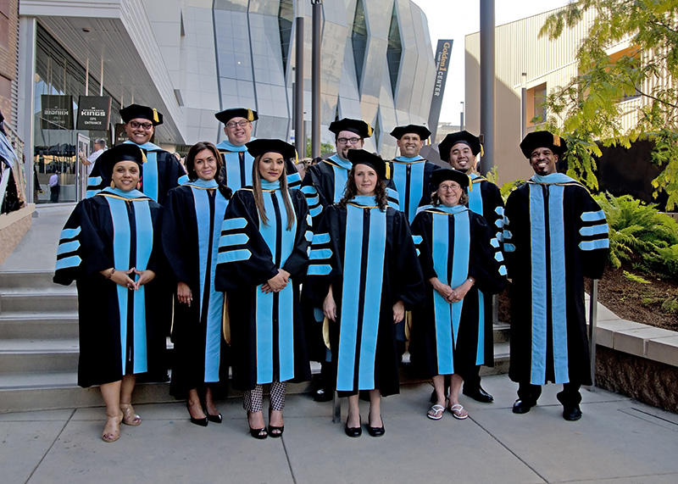
Introduction to the Doctorate in Educational Leadership
https://youtu.be/GOxvLUGk0kQ

Slide 3
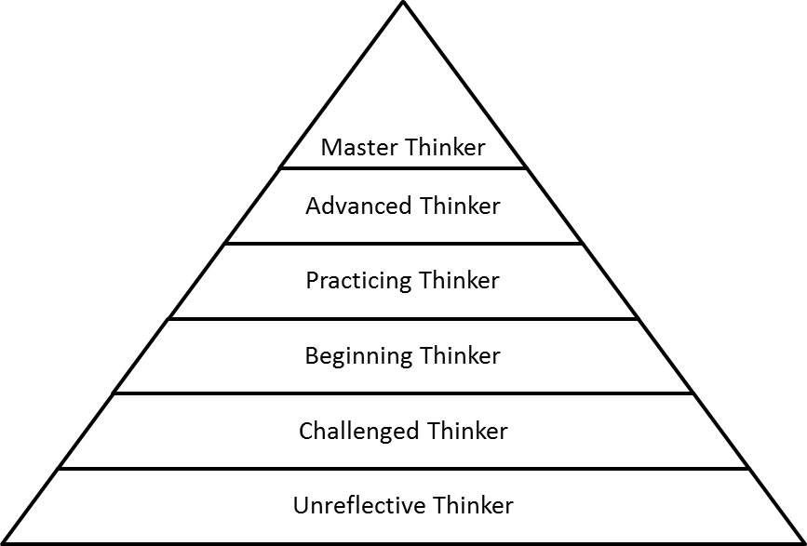
Mission
The mission of Sacramento State’s Ed.D. program is to address the urgent need for well prepared individuals to assume key leadership positions in the state’s public K-12 schools and community colleges.

Slide 4
Student Learning Objectives
The Ed.D. Program advances knowledge in the field through distinctive objectives and learning outcomes.
Equips school, district, community college and policy leaders with competencies grounded in strategic thinking and applied research.
A practical skill-based curriculum gives doctoral students the skills to be effective educational leaders.

Slide 5
Ed.D. Program Themes
Transformational Leadership
Informed Decision Making
Critical Policy Analysis & Action

Slide 6
Program Themes
Transformational Leadership: Leaders understand, implement and evaluate strategic equitable leadership practices. These practices are based on various theories, models, and approaches for achieving organizational transformation.
Critical Policy Analysis and Action: Students engage in critical analyses of policy at the local, state, national and international levels. Specific California and federal policy environment structures and processes are examined, particularly those impacting education.
Informed Decision-Making: Effective decision making considers raw data, stakeholder perspectives and potential consequences of decisions. Students learn skillful decision making strategies in the context of multiple competing interests, problem situations, change and influences of power and control.
Alumni Perspective
“The degree makes me more marketable for district level positions, including the superintendent position. It helps to separate me from other candidates.”

Slide 7
Program Goals
Develop leaders that are:
Visionary and effective education leaders grounded in applied research and policy development
Knowledgeable education leaders skillful in guiding organizations to increase student achievement while promoting access and equity for all
Ethical education leaders who model and promote high standards of professional conduct particularly in the development and implementation of education policy and practices impacting all stakeholders

Slide 8
Program Overview
3 year program (fall, spring, summer)
60 units of study
48 units coursework
12 units dissertation
Written Qualifying Examination
Dissertation Proposal and Defense
Dissertation Defense

Slide 9
Term | Year 1 | Year 2 | Year 3
Fall | Transformational Leadership (3) | Organizational Leadership and Change (3) | Dissertation I (6)
 | Policy and Practice for Educational Leaders I (3) | Policy and Practice for Educational Leaders II (3)
 | Introduction to Educational Research(3) | Quantitative Research Methods (3)
Spring | Community and Communication in Educational Leadership (3) | Legal Issues for Educational Leaders (2) | Dissertation II (6)
 | Diversity and Equity in Complex Organizations (3) | Student Services in Education (2)
 | Qualitative Research Methods (3) | Finance and Budget for Educational Leaders (2)
 |  | Issues in Educational Leadership: Application and Synthesis (3)
 |  | Qualifying Examination | Dissertation Defense and Graduation
Summer | Curriculum & Instruction (3) | Dissertation Proposal Seminar (6)
 | Human Resource Management (3) | Dissertation Proposal Defense

Slide 10
Graduates of this program are prepared to lead:
Educational environments that promote learning, equity, and increased academic achievement for all students
Manage the complexities of educational organizations, effect school changes, and shape educational policy
Alumni Perspective
“Priceless!!! I am an entirely different person. The personal journey was amazing and changed my life.”

Slide 11
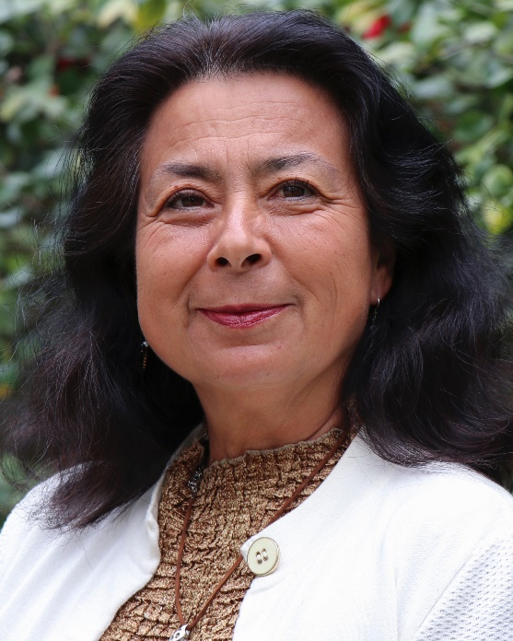
Program Leadership
Rose Borunda, Ed.D.
Interim Director
2017 Juliana Raskauskas Legacy Lecture Award
2018-19 Outstanding Faculty Award recipient for Community Service
Keynote speaker & Committee Chair for California Indian Summits; U.C. Berkeley, San Diego State, Sac State.
Author: “What is the Color of Your Heart?” and “Speaking from the Heart: Herstories of Chicana, Latina and Amerindian Women.”

Slide 12
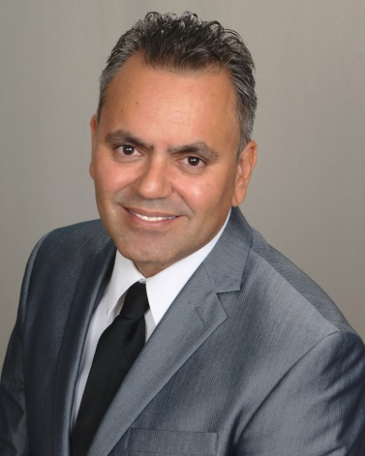
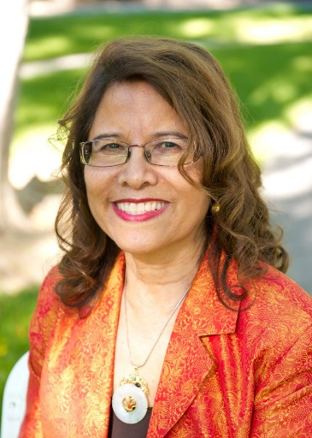
Standing Faculty
Dr. Carlos Nevarez
2015-2016 Outstanding Faculty Award recipient for Scholarly and Creative Activities
Published in the Community College Journal of Research and Practice, the Journal of Hispanics in Higher Education, and Education Studies
Currently working on fourth book with emphasis on developing an institutional change model
Executive Editor, Journal of Transformative Leadership and Policy Studies (JTLPS)
Dr. Caroline Turner
Internationally recognized and award winning scholar
Book Mentoring as Transformative Practice: Supporting Student and Faculty Diversity is in press
Areas of Research:
access, equity and leadership in higher education, organizational change, and faculty gender and racial diversity

Slide 13
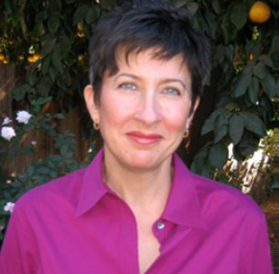
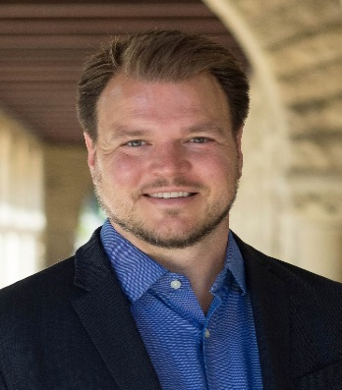
Ed.D. Faculty
Standing Faculty
Dr. Lisa Romero
Recipient of Center of Teaching and Learning Pedagogical Enhancement Award
Article, “Trust, Behavior, and High School Achievement” was recently published in The Journal of Educational Administration (JEA)
Experience in public education provides particular insight into the nexus between policy goals and ideals and the reality of schools and education in America
Dr. Frank Adamson
CSUS from the Stanford Center for Opportunity Policy in Education
currently studies the effects of different political and economic approaches to education on student experiences and their performance in schools
Areas of Research:
the economics and sociology of education, U.S. and international education policy, and educational equity and opportunity

Slide 14
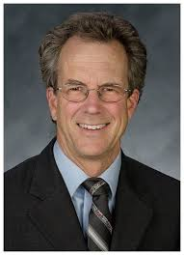
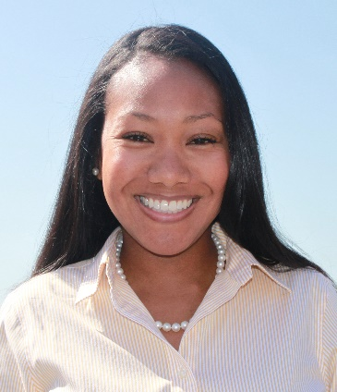
Core Faculty
Dr. Ted Lascher
Prior Interim Dean for College of Social Sciences & Interdisciplinary Studies
Professor, Department of Public Policy and Administration
Co-authored the article, “Campus Racial Climate and Student Academic Outcomes: A Critique of Prior Research and Recommendations for Future Study”
Areas of Research: policy process, legislative structures, and the impact of institutional structures on policy outcomes
Dr. Su Jin Jez (on leave)
Director of the California State University Student Success Network
Currently leading legislatively mandated evaluation of California Community College’s Economic Workface Development and review of private postsecondary institutions’ reporting requirements
Published in Research in Higher Education with article, "The Differential Impact of Wealth vs. Income in the College-Going Process”

Slide 15
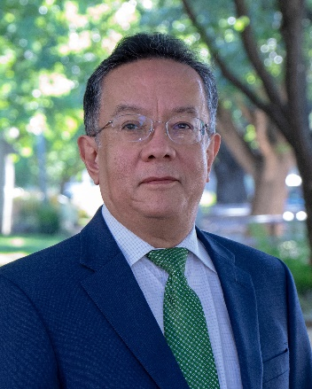
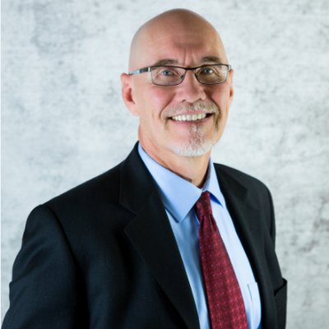
Ed.D. Faculty
Core Faculty
Dr. Porfirio Loeza
Began implementation of National Bilingual Education Plan for Language and Literacy Development for Guatemalan Ministry of Education and U.S. Agency for International Development
Initiated pilot program in the Quiche highlands of the Guatemalan state of Totonicapán
Second edition of 2013 book on bilingual instructional strategies, Best Practices in Bilingual and Multicultural Education: Pedagogical Interventions Based on Cultural and Sociolinguistic Characteristics
Editor, JTLPS.
Dr. Stephen Brock
professor and coordinator of the School Psychology Program in the College of Education at Sacramento State
his professional preparation includes undergraduate and graduate degrees in psychology, and a Ph.D. in Education (with an emphasis in psychological studies) at the University of California, Davis, where he researched Attention-deficit Hyperactivity Disorder
selected by the College of Education to receive the 2012-2013 Outstanding Scholarly and Creative Activities Award, and the 2017 Juliana Raskauskas Legacy Lecture Award

Slide 16
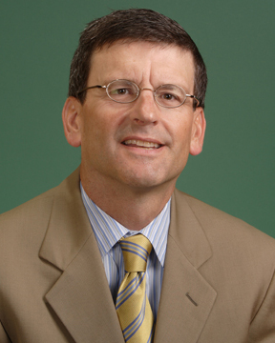
Core Faculty
Dr. Robert Wassmer
Director, Master’s Program in Urban Land Development at Sac State
Research appears in Economics of Education Review, Government and Policy, Land Economics, Urban Studies
Presented his report, “The Relative Importance of Supply and Demand Factors in Determining Preschool Attendance and Hours Attended,” at Western Economic Association Meeting , 2014
Areas of Research: topics relating to state/local public finance and urban economic development

Slide 17
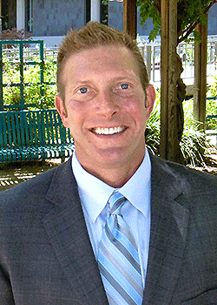
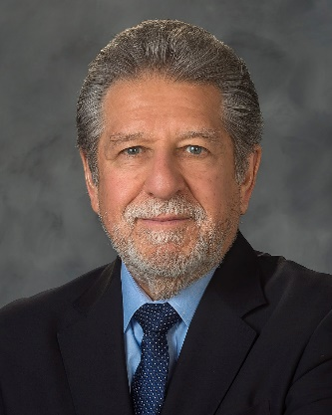
Affiliated Faculty
Dr. Frank Lilly
Recipient of CSUS Outstanding Teaching Award 2012-2013
Co-Director of Accelerated College Entrance Program and serves the university in numerous capacities
Areas of Research: Appreciative Inquiry, Creativity and Dual Enrollment
Ph.D., McGill University
Dr. Alexander Gonzalez
Served as president of CSU Sacramento (2003-2015)
Served as president of CSU San Marcos (1997-2003)
Masters & Ph.D., UC Santa Cruz

Slide 18
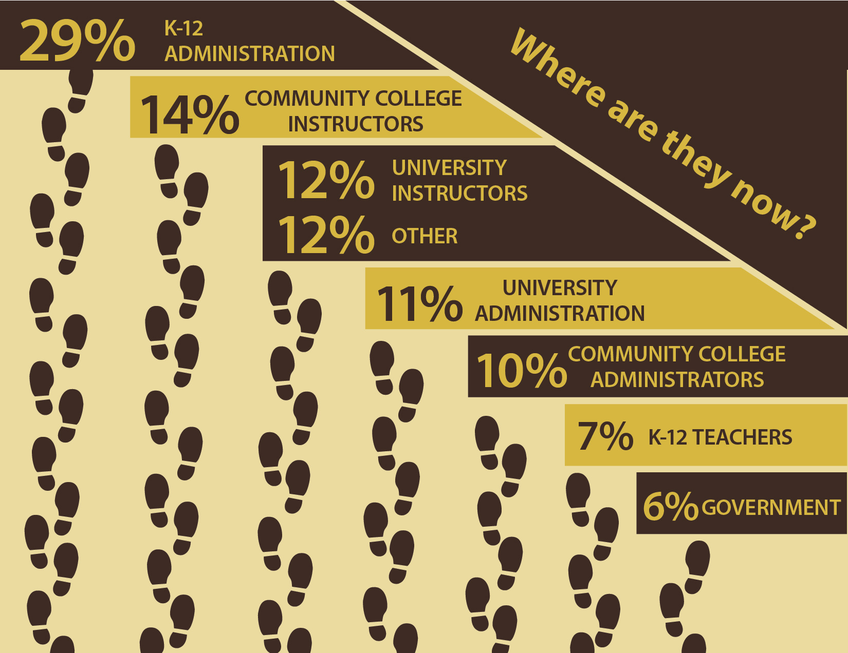

Slide 19
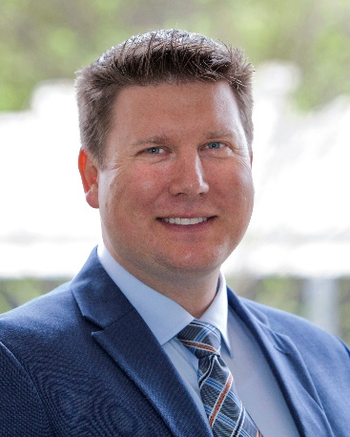
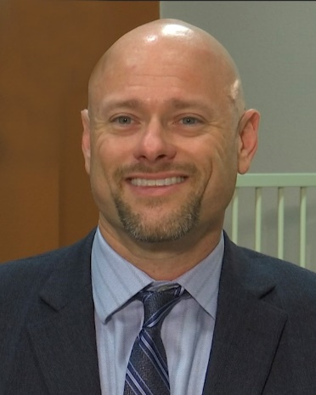
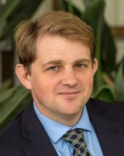
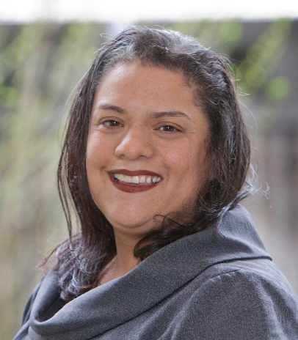
Notable professional accomplishments
Dr. Jeffrey Mrizek:
Dean of Career Technical Education, CA Community College Chancellor's Office
Cohort 7
Dr. Daren Otten:
President/Superintendent Copper Mountain College
Cohort 5
Dr. Erik Cooper:
Dean of Planning, Research and Resource Development,
Sierra College
Cohort 5
Dr. Delmy Spencer:
Dean of Student Services
Yuba College
Cohort 7

Slide 20
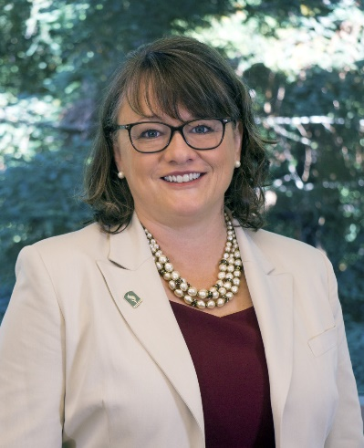
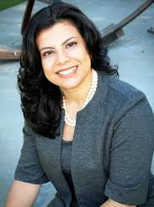
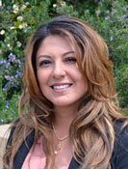
Notable professional accomplishments
Dr. Jenni Murphy
Dean, College of Continuing Education, Sacramento State
Cohort 3
Dr. Viridiana Diaz
Assistant Vice President, Strategic Diversity Initiatives, and Director, College Migrant Assistance Program, Sacramento State Cohort 3
Dr. Daryl Camp
Superintendent,
San Lorenzo Unified School District
Cohort 4
Dr. Eva Munguía
Dean, Counseling
and Student Success,
Ohlone College
Cohort 2

Slide 21
STUDENT INFORMATION BY GENDER
Student Information
Cohorts 1-12

Slide 22
STUDENT EMPHASIS
Student Emphasis
Cohorts 1-12
Alumni Perspective
“The cohort is the reason I went into the Ed.D. program at CSUS and it is the reason I graduated with my doctorate. I could not have done it without my cohort.”

Slide 23
STUDENT EMPHASIS BY GENDER
Student Emphasis
Cohorts 1-12

Slide 24
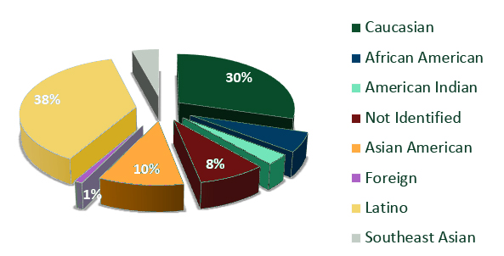
STUDENT DEMOGRAPHICS

Slide 25
Ed.D. Student Enrollment
Average number of students in a cohort:
18
Alumni Perspective
“Tremendous program geared toward working professionals with families.”

Slide 26
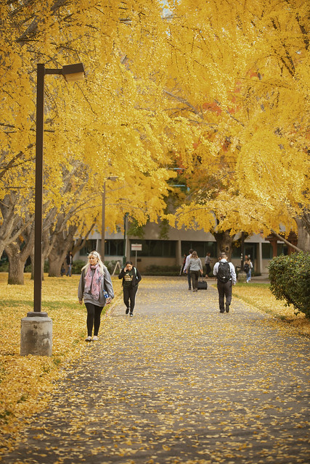
Tuition & Fees (2020—21 fees TBD)
Fall 2019 $5,919 + $813 (campus fees) = $6,732 Spring 2019 $5,919 + $813 (campus fees) = $6,732
Summer tuition 2019* $5,919 + $365 (campus fees) = $6,284
Tuition & Fees for 12-month Study
$19,748
* The doctorate program has a summer session after Years 1 and 2.

Slide 27
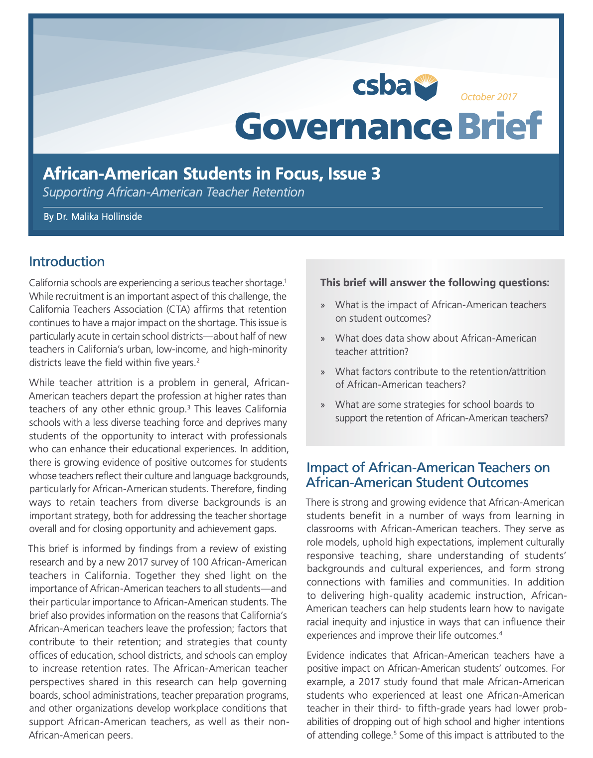
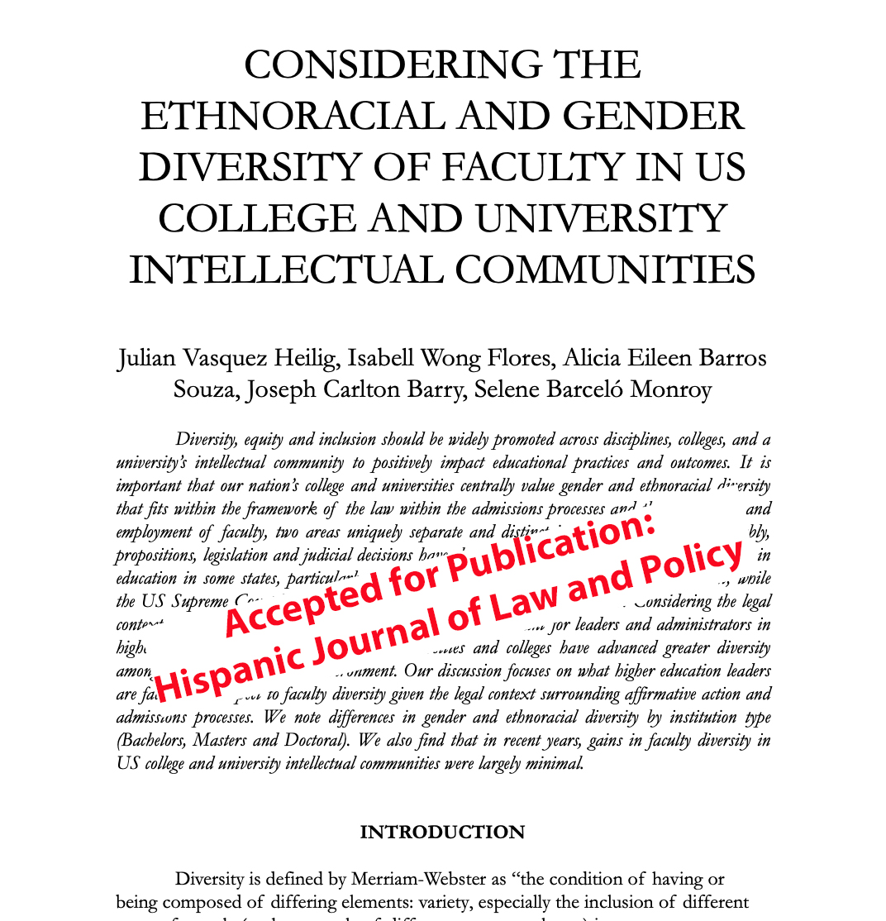
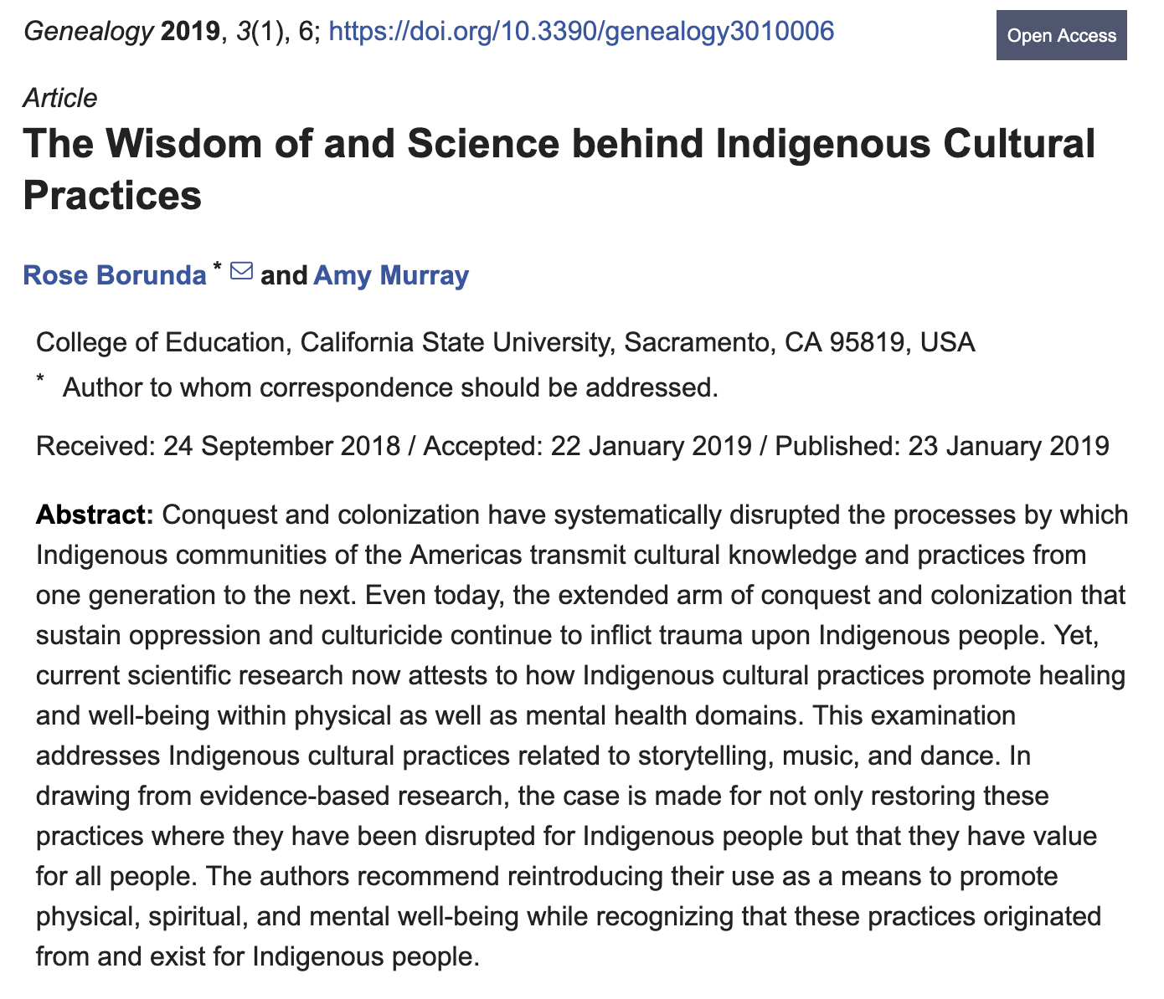
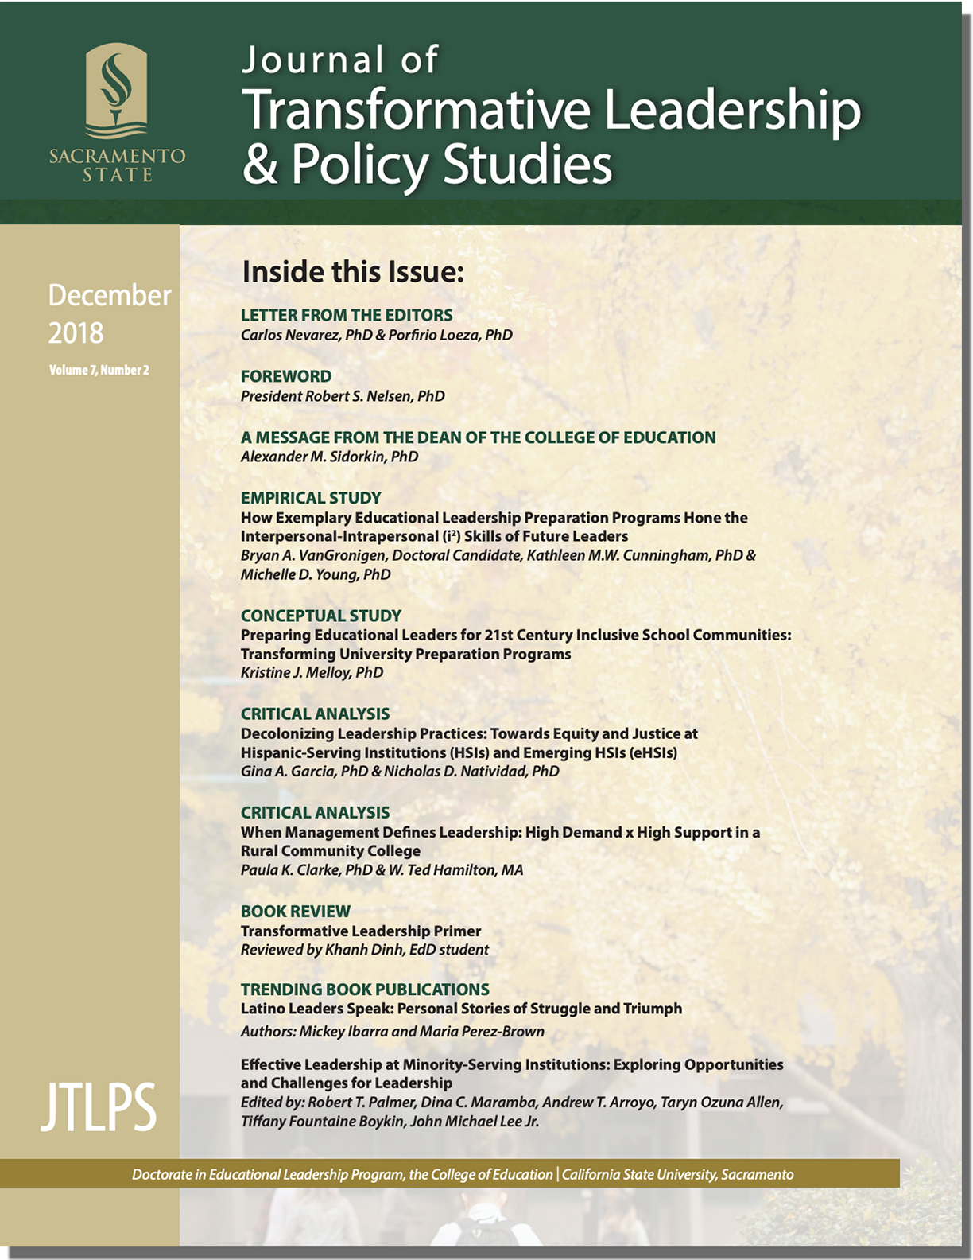
Funding & Publishing
Opportunities
Research Assistantships ($6,000/semester)
CSU Trustee’s Award ($6,000 scholarship)
CSBA Fellowship ($1,000 + publication + travel to present at AEC)
Travel funds for presenting at conferences ($600)
Publishing opportunities with professors

Slide 28
Free Summer Writing Course
Student comments:
“Dr. Merrill provided an engaging and extremely useful seminar. I am confident that the skills practiced and resources provided will be quite useful for the EdD program.”
“Dr. Merrill's planning and delivery were impeccable. I am grateful that what I learned exceeded my expectations for a two day course and will positively affect my writing for the rest of my career/life. If this is the type of instruction Cohort 13 can expect from other professors, we have a lot more to look forward to than I originally anticipated.”

Slide 29
The Journal of Transformational Leadership and Policy Studies (JTLPS)
Hosted by the CSU, Sacramento Doctorate in Educational Leadership Program and Ed.D. Programs from across the CSU System.
Publishes studies focused on leadership practices for educational leaders in PreK-16
Currently shown is the cover of the Seventh volume of the newest publication, released December 2018.
Journal can be found at: https://journals.calstate.edu/jtlps/

Slide 30
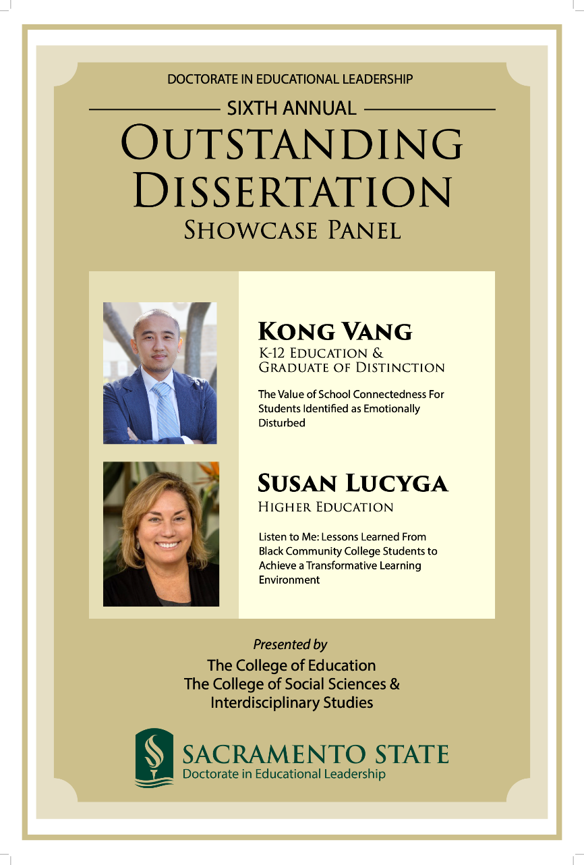
Recent Outstanding
Dissertation Showcase

Slide 31
Events Celebration of Education Leadership and Policy
Journal of Transformative Leadership and Policy Studies "Meet the Editors" reception

Slide 32
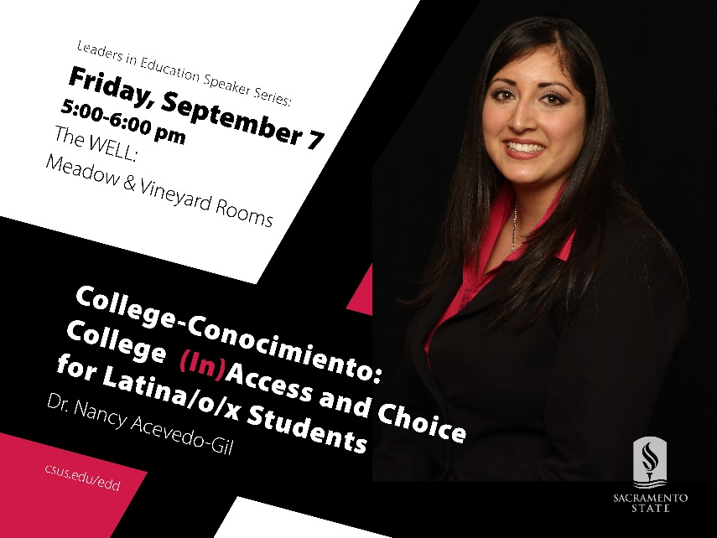
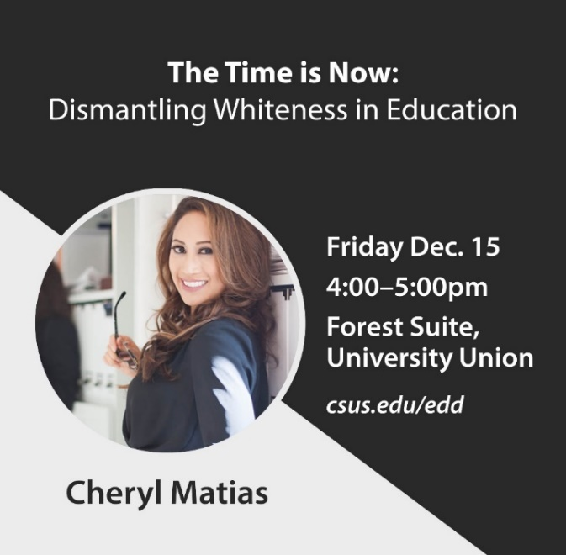
Visiting Scholars
UT Austin Professor Terrance L. Green ‘Leading for Equity in School-Community Engagement: Closing Opportunity and Equity Gaps’

Slide 33
To Apply…
https://www2.calstate.edu/apply
Complete the Cal State Apply application
Please DO NOT upload any documents to the Cal State Apply website
Within 3 business days, OGS will direct you to the Supplemental Document Upload Website, where you will submit ALL necessary documents
Priority deadline: December 1
Final deadline for Fall admission: March 1

