Slide 1


How to Fund your Teaching Credential: FAFSA, grants, scholarships, residencies
Dr. Figueroa-Ramírez figueroaramirez@csus.edu
Educational Equity Program Peer Mentors
edeq@csus.edu
@sacstate_edequity

Slide 2
CSET Registration Procedures
Login to Pearson System Registration to choose a test center and date: https://www.ctcexams.nesinc.com/PageView.aspx?f=GEN_Tests.htm
Offered online or in person as Computer-Based Testing (CBT)
Choose for scores to be sent via email or hard copy in the mail
Results within 5 weeks
Proctor exam results may be delayed additional 2 weeks

Slide 3
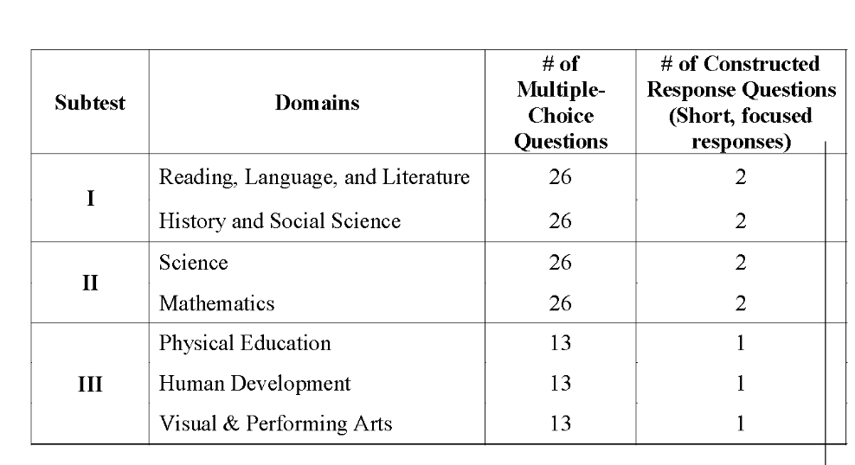
CSET Breakdown
3 Subtests & times vary
Subtest I ONLY = 180 min. (3 hrs.)
(52 Multiple Choice; 4 Constructed Responses)
Subtest II ONLY = 180 min. (3 hrs.)
(52 Multiple Choice; 4 Constructed Responses)
Subtest III ONLY= 135 min. (2.25 hrs.)
(39 Multiple Choice; 3 Constructed Responses)
All Subtests Taken Together= 300 min. (5 hrs.)

Slide 4
Tips to prepare
Take the practice tests for each subtest required for your credential. Time yourself for each subtest. Do not take all practice tests in one sitting. Consider spacing them out with a significant break (hours or even days) in between each practice subtest. (You can sequence the actual subtest exams this way too).
Grade yourself; the answers are available towards the end of the practice test.
3. Analyze and evaluate your results: identify your strengths and weaknesses in all sections. Create an Action Plan – decide how much time you will require in tutoring for corresponding sections
4. If you score lower than a 75% we recommend you contact us for a follow up appointment with one of our Peer Mentors/Tutors at EdEq@csus.edu and let us know which subtests you need further support. Tutoring for the three subtests will be available throughout summer 2025 via email and zoom.

Slide 5
Tips from those who passed:
• Set aside minimum 3-4 hours each day and dedicate this time to study one section/subtest at a time
• Write as much as you know for each topic. Writing can be good practice for remembering key terms.
• YouTube will become your best friend. Typing in "CSET Multiple Subjects" will not return helpful videos. Instead, search for specific topics like "The Water Cycle"
• Watch documentaries. This is especially helpful with the Multiple Subject social science section (subtest I).

Slide 6


Slide 7
San Diego County Office of Education
Offers free test prep
Registration is free and online

Slide 8

Why is this Important?
You can get up to $60,000 to pay for your credential
Studies show that student teacher models are most effective

Slide 9

FAFSA and CADAA
March 22, 2026 deadline to submit COE scholarship applications
April 2, 2026 deadline to submit FAFSA and CADAA

Slide 10

Free Application for Federal Student Aid (F A F S A)
  Application opens December 1, 2025
  Priority deadline to submit is 4/2
  Apply as a 5th year undergraduate student, “undergraduate and beyond”
  Drop-in clinics available January
https://www.usa.gov/fafsa

Slide 11
California Dream Act Application (CADAA)
  DACA, Undocu-students CADAA rather than FAFSA
  Not eligible for federal aid but ARE eligible for CA state aid, COE Scholarships, AB 540 CA Grant
  Apply as a 5th year undergraduate student
  Visit the Dreamer Resource Center (DRC)
https://www.usa.gov/fafsa

Slide 12

Individual Taxpayer Identification Number (ITIN)
If you complete credential program requirements, you CAN be recommended for state licensure (teaching/counselor credential) at Sacramento State.
ITIN, 9-digit number for ID purpose only
ITIN is not a work permit
Use to obtain Certificate of Clearance

Slide 13
The Carlsen Center
Entrepreneurship and Innovation
For assistance to apply for a Contractor License
The Carlsen Center for Innovation & Entrepreneurship
Sac State Library, Room 1520
Mon. – Fri. 8 a.m. – 5 p.m.
Phone: (916) 278-5001
carlsen.center@csus.edu

Slide 14
Students with an ITIN
On campus:
Dreamer Resource Center (follow on Instagram/social media for workshop updates)
CARES office (emergency grant-Undocu can apply)
ASI student scholarships
Off campus:
Immigrants Rising
CHIRLA
CA Rural Legal Assistance
Online:
The Dream.US
International Empowerment
Dreamersroadmap.org

Slide 15
Cal Grant & Pell Grant Funding
If received Pell funds, you may be eligible for one additional year while in the credential program.
  Pell Determined by Fin Aid from your FAFSA
If received a Cal Grant as an undergrad, can receive up to one additional while in the credential program.
  Apply directly with the California Student Aid Commission (C S A C) for the Cal Grant

Slide 16




Grants, Scholarships & Residency Options

Slide 18
Funding Source | Amount | Guidance
Golden State Teacher Grant | Up to $10,000 | Agree to teach in a priority school, 4 years upon completing cred program. (Undocu?)
Cal Grant | Up to $13,000 | Cal Grant A and B recipients may be eligible, complete your FAFSA. If you have dependents, you may be eligible for another $6,000 through the Students with Dependent Children Grant.
Pell Grant | Up to $7,000 | May be eligible, complete your FAFSA
Teach Grant | Up to $4,000 | Per year, agree to teach in a high need field, low-income school, 4 years.
COE Scholarships | Varies | We award over $100,000 in scholarship awards every year. Apply through COE scholarship portal

Slide 19
Funding Source | Amount | Guidance
Math and Science Teacher Initiative (MSTI) | Varies | Scholarships available for undergraduate and current teacher candidates that are pursuing a math or science teaching credential.
NOYCE Scholarship | 2025-2026 | Check back. Not currently being offered. Math and science teachers
Ed Equity Program fee waivers, resource library materials | Varies | Inquire figueroaramirez@csus.edu for eligibility for a test fee waiver, fingerprinting/livescan, edTPA

Slide 20
Golden State Teacher Grant
Apply in May/June – NOT competing against anyone!
Up to $10,000
Must be enrolled in the credential program
Must commit to work at a “priority school” in CA for 4 years within 8 years of completion
Must complete the FAFSA or Dream Act Application

Slide 21
Teach Grant
Up to $4,000 per year
Must have overall GPA 3.25 or above
Must prepare to teach in a “high needs” area:
  Special Education
  Single Subject – math, science, world language
  Bilingual Authorization
ALL of our accepted students are considered for this grant; you don’t have to submit an app.

Slide 22
Sac StateScholarships (COE)
Overall deadline is 3/2/2026
OUR deadline is 3/22/2026
COE webpage with scholarship information
CSUS Scholarships Application page

Slide 23
College of Education
Provide resources and support
  Pell eligible, bilingual,1st Gen
Services Include
  Peer mentors &Tutoring
  Evaluation for bilingual authorizations, BSR, and SMC
  Assistance with DACA and Undocu financial aid applications
  Multilingual (Spanish, Hmong) & first-generation applicants eligible for test fee waivers & other support
Eureka Hall 437, figueroaramirez@csus.edu or edeq@csus.edu

Slide 24
Future Math and Science Teachers
Math and Science Teacher Initiative (MSTI) $500 -$2,500 funds about 12 candidates
We will email every future STEM teacher with application information
Not currently offered, check back 2025-2026 Noyce NSF Scholarship: $15,000 (usually fund around 5-8 recipients)

Slide 25



Teacher Residency Grants
Inspired by the medical school approach to training doctors, where instruction and practice are combined. Once you earn your bachelor’s degree, as a teacher resident you will student teach with an experienced mentor teacher.
You’ll engage in this pre-service clinical practice 3-4 days a week while completing coursework to earn a Preliminary credential.
After receiving the credential, you will likely serve as teacher of record (a full-time teacher) in the same district where you conducted your pre-service clinical practice.
Apply once you’re admitted (May/June)

Slide 26
Diverse Educators (WAUSD),
%80 tuition paid, $600 p/month when living in district boundaries, up to $10,000 add’l incentives
BRIDGE (SCUSD)
Multiple and Single Subject are eligible, must teach in SCUSD, up to $20,000?
Natomas USD
Diverse Educators Program
$500 stipend monthly, if living in district, add’l stipend
SMTR
Special Education
Credential candidates; must teach in a partner district
Notes:
STAR Residency? EGUSD?
Woodland Joint USD?
Diverse Educators (WAUSD), %80 tuition paid, $600 p/month when living in district boundaries, up to $10,000 add’l incentives
1
SMTR: University Partner: Sacramento State, 10 School District Partners: Twin Rivers Uniﬁed, Davis Joint Uniﬁed,
Sacramento City Uniﬁed, Elk Grove Uniﬁed, Washington Uniﬁed, California Montessori Project, St. Hope Public Schools, Woodland Joint Uniﬁed, Esparto Uniﬁed, Winters Joint Uniﬁed

Slide 27

Additional Resources

Slide 28
Consider Substitute Teaching
Apply in school districts
There are guidelines to subbing during credential program
What to do right now:
  Create an account on edjoin.org and upload all required documents
  Obtain 3 letters of recommendation, if you don’t already have them
  District offices will help you get the substitute permit

Slide 29
Federal Teacher Loan Forgiveness Program
Teach for 5+ years in low-income school
Math, Science or Special Ed = up to $17,500 forgiven
ANY other subject = up to $5,000 forgiven
studentaid.gov

Slide 30
State and Federal Financial Resources
You may qualify for public resources such as:
• CalFresh and WIC
• Medi-Cal
• Utility discounts (see the CARE/FERA Program and LIHEAP)
• Childcare and Family Care
• Public transportation discount

Slide 31
Program Costs

Slide 32



Program Costs
With Sac State’s Tuition/Fees you get:
2024-2025 Tuition/Fees
Credential (first 1 or 2 years)
Full-time (>6.1 units): $4,498/semester
Master of Arts in Teaching (MAT) (3 semesters) part-time (>6.1 units):
$3,175/semester
\+Books
+Taskstream account
+ Parking fees
free healthcare on campus for student, including counseling
free gym membership at The WELL
CalFresh card for food (if eligible)
free Transit Card
access to Sac State’s weekly Food Pantry with groceries and toiletries

Slide 33
Next steps
Complete your FAFSA/CADAA
Check your email regularly! You must be interviewed & submit information about how you are meeting entrance requirements BEFORE we can make an admissions decision. Send to coe-cred@csus.edu!
We will host another workshop in May with next steps for all the grants and financial assistance we described here.

Slide 34


College of Education Contacts
Student S u c c e s s Center
(Advising)
E d u c a t i o n a l E q u i t y
Program
Ashley Ciraulo-Stuart
Lead Advisor
Expertise: Application Process & Undergraduate pathways
Dr. Karina Figueroa-Ramirez
Ed Equity Coordinator
Application and scholarship assistance for diverse candidates (including DACA), bilingual authorization advising
Figueroaramirez@csus.edu
(916) 278-6403
aciraulo@csus.edu
@sacstate_edequity
Undocu- students - visit the Sac State Dreamer Resource Center
30

