Slide 1
CSUS CHHS Interprofessional Education Center for Innovative Teaching & Learning
Nassrine Noureddine
School of Nursing
Darla K. Hagge Ph.D., CCC-SLP
Department of Communication Sciences & Disorders
Co-directors

Slide 2
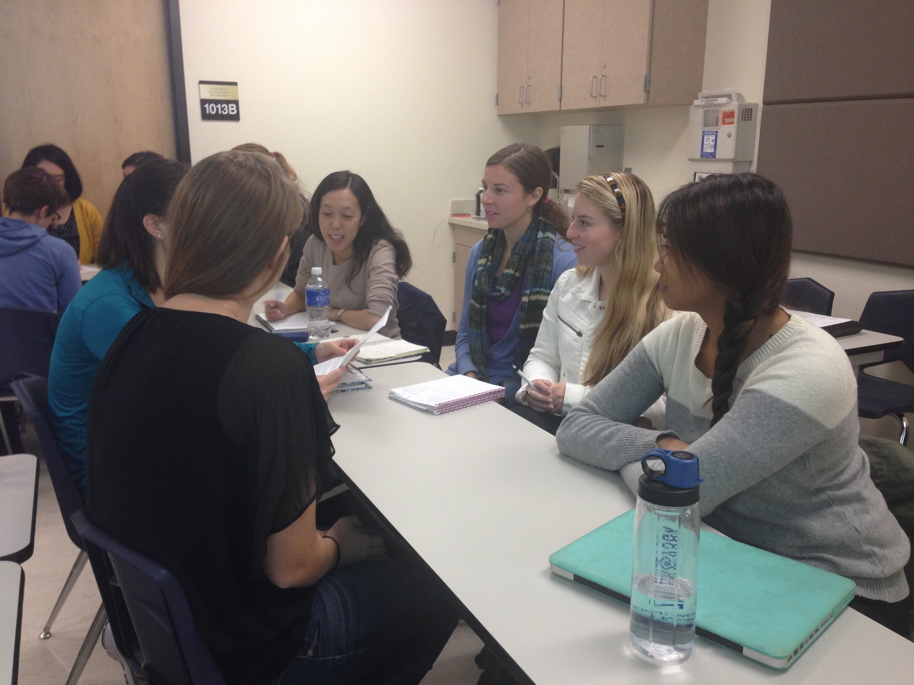

Slide 3
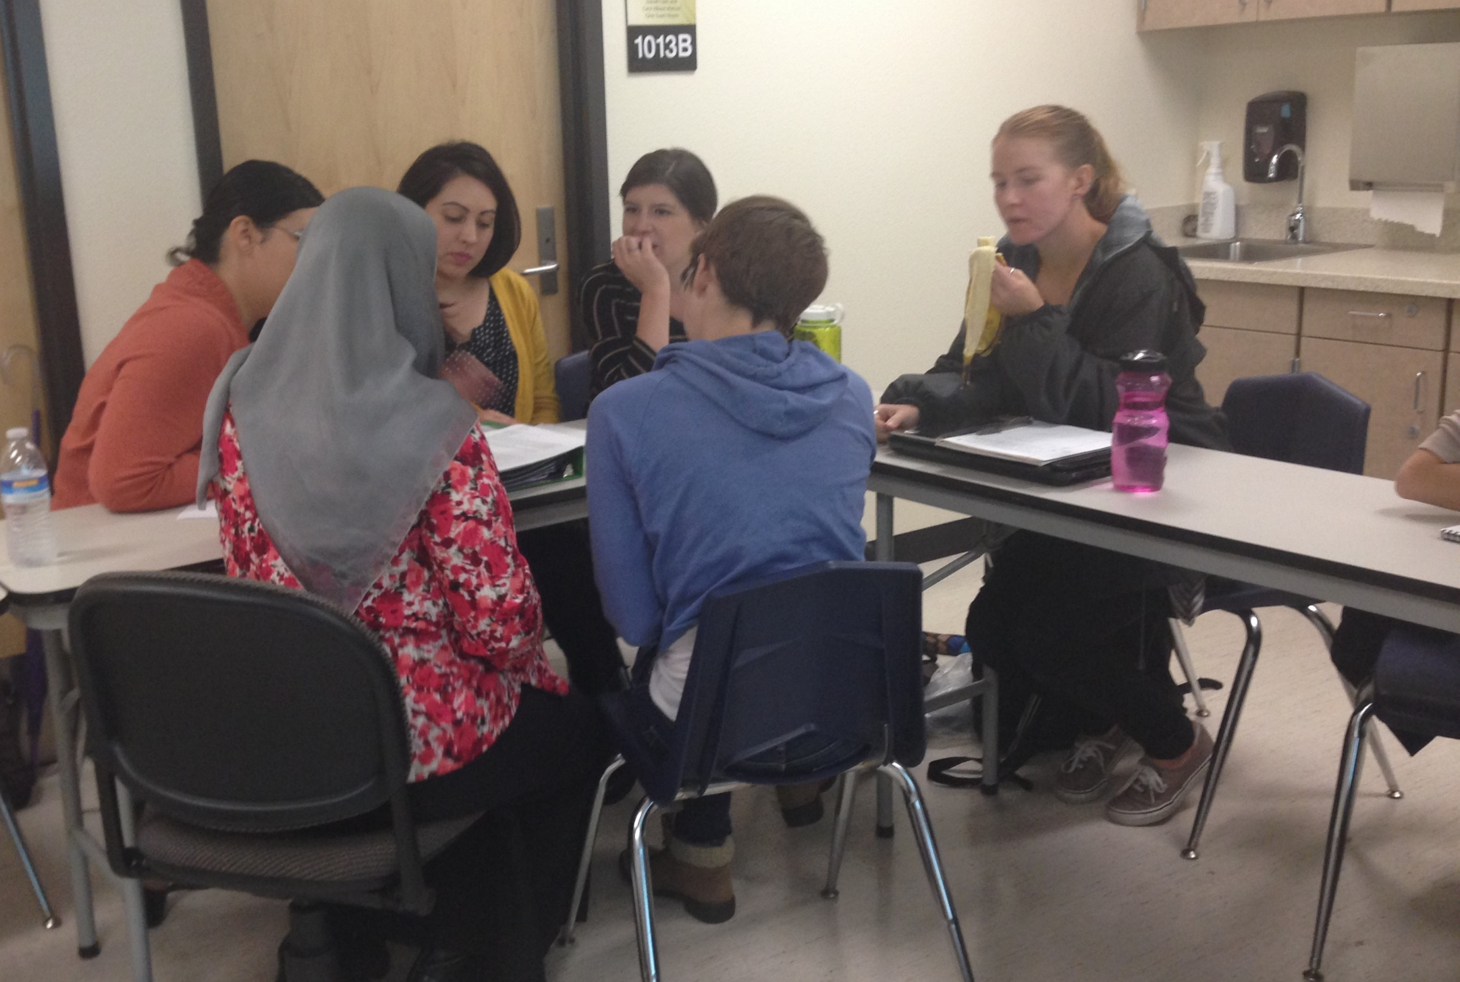

Slide 4
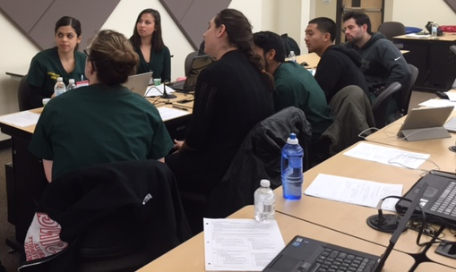

Slide 5
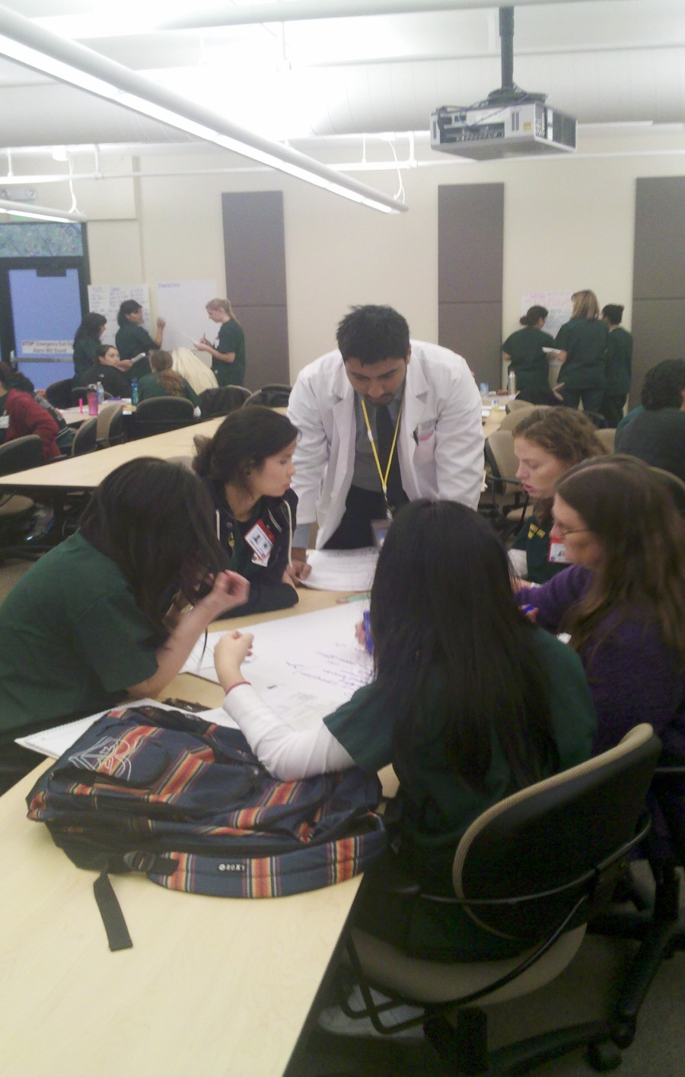

Slide 6
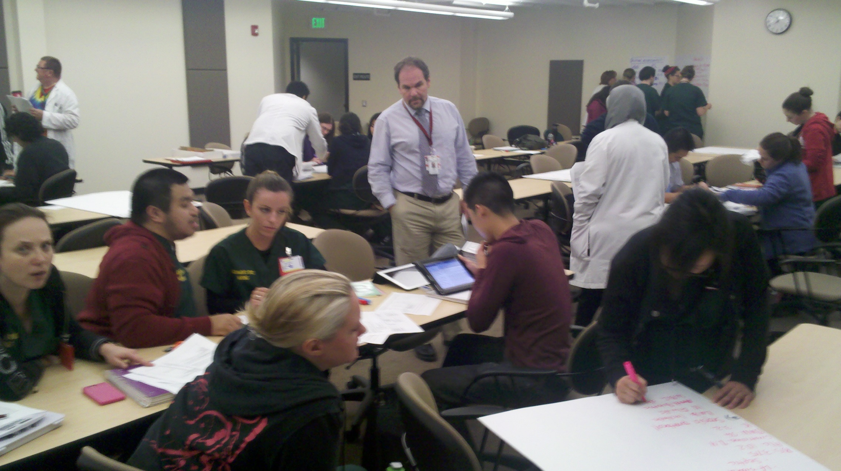

Slide 7
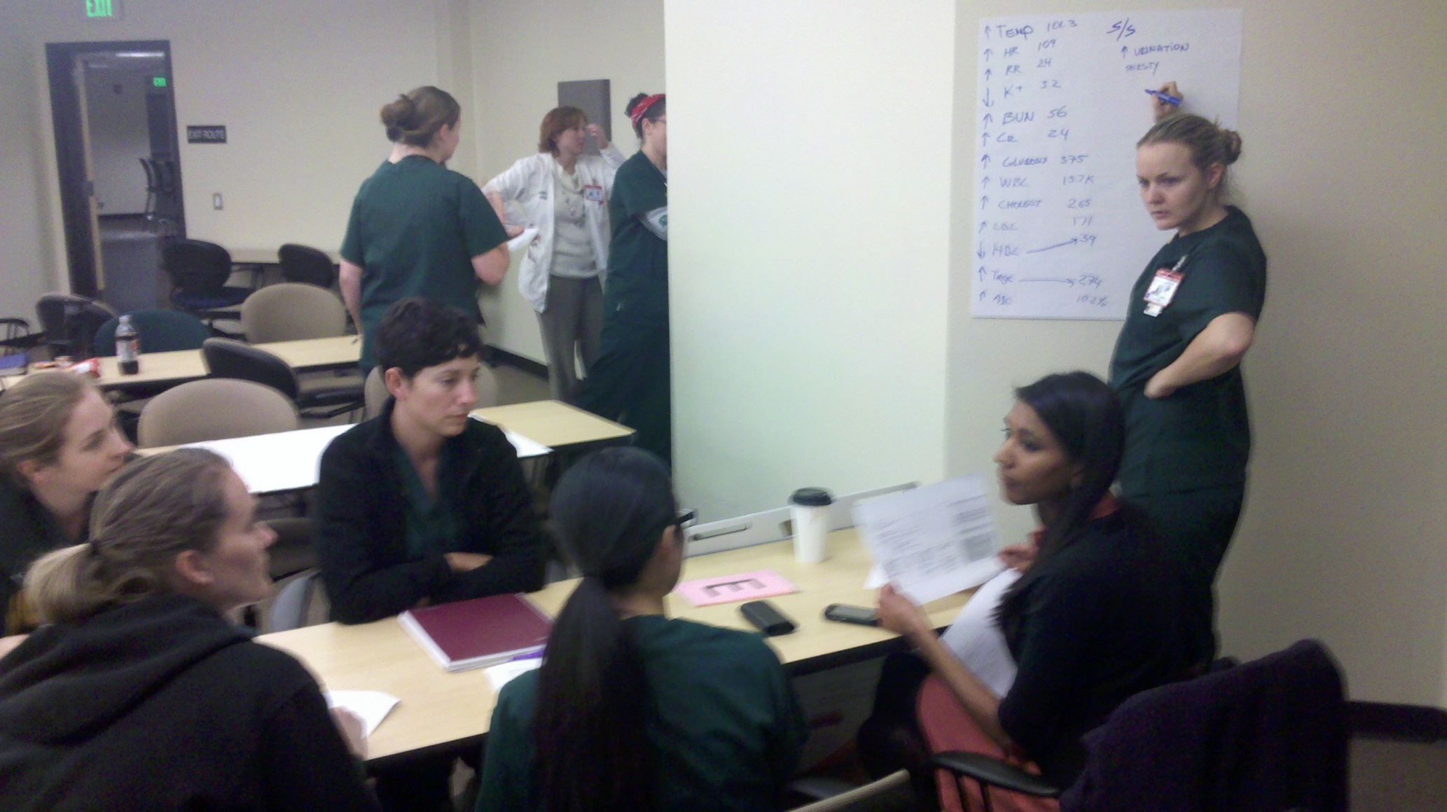

Slide 8
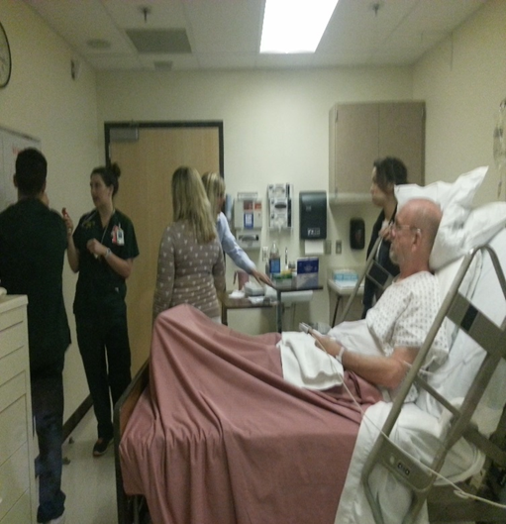

Slide 9
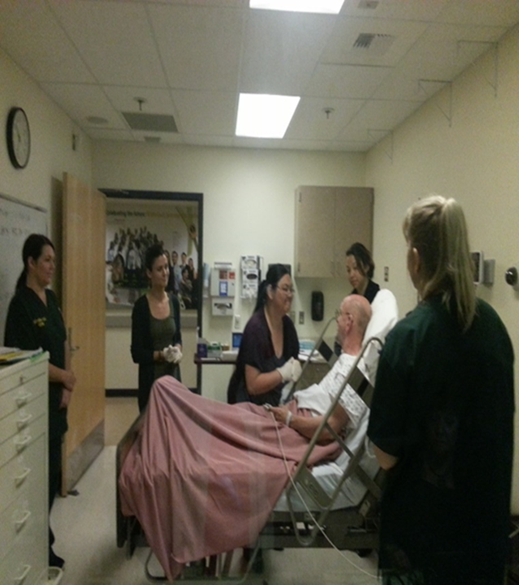

Slide 10
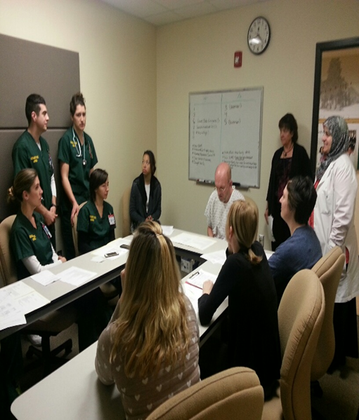

Slide 11
