Slide 1
COLLEGE OF HEALTH & HUMAN SERVICES
RTP COMMITTEE WORKSHOP
September 2023

Slide 2
AGENDA
Roles and Responsibilities
Primary & Secondary Review Distribution
File Organization
Acrobat Sign & OneDrive
Procedural Guidance
23-24 Review Timeline
2

Slide 3
ROLES & RESPONSIBILITIES
Department Chair
“Supervise[s] the evaluation of department faculty and staff as required by departmental personnel procedures”
Given “view” access until file closure deadline (unless completing an independent review)
Primary Committee
Department-level review of peers; must be tenured faculty at a higher rank than those being evaluated
Secondary Committee
College-level, independent review; must be tenured faculty at a higher rank than those being evaluated
One representative from each academic department within HHS
Dean
Completes a separate and independent review from Primary, Chair (if applicable), and Secondary reviews
Final decision in periodic & retention reviews (except P4)
Provost
Makes the final decision for P4, and all Tenure and/or Promotion files (P6, Early T/P, or Full)
3

Slide 4
RETENTION, TENURE, AND PROMOTION
(ARTP) POLICIES
MEMORANDUM OF UNDERSTANDING (MOU) FOR UNIT 3 FACULTY
CSU BOARD OF TRUSTEES POLICIES ON EVALUATION CRITERIA
SACRAMENTO STATE ARTP POLICY
PRESIDENTIAL MEMORANDUM FSA 00-11
COLLEGE ARTP POLICY
DEPARTMENT ARTP POLICY
4

Slide 5
PROBATIONARY FACULTY
P-1: Newly hired probationary faculty members without credit towards tenure.
P-2: Probationary faculty in their second year, or first year hired with one year toward tenure.
P-3: Probationary faculty in their third year, or first year hired with two years toward tenure, or second year hired with one year toward tenure
P-4: Probationary faculty in their fourth year. Final decisions for retention at this level rest with the Provost.
P-5: Probationary faculty in their fifth year.
P-6: Probationary faculty in their sixth year. Faculty in this classification must be reviewed for tenure and/or promotion.
5

Slide 6
PRIMARY COMMITTEE
Retention
All retention files (P2-P5) may be reviewed by either Tenured Associate or Full Professors
WPAF File Closure is September 18 - Primary Committee gains access by September 20.
Note: P4 w/2 years toward tenure has an accelerated timeline; letters are due to Dean’s Office by October 4.
All other retention evaluation letters are due to Dean’s Office by October 16
Tenure and/or Promotion
Tenure & Promotion files (early, P6, Full) must be reviewed by tenured faculty at a higher rank
i.e., P6 faculty may be reviewed by Tenured Associates, but Associates requesting promotion to Full must be reviewed by Tenured Full professors.
WPAF File Closure is October 9 - Primary Committee gains access by October 11
Letters due to Dean’s Office by November 3
6

Slide 7
SECONDARY COMMITTEE
Changes for AY 2023/24: P3 & P5 review now with Secondary A
Secondary A
ALL retention files (P2-P5)
Members are Tenured Associate or Full Professors
Note: P4 w/2 years toward tenure has an accelerated timeline, so Secondary A has two timelines to follow
Letters due to Dean’s Office by November 20 or December 11
Secondary B
ALL Tenure & Promotion files (early, P6, Full)
Members are Tenured Full Professors ONLY
Letters due to Dean’s Office by February 7
Committees ensure that all Primary Committees follow policies & procedures while conducting an independent evaluation
7

Slide 8
FILE ORGANIZATION
All WPAFs/PAFs are in OneDrive
Files are developed by the faculty member & the Dean’s Office
Timeline of materials to include:
Retention -
items from AY 22/23
Tenure and/or Promotion -
P6 or early T/P: items from hire date to current file closure
Promotion to Full: items from last review closure to current file closure
Added to file by Dean’s Office:
Appointment Letter
Access Log
Verification of Contents & Transmittal Sheets (Appendices)
Current & Past RTP Evaluations
Student Course Evaluations
8

Slide 9
ORGANIZATION OF WPAF IN ONEDRIVE
Faculty under evaluation and the custodian of PAFs (Dean’s Office) shall place materials in the WPAF in the following order:
Current RTP Evaluations (DO)
CV (Faculty)
Index (Faculty)
Letter of Transmittal (Faculty)
Previous RTP Evaluations (DO)
Student Evaluations of Teaching (Faculty)
Supporting Docs (Faculty)
Teaching Effectiveness
Scholarship & Creative Activities
Service to Campus, College & Department
Service to Community
Verification of File Contents (DO)
9

Slide 10
ONEDRIVE
Faculty member has “edit/upload” access and Department Chair has “view” access until file closure date
Upon file closure Dean’s Office will add the Access Log and grant access to Primary Committee during the primary review period
Once Primary review period ends access is removed, and then granted to Secondary Committee during the secondary review period
Training guides on OneDrive are available on the HHS RTP website
WPAF ACCESS LOG
Spreadsheet within each faculty member’s WPAF
Each reviewer must log name & date each time the file is viewed
10

Slide 11
SUGGESTED FILE NAMING CONVENTION
For ease for the reviewers, faculty are asked to follow a simple file naming convention, matching the number on their uploaded document to the number in their index.
Note: all files have a 30-character limit
11

Slide 12
PRIMARY REVIEW DISTRIBUTION
New Process!
Evaluation Letters
Committee Chairs will be responsible for sending final letters for signature on Letterhead via Acrobat Sign
Signed, PDF letter(s) should be uploaded into OneDrive “Committee” Folder for Dean’s Office to distribute & upload into faculty’s WPAF.
Appendix A (Primary Committee Transmittal Sheet)
Committee Chairs will be responsible for initiating the new Acrobat Sign Workflow and completing the form with the Committee’s vote.
Workflow links are available on the HHS RTP Website
All review letters will be delivered via email & uploaded into the WPAF in OneDrive by the Dean’s Office
12

Slide 13
APPENDIX A
ENTER “YES” OR “NO” IN THE BOX(ES) THAT CORRESPOND(S) TO THE ACTION(S) CONSIDERED.
FORMAT THE “VOTE” BOX(ES) AS THE NUMBER OF
“Y-N” VOTES
EX: 3-0 IF UNANIMOUS YES, OR 0-3 FOR UNANIMOUS NO
13

Slide 14
SECONDARY REVIEW DISTRIBUTION
New Process!
Evaluation Letters
Committee Chairs will be responsible for sending final letters for signature on Letterhead via Acrobat Sign
Signed, PDF letter(s) should be uploaded into OneDrive “Committee” Folder for Dean’s Office to distribute & upload into faculty’s WPAF.
Appendix C (Seondary Committee Transmittal Sheet)
Committee Chairs will be responsible for initiating the new Acrobat Sign Workflow and completing the form with the Committee’s vote.
Workflow links are available on the HHS RTP Website
All review letters will be delivered via email & uploaded into the WPAF in OneDrive by the Dean’s Office
14

Slide 15
APPENDIX C
ENTER “YES” OR “NO” IN THE BOX(ES) THAT CORRESPOND(S) TO THE ACTION(S) CONSIDERED.
FORMAT THE “VOTE” BOX(ES) AS THE NUMBER OF
“Y-N” VOTES
EX: 3-0 IF UNANIMOUS YES, OR 0-3 FOR UNANIMOUS NO
15

Slide 16
PROCEDURAL GUIDANCE
WPAF File Closure - 4 PM!
Faculty submits Verification of File Contents via Adobe Sign on file closure date
After this, no other items may be added or removed from the WPAF, and edit access is removed.
Once closed, files are submitted to Primary Committee for review
Only the Dean’s Office inserts Primary, Chair, Secondary, and Dean’s review letters.
File Closure Dates:
All Retention (P2-P5): September 18, 2023
All P6, Tenure and/or Promotion: October 9, 2023
16

Slide 17
TENURE/PROMOTION
Six years is the standard timeline to request tenure & promotion to Associate Professor
Truncated if hired with years toward tenure
Tenure review is required by the sixth probationary year (P6)
Promotion reviews are optional; must indicate in writing if not desired
Once tenure is granted, faculty must be reviewed every five years
Early Promotion
“Outstanding” performance in teaching; appropriate academic preparation; “Outstanding” in 2 of the other 3 areas of evaluation
Consider: What is “Outstanding”?
Early Tenure
Performance must be substantially beyond that required for tenure after a normal six-year probationary period
Activities bring widespread recognition to the individual and university from the academic community and/or the general public
“Outstanding” performance in teaching; appropriate academic preparation; “Outstanding” in 2 of the other 3 areas of evaluation
17

Slide 18
TIPS
Review stated action for accuracy (retention, tenure, promotion, early, etc...)
Look for responses to earlier reviews
Be specific in your recommendations
Ask for any items you need to review that are not in the file (not denoted by an asterisk)
Note activities that span timelines and cross categories
Encourage candidates to work on files year-round
Include rebuttal in your review (if applicable)
18

Slide 19
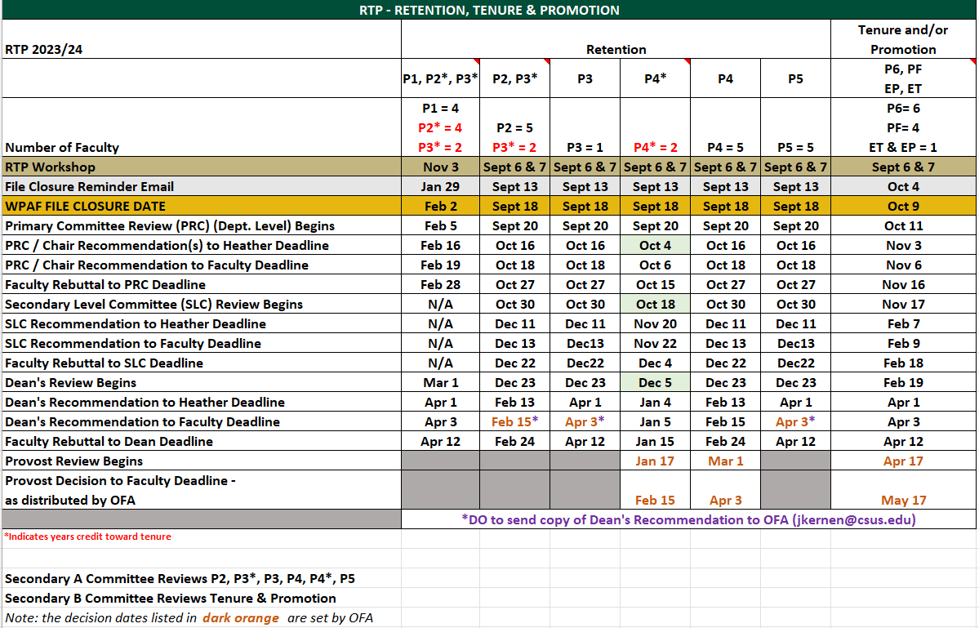
COLLEGE OF HHS 2023-24 RTP CALENDAR OF DEADLINES
19

Slide 20
QUESTIONS?
20

Slide 21
CONTACT
Dean Mary Maguire
maguirem@csus.edu
Heather Crummett
Budget & Personnel Analyst
crummetth@csus.edu
21

