Slide 1
College of Health and Human Services RTP Workshop
September 2023

Slide 2
Agenda
Overview
PAF and 23-24 WPAF
OneDrive and Adobe Sign
Secondary Committee
Dean’s Review
Early Tenure and/or Promotion
Tips
Quality v Quantity
23-24 Review Timeline

Slide 3
Retention, Tenure and Promotion (ARTP) Policies
Memorandum of
Understanding (MOU)
For Unit 3 Faculty
Sacramento State ARTP Policy
Presidential Memorandum FSA 00-11
College ARTP Policy
Department ARTP Policy

Slide 4
Retention Tenure Promotion (RTP) Flow Process
Primary Level Review
Department Committee
Independent Department
Chair’s Review
Recommendation
Forwarded
Secondary Level Review
College Committee
Ten-day rebuttal period after each review
Recommendation
Forwarded
Dean’s Review
Recommendation
Forwarded
Provost & Vice President
Academic Affairs
Decision
Forwarded
Faculty Member

Slide 5
Probationary Faculty
P-1: Newly hired probationary faculty members without credit towards tenure.
P-2: Probationary faculty in their second year, or first year hired with one year toward tenure.
P-3: Probationary faculty in their third year, or first year hired with two years toward tenure, or second year hired with one year toward tenure
P-4: Probationary faculty in their fourth year. Final decisions for retention at this level rest with the Provost.
P-5: Probationary faculty in their fifth year.
P-6: Probationary faculty in their sixth year. Faculty in this classification must be reviewed for tenure and/or promotion.

Slide 6
2023-24 WPAF
One Drive
Developed by faculty member and DO
Permanent Custodian is the Dean
Timeline of materials to include:
Retention: 22-23 materials
Tenure and/or Promotion: from last review file closure to current file closure
Added by college:
Appointment letter
Access log
Transmittal Sheets
Verification of Contents
Current RTP Evaluations
Past RTP Evaluations
Student Evaluations

Slide 7
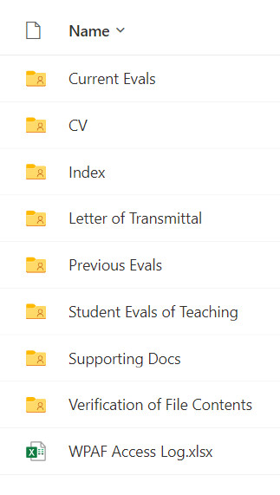
Organization of WPAF OneDrive
Faculty under evaluation and custodian of PAFs shall place materials in the WPAF in the following order:
Current RTP Evals (DO)
CV (Faculty)
Index (Faculty)
Letter of Transmittal (Faculty)
Previous RTP Evals (DO)
Student Evals of Teaching (DO)
Supporting Docs (Faculty)
Teaching Effectiveness
Scholarship and Creative Activities
Service to Campus, College & Dept
Service to Community
Verification of File Contents (DO)

Slide 8
OneDrive

Slide 9
OneDrive
Faculty member has edit/upload access and Chair has view access until file closure date
Upon file closure, DO will grant access to Primary Committee.
Training guides are available on our internal CHHS RTP Webpage
Keep file name length reasonable (less than 30 characters)

Slide 10
Suggested File Naming Convention
Match number on uploaded document to index:
Note: Please adhere to a 30 character limit for file all names.

Slide 11
Adobe Sign
DO will send following through Adobe Sign
Verification of file contents to Faculty and Chair
File Closure Date
Appendices for Primary Committee, Secondary Committee, and Dean

Slide 12
Areas of Review
Teaching Effectiveness
Scholarly and Creative Achievements
Contributions to the University
Contributions to the Community

Slide 13
Index
Index of items in following section of binder (A-E)
Evidence for teaching effectiveness
Student evaluations
Peer evaluations; if any;
Syllabi (at least one for each course taught)
Other evidence of teaching effectiveness
Evidence for scholarly and creative activities
Evidence for institutional service
Evidence for community service
Other materials required by the College ARTP policies not included elsewhere

Slide 14
Index
A record of activities and materials in the WPAF in outline format
Covers time period being reviewed
Use asterisk to indicate which items in file
Items without asterisk can be called for at any review level with 24 hour notice
Most recent items first
Use “mini” index for each area of review

Slide 15
Letter of Transmittal
State action requested
Indicate activity specified as condition of employment, i.e., doctorate
Summarize activities documented in file for each of four evaluation categories
Help guide and focus the reader
Include preferred pronoun (not required)
Use “mini” letter of transmittal and index

Slide 16
WPAF Closure – 4PM!
Must verify file contents with Chair
DO will send verification of file contents via Adobe Sign on file closure date
After this, no other items may be added or removed from the WPAF, Dean’s Office inserts Primary, Secondary and Dean Reviews
Once closed, submitted to Primary Committee for review
9/18 – P2, P3 w/1 yr, P3, P4, P4 w/2 yrs, P5
10/9 – P6, T/P

Slide 17
Role of Department Chair
Per University Policy:
“…Supervise the evaluation of department faculty and staff as required by departmental personnel procedures.”
Will be given view access until file closure deadline.

Slide 18
Secondary Committee
Secondary A: Retention
Members are Tenured Assoc or Full
Secondary B: Tenure and Promotion
Members are Tenured Full
Ensures Primary Committee follows policies and procedures
Conducts independent evaluation

Slide 19
Dean’s Review
Separate and independent from Primary, Chair (if applicable), and Secondary reviews
P4, P6, and Tenure and/or Promotion go to Provost for final decision

Slide 20
Ten Day Rebuttal Period
The faculty unit employee may submit a rebuttal statement or response in writing and/or request a meeting be held to discuss the recommendation within ten (10) [calendar] days following receipt of the recommendation. A copy of the response or rebuttal statement shall accompany the Working Personnel Action File and also be sent to all previous levels of review. This section shall not require that evaluation timelines be extended.

Slide 21
TP Timelines
Six years standard time to request Tenure and promotion to Associate Professor
Tenure review required by the sixth probationary year (P6)
Promotion reviews are optional; must indicate in writing if not desired
Post-tenure, all faculty must be reviewed every five years

Slide 22
Early Promotion
Outstanding performance in teaching; appropriate academic preparation; outstanding in 2 of the other 3 areas of evaluation
Outstanding?

Slide 23
Early Tenure
Performance substantially beyond that required for tenure after normal 6 year probationary period
Activities bring widespread recognition to individual and university from academic community and / or general public
Outstanding teaching, appropriate academic preparation; outstanding in 2 of the 3 remaining criteria

Slide 24
Tips
Read and respond to previous reviews
If no teaching assignment, memo from supervisor indicating work done
Don’t vary order for presentation of material
Label each item so relevance is apparent
Items can only be used in a single category, however, some items cross categories
Work on your file year-round, finalize before review

Slide 25
And now for…
A Discussion About
Quality over Quantity

Slide 26
Quality/Quantity
Demonstrated achievement in teaching, scholarship/creative activity, and service.
Grounded in academic and disciplinary standards. Know your discipline and how it is evolving.
Just enough to make your case, not an ounce more.
Anything listed in the index can be requested for review.
Therefore, not everything needs to be included, just the best of it.

Slide 27
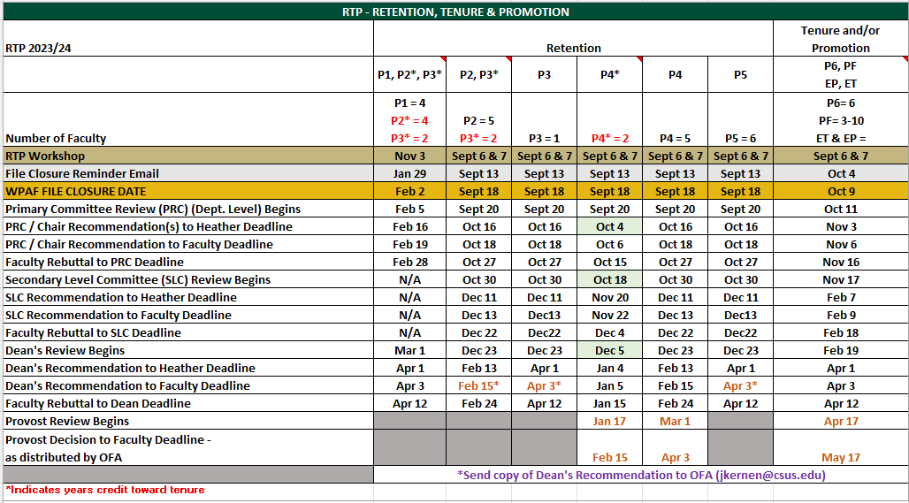
College of HHS 2023-24 RTP Calendar of Deadlines Retention

Slide 28
Contact
Dean Maguire
maguirem@csus.edu
Associate Dean Pieretti
sac19804@csus.edu
Heather Crummett, Budget Analyst
crummetth@csus.edu

Slide 29
Questions?

