Slide 1
College of Health and Human Services RTP Workshop – New Faculty Mentoring
November, 2023

Slide 2
Agenda
Overview
PAF and WPAF
Early Tenure and/or Promotion
Secondary Committee
Dean’s Review
Tips
Quality v Quantity

Slide 3
Retention, Tenure and Promotion (ARTP) Policies
Memorandum of
Understanding (MOU)
For Unit 3 Faculty
Sacramento State ARTP Policy
Presidential Memorandum FSA 00-11
College ARTP Policy
Department ARTP Policy

Slide 4
Retention Tenure Promotion (RTP) Flow Process
Primary Level Review
Department Committee
Independent Department
Chair’s Review
Recommendation
Forwarded
Secondary Level Review
College Committee
Ten-day rebuttal period after each review
Recommendation
Forwarded
Dean’s Review
Recommendation
Forwarded
Provost & Vice President
Academic Affairs
Decision
Forwarded
Faculty Member

Slide 5
NEW Probationary Faculty
P-1: Newly hired probationary faculty members without credit towards tenure.
P-2*: Probationary faculty in their first year, hired with one year toward tenure.
P-3*: Probationary faculty in their first year, hired with two years toward tenure, or second year hired with one year toward tenure
Note: All P-1, P-2*, and P-3* faculty in their first year of employment at Sacramento State are evaluated in the Spring Semester of their first full year of tenure-track employment.

Slide 6
P1/P2*/P3* Review
First year faculty (P1, P2*, P3*) will undergo an abridged* review during the spring semester of their first full year of tenure-track employment.
File closure deadline is February 2, 2024.
Primary committees will complete an evaluation letter by February 16, 2024 (to be distributed by Dean’s office to faculty by February 19).
Faculty will get a retention decision letter from the Dean by April 3, 2024.
*meaning a shortened timeline and only
one semester’s worth of materials

Slide 7
Probationary Faculty
P-1: Newly hired probationary faculty members without credit towards tenure.
P-2: Probationary faculty in their second year, or first year hired with one year toward tenure.
P-3: Probationary faculty in their third year, or first year hired with two years toward tenure, or second year hired with one year toward tenure
P-4: Probationary faculty in their fourth year. Final decisions for retention at this level rest with the Provost.
P-5: Probationary faculty in their fifth year.
P-6: Probationary faculty in their sixth year. Faculty in this classification must be reviewed for tenure and/or promotion.

Slide 8
Timelines
Six years standard time to request Tenure and promotion to Associate Professor
Tenure review required by the sixth probationary year (P6)
Promotion reviews are optional; must indicate in writing if not desired
Must be reviewed every five years after tenure

Slide 9
Personnel Action File (PAF)
Volume 1 – Official Personnel File
Permanent Custodian is Dean
Permanent Location is OneDrive
Access
Can request placement of items in file through Dean’s Office
Only the Dean places items in the PAF
Cannot be removed from Dean’s Office Control

Slide 10
Working Personnel Action File (WPAF)
23/24 Format - OneDrive
Developed by faculty member
Timeline of materials to include:
Retention to Tenure/First Promotion: from appointment date until file closure
Subsequent promotions: from last promotional review closure to current file closure

Slide 11
Working Personnel Action File (WPAF)
Documents added by College:
Appointment letter
Access log and transmittal sheets
Appendices
Verification of Contents
Current Reviewer Evaluations
Past Reviewer Evaluations
College inserts student evaluations
At the end of review cycle, the Dean updates the PAF and WPAF is returned to candidate
Evaluations, CV, transmittal sheets, index, and appendices

Slide 12
Organization of WPAF 4.08E of UARTP
Faculty under evaluation and custodian of PAFs shall place materials in the WPAF in the following order:
Access log
Verification of WPAF contents
CV/resumé (current CV/resumé and CV/resumé from either the original appointment (for tenure and promotion to Associate Professor) or from the last time the faculty member was promoted (for promotion to Full Professor)
Current RTP Evaluations
Past RTP evaluations
RTP narratives/summaries/reflective statements/personal action plan/faculty development plan (as appropriate for each College) addressing:
Teaching effectiveness
Scholarly and creative activities
Service (contributions to the community and to the institution)

Slide 13
Organization of WPAF 4.08E of UARTP
7.
Index of items in following section of binder (A-E)
Evidence for teaching effectiveness
Student evaluations
Peer evaluations; if any;
Syllabi (at least one for each course taught)
Other evidence of teaching effectiveness
Evidence for scholarly and creative activities
Evidence for institutional service
Evidence for community service
Other materials required by the College ARTP policies not included elsewhere (including letter of appointment, additional resumes, previous indices, etc.)

Slide 14
Suggested File Naming Convention
Match number on uploaded document to index:
Note: Please adhere to a 30 character limit for file all names.

Slide 15
Areas of Review
Teaching Effectiveness
Scholarly and Creative Achievements
Contributions to the University
Contributions to the Community

Slide 16
Items Used for Review
Student Course Evaluations for all courses
Summer is not included, unless contractually obligated (AuD)
Peer Evaluation or Visitation (per departmental practices)
Course materials
Syllabus for each course taught during review cycle
Evidence of pedagogical excellence
Evidence of accomplishment in Scholarly & Creative Activity (appropriate to your discipline/appointment)
Service to the campus, community, profession

Slide 17
Index
A record of activities and materials in the WPAF in outline format
Covers time period being reviewed
Use asterisk to indicate which items are in file
Items without asterisk can be called for at any review level with 24 hour notice
Newest items first

Slide 18
Resume/Curriculum Vitae
Current educational and professional experience
Get in the habit of updating each year
This is important, it may be the first thing considered

Slide 19
Letter of Transmittal
State the action requested (retention, or tenure and/or promotion)
Indicate activity specified as condition of employment, i.e., doctorate
Summarize activities documented in file for each of four evaluation categories
Help guide and focus the reader
Include preferred pronoun (not required)

Slide 20
WPAF Closure
Must verify file contents and close WPAF by signing verification form
After this, no other items may be added or removed from the WPAF, Dean’s Office inserts Secondary and Dean Reviews
Once closed, submitted to Primary Committee for review

Slide 21
Role of Department Chair
Per University Policy:
“…Supervise the evaluation of department faculty and staff as required by departmental personnel procedures.”

Slide 22
Early Promotion
Outstanding performance in teaching; appropriate academic preparation; outstanding in 2 of the other 3 areas of evaluation
What is Outstanding?

Slide 23
Early Tenure
Performance substantially beyond that required for tenure after normal 6-year probationary period
Activities bring widespread recognition to individual and university from academic community and / or general public
Outstanding teaching, appropriate academic preparation; outstanding in 2 of the 3 remaining criteria

Slide 24
Secondary Committee
Ensures evidence justifies recommendation of Primary Committee
Ensures Primary Committee follows policies and procedures
Conducts independent evaluation

Slide 25
Secondary Committee Composition
One tenured Full Professor from each unit in College (Committee A or B); tenured Associate Professors may serve on Committee A
FERP faculty eligible if during term of service
Members may not serve on both Primary & Secondary Committee
One Alternate elected from each unit
Alternates may not serve simultaneously on Primary & Secondary Committees

Slide 26
Dean’s Review
Separate and independent from Primary, Chair (if applicable), and Secondary reviews
P4, P6, and Tenure and/or Promotion go to Provost for final decision

Slide 27
Ten Day Rebuttal Period
The faculty unit employee may submit a rebuttal statement or response in writing and/or request a meeting be held to discuss the recommendation within ten (10) [calendar] days following receipt of the recommendation. A copy of the response or rebuttal statement shall accompany the Working Personnel Action File and also be sent to all previous levels of review. This section shall not require that evaluation timelines be extended.

Slide 28
And now for…
A Discussion About
Quality vs Quantity

Slide 29
Quantity
Just enough to make your case, not an ounce more…
Anything you list in your index as an accomplishment or as evidence of your excellence can be requested for review.
Therefore, not everything needs to be included, just the best of it.
Consider including no more than one piece of evidence for each achievement.

Slide 30
Quality
Always a challenge…
Demonstrated achievement in teaching, scholarship/creative activity, and service.
Grounded in academic and disciplinary standards.
Know your discipline and how it is evolving.
Talk with your chair, colleagues, deans, mentors.

Slide 31
Tips
Don’t vary order for presentation of material
Clearly label each evaluation category
Label each item so relevance is apparent
Items can only be used in a single category, however, some items cross categories
Use “mini” letter of transmittal and index

Slide 32
Tips
Make file organized and easy to follow
Carefully choose what to include, if you included it, you want it to be considered
Put most recent items first
Read and respond to previous reviews
If no teaching assignment, memo from supervisor indicating work done

Slide 33
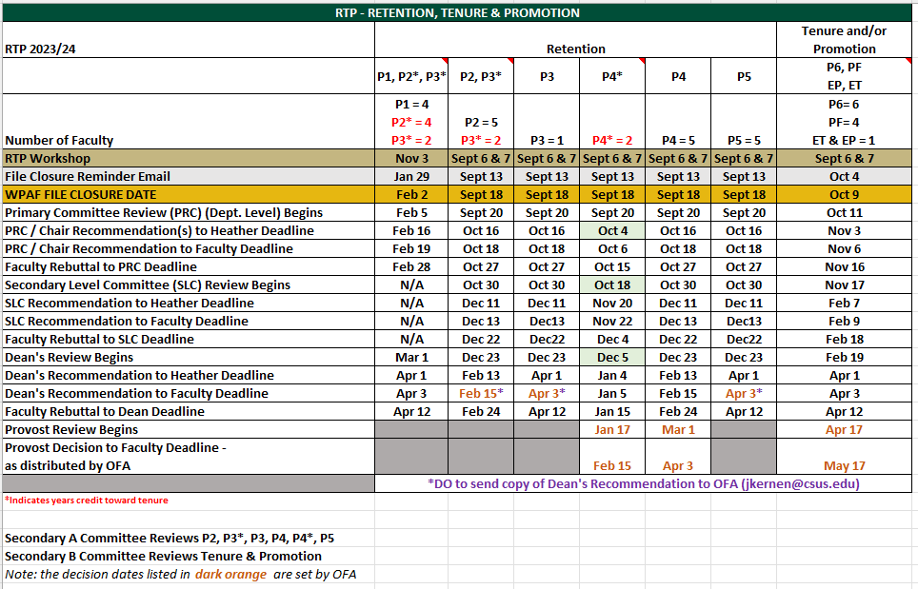
Deadlines

Slide 34
Contact
Dean Maguire
maguirem@csus.edu
Heather Crummett, Budget Analyst
crummetth@csus.edu

Slide 35
Questions?

