Slide 1
Doctor of Physical Therapy Program
Group Advising Session
Program Information
Applying to the program
Tour of Facilities
Notes:
Welcome
Introduce
Welcome to the Profession
Who you are

Slide 2
Welcome!
Introductions: Name, College
Where you are in the process/ journey?
Goals/ expectations/ what you want to achieve by attending this session
Notes:
I want to make sure I do everything that would allow you to achieve your goal for being here today. Some of you may have been from far away, and I want to make it worth your while
Welcome to the profession of PT
JOT DOWN what they say!!!

Slide 3

















California DPT programs

Slide 4
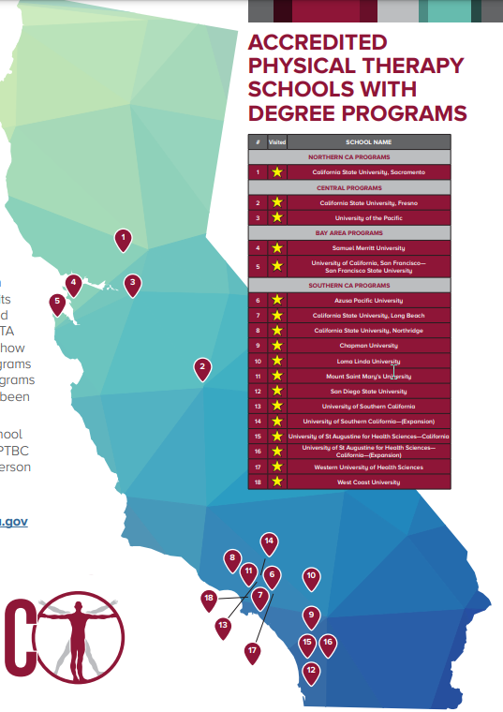

Slide 5
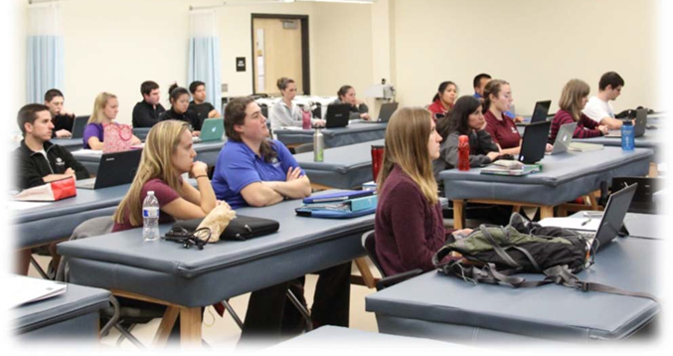
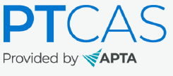
Physical Therapist Centralized Application Service (PTCAS) Data: National Applicant Trends
2022:
17,416 unique applicants submitted 93,169 applications to 284 PTCAS programs
Decrease of 4% from prior year

Slide 6
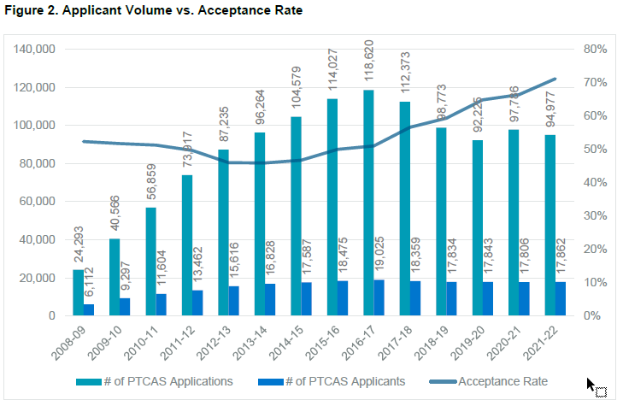
National Data Applicant Trends
2021-22: 284 programs: ave. 5.3 applications per applicant; 71% accepted to at least 1 program

Slide 7
Sacramento State Department of Physical Therapy
Accepts 32 students every Fall Semester
Program is 9 semesters in length
There are 3 full-time clinical experiences, 12 weeks each
Students participate in multiple community clinics (mentored practice) during their coursework which include:
Ortho – available for students, faculty, staff and community members
Neuro – available to patients with stroke or other neurological conditions
STEPS – pediatric clinic for children with neuromotor impartments
Notes:
Mentored practice under faculty
Watch you and say “you are ready”
Safe environment
Millennials- commitment to serving others
Why so late??? Summer of 2nd year---- by then you would have had at last 5 pro bono (either observing or having your patient), exposure to people additional twice (in PT 606 and Geriatrics)- you really are not missing any.
With Steps, or other research, even more.

Slide 8
Applying to Sacramento State
Admission Requirements
Bachelor’s Degree prior to matriculation
11 Prerequisite courses
Graduate Record Examination (GRE)
Observation Hours (volunteer/work) hours: ≥50
Letters of Recommendation: 3
Interview
Notes:
Each program has a specific set of prereqs
Exposure to the profession

Slide 9
Change in Admission Requirements due to COVID
Applicants unable to find a 2nd Physical Therapist to write a letter of recommendation may submit their 3rd letter from another College Professor or an Employer.
A minimum of 50 observation hours of exposure to PT practice is required. A mix of both outpatient and inpatient settings is strongly suggested, but not required for this upcoming application cycle.

Slide 10
Change in Admission Requirements due to COVID
Credit/No Credit grades accepted for required classes taken Spring 2020 -2022 only
Virtual labs accepted for required classes taken during the year of 2020, 2021 and 2022

Slide 11
How to Apply
Step 1: Prepare to Apply
Review Admission Requirements listed on our webpage and on PTCAS to verify you have met all minimum requirements
Make sure you are on track to complete your prerequisite coursework
Complete your volunteer/work hours by October 2, 2023
Identify who will be willing to write your letters of recommendation
Take GRE by October 2, 2023
Step 2: Apply
Submit complete PTCAS application at www.ptcas.org by October 2nd deadline.
Notes:
EVERYTHING WE DISCUSS HERE IS ON THE WEBPAGE!!!
CANNOT EVEN BE CONSIDERED IF NOT ACHIEVED MINIMUM

Slide 12
What does a complete application look like?
Prerequisites are completed by the required deadline with a minimum 3.00 GPA.
DPT Prerequisite Supplemental Worksheet completed and submitted with PTCAS application.
GRE exam taken by deadline with minimum scores of 3.5 for Analytical, and 29th percentile for Quantitative.
Volunteer/work hours completed and verified in PTCAS by deadline date.
All letters of recommendation received in PTCAS by deadline date.
Official transcripts from all colleges/universities attended sent to PTCAS.
PTCAS application submitted by October deadline.

Slide 13
Prerequisite Courses
Human Anatomy w/lab (4 units)
Human Physiology w/lab (4 units)
General Psychology (3 units)
Additional Psychology (3 units)
Statistics (3 units)
General Chemistry I & II w/lab (8-10 units)
Physics I & II w/lab (8 units)
Biomechanics (3 units)
Exercise Physiology (3 units)

Slide 14
Prerequisite Requirements
Minimum prerequisite GPA of 3.00 or higher.
Prerequisite courses must be completed at an accredited college or university with a minimum grade of “C” or better. Course grades of “C-” or lower are not accepted.
Applicants may have up to 4 pending prerequisite courses when submitting their application. At least 2 of pending courses must be completed by end of fall semester, and the remaining 2 courses to be completed following spring semester.
Anatomy, Physiology, Biomechanics, and Exercise Physiology courses must have been completed within the past 10 years.
Notes:
Complete by summer before you join us. Use the summer to….
Pretty standard.

Slide 15
Prerequisite Repeat Policy
Grades from any and all courses taken to fulfill each prerequisite will be considered in calculating your GPA.
If a course was taken twice (2), only the higher course grade will be used.
If a course is taken three (3) times, all three (3) grades will be averaged.
If a course was taken four (4) times to complete one required prerequisite, application will not be reviewed.
A course is considered a “repeat” even if it is taken at a different university, or has a different course number.
Notes:
TWICE is your best bet!!!
Not all programs do this.

Slide 16
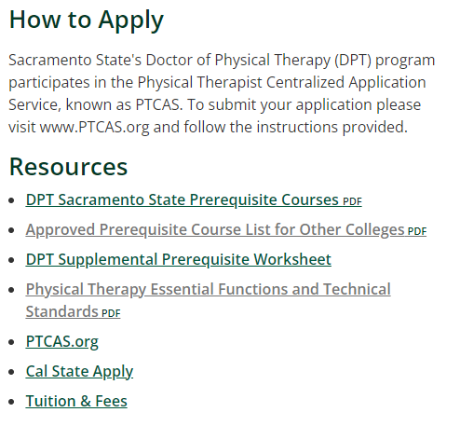
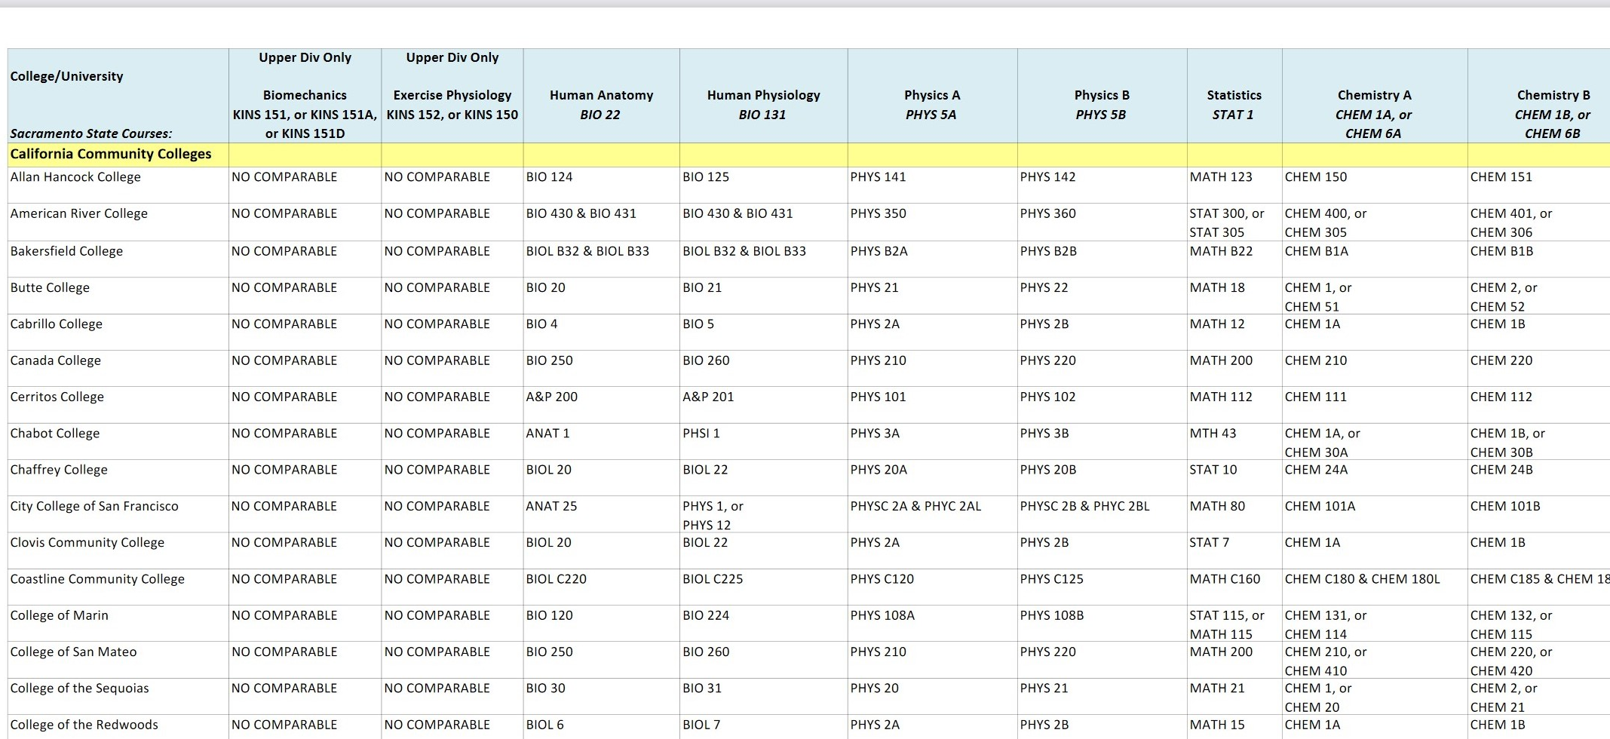
Approved Prerequisite List
Notes:
Complete by summer before you join us. Use the summer to….
Pretty standard.

Slide 17
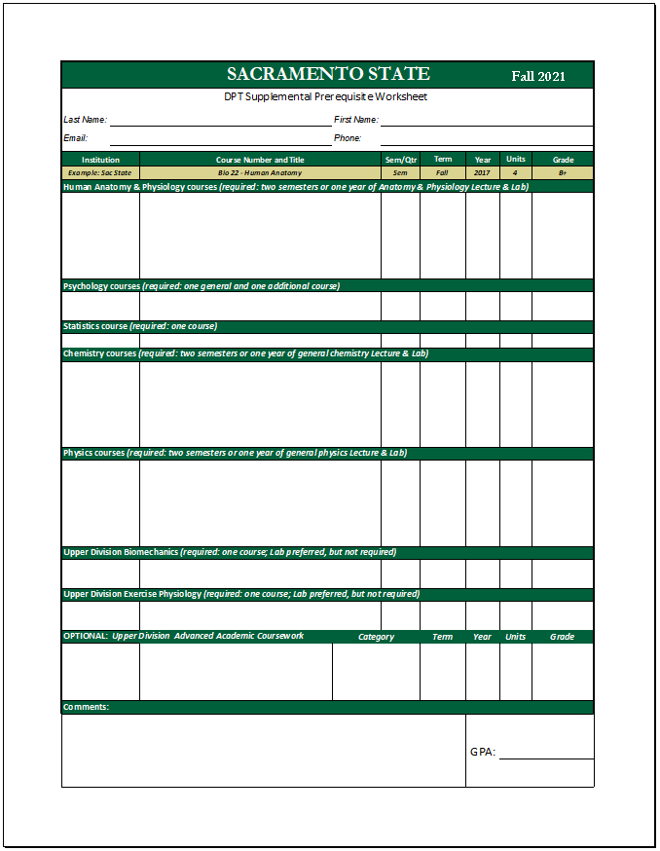
DPT Supplemental Prerequisite Worksheet
All applicants must submit the DPT Supplemental Prerequisite Worksheet with their PTCAS application. This worksheet can be found on our website at www.csus.edu/college/health-human-services/physical-therapy/prerequisite-worksheet.html and must be uploaded to your PTCAS application by the deadline.
Applicants will submit the following information for each course:
Name of institution where course was taken
Course number and title
Semester or quarter units
Semester and year course was taken
Number of units and grade
In-progress or planned status for pending courses
Applications missing this document will be considered incomplete and will not be reviewed.
Notes:
Tease out all the courses we require.

Slide 18
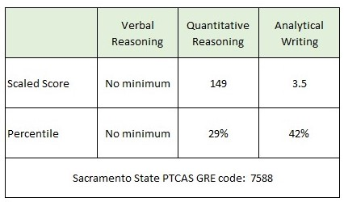
Graduate Record Examination - GRE
GRE results taken within last five years are sent directly to PTCAS using GRE code 7588. The last date to take the GRE is October 2, 2023. Minimum required GRE scores are 3.5 for Analytical, and 29th percentile for the Quantitative. There is no minimum threshold for Verbal Reasoning.

Slide 19
Observation Hours
Applicants must complete and verify on PTCAS a minimum 50 total hours of volunteer/work experience. All hours must be under direct supervision of a licensed physical therapist. Hours that have not been completed and verified by the application deadline will not count towards the 50 required hours minimum, and your application will be disqualified.
OUTPATIENT
Physical Therapy Clinics
Hospital Clinics
School/Preschool
Wellness/Prevention/
Fitness
Industrial/Occupational Health
INPATIENT
Acute care
Rehab/Subacute care
Extended care
Skilled Nursing

Slide 20
Letters of Recommendation
Applicants must arrange to have three letters of recommendation sent to PTCAS. All three letters must be received by the deadline date.
One letter from a licensed physical therapist you have volunteered or worked with.
One from a college professor you have taken a course from.
One letter from another physical therapist, college professor, or your employer/supervisor.

Slide 21

How to strengthen your application
Applicants can earn additional admission points if they qualify for the following:
Advanced Upper Division Coursework
Background Characteristics

Slide 22
Advanced Upper Division Coursework
Applicants that have completed upper division advanced coursework may be eligible for additional admission points. A maximum of four courses may be submitted for consideration. However, only one course may be submitted from each of the following categories. All Advanced coursework must have a grade of "B-" or higher.
Advanced Human Anatomy
Neuroanatomy
Neurophysiology
Advanced Biomechanics
Advanced Exercise Physiology or Cardiac
General Microbiology
Motor Learning
Therapeutic Exercise
Notes:
COMMITMENT TO ADVANCED EDUCATION

Slide 23
Background Characteristics
Additional admissions points are available for:
Second Language Competency
Disadvantaged Economic Background
Disadvantaged Educational Background
Disadvantaged Environmental Background
Notes:
COMMITMENT TO LOOKING AT DISADVANTAGED POPULATIONS

Slide 24
Interviews
In mid-December the top 120 qualified applicants are invited to apply to Cal State Apply ($70), and schedule an on-campus interview.
A typical interview day consists of
Meeting current DPT students
Each applicant interviews with a 3-person Panel: 1 faculty member + 2 clinicians
Tour of DPT facilities
Interviews are usually scheduled in late January.

Slide 25
Common Mistakes to Avoid
GRE scores do not meet minimum, or scores were never received by PTCAS.
Less than 50 observations hours were verified and completed by deadline.
Not all required letters of recommendation were received, or the letters were received were not from the type of correct evaluator.
Prerequisite GPA less than 3.00.
Overall GPA less than 3.00.
Too many outstanding prerequisites.
Not all college transcripts were sent to PTCAS
For the 2022-2023 cycle, 382 applications were received, only 191 applicants met the minimum requirements.

Slide 26
Who Matriculated at Sacramento State?
Class of | 2017 | 2018 | 2019 | 2020 | 2021 | 2022 | 2023 | 2024 | 2025 | 2026
Year of Application | 2013 | 2014 | 2015 | 2016 | 2017 | 2018 | 2019 | 2020 | 2021 | 2022
Applications Received | 662 | 500 | 562 | 585 | 541 | 474 | 477 | 503 | 486 | 382
Class Size | 32 | 32 | 32 | 32 | 32 | 32 | 32 | 32 | 32 | 32
Offers Made | 43 | 62 | 62 | 57 | 60 | 55 | 59 | 59 | 63 | 70
Female | 23 | 19 | 17 | 13 | 19 | 18 | 18 | 15 | 19 | 18
Male | 9 | 13 | 15 | 19 | 13 | 14 | 14 | 17 | 13 | 14
Average Age | 25 | 25 | 26 | 24 | 24 | 25 | 24 | 25 | 25 | 25
% Minority | 38% | 28% | 44% | 41% | 32% | 41% | 41% | 63% | 44% | 53%
Prerequisite GPA | 3.78 | 3.78 | 3.82 | 3.76 | 3.81 | 3.83 | 3.75 | 3.85 | 3.84 | 3.79
CA Resident | 94% | 81% | 84% | 91% | 97% | 100% | 100% | 97% | 100% | 94%
Notes:
MEN
UP TO 57 ON WAITLIST; INTERVIEW GIVES YOU ABOUT 1 IN 2 CHANCES OF GETTING IN
GPA much higher than minimum

Slide 27
Sac State Selection Process
All application materials are reviewed to determine if they meet minimum requirements.
Complete applications are then ranked according to:
Strength of Academic Record (Prerequisite GPA)
Professional References
Background Characteristics
Advanced Coursework.
Once ranked, top 130 are invited for an interview.
After interviews, the interviewees are rank ordered.
Top 32 are offered seats, remaining applicants placed on wait list
Applicants are notified of their initial status within 2 weeks of final interviews.

Slide 28
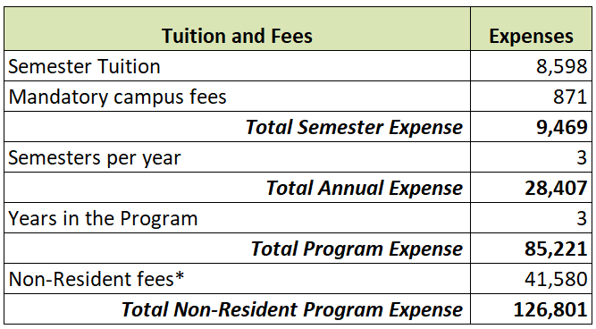
Sacramento State DPT Tuition & Fees
Tuition is charged as a flat rate per semester fee and is not based on number of units.
*Non-residents pay an additional $396.00 per unit. Students take between 105-114 units depending on how many electives they choose to take. The minimum 105 units includes the two required elective units.

Slide 29
Application Timeline
2023-24 Application Deadlines
Date | Event
June 1, 2023 | PTCAS 2023-24 Application Cycle Opens
October 2, 2023 | Deadline to take GRE Exam (shorter test begins September 22)
October 2, 2023 | Deadline to submit PTCAS Application (11:59 pm EST)
Mid-December 2023 | Interview notifications sent to all applicants
Late January 2024 (details in the fall of 2023) | On campus interviews for invited applicants
Mid-February 2024 | Offers of admission until class filled
August 23, 2024 | DPT New Student Orientation
August 26, 2024 | First day of instruction

Slide 30
Why Sacramento State
Excellent outcomes
State-of-the-art facilities
Commitment to professional development
Student professional development funds
Supplies/equipment
Online resources
Electives (research, CSCS, specialty patient care)
Community service while being mentored by faculty
Top notch faculty
Excellent administrative support
Diversity

Slide 31
2021-22 National Data
Gender, Race/Ethnic Identity
• 2021: 17,862 applicants
Accepted: 61.3% female, 38.7% male
CSUS current 3 Doctoral Classes: 54% female, 46% male
Gender Gap in acceptance rates:
Acceptance rate for females: 72.5%
Acceptance rate for males: 69.1%
Race/ethnicity accepted:
National average: 77% White alone
CSUS most recent 3 Doctoral Classes: 47% White alone
Notes:
In 2021, femal
[
[minoritized race: 42.5%]
minoritized race: 35.6%]es were 47%, males 53%

Slide 32
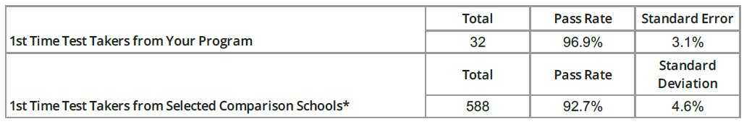
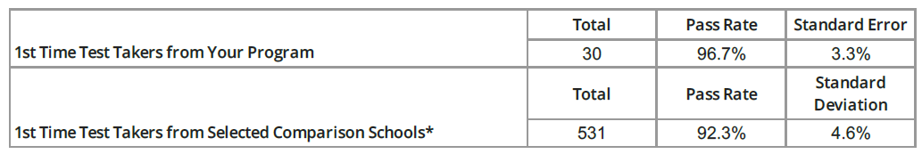
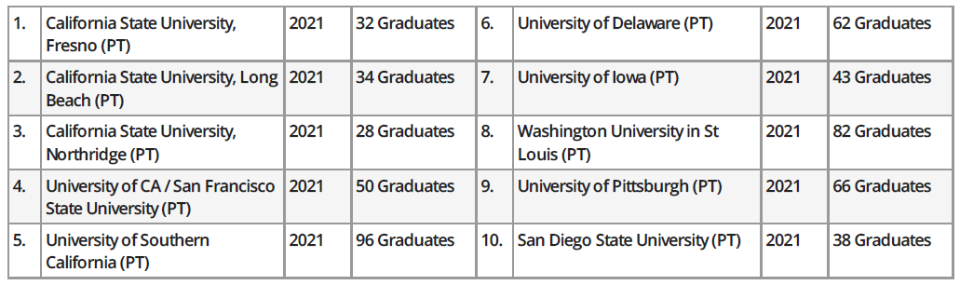
National Licensure Examination Results
Pass Rate
2020
2021
Comparison Schools

Slide 33
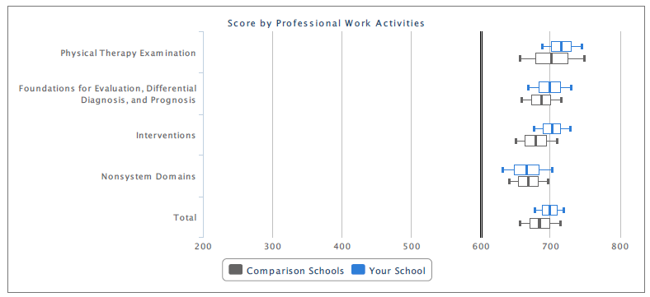
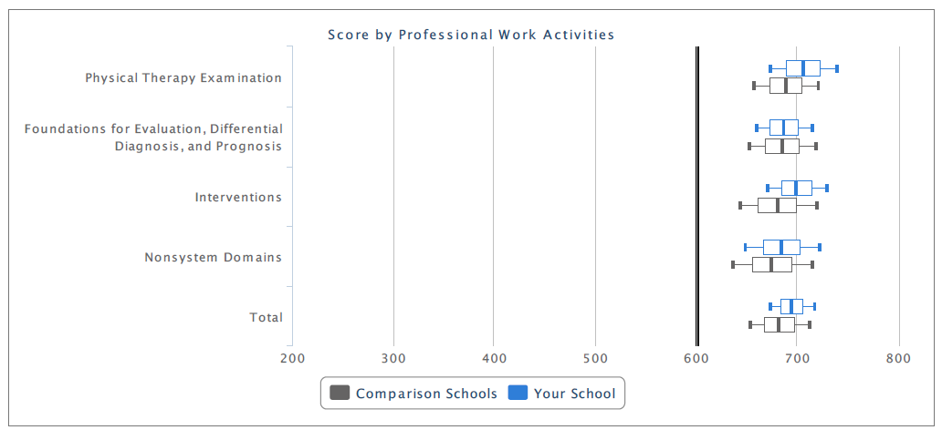
National Licensure Examination Results
2020
2021

Slide 34
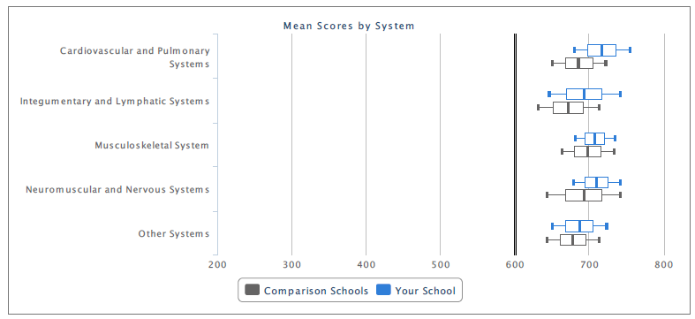
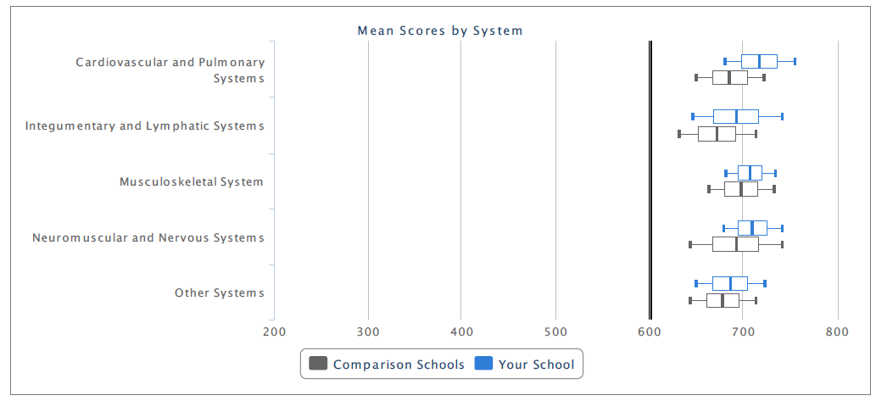
National Licensure Examination Results
2020
2021

Slide 35
Considerations
Location (support systems, cost)
Facilities: space, technology
Length of the program and your learning style
Program philosophy congruent to yours
Student support (available or “sink or swim”)
Available options and what you want to be as a PT
Program “feel”

Slide 36
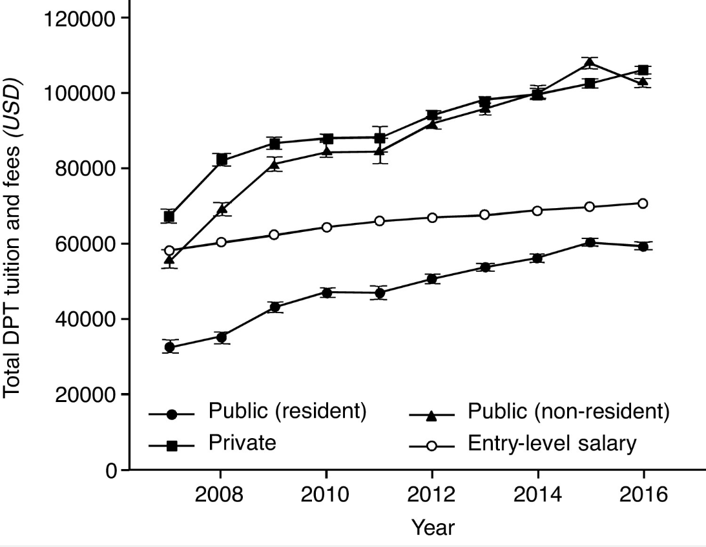
Final thoughts… debt load
) Shields and Dudley-Javoroski (2018)
Notes:
By 2021, the DPT at public (residents) will ave $77,447, and private $125,171. Entry-level salaries ave $78,316
conducted a study examining net present value (NPV) across several health professions. NPV is a modelling technique to estimate the economic consequences of an investment by using educational costs, wages, and duration of a career. They reported that physical therapist education is a good investment up to a certain amount of debt. At $150,000 of debt, the NPV for the DPT is lower than all health professions careers other than veterinary medicine and chiropractic, and once debt exceeds $200,000, DPT graduates exceed all debt-to-income repayment recommendations.

Slide 37
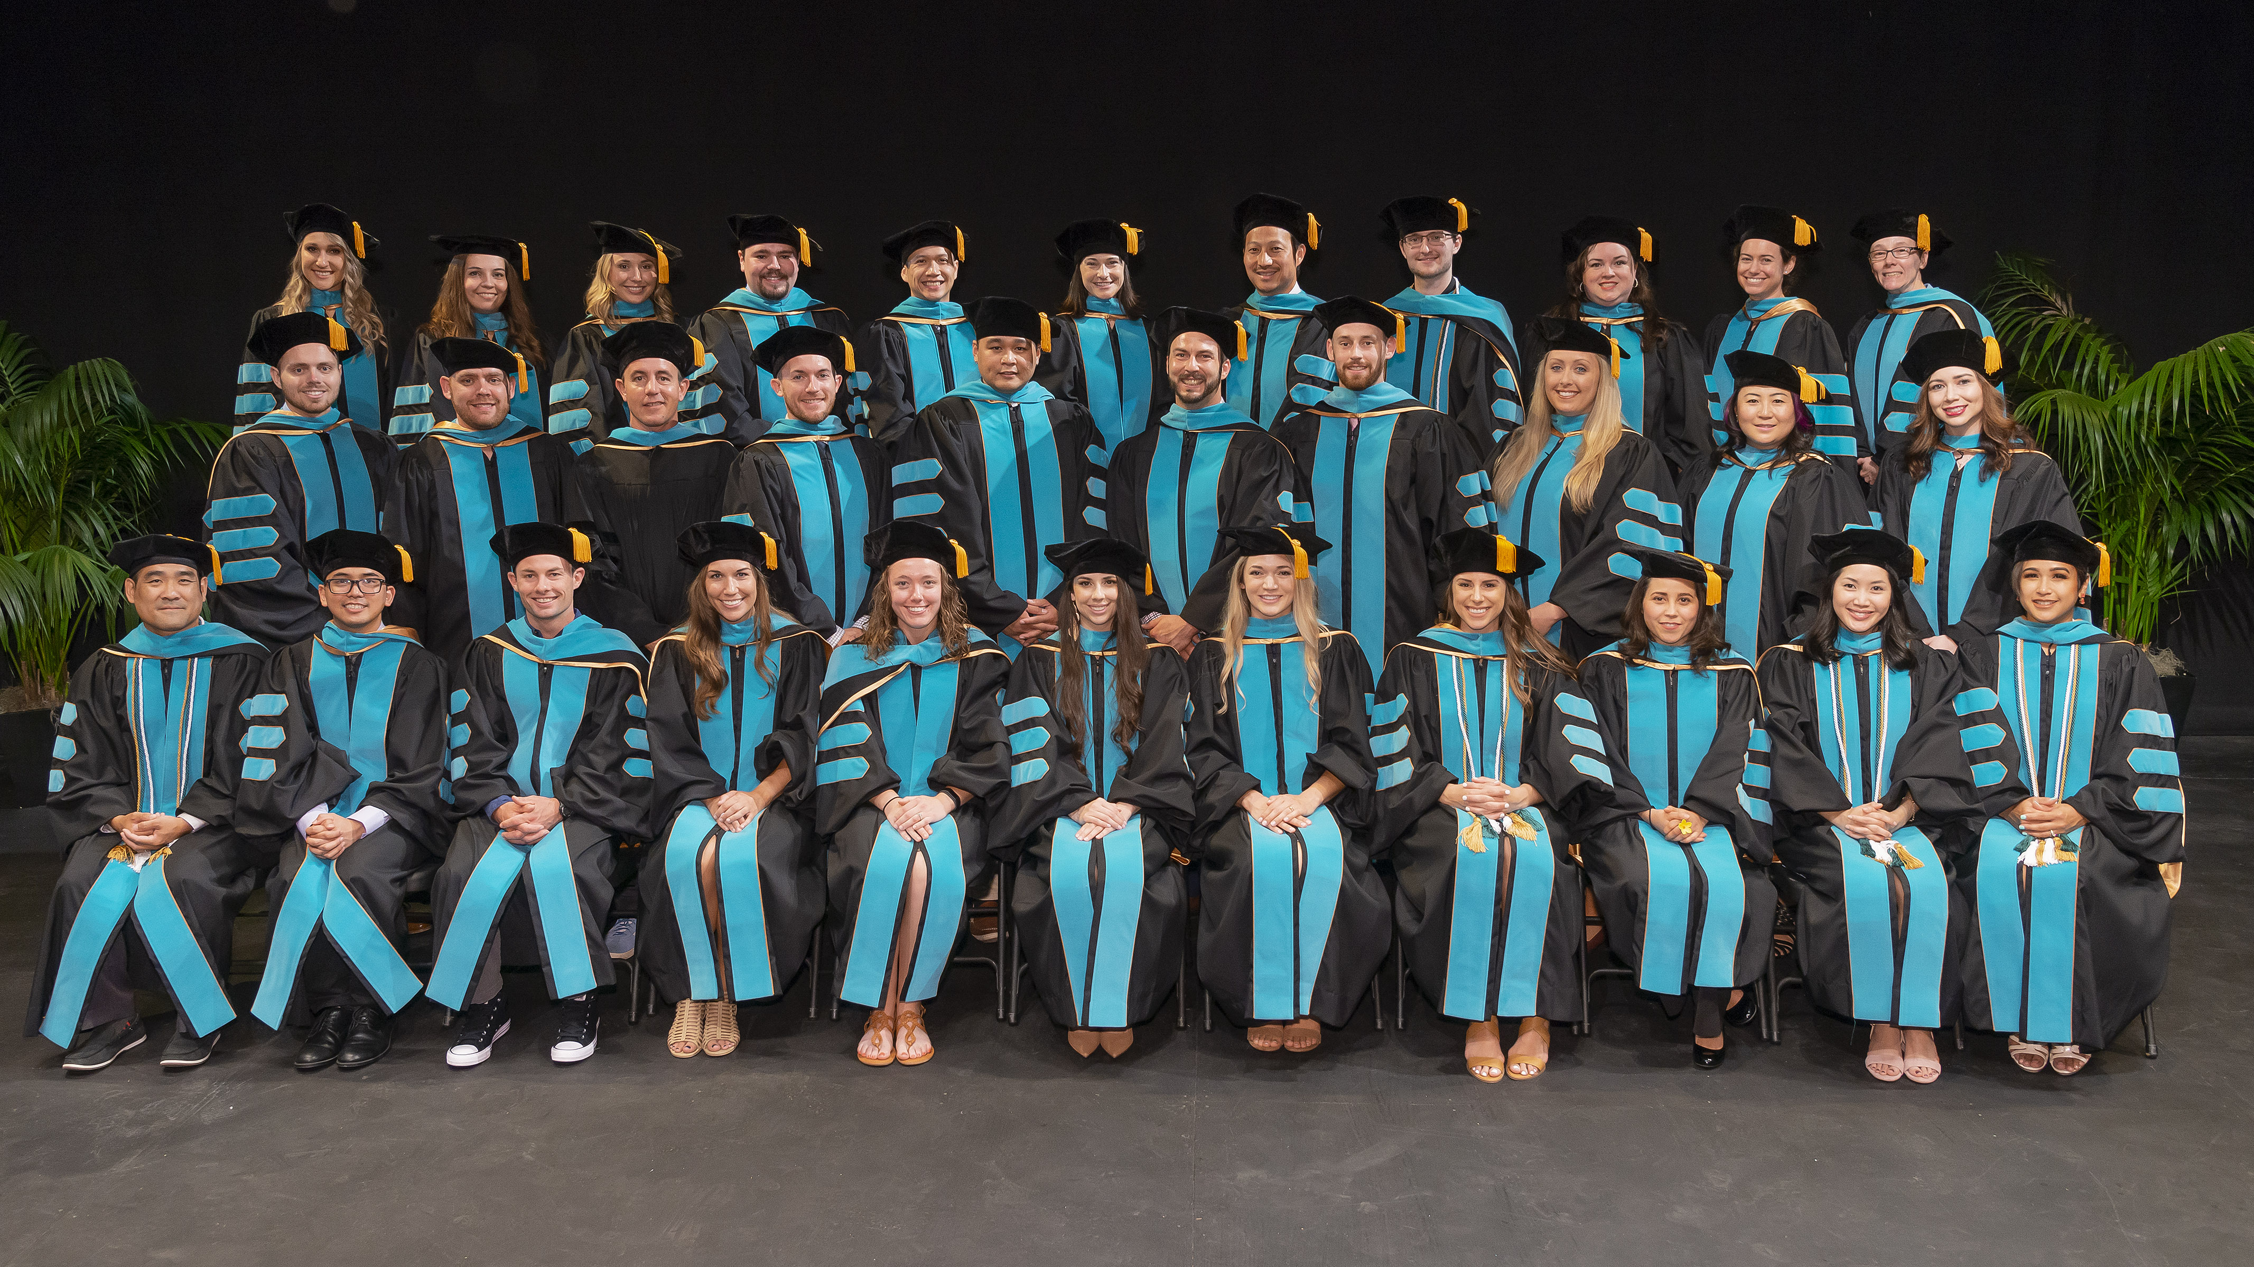
Hope to see You Here!

Slide 38

Questions?

Slide 39
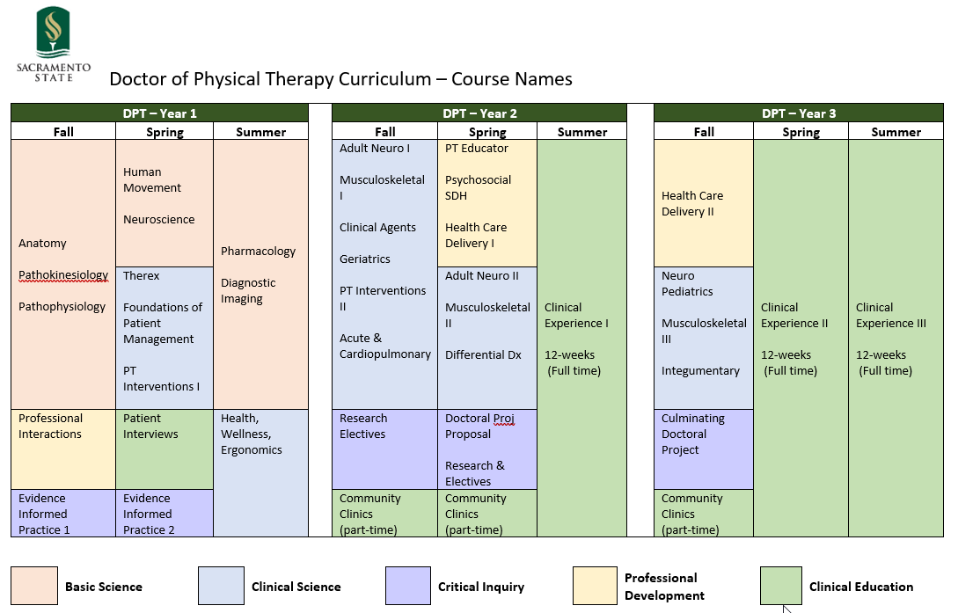

Slide 40
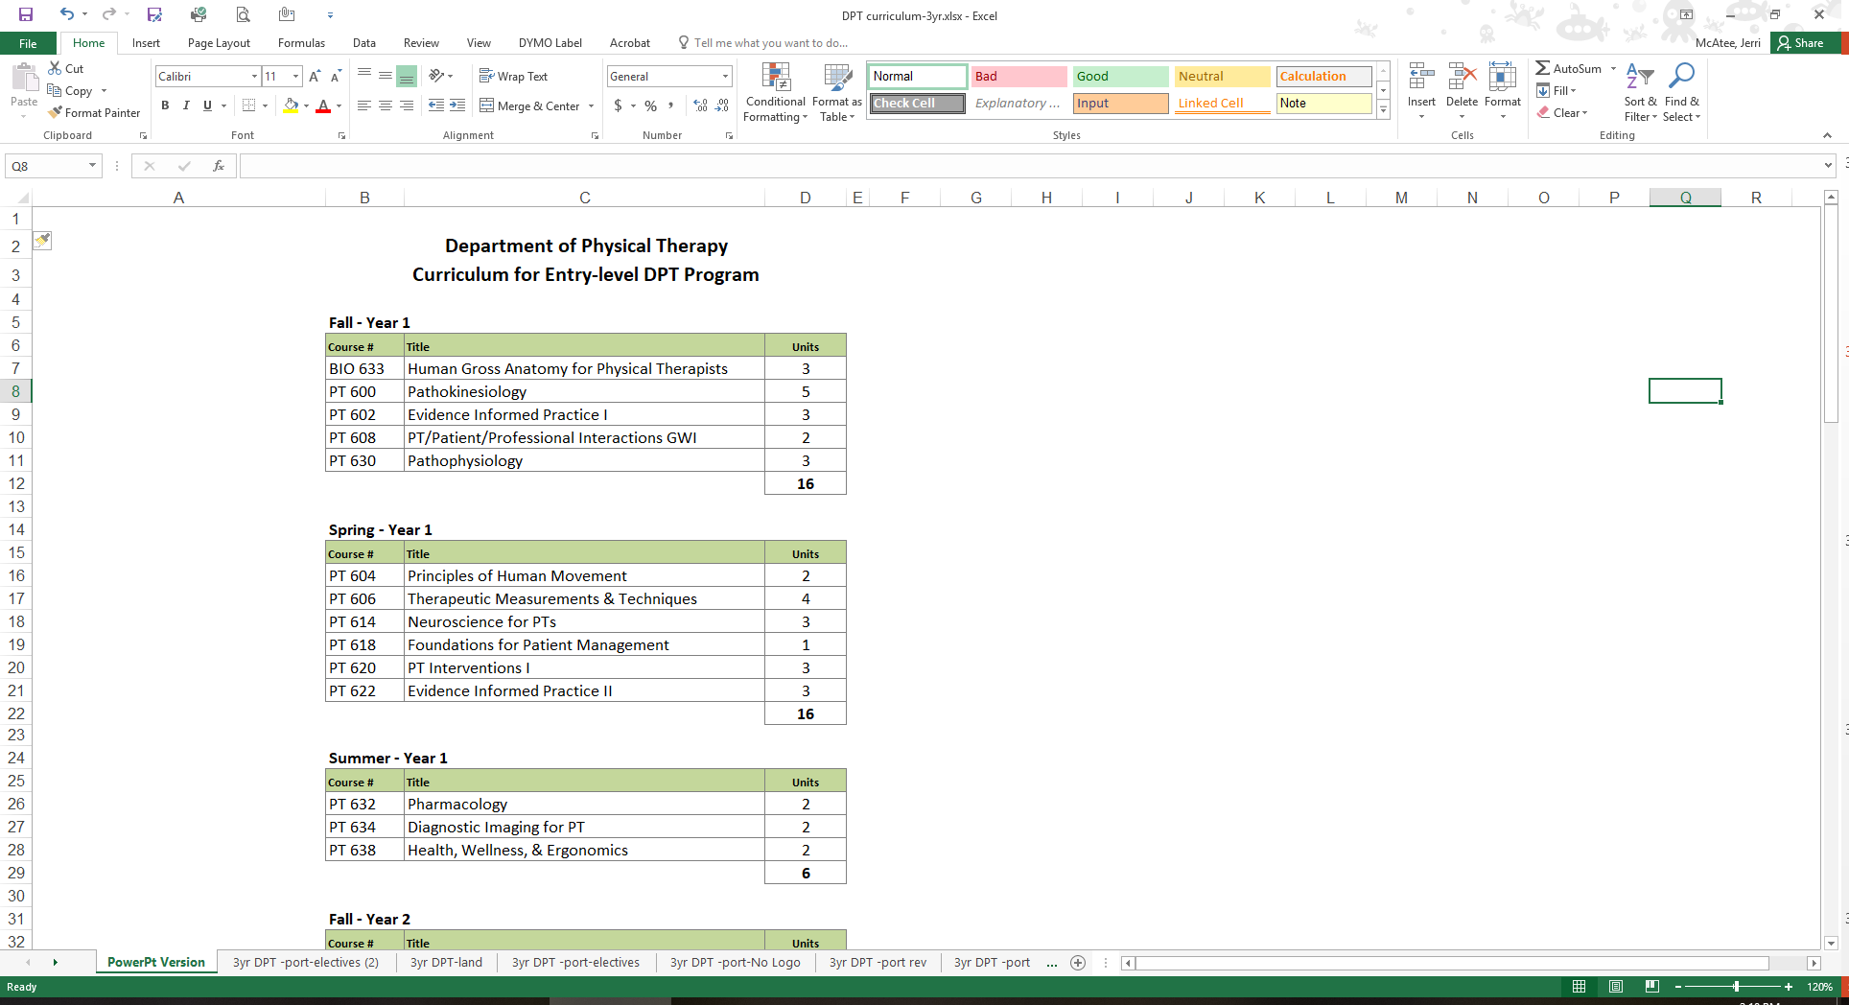


Slide 41
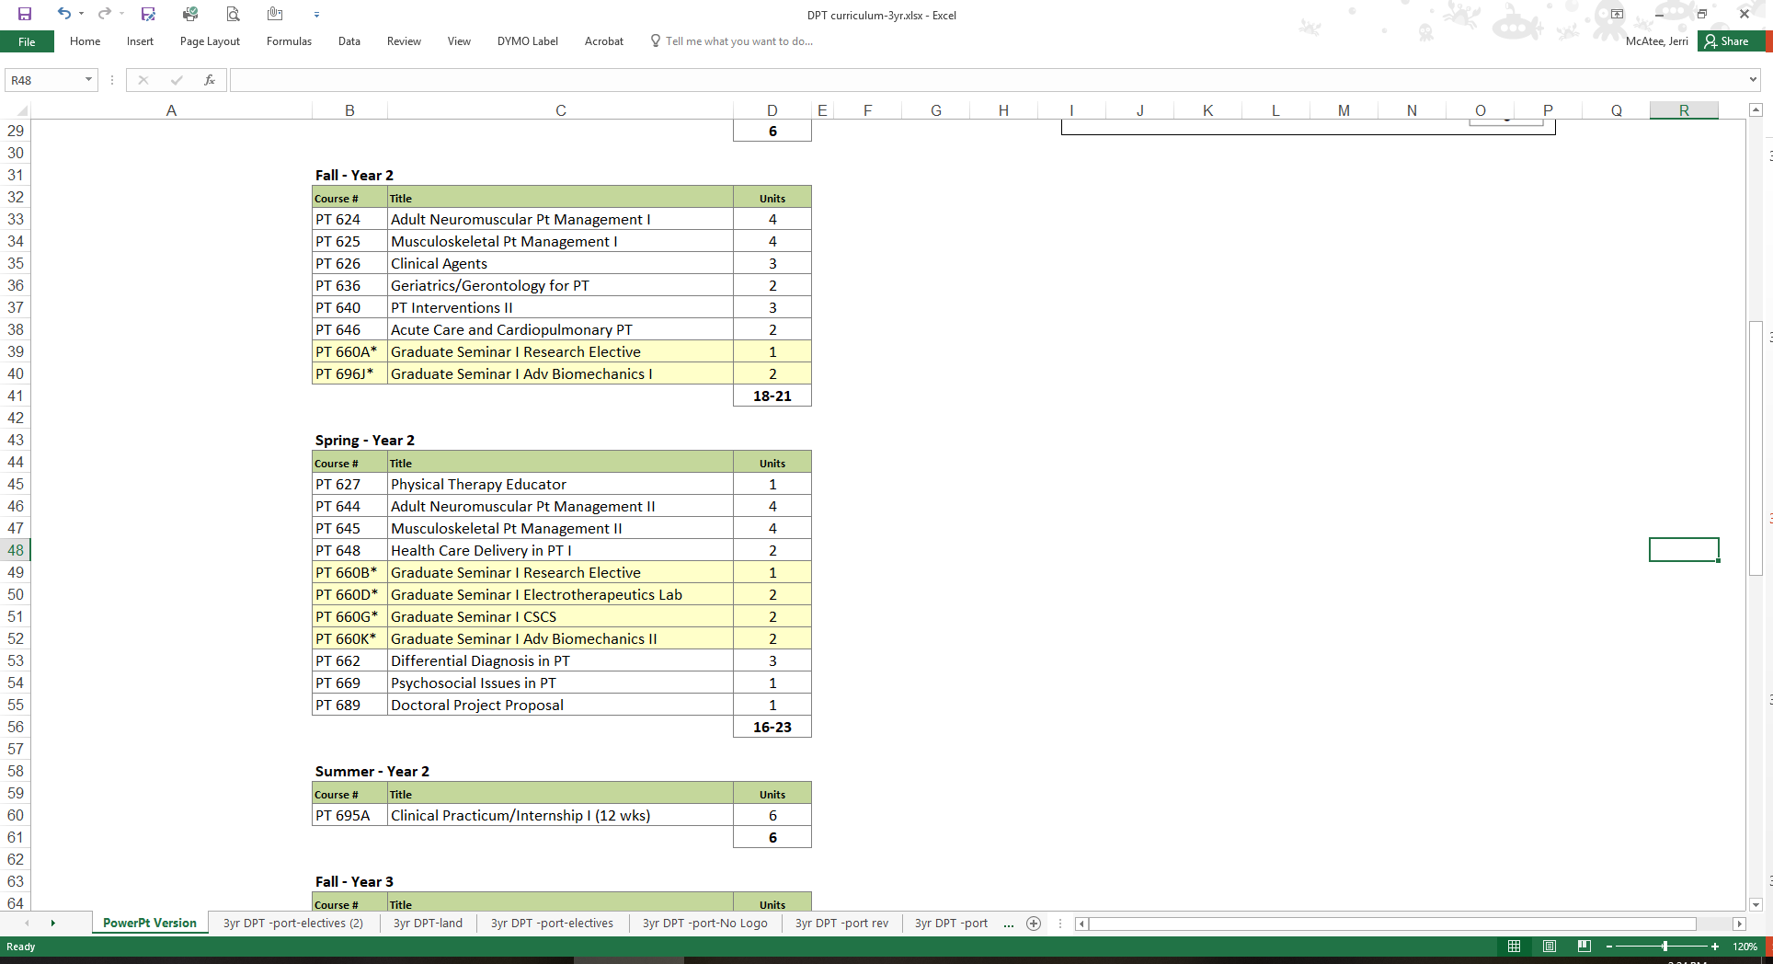

Slide 42
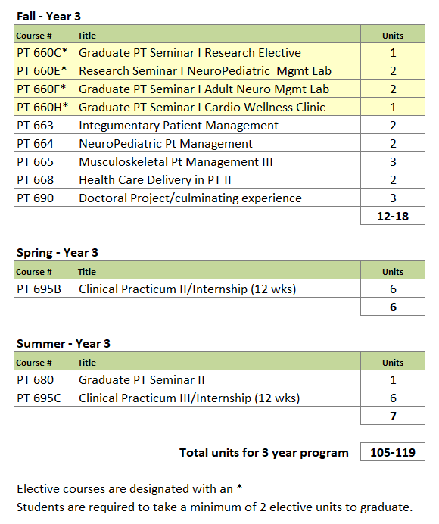

Slide 43
PTCAS Data
8 MOST often identified majors of Bachelor’s Degree:
Exercise Science
Kinesiology
Health Science
Biology
Psychology
Pre‐physical therapy
PT Assistant
Athletic training

