Slide 1
Department of Recreation, Park & Tourism Administration (RPTA)
Orientation and Major Advising
Dr. Jamie Hoffman, Associate Professor and Chair
Notes:
Major/Program Faculty Advisors will be available when the semester begins.

Slide 2
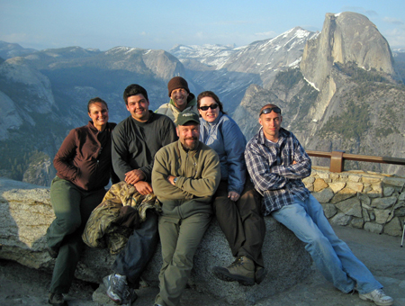
Agenda
What is RPTA?
How will you be successful?
Registration!!!

Slide 3
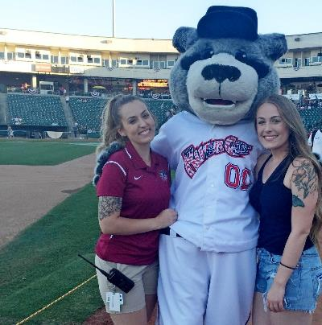
What am I studying?
RPTA is an academic discipline which involves the study of recreation, parks and tourism its impact on health, society and quality of life. It includes, but is not limited to, such areas of study as hotel management, outdoor recreation, park and facility management, park ranger, community recreation, non-profit management, and recreational therapy etc.
Notes:
Perhaps add a better picture?

Slide 4
Bachelors of Science
The degree provides students with the skills to manage people, programs, and events in a variety of recreational settings that include city parks and recreation programs, state and national parks, hotels, playgrounds, forests, beaches, health clubs, tourism destinations, recreational therapy programs, and non-profit community centers. Students will also gain an understanding of professional advocacy, ethics, inclusion, and current evaluation procedures applicable in a variety of employment settings.

Slide 5
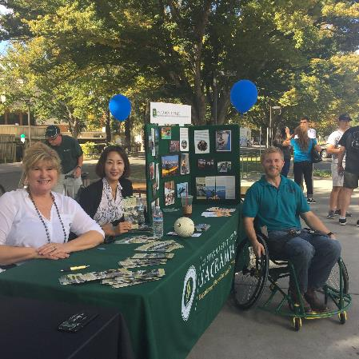
Bachelors of Science
Recreation and Park Management (RPM)
Hospitality and Tourism Management (HTM)
Recreational Therapy (RT)

Slide 6
Certificates
Certificate in Event Planning
Certificate in Hospitality and Tourism Administration
Certificate in Natural Resources Administration
Certificate in Non-​Profit Administration
Certificate in Outdoor Adventure Administration

Slide 7
Masters of Science in Recreation, Hospitality, Parks and Nonprofit Management
The graduate program leading to the Master of Science degree offers diversified opportunities for study. Through individual counseling, graduate students are able to develop a course of study for advanced work in areas which complement previous experience and training. There is sufficient flexibility in the program to allow students to pursue their individual areas of interest.

Slide 8
Enhance your Success . . .
Get to know your classmates and faculty – create meaningful community
See your advisor early and often - follow the plan (at least 1X per semester)
Utilize campus-wide resources (clubs, learning aids, career center, library, WELL)
Consider Summer term registration
Seek applied experiences in research, community programs, etc . . .
Dedicate time to reading, studying, and talking about your coursework
Keep exploring your own expanding interests and knowledge
Gain experience: volunteer, work in the field

Slide 9
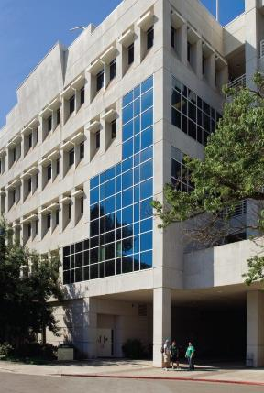
Department Office and Information
Location: Solano Hall, 4000
Hours: Monday-Friday
8:00am-5:00pm
Phone: (916) 278-6752
Advisor Assignments
Web Page Updates
This web site is your new best friend!
https://www.csus.edu/college/health-human-services/internal/inside-rpt/

Slide 10
RPTA Staff Members
Throughout your studies in RPTA:
Get to know…
Communicate with…
Respect these excellent “human” resources…
Geraldine Nicholson- Administrative Coordinator
Krystle Peay– Front-line administrative staff

Slide 11
Department of Recreation, Park & Tourism Administration
Notes:
Play Video of Andrea Describing Program

Slide 12
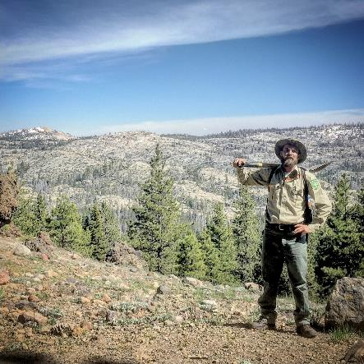
BS in Recreation and Park Management: Program Requirements
(57 Units)
All courses counted towards the major MUST be completed with “C-” or Better
600 pre-internship hours
400 internship hours
Notes:
Insert link to Kinesiology 1-page advising sheet

Slide 13
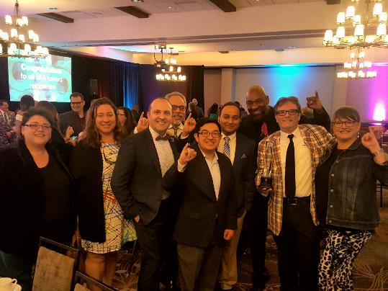
BS in Hospitality and Tourism Management: Program Requirements
(57 Units)
All courses counted towards the major MUST be completed with “C-” or Better
600 pre-internship hours
400 internship hours
Notes:
Insert link to Kinesiology 1-page advising sheet

Slide 14
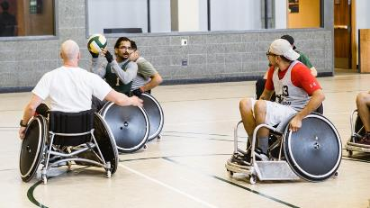
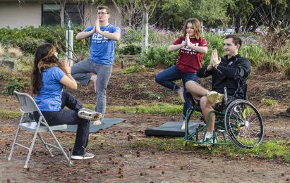
BS in Recreational Therapy: Program Requirements
(70 Units)
All courses counted towards the major MUST be completed with “C-” or Better
600 pre-internship hours
560 internship hours
Notes:
Insert link to Kinesiology 1-page advising sheet

Slide 15
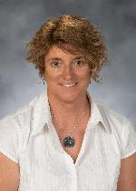
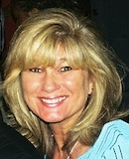
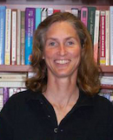
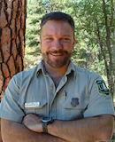
BS in Recreation and Park Management: Core Faculty
Dr. Mary Breunig
Dr. Lisa Easterla
Dr. Beth Erickson
Dr. David Rolloff
Advising Areas:
Experiential Education,
Outdoor Recreation
Interests:
Social Justice,
Experiential Education
Advising Areas:
Community Recreation, Graduate Coordinator
Interests:
Community Recreation Management
Advising Areas:
Community Recreation
Interests: Community Recreation Management, Event Planning
Advising Areas: Outdoor Recreation
Interests:
Outdoor Interpretation, Resource Management
Notes:
Insert Link to each faculty’s name to Sac state bio page

Slide 16
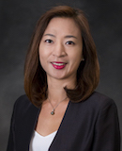
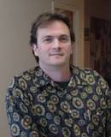
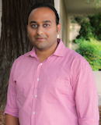
BS in Hospitality and Tourism Management: Core Faculty
Dr. Christine Hur
Dr. Tony Sheppard
Dr. Abhijeet Shirsat
Advising Areas:
Hospitality and Tourism
Interests:
Hospitality, Event Management, Evaluation
Advising Areas:
Hospitality and Tourism
Interests:
Hospitality Tourism and Event Management
Advising Areas:
Hospitality and Tourism Management
Interests:
Hospitality and Tourism, Lodging, Gastronomy
Notes:
Insert Link to each faculty’s name to Sac state bio page

Slide 17
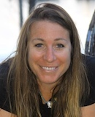
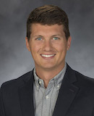
BS in Recreational Therapy: Core Faculty
Dr. Jamie Hoffman
Dr. Erik Luvaas
Advising Areas:
Department Chair,
Recreational Therapy Coordinator
Interests:
Adaptive Sports, Outdoor Recreation, Veterans
Advising Areas:
Recreational Therapy
Interests:
Experiential Education, Nature Based Recreation
Notes:
Insert Link to each faculty’s name to Sac state bio page

Slide 18
BS in RPTA: Careers
Our students have found jobs at :
Raley Field | Sheraton Grand Sacramento | Sacramento Kings
Disney | 24 Hour Fitness | Sutter Health
California State Parks | Hilton | Shriners Hospital
US Park Service | Army Corp of Engineers | Kaiser
CA Dept. of Corrections | CSUS WELL | National Outdoor Leadership School

Slide 19
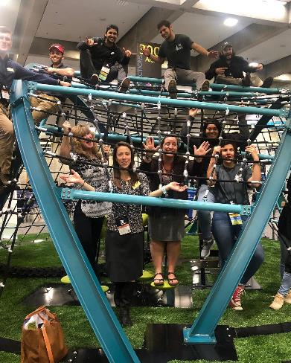
BS in RPM/HTM: Program Requirements
Complete 57 major units
Maintain a 2.0 GPA or better
Fill out "Change of Major" change form with advisor's approval
Foreign Language Not Required

Slide 20
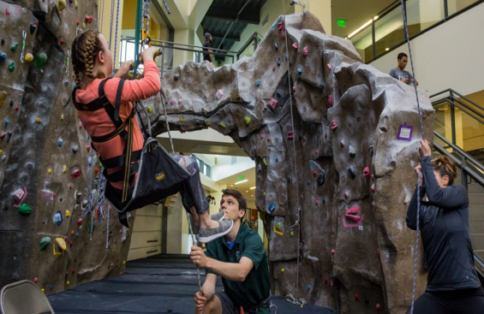
BS in RT: Program Requirements
Complete 70 major units
Maintain a 2.0 GPA or better
Fill out "Change of Major" change form with advisor's approval
Foreign Language Not Required

Slide 21
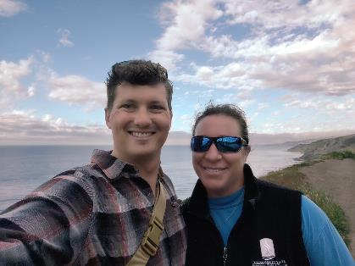
BS in RPM/HTM/RT: Advisor Info
Advisor listed on your Student Center
Contact your advisor this fall & follow-up on classes
Discuss major electives
You & your advisor will submit a graduation application 1-2 semesters before you intend to finish your coursework

