Slide 1
Master of Social Work
(MSW) Program
School of Social Work
College of Health & Human Services

Slide 2
History of the School of Social Work
(Established 1964)
The School of Social Work, located in the California state capital, strives to prepare ethical and competent social workers who can both lead and serve our richly diverse populations in the development and delivery of services that contribute to human well-being and social justice. The School offers professional undergraduate and graduate degree programs that prepare competent and reflective social workers who apply critical thinking in social work practice and research. Rooted in long standing and evolving partnerships with community-based agencies, educational institutions, local and state government, we prepare students to effectively serve culturally-diverse and vulnerable individuals, families and communities in various areas and capacities including as practitioners, leaders and social justice advocates.

Slide 3
Anti-Racism, Diversity, Equity, & Inclusion (ADEI) Statement
It is expected that students entering and participating in our program learn to honor and respect diverse life experiences while challenging biases, prejudices, and discriminatory practices perpetuated by themselves or others. This includes biases, prejudices, and discriminatory practices held toward LGBTQ+ individuals, people of color, people living with mental or physical disabilities, the aging, people from diverse socioeconomic backgrounds, and people of different genders.
Therefore, any prospective student contemplating applying to the School of Social Work should examine carefully their own issues or beliefs which might impede their ability to comply with the values expressed in the above statement

Slide 4
Where are MSW Graduates Now?
Licensed Clinical Social Workers (LCSW)
Medical Social Work
Child Welfare Workers
Geriatric Social Work
Substance Abuse
School Social Work
Management and Administration
Corrections and Probation
Psychotherapy
Policy Advocacy

Slide 5
Admissions Requirements
Have attained a grade point average of at least 2.8 in the last 60 semester (90 quarter) units attempted
Have completed a four-year college course of study and hold a baccalaureate degree from an institution accredited by a regional accrediting association by August 2025
Have completed a liberal arts perspective (Note: Degrees completed after 1978 at a CSU or UC satisfy this requirement)
Have passed an approved lower or upper division course in statistics with a grade of “C” (not C-) or better by August before Fall semester
Have passed an approved lower or upper division biology course that includes human biology content passed with a “C” (not C-) or better by August before Fall semester

Slide 6
Advanced Standing Admission Requirements
Applicants that are interested in applying for the Advanced Standing Program must have:
  Graduated from a CSWE-BSW program within the last five years
  A cumulative GPA of 3.5
  Additional references from your Field Instructor and Field Liaison (these will be requested after you submit your MSW application)
*Summer Intensive Program (SIP) students cannot apply for Fall Advanced Standing Program until following Fall (SIP can apply for 2 year program)

Slide 7
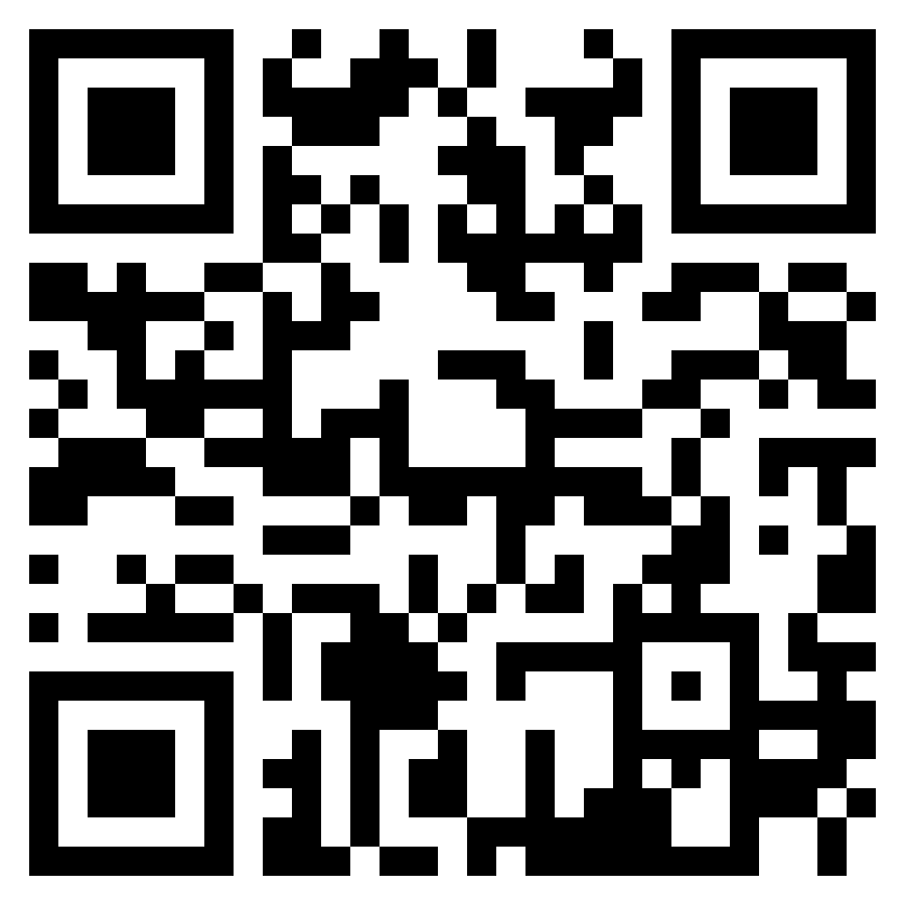
Admissions Process
(First Step)
Complete Cal State application
This is to apply to the University and is application 1 of 2
  Applicants that completed their Bachelor’s degree at CSUS will still need to complete a new application to the university
  Submit you reference e-mails and names here
  If needed submit Liberal Arts form here
  Personal statement is NOT required
Once you complete the application you will receive an email from the Office of Graduate Studies to set up your SacLink account and student CSUS e-mail. This process can take several days and you may need to check your junk/spam folder for the e-mail
Office of Graduate Studies

Slide 8
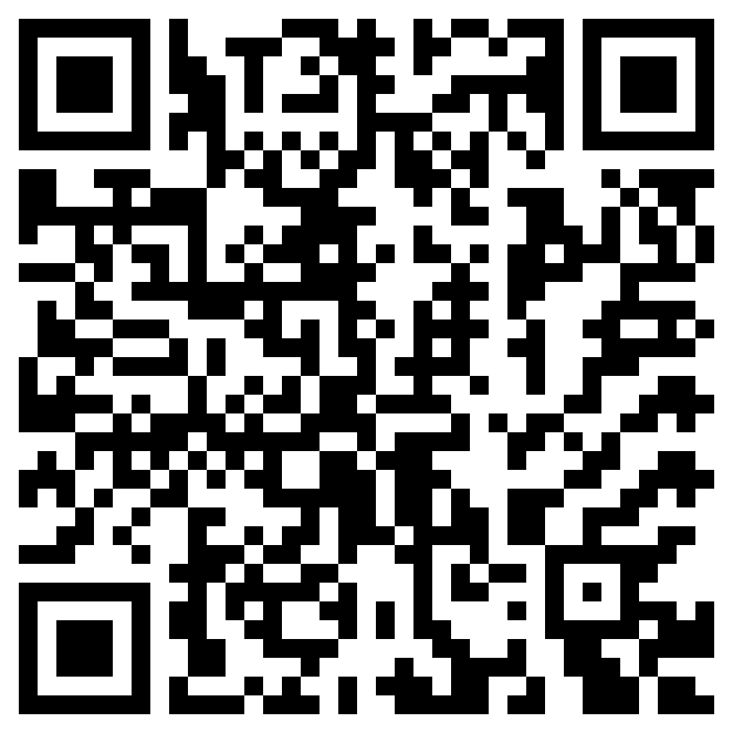
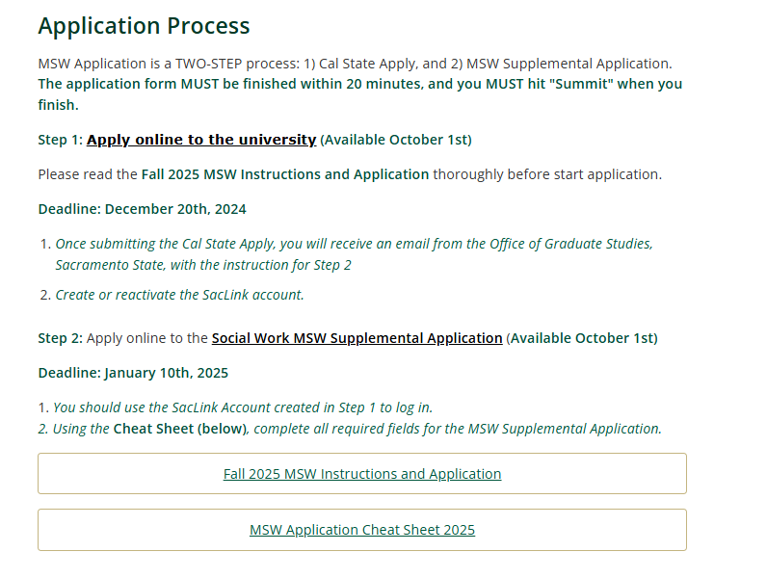
Admissions Process
(Second Step)
MSW Application Page
Complete the Cheat Sheet (link) application to copy and paste into the Supplemental MSW application.
Complete the supplemental MSW application –
This is how to apply to the School of Social Work and MSW application
  SacLink account is required to log in for the application

Slide 9
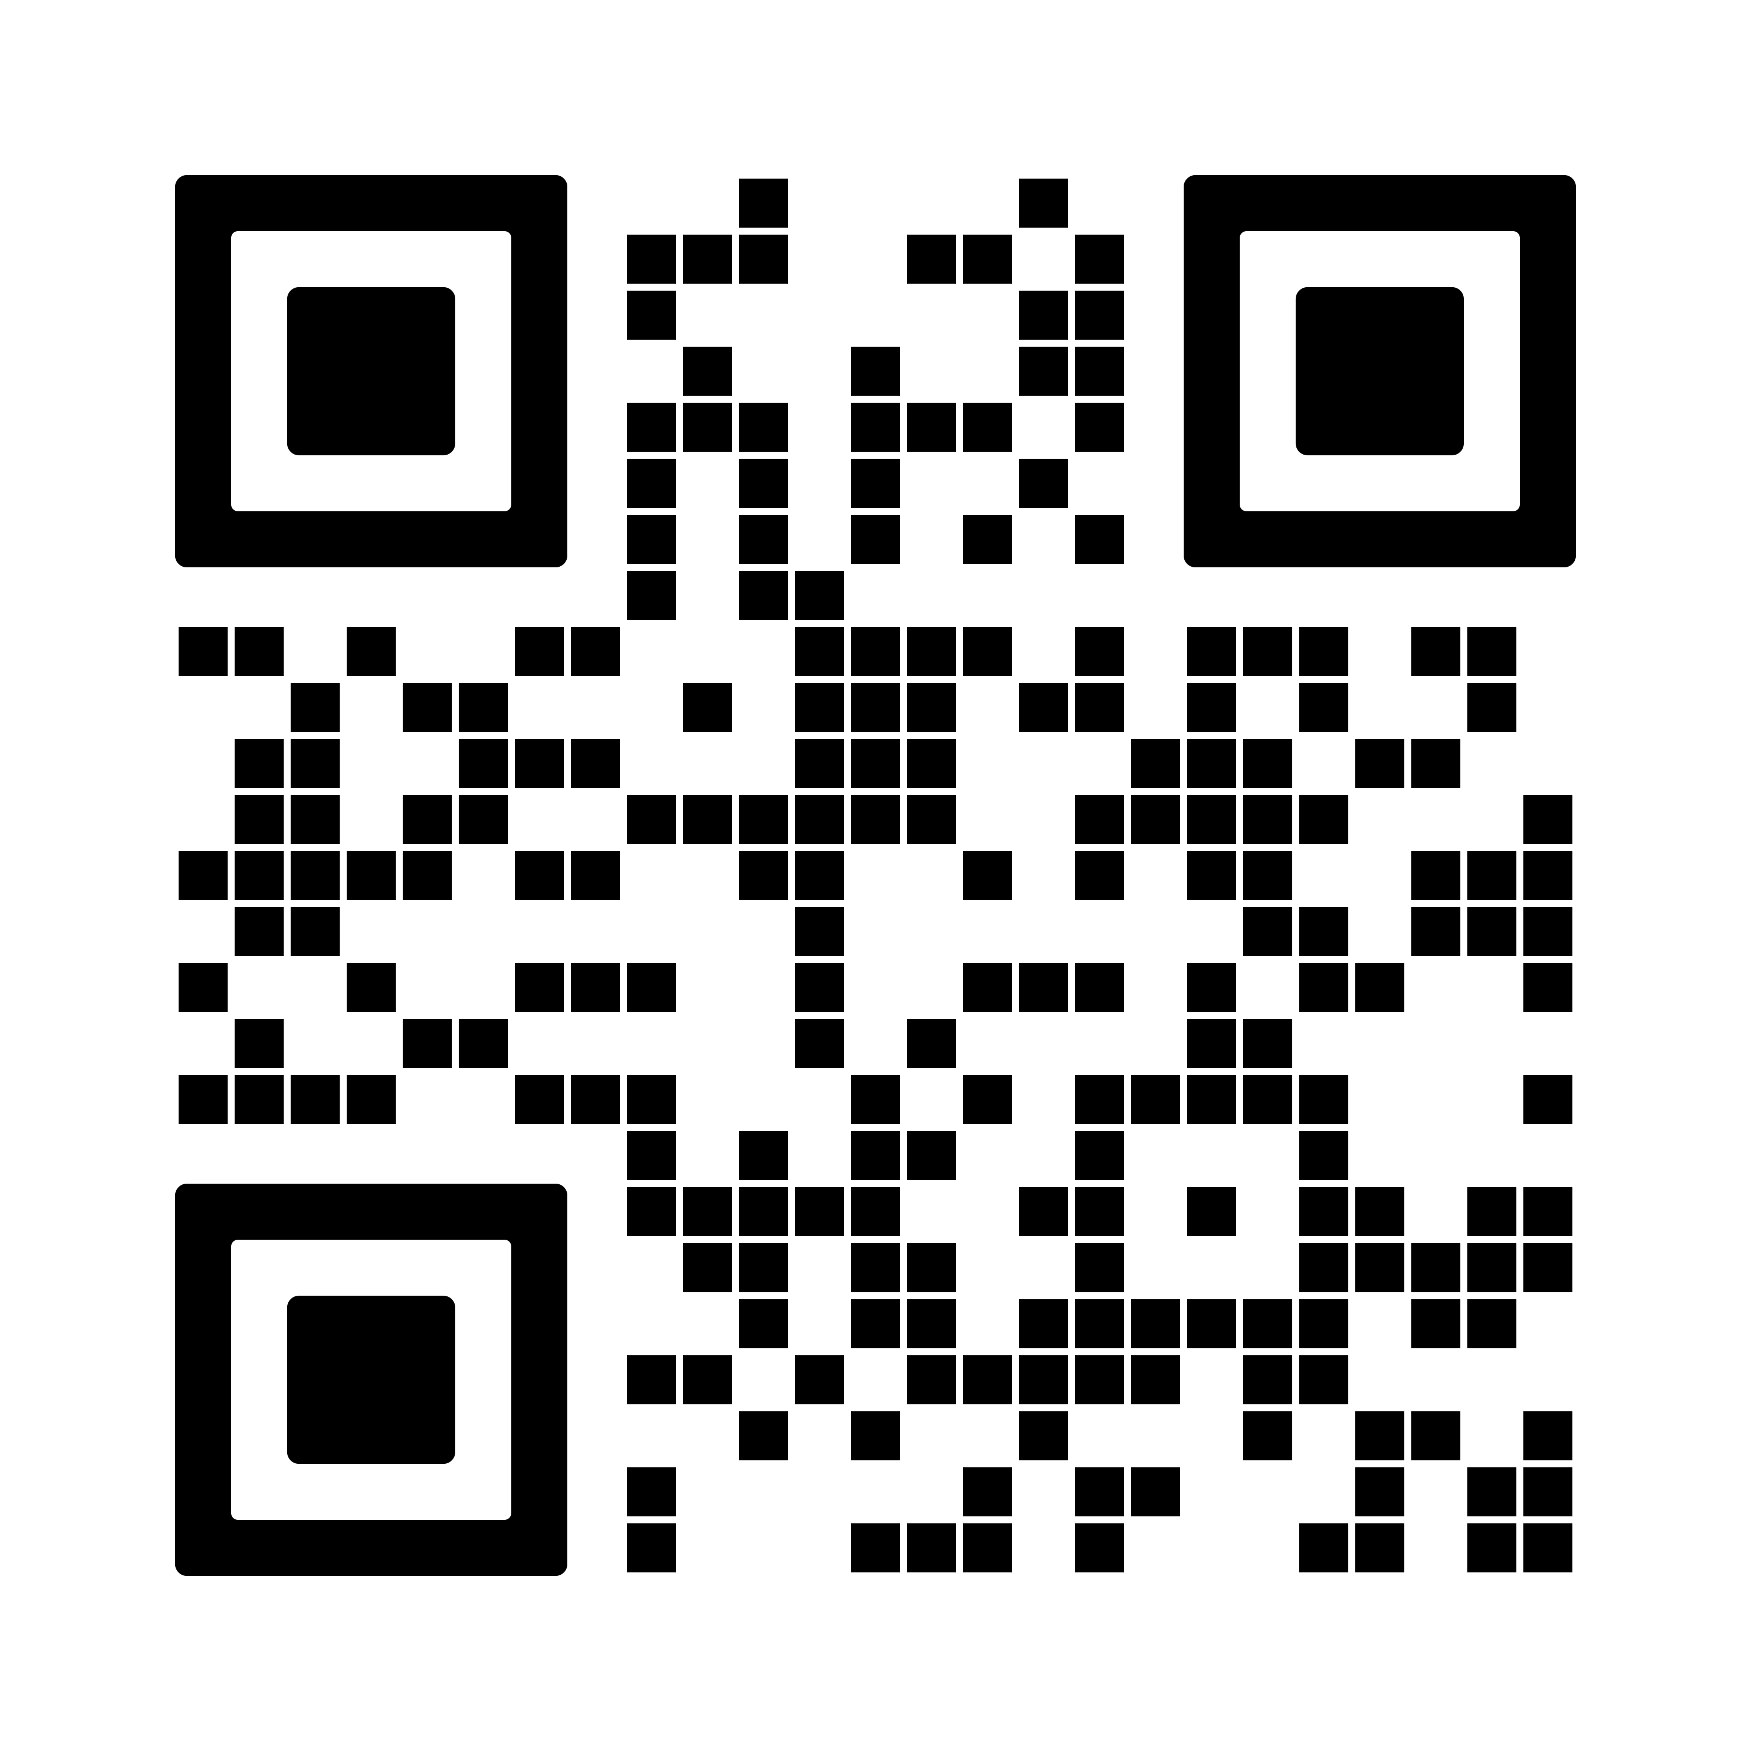
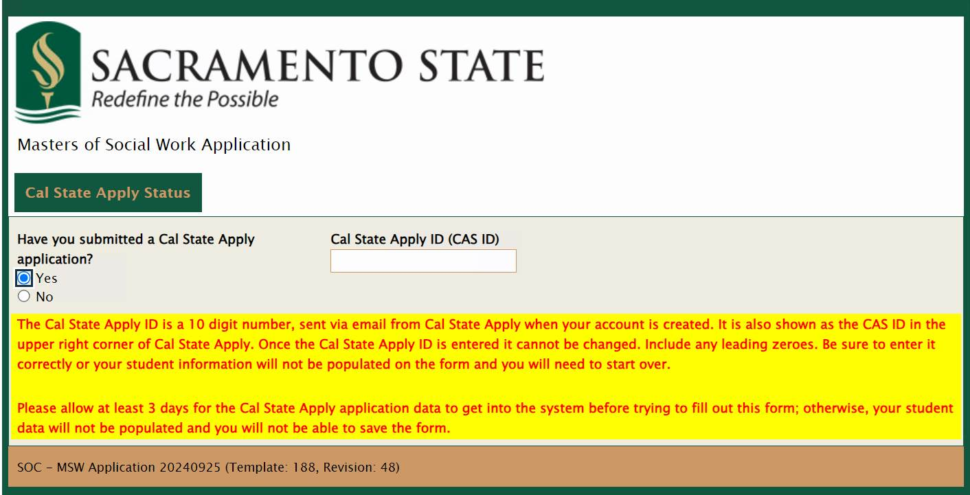
MSW Application
MSW Application Instructions
Greyed out fields will be filled out when you insert your Cal State Apply ID (CAS ID)
The application CANNOT BE SAVED and must be finished within 20 minutes in one sitting. Please have all the required information ready before starting.
  You can log into the application more than one time
  Check out the MSW "Cheat Sheet" for help on filling out the application (found on the MSW instructional PDF)

Slide 10
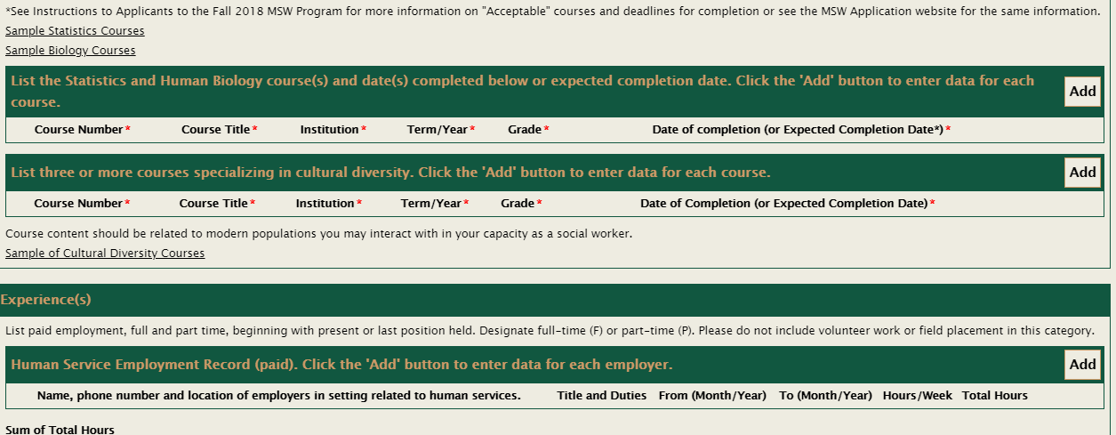
MSW Application
1
2
Links will take you to list of sample courses
Use the “Add” button on the right-hand side to add one more rows when needed

Slide 11
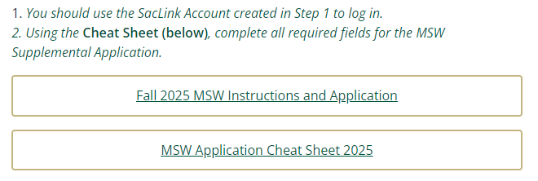
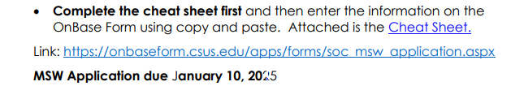
MSW Application “Cheat Sheet”
Word document “cheat sheet” of application to help applicants prepare for the MSW supplemental application

Slide 12
MSW Application/Evaluation
Academic Work (2.8 minimum GPA in last 60/90 units)
GRE analytical writing score (Waived for Fall 2025)
Length and type of field work, employment and unpaid human services experience
  Describe employment and volunteer information clearly to show social work relevance
Special knowledge and skills
  Courses specializing in cultural diversity, be sure to list 3 courses to receive credit
  Fluency in a second language
Leadership skills
  Provide any experience that you feel demonstrates your leadership qualities
Reference forms
  Submit 3 professional references. Current students should include faculty references.
Human Biology & Statistics prerequisite
  Review information on our website – if you still have questions or want to verify your class, contact the Admissions Director at dinis@csus.edu for more information

Slide 13
Program Structures
Advanced Standing Program
Two Year Program
  Title IV-E Stipend Program
Three Year (currently limited to IV-E Applicants)
  Available Fall 2027

Slide 14
Advanced Standing
Fall 2025 Swrk 206/7/8A Specialized Practice Swrk 296/7/8A Specialized Field Swrk 252/3/4 Specialized Advanced Policy Swrk Elective Swrk 500/501 Culminating Experience | Spring 2026 Swrk 206/7/8B Specialized Practice Swrk 296/7/8B Specialized Field Swrk Elective Swrk 500/502 Culminating Experience

Slide 15
Two Year Program
(Title IV-E included)
Fall 2025 Swrk 202 Diversity & Social Justice Swrk 204A Practice I Swrk 250 Policy Swrk 235A HBSE I Swrk 295A Field I | Spring 2026 Swrk 210 Research Swrk 204B Practice II Swrk 235B HBSE II Swrk Elective Swrk 295B Field II
Fall 2026 Swrk 206/7/8A Specialized Practice Swrk 296/7/8A Specialized Field Swrk 252/3/4 Specialized Advanced Policy Swrk Elective Swrk 500/501 Culminating Experience | Spring 2027 Swrk 206/7/8B Specialized Practice Swrk 296/7/8B Specialized Field Swrk Elective Swrk 500/502 Culminating Experience

Slide 16
Three Year Program
(Available for Applying for Fall 2027)
Fall 2027 Swrk 235A HBSE I Swrk 250 Policy | Spring 2028 Swrk 235B HBSE II Swrk Elective
Fall 2028 Swrk 202 Diversity & Social Justice Swrk 204A Practice I Swrk 295A Field I Swrk Elective | Spring 2029 Swrk 210 Research Swrk 204B Practice II Swrk 295B Field II
Fall 2029 Swrk 206/7/8A Specialized Practice Swrk 296/7/8A Specialized Field Swrk 252/3/4 Specialized Policy Swrk 500/501 Culminating Experience | Spring 2030 Swrk 206/7/8B Specialized Practice Swrk 296/7/8B Specialized Field Swrk Elective Swrk 500/502 Culminating Experience

Slide 17
MSW Specializations
MSW Specializations
  Behavioral Health
  Health & Aging
  Children & Families
    Required for Title-IV-E students

Slide 18
Behavioral Health Specialization
The focus is to train graduate level practitioners to work with people living with severe and persistent mental illnesses and substance use problems (among other comorbid conditions), work within the community mental health system, conduct complex clinical assessments, differential psychodiagnosis, perform time-limited psychotherapeutic interventions, conduct clinical case management, integrate autonomous practice with advanced ethics and mental health law, be a liaison with the courts and other forensic services.

Slide 19
Behavioral Health Specialization
Recommended Electives
218 Alcohol and Other Drugs: Use, misuse, abuse
223 New Developments in Psychodiagnosis (DSM-5-TR)
224 Advanced Mental Health Practice
262 Social Work Practice and Rehabilitation
228 Clinical Intervention in Sexual Abuse

Slide 20
Health & Aging Specialization
The focus is to train graduate level practitioners in medical social work and interprofessional practice, to work in acute and chronic care settings, to provide a range of services including health education, to conduct crisis and brief interventions, to conduct individual, family and group supportive counseling, and to do case management to with individuals of all ages.

Slide 21
Health & Aging Specialization
Recommended Electives
219 Social Work Practice in Health Care Settings
230 Geriatric Health/Mental Health
245 Death, Grief and Growth
269 Aging Policy and Services

Slide 22
Children & Families Specialization
The focus is to train graduate-level practitioners in child welfare, with children and families, with school and social service settings to conduct brief interventions and case management.

Slide 23
Children & Families Specialization
Recommended Electives
213 Public Child Welfare Practice (required for Title IV-E students)
226 Family Interventions
246 Forensic Social Work

Slide 24
Other Electives
215 Mediation and Restorative Justice
218 Chemical Dependence: Strategies and Tactics for Social Work Practice
221 Community Organizing Practice
225 Advanced Group Work Methods
232 Spirituality in Social Work
259 International Social Work
261 Grant Writing and Resource Development
244 Working with LGBTQ+ Publics
245 Forensic Social Work with Adults
246 Forensic Social Work with Youth
296D Developmental Disabilities and Practice

Slide 25
Other Options
Pupil Personnel School Credential One-year Program
  This program is now handled by the College of Continuing Education: https://www.cce.csus.edu/pupil-personnel-services-credential-school-social-work

Slide 26
Financial Aid
Students should contact the Bursar’s Office about payment plans.
  https://www.csus.edu/administration-business-affairs/bursar/
MSW scholarships include
  The Isabel Louisson Memorial Scholarship
  Louis Bronson Scholarship
  David Humphers Scholarship
  Sutter Health Scholarship

Slide 27
Title IV-E

Slide 28
Title IV-E Stipend Program:
Pipeline to Child Welfare System
Information available at: https://www.csus.edu/college/health-human-services/social-work/title-ive.html OR http://calswec.berkeley.edu/
In 1990 , the deans and directors of California’s graduate schools of social work and the County Welfare Directors Association collaborated to create the California Social Work Education Center (CalSWEC).
CalSWEC’s goal is to improve the education and training of social workers for the publicly supported social services.
In 1992, CalSWEC entered into a contract with the California Department of Social Services to develop the MSW Title IV-E Stipend Program to prepare students for careers in public child welfare.

Slide 29
Title IV-E Stipend Program
  How much financial aid/stipend is provided?
    The Title IV-E Stipend Program provides two years of support for full-time students who complete the MSW program. The stipend is considered financial aid. The stipend amount is $25,000 per year for both new and continuing students.
    Part-time students, limited to current employees of a county CPS agencies or the state Department of Social Services, receive reimbursement for full tuition and fees, costs for required books, and a travel allowance for each day of class.
  How many stipends are available?
    Up to 20 stipends per class of full-time students are awarded each academic year. The part-time program may award up to 25 slots of student support per class of part-time students, for a maximum of 25 students. Numbers vary depending on previous years’ graduates.
  How are students selected to receive the stipends?
    Applicants may apply for the Title IV-E Stipend Program stipends by completing an application. A committee consisting of both faculty and agency representatives from county child welfare services makes award decisions.

Slide 30
Title IV-E Stipend Program
What academic requirements must students fulfill to receive the financial aid?
  Students must complete the entire MSW child welfare program with a minimum 3.0 GPA, including the equivalent of two years of fieldwork.
  Both years of fieldwork must be in a county child welfare agency serving Title IV-E children and families. Students will be placed for first year of the program. Second year internships must be in a county cps or state social service agency.
What is the student’s commitment after graduation?
  Upon graduation students must work in a county child welfare services agency, California Department of Social Services (CDSS) child welfare division or tribal agency, each year of support received., 2 year or 24 months.
  Part time students employed at county or state Department of Social Service’s must return to that agency and render one year of full-time employment for each year of stipend award, 2 years or 24 months.

Slide 31
Title IV-E Admissions Process
Complete the CalState Apply Application and MSW Supplemental application. (Application 1 and 2)
Complete the Title IV-E Supplemental Application (3rd application)
Submit all required supplement materials to Royce Gonzales at rgonzal@csus.edu

Slide 32
Title IV-E Stipend Program
Application for the Title IV-E Stipend Program is available on the website on October 1, 2024. Applications are DUE: January 10th, 2025. Additional documents also due January 10th, 2025. Check the website for updated information http://www.csus.edu/hhs/sw/title-ive/title-iv-e-application.pdf
Dr. Tracy Kent
  Title IV-E Program Director
  (916) 278-4161
  E-mail: kentt@csus.edu
Royce Gonzales
  Administrative Support Coordinator
  (916) 278-5057
  E-mail: rgonzal@csus.edu

Slide 33
Additional Stipends like Title IV-E
Public Behavioral Health
  For MSW I and II students; must specialize in Behavioral Health
  One year stipend ($25,000); approximately 10 stipends available
  Practicum in a public behavioral health agency
  One year repayment post-graduation in any PBH agency in CA
Adult Protective Services (Gerontology)
  For MSW I and II students; must specialize in Health & Aging
  One year stipend ($20 or $25K, TBD next year); approximately 5
  Practicum in an APS or other approved gerontology setting
  One year repayment post-graduation in any APS in CA

Slide 34
Field Practicum

Slide 35
Mission of Field Practicums​
Social work practicums provide students with a unique opportunity to apply what they are learning in the classroom to practice in “real life” social work settings. ​
Participating in a practicum at a social work field agency allows students to leverage classroom theory and knowledge to develop their professional competence and identity, as well as begin their commitment to serving clients and communities. ​
The profession of Social Work uses field education as the avenue through which it “professionalizes” its members. It is through a field practicum that the student learns how to think and act like a professional social worker.

Slide 36
What is a SW Field Practicum?​
A SW field practicum is a class and not a job.
A field practicum involves an educational experience, not an internship.
The SW student is not an intern, they are a practicum student.
Internships: Occur after one receives their degree and enters an entry level “work” experience. They are treated as an employee and expected to perform tasks equal to other employees who’ve earned the same degree.
Practicums: Are a component of your academic coursework and are required for degree completion. It’s focus is applying classroom knowledge to “real-world” settings while in school. The emphasis and purpose is on learning and skill development rather than project completions, work experience a simple accrual of hours.

Slide 37
Field Requirements ​
Hours/Days​
  MSW1- Th/F (16 hours per week)​: Field Seminars 5x/semester
  MSW2- M/T/W (24 hours per week)​: Field Seminars 5x/semester
Evening & Weekend Policy​
  Student needs to be at their field practicum when the “life of the agency exists” ​and a has access to an approved field instructor
Employment-Based Field Practicum​
  Protocols and Procedures​
  Zoom sessions required for all interested students
Field Instructors​
  Degreed social workers, approved and trained by School of Social Work Field Office

Slide 38
Deadlines
Cal State Apply Application
  Friday, December 20, 2024 (available October 1, 2024)
School of Social Work Application
  Friday, January 10, 2025 (separate from the Cal State Apply application and is available October 1, 2024)
Title IV-E Stipend Application
  Friday, January 10, 2025 (available October 1, 2024)

Slide 39
Accepted or Denied?
The number one reason why students are not accepted is…..INCOMPLETE APPLICATIONS
YOU are responsible for ALL materials being turned in ON TIME!

Slide 40

Q & A
Maria Dinis, PhD, MSW
Admissions Director & Professor
Email: dinis@csus.edu
Dr. Tracy Kent
Title IV-E Program Director
Email: kentt@csus.edu
Lisa Marsh
Director of Field Education
Email: lisa.marsh@csus.edu

