Slide 1



PPA 500 Culminating Project Orientation
6 pm, Monday, December 11, 2023
Join Zoom Meeting
https://csus.zoom.us/j/81231650139
Virtual Welcome
Notes:
Rob

Slide 2



Agenda
Spring 2024 Advisor Assignments
PPA Culminating Options
Example Spring 2024 Syllabus
“To-Do” List before May 1, 2024
Attend Project Showcase
Q&A
Notes:
Rob

Slide 3
Spring 2024 Advisor Assignments
I advise choosing a project “partner(s)” who is also advised by you advisor
Notes:
Rob

Slide 4
Culminating Options
Option # | Principal Product | Based on Course “Artifacts” | Oral PP Presentation | Executive Summary Submitted to OGS
1 | Applied professional public policy or public administration report | Assignment(s) [artifacts] from PPA course(s) | Yes | Yes
2 | Draft Article in the Style of an Academic Journal | An assignment [artifact] from one PPA course that the instructor agrees is relevant for expansion to an article | Yes | Yes
3 | A professional portfolio that includes a 3-4 page reflective essay and professional development plan (resume, cover letter to “ideal” job, and professional development goals | Three or more revised assignments [artifacts] from PPA courses that demonstrate your ability to perform the job you are seeking | Yes | Yes, of your revised assignments
Examples from 2021- 2023 @ https://www.csus.edu/college/social-sciences-interdisciplinary-studies/public-policy-administration/thesis-project-bank.html
Notes:
Sara & Suzi

Slide 5
Answers to FAQs
New format emphasizes integrating crucial ideas and applying tools and models from the core curriculum.
PPA faculty have assigned potential artifacts in classes and explicitly called them out to students for potential PPA 500 use.
  Scaffolding in bi-weekly PPA 500 Zoom sessions helps students maintain momentum.
Advisors will lead Zoom check-in sessions
Option 1 is very likely to be undertaken by the majority of students
  Options 2 and 3 (professional exam/portfolio) may require more work and time than faculty and students anticipate.
Notes:
Rob

Slide 6
Example Spring 2024 syllabus and schedule
https://www.csus.edu/college/social-sciences-interdisciplinary-studies/public-policy-administration/internal/_internal/_documents/syllabi/ppa500_fall2023.pdf
Notes:
Rob

Slide 7
“To-Do” List before May 1, 2024 ~~ 120 Days from Jan 1
1-Jan-24 | Monday | Sent email to advisor: project type and one-paragraph description
2-Jan-24
3-Jan-24
4-Jan-24
5-Jan-24
6-Jan-24
7-Jan-24
8-Jan-24 | Monday
9-Jan-24
10-Jan-24
11-Jan-24
12-Jan-24
13-Jan-24
14-Jan-24
15-Jan-24 | Monday | Sent email to advisor outlining layout of project
16-Jan-24
17-Jan-24
18-Jan-24
19-Jan-24
20-Jan-24
21-Jan-24
22-Jan-24 | Monday | Semester Starts
23-Jan-24
24-Jan-24
25-Jan-24
26-Jan-24
27-Jan-24
28-Jan-24
29-Jan-24 | Monday
30-Jan-24
31-Jan-24
Fill in meetings and deadlines provided on advisor’s PPA 500 syllabus
1-Feb-24
2-Feb-24
3-Feb-24
4-Feb-24
5-Feb-24 | Monday | Register OGS Workshop
6-Feb-24
7-Feb-24
8-Feb-24
9-Feb-24
10-Feb-24
11-Feb-24
12-Feb-24 | Monday
13-Feb-24
14-Feb-24
15-Feb-24
16-Feb-24
17-Feb-24
18-Feb-24
19-Feb-24 | Monday
20-Feb-24
21-Feb-24
22-Feb-24
23-Feb-24
24-Feb-24
25-Feb-24
26-Feb-24 | Monday
27-Feb-24
28-Feb-24
29-Feb-24
1-Mar-24
2-Mar-24
3-Mar-24
4-Mar-24 | Monday
5-Mar-24
6-Mar-24
7-Mar-24
8-Mar-24
9-Mar-24
10-Mar-24
11-Mar-24 | Monday
12-Mar-24
13-Mar-24
14-Mar-24
15-Mar-24
16-Mar-24
17-Mar-24
18-Mar-24 | Monday | Spring Break Starts
19-Mar-24
20-Mar-24
21-Mar-24
22-Mar-24 |  | Spring Break Ends
23-Mar-24
24-Mar-24
25-Mar-24 | Monday
26-Mar-24
27-Mar-24
28-Mar-24
29-Mar-24
30-Mar-24
31-Mar-24
1-Apr-24 | Monday
2-Apr-24
3-Apr-24
4-Apr-24
5-Apr-24
6-Apr-24
7-Apr-24
8-Apr-24 | Monday
9-Apr-24
10-Apr-24
11-Apr-24
12-Apr-24
13-Apr-24
14-Apr-24
15-Apr-24 | Monday
16-Apr-24
17-Apr-24
18-Apr-24
19-Apr-24
20-Apr-24
21-Apr-24
22-Apr-24 | Monday
23-Apr-24
24-Apr-24
25-Apr-24
26-Apr-24
27-Apr-24
28-Apr-24
29-Apr-24 | Monday
30-Apr-24
1-May-24 |  | Final Draft Due
Notes:
Rob

Slide 8
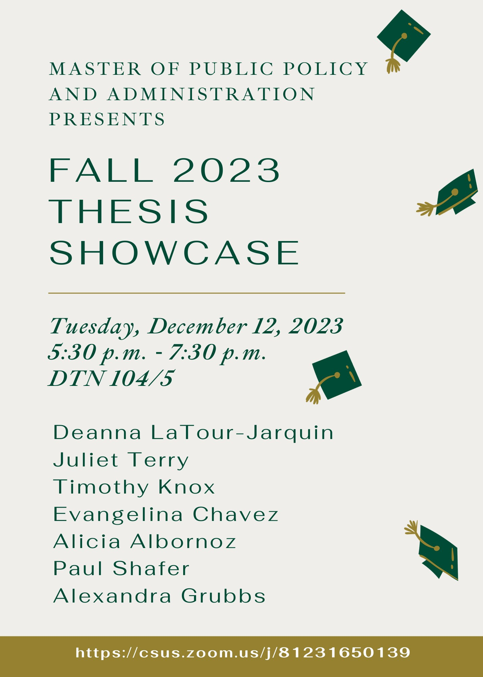
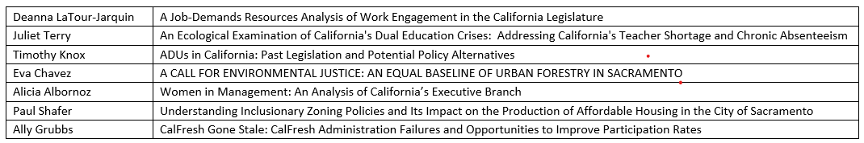

Slide 9

Questions??
Notes:
Rob

